Slide 1
Register with a GP surgery service
ICB Starter Pack
Notes:
Standard title slide

Slide 2
Aim
Our aim is to make registration simpler, easier and more inclusive for both patients and practices
Overview
The Register with a GP surgery service:
​reduces GP practice processing time
digitises and standardises registration
is supported by a new paper form (PRF1)
is integrated with national services with better data quality

Slide 3
Where we are
Simplifying registration for patients and practices
Practices
ICBs
1,700+ LIVE / Enrolled Practices
1 in 4 practices now use the service
LIVE in ALL 42 ICBs
  40% +
  Surrey Heartlands (92.3%)
  Kent and Medway (50.3%)
  BNSSG (46.8%)
  Shropshire, Telford and Wrekin (43.1%)
  North-West London (42.5%)
525,000+ Total patient submissions
20,000+ Weekly patient submissions
30% +
  BSW (39.8%)
  Cambridge & Peterborough (38.2%)
  South-East London (34.7%)
  Sussex (30.4%)
93% Patient Satisfaction Score
Rollout Dashboard – see the progress of your ICB here
3

Slide 4






Benefits
Improves data quality
Integrates with national services
Supports catchment area checks
90% Spine (PDS & NHS Number) match success rate
Secure access through NHS login
Available Find a GP page and the NHS App
Integrated with eDEC to support practice catchment area policy
Practices are still in full control of accepting or rejecting registrations
Promotes accessibility
Reduces Administration
Cost reduction
Meets web accessibility standards
Compatible with browser translator services
New paper form equivalent
Free to use
The core online registration service is centrally provided by NHS England at no cost to practices
Compatible with GP links to minimise patient exceptions
Reduces patient registration processing time

Slide 5

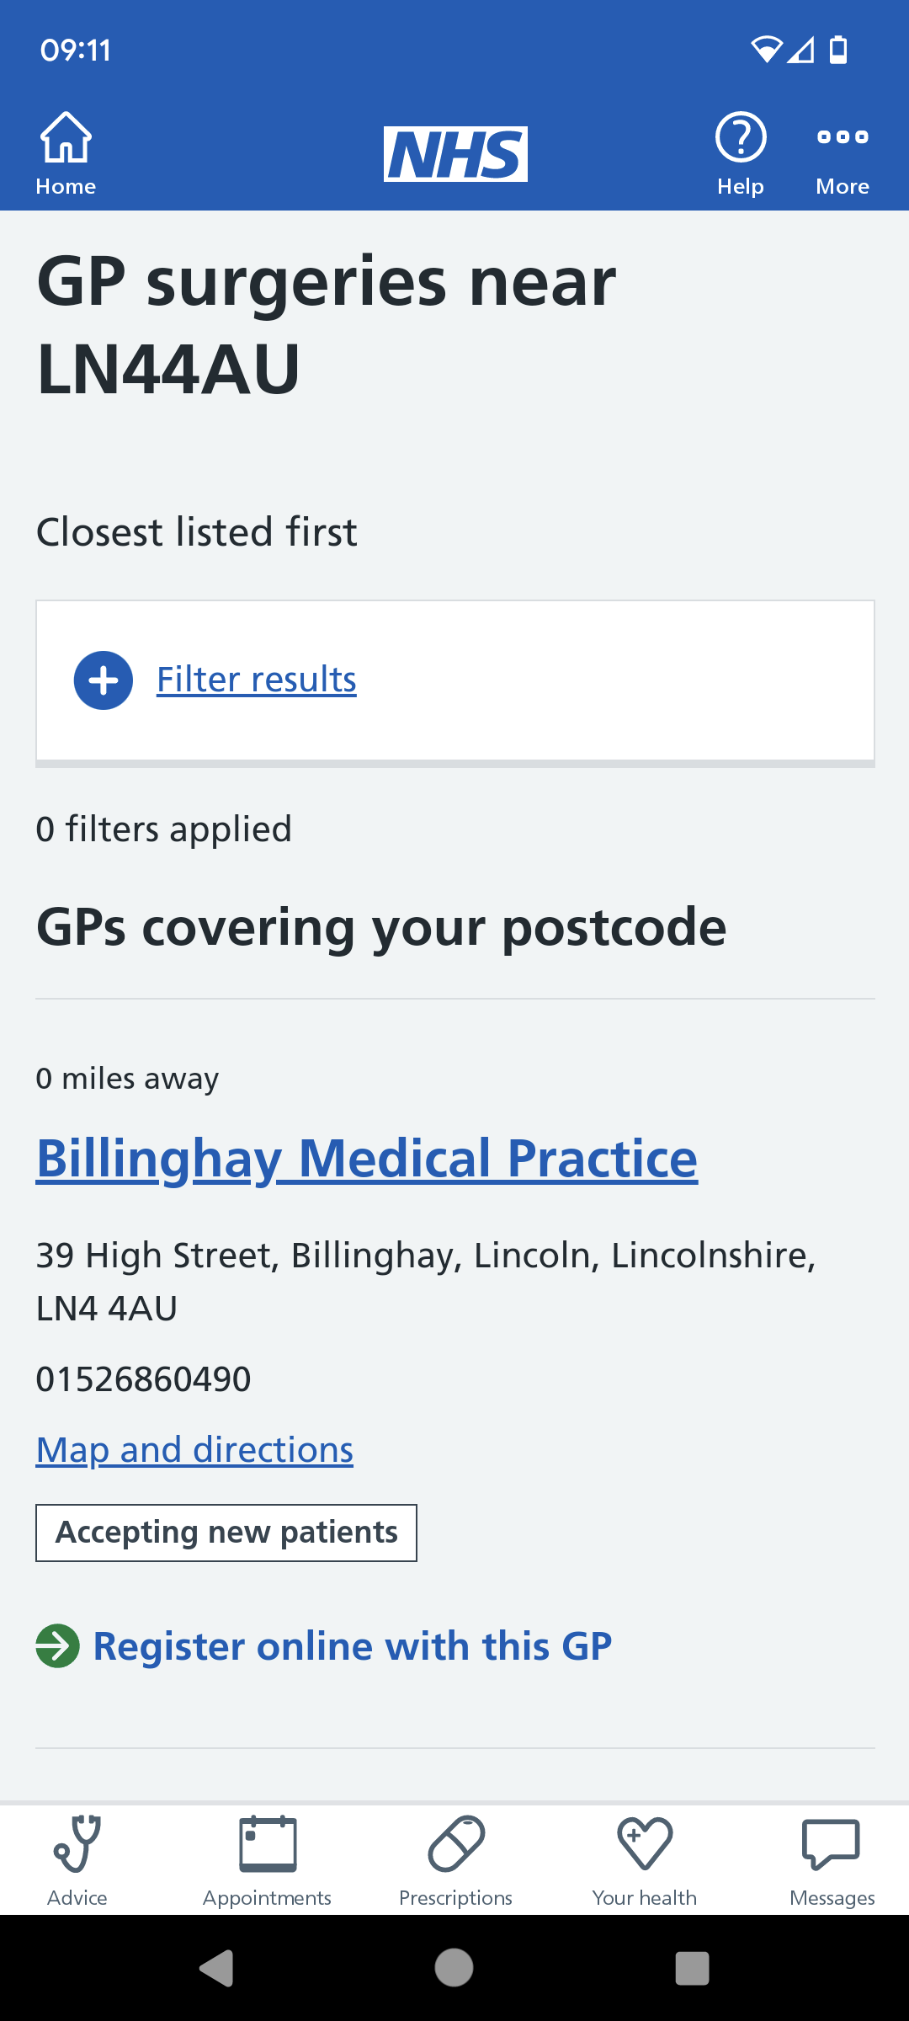
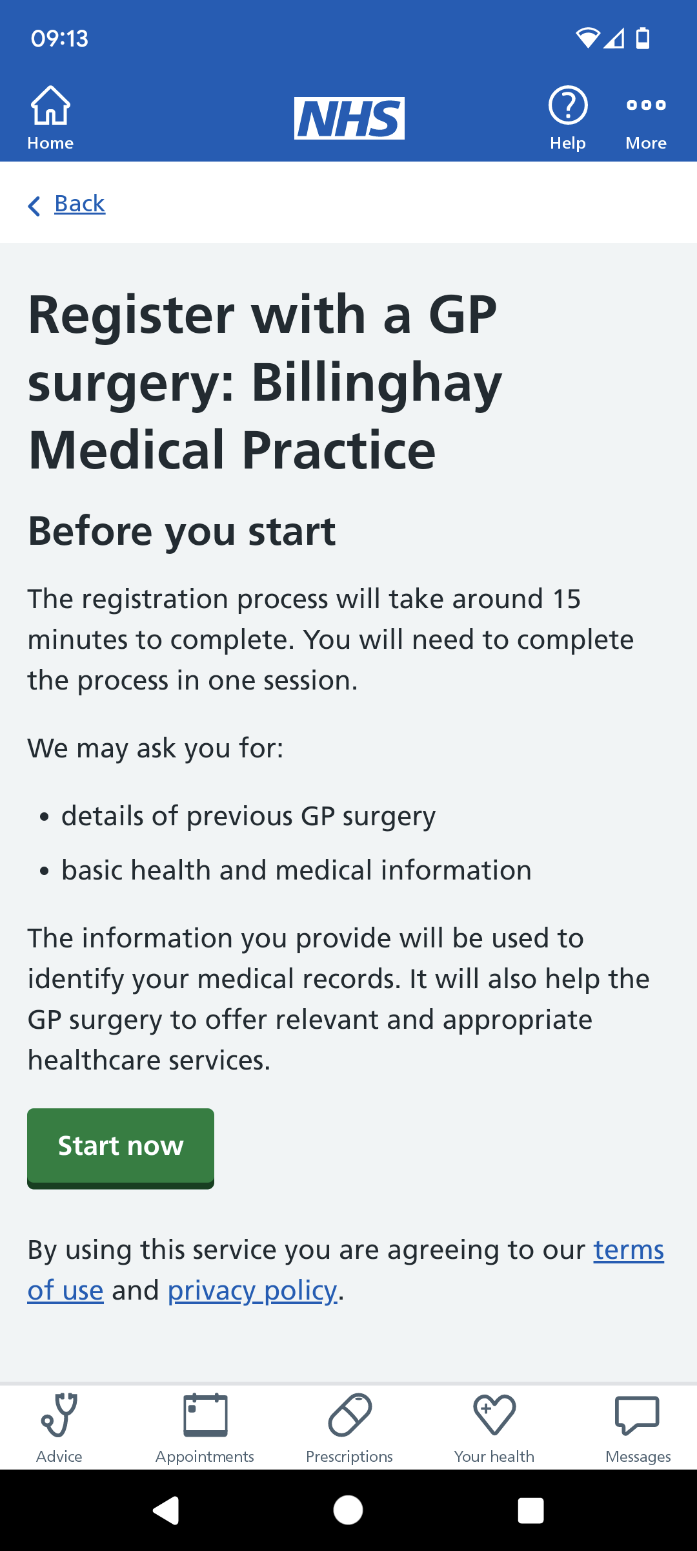
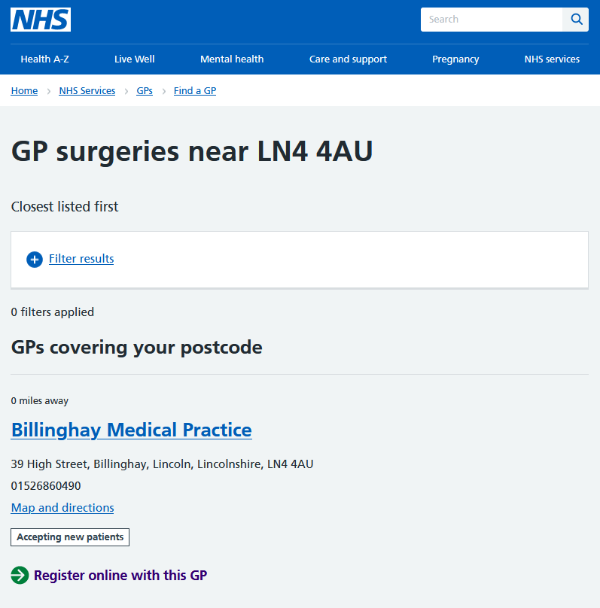
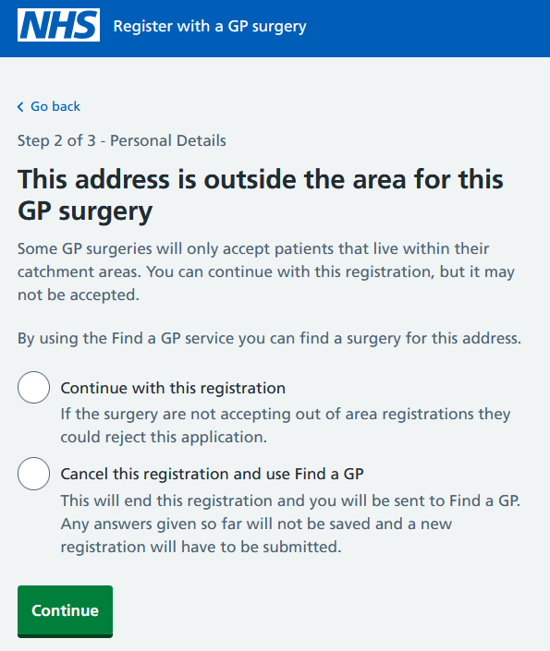
Increasing your Practice Visibility
Easily access NHS Find a GP and NHS App & login
NHS Find a GP & Catchment Area
NHS App & NHS login

Slide 6
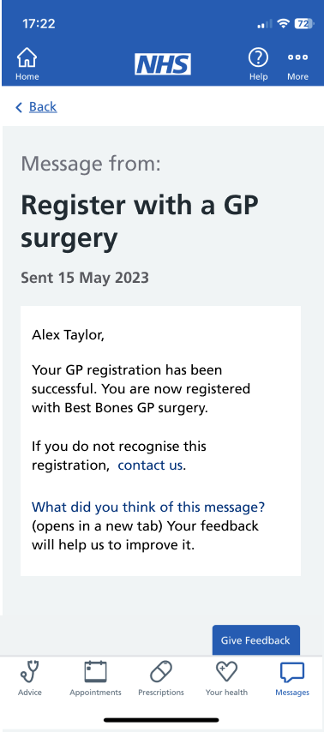
Complementing Online Registrations
NEW Patient notifications
A new feature has been made available within the Register with a GP surgery service which reduces burden by reducing patient interventions to confirm registration status
Provides an immediate, standard notification message to patients once the change of GP has been recorded in SPINE, via NHS App, email, SMS, or letter
This is currently in pilot and will be available for FREE to All users in October.
Practices are able to automatically turn this feature on / off via Profile Manager.
All registrations, whether they are from paper or digital forms, will receive a notification except for the following groups - First registrations, bulk-transfers,
S-flagged patients and armed services

Slide 7



Notification & GP registrations
The first use case will notify patients when their GP practice registration has been completed
NEW - Accept Notify a Patient feature to your clinical system then ' we can automate a registration confirmation message.
Respond - Patients can address incorrect or malicious registrations. GP staff will no longer need to send a manual registration confirmation message. Reduced calls to practices to confirm registration status
MESSAGE - A proposed new messaging service to notify patients when changes are made to their details.
Send - An NHS App Message, if the patient as the app.
An email or an SMS
Post - for those who do not have digital channels enabled.
For more information visit Notify a patient service - NHS Digital To register in the pilot, please contact us at england.register-gp-surgery.support@nhs.net

Slide 8
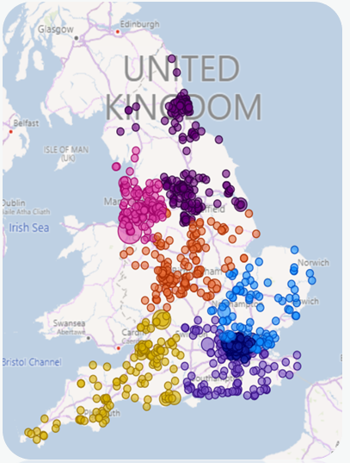
National rollout across England
“
We aim to have it rolled out to up to 2,000 practices by December 2023*
Region | Total Practices | Enrolled Practices | % of Practices Enrolled
South East | 815 | 274 | 36.8%
South West | 545 | 170 | 33.6%
London | 1177 | 344 | 30.0%
North East & Yorkshire | 966 | 223 | 24.2%
North West | 971 | 221 | 24.2%
Midlands | 1285 | 264 | 23.4%
East of England | 666 | 135 | 21.3%
Total | 6425 | 1631 | 27.2%
Rollout Dashboard – see the progress of your ICB here
*Source: 2023 Primary Care Access Recovery Plan – Here

Slide 9
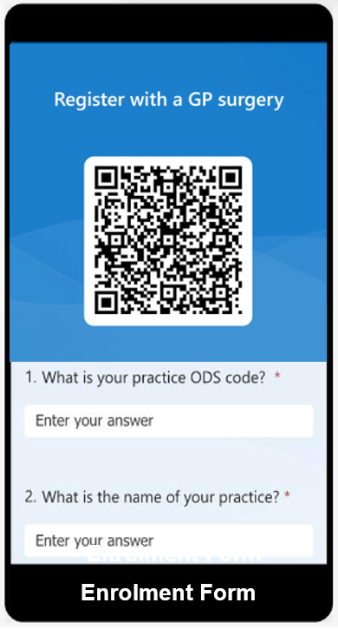
Step by step guide to bulk enrol
Email us a request to enrol on the service with a list of your practice details or simply request fill in the form Register with a GP surgery (office.com) for as many practices as you want registered as we need your permission to register any of your practices.
Step 1. Enter you ODS Code
Step 2. Enter your Practice Name
Step 3. Enter your Practice Shared email
Step 4. Enter your Practice Manager email
ENROLMENT IS EASY!

Slide 10
Simple ICB Onboarding Process
Start
01
02
03
04
Live
Engage ICB
Present to Practice/ICB
Tailor Approach & Support
Bulk Enrol/
Self enrol
Re-Engage
1
2
3
Engagement Lead with Regional / ICB Leads
Present Demo | Profile Manager sign up/in | Pause
Enrol

Slide 11


How can YOU help?
Recommend an ICB representative to work with the national service team
Share your testimonials

Slide 12
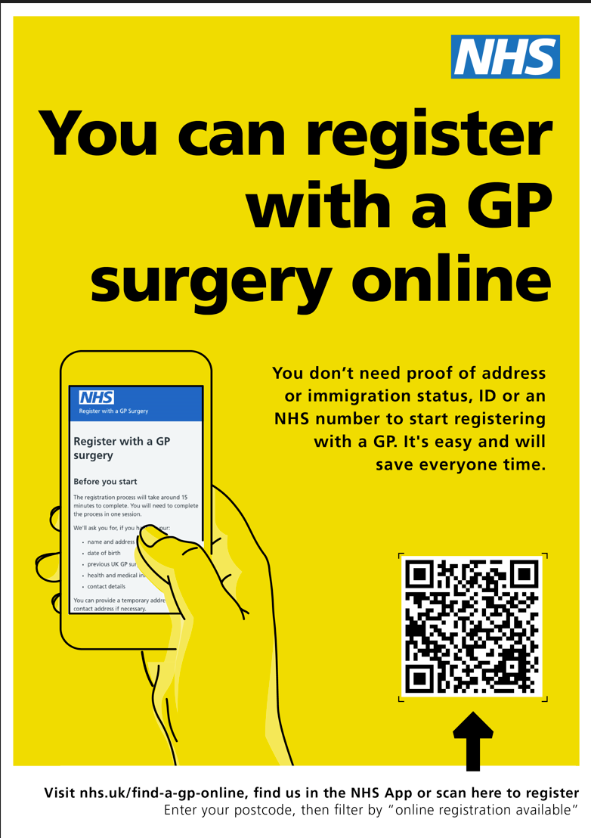



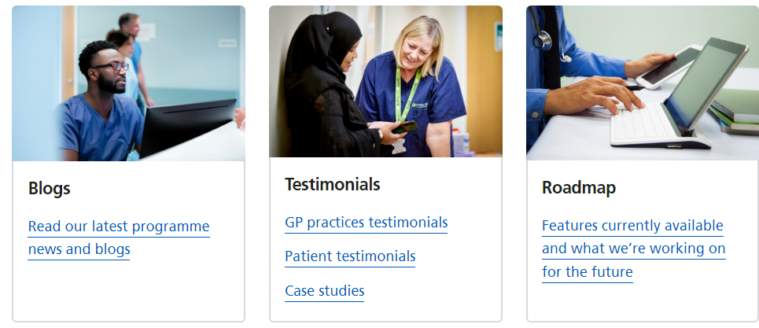
What do we offer
Personalised practice posters
Find more - Resource hub for Register with a GP surgery service - NHS Digital
Promotional Material
Updates
HELPFUL LINKS
Testimonials
Dashboard - Microsoft Power BI
Learn more - Visit our resource hub
Latest news about the service https://digital.nhs.uk/services/register-with-a-gp-surgery-service#news-about-the-service
Try out our demo site or join our demo sessions
CONTACT THE CENTRAL TEAM england.register-gp-surgery.support@nhs.net
Blogs
Latest News
Press Releases
Newsletter Communication
Case Studies
Roadmap
Patient Testimonials
Practice Testimonials

Slide 13
Appendix
13

Slide 14
Testimonials
94%
Positive patient feedback
“
The current forms are prone to errors, misspellings and incorrect digits which often make it impossible to 100% accurately match new registrations to patients who have records from a previous practice.”
Dr Matt Curtis, a GP at Holycroft Surgery in Keighley, West Yorkshire
“
We live in a ‘one-click’ culture and we recognise that many busy people want online solutions.
Vulnerable patients and those with physical access needs don’t need to visit the GP surgery to register, and people can access the service at any time, including outside of working hours to fit around their other responsibilities.”
Dr Shanker Vijay, Digital First Clinical Lead for London and a practising GP

Slide 15
Automating Patient Registrations using RPA
RPA (Robotic Process Automation) is a technology that makes it easy to build, deploy, and manage digital robots that emulate human actions interacting with digital systems
Automating the manual data entry task of putting in the registration information into the clinical system is the most requested feature through GP Feedback.
Providers Working with existing RPA Providers, we have developed an interim automated solution compatible with the NHSE Registration Form to support practices reducing their administrative burden from managing registrations.
Integration - Our strategic aim is to offer full integration with GP IT systems through the GP Connect API. Direct integration with Clinical Systems is expected late 2024 due to the complexity of clinical eco-system
Supplier​ | Clinical system​ | Status​
GP Automate​ | EMIS​ TPP​ | Available​ In development​
Healthtech 1​ | EMIS​ TPP​ | Available​ Pilot ​
Royal Free London (NHS Foundation Trust)​ | EMIS​ TPP​ | In development​ In development​
Learn more about NHSE GPREG & RPA here

Slide 16
End slide
england.register-gp-surgery.support@nhs.net

