Slide 1
Covid-19 response for April 2020 reconfiguration changes
Reconfiguration 2020
Presented by
  Mark Dye & Alan Keen

Slide 2
Background
ODS were requested by NHSE/I and NHS Digital to minimise any change activity that could impact NHS operations during the Public Health emergency (Covid-19).
ODS analysed how impact could be minimised and identified that the legal closure of predecessor organisations, within April 2020 Reconfiguration, could be delayed.
Sessions were held with key systems and services to highlight any unknown, adverse impacts of this proposal. It was concluded that this delay would benefit the system where areas may not be able to migrate to the new hierarchical structure right away, under possible constrained resources. No adverse impacts are anticipated.
Legal closure of predecessor organisations is delayed and will be reviewed periodically. Notice will be provided before legal close dates are applied to these predecessor organisations in future.

Slide 3
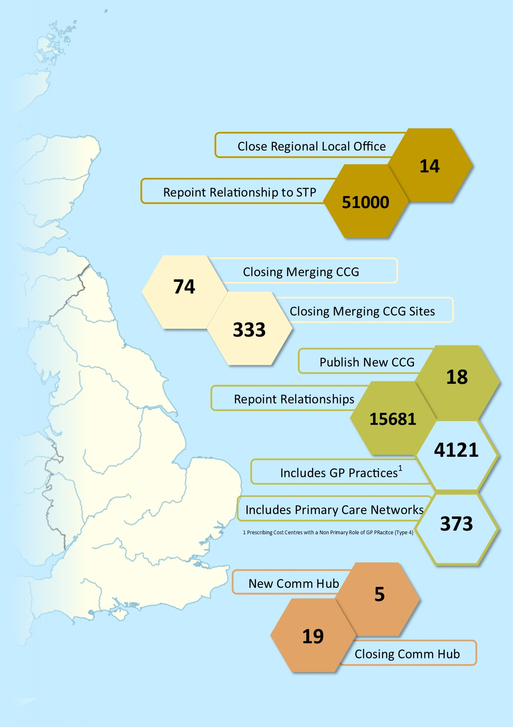
Change Summary
CCG Mergers
Close 74 CCGs
STP Implementation
Close 14 Regional Local Office aka Direct Commissioning Offices
Commissioning hubs
5 new commissioning hubs ✓
5 commissioning hubs changing name
19 commissioning hubs closing
Create 18 new CCG ✓
Reparent 15,000 relationships
STP already exist ✓
Reparent 51,000 relationships
Reparent 4,000 relationships
Completed
In progress
Delayed
Completed
In progress
Delayed
Completed
In progress
In progress
Delayed
4 Acute Acquisitions
In progress

Slide 4
ODS Key Dates
OPERATIONAL
12 Feb
AUTHORITATIVE
New CCG codes
formally issued
to wider NHS
1 Apr
16 Oct 2019
New codes legally effective
30 Sep 2020
CCG mergers approved by NHSE
28 Feb
8 Apr
Predecessor codes operationally closed
NHSE Region Leads request new CCG codes
New CCG codes published in monthly ODS XML file and ODS CSVs
Organisations re-parented to new CCG/STP
New CCG codes reserved and communicated to NHSE / CCG
13 Feb
31 Mar
New CCG Codes published in ODS API, ODS Portal, Care Identity Service (CIS) and Spine
Predecessor codes legally closed
Delayed until
further notice
CCGs complete ODS Reconfiguration Toolkit

Slide 5
Summary
Legal closure is delayed for:
  74 CCG codes
  14 Region (Local Office) codes
  19 Commissioning Hub codes
  NHS Trusts being acquired on 1st April (volume to be confirmed by receipt of Grant of Acquisitions / formal approval by NHS Improvements)
An April 2020 Reconfiguration Mapping file is available which outlines the predecessor organisations and their successors
Forecasted NHS Trust acquisitions are listed
Predecessor organisations will be closed with a date of 31/03/2020 at some point in the future and when this is due to happen we will communicate to users in advance

