Slide 1

Guidance Pack
NHS App Core Capabilities
Please scan the QR code or go to https://nhsapp.short.gy/corecapabilities to confirm you are accessing the most current version of this guidance.
Tara Bush – Programme Manager
London Digital Transformation (Primary Care) Team
July 2026

Slide 2
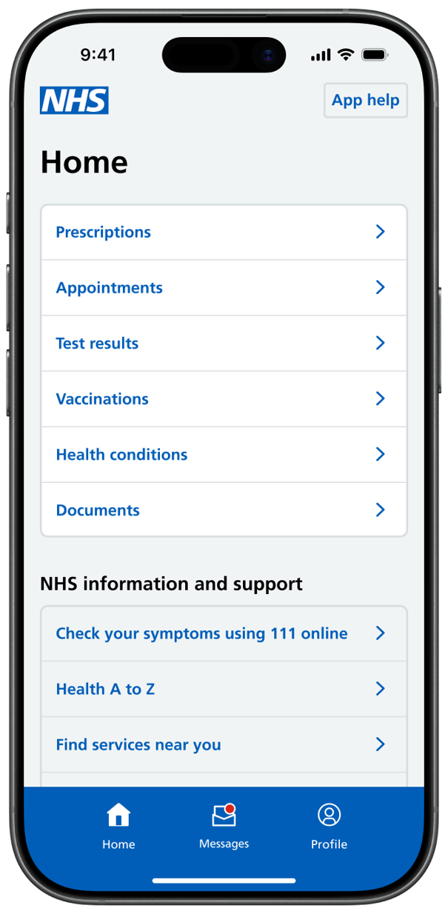
Introduction
Health record access
Prescriptions management
The operational planning guidance sets out that all GP surgeries must ensure all core NHS App capabilities are enabled; these include health record access, online consultations, appointment management, prescriptions management, online registration and patient messaging.
This guide provides a brief overview of each capability, as well as how staff can ensure that these are configured and made available to their patients.
Online consultations
Online registration
Appointment management
Patient messaging
Definitions
Benefits
This guidance pack is interactive — click the underlined words to navigate directly to different sections and/or external sources.

Slide 3
Definitions
Item | Definition | Timescale
Active ODS Code | All active GP practices in England | Active English GP Practices at any time in given month.
Health Record Access | Event activity is recorded when a user accesses their GP health record through the NHS App and selects continue. Events falls into 1 of 4 record access levels, but full access that's required is only provided by the "Summary Access + Detailed Access" event. | If any event has been recorded at least once in the month the table shows: ‘Enabled' If any event hasn't been recorded at least once in the month the table shows: 'Not Enabled' If the practice has no NHS App activity events at all recorded for the month: 'No info'
Online Consultations | *Only shows as ‘enabled’ for practices using suppliers that are integrated with the NHS App Event activity is recorded when a user: requires any sort of medical consultation from a GP and navigates to ‘Ask about a health problem’ looks at any messages received from their GP regarding medical or non-medical requests such as travel vaccinations, sick notes etc. by navigating to the Messages section requires any medical documentation such as sick notes or travel vaccinations and navigates to ‘Request a letter or information’ jumps off to complete questionnaires
Appointment Management | *Includes appointments booked and/or cancelled via the NHS App Event activity is recorded when a user: navigates to the ‘Appointments’ section and views, books or cancels an appointment via the NHS App has been sent an appointment reminder message (note: appointment reminder messages only cover messages sent out by Accurx which covers most of primary care messaging)
Prescriptions Management | Event activity is recorded when a user sends a repeat prescription request to their GP from within the NHS App
Patient Messaging | *Includes individual and bulk messages delivered through the NHS App interface. Messages are sent via SMS suppliers integrated with the NHS App and platforms with NHS Notify API. Event activity recorded when messages are successfully delivered to patients via the NHS App | If any event has been recorded at least once in the month the table shows: ‘Enabled' If any event hasn't been recorded at least once in the month the table shows: 'Not Enabled'
Online Registration | Event activity is recorded when a user is attempting to register with a GP surgery, via the Profile' section of the NHS App | If a practice is enrolled by the end of the month the table shows: 'Enabled' If a practice isn't enrolled by the end of the month the table shows: 'Not Enabled' If the practice isn't in the GPREG dashboard: 'No info'
All Core Features | If all service columns for a practice are either "Enabled" or "NA", then all core features are considered as "Enabled", otherwise this column will be "Not Enabled"
Note: Usage data is being used as a proxy for enablement for all core features except online registration. This means that some practices will not be marked as ‘enabled’ if the feature has not been used within the reporting period. There may be instances where some events have not been mapped to an ODS code. The dataset may include some practices that are out of scope, e.g. care home practices, special allocation scheme services etc.

Slide 4
Benefits for staff and patients
Health record access
Online consultations
Appointment management
Prescriptions management
Online registration
Patient messaging
Reduces patient queries related to test results or referrals, which saves staff time
More convenient - patients don’t need to call, attend the surgery or search the practice website for the online form
Relieves some of administrative workload by reducing patient phone calls and visits
Less administrative workload, e.g. transcribing email or paper requests
Can halve time taken to register a patient –takes staff 10-15 mins
NHS App messaging is free and supports a reduction in SMS costs
Using NHS login is less work for practices as patients will already have verified identity
Empowers patients to manage their health and care
Fewer transcription errors
More secure than other channels like SMS
Can reduce DNAs
Same experience for users and GP surgery staff – details entered in the NHS App are seamlessly passed into the online consultation system
Improved audit trails
Standardises details needed to onboard a patient - easier to read and in correct format
Reduces costs associated with printing and sending letters, also reducing carbon footprint
Higher levels of patient satisfaction
Shows when prescriptions are issued and ready to collect, reducing calls or visits to the practice
Messages can be longer and richer in content, e.g. with branding and links
Increased operational efficiencies
Validates answers provided by patients
Improved communication between patients and practices
Auto-registration
Even if a patient changes their contact details, you will still be able to contact them
Prescription barcodes save time for dispensers
Streamlines process via ‘Manage Patients Registrations’ portal

Slide 5
Health record access

Slide 6
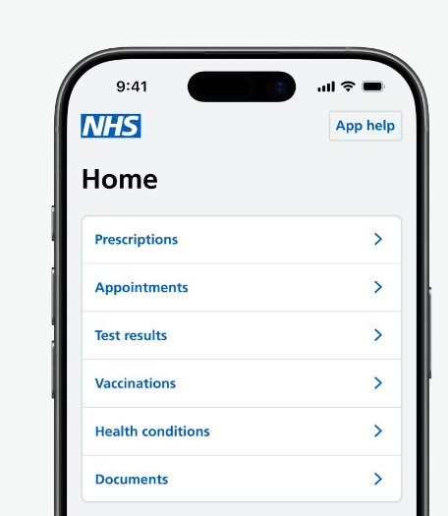
Health record access
How patients can access this feature
  Patients can access their health record under the prescriptions, appointments, test results, health conditions and documents sections of the NHS App. A security message will flag that they will be accessing personal and sensitive data. They can also access someone else’s records if authorised to do so. Watch this short walk-through video to find out more.
  Summary Care Record: can see information about their medicines and allergies
  Detailed Coded Record: requires patients to contact their GP surgery to request access to information such as test results and immunisations
  Prospective Record Access: Most patients are automatically given access to information added to their record from around November 2023 onwards. This includes letters, test results and appointment notes. Some may also have access to information added before this date. Further details and support can be found here.
Prescriptions: Medicines record contains details of prescriptions, e.g. items prescribed and prescription type
Appointments: Appointment notes and other updates (consultation notes and events)
Test results: GP and hospital ordered test results
Documents: e.g. letters and questionnaires from a GP surgery or hospital
Health conditions: allergies, adverse reactions and health conditions
How to enable
You can find step-by-step screenshots on how to enable record access here: Optum EMIS Web, TPP SystmOne and Medicus.
  Patients should only be denied access to their health information in rare circumstances and so only a very few patients should be excluded. Practices should apply SNOMED code ‘1364731000000104 Enhanced review indicated before granting access to your own health record’ where the clinician feels there is a potential safeguarding issue and undertake a review of the patient record before determining whether the patient should be granted access or not. This code should not be applied unless the clinician feels there is a safeguarding issue with that patient (and should not be applied in bulk as this may cause additional workload further down the line).
    If following review, the clinician feels the patient should have access, the practice should apply SNOMED code ‘1290311000000106 Online access to own health record granted following enhanced health record review’. Records access will then need to be manually enabled.
    If the clinician feels there would be a risk in giving the patient access, the practice should apply SNOMED code ’1290301000000109 Online access to own health record withheld following enhanced record review’.
  Any changes to your workflow should be clearly documented and understood by staff - ensure that any sensitive or third-party information is redacted and know when it may be inappropriate to give a patient access to their record. You can review or remove access at any point. Find out more here.
  Some patients may experience issues with accessing their medical records – the NHS App troubleshooting guide shows what to check for if this happens.

Slide 7
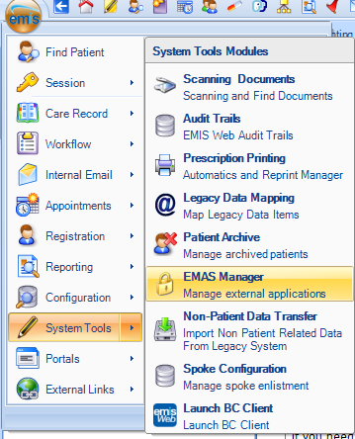
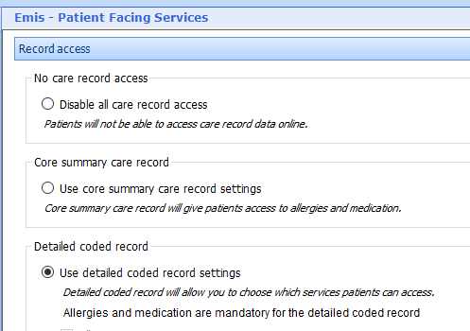
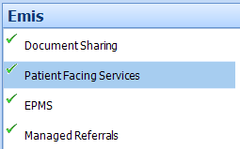
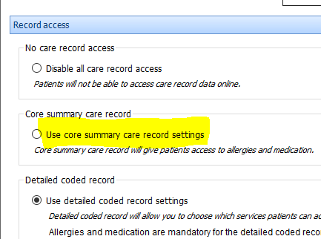
Optum EMIS Web – Configuring Record Access
1
  Go to System Tools > EMAS Manager
2
  At the bottom of the navigation pane, click the EMIS tab. Select Patient Facing Services.
3
  Under Record Access, select the appropriate option
4
To configure prospective record access, select Use detailed coded record settings. Make sure each data type is ticked along with each Display free text from: box and enter a date of 01-Jan-1900 (1st January 1900) into each Display free text from: date box as shown below.
Click here for further details on how to enable record access in EMIS Web. You can find out more about how to enable prospective record access by accessing the GP Patient Record Identification & Enablement Guide (Optum).

Slide 8
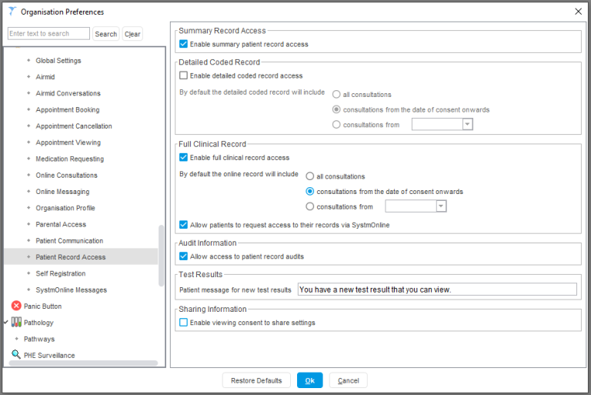
TPP SystmOne – Configuring Record Access
1
Finding the preference
Log into SystmOne and make sure you have ‘System Administrator’ access right.
Navigate to Setup > Users & Policy > Organisation Preferences > Online services > Patient Record Access.
2
Setting the preferences
You can set what level of record access your patients can view and from what date.
N.B. these preferences work in conjunction with the patient level record access preferences you can set in an individual patient record via the ‘Online Services’ node.
3
Your patient will now be able to view their medical record in line with the permissions you have set.
Click here for further details on how to enable record access in SystmOne. You can find out more about how to enable prospective record access by accessing the GP Patient Record Identification & Enablement Guide (TPP).

Slide 9
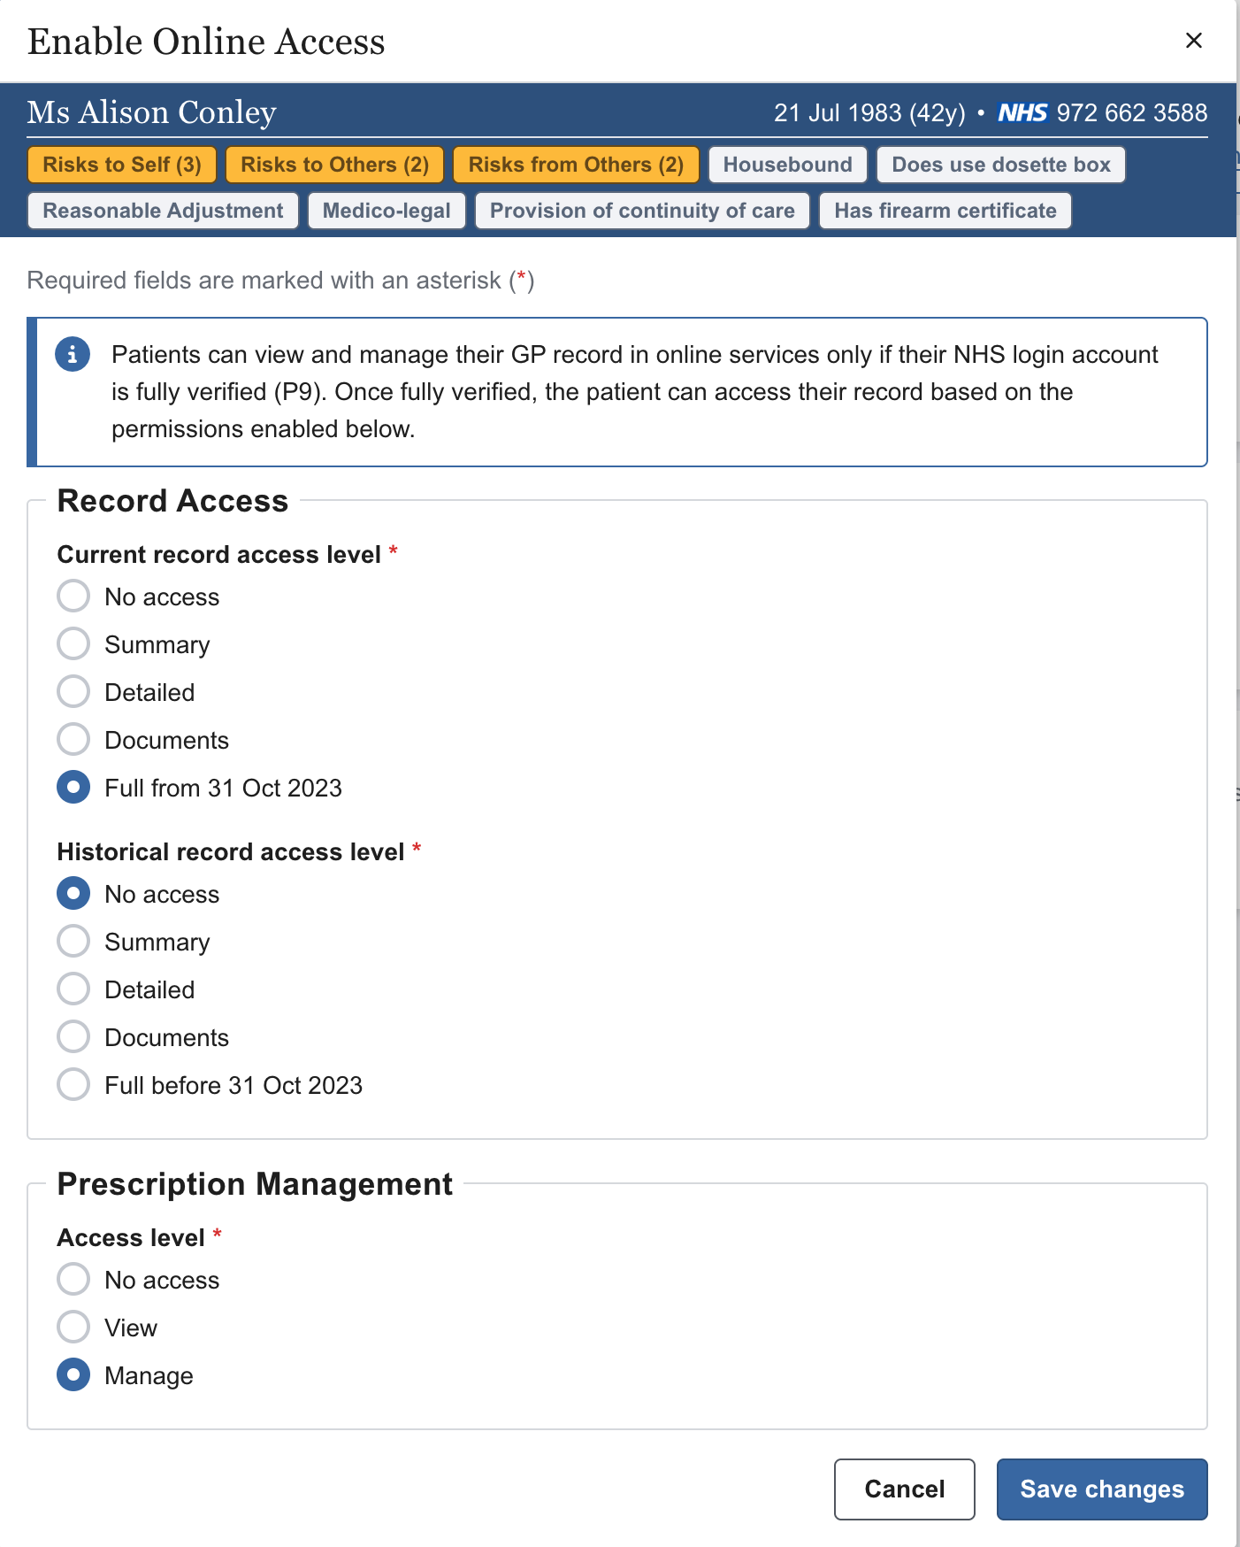
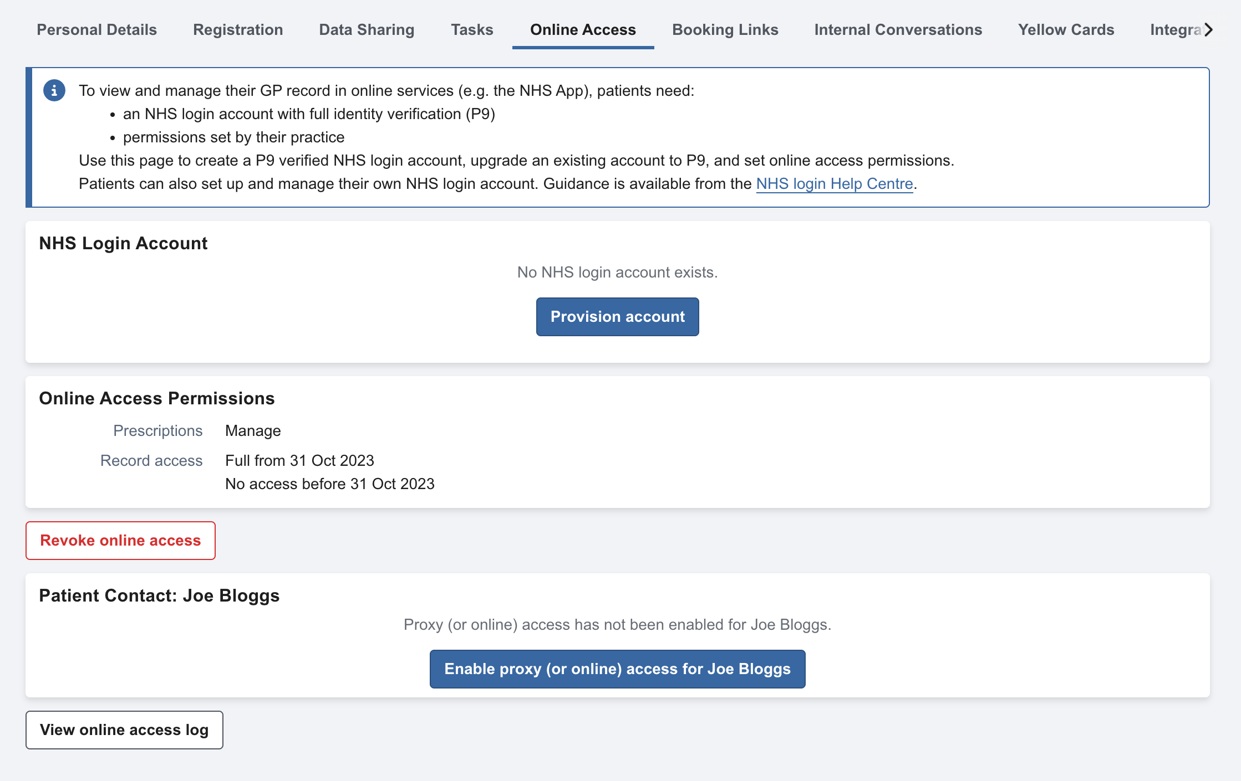
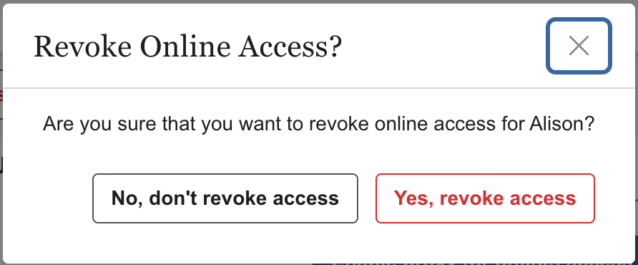
Medicus – Configuring Record Access
Enabling online access
Updating online access
1
To update a patient's online access (e.g. to change their access levels) you must first revoke their existing online access.
1
Open the patient’s administrative record
Select Enable Online Access
2
Confirm that you wish to revoke the access, then follow the steps to enable online access again, selecting the required access levels before saving your changes.
2
Choose patient’s access level
Select appropriate level for Current Record Access Level, Historical Record Access Level, and Prescription Access Level
3
Save changes
Click Save Changes to apply the selected changes
Click here for further details on how to enable record access in Medicus. Note: To access online services such as the NHS App and view their GP record, patients need an NHS login account with full identity verification (P9).

Slide 10
Online consultations

Slide 11

Online consultations
How patients can access this feature
  Patients can use an online form to tell their GP surgery about non-urgent health symptoms.
  For health advice, patients can click on ‘Appointments’ > ‘Book an appointment’ > ‘Ask about a health problem’. They will be asked to fill in a form with information about their symptoms, conditions or treatment (or on someone else’s behalf). Once submitted, a GP or appropriate healthcare professional reviews the form and decides on the right care, including offering guidance or asking the patient to book an appointment. Patients are directed to seek acute care if they hit a red flag.
  Patients can also make administrative requests, such as help with fit notes, by clicking on ‘Appointments’ > ‘Request a letter or information’. Watch this short walk-through video to find out more.
How to enable
Your practice doesn’t need to do anything if it already uses an online consultation system that is integrated with the NHS App. You can view a list of suppliers already integrated with the App here. If you are not sure whether you are correctly set up, please contact the provider of your online consultation system.
Please note that if your practice switches to a different online consultation supplier, there may be additional steps required during the transition, particularly if moving from a supplier that is already integrated with the NHS App:
  The new supplier will need to contact the NHS app team to request that the practice is enabled
  Once decommissioned, the outgoing supplier should notify the NHS App team to disable the practice
  Note that this process can take around 2 weeks. Patients may face intermittent disruption to submit online consultation requests via the app. Practices are advised to inform patients about the potential disruption prior to going live with the new supplier, suggesting they use the practice website in the interim.
Set up practice workflows for triage and ensure that patients are made aware of how they can access this service.
Ensure that staff are trained to manage incoming requests and that protocols are in place to deal with these in a timely, safe manner.

Slide 12
Appointment management

Slide 13
Appointment management
How patients can access this feature
  Patients can use the NHS App to book and manage GP appointments if their GP surgery has made these available online. They can book a GP appointment by selecting ‘Appointments’ > ‘Book an appointment’ > ‘Check for available GP appointments’. Watch this short walk-through video to find out more.
  Appointment management also means being able to view appointments in one place. This includes seeing the date, time, type, and location. If circumstances change, patients can cancel or reschedule appointments directly through the app without needing to call the practice — freeing up slots for others and reducing missed appointments. To view and manage upcoming and past GP appointments, patients can click on ‘Appointments’ > ‘Manage GP appointments’.
How to enable
You can find step-by-step screenshots on how to enable appointment management here: Optum EMIS Web (Configuring Appointments and Making Appointments Bookable) or TPP SystmOne. Medicus does not currently have appointment management functionality through the NHS App.
Offering some appointments through the NHS App can help reduce the number of phone calls to your practice. You can use features in your clinical systems to support your processes. What patients see in the NHS App depends on the specific settings you have enabled. For guidance on how to check your clinical system settings and make sure your patients have the best possible experience when they use the NHS App, please click here.
The NHS App will show any appointments you have made available for online booking within the next 16 weeks, but you can decide how far in advance appointments are available to book. It is important that your patients understand appointment names and terminology used. Click here for guidance on naming appointments in your clinical system. You can set up a test patient once you’ve amended the settings to see how it appears in the App.
This webinar highlights examples of how practices have enabled appointment booking via the NHS App, with approaches that may be suitable for your practice.

Slide 14
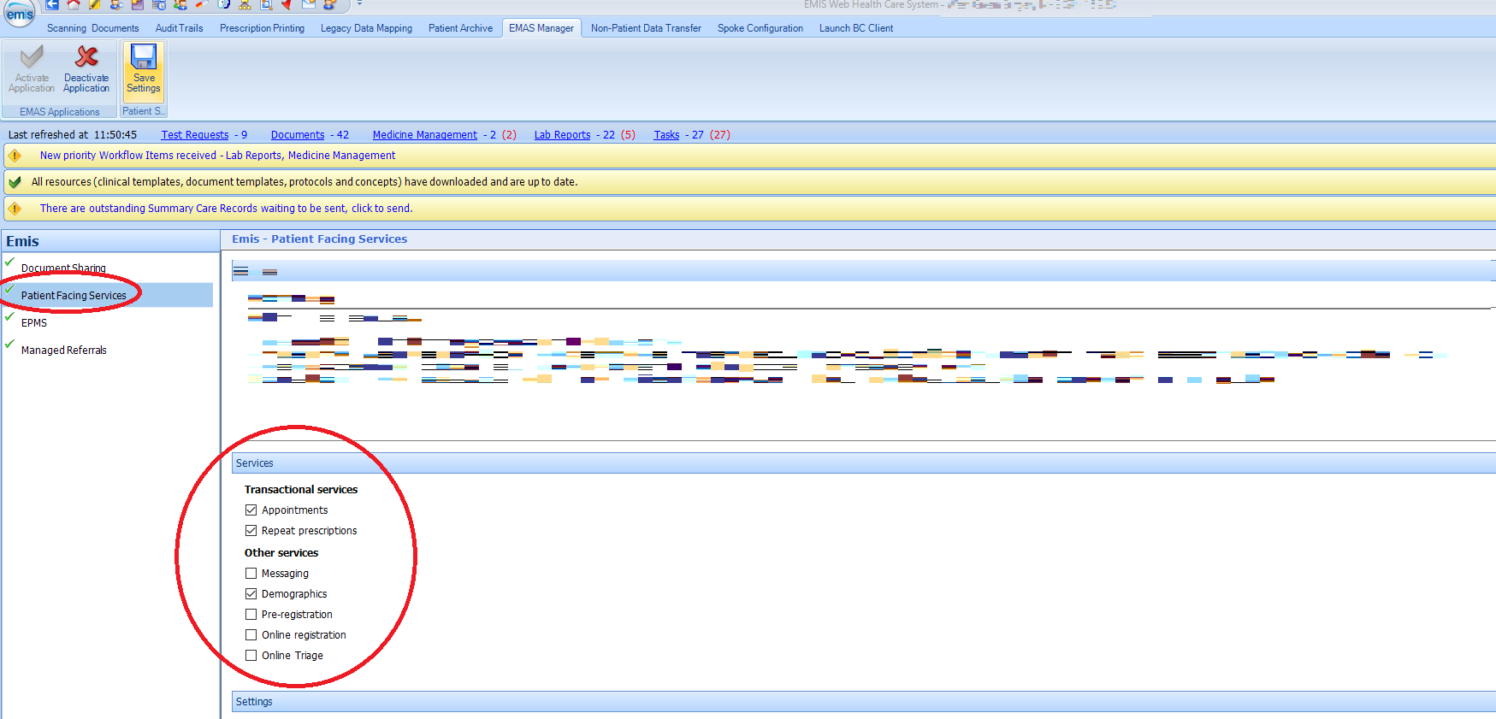
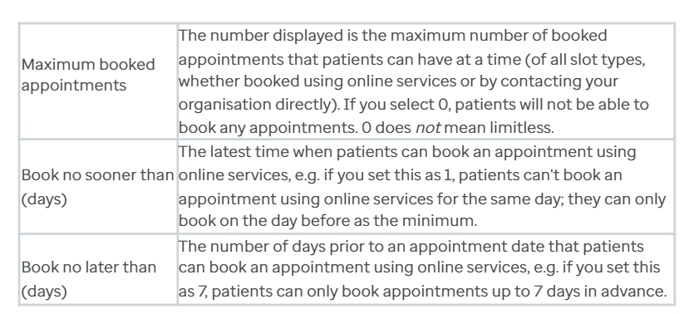
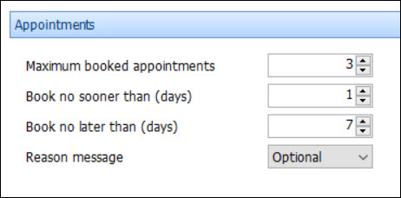
Optum EMIS Web – Configuring Appointments
Enabling appointment management means:
Patients can book appointments online
Patients can cancel appointments online - this applies regardless of how the appointment was originally booked
Note: There are no settings to configure cancellations for online appointments as if a patient can book appointments, they can also cancel them in the NHS App.
1
  Go to System Tools > EMAS Manager. At the bottom of the navigation pane, click the EMIS tab.
2
  Select Patient Facing Services. This information is displayed in the right-hand pane.
3
  Under Transactional Services, ensure that Appointments is ticked so your patients can use this feature.
  Ensure you have enabled Online Services appointments in EMAS Manager. You can do this by clicking on ‘Activate Application’ on the EMAS Manager ribbon. A green tick is displayed beside Patient Facing Services in the navigation pane.
5
  In the Reason message field, click the dropdown arrow icon and select Disabled, Optional or Mandatory. Here you have the option to type a message in the Appointments message field to be displayed for patients who use online services to book appointments. Click Save Settings at the top.
4
  In the Appointments section, make sure that at least there is 1 or more Maximum booked appointments. Also, double check the other settings are correct to your practice’s preference.
  E.g. on the right, the window for appointment booking would be between 1 and 7 days before the appointment, i.e. the week before.
Please see the EMIS Web Configuration Guide: Configuring appointments for Online Services in EMIS Web for further details.
Note: the guidance is not specific to the NHS App as the settings are the same whether you are setting them up for the NHS App, Patient Access or any other provider.

Slide 15
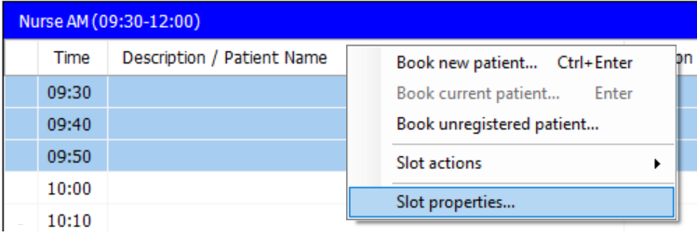
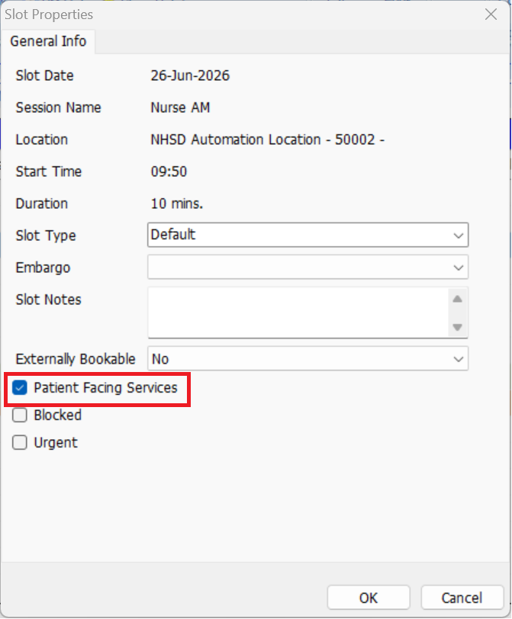
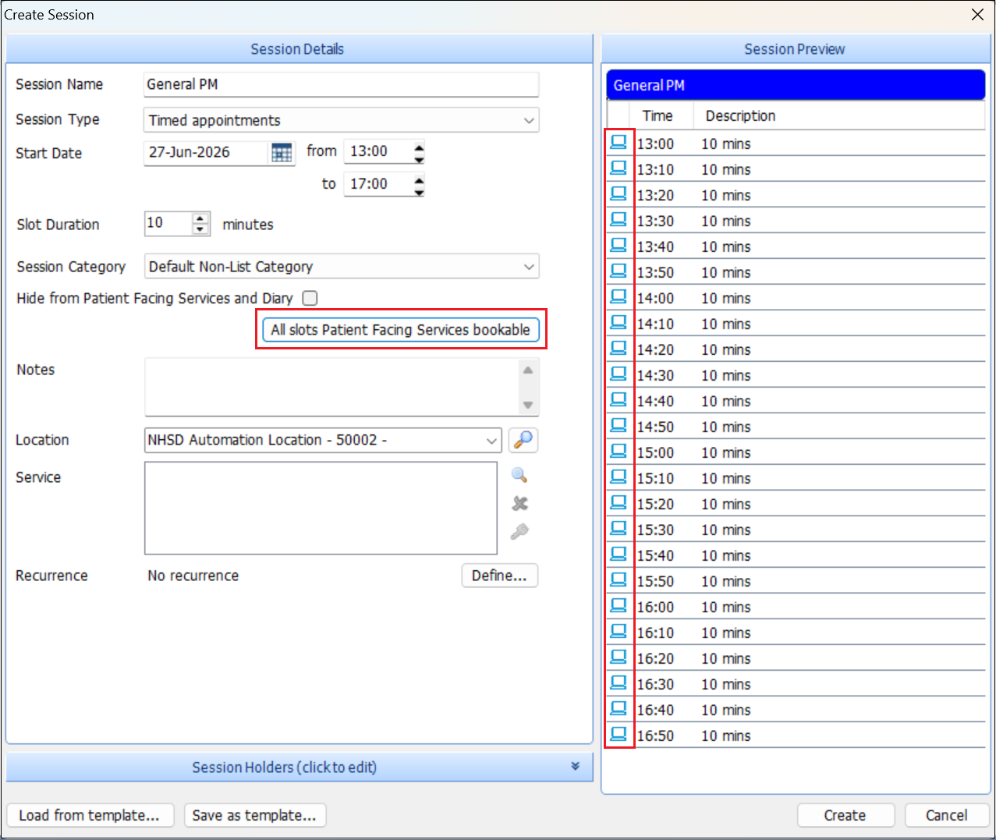
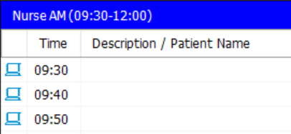
Optum EMIS Web – Making Appointments Bookable
  Configure new sessions for online booking
  Configure slots for existing sessions
1
1
  Click the EMIS button > Appointments > Appointment Book
  Click the EMIS button > Appointments > Appointment Book
2
  Click Create session
2
  Select the required appointment session that you want to make online bookable
3
3
  Right-click the required slot and select Slot Properties. To select more than one appointment slot, hold down CTRL and click each required appointment slot in turn.
  Complete the Session Details and Session Holders
4
  Select All slots Patient Facing Services bookable. The Patient Facing Services icon is then displayed beside the slots in the Session Preview and Appointment Book.
4
  In the Slot Type field, click the dropdown arrow and select the required appointment slot type. Non-default appointment slot types are displayed separately on the website.
5
  Click Create
5
  Select Patient Facing Services
6
  Click OK. The selected slot is made available for patients to book using Online Services, and a Patient Facing Services icon is displayed beside the slot in the Appointment Book.
7
  Repeat steps 2 to 5 for each slot that you want to make available for patients to book using Online Services.
Click here for further details on how to configure appointments in EMIS Web.

Slide 16
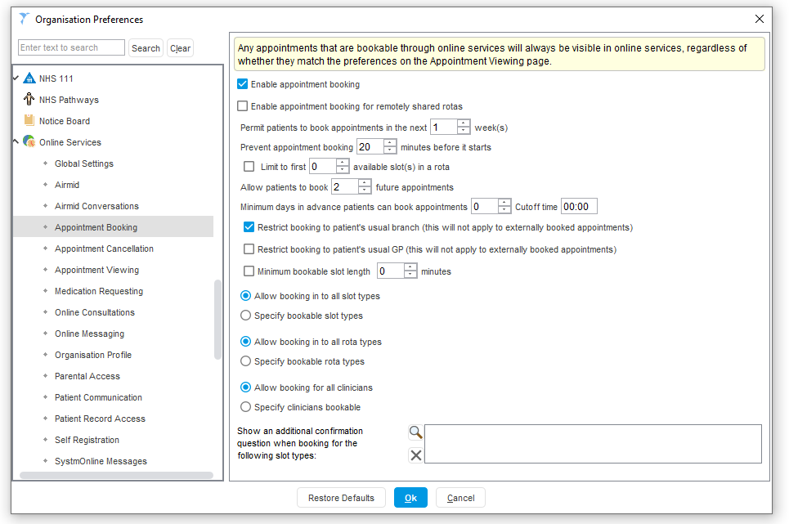
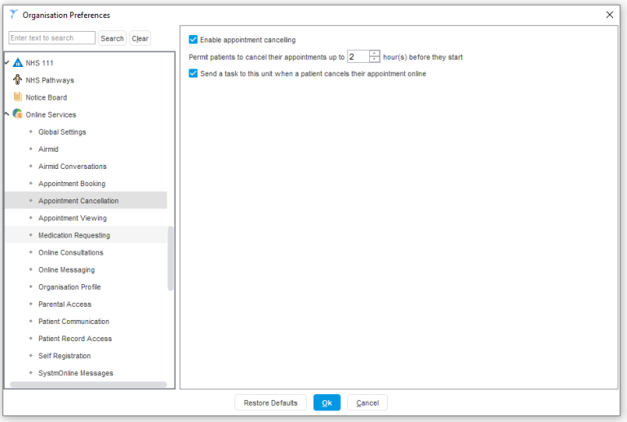
TPP SystmOne – Configuring Appointments
  Appointment Booking
1
Finding the preference
Log into SystmOne and make sure you have the ‘System Administrator’ access right.
Navigate to Setup > Users & Policy > Organisation Preferences > Online services > Appointment Booking.
2
Which appointments can be booked
This preferences page gives you complete control over which appointments can be booked into and when they become available for booking. You can also limit how many appointments any one patient can book into.
  Appointment Cancellation
1
Finding the preference
Log into SystmOne and make sure you have the ‘System Administrator’ access right.
Navigate to Setup > Users & Policy > Organisation Preferences >Online services > Appointment Cancellation.
2
Setting the preferences
Choose whether to enable or disable appointment cancellations
Choose to limit how close to an appointment time an appointment can be cancelled
Choose to receive a Task when a patient cancels an appointment
See the following links for further details on how to configure appointments in SystmOne: booking and cancelling.

Slide 17
Prescriptions management

Slide 18
Prescriptions management
How patients can access this feature
  Patients can request repeat prescriptions via the NHS App if the medication item is available to order.
  This can be accessed by selecting ‘Prescriptions’ > ‘Request a repeat prescription’. After selecting the medicine(s) they want to order, the request is sent directly to the GP surgery for sign-off and issued to the nominated pharmacy. Orders can be made at any time, even when the surgery is closed.
  Under ‘Prescriptions’, patients can also view or nominate their chosen pharmacy. They can check the history and progress of their prescriptions, including when an item was last ordered.
  The prescription barcode allows patients to collect their medicine at a pharmacy of their choice if they don’t have a nominated pharmacy.
  Click here for further information or watch this short walk-through video for a step-by-step overview.
How to enable
You will need to allow patients to request repeat medications online by configuring your clinical system settings.
You can find step-by-step screenshots on how to enable prescription management here: Optum EMIS Web, TPP SystmOne and Medicus.

Slide 19
Optum EMIS Web – Configuring Prescriptions
1
  Go to System Tools > EMAS Manager
2
  At the bottom of the navigation pane, click the EMIS tab. Select Patient Facing Services.
3
  On the EMAS Manager ribbon, click Activate Application. A green tick is displayed beside Patient Facing Services in the navigation pane, and the Patient Facing Services Settings in the top right-hand pane are enabled.
4
  In the Services section, select the box beside each feature that you want your patients to be able to use. Under Transactional Services ensure that Repeat Prescriptions is selected to allow patients to request repeat medications online.
5
  Configure settings for Prescriptions: In the Script request message field, click the drop-down arrow and select Disabled, Optional or Mandatory. If you want a message to be displayed for patients who use online services to request repeat prescriptions, type the message in the Prescribing Warning Message field. If you don't type a message in this field, the message panel isn't displayed on the service provider's website.
Click here for further details on how to configure prescriptions (and other online services) in EMIS Web.

Slide 20
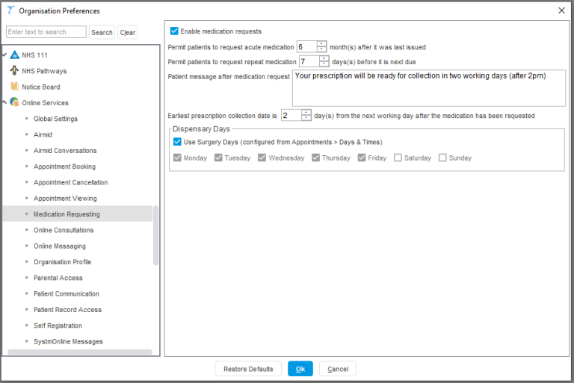
TPP SystmOne – Configuring Prescriptions
1
Finding the preference
Log into SystmOne and make sure you have ‘System Administrator’ access right.
Navigate to Setup > Users & Policy > Organisation Preferences > Online services > Medication Requesting.
2
Setting the preferences
Set when your patients will be able to request repeat and acute medication.
3
The request on SystmOne
Medication requests generated from the NHS App are sent through to SystmOne in the same manner as requests made for other mobile applications and Airmid/SystmOnline.
Click here for further details on how to configure prescriptions in SystmOne.

Slide 21
Medicus – Configuring Prescriptions
1
Open the patient’s administrative record
Select Enable Online Access
2
Choose patient’s access level
Configure the patient's Prescription Management Access Level alongside their record access permissions
3
Save changes
Click Save Changes to apply the selected changes
4
Updating access level
If access needs changing, revoke existing online access and re-enable with the updated settings
Click here for further details on how to configure prescriptions in Medicus. Note: To access online services such as the NHS App, patients need an NHS login account with full identity verification (P9).

Slide 22
Online registration

Slide 23
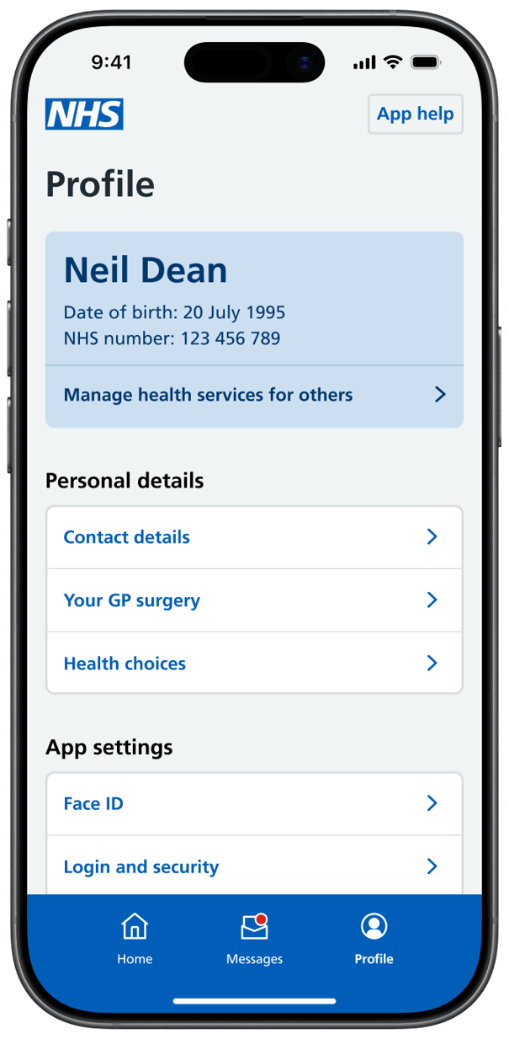
Online registration
How patients can access this feature
  Patients use the Register with a GP Surgery service to find a GP and apply to register themselves or someone they care for via the NHS App. It is simpler, easier and more inclusive for both patients and GP surgeries, whilst also reducing the administrative time required to complete the process.
  They can access this on the App under ‘Profile’ > ‘Your GP surgery’ > ‘Change GP surgery’. After entering their postcode, they can click to ‘Register online with this GP’ if that GP surgery has enrolled with the service.
  You can find out more here or watch this demo for further details.
  There is also an updated paper form for patients with limited or no access to the online service which you can download here.
How to enable / adjust settings
GP surgeries can sign up to the service or adjust settings in NHS Profile Manager. Click here to find out more.
Once enrolled with the service, you will be given a:
  unique link to add to your practice website
  test patient profile to check it's working correctly
  link to download a copy of the updated paper registration form (PRF1) - this replaces the GMS1 form
This older webinar explains how practices can set up this service and this more recent webinar explains how practices can optimise their use of it.
You can use these materials to promote the service.

Slide 24
Patient messaging

Slide 25
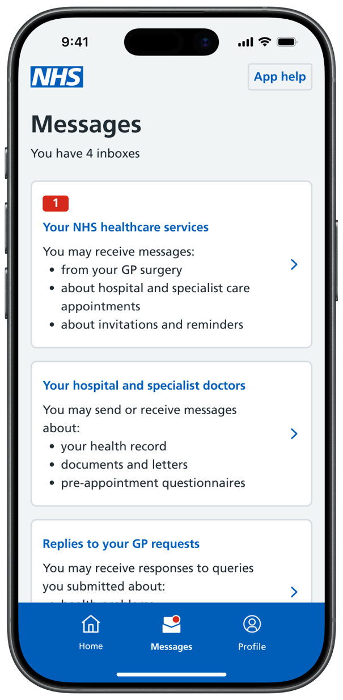
Patient messaging
How patients can access this feature
  Patients can receive messages securely from their practice via NHS App instead of SMS, providing they have downloaded the app and enabled notifications. ​This short video shows how patients can see their messages in the NHS App.
  Patients can turn notifications on by clicking on ‘Profile’ > 'Notifications' > ‘go to your device settings’. Here patients can turn on notifications for the NHS App.
  Patients can access their messages from their healthcare provider(s) by clicking on ‘Messages’.
  If a message is not successfully delivered to the NHS App, it should automatically be resent via another channel such as SMS. Time-critical messages are not sent via NHS App.
How to enable
Check here to see if your current messaging service supplier offers NHS App Messaging. If they do, ask them when they will be rolling this service out in your practice. If they don’t, encourage them to contact the NHS England app onboarding team at app.integration@nhs.net
Consider updating your privacy policy to explain to patients who their data is shared with and why.
Plan how you will tell patients about this service – you can use these promotional materials and follow guidance here.

Slide 27
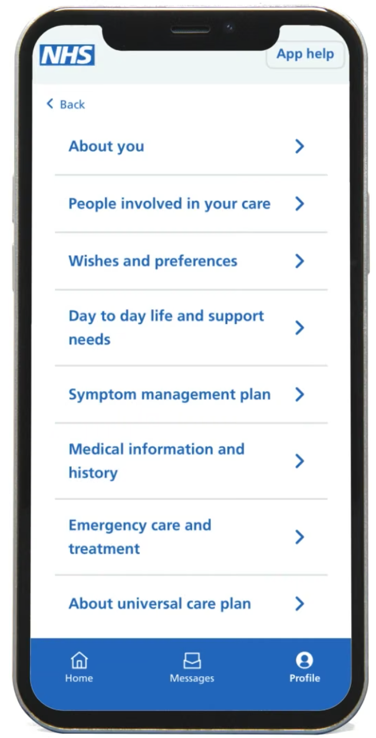
Appendix: Universal Care Plan
How patients can access this feature
  Note: this feature is currently only available in certain areas, mainly London.
  Londoners can create, view and update their Universal Care Plan (UCP) through the NHS App or NHS login service. They can find this feature under ‘Profile’ > ‘Care plans’.
  Patients can add or update personal information and key sections such as “What matters to you”, people involved in their care, wishes and preferences, day-to-day support needs and symptom management.
  The UCP complements the core capabilities of the NHS App by providing a more complete view of a patient's care and support needs.
Benefits
Supporting resources
Improves the accuracy and completeness of care plans
Strengthens collaboration between patients, carers and professionals
Supports better coordinated care and outcomes
Main website which signposts to guidance and resources for health care professionals and the public
Short walkthrough video
A more detailed step-by-step walkthrough video
  If you have any queries about the UCP, please contact the team: ucp.programme@swlondon.nhs.uk

