Slide 1
Migration Playbook
A guide to carrying out cloud migrations
Notes:
Standard title slide

Slide 2



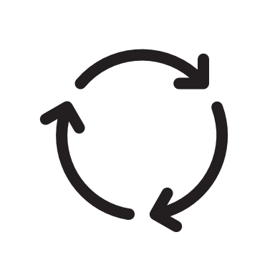
Improving the Migration and Modernisation Capability
First Steps
Objectives
Develop a defined migration process following best practices and incorporate existing lessons
Utilise tools (The Playbook) and templates (7R assessment) to make the process easier and usable
Utilise the tools and templates when starting the migration journey
The Playbook promotes understanding of the migration process and phases
The guidance in the Playbook can be utilised to plan out activities within migration phases
The guidance in the Playbook can be utilised to validate migration partner plans and activities
Implementation
CCoE collaboration / support
The Playbook user:
  can start by following the assessment guidance to complete an assessment (themselves or with a partner)
  can move to the planning guidance and complete migration planning
  complete their migration through following guidance in the execution phase of the Playbook
The user can use lessons learnt to improve future migration activity - as well as feeding this back towards the CCoE to improve the Playbook
CCoE support - introduction, support around phases, analysis (insight creation), planning.
CCoE collecting benchmarking/reference data - costs, time to migrate, partner ISV cloud readiness

Slide 3

Contents
Migration Playbook
Table of Contents
Purpose
Migration approach and phases
Lessons and considerations
How to use this guide
Assessment
  Timeline
  Activities and workstreams
  Inputs
  Activity descriptions
  Outputs
  Templates
  Funding
Planning
  Timeline
  Activities and workstreams
  Inputs
  Activity descriptions
  Outputs
  Templates
  Funding
Execution
  Timeline
  Activities and workstreams
  Inputs
  Activity descriptions
  Outputs
  Funding
Modernisation
  Timeline
  Activities and workstreams
  Inputs
  Activity descriptions
  Outputs
  Templates
  Funding
Appendices
A guide to carrying out cloud migrations

Slide 4
Purpose of the Playbook
Purpose
NHS organisations are moving towards adopting Cloud hosting, driven by the benefits of Cloud hosting and an NHS Cloud strategy shaped by a requirement for government organisations to evaluate Cloud solutions before other hosting options.
In order to move to Cloud hosting, NHS organisations need to develop capabilities around Cloud Migration and Modernisation.
This Playbook is a tool to promote those capabilities.
The Playbook explains at a high-level the stages of Migration Delivery Approach,
comprising Migration Assessment, Migration Planning, and Migration Execution:
Prescriptive guidance to migration, tuned for an NHS context
A technical guide to the phases and activities involved in a migration
A framework on which to compare partner-led migration activities
A benchmark for migration activities
Lessons learned and considerations around migration
Link to NHS Digital CCoE Business case for cloud: https://digital.nhs.uk/services/cloud-centre-of-excellence/ccoe-services/business-case-for-cloud

Slide 5






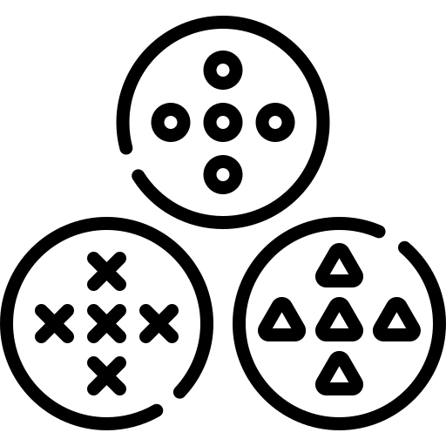

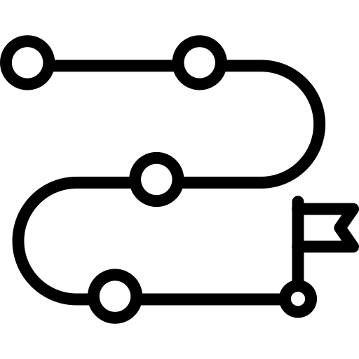
Migration Delivery Approach - Phases
A migration consists of 3 phases: Assessment, Planning and Execution.
A modernisation process extends from each phase dependent on when applications are identified for modernisation.
This guide contains an overview of each phase, including details of inputs, activities and outputs required to deliver a phase.
4-8 weeks
8+ weeks
Timeline will be determined during planning
MIGRATION
ASSESSMENT
MIGRATION
PLANNING
MIGRATION
EXECUTION
Workshops
Rapid Discovery
High level business case
Validation
Detailed Discovery
Application Grouping
Migrate, integrate, validate, cutover
Migration Plan
Migration Design
Migrate, integrate, validate, cutover
Migrate, integrate, validate, cutover
Strategy + roadmap
Timeline will be determined during planning
MODERNISATION
NHS Digital CCoE Modernisation and Migration:
https://digital.nhs.uk/services/cloud-centre-of-excellence/cloud-topic-areas/application-migration-and-modernisation
CCoE Microsoft Azure Resources:
https://digital.nhs.uk/services/cloud-centre-of-excellence/cloud-consultancy-and-guidance/microsoft-azure-resources
CCoE Amazon Web Services Resources:
https://digital.nhs.uk/services/cloud-centre-of-excellence/cloud-consultancy-and-guidance/amazon-web-services-aws-resources

Slide 6









Process flow
The ultimate goal is to migrate to cloud. Each of the process phases covers different inputs, activities and outputs. Outputs from prior phases feed in as inputs to subsequent phases.
4-8 weeks
8+ weeks
Timeline will be determined during planning
ASSESSMENT
PLANNING
EXECUTION
MIGRATION TO CLOUD
Activities & Outcomes
Activities & Outcomes
Activities & Outcomes
Scope, effort and landscape understanding
Documentation and information gathering (interviews and workshops)
Rapid, functional and technical -discovery
Application detailed discovery and validation
Workshops, migration coordination planning and design
Migration work alignment for decreased workload and risk control
Well prepared Landing zone, training and PoC
Migration, integration, validation and cutover
Provides a smooth transition to cloud
Inputs and Outputs
Inputs and Outputs
Inputs and Outputs
Inputs
  Structure, domains, inventory
  Data, costs, interviews, architecture and workshops
Outputs
  Summary, portfolio, scope, reports and recommendations
  Business case, migration strategy and roadmap
Inputs
  Workshops and interviews
  Application inventory and groups
Outputs
  Migration wave plan
  Migration groups and approach
  Migration cutover and test plan
  Application group migration designs
Inputs
  Migration group plan and design
Outputs
  Landing zone, training plans
  Migration readiness
  Applications in cloud
  Cutover readiness and migrated applications

Slide 7
Lessons and considerations
Structure
Phases
Migration journey can be a complex process, therefore it’s important to take a well structured top down approach with the migration. Use of reference architecture is highly recommended to guide rapid discovery and to ensure that viable strategies are chosen.
A shorter time spent during the assessment phase will result in more time completing the planning phase. In other words, lightweight assessment requires heavy planning.
Partner
Funding
Migration planning, assessment and execution is a complex process, it’s often best to work with a partner to benefit from their experience delivering assessments.
Migration work can be funded by cloud vendors when a vendor has been chosen and the requirements for funding have been met. Vendor funding is usually tied to migration work being carried out by a vendor partner.
Domain level view
Time constraints
It’s critical for efficient and labour-saving migration to include a domain level view to provide context and structure for migration activities (as opposed to migrating en masse without structure).
The phases’ elapsed time is highly dependent on engagement from application owners, the availability of data and the complexity of the existing environment.
Tooling
Tooling provides a part of the whole migration picture. Using only the tooling without properly going through all the activities will not result in ideal outcomes.

Slide 8
Key factors influencing migration success
People
Business
Portfolio
Alignment with stakeholders
  Maintains momentum of the migration
Availability of stakeholders and application owners
  Allows faster resolution of issues
Migration team size
  Larger team size can reduce duration up to a point
Parallel work
  Ability to resource multiple migration activities concurrently to reduce duration.
Support from operational staff
  Good support decreases timeline and costs
Cloud knowledge
  Lack of knowledge adds training cost and slows timeline
Finance
  Budget to complete migration work
  Lack of financial understanding of cloud - can cause increased TCO after migration
Culture
  Support from senior management - resistance to change increases time and costs
Time constraints
  The need to migrate quickly can increase TCO of migrated applications
Lack of common understanding of next steps
Business context and dependencies
  Constraints against other programs and projects, milestones, dates
  Constraints against BAU work, production activity, maintenance requirements
Clarity and understanding of scope and applications
The number of applications and servers in scope for migration
Application complexity, complexity of dependencies
Lack of ownership of applications
Lack of existing means to test applications.
  Difficulty validating migration success.
  More steps to establish tests, or more risks taken during migration
Legacy and outdated architectures and software
Vendor constraints
  Support, contracts, licensing

Slide 9
How to use this guide
Each phase of migration has a section. Within a section you can find the following:
Slide | Description
Timeline | Shows guidance on how to lay out the general activities over time. Includes inputs required as well as the expected outputs to be created.
Activities and workstreams | Shows more detail on the activities to be carried out and where they fit within separate workstreams.
Inputs | More detail on the expected inputs. Templates are provided to help capture inputs.
Activity descriptions | Detail on each activity. Templates are provided to help guide activities.
Outputs | Detail on the purpose of outputs. Templates are provided to make capturing and reporting results easier.
Templates | Links and descriptions of template documentation that can be used within the activities. Templates are highlighted blue throughout other sections.
Funding | Information on available cloud funding from hyperscalers.

Slide 10
Assessment
3 phases within assessment
Mobilisation
Discovery
Reports and roadmap
Aims
Understand your situation in relation to cloud migration.
Assess the current state of domains and applications to:
  Create a business case for cloud migration.
  Understand the 7R¹ strategies that can be applied to applications.
  Develop a high level roadmap for cloud migration.
¹ See slide 41 for an explanation of the 7R

Slide 11
Timeline
Migration Assessment
Mobilisation
Discovery
Reports and Roadmap
Inputs
Strategic Initiatives
Org. Structure
Bus. Domains
App Inventory
CMDB Data
IT Assets Cost
Interviews
Reference Architecture
Interviews
Workshops
Tooling Data
Discovery Tool Installation
Rapid-Discovery
Functional-Discovery
Output Review and Reporting
Activities
Documentation Gathering
Interview and Workshops Set Up
Technical Discovery
Outputs
Discovery Plan
Portfolio Summary
Application Portfolio
Scope
App Arch. Summary
Discovery Tool Report
App to Infra mapping
7Rs Recommendations
Business Case
Migration
Strategy
Migration
Roadmap
Timeline of 4-8 weeks
Assessment approach:
  Top-Down (starting with business domains & capabilities)
  Bottom-Up (starting with tool-based discovery & CMDB data)
Outcomes (overview reports):
  Initial Business case, TCO and migration effort estimates
  Application-domain migration strategy and roadmap
  7R migration strategy
  Migration roadmap

Slide 12
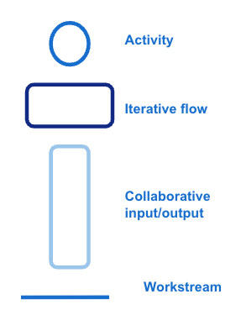
Activities and workstreams
Migration Assessment
Mobilisation
Discovery
Reporting
Kickoff/Initial
Business Case
Scoping
Application architecture
Business Case
and TCO
Roadmap
TRUST
PERSPECTIVE
A workstream for the top down discovery and assessment.
Includes high level migration aspects, business case, architecture, scope and roadmap.
Business Case
Increment
Rapid Discovery & Assessment
Scope
Final Business Case and Roadmap
INITIAL
ASSESSMENT
Stakeholder Engagement
Trust Understanding
The initial assessment workstream, where initial data is rapidly assessed to assist with scope and the first assessment increment. Can define the direction for the full assessment.
Assessment
Increment
APPLICATION ASSESSMENT
A workstream for the assessment itself. Begins with the installation of discovery tooling, followed by iterative discovery and assessment of applications with the aid of application owner interviews.
Discovery &
Assessment Tooling
Application
Owner
interviews
Discovery &
Assessment
App to Infra mapping
7R
Migration assessment Report

Slide 13
Inputs
Migration Assessment
Provided templates are highlighted blue and explained in a further slide
Input | Description
Strategic initiatives, Org structure, business domains | An understanding of the top down strategic aspects of the organisation is required to help with determining a structure for a migration. The organisation can be associated with a persona to help guide to assessment and future migration activity. See Persona Model slide in Appendices.
Application inventory | A list of all applications in scope for migration. Used to provide an initial understanding of migration scope. Populate the Application Inventory template to collate this data.
CMDB | More detailed information about the applications and infrastructure to be migrated. Derived from an existing CMDB. Up to date and accurate information is key to assessing the migration, the key requirement for the discovery input data is to gain enough depth of understanding about applications in migration scope to be able to associate a migration strategy with those applications. Examples of the kind of details required from the CMDB can be found in the Application Inventory and 7R assessment tool templates.
Asset costs | Cost information related to existing applications and infrastructure. To enable calculation of the as-is TCO for comparison against future migration and cloud hosting costs.
Reference Architecture | The reference architecture can be used to map existing applications to domains and provide input into functional discovery. Knowing the domain of an application helps with migration grouping and with determining appropriate strategy for migration. The NHS reference architecture can be found in slide 43.
Interviews | Interviews with application owners, architects and subject matter experts. To provide additional information on applications and fill in gaps in data. The Application Discovery Interview template provides a guide to the types of questions to ask during these interviews.
Workshops | Workshops with application owners, architects and subject matter experts to validate the assessment findings.
Tooling data | Data derived from discovery tooling used. Usually available towards the end of the assessment period.
Provided templates are highlighted blue and explained in a further slide

Slide 14
Activity descriptions
Migration Assessment
Provided templates are highlighted blue and explained in a further slide
Activity | Description
Kickoff/initial business case | Start the assessment project with a kickoff workshop, discuss business drivers to migration and initial business case
Rapid discovery and assessment | Utilising existing knowledge and architecture to determine migration strategies at domain level. Doing this rapidly at the start of the process can help to identify direction and focus for a migration assessment. The assessment can iterate from this initial rapid discovery.
Discovery and assessment tooling | Choose some suitable migration discovery tooling and install this on the existing estate. Discovery tooling identifies existing on-premise infrastructure, which determines the scale of the migration. These tools can also sometimes provide additional assessment around migration strategy, application grouping, business case and roadmap. Discovery tooling will need to run for a minimum of 2 weeks to gather enough data for analysis. Some tooling will provide both discovery and analysis. See Tooling Options
Scoping | Determine the scope of the assessment. This ensures effort is only spent assessing relevant data, applications and infrastructure. This will be an iterative process.
Discovery and assessment (Application owner interviews) | Discovery an assessment should cover both a top down business and functional view and a bottom up technical view. Business aspects can be derived from application owner interviews (Utilising the Application Discovery Interview template to guide interviews towards relevant discovery). Technical aspects will come from results captured by tooling. Functionally derived information can be combined with the technical defined information to develop assessment conclusions for domain level strategy, roadmap and business case.
Application to Infrastructure mapping | An essential step to understand how the applications discovered relate to the infrastructure. The basis of 7R, TCO and roadmap results from this mapping.
7R | Utilising the 7R assessment tool to determine migration strategies for each application. Using knowledge from discovery and assessment activities to validate migration strategies and apply migration strategies to the domain level. For explanation of the 7 migration strategies see Slide 41: Migration Strategies - 7R in the Appendices.
Application architecture | Mapping the application inventory to NHS reference architecture (Slide 43) in order to identify domains and key migration levers.
Business case and TCO | Defining the drivers for cloud migration along with costs. Utilise a TCO modelling tool to define TCO across existing hosting, cloud hosting, migration costs and wider cost benefits.
Roadmap | Defining a cloud migration and transformation roadmap from a domain perspective
Assessment reporting | Documenting the assessment and conclusions
Provided templates are highlighted blue and explained in a further slide

Slide 15
Outputs
Migration Assessment
Provided templates are highlighted blue and explained in a further slide
Output | Purpose
Discovery plan | Resource and time plan for the completion of the discovery work
Portfolio summary | Utilise the Application Inventory template to gather all of the data on applications, summarise this data to build understanding of the portfolio.
Application portfolio | Utilise the Application Inventory template to gather all of the data on applications. This data will come from many sources and should be collated together to gain a complete picture. The aim of this data in the assessment phase is to have enough understanding and known application attributes to be able to conclude migration strategy and application domains across the portfolio. It identifies gaps to be filled in future assessment iterations and migration planning.
Scope | Include the scope in the Application Inventory. The scope is crucial to the scale of future migrations. This defines the scope and scale of a future migration.
Application architecture | The output of the application architecture activity and reference architecture (Slide 43). This helps to build understanding of the overall structure for migration and defines migration strategy and roadmap for business domains.
Discovery tool report | If a discovery tool tool is used it will produce a report which will provide data on existing infrastructure to input into migration strategy, application grouping, business case and roadmap. This will be a primary output of vendor driven migration assessments.
7R recommendation (migration strategy) | Utilising the 7R assessment tool to map applications to migration strategies (7R). This data on 7R migration strategy can be combined with discovery tool output, functional discovery and context to conclude on the domain level migration strategy.
Business case | Defining the drivers to cloud migration. Showing the estimated costs for migration and future cloud hosting, compared against existing costs and cloud cost benefits. Summarise within Migration Assessment Report - summary and document within Migration Assessment report.
Migration strategy | The conclusion from the assessment on the migration strategies to utilise across domains and across applications. This feeds into future migration plans and highlights the level of effort and work to complete cloud migration across an application portfolio. Migration Assessment Report - summary and document within Migration Assessment report.
Migration roadmap | Presenting a high level plan for cloud migration across domains. Defining how migration can be achieved. Migration Assessment Report - summary and document within Migration Assessment report.
Notes:
Provided templates are highlighted blue and explained in a further slide

Slide 16
Templates/tools
Migration Assessment
Template | Notes
Migration Assessment Report - summary | Covers the high level strategy breakdown/journey to cloud, high level roadmap stages, business case value factors and costs, conceptual plan, key findings
Migration Assessment report | A detailed report showing the findings of the assessment. Includes scope of assessment, summary of application and inventory, 7R strategy mapping + business domain view, migration roadmap + business domain view, Business case and TCO
Application Inventory | A spreadsheet to hold the complete list of applications and infrastructure in scope for assessment. This will include any analysis done and the migration strategies chosen. The attributes within this template indicate the attributes required to complete the assessment and further migration planning.
Application Discovery Interview template | A set of questions that can be used to guide application discovery interviews.
7R assessment tool | A set of questions which can be answered for each application in order to determine a valid migration strategy for an application based on known application attributes.
All templates include further guidance on use within the templates themselves

Slide 17
Tooling Options
Tool | Type | Notes | Link
Cloudamize | Technical Discovery |  | Cloudamize - Platform
Movere | Technical Discovery |  | Movere - Overview
Azure Migrate | Technical Discovery | Free (cost of Azure storage). Azure based | Azure Migrate - Product Overview
AWS Application Discovery Service | Technical Discovery | Free (cost of AWS storage). AWS based | AWS Application Discovery Service - Migration
Dr Migrate | Analysis | Azure based | Dr Migrate - Cloud Migration Planning Tool
AWS MPA | Analysis | AWS based | AWS - Migration Portfolio Assessment
Txture | Analysis |  | https://txture.io/en
AWS Migration Evaluator | Analysis | AWS Based (Formally TSO Logic) | https://aws.amazon.com/migration-evaluator/

Slide 18
Funding
Migration Assessment
Funding | Description
AWS MAP | Partner based funding. Funding available for small and large projects. Covers some cost of carrying out an assessment. Details on slide 45.
Azure | Microsoft will carry out migration assessment free of charge for the customer. The Azure Immersion and Discover Workshops are delivered free for the customer. More on slide 48.
Other | Service partners can also provide funding. Contact CCoE for support.

Slide 19
Migration Planning
3 phases within planning
Validation
Planning
Design
Aims
To create migration plans for each application group that can be executed in the next migration phase.
Approval of migration plans

Slide 20
Timeline
Migration Planning
Validation
Planning
Design
Inputs
Workshop
App Inventory
Interviews
Application Groups
Workshop
Workshop
Activities
Application detailed discovery
Migration approach
Cutover methods
Migration Design
Migration coordination planning
Test planning
Landing Zone Design
Outputs
Detailed application background
Application groups
Migration wave plan
Per application group migration approach
Per application group Cutover and test plan
Per application group migration design
Approval
Timeline of 8+ weeks
Validates the input from the migration assessment
  Further detailed discovery - filling gaps from
  Application grouping
For each application group plans the migration activity
Outcomes (Detailed plans):
  Application groups and wave plan
  Migration plans

Slide 21
Activities and workstreams
Migration Planning
Validation
Planning
Design
Scoping
OVERALL
PLANNING
A workstream for the overall planning activity. Determines which applications are in scope and how they need to be grouped. The scoping may be iterative as more is learnt about the application portfolio. A prioritised list of migration waves is created and this workstream coordinates the further migration planning activity
Application
grouping
Migration coordination
Wave Plan
PER APP GROUP PLANNING
App -by-app workshops carried out for detailed discovery followed by migration design. Sprints will tackle groups of applications based on priority. This creates migration design documentation and a backlog of per wave migration activity.
Scope
Ready to Migrate
Workshops
Application
Detail Discovery
Approval
Design
APPLICATION OWNER INVOLVEMENT
Migration Approach
A workstream covering application owner involvement. It is critical to successful migration planning and execution that application owners are involved in the planning process, both to provide information and to agree on plans.
MIGRATION EXECUTION
A workstream to set up for migration execution. Migration engineers who will carry out the migrations must be involved in the planning stage to ensure they are aligned prior to execution of the migration plans
Notes:
Additional app detail needed will depend on how much was gathered and analysed in the initial assessment

Slide 22
Inputs
Migration Planning
Input | Description
Application inventory | A complete inventory derived from the migration assessment phase.
Application groups | Created during the validation stage of migration planning and input into the planning stage.
Workshops and Interviews | Workshops and interviews to validate and discover further information required to plan migrations. Workshops are also used to align with application owners and migration engineers around migration plans. Migration plan - App Discovery

Slide 23
Activity descriptions
Migration Planning
Activity | Description
Scoping | Determine the scope of the plan, there may be applications discovered during the assessment phase which are not candidates for migrations and would be out of scope for planning. This ensures effort is only spent assessing relevant data, applications and infrastructure. This will be an iterative process.
Application grouping | Applications should be grouped to aid planning. They can be grouped logically based on what there are and known functional dependencies, and/or technically based on network traffic data derived from migration discovery and assessment tooling.
Application detail discovery | The key is to gain enough detail about applications to be able to form a migration plan. See the Migration plan - App Discovery template to see the type of detail required from the detail discovery activity. Information comes from workshops, interviews, the previous assessment phase and discovery tooling. This activity is iterative, with more detail derived, gaps identified and filled as the migration plans are populated.
Wave plans | Application groups are mapped to migration waves through priority of migration.
Migration approach | For each wave determine the approach to the migration, takes input from the identified migration strategy and adds in application context to determine the details of the approach. A plan for cutover should be developed as well as a migration test plan. The migration approach should be developed alongside application teams to ensure they are aligned with the activity.
Design | The migration target state should be designed, including identifying the migration landing zone and target architecture.
Migration coordination | An activity to ensure the wave plan is progressing.
Approval | It is likely that there will be internal approval steps to making changes. These approval steps should be followed.

Slide 24
Outputs
Migration Planning
Output | Purpose
Detailed application background | Documented in Migration Plan - plan
Application groups | The applications grouped logically and technically
Migration wave plan | A refined roadmap and priority order for migration groups
Application group migration approach | The migration plan and cutover documented in Migration Plan - plan for each migration wave. Form the basis for migration execution.
Application group test and cutover plan | The migration test plan documented in Migration Plan - plan for each migration wave.
Application group migration design | The migration design documented in Migration Plan - plan for each migration wave.
Approval | It is likely that there will be internal approval steps to making changes.

Slide 25
Templates
Migration Planning
Template | Stage | Notes
Migration plan - App Discovery | Validation | Captures detailed key application information. Feeds details into the plan. Can also be used during the assessment phase if there is scope to dive deeper into applications.
Migration Plan - plan | Planning and design | Detailed plans and cloud design for the migration.

Slide 26
Funding
Migration Planning
Funding | Description
AWS MAP | Partner based funding. Funding available for small and large projects. Covers some cost of developing a migration plan. Details on slide 46.
Azure | Microsoft will carry out migration planning free of charge for the customer. More on slide 48.
Other | Service partners can also provide funding. Contact CCoE for support.

Slide 27
Migration Execution
2 phases within a migration execution
Preparation
Execution
Aims
To prepare for migration
To carry out successful application migrations

Slide 28
Timeline
Migration Execution
Preparation
Execution
Inputs
Approved migration group
Migration group plan and design
Migration group plan and design
Complete LZ
Customer training
Activities
Migrate
Integrate
Validate
Cutover
Landing zone creation
PoC
Outputs
Landing zone
Complete training plans
Migration readiness
Application in cloud
Scripts to integrate the application on cutover
Signed off application testing
Readiness to cutover
Migrated applications
Timeline will be determined during planning
Migration execution is iterative and occurs for each planned migration wave
The migrations will occur alongside the continuing migration planning
The whole migration will be coordinated as part of the previous phase of migration planning
A migration PoC is advised prior to starting further migration execution activities, this can be in the form of migrating a single application using the migration execution process to validate the process.
Outcomes (Completed migrations):
  Landing zone established in the cloud
  Application groups migrated and running in the cloud
  Applications in cloud handed over to trained customer operators

Slide 29
Activities and workstreams
Migration Execution
Preparation
Execution
TRUST
A workstream for the trust overall to develop the skills and capabilities required to manage applications once they are migrated to the cloud.
Training/
Skills
Ready to Migrate
Design/Approach
MIGRATION EXECUTION
The migration execution team, having collaborated on application migration design, take waves of applications through sprints as the application groups are approved for migration. Delivering completed migrations.
Migrate
LZ build
Integrate
Validate
Cutover
The whole delivery process is iterative, happening for each application group migration wave
Notes:
Additional app detail needed will depend on how much was gathered and analysed in the initial assessment

Slide 30
Inputs
Migration Execution
Input | Description
Approved migration group | The main input into the migration execution process. Defines the applications to be migrated in a migration wave. There will be a priority list of migration groups being worked through in the planning phase, feeding into the execution phase as the plans are completed.
Migration group plan and design | The plan and design for a particular migration wave. There will be a plan and design for each migration wave, these plans will be actionable and include the migration steps, configuration and testing.
Completed Landing Zone | Created during the preparation stage of the migration execution. Creates the prerequisites such as cloud accounts and networks required to be a target for the migration.

Slide 31
Activity descriptions
Migration Execution
Activity | Description
Training/skills | An activity to ensure that the skills and capabilities exist to allow migrated applications to be operated in the cloud.
Landing Zone (LZ) build | The building of a suitable landing zone to act as a target for migration, as defined in migration plans.
Migrate | Migration should follow standard steps dependent on migration strategy, with any customisation detailed in the migration plans.
Integrate | Integration with dependencies, this should be automated.
Validate | The validation activity in which the documented test plan is carried out.
Cutover | Switching from a test state to a live traffic state. The activity will be detailed in the migration plan.

Slide 32
Outputs
Migration Execution
Output | Purpose
Completed landing zone | To provide a target for migrations. This is a prerequisite for further migration execution phases.
Training plans and completed training | To ensure migrated applications can be successfully operated, managed and developed further in the cloud.
Scripts to integrate applications | Integration should be automated to enable smooth cutover.
Signed off testing | Completed testing should be signed off before proceeding to cutover.
Application/s migrated to the cloud | To complete the migration activity and have cutover and usable applications in the cloud. To realise the benefits of migration to the cloud.

Slide 33
Funding
Migration Execution
Funding | Description
AWS MAP | Credit based funding. Funding available for small and large projects. Covers some cost of migration. Details on slide 47.
Azure | Azure Consumption based funding. Funding varies based on the investment and Azure consumption size. More details on slide 48.
Other | Service partners can also provide funding. Contact CCoE for support.

Slide 34
Introduction to Modernisation
Modernisation can begin for an application that is identified during the initial assessment or planning phases of a migration. Once an application is identified for modernisation it begins its own workstream.
4 phases within modernisation
Validation
Planning
Design
Execution

Slide 35
Timeline
Modernisation
Validation
Planning
Design
Execution
Inputs
Application to be modernised
Workshops
Requirements
Requirements
Plan and design
Activities
Deep application discovery
Planning
Solution Design
Iterative development
Testing
Options analysis
PoC
Landing zone creation
Go Live
Outputs
Application detail
Chosen option
Modernisation Plan
Solution Design
Complete LZ
Development increments
Modernised application
Modernisation activity follows the plan and migrate phase activities, closely matching their stages, but adding further detail, options analysis and a full solution design. Execution is an iterative development process.
While the modernisation process is compressed in this guide the effort and elapsed time will be longer than that of other migration strategies

Slide 36
Activities and workstreams
Modernisation
Validation
Planning
Design
Execution
Detailed application planning
Workshops
Application
Detail
APPLICATION OWNER INVOLVEMENT
Modernisation candidate
Design
Application delivery increments
Migration Options
POC
EXECUTION
Sprint based application development
Notes:
Additional app detail needed will depend on how much was gathered and analysed in the initial assessment

Slide 37
Inputs
Modernisation
Input | Description
Application to be modernised | The application in scope for modernisation
Workshops | Help to capture detailed additional application information and requirements.
Requirements | The functional requirements of the existing and to be developed application.

Slide 38
Activity descriptions
Modernisation
Activity | Description
Deep application discovery | In this activity, the applications are discovered in great detail for best modernisation outcomes.
Options analysis | Compares the component options. May include aspects already considered in cloud migration options.
Planning | Describes the modernisation steps, phases and activities.
Solution design | Prior to the PoC phase, the modernisation solution is designed.
POC | Proof of Concept.
Iterative development | Iterative development is a way of breaking down the development of a large application into smaller chunks. In iterative development, feature code is designed, developed and tested in repeated cycles.
Landing Zone creation | The Landing Zone is created in this phase. See next slide for detailed Landing Zone definition.
Testing | This activity includes the final testing before go live phase.
Go Live | In this phase the modernised application is running in the cloud.

Slide 39
Outputs
Modernisation
Output | Purpose
Application detail | The additional application detail should include the following key areas, where information was not obtained during the assessment - server details - Configurations - apache, nginx etc that will need to be reconfigured on migration - usage and volumes - network connectivity - DNS which may need to be reconfigured - data + usage and sizes - Internal and External dependencies - licensing - check for cloud support - Windows OS considerations - AD, computer names - Clustering considerations
Chosen option | The option that is chosen to continue with the modernisation activities.
Modernisation plan | Step by step detailed plan that is decided for efficient modernisation activities.
Solution design | Final chosen solution that is decided before the execution phase.
Landing Zone | Landing Zone provides a baseline to get started with multi-account architecture, identity and access management, governance, data security, network design, and logging.
Development increments | Increments of the development presented.
Modernised application | Live application in cloud.

Slide 40
Appendices

Slide 41
Migration Strategies - 7R
Rehost
Relocate
Replatform
Lift and shift candidates, migrated to an IaaS set up in the cloud.
The strategy is related to the moving of Virtual Machine infrastructure to the cloud. Also known as hypervisor level lift-and-shift. This Includes VMware Cloud on AWS.
The strategy involves moving applications almost as-is, but replacing some components to take advantage of the cloud. Candidates may need some form of upgrade on OS or DB level.
Re-architect / refactor
Repurchase
Retire
Retain
When refactoring an application for a cloud migration, you are making modifications to the application, possibly including its architecture.
The application is re-architected / refactored to take advantage of the cloud-native features available in its new environment.
Modernisation efforts will be too high, replace with suitable alternatives that work in the cloud. This is a smaller effort than “lift and shift”
Applications scheduled for retirement / decommission. Don’t incur migration cost
Shutting them down can represent a cost saving.
Applications not suitable for the cloud in one way or another. Retain on-prem. Can also include already migrated applications or applications not yet ready to be migrated.

Slide 42





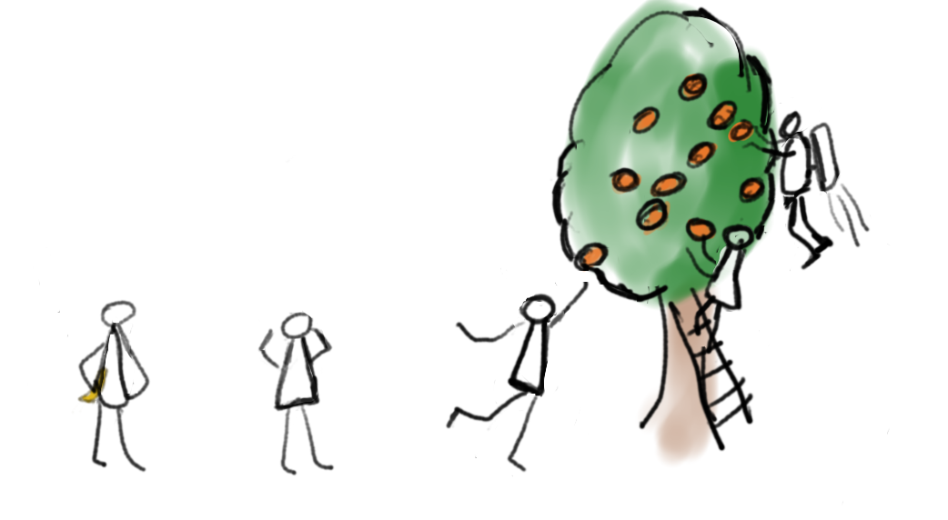
Persona Model
Personas
Novice
Endeavourer
Inspired
Pioneer
Champion
“This won’t work for health, it’s too expensive”
“I see some value but just can’t comprehend doing more, have to keep the lights on.”
“I got some ideas for PoCs but am struggling to get moving.”
“I got a multiple workloads in the cloud, learning some of the strengths and pitfalls ”
“Cloud ready? We are the people giving the talks at cloud conferences.”
Personas Tree Model
Cloud Endeavourer
“I like oranges but I’m not sure how to pick them. I might fall off that ladder”
Cloud Inspired
“I wish I could get to those oranges – where do I get my ladder?”
Cloud Champion
“Look at me - I can pick all the oranges up there (and yes, I have a jetpack)”
Cloud Novice
“Why would I need oranges, I already have a banana.”
Cloud Pioneer
“I am picking the low hanging fruit, wish I knew how to get to the highest ones”

Slide 43
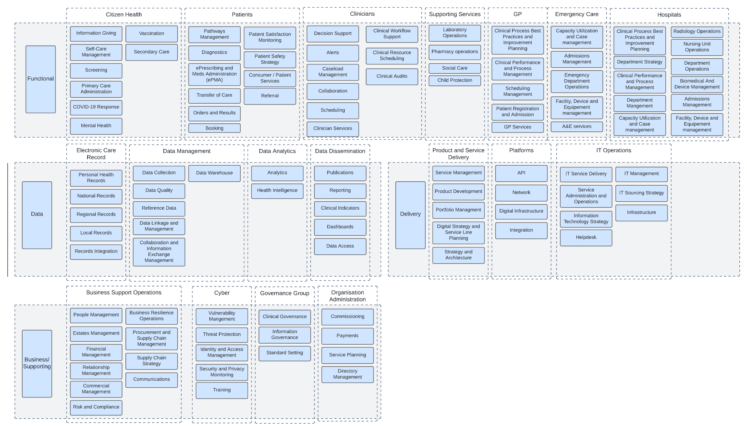
NHS reference Architecture
Notes:
A domain model for NHS healthcare
Taking into account NHS Digital’s capabilities, application portfolio and other Healthcare and NHS domains to build a health care domain model
4 layers to the domains
Functional - user facing domains. 2 main groups, those relating to people and those relating to locations - reading left to right aligns with a citizens journey and the people and locations they may encounter
Data - support the functional - shared data services. Data collection and management for the functional domain
Delivery - supports the delivery and management of the functional layer
Business supporting - supports business operations and covers wider governance. Also includes domains covering business activities within business support and administration
This domain model can evolve and is likely to change with information from the application portfolios associated with trusts.

Slide 44
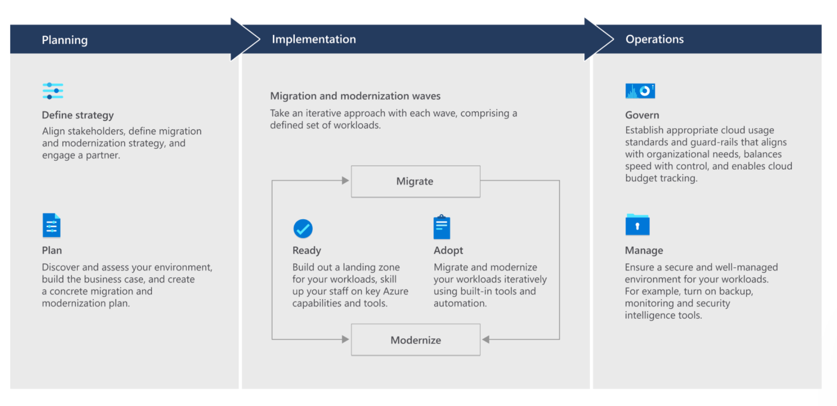
Azure Migration Delivery Approach
A migration consists of 3 phases; Planning, Implementation and Operations.
The migration process itself is done in similar way as with AWS. The high level migration and modernization journey is presented below.
Microsoft’s guide to migration journey, you can get more insights from CCoE or Partner: https://azure.microsoft.com/en-us/solutions/migration/migration-journey/#how-to-migrate

Slide 45
Migration Assessment - Funding - AWS MAP
MAP partner cash, provided to an AWS partner to enable them to offer funding for development of a business case for cloud migration.
Early engagement required, funding requests at least 3 weeks before project start date.
Project Size | Large >$500K ARR¹ | Small <$500K ARR
Available funds | $60k cash to a partner to deliver an assessment | $15K cash to a partner to deliver an assessment
Requirements | A SOW for the assess phase must be approved by AWS Must have an estimate for post migration ARR | A SOW for the assess phase must be approved by AWS Must have an estimate for post migration ARR
Deliverables | Customer sign off template Assess Analysis report | Customer sign off template Assess Analysis report
¹ ARR - Annual Recurring Revenue. An estimate of the amount of spend on AWS post migration activity.
* Funding for NHS may differ due to specific agreements with AWS

Slide 46
Migration Planning - Funding - AWS MAP
MAP partner cash, provided to an AWS partner to enable them to offer funding for development of a cloud migration plan.
Early engagement required, funding requests at least 3 weeks before project start date.
Project Size | Large >$500K ARR¹ | Small <$500K ARR
Available funds | Match costs for migration project planning - up to 40% of post migration ARR (max $400k) | Match costs of planning up to 20% of post ARR cash
Requirements | SOW for the mobilize(Planning) phase approved by AWS An active AWS account Must have an estimate for post migration ARR confirmation of migration tagging for pilot migrations | SOW for the mobilize(Planning) phase approved by AWS An active AWS account Must have an estimate for post migration ARR
Deliverables | Must submit customer sign off template, well architected review and success criteria report | Must submit customer sign off template, well architected review and success criteria report
¹ ARR - Annual Recurring Revenue. An estimate of the amount of spend on AWS post migration activity.
* Funding for NHS may differ due to specific agreements with AWS

Slide 47
Migration Execution - Funding - AWS MAP
Credits provided to offset migration costs
Early engagement required, funding requests at least 3 weeks before project start date.
Project Size | Large >$500K ARR¹ | Small <$500K ARR
Available funds | 25% of post migration ARR in credits for the customer during the migration | 15% of post migration ARR in credits
Requirements | SOW for the migrate phase approved by AWS An active AWS account Must have an estimate for post migration ARR - including a tagging plan and revenue ramp up estimates Migration program engagement (MPE) ID for tagging | SOW for the migrate phase approved by AWS An active AWS account Must have an estimate for post migration ARR - including a tagging plan and revenue ramp up estimates
Deliverables | Tagging must be implemented on migrated workloads Migration readiness assessment (From the Assess phase) Milestones schedule Customer sign off | Tagging must be implemented on migrated workloads Customer sign off
¹ ARR - Annual Recurring Revenue. An estimate of the amount of spend on AWS post migration activity.
* Funding for NHS may differ due to specific agreements with AWS

Slide 48
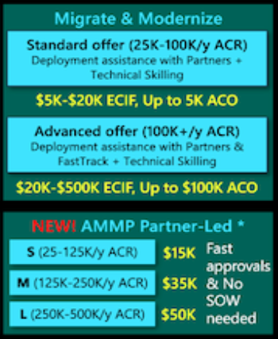
Migration Assessment - Funding - Azure
Migration Assessment | Migration Planning | Migration Execution
Microsoft will carry out migration assessment free of charge for the customer. The Azure Immersion and Discover Workshops are delivered free for the customer. | Microsoft will carry out migration planning free of charge for the customer.
¹ ACR - Azure Consumption Revenue
² ECIF - End Customer Investment Funds
³ ACO - Azure Credit Offer
⁴ AMMP - Azure Migration and Modernization Program
* Funding for NHS may differ due to specific agreements with Microsoft. The presented numbers and values in this slide are indicative and more detailed information and support should be requested from CCoE and Migration Partner.

Slide 49
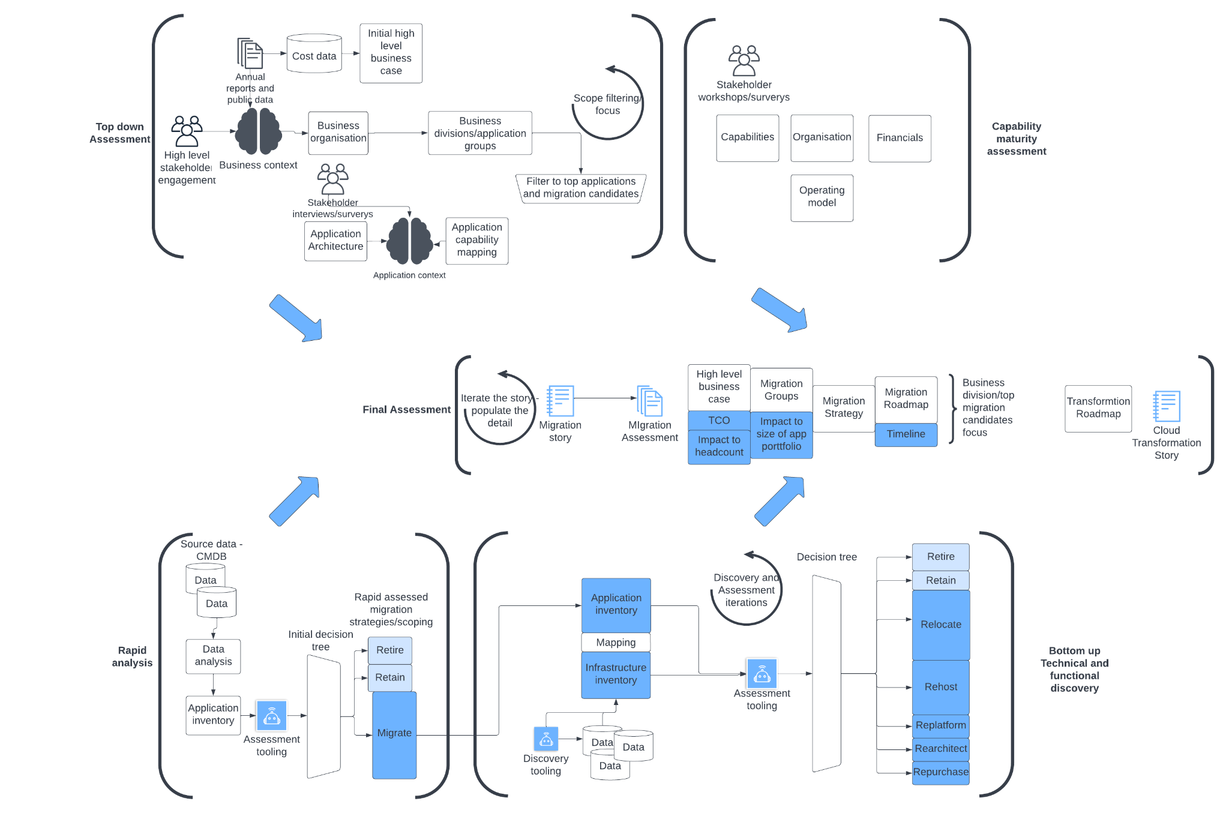
Detailed Process Flow - Migration Assessment
Notes:
Transformation story - v important

Slide 50
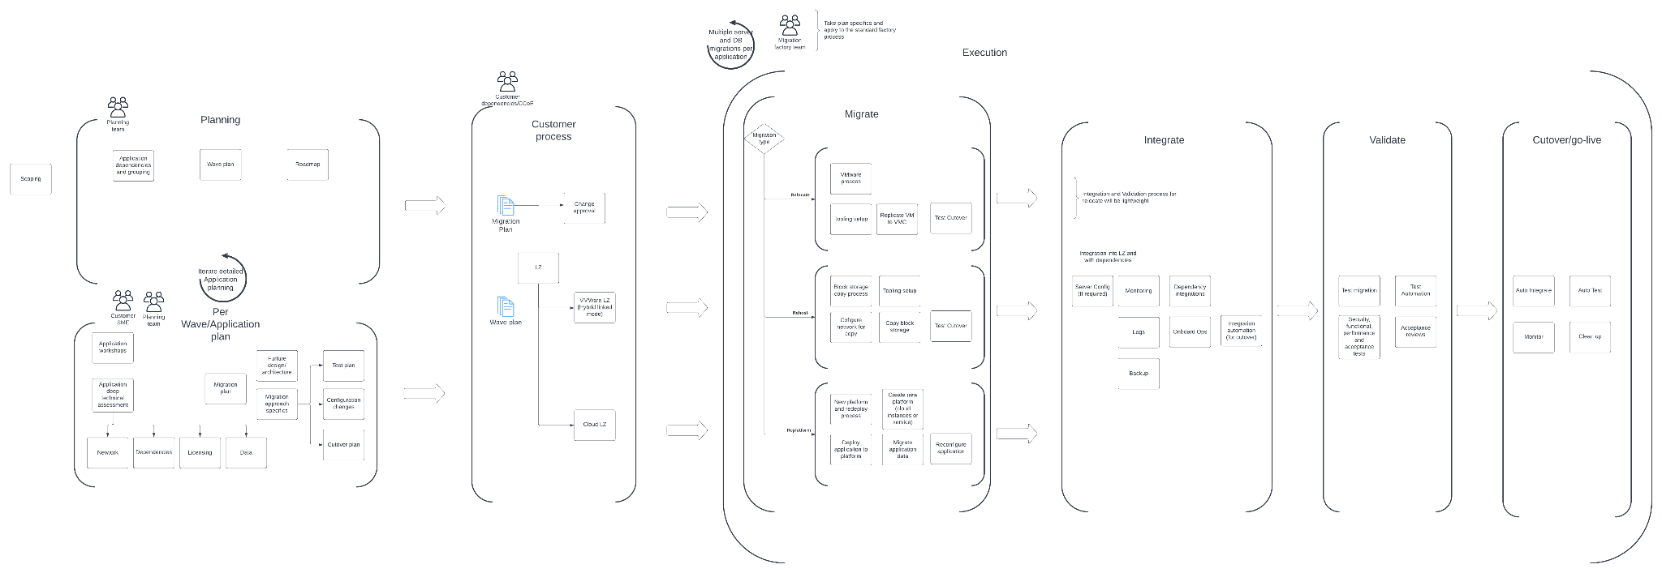
Detailed Process Flow - Migration Planning + Execution

