Slide 1
NHS Cloud System Transformation – Executive Introduction
v6
11-Oct-24
Notes:
Standard title slide

Slide 2

Welcome to the NHS Cloud Exec Level Introduction.
The NHS Cloud Centre of Excellence are committed to helping you harness the power of cloud computing to improve patient outcomes and adopt and optimise Cloud hosting arrangements.
We are working in alignment with the UK government's "Cloud First" policy, launched in 2013 and revised in 2023. This acts as a strategic directive for public sector organisations, including NHS Trusts, to consider cloud technology first and foremost over other hosting alternatives. The policy advocates prioritising cloud-based solutions over traditional on-premises options when procuring or updating services.
This pack details a wide range of benefits the cloud could bring to your organisation, such as business continuity, application and service availability, flexibility/scalability, data sharing capabilities, personalised treatment for patients, reduction of operational costs, and security benefits to protect data from cyber security threats.
We hope this pack provides you with an introduction to what we offer. Please reach out to us if you have any further questions. Alternatively, for further information refer to the CCOE website here:
https://digital.nhs.uk/services/cloud-centre-of-excellence/ccoe-services
Neil Gibbs
Cloud Engagement Lead
cloudcoe@nhs.net

Slide 3
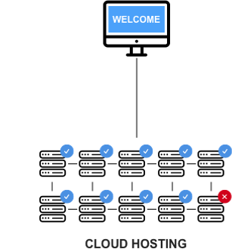
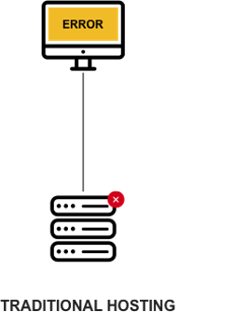




What is Cloud?
On demand delivery to a wide array of computing services, including storage, databases, computing power, and other IT resources, delivered seamlessly via the internet.
How is it different from
traditional hosting?
Cloud Deployment Models:
Outlines how cloud resources are provisioned and made available to users.
Cloud computing, in contrast to traditional hosting, uses a network of remote internet servers for data storage, management, and processing. This provides users with scalable, flexible, and cost-efficient computing resources without the need for on-site infrastructure.
Decrease in the level of customer control and management
Internet as a Service
(IaaS):
Leasing virtual computing resources online, removing the need for owning or directly managing
hardware.
Platform as a Service (PaaS):
A streamlined online workspace, removing infrastructure details for easier app development and deployment.
Software as a Service (SaaS):
Like renting software online through a subscription. It allows access from any internet-connected device, eliminating the need for installation hassle.
What are Hyperscalers?
Cloud Computing Types:
These service models offer diverse control levels and flexibility for users to use cloud resources.
A company that operates data centers and provides cloud services on a large scale, offering extensive computing resources and infrastructure to businesses globally.
Examples include AWS, Azure, GCP and IBM Cloud.
Private cloud:
An exclusive cloud computing environment for a single organisation, offering enhanced control, privacy, and customisation.
Public Cloud:
An internet-based cloud computing service provided by third-party companies, available to multiple users or organisations.
Hybrid Cloud:
Combines private & public cloud services, enabling organisations to use both on-premises and external cloud resources for a flexible computing environment.

Slide 4






Benefits of Cloud – Chief Executive
Strategic Agility: Cloud adoption facilitates rapid deployment of healthcare solutions, aligning with your strategic goals for agility and responsiveness.
Cloud technology can help our NHS trust streamline operations, improve patient care, and enhance data security. By migrating to cloud-based systems, we can reduce IT costs, increase scalability, and enable real-time collaboration across teams and locations.
Cost Optimization: Cloud services offer potential cost savings through efficient resource utilization and pay-as-you-go models.
Services you may find useful:
Business Case – High-level rapid assessment of potential value of migration to the cloud, and 1-2-1 clinics to review in depth.
Capability Maturity Assessment – Interview based assessment, done by the CCoE, of organisational capability and readiness for cloud adoption across multiple functional domains.
Project Scoping and Management – A cloud adoption framework provides a baseline for organisations to use when mapping out their cloud migration journey.
Strategy – The NHS Cloud Strategy has been shaped by a requirement to evaluate Cloud solutions before other hosting options, as highlighted in the documents listed below.
Innovation and Patient Care: Cloud-driven innovation enhances patient care, supporting your vision for improved healthcare outcomes.
Data Security: Address concerns by emphasizing robust cloud security measures and compliance with healthcare regulations.
ROI: Present a clear cost-benefit analysis, showcasing how cloud adoption aligns with organizational financial objectives.
Notes:
A better business case would be good
Strategy stuff is v. high level
Good to have examples

Slide 5



Benefits of Cloud – Chief Operating Officer
Scalability: NHS cloud adoption scales resources dynamically to meet evolving healthcare needs, empowering professionals with efficient and tailored services through advanced features like generative AI.
Cloud technology can help us optimize our estate management, reduce energy consumption, and improve facility maintenance. Using cloud, we can optimize energy consumption, reduce costs , and enable real-time collaboration across teams and locations.
Remote Access: Cloud facilitates remote management and access to healthcare facilities, enhancing operational efficiency.
Services you may find useful:
Business Case – High-level rapid assessment of potential value of migration to the cloud , and 1-2-1 clinics to review in depth.
Orchestration and Automation – Orchestration often refers to the automated configuration, coordination, and management of computer systems and services.
Data and Insight – Cloud computing analytics helps streamline the process of gathering, integrating, analysing, and using data to extract actionable insights
Data Security: Address concerns by emphasizing robust cloud security measures and compliance with healthcare regulations.
Integration Complexity: Highlight phased integration approaches and the support available for seamless integration with existing systems.
Operational Disruption: Emphasise the gradual and planned nature of cloud adoption to minimise disruption to facilities and services.

Slide 6




Benefits of Cloud – Medical Director
Enhanced Collaboration: Cloud tools centralise real-time information access and sharing, promoting seamless collaboration across geographical locations.
Cloud computing can help us improve patient outcomes by providing secure, instant access to medical records and imaging, enabling remote consultations, and facilitating data-driven decision-making. This can also help us reduce costs and improve efficiency in our clinical settings.
Advanced Analytics: Cloud platforms empower NHS trusts with computational power and storage for advanced analytics, extracting meaningful insights from extensive datasets.
Patient-Centric Approach: Embracing SaaS via the cloud eliminates infrastructure management, addresses technical obsolescence, enabling healthcare professionals to prioritise patient care.
Services you may find useful:
Data and Insight – Cloud computing analytics helps streamline the process of gathering, integrating, analysing, and using data to extract actionable insights
Digital development/DevOps – DevOps is a set of practices, tools, and a cultural philosophy that automate and integrate the processes between software development and IT teams.
Training – Access cloud training and certification resources from our partner organisations.
Data Privacy: Highlight secure data practices and encryption protocols to address concerns about patient data privacy.
Workflow Disruption: Emphasise phased implementation strategies to minimize disruptions to existing healthcare workflows.
Notes:
?Services for MD

Slide 7




Benefits of Cloud – Director of Finance
Cost Efficiency: Cloud adoption allows NHS trusts to achieve cost efficiencies by outsourcing infrastructure management to providers, leveraging economies of scale, beneficial for trusts facing constraints.
Moving to the cloud can help us optimize our financial operations, reduce hardware and maintenance costs, and improve budgeting accuracy. Cloud-based financial systems can also provide real-time insights, enable better forecasting, and enhance financial reporting and compliance.
Efficient Budgeting: Cloud's pay-as-you-go model allows for easier budget forecasting, aligning with your financial planning goals, and delivers long-term cost benefits and reduced TCO through Cloud optimisation and use of FinOps (e.g. dynamic compute scaling).
Compliance and Risk Mitigation: Cloud services can enhance compliance with financial regulations and mitigate risks associated with data breaches.
Services you may find useful:
Financial operations (FinOps) – Cloud adoption introduces significant changes to the way financial aspects of the IT service are managed.
Business Case – High-level rapid assessment of potential value of migration to the cloud , and 1-2-1 clinics to review in depth.
Data and Insight – Cloud computing analytics helps streamline the process of gathering, integrating, analysing, and using data to extract actionable insights
NO Upfront Costs: Shift from capital to operational expenditure, releasing capital spend from IT infrastructure upgrading and maintenance for other investments, whilst allowing access to the latest technology and security enhancements.
Data Governance: Emphasise cloud providers' commitment to data governance and regulatory compliance.

Slide 8

Benefits of Cloud – Director of Estates
Scalability: NHS cloud adoption scales resources dynamically to meet evolving healthcare needs, empowering professionals with efficient and tailored services through advanced features like generative AI.
Cloud technology can help us optimize our estate management, reduce energy consumption, and improve facility maintenance. Using cloud, we can optimize energy consumption, reduce costs, and create a more sustainable future for your NHS trust.
Cost Efficiency: Cloud adoption allows NHS trusts to achieve cost efficiencies by outsourcing infrastructure management to providers, leveraging economies of scale, beneficial for trusts facing constraints.
Services you may find useful:
Strategy – The NHS Cloud Strategy has been shaped by a requirement to evaluate Cloud solutions before other hosting options, as highlighted in the documents listed below.
Data and Insight – Cloud computing analytics helps streamline the process of gathering, integrating, analysing, and using data to extract actionable insights
Orchestration and Automation – Orchestration often refers to the automated configuration, coordination, and management of computer systems and services.
Sustainability: Cloud technologies align with sustainability goals, reducing the need for physical infrastructure and promoting eco-friendly practices.
Strategic Agility: Cloud adoption facilitates rapid deployment of healthcare solutions, aligning with your strategic goals for agility and responsiveness.
Operational Disruption: Emphasise the gradual and planned nature of cloud adoption to minimise disruption to facilities and services.

Slide 9
Data, Security and Compliance

Slide 10
Misconceptions of Cloud
Addressing misconceptions about the cloud and highlighting the distinctions from reality.
Misconceptions
Reality
Cloud storage is vulnerable to data breaches.
Cloud providers secure data through advanced encryption, even in unauthorized access situations.
Data encryption
Cloud services don’t comply with industry standards and regulations.
Leading providers surpass industry security standards with regular audits for strict compliance.
Security
Cloud services are always more expensive than traditional on-premises solutions.
The FinOps team at NHS England analyse cloud usage data, making organisation-wide commitments that save million pounds annually – approximately a 40% reduction can be achieved.
Cost
Cloud environments lack robust access controls.
Cloud services offer robust identity and access management, reinforced by multi-factor authentication.
Authentication
Disaster Recovery
Cloud services are vulnerable to data loss and downtime.
Providers prioritize high availability and swift recovery in the event of hardware failures or data center outages.

Slide 11

Security
Data privacy and compliance are vital in healthcare, safeguarding patient confidentiality and building trust. Compliance with GDPR and NHS England guidelines protects patient rights, ensures data integrity, and prevents unauthorised access to sensitive medical information.
Choosing Cloud: Elevating NHS Security Beyond On-Premises
Resilience Challenges within NHS
Choosing Cloud: Shared Responsibility
 | Cloud | On-premises
Security Measures | Introduces advanced encryption, access controls, and monitoring tools, providing a fortified defence. | Higher costs and dependencies on internal resources may compromise security.
Security Responsibilities | Responsibilities are shared; reducing strain on resources. | Internal teams manage updates, potentially leading to vulnerabilities.
Scalability and Adaptability | Cloud security scales dynamically with business needs. | On-premises security may struggle with scalability.
Guy’s and St Thomas’ Trust had to cancel operations, postpone appointments and divert seriously ill patients to other hospitals as a result of the IT meltdown.
In the cloud, NHS Trusts share security responsibilities, ensuring a collaborative effort for a secure computing environment.
Opportunity
The Cloud Service Provider is responsible for:
Securing the underlying infrastructure (physical data centers, networking, & hypervisors).
Cloud infrastructure provides robust disaster recovery and data backup capabilities, ensuring continuous healthcare service delivery even during system failures or unforeseen emergencies.
Customers are responsible for:
Securing their data, applications, identities,
and configurations
within the
cloud environment.
Implication
The Trust incurred £1.4m spending on technology services to respond to this incident. This included a cloud-hosted environment to provide resilience for data backups.
Have GSTT migrated to cloud

Slide 12
Case Studies & Success Stories

Slide 13

jn
Challenges
Case Study 1
The trust faced challenges with a previous private cloud hosting platform: excessive storage costs, capital-intensive capacity upgrades, and slow adaptation to evolving digital needs and increased demand for services.
Central and North West London NHS Foundation Trust Cloud opted for a Hybrid Cloud Strategy
The trust required a high-performing, secure, and resilient hosting environment for their data and applications at the best value. Their previous use of a private cloud hosting platform posed challenges, including excess storage costs and the need for substantial upfront capital investment for capacity expansion due to its legacy design.
Solution
Hybrid Cloud Migration- A move over to the public cloud would allow them to scale up and increase their storage capacity, without the need for a large financial outlay.
Outcome
Achieved a 15% reduction in operational costs for the application and data estate.
Utilised a scalable platform to meet patient and clinician demand, facilitating more frequent digital innovation trials throughout the trust.
Significantly lowered carbon footprint with carbon net zero hosting environments, aligning with sustainability goals.

Slide 14

Case Study 2
Challenges
GE Healthcare, AWS Bring Partnership to Europe with First Cloud Deployment at Royal Orthopaedic Hospital
The Royal Orthopaedic Hospital in Birmingham, England has introduced tools to support radiologists with productivity, improved diagnostic precision, reduced errors, and enable more confident diagnoses.
Radiologists faced heightened pressure post-COVID-19. The hospital sought tools for more efficient tasks with fewer resources, aiding the transition from traditional to a decentralized virtual care model.
Solution
Healthcare’s strategic collaboration agreement with AWS enables delivery of cloud-based imaging solutions, integrated data, and clinical operational insights to hospitals and healthcare providers.
Outcome
Continuous cyber security patching and maintenance that cloud hosting offers, enhancing resiliency of the PACS network.
Migration has helped to reduce the carbon footprint
Dynamically upscale and downscale the environment to meet business needs.
Cloud-based tools enable remote and convenient access to the different tools needed with a smaller footprint and long-term cost of ownership.

Slide 15

Case Study 3
Challenges
Kettering General Hospital
migration to the Cloud
Kettering General Hospital (KGH), part of the University Hospitals of Northamptonshire NHS Group, set out their ambitions in 2019 to be the most digitally enabled hospital group in England by 2023.
The NHS Trust sought cloud migration to replace inefficient procurement practices. Traditional sizing models resulted in £1 million costs for each server and storage refresh, leading to unnecessary expenditure.
Solution
New services were built directly in the cloud or procured as cloud-based services, therefore adhering to cloud native PaaS and SaaS principles. In total, 14 servers were de-scoped and other new services were commissioned directly in the cloud.
Outcome
Improved Security: Implemented Multi-Factor Authentication and conditional access policies.
Increased Stability: Regular backup routines and restores services within an hour in case of a complete loss.
New Skillsets: IT Infrastructure team gained cloud-based technical skills.
Improved Scalability: Scales cloud-based services to meet demand.

Slide 16
Building Blocks
The necessary steps for a successful cloud adoption journey.
EPR and Procurement
Prioritise the seamless transition of EPR systems to the cloud, ensuring compliance with data protection regulations and robust procurement processes for selecting suitable cloud service providers.
Migration and Modernisation
Strategically migrate and modernize remaining applications, optimizing performance and ensuring seamless integration with cloud infrastructure through comprehensive planning and automation.
PoC Migration
Conduct small-scale proof of concept migrations to test the feasibility and performance of migrating critical applications and data to the cloud, ensuring minimal disruption to operations.
Landing Zone
Establish a secure and scalable landing zone within the cloud environment, ensuring compliance with regulatory standards and best practices for data security and privacy.
Portfolio Assessment
Conduct a thorough assessment of the existing IT portfolio to identify applications and workloads suitable for migration to the cloud, considering factors like security, compliance, and performance requirements.
Business Case
Outlines the specific goals and benefits of transitioning to the cloud, including cost savings, scalability, and security.
Notes:
Why EPR?

Slide 17
Action Plan for Cloud Adoption
Explore CCoE's support for your cloud journey planning and migration.
NHSE’s CCoE is ready to help with cloud journey planning and migration activities.
Key Area | What the CCoE Offers
Funding | Advice on writing a Cloud Business Case for Cloud here
Cloud Strategy | Cloud Strategy Guidance and Best Practice available here
Cost Management | FinOps Information here
Expertise and training | Build Skills with access to Cloud Training and certification resources, available here Regular Training Events in the NHS Cloud Community Cloud Training Roadmap in Progress – Live March '24
Security and compliance | Governance, Security and Controls information here Architecture evalutation- Embarking on a cloud journey to assess current system architecture readiness and determine the necessary steps to achieve the target state. Workload migration assessment- Provides an understanding of the application portfolio and how it can be migrated to the cloud.
Access to expertise: If you need further support with Cloud Services, contact us using our feedback form for an introductory conversation.
  Find out more here: Cloud Centre of Excellence (CCoE)
  Join the Cloud Community here: NHS Cloud Community
  For further information contact: cloudcoe@nhs.net or reach out on the NHS Cloud Community.

Slide 18
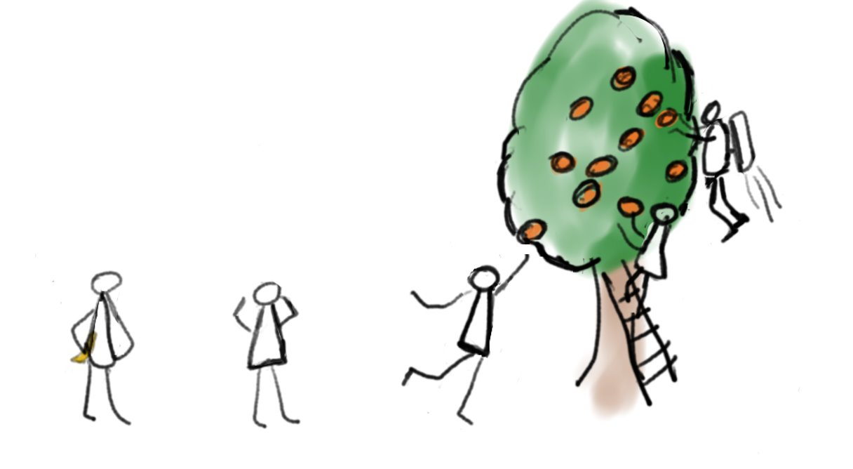
Appendix - Cloud Journey and Personas
Different organisations are operating at different levels of cloud maturity. We use the following personas to identify where you sit in your cloud journey. This can enable us to direct you to resources and support that are most relevant to you.
Champion
Highest level of maturity.
Fully embracing cloud-native development, leading in innovations.
Pioneer
Leading in advanced tech adoption.
Implementing DevOps, exploring cutting-edge services.
Inspired
Success-driven motivation.
Embracing advanced cloud-native practices.
Endeavourer
Actively migrating workloads.
Optimising costs, deeper cloud understanding.
Novice
Early cloud exploration.
Basic services, initial familiarity.
Refer to appendix for further detail on recommended services

Slide 19
Appendix - Cloud Journey and Personas
Different organisations are operating at different levels of cloud maturity. We use the following personas to identify where you sit in your cloud journey. This can enable us to direct you to resources and support that are most relevant to you.
 | Novice | Endeavourer | Inspired | Pioneer | Champion
Decision Maker Motivation: | Optimise services. | Benefits needs to be clarified. | Benefits realised but roadmap is unclear. | Motivated by compelling business needs, experience and cost reduction. | IT as opportunity for creating new services & capabilities to serve their patients and staff.
Budget: | Prioritised; sceptical about transformation initiatives. | Will be requested to operate and improve IT landscape. | Need help to make business case for cloud. | Least price sensitive and are demanding in product feature set /performance. | Fully embraced the variable opex budget model. Have adopted solid FinOps disciplines.
Organisation Readiness: | Desire to maintain status quo. | Appetite for change .but lack of skills. | Can not define breadth & depth of change to achieve effective cloud service capability. | 'Risk tolerant' culture and have high level of cloud and IT expertise. | Staff are able to handle change and are motivated to develop new skills and abilities.
Workload Suitability for Cloud: | Legacy workloads not assessed for Cloud. | Sizable cloud suitable workloads. | Organisation has not undertaken a systemic analysis of workloads. | Clear understanding of suitability of IT estate & have programmes to make apps cloud ready. | Most workloads are either ready are in the cloud or are in the process of being made cloud-ready.
Security and Compliance: | Risk adverse & minimal understanding of operating securely in the Cloud. | Governance is good. | Have foundations to extend working practices to cloud. | In process of implementing a standardised approach. | Proven compliance posture, evidenced by positive audit results.
Cloud Consumption | Limited or no cloud consumption. | The team is not confident in realising cloud's value. | Cloud adoption is sporadic. | Workloads in the cloud with plans to continue migration. | Only services that rely on special infrastructure are kept on premises.
Recommended Services | Business case, Capability Maturity Assessment. | Architecture evaluation, Workload migration assessment | Architecture Support | Architecture Support | Capability Maturity Assessment

Slide 20
End slide
Notes:
Connect with us

