Slide 1
Workload Migration Assessment
NHSD CCoE Service Offering
Notes:
Standard title slide

Slide 2
Contents
Introduction
Approach
Process
Key Outputs
Delivery plan
Risks
Prerequisites
  Stakeholder list and time commitment
  Information requirement
Appendices
Product descriptions
Workshop Agendas
Example Summary Findings Report

Slide 3
Introduction
This pack describes the Workload Migration Assessment approach adopted by the NHS Digital CCoE
The Workload Migration Assessment provides an understanding of the application portfolio and how it can be migrated to the cloud.
More specifically it:
Identifies the migration strategies that can be applied.
Quantifies the effort, cost, dependencies and risks to execute migrations
Informs the overall migration strategy, business case and plans.
The assessment is structured as a repeatable work package based on standardised templates, to be delivered on a fixed timeline / fixed effort basis over the course of 10 weeks, preceded by a brief mobilisation period.

Slide 4





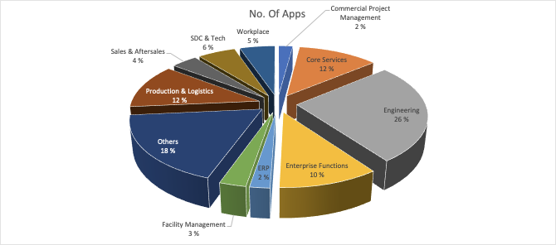
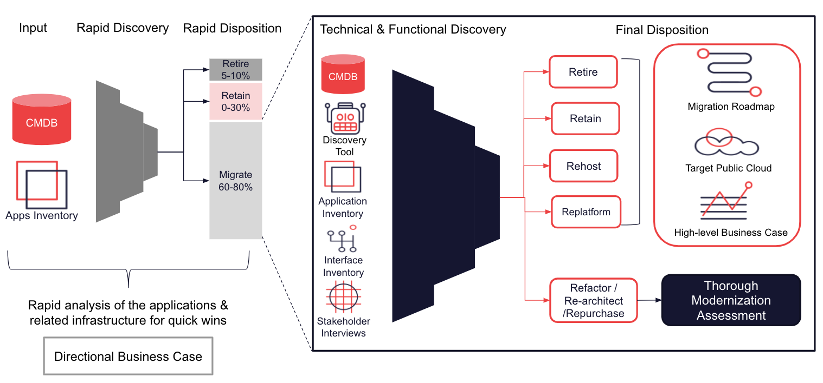
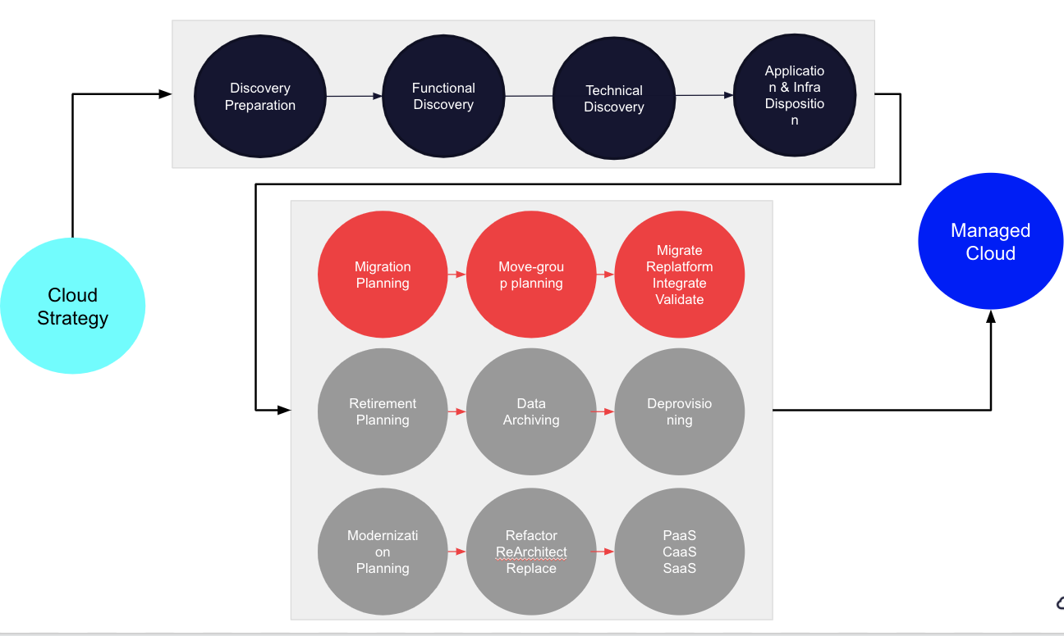
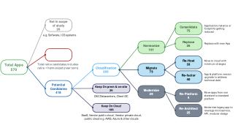
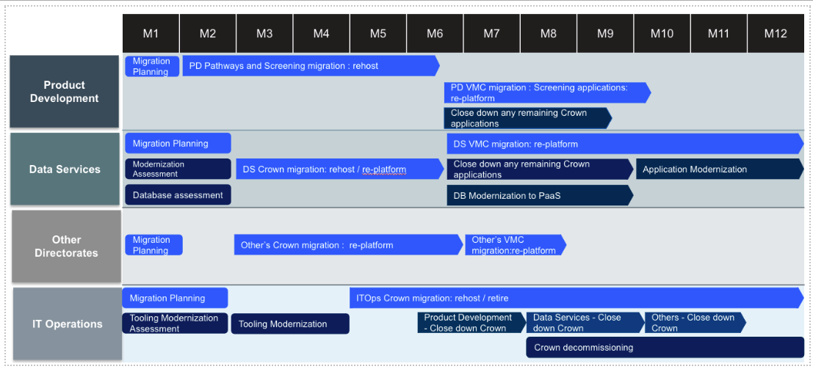
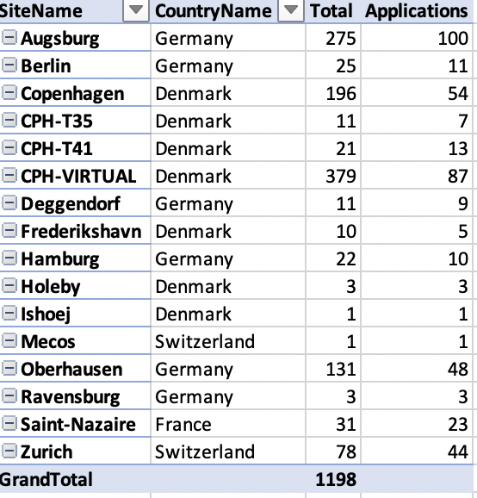
Delivery Approach
The Migration Assessment follows a proven, structured approach to deliver clear results, fast.
Approach
Understand the current estate
Assess the Current Estate
Create
Options
Develop the Action Plan
Create the Roadmap
Analyse CMDB Data
Fill the Application Inventory Template
Agree missing data collection strategy
Create the Application Disposition hypothesis
Top-down business case
Run Discovery tool
Functional Discovery
Analyse the combined data
Reference architecture
Refine the Disposition Hypothesis
Run rules engine anlysis of application and infrastructure
TCO calculation for target state
Estimate cost of change
Correct grouping based on dependencies
Level 1 Migration Strategy ( Sites / Directorates / Pilot)
Level 2 Migration Strategy (app wise recommendation)
Application dependencies list
Provide short term & mid term migration strategies to create an executable roadmap
TCO optimization possibilities (like License, PaaS etc)
Activities
Deliverables

Slide 5
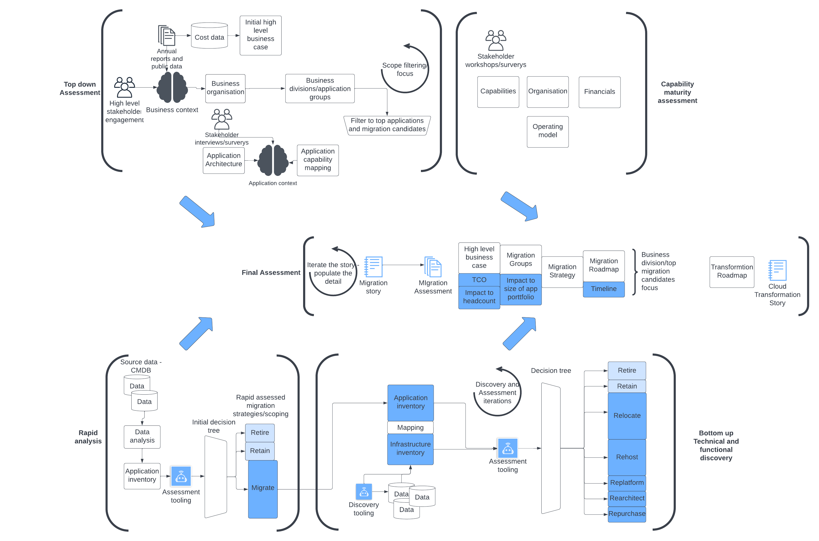
Delivery Process
The assessment of NHS Trusts follows a multi-stage iterative process to gain an understanding of the application portfolio, assessing this to produce the migration strategies and roadmap to be used.
The process starts with rapid discovery and assessment, a top-down approach taking existing Trust knowledge, determining Trust structure and capabilities, and identifying the most important applications.
A rapid assessment of the application portfolio is carried out to determine a scope and assess the potential for migration.
The bottom-up assessment makes use of tooling to build an application and infrastructure inventory, and a decision tree assists with mapping applications to strategies and groups to form a migration roadmap.
Combining the top-down and bottom-up analysis produces the final migration assessment report.

Slide 6
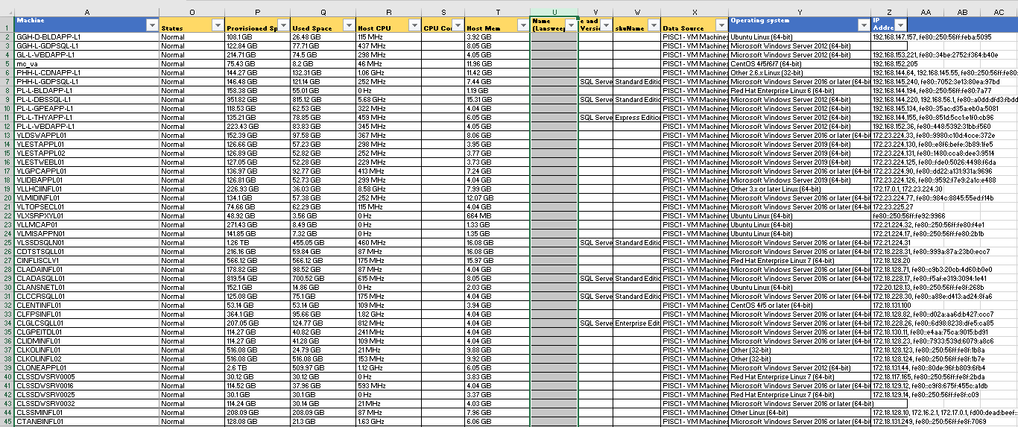
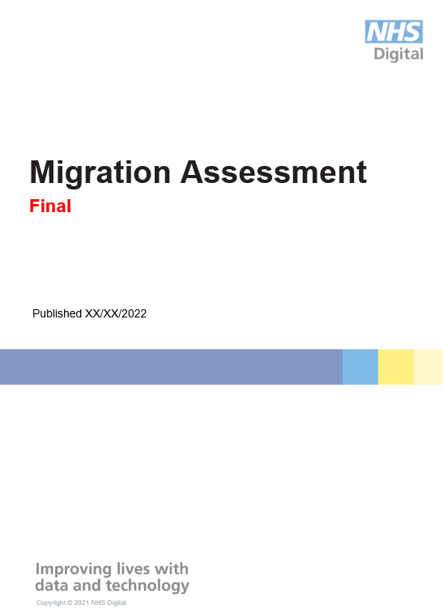
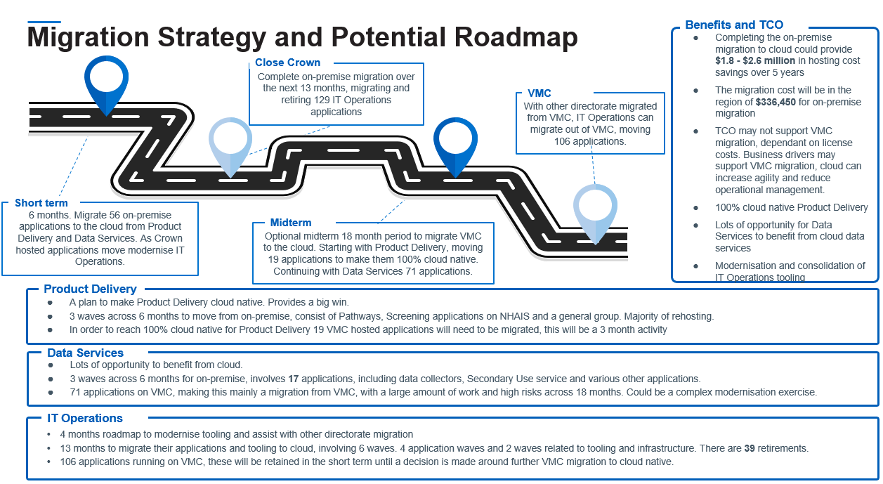
Outputs
The Assessment will produce the following outputs
Overall Migration Assessment report
Workload Migrations Assessment
Infrastructure Right-sizing
Applications Migration Strategy
Migration Roadmap
Each output is described in the Appendix A - Product Descriptions
Notes:
Overall migration readiness assessment
Workload migrations assessment,
Infrastructure sizing
Application Migration Strategy
Migration roadmap

Slide 7
Delivery

Slide 8
Delivery Sequence Plan
Initial Business Case
Scoping
Application Architecture
Business Case and TCO
Roadmap
TRUST
PERSPECTIVE
Business Case
Increment
Rapid Discovery & Assessment
Scope
Final Business Case and Roadmap
INITIAL
ASSESSMENT
Stakeholder Engagement
Trust Understanding
Assessment
Increment
APPLICATION ASSESSMENT
Discovery &
Assessment Tooling
Discovery &
Assessment
7R
Migration assessment Report
Application Owner interviews

Slide 9
Delivery Plan
The main work of the assessment is preceded by a 3-week mobilisation period to allow for initial data collection and analysis, stakeholder engagement and alignment of strategy objectives.
 | Key Areas | Activities | Responsible |  | Timeline
 |  |  | Customer | Delivery | Wk-3 | Wk-2 | Wk-1 | Wk1 | Wk2 | Wk3 | Wk4 | Wk5 | Wk6 | Wk7 | Wk8
Top Down Assessment | Trust understanding | Initial high level business case | I | AR
 |  | Identify Stakeholders | R | AR
 |  | Identify Trust Organisation | R | AR
 |  | Model Application Architecture | I | AR
Rapid Discovery | Baselining | Provide CMDB dump | RA | I
 |  | Provide Application Inventory | RA | I
 |  | Ingest & Analysis of the inputs | I | AR
 |  | Gap Analysis and Resolution Strategy | C | AR
 |  | Scoping Workshop – Infra | R | AR
 |  | Scoping Workshop - Apps + Key Apps identification | R | AR
 |  | Scoping Workshop – Architecture | R | AR
 |  | Rapid High-level migration strategy for apps | I | AR
 |  | Validation by Customer | AR | C
Technical & Functional Discovery | Portfolio Analysis | Key apps interviews | R | AR
 |  | Missing data collection | AR | C
 |  | Database Assessment | R | AR
 | Tool Analysis | Cloudamize installation | R | ARC
 |  | Cloudamize based Infra scanning and analysis | C | AR
 |  | Configure Txture tooling | I | AR
 |  | Txture analysis of all apps | C | AR
Final Assessment | Deliverables | Business Case and TCO Opportunity Analysis | I | AR
 |  | Final Migration strategy for the apps | I | AR
 |  | Migration Groups | I | AR
 |  | Migration Roadmap - Phase wise Execution Plan | I | AR
 |  | Final Report encompassing all the above | I | AR
Key: R=Responsible, A=Accountable, C=Consulted, I=Informed

Slide 10
Proposed team
For a 10 week elapsed engagement, we propose the following team
Role | Responsibilities
Project Manager | Co-ordinate delivery of work to plan. Manage customer expectations.
Migration Lead Architect | Lead migration strategy planning.
Migration Architect | Reference architecture and migration assessment report.
Migration Engineer | Data collection and analysis.
Tooling Consultant | Installation and operation of Cloudamize or other discovery tools
Business Advisory Consultant | Business case, TCO analysis and savings drivers.

Slide 11
Risks / Mitigations
Risk | Mitigation
Gaps in understanding on the scope | Hold scoping workshop during mobilisation phase to lock down the scope and expectations for the project.
Delay in tool deployment | Identify relevant SME’s who can assist with deployment and request permission to deploy at the outset of the project.
Availability of client-side SME’s to interpret data, provide guidance and timely feedback. | Outline expectations from the project outset.
Gaps in recommendations and guidance in case of unavailable or incomplete data. | Prepare data inputs in advance of the start of the engagement. The requirements are outlined in this pack.
Non-alignment with customer on the final deliverable/content of the final deliverable | Align on deliverable content, structure and level of detail during mobilisation. A sample report is provided in this pack.

Slide 12
Plan Assumptions
The delivery plan, resourcing and cost of this work is based on the following assumptions:
Scope / quantities
The customer will provide the data described in the Information Requirement page of this pack at the start of the mobilisation.
Data will be provided promptly, or the analysis will be delayed.
There will be clarity around the scope of the assessment, especially if this differs from the scope in any provided data.
The discovery and assessment is time bound. Delays will affect what can be produced in the time.
Data quality
In cases where there are gaps in available data, stakeholders must be available to validate assumptions.
There must be a means to map applications and infrastructure, without this the assessment may be incomplete.
Data quality must be sufficient for realistic conclusions to be made. Lack of data will require use of assumptions which may affect the final assessment.
Stakeholder availability
Stakeholders will be available in line with the plan to provide required input for the assessment, validate findings, progress and recommendations. Without stakeholder involvement assumptions will be made.
Customer SMEs will respond in a timely fashion to allow the assessment to run at pace.
Product reviews
Draft products will be reviewed within 5 working days from issue.
There will be a common understanding and communication about next steps. This will be essential to maintaining the direction for the assessment and providing valuable output to the trust
Systems access
Access will be provided, or stakeholder commitment given to install tooling agents for infrastructure gathering. Cloudamize must run for 4 weeks, any delay may delay completion of the assessment, or result in not using this data source.
Deeper analysis may require additional access to trust systems. The lead time for this will not be long enough to impact the plan.
Software licences
The customer is responsible for providing all necessary software licences. Licence costs are excluded from the cost estimates.

Slide 13
Prerequisites

Slide 14
Stakeholder roles
For the assessment to be successful, the project team will need access to key stakeholders for information and regular dialogue.
Executive Sponsor - Overall Owner
SPoC – Customer Programme Manager with access to key resources and ability to influence
Application Owners – Thorough knowledge of the applications, dependencies and lifecycle
Architects – Infra, Security and Cloud Architects. Able to contribute in Architecture requirements and Strategy
Business IT Leads – IT liaisons to business. Understanding of Business Value and functional requirements and possible functional overlaps
CMDB / Application inventory SME – to assist with collection and interpretation of the application inventory.
Technology / Infrastructure SME – to assist with deployment of discovery tools.

Slide 15
Stakeholder minimum commitment
Successful execution of this work will depend on access to key stakeholders to plan the engagement, discuss findings, take feedback.
Activities | Trust Resources | Estimated Effort [hrs]
Kick-off | Project sponsor Enterprise Architect Infrastucture owner | 1
Data gathering | Application Owners (SPoC can coordinate) | 0.5 per application owner
Access during discovery tool Installation | Infrastructure Owners (SpoC can coordinate) | 5-10 days depending on # of servers.
Application workshops | Enterprise Architect Infrastructure Owners Application Leads | 2
Migration Strategy Workshop | Key Application Owners DC, Infra, Security and Cloud Architects | Multiple 1 hour sessions
Report Presentation | Key Application Owners Overall Owners SPoC | 1.5

Slide 16
Information requirement
The delivery team require ready access to the following information and systems to conduct the assessment:
Source | Format / Key Content
CMDB Dump / Application Inventory | Ideally in template provided. “ImportSchemaTemplate”
Infrastructure Inventory | Servers, network traffic dependencies, databases, storage
Mapping of applications to infrastructure
Availability based on Interview schedules
Costing for current spend on datacentre, infrastructure, licences and operations for the applications in scope. | Based on IT TCO Model template
Current or Planned organization for Centre of Excellence | Documentation about structure, scope of services offered, development plans.
System Access
Access to Customer / 3rd Party Hosted environments | Provide SME support for tool installation
Approvals to run 3rd party tools for technical discovery | Email

Slide 17
Appendices

Slide 18
Product Descriptions

Slide 19
Product Descriptions
Migration Assessment Report
Purpose | Present the migration strategy and roadmap. Summarise the analysis and key findings of the migration assessment.
Composition | Key findings and recommendations Application portfolio analysis Migration Strategy / 7 R’s mapping Migration Roadmap Cost of Change Business case and TCO Assessment Methodology Supporting data and commentary
Derivation / Inputs | Inventory data, interviews, validation workshops. Outline report is based on a standard template.
Definition of Done / Quality Criteria | Correct document template Coverage of agreed technical scope Clear and concise summary Actionable roadmap
Review Points | End Week 2 – first draft for review Iteration reviews based on availability of new data. End Week 7 – final draft for review Week 8 – stakeholder presentation
Reviewers | Executive sponsor, Architects, Programme Manager
Approver | Customer Programme Manager
Workload Migration Assessment
Purpose | Bottom-up assessment of each workload in the inventory identified by the discovery tool.
Composition | Discovery data sheets Decision tree Decision-tree based analysis and recommendation Data quality scoreboard Summary pivot tables and graphs File format: Excel.
Derivation / Inputs | The assessment makes use of tooling (Cloudamize and Txture) to build an application and infrastructure inventory. The inventory is evaluated against a decision tree to map applications to migration strategies. Technical dependency analysis identifies candidate migration groups.
Definition of Done / Quality Criteria | Coverage of analysis aligns with agreed scope.
Review Points | End Week 4 – first draft for review End Week 6 – final draft for review Week 7 – Finalise for issue
Reviewers | Architects, Application Owners
Approver | Lead Cloud Architect
Notes:
Overall migration readiness assessment
Workload migrations assessment,
Infrastructure sizing
Application Migration Strategy
Migration roadmap
= = = = = = =
Title / purpose / Composition ToC headings / Derivation-Inputs /
DoD – Acceptance criteria
Review inputs required – week 3 Draft / Week 6 final
Responsibilities – reviewers / approver

Slide 20
Product Descriptions
Application Migration Strategy
Purpose | Summarise the recommended migration approach to meet the stated migration objectives, over short, medium and long term planning horizons.
Composition | Target design hypothesis for Landing Zones and accounts Proposed target state / final disposition of apps
Derivation / Inputs | 7R’s analysis based on application inventory data, augmented with additional context from stakeholder interviews.
Definition of Done / Quality Criteria | Strategy can realistically achieve the stated objectives. Completeness of vision and analysis. Note: dependency on source data for completeness and accuracy.
Review Points | End Week 6 – first draft for review End Week 7 – final draft for review Week 8 – stakeholder presentation and issue.
Reviewers | Architects, Application Owners
Approver | Lead Cloud Architect
Migration Roadmap
Purpose | Phase-wise sequence of migration activities over time to aid understanding of timescale and effort required to complete migration.
Composition | One page view of indicative migration plan. Up to a maximum of three different scenarios.
Derivation / Inputs | Migration strategy; dependency mapping derived from analysis of IT applications and infrastructure.
Definition of Done / Quality Criteria
Review Points | End Week 6 – first draft for review End Week 7 – final draft for review Week 8 – stakeholder presentation and issue.
Reviewers | Executive sponsor, Architects, Programme Manager
Approver | Customer Programme Manager
Notes:
Overall migration readiness assessment
Workload migrations assessment,
Infrastructure sizing
Application Migration Strategy
Migration roadmap
= = = = = = =
Title / purpose / Composition ToC headings / Derivation-Inputs /
DoD – Acceptance criteria
Review inputs required – week 3 Draft / Week 6 final
Responsibilities – reviewers / approver

Slide 21
Product Descriptions
Infrastructure Right-sizing
Purpose | Sizing recommendation for cloud infrastructure. This model underpins the estimate for the “to be” cloud infrastructure costs.
Composition | Inventory based list showing existing on premise infrastructure and proposed cloud infrastructure (compute, storage) for each item. File format: Excel.
Derivation / Inputs | Analysis and evaluation of on premise infrastructure
Definition of Done / Quality Criteria
Review Points | End Week 5 – first draft for review End Week 7 – final draft for review Week 8 – stakeholder presentation
Reviewers | Executive sponsor, Architects, Programme Manager
Approver | Customer Programme Manager
Notes:
Overall migration readiness assessment
Workload migrations assessment,
Infrastructure sizing
Application Migration Strategy
Migration roadmap
= = = = = = =
Title / purpose / Composition ToC headings / Derivation-Inputs /
DoD – Acceptance criteria
Review inputs required – week 3 Draft / Week 6 final
Responsibilities – reviewers / approver

Slide 22
Workshop Agendas

Slide 23
Workshop Agendas
Mobilisation Meeting
Purpose | Identify stakeholders Align on the delivery approach and expectations Ensure mobilisation of stakeholders and understanding of pre-requisites.
Attendees | Executive Sponsor, Customer Programme Manager, Cloud Architect
Agenda Topics | Current cloud context – technology, organisation, CCoE Objectives and success criteria Delivery approach Stakeholder mapping Data sources – e.g. CMDB, application inventory, interfaces. SME’s Progress reporting Deliverable reviews
Outputs | Project charter (short form)
Inputs | Organisation chart IT Application Owner/Portfolio view
Duration | 2 hours
Timing | Week -3
Scoping Workshop (similar form for Infra, Apps, Architecture)
Purpose | Define the scope of the assessment in terms of: Functional areas / application portfolios Physical / logical partitions (i.e. specific datacentre or network zones) Identify where the automated discovery tools can / cannot be deployed.
Attendees | Executive Sponsor, Customer Programme Manager, Cloud Architect, Application owners / Business IT Leads, CMDB / Inventory lead.
Agenda Topics | IT application landscape Architecture blueprints Physical layout Logical layout Existing cloud platforms Identity constraints and opportunities Agree scope
Outputs | Scope statement for project charter
Inputs | Application and infrastructure inventory provided in Week -3 SME knowledge
Duration | 2 hours
Timing | Week 2

Slide 24
Workshop Agendas
Application Owner Interviews
Purpose | To identify further context and information about specific applications
Attendees | Application owners, Architects, Business IT Leads
Agenda Topics | Deep dive into application Architecture Dependencies Identification of missing data and data completion
Outputs | Additional context and data completion for application inventory and migration analysis
Inputs | Application inventory SME knowledge
Duration | 2 hours
Timing | Week 3

Slide 25
Workshop Agendas
Interim Findings/Migration Strategy Workshop
Purpose | To show incremental findings and validate direction of the assessment
Attendees | Executive Sponsor, Customer Programme Manager, key application owners, Architects
Agenda Topics | Review incremental findings
Outputs | Interim findings review and comments
Inputs | Interim assessment
Duration | Multiple 1 hour sessions
Timing | Week 2 onwards. Every 2 weeks.
Final presentation of findings
Purpose | To show the final strategy, migration roadmap and business case
Attendees | Executive Sponsor, Customer Programme Manager
Agenda Topics | Review key findings, final migration strategy, roadmap, business case and TCO
Outputs | Final migration assessment comments
Inputs | Final Migration Assessment
Duration | 1 hour
Timing | Week 7/8

Slide 26
Example Summary Report

Slide 27
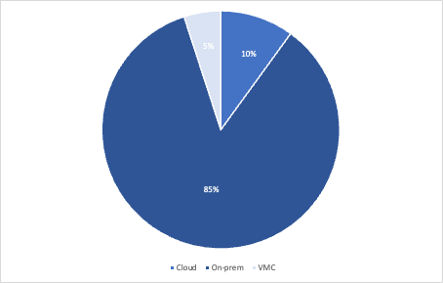
Workload Assessment
NHS Trust
Goals and drivers
NHS Trust are just starting on the public cloud.
The majority of their application portfolio (85%) Run on-premise. 5% are cloud native and 10% on VMware on AWS (VMC)
NHS Trust are interested in determining the migration strategies and roadmap for the remaining on-premise applications
The migration assessment must demonstrate the strategies and roadmap to produce a successful cloud migration
2 Business units within NHS Trust are considered
To follow the NHS public cloud first principle
To migrate all on-premise applications to cloud
To enable the close down of the trusts data centre
To modernise applications to take full advantage of cost savings and cloud service benefits
Trust Services
Cloud Skeptic. 150 applications to migrate. Trust Services are not convinced about migration
Trust Operations
Cloud Inspired. Keen to move to cloud to reduce the burden on operational management.
Already run some tooling on Cloud
Infrastructure inventory

Slide 28
Migration Strategy and Potential Roadmap
Benefits and TCO
Completing the on-premise migration to cloud could provide $2 - $3 million in hosting cost savings over 5 years
The migration cost will be in the region of $600,000 for on-premise migration
100% cloud native Trust Services
Lots of opportunity for Trust operations to consolidate tooling
Modernisation of Trust Services
Migrate Trust Services
Over 2 years migrate trust services.
Long term
Work on modernisation of trust services to take full advantage of the cloud
Infrastructure inventory
Short term
Over 12 months migrate the majority of Trust Operations to Cloud. Skill up Operations staff on Cloud operations
Close Data Center
Migrate the final set of trust operations tools and close down the data center.
Trust Services
A plan to make Trust Services cloud native.
Some migration to VMC
5 waves across 18 months to move from on-premise, consist of hospital admissions, nursing management and a general group. Majority of rehosting.
Trust Operations
12 months to migrate Trust Operations tools and applications to cloud.
6 months to migrate and retire the final set of tools after trust services have completed their migration

Slide 29
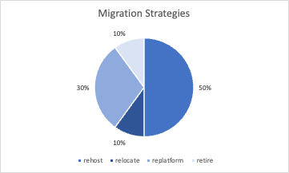
The numbers
Application inventory
Application Location
Infrastructure inventory
320 In-Scope Applications, data enhanced with assumptions, manual analysis and mapping of additional data sources
Business Units mapped and used in the analysis. There are 2 primary business units.
There are 1052 servers in scope
On the servers there are 34% running out of support OS versions
There are 256 servers with SQL Server Database.
Application inventory
Location | % of total applications | Y1 | Y2
Cloud native | 5% | 50% | 80%
VMC | 10% | 20% | 20%
On-premise | 85% | 30% | 0%
Infrastructure inventory
Application inventory
Where rehost describes a lift and shift to cloud native IaaS.

Slide 30
Notes:
Connect with us

