Slide 1
Cloud Capability
Maturity Assessment
NHSD CCoE Service Offering
Notes:
Standard title slide

Slide 2
Introduction
This pack aims to describe the Cloud Capability Maturity Assessment service adopted by the NHSD CCoE
The Cloud Capability Maturity Assessment is an interview based assessment of organisation capability readiness for cloud adoption across multiple functional domains.
More specifically:
The Cloud Maturity Assessment evaluates the maturity of Cloud implementation in an organisation from two key perspectives: Technical and Non-technical capabilities.
The Cloud Maturity Assessment ensures that the necessary elements are identified to develop a reasonable and actionable roadmap in order to achieve the expected outcome of cloud benefits.
The assessment is structured as a repeatable work package based on standardised templates, to be delivered on a fixed timeline / fixed effort basis over the course of 9 weeks, preceded by a brief mobilisation period.

Slide 3
Contents
Approach
The CCMA Model
Process
Key Outputs
Delivery plan
Risks
Prerequisites
    Information requirement
    Stakeholder list and time commitment
Appendices
Product descriptions
Workshop Agendas
Example Exec summary report

Slide 4
The CCMA Model

Slide 5
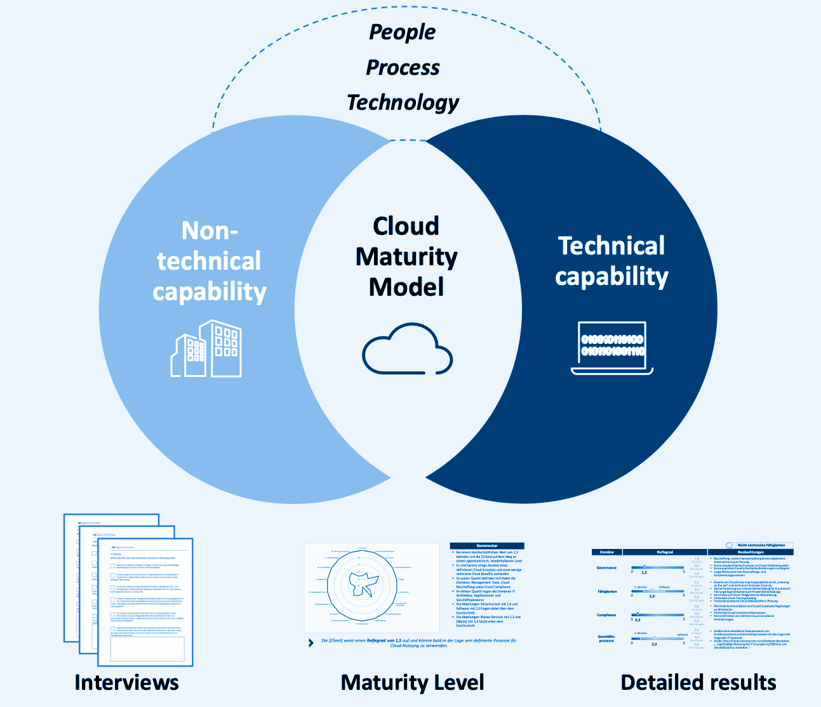


The Cloud Maturity Assessment evaluates the maturity of both technical and non-technical cloud capabilities
Maturity Assessment - Cloud Maturity Model
Activities
Structured survey and interviews of key stakeholders regarding the current state and future aspirations concerning IT, business strategy and cloud adoption.
Evaluation of findings using the Cloud Maturity Model by the OPEN ALLIANCE for CLOUD ADOPTION (OACA)
Collate findings
Define an actionable roadmap.
Results
Assessment results
Road map of actions
Gap closure plan between current and target maturity levels
Analysis charter
Barrier elimination projects

Slide 6
How the model is structured
The Cloud Capability Maturity Model is a model that evaluates and improves an enterprise’s capabilities in cloud operations.
It is structured to explore several domains and provide a score of the current state and future ambition – based on six levels
People, process & technology domains
Maturity Levels
Finance
Enterprise strategy
Structure
Non-Technical
Capability
Culture
Governance
Skills
Optimizing
Compliance
Bus process
Procurement
Commercial/FinOps
Portfolio Mgmt
Projects
Managed
Defined
IT Architecture
Operations/processes
XaaS
Technical
Capability
Applications
DevOps
Information Services
Repeatable
Management tools/CMDB
Security
Data
Initial
Network
AI
IOT
Non-existing
API’s
Config Mgt
In our experience the most value is in 8 domains. These will need to be selected during the initiation and scoping meetings.

Slide 7
The capability cloud maturity model*
The Cloud Capability Maturity Model is a model that evaluates and improves an enterprise’s information technology capabilities in cloud operations. It is designed to derive greater value from transformation from traditional on-premise IT environments to effective and efficient use of cloud platforms.
Non-existing
Initial
Repeatable
Defined
Managed
Optimizing
Level Zero
Non-existing
Work is not done.
Level One
Initial
Work is performed informally.
Organization at this level is characterized by AD-HOC activities (work is not planned in advance).
Level Two
Repeatable
Work is planned and tracked.
This level of organization has a basic and consistent management processes to TRACK COST, SCHEDULE, AND FUNCTIONALITY.
The process is in place to repeat the earlier successes on projects and operations with similar applications.
Level Three
Defined
Work is well defined.
At this level the process for both management and engineering activities are DEFINED AND DOCUMENTED.
Level Four
Managed
Work is qualitatively and quantitatively controlled.
Qualitative
Management
Management can effectively control the effort using precise measurements. At this level, organization set a quantitative quality goal for both operations and maintenance.
Quantitative
Management
At this maturity level, The performance of processes is controlled using statistical and other quantitative techniques and is quantitatively predictable.
Level Five
Optimizing
Work is Based Upon Continuous Improvement.
The key characteristic of this level is focusing on CONTINUOUSLY IMPROVING PROCESS performance.
Key features are:
Process change management
Technology change management
Defect prevention
N/A
No Level
Capability is not needed in NHS
*Cloud Maturity Model based on Open Alliance for Cloud AdoptionSM

Slide 8
Approach

Slide 9
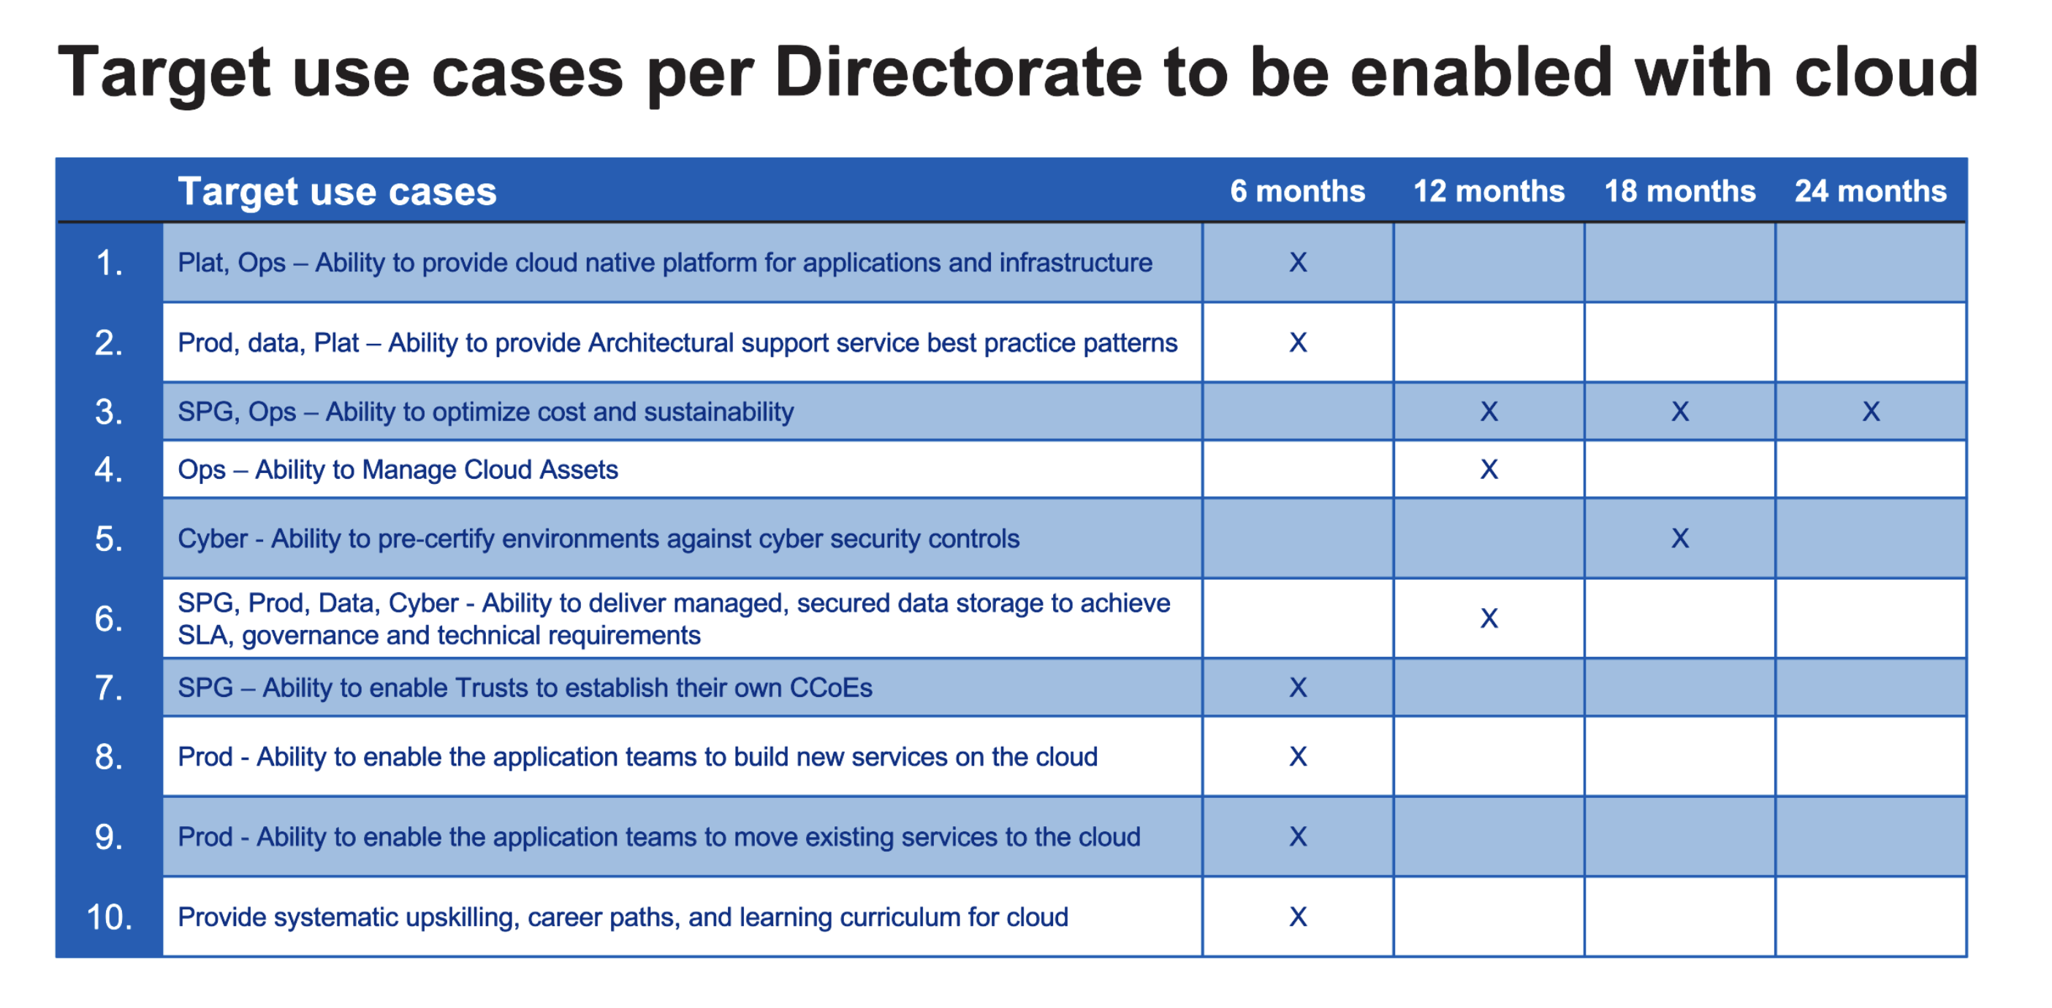
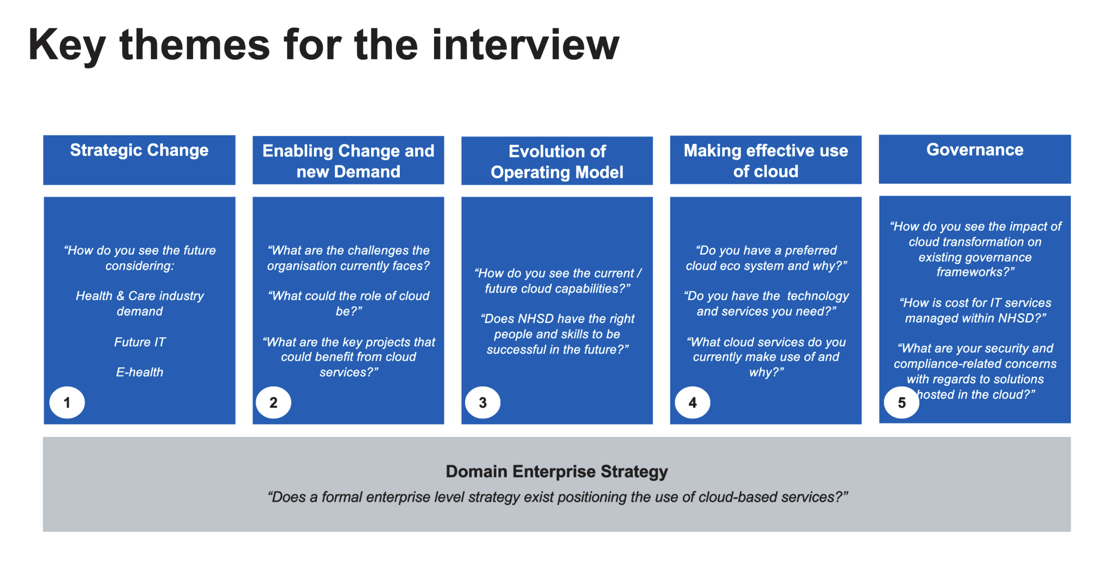
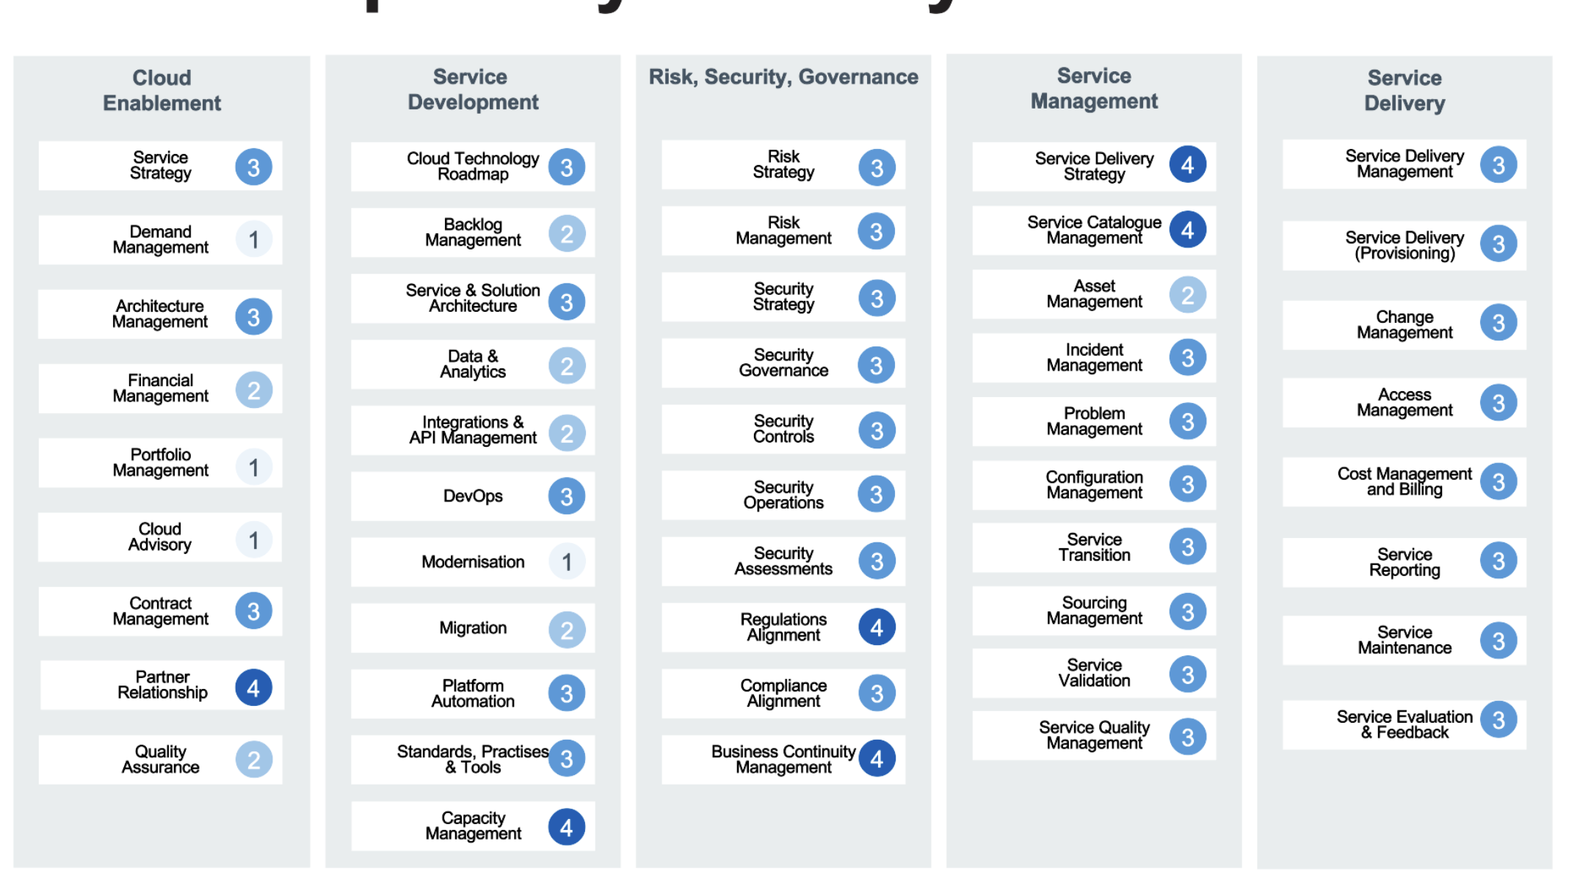

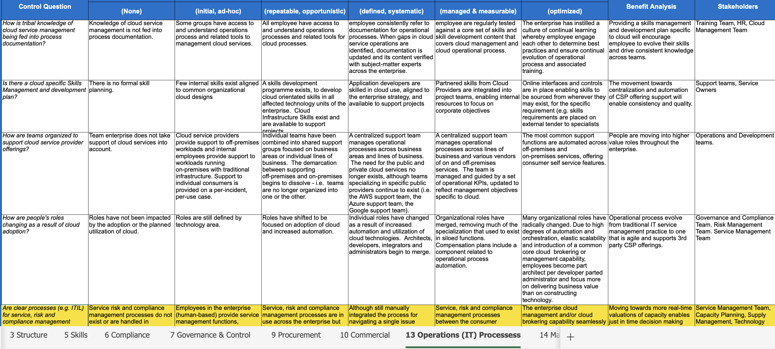
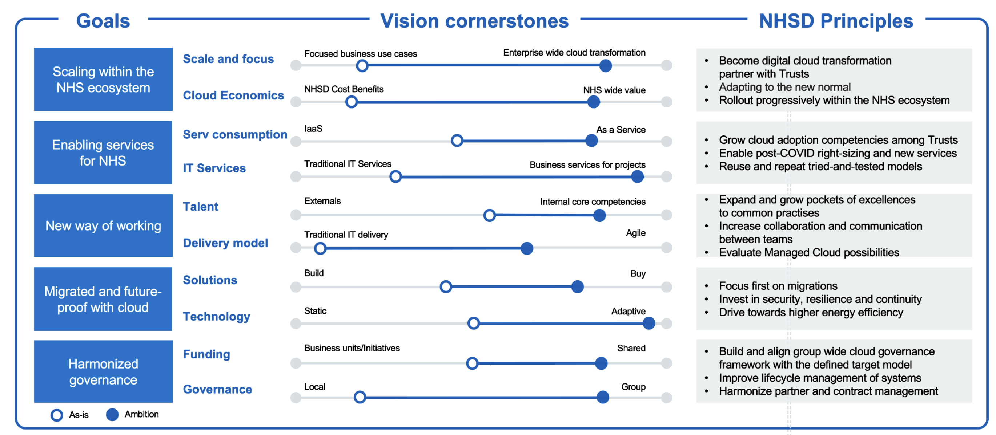
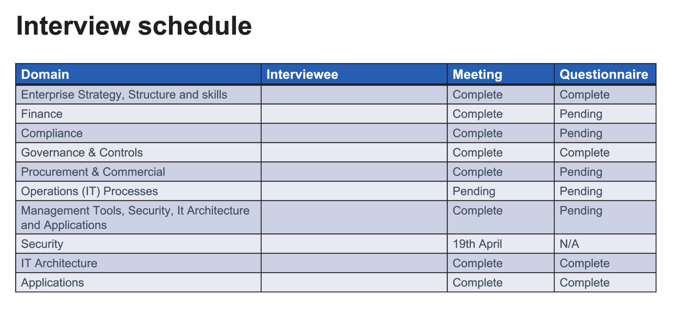
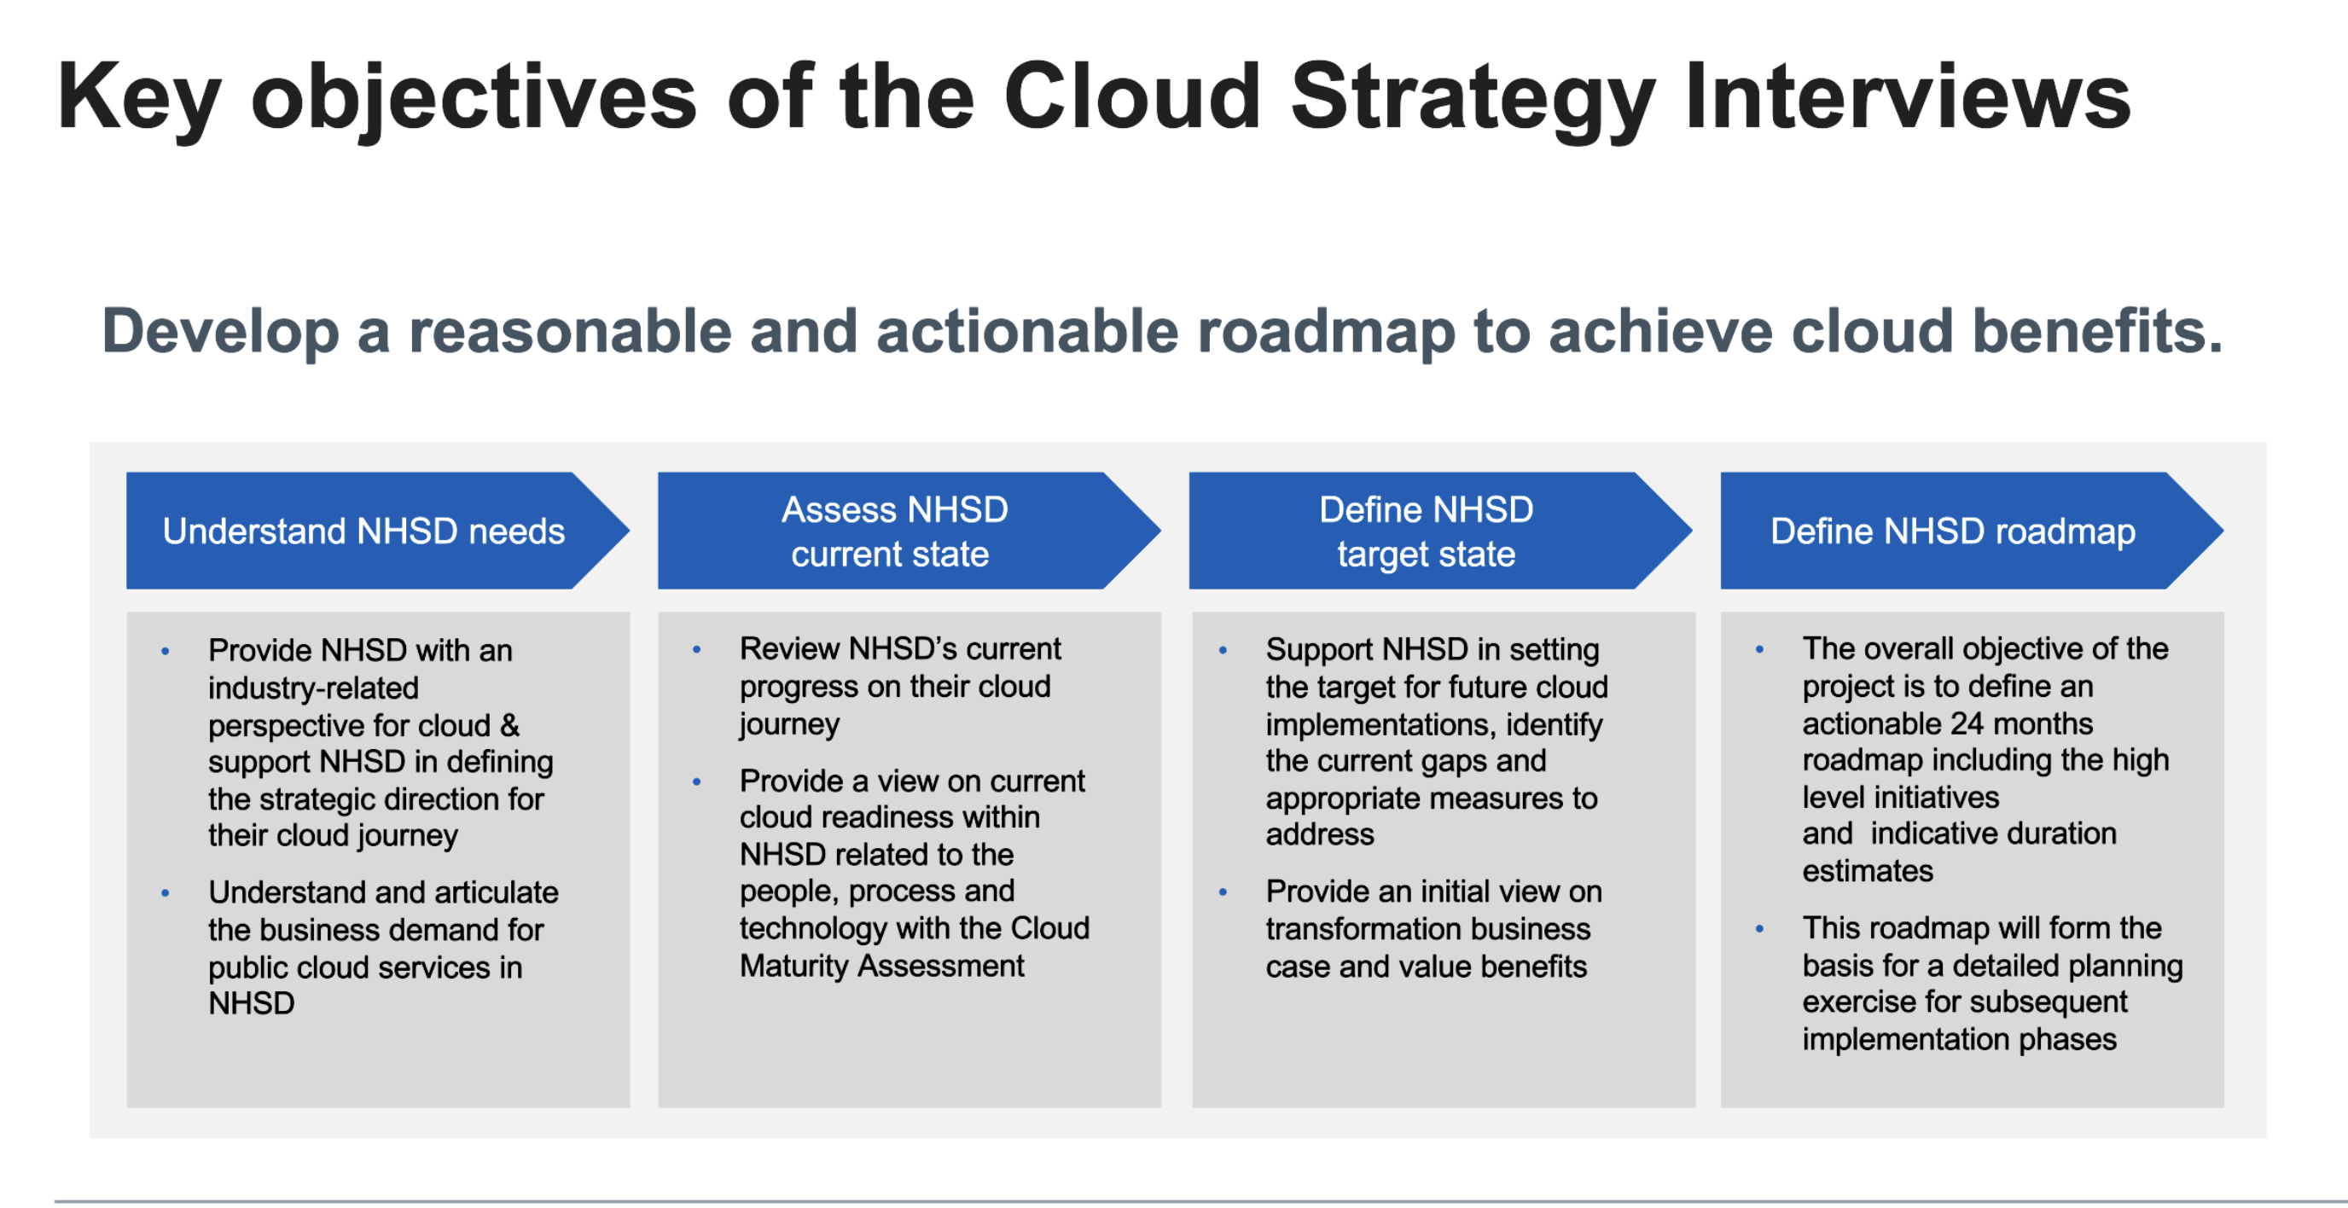
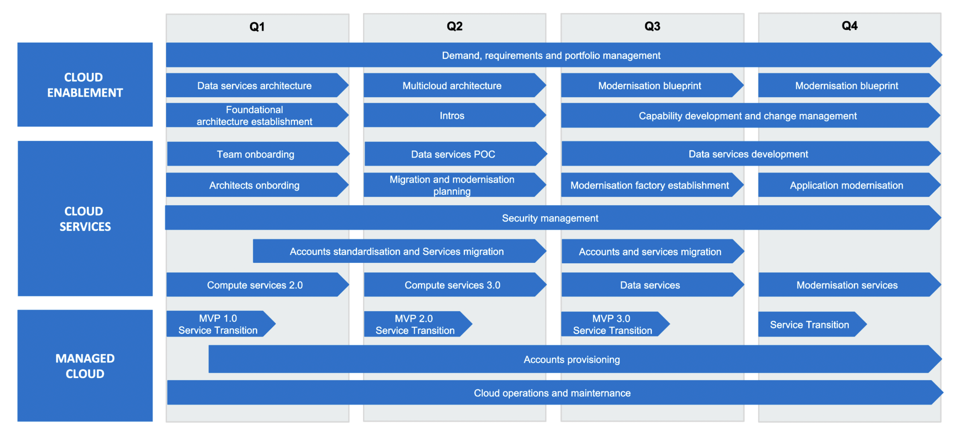
Step by step approach for the Cloud Capability Maturity Assessment
1
2
3
Analysis scope & stakeholders
Preparation for assessment
Conduct Assessment
Conduct interviews
Fill-in questionnaires
Identify gaps
Identify optimization potentials
Create roadmap
Consolidate report
Result:
  Scope statement including target use cases to be enabled
  Timeline in which those use cases should be delivered
  Relevant domains are selected
  Interviews are scheduled
  Result:
  A list of key themes and questions
  A short slide overview to introduce the stakeholders to the audit
  Statement of the desired target state per domain
  Questionnaires per domain
  Result:
  Consolidated interview notes
  OACA Questionnaires filled-in
  Capability map with current and target maturity levels
  Detailed overview of current state with respect to processes, technology and people
  Gap Analysis between assessment results and targeted maturity level.
  Roadmap with defined set of steps to move each domain from current to target state
  Consolidated outputs of analysis and roadmap

Slide 10
To measure Cloud Maturity level, selected domains are analysed by conducting interviews/surveys with the relevant key stakeholders
People, process & technology aspects
Domains
Compliance
Procurement
Structure
Non-Technical
Capability
Finance
Governance
Commercial/FinOps
Enterprise strategy
Skills
Domains
IT Architecture
Operations/processes
Technical
Capability
Applications
Security
Management tools/CMDB
Identify key stakeholders for interviews

Slide 11
It is recommended to focus on eight to ten domains
People, process & technology aspects
Domains
Finance
Enterprise strategy
Structure
Non-Technical
Capability
Culture
Governance
Skills
Compliance
Bus process
Procurement
Commercial/FinOps
Portfolio Mgmt
Projects
Domains
IT Architecture
Operations/processes
XaaS
Applications
DevOps
Information Services
Technical
Capability
Management tools/CMDB
Security
Data
Network
AI
IOT
API’s
Config Mgt

Slide 12
Delivery

Slide 13
Assessment week-by-week plan
Key Areas | Activities | Responsible |  | Timeline
 |  | Trust | IBM/NC | Wk-3 | Wk-2 | Wk-1 | Wk1 | Wk2 | Wk3 | Wk4 | Wk5 | Wk6
Analysis scope | Define the analysis scope and target use cases to be enabled | C | AR
 | Define timeline in which use cases should be delivered | C | AR
 | Select relevant domains based on scope and use cases | C | AR
 | Scoping Workshop - Sponsors | C | AR
 | Gap Analysis and Resolution Strategy | C | AR
 | Ingest & Analysis of the inputs | I | AR
 | Validation by Customer | R | A
Stakeholders | Define the stakeholders to be interviewed | R | AR
 | Schedule the interviews | C | AR
Preparation | A list of key themes and questions | C | AR
 | Stakeholder briefing pack to introduce the audit | C | AR
 | Statement of the desired target state per domain | C | AR
 | Questionnaires per domain | C | AR
Conducting assessment | Conduct interviews | C | AR
 | Fill-in questionnaires | C | AR
 | Consolidate interview notes | C | AR
 | Identify gaps and optimisation potentials | R | AR
 | Align with workload migration assessment | I | AR
Deliverables | Capability map with current and target maturity levels | C | AR
 | Roadmap with defined set of steps to move each domain from current to target state | C | AR
 | Risk log | C | AR
 | Consolidated outputs of analysis and roadmap | C | AR
Validation | Interim Findings Validation by customer | R | A
 | Presentation to key stakeholders and interviewees | C | AR
 | Collect feedback and make final adjustments to deliverables | C | AR
 | Sign-off | R | A

Slide 14
Plan Assumptions
The delivery plan, resourcing and cost of this work is based on the following assumptions:
Scope / quantities
The assessment will be limited to ten domains which will be selected during the mobilisation workshop.
Stakeholder availability
A plan of stakeholder meetings will be agreed during mobilisation
Stakeholders will be available to meet at the agreed times.
The plan allows for up to 2 postponements. Beyond this consideration will be given to reducing scope or extending the engagement timeline.
Product reviews
Feedback on draft documents will be provided within 5 working days of issue.

Slide 15
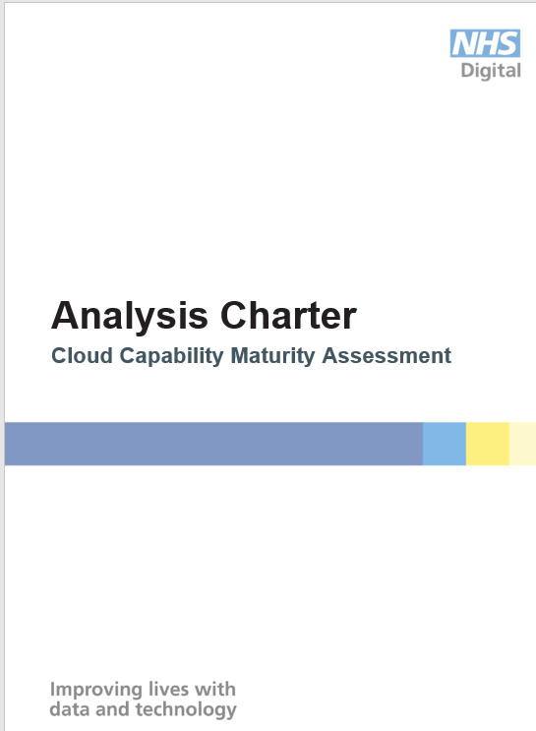
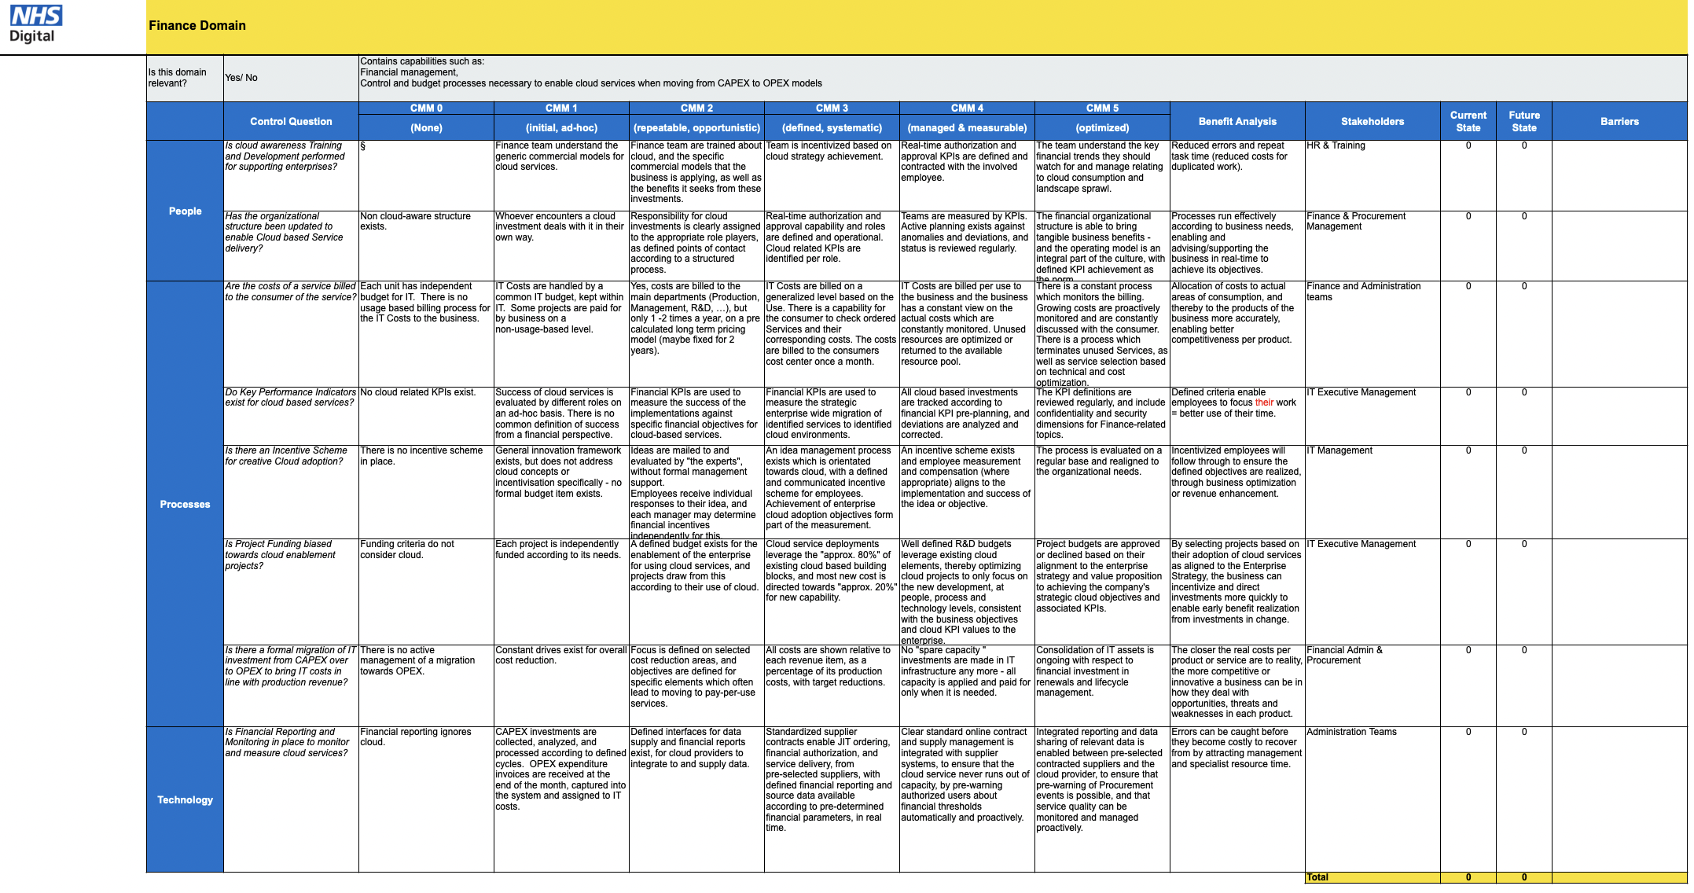
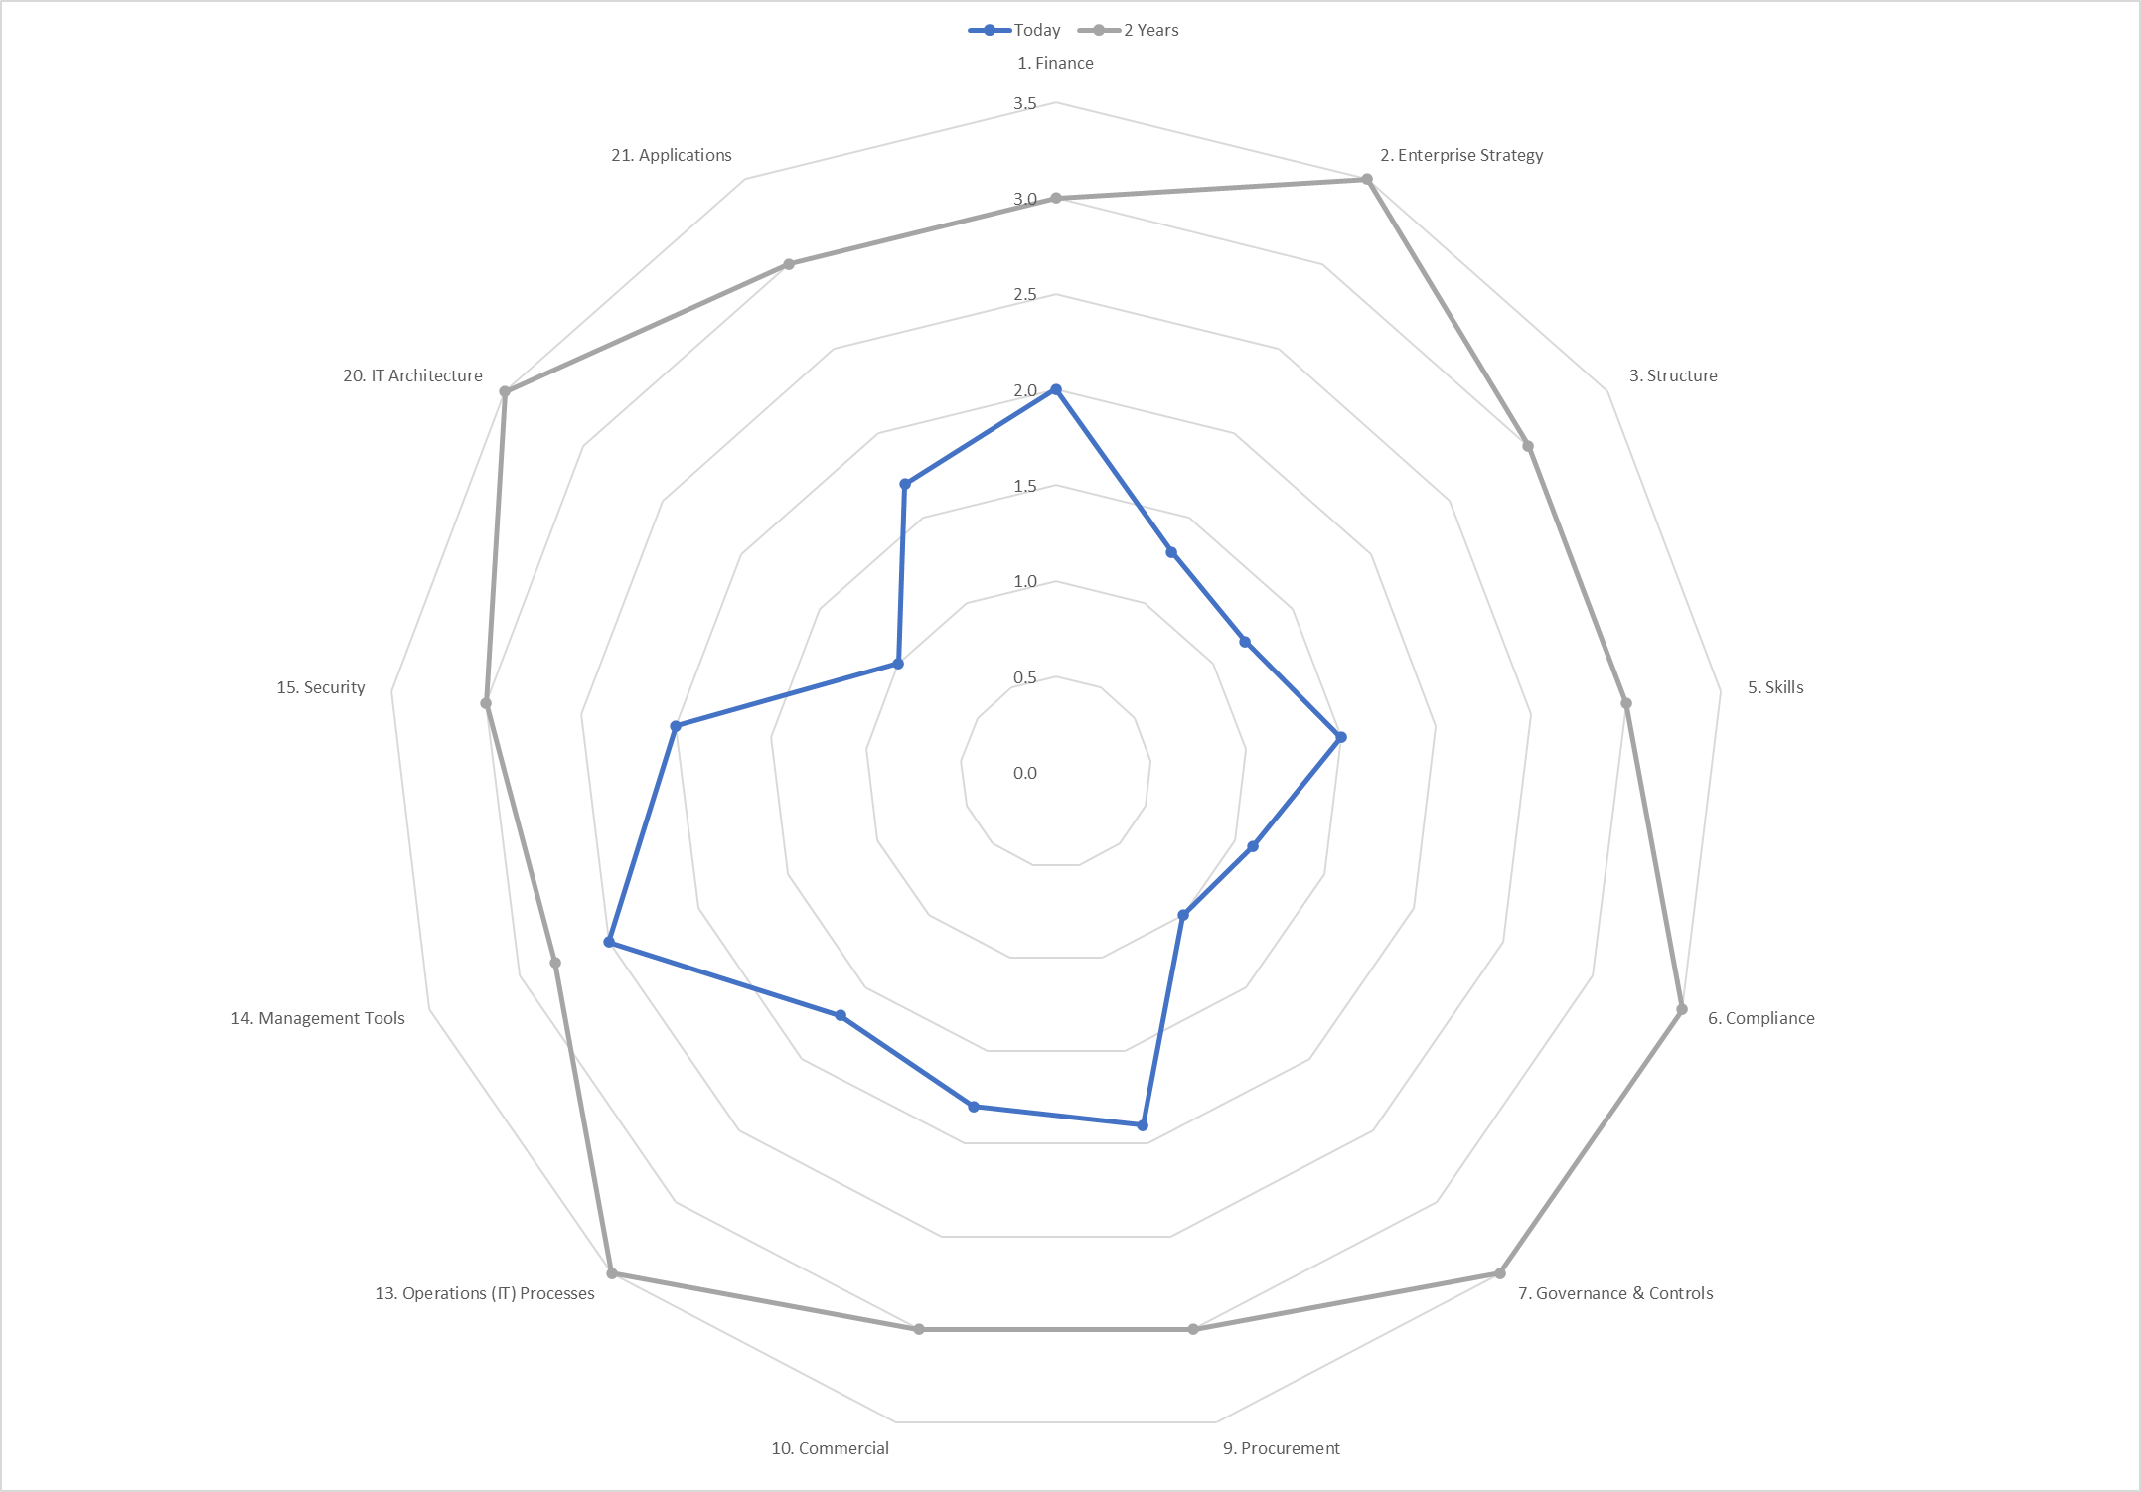
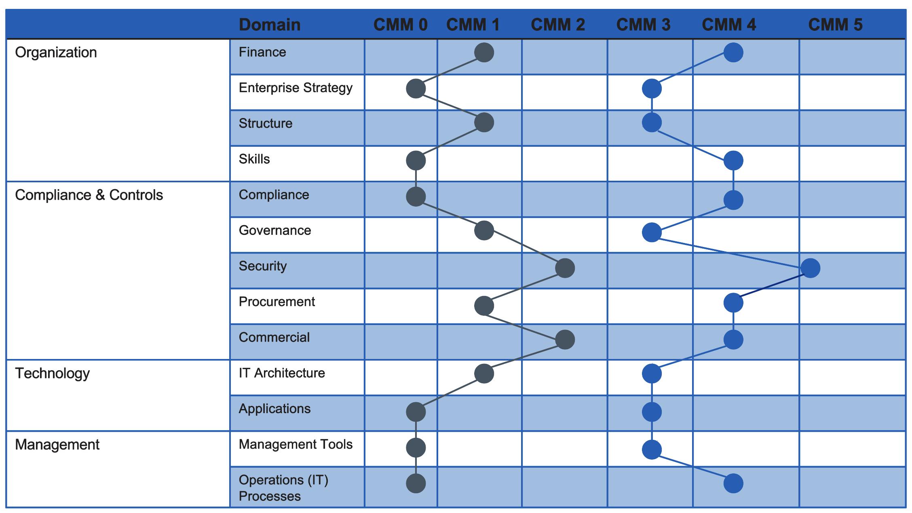
Outputs
The Assessment will produce the following outputs
Assessment Charter
Interview framework
Capability build plan
Polar graph
Gap Analysis
Findings report and roadmap
Each output is described in the Appendix A - Product Descriptions
Notes:
Workload migrations assessment,
Overall migration readiness assessment
Dependency mapping
Application Migration Strategy
Right-sizing of infrastructure
Migration roadmap

Slide 16
Proposed team
For a 9 week elapsed engagement, we propose the following team
Role | Responsibilities
Lead Consultant | Co-ordinate delivery of work to plan. Lead the interviews and assessment process.
Consultant | Data collection and analysis. Production of report and slide pack.
Senior Advisor | Alignment of findings to objectives of broader programme. Quality assurance.

Slide 17
Risks / Mitigations
Risk | Mitigation
Timely availability of stakeholders for interviews, workshops and presentations. | Set expectations and schedule at the start of the engagement
Timely availability of the sponsor to review the findings and recommended action plan. | Schedule time for findings review.

Slide 18
Prerequisites

Slide 19
Stakeholder roles
For the assessment to be successful, the project team will need access to key stakeholders for information and regular dialogue.
Executive Sponsor - Overall Owner
Customer Programme Manager with access to key resources and ability to influence their priorities
Subject matter experts for each of the domains in scope:
Finance
Enterprise Strategy
Governance, Regulatory, Compliance
Procurement / Commercial
IT Finance / FinOps
Skills and development
IT architecture
IT Operations / IT Service Management / CMDB
Security

Slide 20
Stakeholder commitment
Successful execution of this work will depend on access to key stakeholders to plan the engagement, discuss findings, take feedback.
Activities | Trust Resources | Estimated Effort [hrs]
Mobilisation and scoping | Project sponsor Programme Lead | 2 hours
Kick-off | Project sponsor Programme Lead SME’s for each of the domains in scope | 1 hour
Stakeholder interviews | SME’s for each of the domains in scope | 1 hour each
Interim findings & feedback | Project sponsor Programme Lead | 2 hours
Final presentation to exec sponsor / steering | Project sponsor Programme Lead | 1 hour
Final presentation to the interviewees | Subject matter experts | 1 hour
Document review and feedback | SME’s for each of the domains in scope | 1 hour each

Slide 21
Information requirement
The delivery team require ready access to the following information and systems to conduct the assessment:
Source | Format / Key Content
Organisation chart | Business domains IT domains Cloud delivery / CCoE if exists
Headcount information for relevant teams
Stakeholders map for the domains in scope
Operating model and Process documentation
Cloud usage information – approximate value of annual cloud spend
Existing risk logs
Any existing information that might be of use (upskilling plans, etc.)

Slide 22
Appendices

Slide 23
Product Descriptions

Slide 24
Product Descriptions
Capability Maturity Assessment Report
Purpose | Summarise findings and recommend and actionable roadmap
Composition | Executive summary – 3 pages Overview of current state and target state ambition with respect to processes, technology and people Consolidated outputs of analysis and roadmap Pareto chart of barriers between each use case and domains Gap analysis and polar graphs. Proposed barrier reduction projects
Derivation / Inputs | Maturity assessment interviews and scoring Consultation with key stakeholders
Definition of Done / Quality Criteria | Report describes findings based on interviews and evidence presented. Report articulates the actions required to reach the target level of maturity
Review Points | Interim – week 5 Final – week 6
Reviewers | Key stakeholders
Approver | Executive Sponsor
Roadmap
Purpose | Propose an actionable plan to steps to move each domain from current to target state, with consideration for the barriers and dependencies identified during the assessment.
Composition | PowerPoint presentation, outlining tasks over time. 12-18 month timeline.
Derivation / Inputs | Maturity assessment interviews and scoring Consultation with key stakeholders
Definition of Done / Quality Criteria | Tasks will, if completed, take the organisation to the desired target state of maturity.
Review Points | Interim – week 5 Final – week 6
Reviewers | Key stakeholders
Approver | Executive Sponsor

Slide 25
Product Descriptions
Analysis Charter
Purpose | Formalise the terms of reference for the assessment.
Composition | Scope Objectives Chosen domains Use cases Plan Stakeholders and point of contact Organisation coverage
Derivation / Inputs | Mobilisation workshop and context data provided by customer (see information requirement)
Definition of Done / Quality Criteria | Key points are covered and agreed with the client sponsor.
Review Points | Week -2
Reviewers | Programme Manager
Approver | Executive Sponsor
Domain Questionnaires
Purpose | Basis of structured interviews for each domain in scope.
Composition | List of questions which explore the topics for the domain Scoring criteria related to the questions.
Derivation / Inputs | OACA Assessment Framework, tailored for domains in scope and context.
Definition of Done / Quality Criteria | Coverage and relevance of the domain topics.
Review Points | Week 1 and 2. Staggered by domain.
Reviewers | Programme Manager
Approver | Programme Manager

Slide 26
Product Descriptions
Stakeholder briefing pack
Purpose | Inform the involved stakeholders about the assessment process and set out expectations for the interviews.
Composition | PowerPoint presentation containing: Principles Objective Method Discussion themes and questions
Derivation / Inputs | Mobilisation workshop and content of Analysis Charter
Definition of Done / Quality Criteria | Stakeholders understand the process and what is expected of them.
Review Points | End of week 1 – prior to interviews
Reviewers | NA
Approver | Programme Manager

Slide 27
Workshop Agendas

Slide 28
Workshop Agendas
Scoping Meeting
Purpose | Define the terms of reference for the assessment which are captured in the Analysis Charter.
Attendees | Project sponsor Programme Manager
Agenda Topics | Review the method and approach for conducting the assessment. Capture and agree content for the Analysis Charter Scope Objectives Chosen domains Use cases Plan Stakeholders and point of contact Organisation coverage
Outputs | Draft Analysis Charter
Inputs | Organisation chart Scope and Objectives
Duration | 1.5 hours
Timing | Week -3
Stakeholder Domain Interviews
Purpose | Gather insight and data on which to base the maturity assessment.
Attendees | SME’s for each of the domains in scope. Specific roles will depend on the domains selected.
Agenda Topics | Domain specific topics are outlined in slides below.
Outputs | Interview notes
Inputs
Duration | Approximately one hour each.
Timing | To be scheduled in weeks 2, 3 and 4.
Notes:
CCMA scope, objectives, planning.
CCMA kick-off {explain process, confirm plan, set homework, }
Stakeholder interviews
Interim findings & feedback
Final presentation to exec sponsor / steering

Slide 29
Workshop Agendas
Findings validation / Interim findings
Purpose | Review draft findings and proposed roadmap. Align messages for executive presentation
Attendees | Project sponsor Programme Lead Domain leads
Agenda Topics | Findings Action plan Roadmap Key messages
Outputs | Aligned messages
Inputs | Draft assessment report findings, action plan, roadmap.
Duration | 1 hour (may need two separate meetings)
Timing | Week 5 - 6
Findings presentation
Purpose | Final presentation of the assessment reports.
Attendees | Executive sponsor Key programme stakeholders
Agenda Topics | Key messages Findings Action plan Roadmap Q&A
Outputs | Final report
Inputs | Validated, final report.
Duration | 1.5 hours
Timing | Week 6
Notes:
CCMA scope, objectives, planning.
CCMA kick-off {explain process, confirm plan, set homework, }
Stakeholder interviews
Interim findings & feedback
Final presentation to exec sponsor / steering

Slide 30
High-level themes for the interviews
Each interview will first cover high level themes to gauge alignment to the overall vision, then explore domain specific topics as outlined on the following slides.
Strategic Change
Enabling Change and new Demand
Evolution of Operating Model
Making effective use of cloud
Governance
“How do you see the future considering:
Health & Care industry demand
Future IT
E-health
“What are the challenges the organisation currently faces?
“What could the role of cloud be?”
“What are the key projects that could benefit from cloud services?”
“How do you see the current / future cloud capabilities?”
“Does NHSD have the right people and skills to be successful in the future?”
“Do you have a preferred cloud eco system and why?”
“Do you have the technology and services you need?”
“What cloud services do you currently make use of and why?”
“How do you see the impact of cloud transformation on existing governance frameworks?”
“How is cost for IT services managed within NHSD?”
“What are your security and compliance-related concerns with regards to solutions hosted in the cloud?”
1
2
3
4
5
Domain specific questions

Slide 31
Domain specific themes for the interviews 1/2
Specific topics for each of the domain interviews.
Domain | People | Processes | Technology
Finance | Education | Formal Enterprise level strategy, Cloud Adoption framework, Organisational change, KPI's | Financial reporting and monitoring
Enterprise strategy | Education Organizational structure | Cost billed to the consumer, KPI's, Incentive scheme, project funding, CAPEX to OPEX migration | Business strategy availability and timeliness
Structure | Formal cloud training to enable cloud | Roles and definitions, organisational structure and business processes to enable cloud | Internal IT coordination and process management system to enable cloud
Skills | Skills and values that are compensated for, soft and technical skills to enable cloud, mechanisms to support cloud skills development and cross-training | Appropriate skillset defined to support all relevant roles, career development and performance evaluation, new hires, skills competencies matrix, budget | Are skills development tracked and integrated into existing HR to management supporting systems, training opportunities made available via e-learning or CBT systems
Compliance | Formal communication, how is it ensured employees have sufficient knowledge and follow corporate policies | Off premise services compliance, formal compliance framework, how non-compliance is handled, how compliance requirements are identified, defined and managed, how privacy is ensured, is continuous monitoring practices used | Definition and maintenance of compliance requirements and standards in the tools used for management and monitoring
Governance and control | Formal communication plan | Finance and procurement in control of the spend process, Enterprise Architecture cloud focus and –awareness, Risk management updated for cloud, security rules and requirements | Brokerage capability, controls and tools to manage risk
Appropriate skillset defined to support all relevant roles, is skills development part of career development and performance evaluation, new hires, skills competencies matrix defined, budget for skill development and training
Off premise services compliance, formal compliance framework, how non-compliance is handled, how compliance requirements
are identified, defined and managed, how privacy is ensured, is continuous monitoring practices used
Definition and maintenance of compliance requirements and standards in the tools used for management and monitoring

Slide 32
Domain specific themes for the interviews 2/2
Domain | People | Processes | Technology
Procurement | Cloud training and development for supporting enterprises | Updates to sourcing, contracting and reporting, service catalogue, shadow IT, cloud vendor selection and management | Tooling
Commercial | Formal framework for partners and clients | Cloud contract templates, KPI's for cloud, cost of a service billed to the consumer of the service, | Integration of contracts and processes to supporting electronic systems
Operations/IT Processes | Tribal knowledge of cloud service management in process documentation, cloud specific skills in the management and development plan, teams organization, people's roles change | Service, risk, compliance, capacity, demand and disasters management, Backup and recovery, platforms and vendors selection, continuous quality feedback loop and release and deployment practices, Runbook documentation | Definition and maintenance of compliance requirements and standards in the tools used for management and monitoring
Management tools | Management tool standards responsibilities | CSP offering policies governance, improvement of service delivery | IT automation and process management tools, monitoring tools, and usage
Security | Training and awareness updates, organizational structure, | Policies and rules, governance and compliance, frameworks and requirements for each class of applications, data security and privacy concept | Reporting and monitoring, tooling updates, security enforcement technology
IT Architecture | Training and responsibilities | Standard designs, planning and processes, cloud application design and development patterns, Business application landscape mapped to platforms | Technological standards
Applications | Developers' skills and training, application development roles, applications organization, application build and deployment, | Architecting and structure of applications, how applications/services communicate with each other | How do applications and services communicate with each other, technologies and frameworks utilized to design and build applications
Appropriate skillset defined to support all relevant roles, is skills development part of career development and performance evaluation, new hires, skills competencies matrix defined, budget for skill development and training
Off premise services compliance, formal compliance framework, how non-compliance is handled, how compliance requirements
are identified, defined and managed, how privacy is ensured, is continuous monitoring practices used
Definition and maintenance of compliance requirements and standards in the tools used for management and monitoring

Slide 33
Templates

Slide 34
Index of Templates
File | Description | Purpose
NHS_Capability Maturity Analysis_Questionnaire.xlsx
NHSD Capability Maturity Sample Output.pptx | Sample summary pack
NHS Cloud Maturity Assessment_Introduction.pptx | Introduction information pack about the assessment. | Set expectations about the process and the interviews.

Slide 35
Notes:
Connect with us

