Slide 1
Cloud Business Case
NHSD CCoE Service Offering
MVP – 27 May 2022
Notes:
Standard title slide

Slide 2
Contents
Introduction
Approach & Key Outputs
Process for Business Case Development
Delivery Plan
Risks
Prerequisites
  Information requirement
  Stakeholder list and time commitment
Appendices
Workshop Agendas
Example Exec Summary
Business case framework readout

Slide 3
Introduction
This pack aims to describe the Cloud Business Case method adopted by the NHS Digital Cloud CoE
The Business Value Assessment service aims to demonstrate the value of moving systems to the cloud, by capturing and analysing the as is costs; providing a projection of cloud costs, likely benefits and value levers.
More specifically it:
Models the costs, savings, and soft benefits in a clear and concise format to support decision making.
Quantifies the value of moving systems to the cloud.
Informs decision making about the migration strategy and plans.
The benefit of this model is that it can begin to quantify the value, based on limited data inputs and minimal stakeholder involvement. The model can be refined incrementally if richer data is available.
The assessment is structured as a repeatable work package based on standardised templates, to be delivered on a fixed timeline / fixed effort basis over the course of 3 weeks, preceded by a brief mobilisation period.

Slide 4
Approach

Slide 5
The BVA aims to articulate the value of cloud adoption
Inputs
Analysis & Estimation
Business Case
Revenue
Budget TCO Hypothesis
Cost Savings
IT Budget
Value Drivers
Value Gains
Context
Business Case Template
Strategic Drivers
Business priorities
Cloud run costs
Calculations
Cloud Strategy – if available
Migration Cost Estimate
Insights & Recommendations
Regulatory & Compliance Constraints
Scenario Modelling
The Cloud Business Value Assessments takes a publicly available data as starting point.
Contextual data, if available, can be used to refine and enrich the model.
An initial hypothesis is derived using industry cost benchmark data. This hypothesis is validated and tuned based on IT cost actuals if available.
Once the As Is costs are established, the model is used to generates a range of cost projections and value cases.
Finally, adoption and migration scenarios are assessed to estimate the cost of change
Insights and recommendations from the Business Value Assessment summary report aim to inform decision-making about the migration strategy and plans.

Slide 6
Cloud value Gains
Cloud value is not limited to savings on infrastructure. The Cloud Business Case aims to provide a full 360° view of the potential business benefits of using public cloud. This will include consideration of the following areas:
IT Infrastructure Cost Savings
IT Productivity Gains
IT Operational Gains
Business Gains
Moving to public cloud unlocks potential savings on IT infrastructure and related costs, e.g. license costs.
Using a cloud native approach (rightsizing, pay as you use) to infrastructure provisioning adds further savings potential by reducing usage of computing, storage or networking resources.
Cloud infrastructure has a sweet spot for automation and DevOps practices, making it easier to gain benefits from them. An extensive support for tooling helps leveraging tools and platforms.
This leads to increased benefits arising from higher productivity of staff.
Cloud infrastructure generally is backed by highly efficient, technically advanced and secure data centres supported by global operations teams.
Automation capabilities are core to how the cloud works.
This enables savings derived from capturing the economics of scale and scope of the Cloud Service Provider for having a secure, available and truly global environment.
Public Cloud not only provides savings and efficiency gains, but also enables and supports accelerated development of new business capabilities.
This not only leads to possible savings, but enable new business capabilities as well.

Slide 7
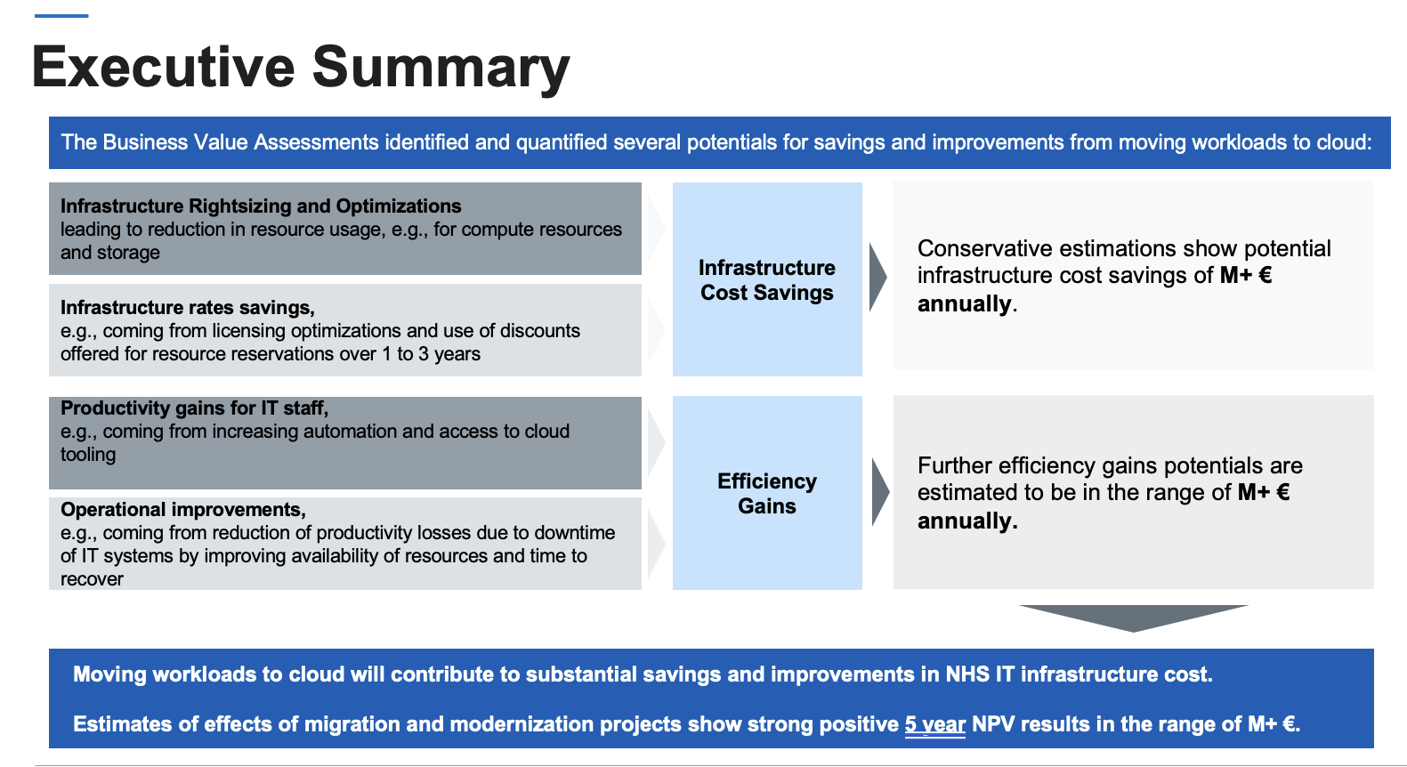
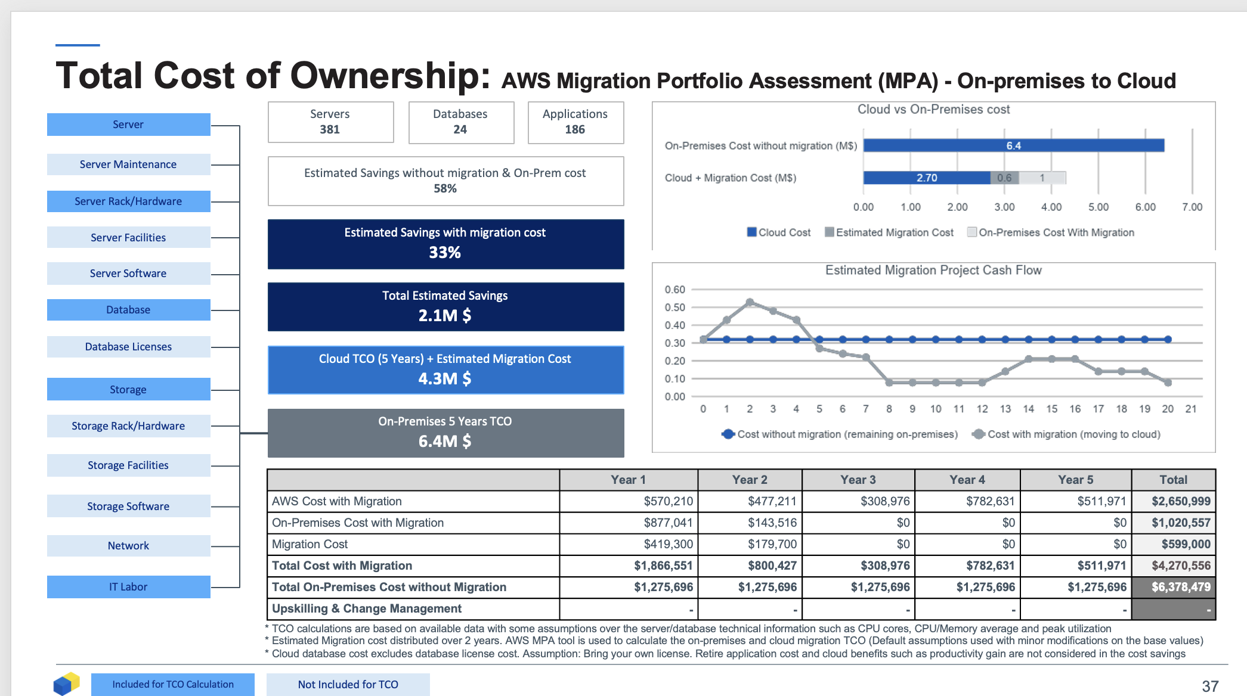
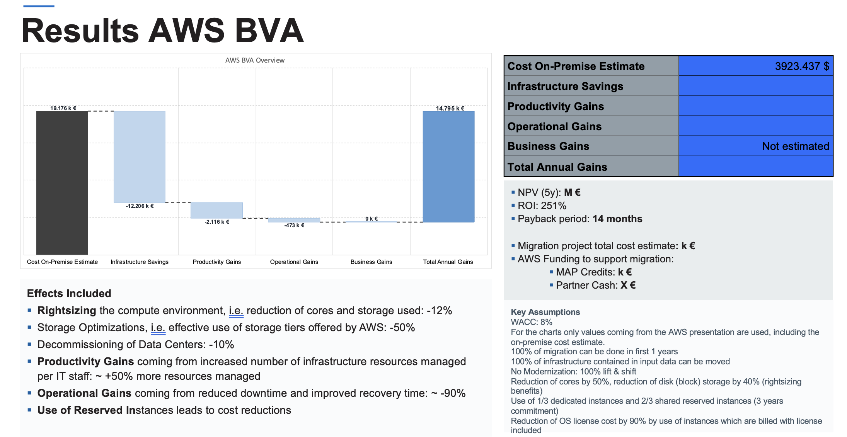
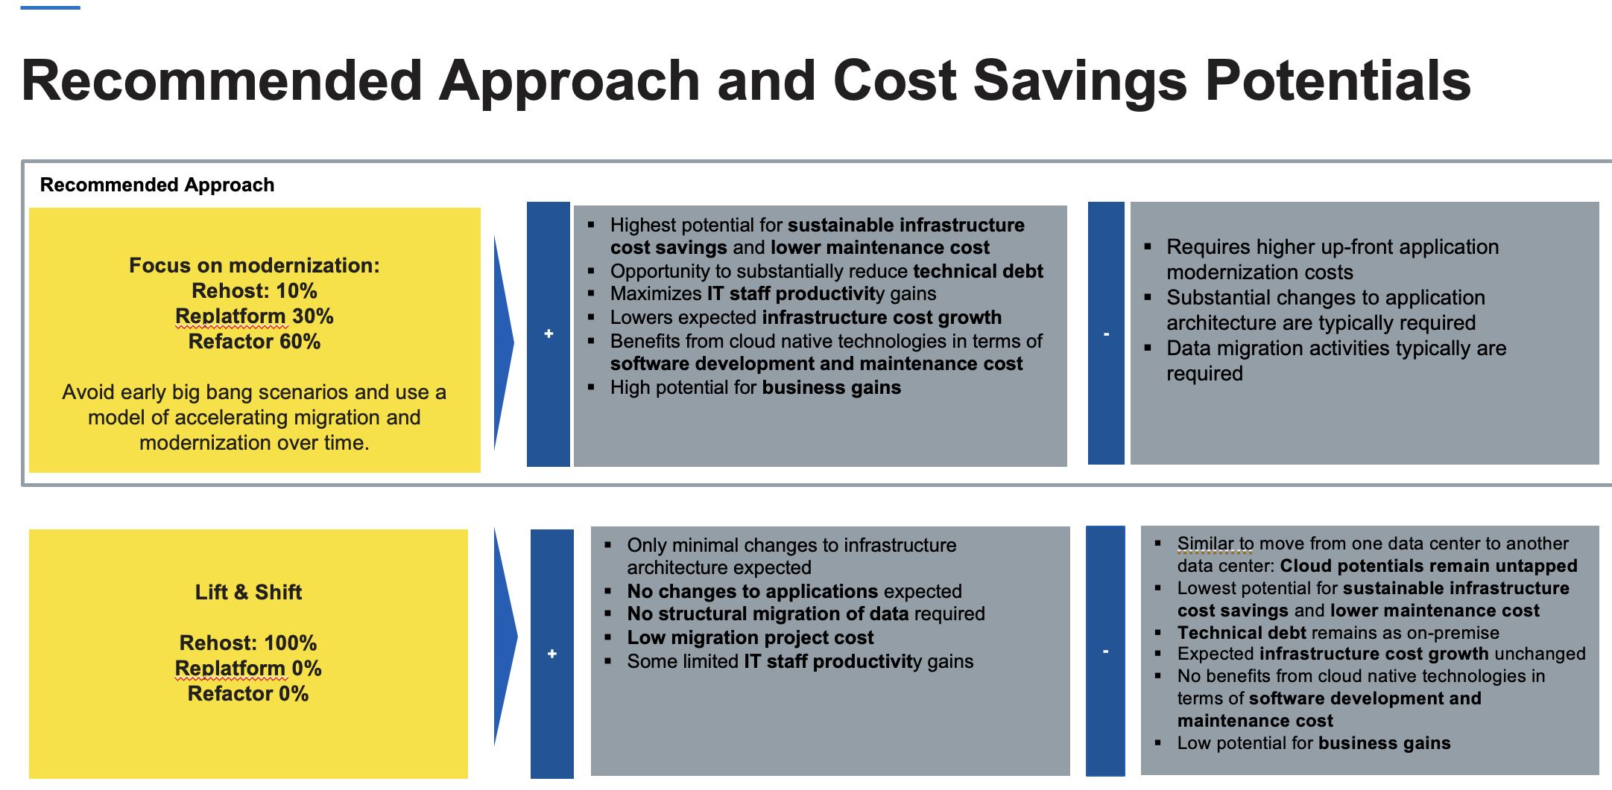
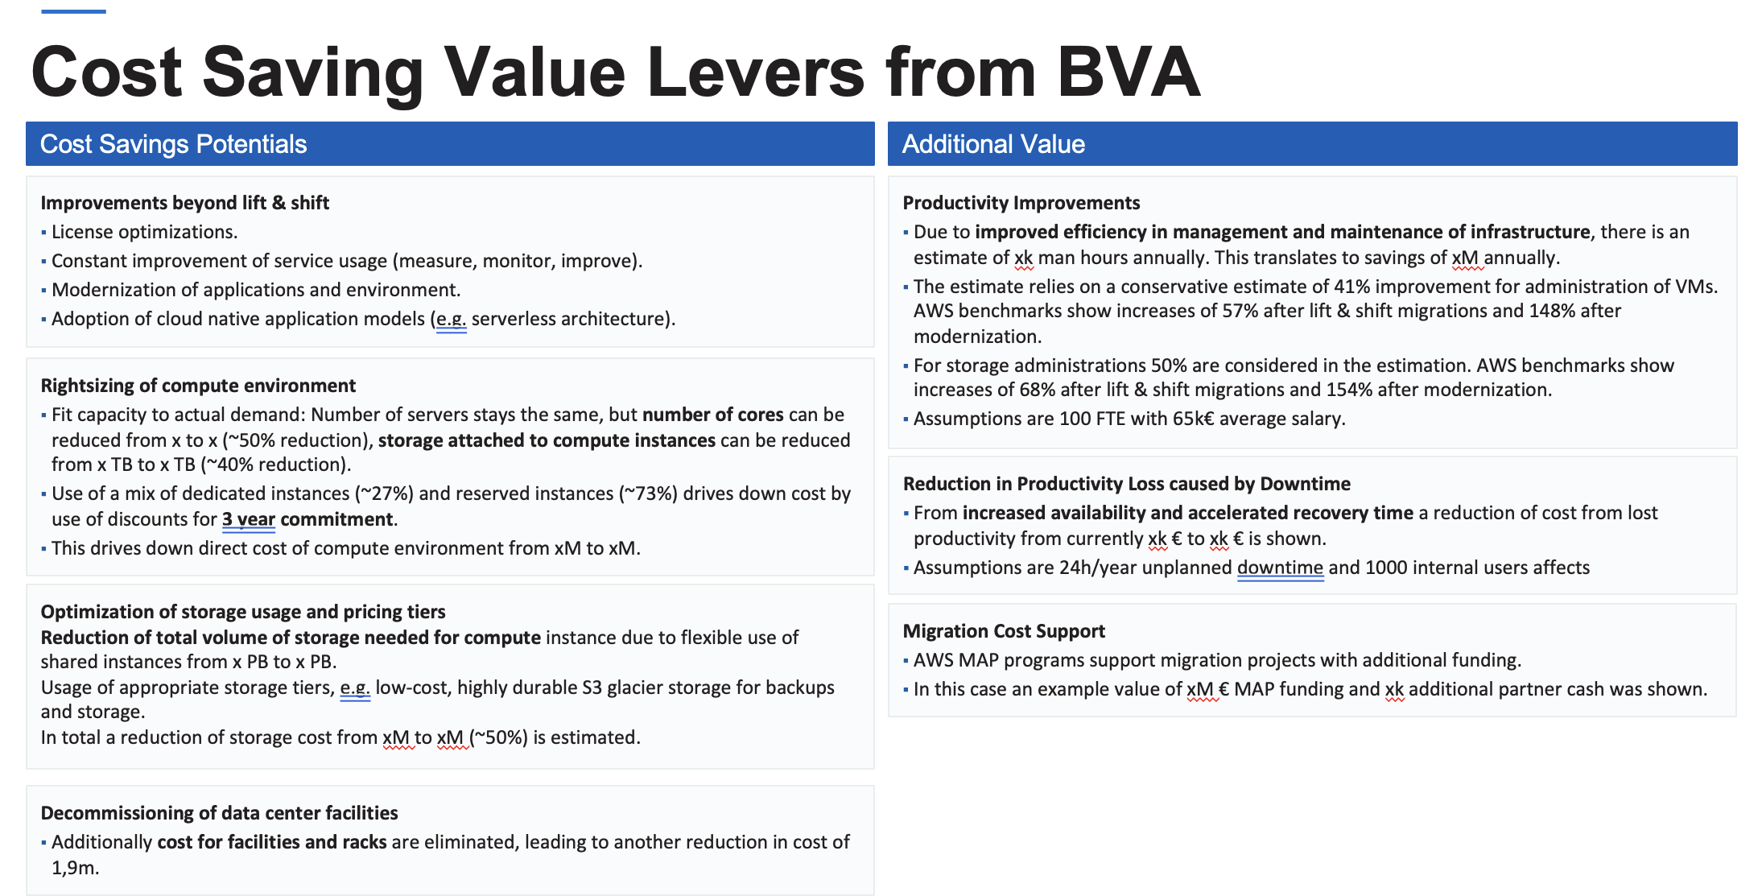
Outputs
The outputs aim to inform the decision-making regarding cloud adoption.

Slide 8
Delivery

Slide 9
Delivery Plan & timelines
Preparation | Week -1 | Week 1 | Week 2 | Week 3
Agree ToR and schedule
Build Budget Hypothesis
Validate Hypothesis
Prioritise value levers
Cost & value estimations
Migration Scenarios and sensitivity analysis
Draft exec summary
Validation
Workshop
Finalise exec summary
Review Draft
Present results
Review call
Review call
Review call
Budget hypothesis
Tuned budget
Cloud TCO estimations
Draft exec summary
Final exec summary
HYPOTHESIS
Business objective & TCO model
ANALYSIS
Estimate target state run costs and cost of change
OUTPUT
To guide strategic decision making
Notes:
Agree schedule of review meetings and final presentation.
Points of contact and data sources
Wk -1: preparation > build budget hypothesis TCO model based on annual report information
Wk 1: meet sponsor / stakeholder to
Sense check and tune
Discuss and prioritise organisation’s value drivers
Review budget hypothesis and tune the model
Confirm scope of the assessment
Week 2
Identify portion of IT budget which is addressable by cloud transformation
Estimate the cost of change (migration, organisation change, training, technical foundations)
Migration scenario modelling
Estimate the range of post-migration running costs
Assess potential transformation benefits, based on value levers
Produce draft report
Week 3
present draft report and agree next steps
Amend and finalise report

Slide 10
Plan Assumptions
The delivery plan, resourcing and cost of this work is based on the following assumptions:
Scope / quantities
This assessment will cover data from one organisation
Data about the organisation will be shared in a consistent and unified manner (no need for manipulation to create a consolidated view)
Stakeholder availability
A plan of stakeholder meetings will be agreed during mobilisation.
The key stakeholder contact will be available as outlined in the stakeholder commitment table to provide clarifications and will be empowered to share budget data.
Product reviews
Feedback on draft documents will be provided within 5 working days of issue.

Slide 11
Proposed team
For a 4 week elapsed engagement, we propose the following team
Role | Responsibilities
Senior Advisor | Alignment of findings to objectives of broader programme. Quality assurance.
Engagement Lead | Quality assurance oversight – part time.

Slide 12
Risks
Risk | Mitigation
Lack of understanding on the scope and cloud native skills. | Hold scoping workshop during mobilisation phase to lock down the scope and expectation. Build communication plan to ensure effective execution.
Mismatched expectations of the scope, purpose or content of the final deliverable. | Share samples in advance of the start of the engagement. Review and align deliverable content, structure and level of detail, during scoping and mobilisation workshop.
Delay / accuracy of data collection | Identify relevant client who can assist with this request.
Availability of client-side SME’s to interpret data, provide guidance and timely feedback. | Default to working on assumptions. This may affect accuracy and validity of the forecasts.

Slide 13
Prerequisites

Slide 14
Stakeholder roles
For the assessment to be successful, the project team will need access to key stakeholders for information and regular dialogue.
Executive Sponsor - Overall Owner
Customer Programme Manager with access to key resources and ability to influence their priorities
IT Finance Manager
IT Infrastructure Manager

Slide 15
Stakeholder commitment
Successful execution of this work will depend on access to key stakeholders to plan the engagement, discuss findings, take feedback.
Activities | Trust Resources | Estimated Effort [hrs]
Mobilisation | Customer Programme Manager | 2 hours
Agree Terms of Reference | Customer Programme Manager | 2 hours
Budget hypothesis review workshop | Customer Programme Manager | 2 hours
Cloud TCO estimation review | Customer Programme Manager | 1 hour
Review & comment draft findings summary | Customer Programme Manager | 2 hours
Exec summary presentation | Customer Programme Manager Exec Sponsor | 1 hours

Slide 16
Information requirement
As a minimum, only a high level figures for revenue and IT spend are needed to conduct the assessment. Accuracy of the estimates improves with more specific data as outlined below.
 | Data Item | Format / Key Content
Mandatory | Revenue for the organisation
Mandatory | IT Budget – top line
Desirable | IT Budget split by cost categories | Split by: hardware, software, staff, services, depreciation Ideally, further split by: Development, Support, Operations, Administration
Desirable | Book value of IT assets | Hardware: compute, storage, networking Software: OS, Middleware, database, Application, other Datacentre
Desirable | NPV assumptions: time, discount rate
Desirable | IT Budget split by: Run / Change / Grow the business
Context | Organisation structure | Business domains IT domains Cloud delivery / CCoE if exists
Context | IT Estate | Application count and prevailing technology types IT infrastructure – top level counts / quantities
 | Data centre commitments | Size / capacity / Number of sites
Context | Cloud usage information – approximate value of annual cloud spend
Context | Scope of current cloud usage

Slide 17
Appendices

Slide 18
Product Descriptions

Slide 19
Product Descriptions
Executive summary presentation pack
Purpose | Summarise and communicate value of cloud adoption based on the organisation’s actual budgets. Inform decision making about next stage of the cloud journey.
Composition | Executive Summary Summary illustration of business case financial model and key highlights Strategic drivers and articulate how the cloud can address them Recommended next steps
Derivation / Inputs | BVA Financial Model Interviews and reviews.
Definition of Done / Quality Criteria | Clear and concise Accuracy +/- 20% (as it is based on several assumptions) Actionable insights
Review Points | Week 2 – first draft Week 3 – final draft Week 3 – Exec presentation
Reviewers | Programme Manager
Approver | Sponsor
BVA Financial model
Purpose | Calculate an estimate of the value of moving systems to the cloud, based on high-level IT budget values.
Composition | Proprietary excel-based tool, based on an industry benchmark estimating model. Summary visualisations of data
Derivation / Inputs | Annual report IT budget, if available IT organisation headcount Contextual information about IT estate, applications and inventory if available. See page on information requirement.
Definition of Done / Quality Criteria | Accuracy +/- 20%
Review Points | Week 1 – review assumptions and refine TCO Week 2 – review and tune migration sensitivity analysis Week 3
Reviewers | Programme Manager
Approver | Sponsor
Notes:
Overall migration readiness assessment
Workload migrations assessment,
Infrastructure sizing
Application Migration Strategy
Migration roadmap
= = = = = = =
Title / purpose / Composition ToC headings / Derivation-Inputs /
DoD – Acceptance criteria
Review inputs required – week 3 Draft / Week 6 final
Responsibilities – reviewers / approver

Slide 20
Workshop Agendas

Slide 21
Workshop Agendas
Mobilisation / Terms of Reference meeting
Purpose | Agree terms of reference and expectations. Ensure mobilisation of right stakeholders and access to relevant data
Attendees | Customer programme manager, Sponsor
Agenda Topics | Delivery approach Stakeholder mapping Data sources and initial assumptions. Estimating model Cost of change (TCO, Migration, Upskilling) Progress reporting Communication plan
Outputs | Scope statement Data input Templates
Inputs | Outline plan and draft terms of reference. BVA estimate model
Duration | 2-3 hours
Timing | Prior to engagement start.
Budget validation workshop
Purpose | Establish common understanding of the IT budget and cost category breakdown. Understand directional priorities and business value levers.
Attendees | Customer programme manager, Sponsor
Agenda Topics | Review budget hypothesis and tune the model Discuss and prioritise organisation’s value drivers Identify portion of IT budget which is addressable by cloud transformation
Outputs | Validated cost breakdown Addressable spend
Inputs | Budget hypothesis
Duration | 2 hours
Timing | Week 1

Slide 22
Workshop Agendas
Final workshop for Business case results
Purpose | Present case for change and supporting data to sponsor and key stakeholders.
Attendees | Project sponsor Programme Manager Additional relevant stakeholders – to be confirmed.
Agenda Topics | Summary of financial model and key highlights Strategic drivers and how the cloud can address them Recommended next steps Optional: method and assumptions used in the model.
Outputs | Decision on next steps
Inputs | Executive Summary Presentation Deck
Duration | 1 hour
Timing | Week 3
Status review call
Purpose | Review progress against plan, risks and issues. Review interim deliverables with key stakeholder. Clarifications Validate assumptions
Attendees | Executives & IT leaders
Agenda Topics | Progress against plan Risks and issues
Outputs | Presentation Templates updates
Inputs | Stakeholder Availability
Duration | 2 hours
Timing | Every 3rd week

Slide 23
Templates

Slide 24
Templates for data inputs
File | Description | Purpose
.xlsx | Template for data inputs and calculation of As is TCO.

Slide 25
Example outputs

Slide 26
Example Exec Summary Template
The Business Value Assessments identified and quantified several potentials for savings and improvements from moving workloads to cloud:
  Infrastructure Rightsizing and Optimizations
  leading to reduction in resource usage, e.g., for compute resources and storage
  Infrastructure Cost Savings
  Conservative estimations show potential infrastructure cost savings of M+ £ annually.
  Infrastructure rates savings,
  e.g., coming from licensing optimizations and use of discounts offered for resource reservations over 1 to 3 years
  Productivity gains for IT staff,
  e.g., coming from increasing automation and access to cloud tooling
  Efficiency
  Gains
  Further efficiency gains potentials are estimated to be in the range of M+ £ annually.
  Operational improvements,
  e.g., coming from reduction of productivity losses due to downtime of IT systems by improving availability of resources and time to recover
  Moving workloads to cloud will contribute to substantial savings and improvements in NHS IT infrastructure cost.
  Estimates of effects of migration and modernization projects have strong positive results in the range of M+ €.

Slide 27
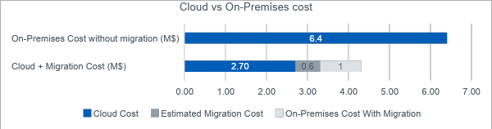
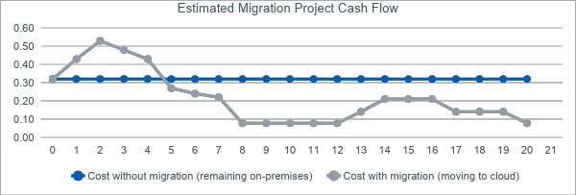
Total Cost of Ownership: AWS Migration Portfolio Assessment (MPA) - On-premises to Cloud
Server
Servers
xxx
Databases
xx
Applications
xxx
Server Maintenance
Estimated Savings without migration & On-Prem cost
58%
Server Rack/Hardware
Server Facilities
Estimated Savings with migration cost
33%
Server Software
Total Estimated Savings
x.1M $
Database
Database Licenses
Cloud TCO (5 Years) + Estimated Migration Cost
x.3M $
Storage
Storage Rack/Hardware
On-Premises 5 Years TCO
x.4M $
Storage Facilities
 | Year 1 | Year 2 | Year 3 | Year 4 | Year 5 | Total
AWS Cost with Migration | $xx0,210 | $xxx,211 | $xxx,976 | $xxx,631 | $xxx,971 | $x,xxx,999
On-Premises Cost with Migration | $xx7,041 | $xxx,516 | $0 | $0 | $0 | $x,xxx,557
Migration Cost | $xxx,300 | $xxx,700 | $0 | $0 | $0 | $xxx,000
Total Cost with Migration | $xxx,551 | $xxx,427 | $xxx,976 | $xxx,631 | $xxx,971 | $x,xxx,556
Total On-Premises Cost without Migration | $x,xxx,696 | $x,xxx,696 | $x,xxx,696 | $x,xxx,696 | $x,xxx,696 | $x,xxx,479
Upskilling & Change Management | - | - | - | - | - | -
Storage Software
Network
IT Labor
* TCO calculations are based on available data with some assumptions over the server/database technical information such as CPU cores, CPU/Memory average and peak utilization
* Estimated Migration cost distributed over 2 years. AWS MPA tool is used to calculate the on-premises and cloud migration TCO (Default assumptions used with minor modifications on the base values)
* Cloud database cost excludes database license cost. Assumption: Bring your own license. Retire application cost and cloud benefits such as productivity gain are not considered in the cost savings
Included for TCO Calculation
Not Included for TCO

Slide 28
Example Business value assessment results
AWS BVA Overview
Cost On-Premise Estimate | xx.176 k £
Infrastructure Savings | -xx.045 k £
Productivity Gains | -x.116 k £
Operational Gains | -xxx k £
Business Gains | Not estimated
Total Annual Gains | xx.633 k £
illustrative
xx.xxxk
xx.xxx k £
NPV (5y): xxM £
ROI: 251%
Payback period: 14 months
Migration project total cost estimate: x.xxx k £
AWS Funding to support migration:
  MAP Credits: x.xxx k £
  Partner Cash: x00k £
-
xx.xxx k
-
0 k £
x.xxx k £
-
xxx k £
Cost On
-
Premise Estimate
Infrastructure Savings
Productivity Gains
Operational Gains
Business Gains
Total Annual Gains
Effects Included
Rightsizing the compute environment, i.e. reduction of cores and storage used: -12%
Storage Optimizations, i.e. effective use of storage tiers offered by AWS: -50%
Decommissioning of Data Centers: -10%
Productivity Gains coming from increased number of infrastructure resources managed per IT staff: ~ +50% more resources managed
Operational Gains coming from reduced downtime and improved recovery time: ~ -90%
Use of Reserved Instances leads to cost reductions
Key Assumptions
WACC: 8%
For the charts only values coming from the AWS presentation are used, including the on-premise cost estimate.
100% of migration can be done in first 1 years
100% of infrastructure contained in input data can be moved
No Modernization: 100% lift & shift
Reduction of cores by 50%, reduction of disk (block) storage by 40% (rightsizing benefits)
Use of 1/3 dedicated instances and 2/3 shared reserved instances (3 years commitment)
Reduction of OS license cost by 90% by use of instances which are billed with license included

Slide 29
TCO calculation results - 5 year view
High level view of TCO estimates based on data received & mapped. Treat as illustrative based on stated assumptions and may require further validation
Year |  | INPUTS | 1Y | 2Y | 3Y | 4Y | 5Y | Total
Stay On-premises “As Is” |  | Server | $xxx.563 | $xxx.563 | $xxx.563 | $xxx.563 | $xxx.563 | $x.xxx.817
 |  | Database | $xx.064 | $xx.064 | $xx.064 | $xx.064 | $xx.064 | $xxx.318
 |  | Database Licenses | $xxx.018 | $xxx.018 | $xxx.018 | $xxx.018 | $xxx.018 | $xxx.092
 |  | Storage | $xx.466 | $xx.466 | $xx.466 | $xx.466 | $xx.466 | $xxx.332
 |  | Network | $0 | $0 | $0 | $0 | $0 | $0
 |  | IT Labor | $xxx.584 | $xxx.584 | $xxx.584 | $xxx.584 | $xxx.584 | $x.xxx.919
 |  |  | $x.xxx.696 | $x.xxx.696 | $x.xxx.696 | $x.xxx.696 | $x.xxx.696 | $x.xxx.478
Migrate to AWS “To Be” | AWS Costs
 |  | Server | $xx.807 | $xxx.740 | $xxx.016 | $xxx.016 | $xxx.016 | $xxx.596
 |  | VMware Cloud on AWS | $0 | $0 | $0 | $0 | $0 | $0
 |  | Database (RDS) | $0 | $0 | $0 | $0 | $0 | $0
 |  | Database Licenses - 3rd party | $0 | $0 | $0 | $0 | $0 | $0
 |  | Storage | $xx.075 | $xxx.860 | $xxx.686 | $xxx.686 | $xxx.686 | $xxx.993
 |  | Network | $0 | $0 | $0 | $0 | $0 | $0
 |  | IT Labor | $xx.152 | $xxx.665 | $xxx.881 | $xxx.881 | $xxx.881 | $xxx.460
 |  | AWS Support | $xx.195 | $xx.513 | $xx.987 | $xx.987 | $xx.987 | $xxx.668
 |  |  | $xxx.210 | $xxx.211 | $xxx.976 | $xxx.631 | $xxx.971 | $x.xxx.999
 | Migration Costs
 |  | Parallel Run Costs | $xxx.041 | $xxx.516 | $0 | $0 | $0 | $x.xxx.577
 |  | Migration Effort | $xxx.300 | $xxx.700 | $0 | $0 | $0 | $xxx.000
 |  |  | $x.xxx.341 | $xxx.216 | $0 | $0 | $0 | $x.xxx.577
 |  |  | $x.xxx.551 | $xxx.427 | $xxx.976 | $xxx.631 | $xxx.971 | $x.xxx.576
Savings |  |  | -$xxx.855 | $xxx.269 | $xxx.720 | $xxx.065 | $xxx.725 | $x.xxx.902
* TCO calculations are based on available data with assumptions about the server/database technical information such as CPU cores, CPU/Memory average and peak utilization
* VMCs are considered as relocate to VMC on AWS and no discount / bring your own license applied over cloud cost

Slide 30
Recommended approach and cost savings potentials
Recommended Approach
Focus on modernization:
Rehost: 10%
Replatform 30%
Refactor 60%
Avoid early big bang scenarios and use a model of accelerating migration and modernization over time.
+
Highest potential for sustainable infrastructure cost savings and lower maintenance cost
Opportunity to substantially reduce technical debt
Maximizes IT staff productivity gains
Lowers expected infrastructure cost growth
Benefits from cloud native technologies in terms of software development and maintenance cost
High potential for business gains
-
Requires higher up-front application modernization costs
Substantial changes to application architecture are typically required
Data migration activities typically are required
Lift & Shift
Rehost: 100%
Replatform 0%
Refactor 0%
+
Only minimal changes to infrastructure architecture expected
No changes to applications expected
No structural migration of data required
Low migration project cost
Some limited IT staff productivity gains
-
Similar to move from one data center to another data center: Cloud potentials remain untapped
Lowest potential for sustainable infrastructure cost savings and lower maintenance cost
Technical debt remains as on-premise
Expected infrastructure cost growth unchanged
No benefits from cloud native technologies in terms of software development and maintenance cost
Low potential for business gains

Slide 31
Value drivers for the business case
Drawn from our experiences, below are some cost saving value levers that will help you navigate cost saving option of using public cloud.
Cost Savings Potential
Additional Value
Improvements beyond lift & shift
License optimizations.
Constant improvement of service usage (measure, monitor, improve).
Modernization of applications and environment.
Adoption of cloud native application models (e.g. serverless architecture).
Productivity Improvements
Due to improved efficiency in management and maintenance of infrastructure, there is an estimate of xk man hours annually. This translates to savings of xM annually.
The estimate relies on a conservative estimate of 41% improvement for administration of VMs. AWS benchmarks show increases of 57% after lift & shift migrations and 148% after modernization.
For storage administrations 50% are considered in the estimation. AWS benchmarks show increases of 68% after lift & shift migrations and 154% after modernization.
Assumptions are 100 FTE with £65k average salary.
Rightsizing of compute environment
Fit capacity to actual demand: Number of servers stays the same, but number of cores can be reduced from x to x (~50% reduction), storage attached to compute instances can be reduced from x TB to x TB (~40% reduction).
Use of a mix of dedicated instances (~27%) and reserved instances (~73%) drives down cost by use of discounts for 3 year commitment.
This drives down direct cost of compute environment from xM to xM.
Reduction in Productivity Loss caused by Downtime
From increased availability and accelerated recovery time a reduction of cost from lost productivity from currently £xk to £xk is shown.
Assumptions are 24h/year unplanned downtime and 1000 internal users affects
Optimization of storage usage and pricing tiers
Reduction of total volume of storage needed for compute instance due to flexible use of shared instances from x PB to x PB.
Usage of appropriate storage tiers, e.g. low-cost, highly durable S3 glacier storage for backups and storage.
In total a reduction of storage cost from xM to xM (~50%) is estimated
Migration Cost Support
AWS MAP programs support migration projects with additional funding.
In this case an example value of £xM MAP funding and £xk additional partner cash was shown.
Decommissioning of data center facilities
Eliminate cost for facilities, energy, maintenance, and security leading to another reduction in cost of £ x,x M.
Upskilling
CSP vendors will help upskilling to NHS staff for Cloud, estimated monetary value ~£ xxk

Slide 32
Conclusions
Cloud Versus On-Premise
Conservative calculations focusing on infrastructure cost savings show a positive NPV (5 years, 8% WACC) of £xxM on AWS and £xx for Azure for a lift & shift migration.
A move to cloud therefore can clearly recommended.
Cloud Service Provider (AWS / Azure)
Both cloud service providers offer very similar rates for basic infrastructure, such as virtual machines and different tiers of storage. After normalising the business case numbers, AWS shows consistently better NPV results for cost savings based calculations. When taking into account business value in a modernization scenario, Azure shows a higher NPV (£xxM Azure vs. £xx,x M AWS).Considering the additional cost shown by Azure for cloud enablement (x,x M) and upskilling (£xxxk, provided for free by Azure), there is no clear advantage of a switch of primary CSP for NHS based on the facts presented by both parties.
Cost Versus Value
Infrastructure cost make up only 20-25% of a typical IT budget. Therefore, more aspects than cost need to be considered.
When comparing typical on-premise infrastructure costs with public cloud costs only, a slight cost advantage in favour of a cloud setup can be seen even for lift and shift migrations.
This advantage of public cloud increases when adding other value components to the equation, such as productivity gains, operational gains and business gains.
The majority of additional benefits described for public cloud can not be realized with on-premise or private cloud setups.
Migration Versus Modernization
The most important driver for benefits from move to cloud is the approach chosen for the applications.
The higher the ratio of applications that are moved to cloud native solutions (modernization), the bigger the expected benefits will become.
Benchmarks from the AWS study suggests a potential for improvement in IT staff productivity from 50% for lift and shift migrations to around 150% for modernization of infrastructure.
Recommendation: Maximize number of modernized applications, use lift & shift only for selected cases.

Slide 33
Supporting Information

Slide 34

Total Cost of Ownership
Elements that must be considered for building a TCO for a business case and key outputs
On premise TCO Elements - “As-Is”
Server
Server Maintenance
Network
Server Rack/Hardware
IT Labor
Database Licenses
Server Facilities
Storage
Storage Rack/Hardware
Server Software
Database
Storage Software
Storage Facilities
Additional Cost
Cloud TCO Elements - “To Be”
Enabler resource cost
Cloud resource cost
Includes the total cost of enabler cloud resources consumes
Includes the total cloud resources consumes
Network Cost
Cloud Service Cost
People Resource Cost
Cloud TCO Model
Cloud Data Transfer Cost
Licensing Cost
Cloud Connectivity Cost
Upskilling & Change Mgmt
Cloud Unit Cost
Transition costs

Slide 35
Value Components: IT Infrastructure Cost Savings
Moving to public cloud unlocks potential savings on IT infrastructure and other costs closely related, e.g. license costs. Using a cloud native approach to infrastructure provisioning adds further savings potential by reducing usage of computing, storage or networking resources.
Levers | Description | Examples
Align infrastructure cost with business needs | Scale IT infrastructure dynamically to provide resources the business requires at the right time. When demand is low, cost goes down. | Scale systems needed for end-of-month processing up for these tasks, reduce size at other times. Systems are sized to average, not to peak as typically is done on-premise. For demand peaks, systems are scaled.
Infrastructure on demand | Infrastructure is created, started and stopped on demand. | NHS COVID App during creation during pandemic. Shutdown development and test environments outside working hours. Create environments for acceptance tests on demand.
Infrastructure modernization | Use of shared resources, platforms and applications instead of provisioning individual infrastructure. Modernize applications to benefit from cloud native, serverless products. | Decommission database servers and migrate to shared database services. Use a managed runtime environment (e.g. AWS Beanstalk or Azure App Service) for applications.
License optimization | Reduce license cost by Switching to solutions requiring fewer or cheaper licenses, Using pay-as-you-go license instead of permanent licenses, or Consolidate machines for optimal usage of licenses. | Run application server machines only when really needed, license is billed pay-as-you-go for only that time.
Access to specialized infrastructure | Use specialized infrastructure for tasks that benefit most from it. | Run accelerated machine learning jobs on GPU-enabled virtual machines.

Slide 36
Value Components: IT Productivity Gains
Cloud infrastructure has a sweet spot for automation and DevOps practices, making it easier to gain benefits from them. An extensive support for tooling helps leveraging tools and platforms. This leads to increased benefits arising from higher productivity of staff.
Levers | Description | Examples
Managed services | Hand over infrastructure management tasks to the cloud provider. | Migration to virtual machines frees resources from managing underlying hardware. Migration to shared database services frees resources from the need to patch or optimize the DB.
Automation | Cloud infrastructure generally provides interfaces and tooling for efficiently automating regular tasks for all resources. | Use terraform to deploy or destroy whole environments. AWS benchmarks show a dramatic increase in the number of infrastructure assets managed per IT staff of 50% (lift & shift migration) to 150% (modernization) for compute instances / VMs.
Preconfigured and integrated tooling | For many development and management tasks CSPs provide tools that are easy to set up and integrate in their environment. This reduces integration cost.
Integrated logging, monitoring, alerting | Use centralized and integrated tools for logging, monitoring and alerting to gain insight into infrastructure status and events.

Slide 37
Value Components: IT Operational Gains
Cloud infrastructure generally is backed by highly efficient, technically advanced and secure datacenters supported by global operations teams. This enables savings coming from capturing the economics of scale and scope of the CSP for having a secure, available and global environment.
Levers | Description | Examples
Availability | Pick the availability that matches the requirements of the application. | Avoid downtime cost (e.g. lost business, lost staff productivity, reputation loss) by picking higher availability Avoid cost for unneeded availability by picking lower availability
Disaster recovery | Establishing a DR site in another cloud region with minimal cost for standby resources. | Use automation for provisioning infrastructure in another region when primary region goes down. Backups that have been mirrored to the DR region are used for recovery.
Security | CSPs have highly skilled security operations teams that will increase resilience against common threats to infrastructure, e.g. attacks targeting specific vulnerabilities or DDoS attacks. Tools for analyzing the security posture and automated response help mitigating security risks. | All hyperscalers quickly applied fixes for the meltdown and spectre bugs in intel chips, which has taken considerably longer in typical on-premise environments. Unusual patterns detected by CSP tooling lead to automated denial of access to resources, thus avoiding a data breach causing damage to reputation.
Cost Transparency | FinOps practices and enhanced infrastructure analytics enable better cost transparency, making it easier to attribute IT cost to specific projects or business units. | IT spend for specific resources is aligned with a project automatically by using a common tagging strategy.

Slide 38
Value Components: Business Gains
Public Cloud not only provides savings and efficiency gains, but also enables and supports development of new business capabilities. This not only leads to possible savings, but increased business as well.
Levers | Description | Examples
Business agility by experimentation | Simple and fast access to tools and components without upfront infrastructure investments support business experimentation.
Technology innovation | All hyperscalers have extensive R&D budgets contributing to the development of new technologies and products that are made available for their customers. | Tommy’s app now hosted on NHSD Azure tenant
Business agility by accelerated product development | Cloud environments have a sweet spot for digital product development supported by agile and DevOps practices. This accelerates the ease to develop new products, e.g. by fast deployments to new development and test environments.
Sustainability using cloud | As organizations of all sizes re-evaluate strategy as a result of the COVID-19 pandemic, it’s clear that deploying technology is key, both for accelerating economic recovery and ensuring we do do in a sustainable way. NHS focus in on sustainable hybrid cloud model that add meaningful value to the society at large. | Reduction of Co2 emission for NHS via cloud migration to hyperscale data center Using CSP tools to give insight into the future energy grid and match workloads with surplus of renewable energy to advance green computing
Leverage CSP ecosystem | Around each major CSPs offerings, a large ecosystem of additional services and products has evolved.
Staff Productivity | Developer velocity increase as more freedom are in hands of engineers.

Slide 39
End slide
Notes:
Connect with us

