Slide 1
Architecture Evaluation
NHSD CCoE Service Offering
Notes:
Standard title slide

Slide 2
Contents
Introduction
Approach
Process
Delivery plan
Key Outputs
Team
Risks
Assumptions
Prerequisites
  Stakeholder roles, list and time commitment
  Information requirement
Appendices
Product descriptions
Workshop Agendas

Slide 3
Introduction
This pack describes the Architecture Evaluation approach adopted by the NHS Digital CCoE
The Architecture Evaluation provides an understanding of the architecture landscape and how it supports and enables the organisation’s cloud strategy.
The evaluation is structured as a repeatable work package based on standardised templates, to be delivered on a fixed timeline / fixed effort basis over the course of 10 weeks, preceded by a brief mobilisation period.
Specifically it:
Reviews any existing Enterprise Architecture (EA) framework and supporting assets within the organisation.
Identifies gaps assuming a standard flow of value to vision → mission → strategy supported by standards, reference architectures and patterns.
Recommends resources and strategies to elevate architectural maturity or fill existing gaps.
Informs the business process relying on and supporting architecture efforts.
Matches technical architecture and capabilities to cloud service requirements
Identifies supporting best practices in patterns, platform and tooling
Notes:
DRAFT DONE

Slide 4
Engagement Scoping
Right sizing the engagement with any inputs from Maturity Assessment and early information capture
The Architecture Evaluation defined here assumes a 10 week fixed engagement with the full team listed on the Proposed team page.
The first part of the engagement will be an initial scoping exercise to collate information from supplied pre-requirements (defined later) and any information or analysis coming from Cloud Maturity Assessment or any other assessments done.
The evaluation exercise will be scoped so as to optimise the output products to match the gaps in the customer’s maturity and capability.
This will have the possible effect of reducing team size and engagement length to reduce cost and speed up delivery.
Scoping will:
Consider the Cloud Maturity Assessment and other assessment materials to identify areas in or out of scope.
Consider information supplied for the assessment pre-requisites to identify areas in or out of scope.
Agree with the customer what can be safely excluded from the assessment to increase delivery velocity.
Re-define the deliverable outputs to match the scoped requirements.
Re-define the team size and commitment to complete the scoped assessment
Provide a pre-engagement overview of the newly scoped engagement length, team and deliverables.
Notes:
DRAFT DONE

Slide 5
Delivery

Slide 6





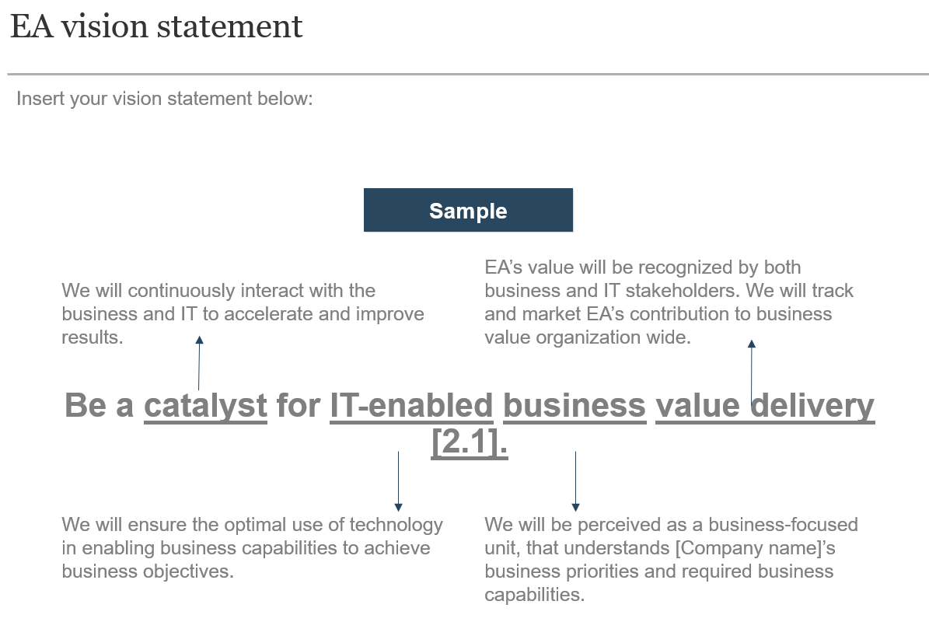
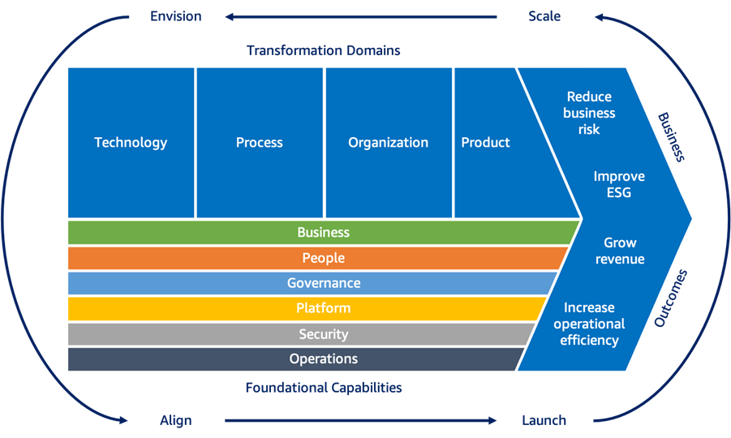
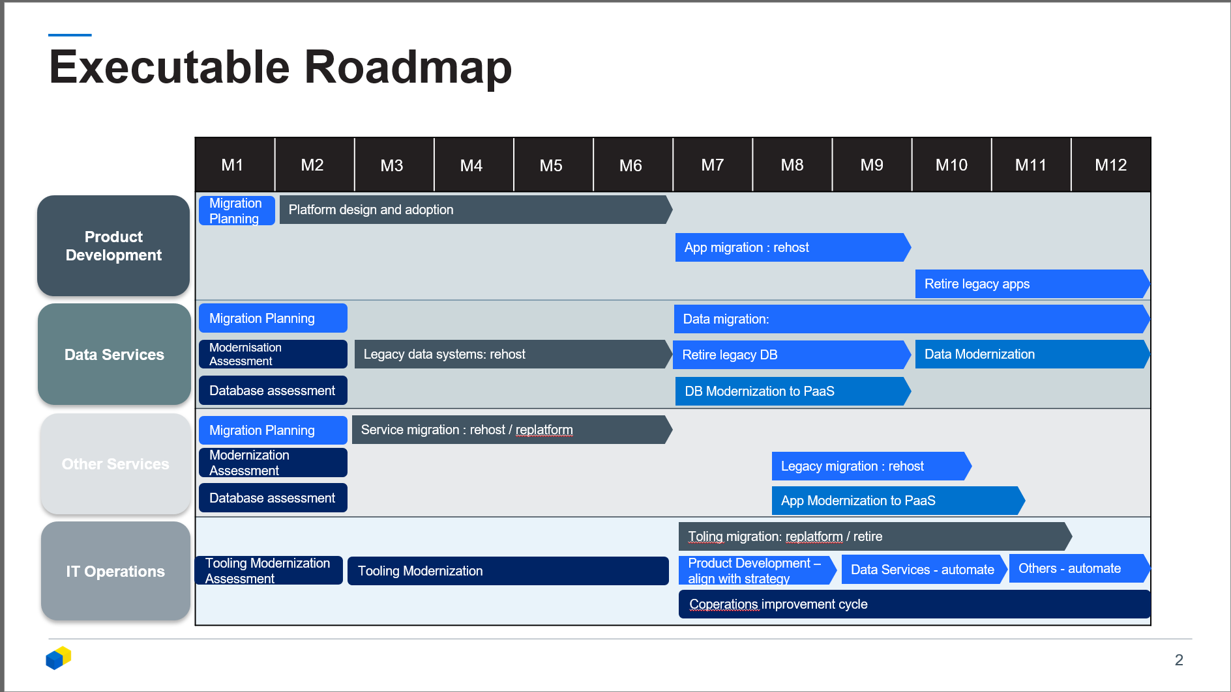


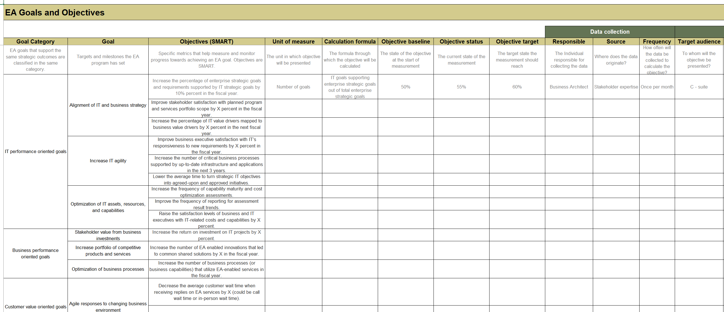
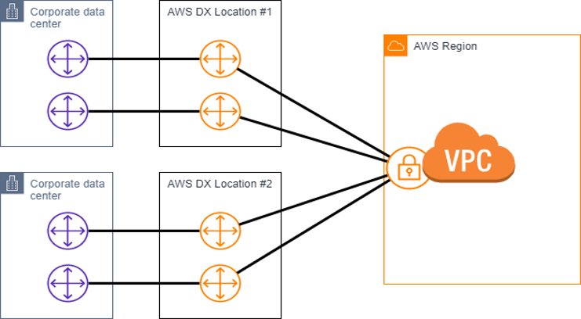
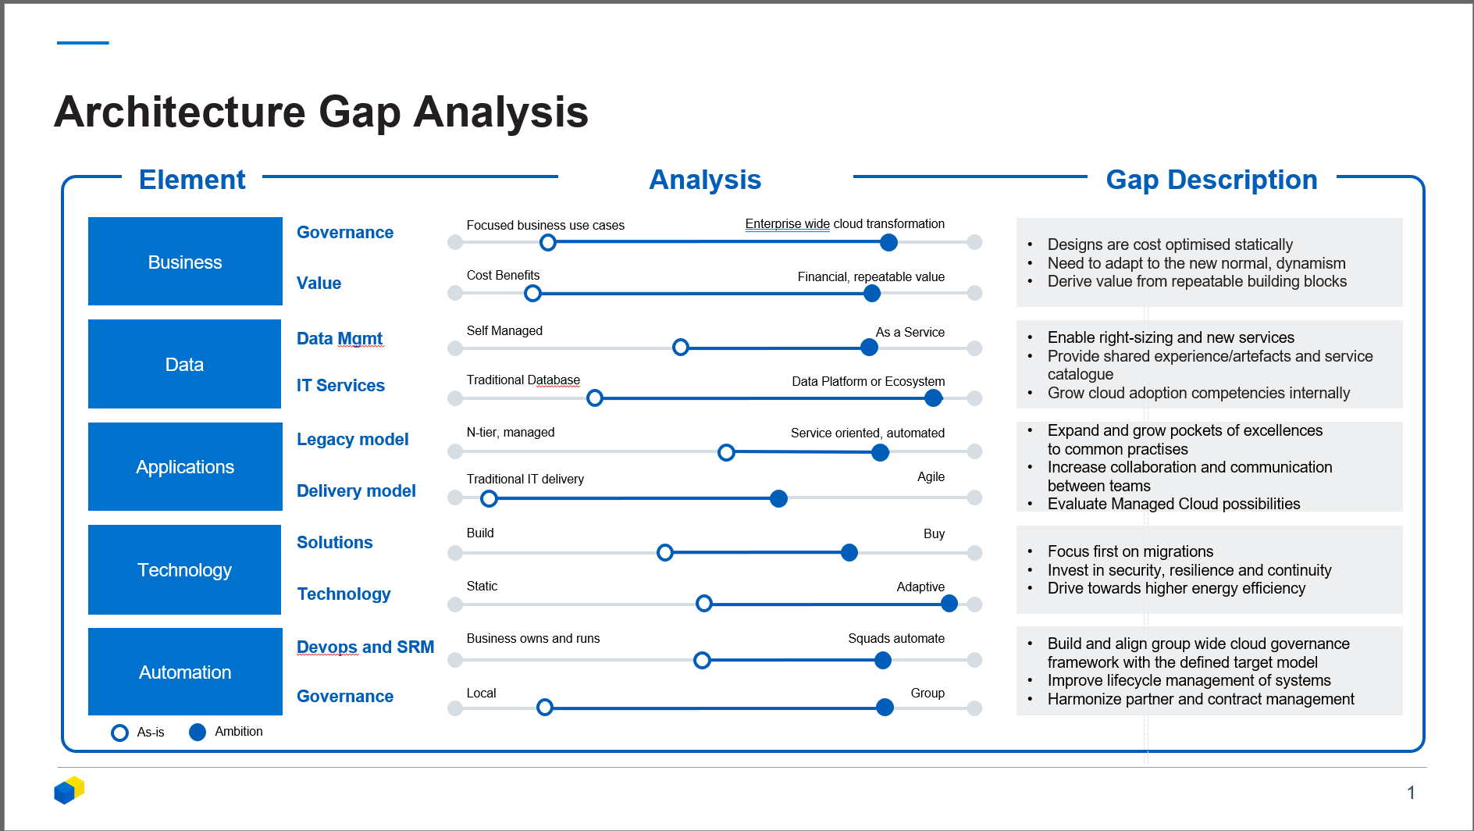
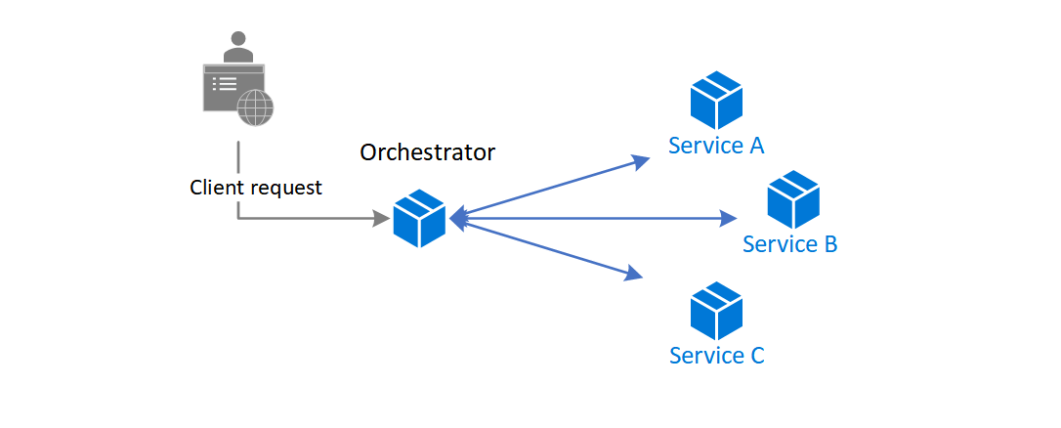
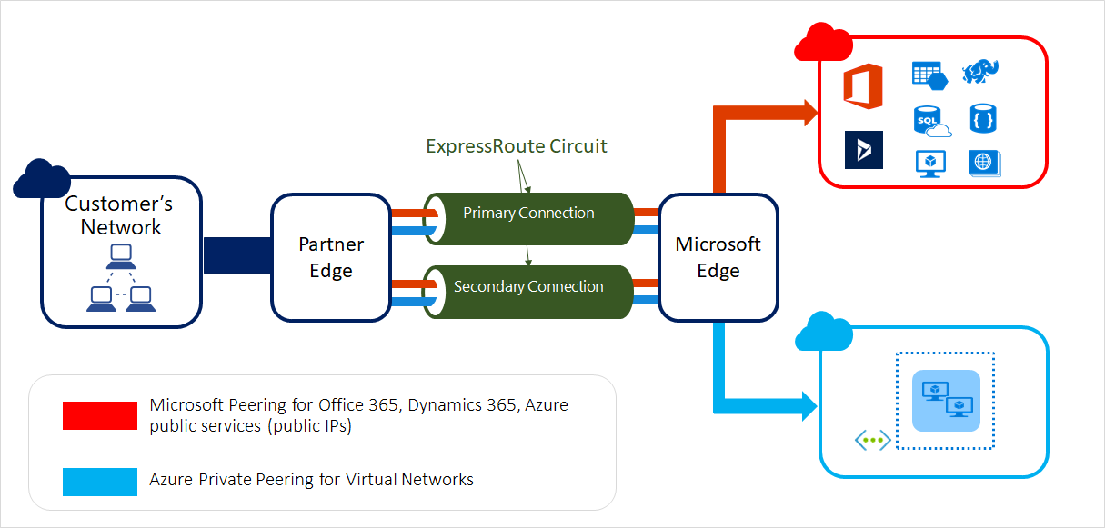
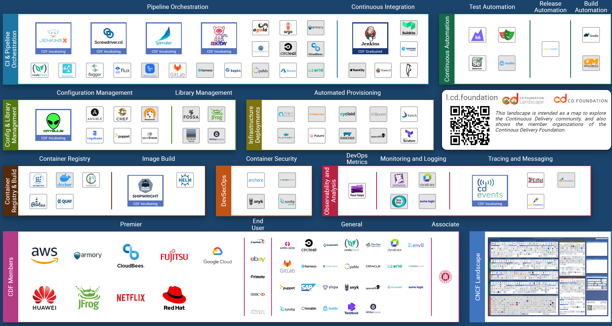
Delivery Approach
The Architecture Evaluation follows a proven, structured approach to deliver clear results, fast.
Approach
Understand the current landscape
Assess the Current Estate
Create
Analysis
Design the Scaffold
Create the Roadmap
Analyse EA vision, strategy and principles
Check Value Propositions , Goals, Objectives
Gather the high level TA artefacts (net, infra, apps)
Create the initial Architecture Summary document
Analyse EA approach and supporting artefacts
Review documenting and modelling processes
Review Reference architectures
Review existing connectivity designs
Identify optimal CSP and usage models
Identify EA gaps for cloud adoption
Analyse current patterns for cloud suitability
Identify TA gaps for cloud adoption
Align Cloud Adoption Framework with Org
Select appropriate adoption strategies
Gather relevant patterns for TA gaps
Select CSP and strategy aligned tooling options
Provide short term & mid term adoption strategies to create an executable roadmap
Strategy optimisation options (like DevOps, PaaS, SaaS etc)
Activities
Deliverables
Notes:
DONE DRAFT

Slide 7
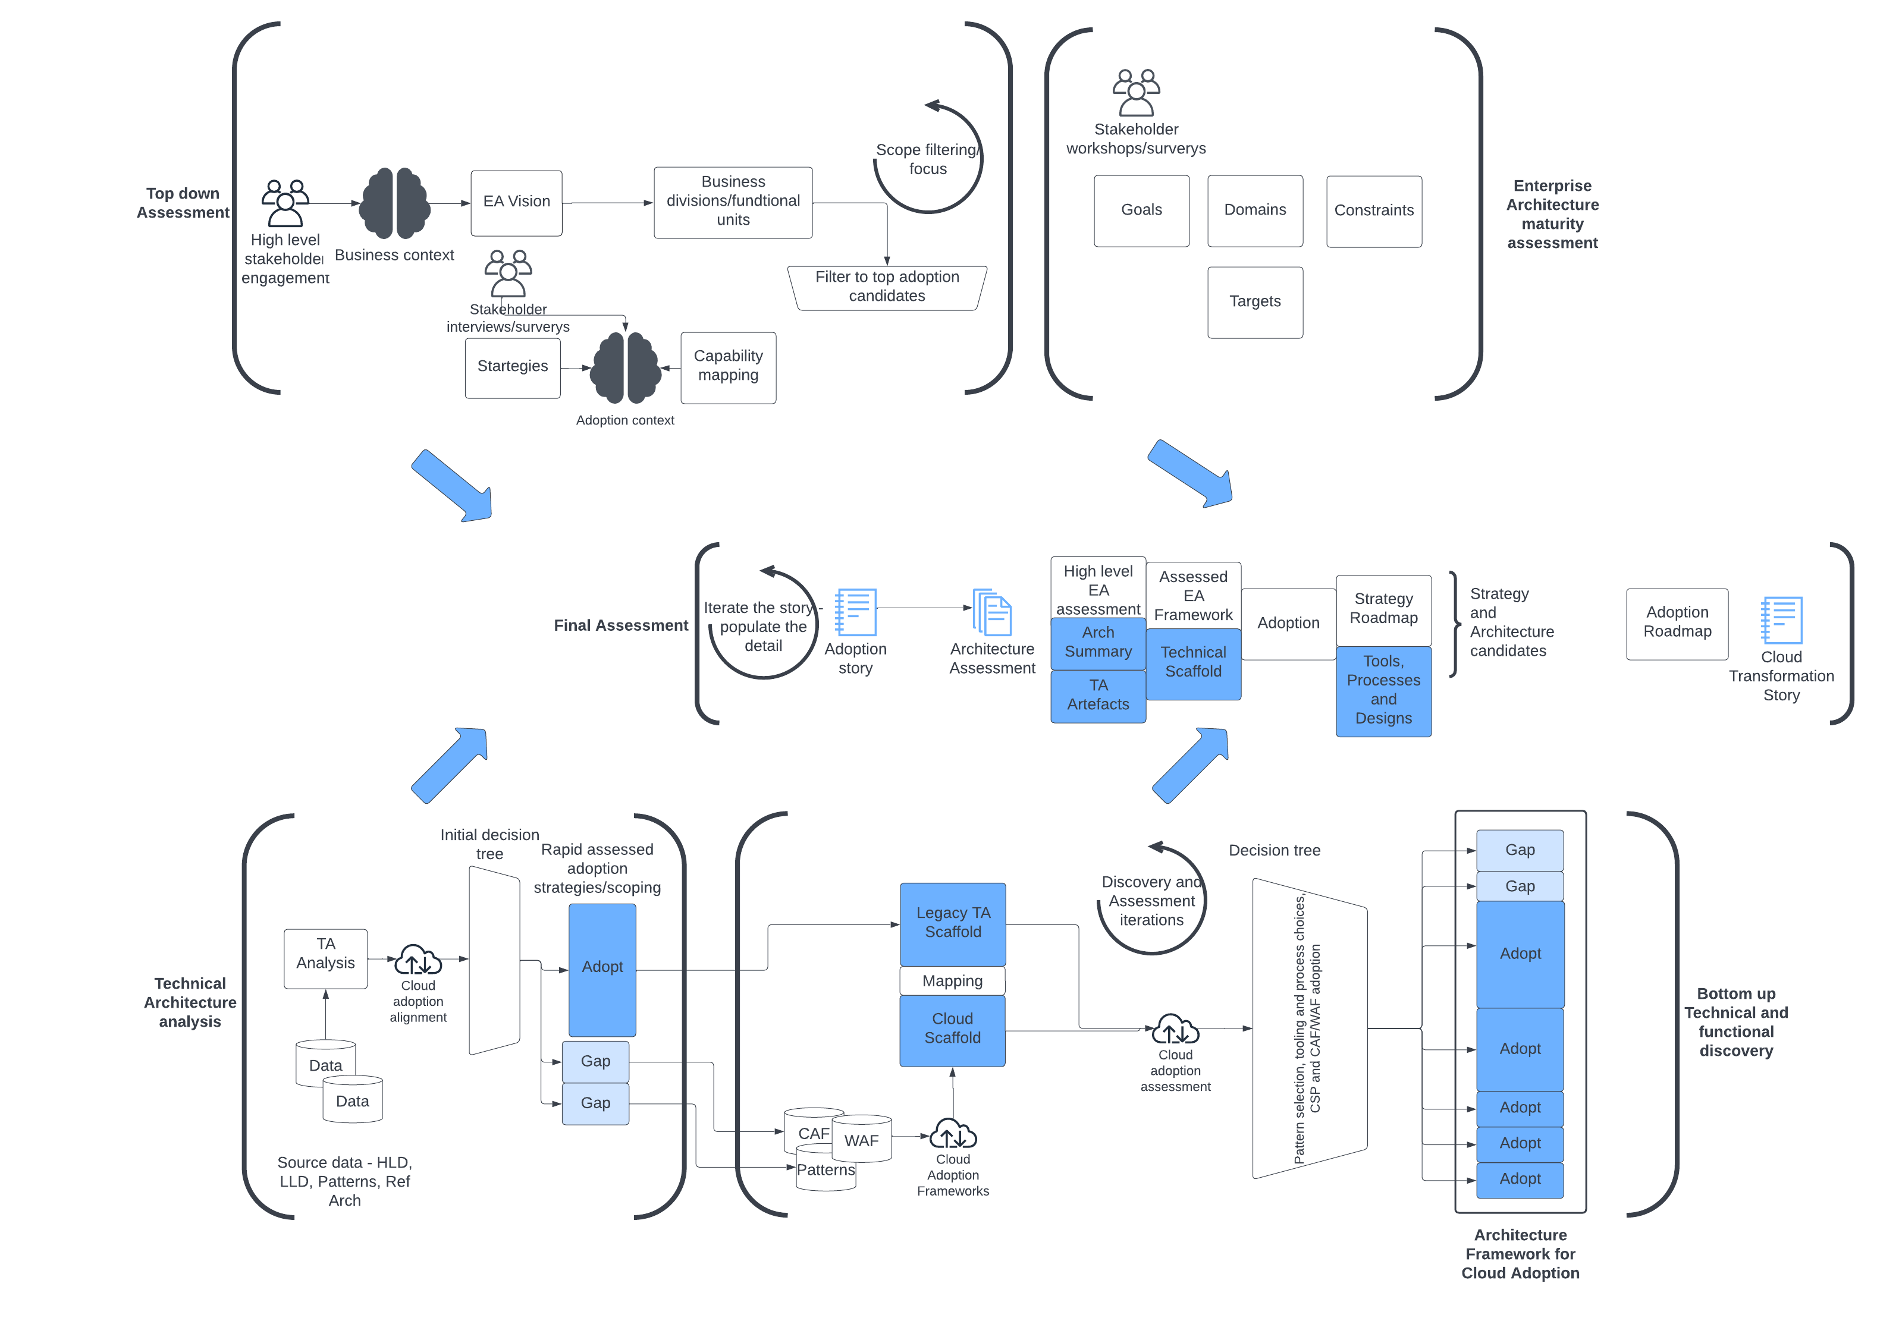
Delivery Process
The evaluation of NHS Trusts follows a multi-stage iterative process to gain an understanding of the EA framework and technical architecture landscape, assessing these to produce the migration strategies and roadmap to be used.
The process starts with rapid discovery and evaluation, a top-down approach taking existing Trust knowledge, determining Trust structure and capabilities, and identifying the most important applications.
A rapid evaluation of the EA maturity is carried out to determine a scope and assess the potential for adoption.
The bottom-up evaluation makes use of technical artefacts to build a view of technical capabilities, and a decision tree assists with mapping current architecture to cloud and best practice frameworks to form an adoption roadmap.
Combining the top-down and bottom-up analysis produces the final Architecture Evaluation report.
Notes:
DONE DRAFT

Slide 8
Delivery Sequence Plan
Initial Vision
Scoping
Strategies and Value
Roadmap
TRUST
PERSPECTIVE
Strategies, Missions
and Value Increment
EA Rapid Discovery
& Evaluation
Scope
Final Value and Roadmap
ENTERPRISE
ARCHITECTURE
EVALUATION
Stakeholder Engagement
Trust Understanding
Evaluation
Increment
TECHNICAL
ARCHITECTURE EVALUATION
TA Discovery & Evaluation
Discovery &
Evaluation
Evaluation and
Gap Analysis
Architecture Evaluation Report
Technical Architect interviews
Notes:
DONE DRAFT

Slide 9
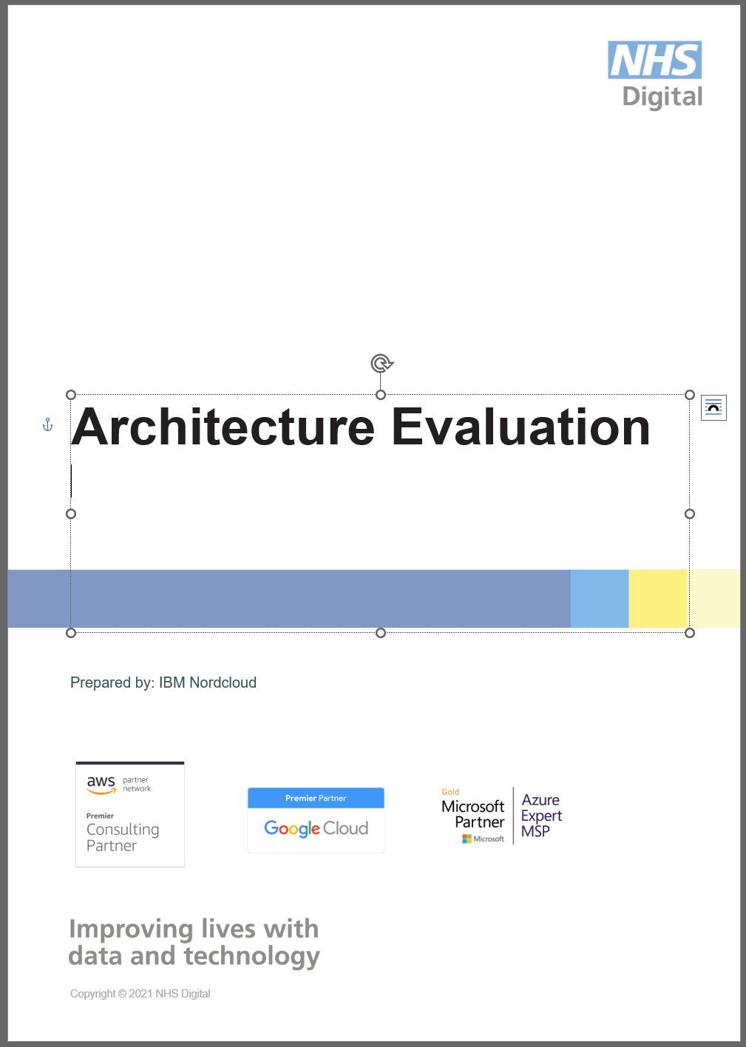

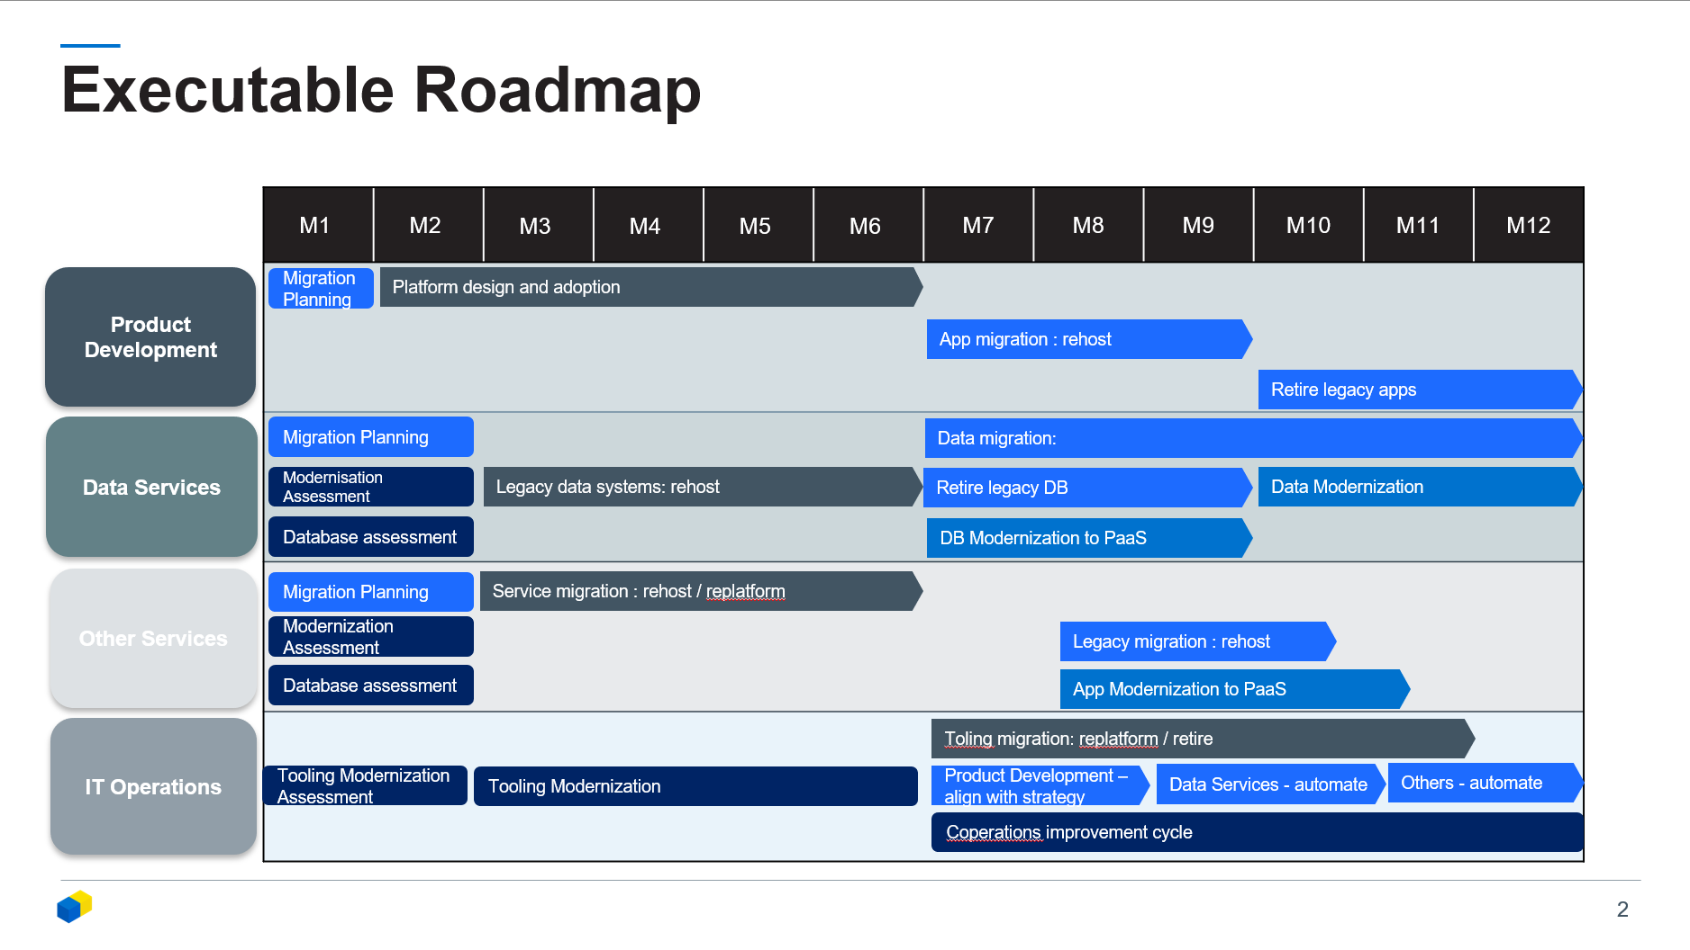
Outputs
The evaluation will produce the following outputs
Overall Architecture Evaluation Report
Technology Selection Document
Architecture Gap Analysis
Architecture Roadmap
Each output is described in the Appendix A - Product Descriptions
Notes:
DONE DRAFT

Slide 10
Proposed team
For a 10 week elapsed engagement, we propose the following team
Role | Responsibilities
Project Manager | Co-ordinate delivery of work to plan. Manage customer expectations.
Lead Architect | Lead strategy planning, EA rapid discovery and evaluation.
Architect | Reference architecture and Architecture Evaluation report.
Architect | Data collection and architectural analysis.
Business Advisory Consultant | Business value case, domain analysis.
Notes:
DONE DRAFT

Slide 11
Risks / Mitigations
Risk | Mitigation
Gaps in understanding on the scope | Hold scoping workshop during mobilisation phase to lock down the scope and expectations for the project.
Delay in artefact and/or artefact repository access | Identify relevant artefact owner/managers who can assist with access and request permission to access at the outset of the project.
Availability of client-side SME’s to provide artefact context, provide guidance and timely feedback. | Outline expectations from the project outset.
Gaps in evaluation and guidance in case of unavailable or incomplete data. | Prepare data inputs in advance of the start of the engagement. The requirements are outlined in this pack.
Non-alignment with customer on the final deliverable/content of the final deliverable | Align on deliverable content, structure and level of detail during mobilisation.
Notes:
DONE DRAFT

Slide 12
Plan Assumptions
The delivery plan, resourcing and cost of this work is based on the following assumptions:
Scope / quantities
The customer will provide the access and artefacts described in the Information Requirement page of this pack at the start of the mobilisation.
Data and access will be provided promptly, or the analysis will be delayed.
There will be clarity around the scope of the evaluation, especially if this differs from the scope in any provided data.
The discovery and evaluation is time bound. Delays will affect what can be produced in the time.
Data quality
In cases where there are gaps in available data, stakeholders must be available to validate assumptions.
There must be a means to map architecture and infrastructure, without this the evaluation may be incomplete.
Data quality must be sufficient for realistic conclusions to be made. Lack of data will require use of assumptions which may affect the final evaluation.
Stakeholder availability
Stakeholders will be available in line with the plan to provide required input for the evaluation, validate findings, progress and recommendations. Without stakeholder involvement assumptions will be made.
Customer SMEs will respond in a timely fashion to allow the evaluation to run at pace.
Product reviews
Draft products will be reviewed within 5 working days from issue.
There will be a common understanding and communication about next steps. This will be essential to maintaining the direction for the evaluation and providing valuable output to the trust
Systems access
Access will be provided and stakeholder commitment given to assist with documentation repositories, any EA or TA tooling.
Deeper analysis may require additional access to systems. The lead time for this will not be long enough to impact the plan.
Software licences
The customer is responsible for providing all necessary software licences. Licence costs are excluded from the cost estimates.
Notes:
DONE DRAFT

Slide 13
Prerequisites

Slide 14
Stakeholder roles
For the evaluation to be successful, the project team will need access to key stakeholders for information and regular dialogue.
Executive Sponsor - Overall Owner
SPoC – Customer Programme Manager with access to key resources and ability to influence
EA Owners – Thorough knowledge of the domains, strategies and values
Architects – Infra, Security and Cloud Architects. Able to contribute in Architecture requirements and Strategy
Business IT Leads – IT liaisons to business. Understanding of Business Value and functional requirements and possible functional overlaps
EA Artefacts / Enterprise Architecture SME – to assist with collection and interpretation of the EA framework.
TA Artefacts / Technical Architecture SME – to assist with collection and interpretation of the TA artefacts.
Notes:
DONE DRAFT

Slide 15
Stakeholder minimum commitment
Successful execution of this work will depend on access to key stakeholders to plan the engagement, discuss findings, take feedback.
Activities | Trust Resources | Estimated Effort [hrs]
Kick-off | Project sponsor Enterprise Architect Technical Architect Infrastructure owner | 1
Data gathering | Artefact Owners (SPoC can coordinate) | 0.5 per artefact owner
Access during artefact and information gathering | Process and repository Owners (SpoC can coordinate) | 3-5 days depending on # of repositories.
Architecture workshops | Enterprise Architect Technical Architect Infratsructure Leads | 2
Adoption Strategy Workshop | Key Architects DC, Infra, Security and Cloud Architects | Multiple 1 hour sessions
Report Presentation | Key Architecture Owners Overall Owners SPoC | 1.5
Notes:
DONE DRAFT

Slide 16
Information requirement
The delivery team require ready access to the following information and systems to conduct the evaluation:
Source | Format / Key Content
Enterprise Architecture Framework documentation | Any readable document format, ideally with context, Archimate modelling
Architectural Principles | Documentation
Technical Architecture designs, HLD, LLD any generic patterns | Visio, Lucid, any readable document
Availability of SME based on Interview schedules | Shared schedule
Existing cloud adoption plans, patterns and designs | Documentation
Current or Planned organisation for Centre of Excellence | Documentation about structure, scope of services offered, development plans.
System Access
Access to Customer / 3rd Party Hosted environments | Provide SME support for direct design review
Access to artefact repositories | Designs, patterns, HLD & LLD documents
Notes:
DONE DRAFT

Slide 17
Appendices

Slide 18
Product Descriptions

Slide 19
Product Descriptions
Overall Architecture Evaluation Report
Purpose | Present the architecture strategy and roadmap. Summarise the analysis and key findings of the Architecture Evaluation.
Composition | Key findings and recommendations Strategy and technology gaps Cloud, tooling and technologies recommendations Business case and risk/benefits Evaluation Methodology Supporting data and commentary
Derivation / Inputs | Inventory data, interviews, validation workshops. Outline report is based on a standard template.
Definition of Done / Quality Criteria | Correct document template Coverage of agreed technical scope Clear and concise summary Actionable roadmap
Review Points | End Week 4 – first draft for review Iteration reviews based on availability of new data. End Week 7 – final draft for review Week 8 – stakeholder presentation
Reviewers | Executive sponsor, Architects, Programme Manager
Approver | Customer Programme Manager
Architecture Gap Analysis
Purpose | Identification and measurement of the as-is vs. to-be states.
Composition | EA vision, domains, strategies and missions against cloud best practice Technical capabilities delivering against service or a target operating model File format: Powerpoint.
Derivation / Inputs | The evaluation makes use of workshop inputs and reviewed architecture artefacts
Definition of Done / Quality Criteria | Coverage of analysis aligns with agreed scope.
Review Points | End Week 4 – first draft for review End Week 6 – final draft for review Week 7 – Finalise for issue
Reviewers | Architects, Domain Owners
Approver | Lead Architect, Enterprise, Technical or both
Notes:
DONE DRAFT

Slide 20
Product Descriptions
Technology Selection Document
Purpose | Summarises the recommended cloud service provider (CSP), Cloud Adoption Framework (CAF), any relevant best practice frameworks (Well Architected Framework for example). LZ design selection if appropriate. Support this with alignment guidance and appropriate tooling selection recommendations.
Composition | An aggregation document of the recommended available best practices in adoption, architecture, tooling and design presented as a few pages of options, selection criteria, selection and linked information.
Derivation / Inputs | Desired state from the initial architectural reviews and workshops, gap analysis to provide areas to be filled by cloud best practice material.
Definition of Done / Quality Criteria | Agreed, documented selection of: cloud service provider, adoption framework, and operating tooling .
Review Points | End Week 6 – first draft for review End Week 7 – final draft for review Week 8 – stakeholder presentation and issue.
Reviewers | Architects
Approver | Lead Cloud Architect
Architecture Roadmap
Purpose | Phase-wise sequence of design activities over time to aid understanding of timescale and effort required to attain desired adoption velocity.
Composition | One page view of indicative architecture plan. Up to a maximum of three different scenarios.
Derivation / Inputs | Architecture strategy; architecture gap analysis derived from analysis of IT architecture and infrastructure. Planned CSP, CAF and tooling implementation priorities.
Definition of Done / Quality Criteria | Roadmap covers identified gaps and defines architectural focus to increase adoption.
Review Points | End Week 6 – first draft for review End Week 7 – final draft for review Week 8 – stakeholder presentation and issue.
Reviewers | Executive sponsor, Architects, Programme Manager
Approver | Customer Programme Manager
Notes:
DONE DRAFT

Slide 21
Workshop Agendas

Slide 22
One-Off Workshop Agendas
Mobilisation Meeting
Purpose | Identify stakeholders Align on the delivery approach and expectations Ensure mobilisation of stakeholders and understanding of pre-requisites.
Attendees | Executive Sponsor, Customer Programme Manager, Cloud Architect
Agenda Topics | Current cloud context – technology, organisation, CCoE Objectives and success criteria Delivery approach Stakeholder mapping Data sources – e.g. architecture artefact repositories, EA models, designs, patterns SME’s Progress reporting Deliverable reviews
Outputs | Outstanding project requirements assigned to customer team members. Delivery plan outline agreed.
Inputs | Organisation chart Evaluation pre-requisites
Duration | 2 hours
Timing | Week -3
Scoping Workshop (similar form for EA, TA)
Purpose | Define the scope of the evaluation in terms of: Functional areas / business and technical capablities Physical / logical partitions (i.e. specific datacentre or network zones) Identify where the architecture evaluation should be out of scope (legacy DC for example)
Attendees | Executive Sponsor, Customer Programme Manager, Cloud Architect, Artefact owners / Business IT Leads, Architecture leads.
Agenda Topics | EA framework or Technical Architecture blueprints, Physical layout, Logical layout Existing cloud platforms Identity constraints and opportunities Agree scope
Outputs | Scope statement for project charter
Inputs | Data sources identified in Week -3 Mobilisation SME knowledge
Duration | 2 hours
Timing | Week 2
Notes:
DONE DRAFT

Slide 23
One-Off Workshop Agendas
Architecture Artefact Owner Interviews
Purpose | To identify further context and information about specific artefacts
Attendees | Artefact owners, Architects, Business IT Leads
Agenda Topics | Deep dive into: Architecture Dependencies and capabilities Identification of missing data and data completion
Outputs | Additional context and data completion for gap analysis, framework selection and roadmap
Inputs | Artefacts SME knowledge
Duration | 2 hours
Timing | Week 3 onwards
Final presentation of findings
 | To show the final strategy, migration roadmap and business case
 | Executive Sponsor, Customer Programme Manager
 | Review key findings, final architecture strategy, adoption roadmap, technology and tooling selections
 | Final Architecture Evaluation comments
 | Final Architecture Evaluation
 | 1 hour
 | Week 7/8
Notes:
DONE DRAFT

Slide 24
Repeating Workshop Agendas
Interim Findings/Architectural Approach Workshop
Purpose | To show incremental findings and validate direction of the evaluation
Attendees | Executive Sponsor, Customer Programme Manager, key artefact owners, Architects
Agenda Topics | Review incremental findings
Outputs | Interim findings review and comments
Inputs | Interim evaluation
Duration | Multiple 1 hour sessions
Timing | Week 2 onwards. Every 2 weeks, expect 2 sessions min. in the week
Notes:
DONE DRAFT

Slide 25
Example Summary Report

Slide 26
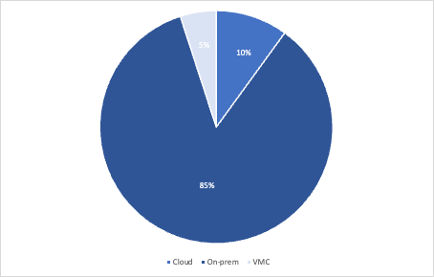
Workload Evaluation
NHS Trust
Goals and drivers
NHS Trust are just starting on the public cloud.
The majority of their application portfolio (85%) Run on-premise. 5% are cloud native and 10% on VMware on AWS (VMC)
NHS Trust are interested in determining the migration strategies and roadmap for the remaining on-premise applications
The Architecture Evaluation must demonstrate the strategies and roadmap to produce a successful cloud migration
2 Business units within NHS Trust are considered
To follow the NHS public cloud first principle
To migrate all on-premise applications to cloud
To enable the close down of the trusts data centre
To modernise applications to take full advantage of cost savings and cloud service benefits
Trust Services
Cloud Skeptic. 150 applications to migrate. Trust Services are not convinced about migration
Trust Operations
Cloud Inspired. Keen to move to cloud to reduce the burden on operational management.
Already run some tooling on Cloud
Infrastructure inventory

Slide 27
Migration Strategy and Potential Roadmap
Benefits and TCO
Completing the on-premise migration to cloud could provide $2 - $3 million in hosting cost savings over 5 years
The migration cost will be in the region of $600,000 for on-premise migration
100% cloud native Trust Services
Lots of opportunity for Trust operations to consolidate tooling
Modernisation of Trust Services
Migrate Trust Services
Over 2 years migrate trust services.
Long term
Work on modernisation of trust services to take full advantage of the cloud
Infrastructure inventory
Short term
Over 12 months migrate the majority of Trust Operations to Cloud. Skill up Operations staff on Cloud operations
Close Data Center
Migrate the final set of trust operations tools and close down the data center.
Trust Services
A plan to make Trust Services cloud native.
Some migration to VMC
5 waves across 18 months to move from on-premise, consist of hospital admissions, nursing management and a general group. Majority of rehosting.
Trust Operations
12 months to migrate Trust Operations tools and applications to cloud.
6 months to migrate and retire the final set of tools after trust services have completed their migration

Slide 28
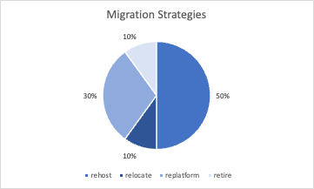
The numbers
Application inventory
Application Location
Infrastructure inventory
320 In-Scope Applications, data enhanced with assumptions, manual analysis and mapping of additional data sources
Business Units mapped and used in the analysis. There are 2 primary business units.
There are 1052 servers in scope
On the servers there are 34% running out of support OS versions
There are 256 servers with SQL Server Database.
Application inventory
Location | % of total applications | Y1 | Y2
Cloud native | 5% | 50% | 80%
VMC | 10% | 20% | 20%
On-premise | 85% | 30% | 0%
Infrastructure inventory
Application inventory
Where rehost describes a lift and shift to cloud native IaaS.

