Slide 1
NHS Digital API Platform
An overview for API producer teams
Tony Heap
Product Owner, API Management

Slide 2
Agenda
API platform
  Vision, mission, goals and principles
  Features
  Benefits

Slide 3
NHS Digital Platforms vision
We believe in the potential of digital technologies to rapidly improve health and care services.
By unlocking the capabilities of our platforms and developing open standards and APIs, we can create an environment for digital innovation to thrive.
That means more digital services designed around the needs of our health and care professionals, patients and public.
Services that offer simple and speedy access to the information and data that matters, whenever and wherever it’s needed.
Cost effective, sustainable solutions that improve investment value, accelerating the digital transformation of the NHS.

Slide 4
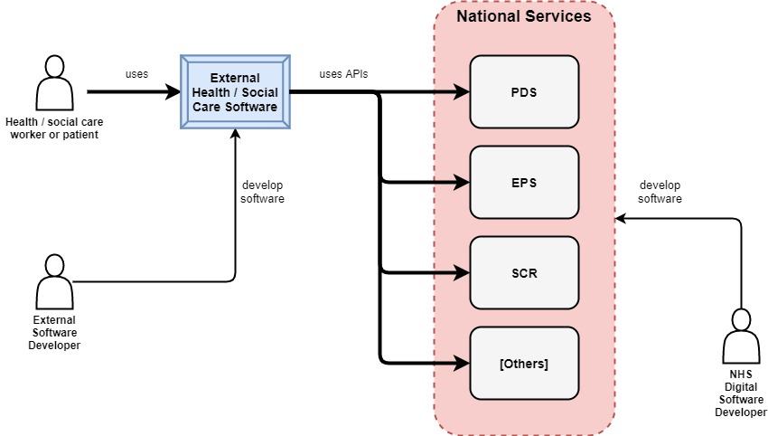
Context – national services

Slide 5
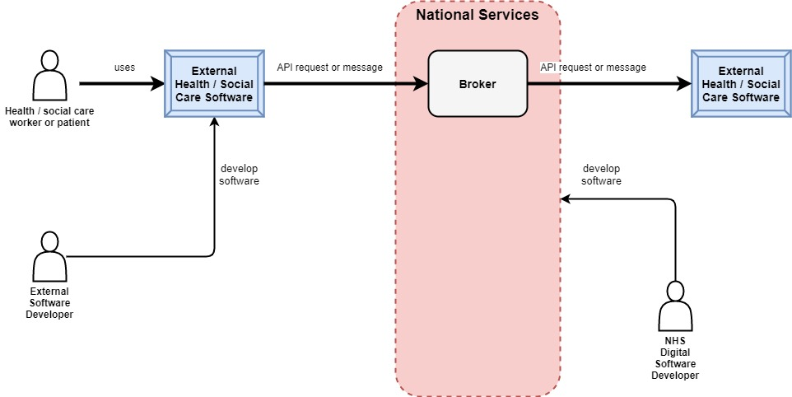
Context – peer-to-peer

Slide 6
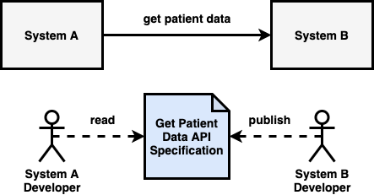
Context – standards

Slide 7
Types of software
GP software
Trust software
NHS App
clinicians
smartcard
clinicians
unattended use
smartcard
patients
NHS login
Pharmacy software
pharmacists
smartcard
Social care software
care workers
out in the field
Disruptive software
for patients

Slide 8
Users and needs
External software developers
Understand API delivery lifecycle
Have a platform to build on
Internal software developers
Coders
Testers
Product Owners
Read spec
Test code
Learn how testing works
System test
Learn how to integrate
Learn about APIs
Understand API capabilities
Understand auth
Get help and support
Get help and support
Managers
Learn how assurance works
Register apps
Understand end-to-end process
Also see https://confluence.digital.nhs.uk/display/APM/Users+and+journeys

Slide 9
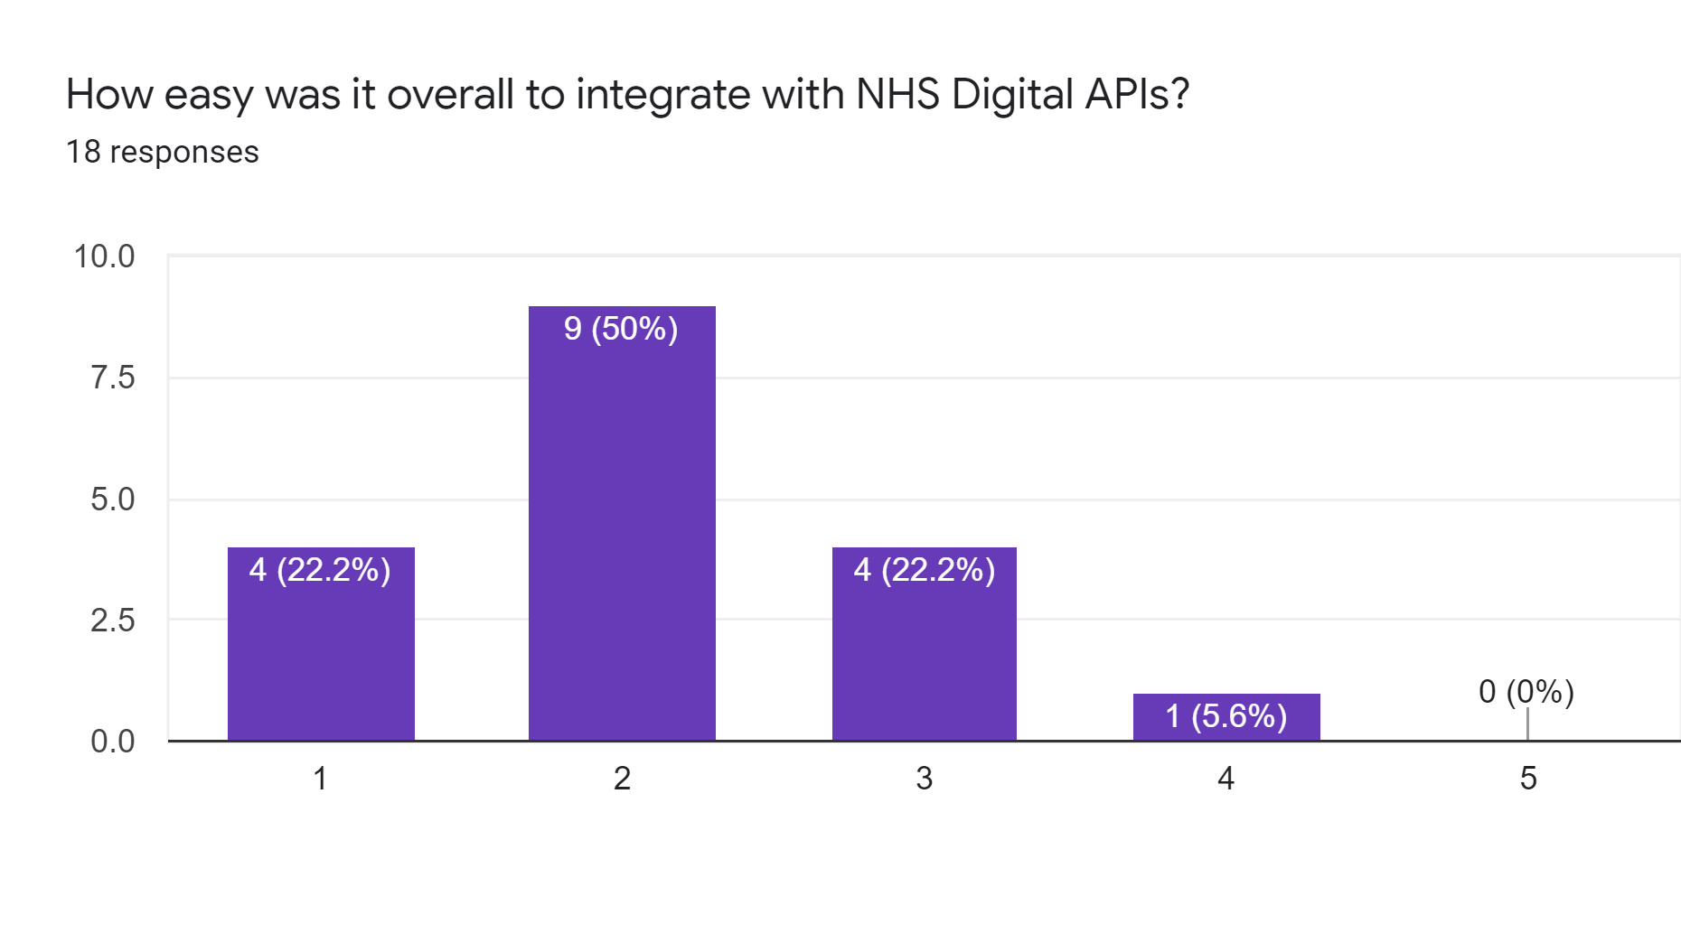
Problem space
“we decided not to proceed with the project”
“too protracted”
“i think the biggest pain was getting set up in the first place”
“we've never assumed integration would be easy ... but we've found it consistently harder than it should be”
Developer integration survey Jan 2020

Slide 10
Pain points
Learning
Design and build
Testing
Onboarding
Help and support
Docs hard to find
Unclear
Incomplete
Inconsistent
Complex APIs
Security hard
Environments not internet-facing
Test suites have issues
Bugs
Protracted
Slow
Complex
Slow
Relies on heroes
No single point of contact

Slide 11
Our mission
Make integration easier
…for everyone – both external and internal
…with a one-stop API Platform
…that is modern, industry best-practice and value for money
“Make it world class”

Slide 12
Goals
For external developers:
  Make learning easier
  Make design and build easier
  Make testing easier
  Make onboarding easier
  Make help and support easier
For internal developers:
  Make building APIs easier

Slide 13
Principles
Make learning easier
Make design and build easier
Make testing easier
Make onboarding easier
Make help and support easier
Our API documentation:
Our APIs:
Testing our APIs:
Our API onboarding process:
Our help and support:
Make building APIs easier
Building APIs on our platform is:
General principles
Follow GDS agile delivery process (for APIs)
is online (self serve)
is easy to find
is easy to understand
is a single source of truth
is accessible
supports different learning styles e.g. visual / non-verbal
includes frictionless feedback channels
Developers can “learn by doing”:
step-by-step tutorials
“try it now” sandboxes
are as simple to use as possible
are internet-facing
use open standards, where appropriate
REST, FHIR, OAuth 2.0
Clinical information standards – SNOMED CT, dm+d, ICD, OPCS, UTL
use NHS Identity and NHS login for authentication
is self-service, where possible
includes easy-to-use sandboxes
is well documented (see “make learning easier”)
is as simple as possible
only requires developers to do things that are needed
protects clinical safety, security, IG etc
is as self-serve as possible
see “make learning easier”
starts from a single point of contact
is fully embedded within our product teams
in the cloud
self-serve
and as painless as possible (not at expense of API consumers)
quick start but also flexible/customisable
structured
with a well-defined API delivery process
backed up by support from the APIM tribe
Governed - but lightly
Discovery, alpha, beta
Get feedback and iterate
Measure success
Measure things
Ask developers to rate us
Do the hard work to make it simple

Slide 14
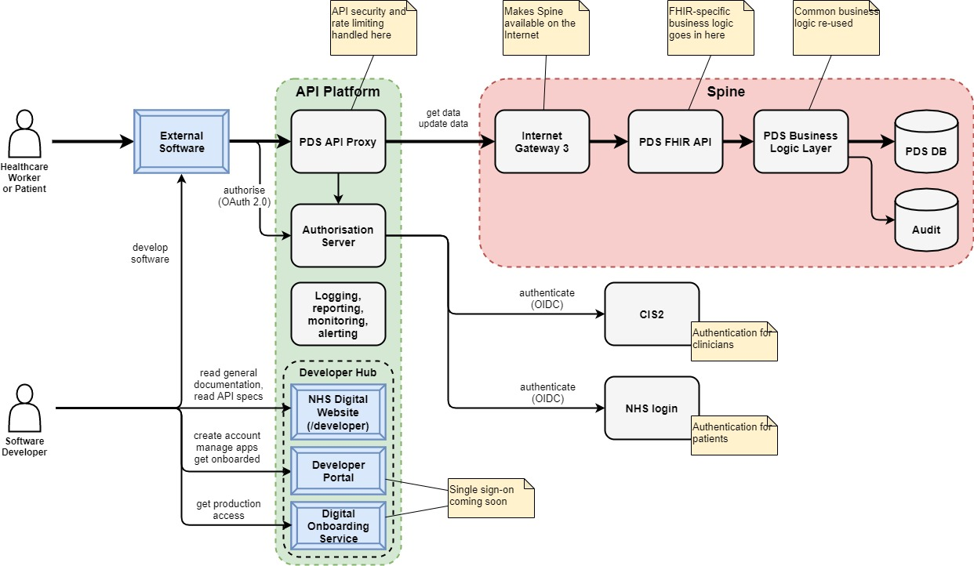
The product

Slide 15
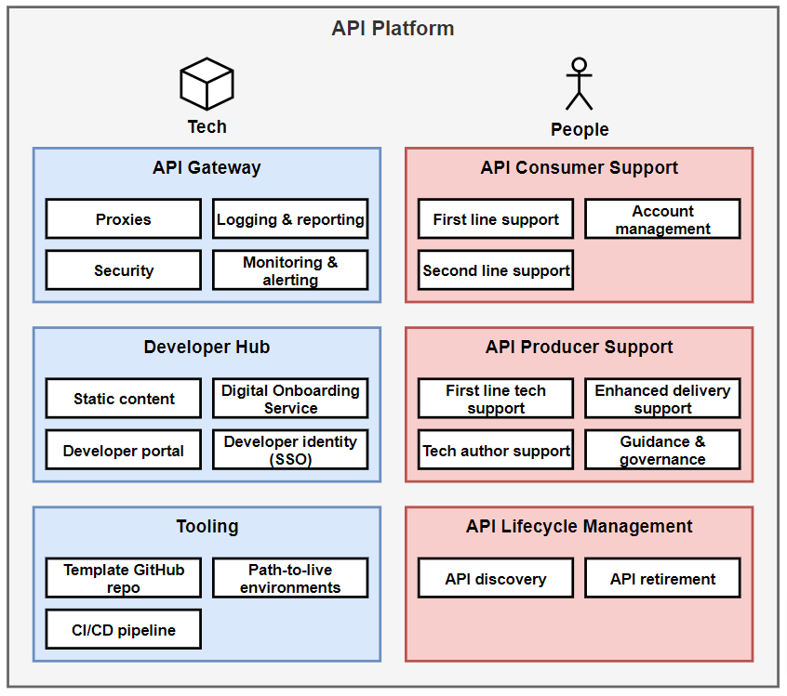
The service
For more details, see https://nhsd-confluence.digital.nhs.uk/display/APM/Product+overview

Slide 16
Is the API platform right for me?
Yes, if:
  You want to build (or migrate) an API
    Use discovery to confirm an API is appropriate
    Refer to the Integration Patterns Book
  AND your API is for external use
    Not if the only consumer will be your own software
No, if:
  Your API is for internal use only

Slide 17
Features and benefits – for API consumers

Slide 18
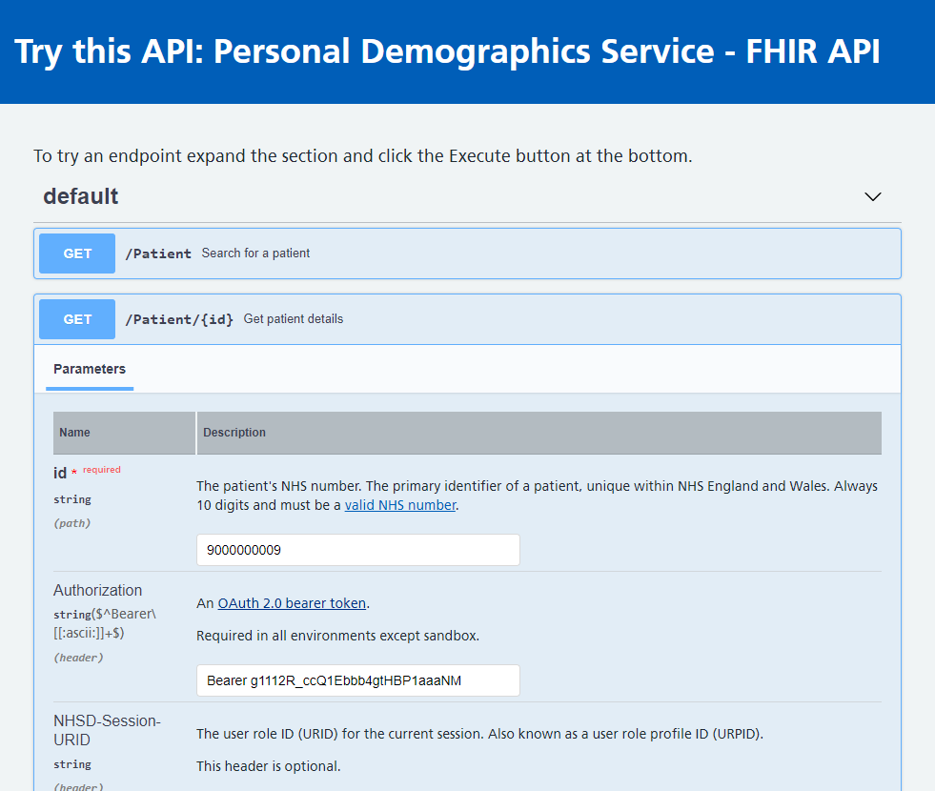
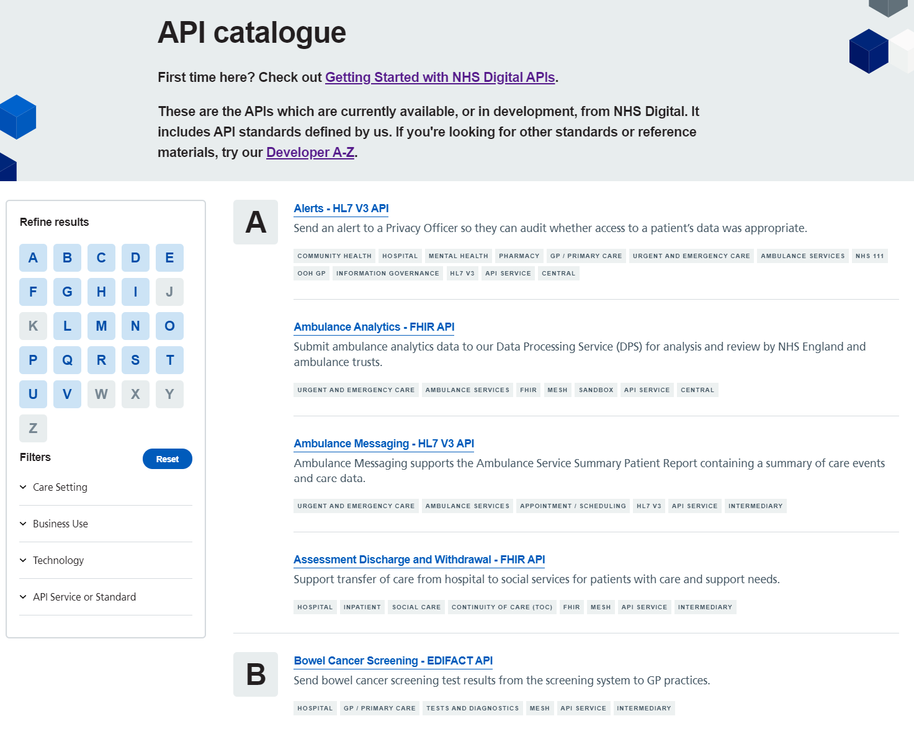

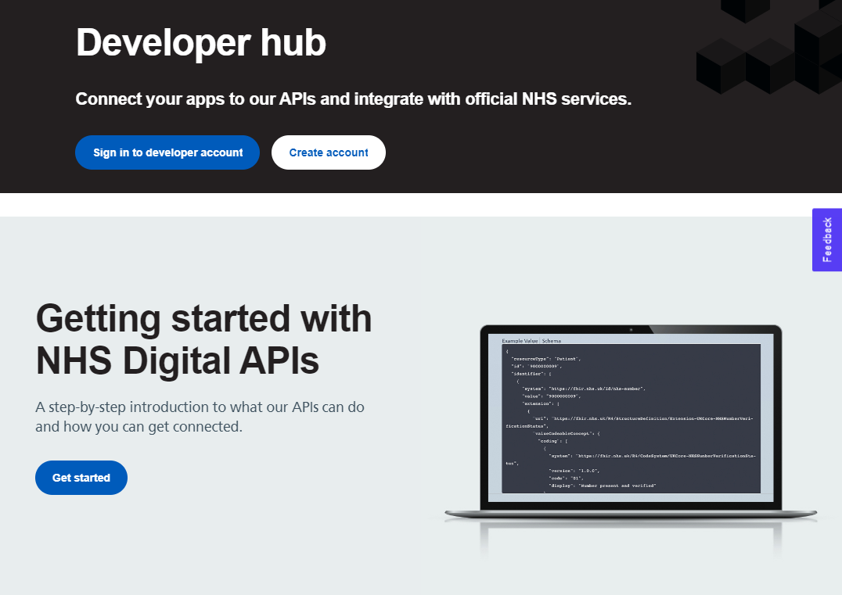
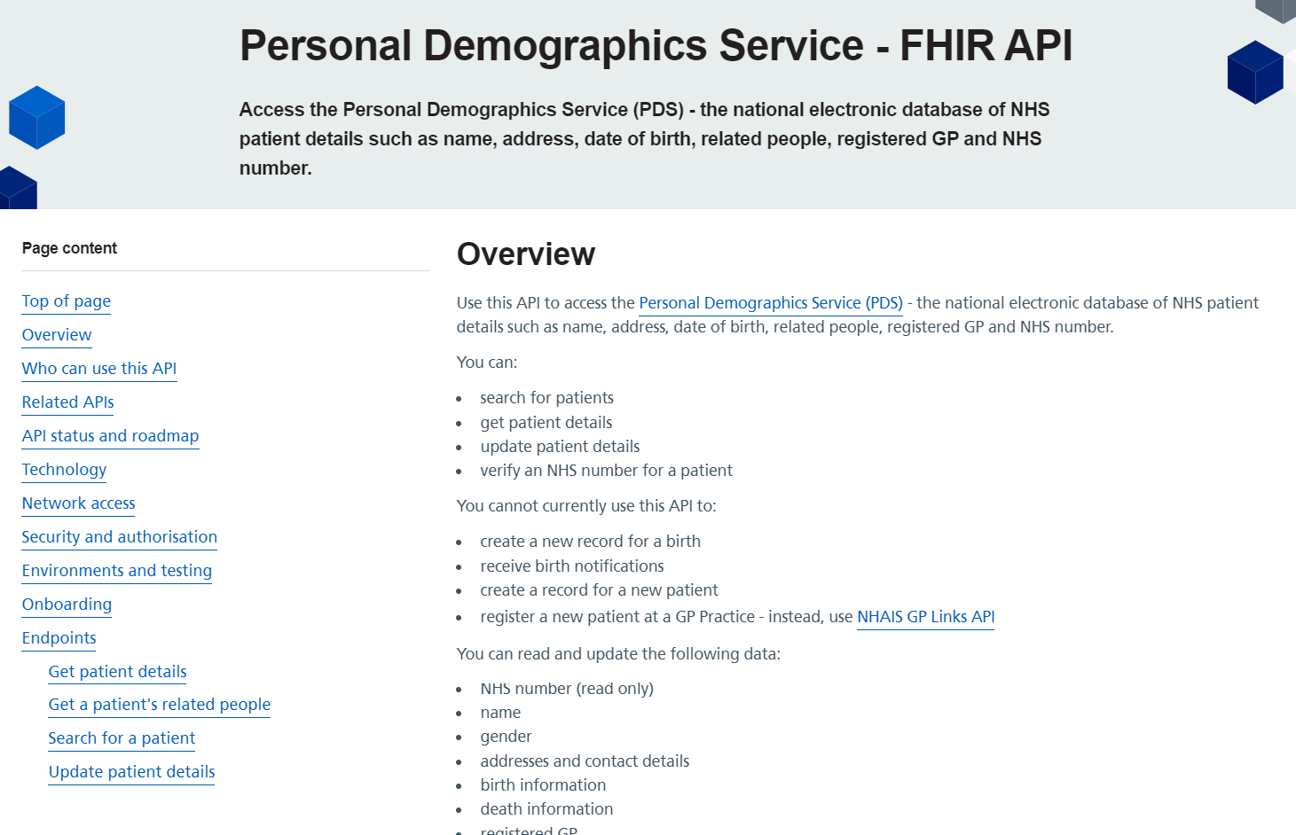
API consumer documentation
API catalogue:
All APIs (old and new)
API standards
Filter & search
Try this API:
Real-time sandbox access
Home page:
Get started
Catalogue
Guides
Access account
Vision & roadmap
Help & support
In-page feedback
Spec page:
Rendered from OAS
Plain English guidance
Endpoint specs
Examples
Schemas
“Try this API”
https://digital.nhs.uk/developer

Slide 19
API consumer documentation
Clear, consistent, modern, accessible
Discoverable
Easy to write
  Auto-generated (from OAS & JSON schema)
Includes “Try this API”
In-page feedback
Tech author support from API Management team

Slide 20
API tech
Internet-facing
Modern API standards
  REST, FHIR, OAuth 2.0
Consistent

Slide 21
API consumer testing
Self-service test environments
Sandbox for early development and test
  Stubbed responses
  Tightly coupled to API spec

Slide 22
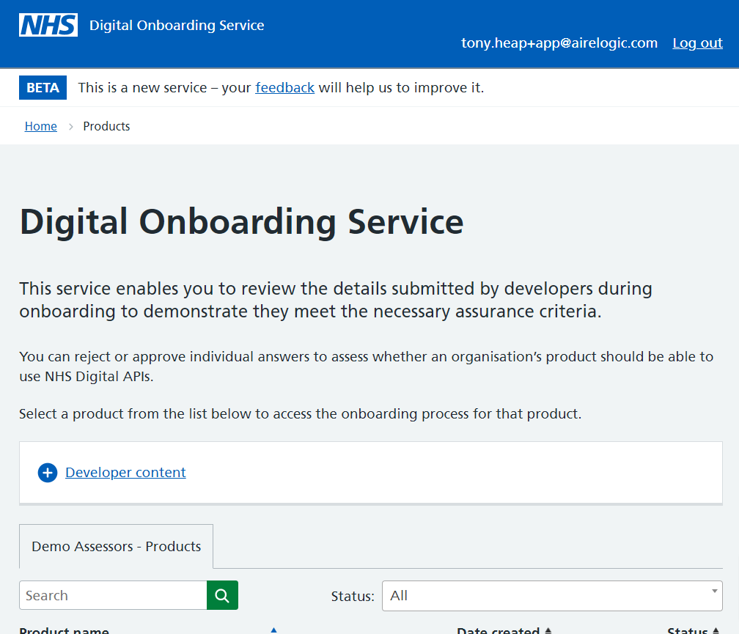
Onboarding
Digital onboarding service
  Easy to use
  Well-explained
  Progress transparent
  Process streamlined

Slide 23
Features and benefits – for API producers

Slide 24
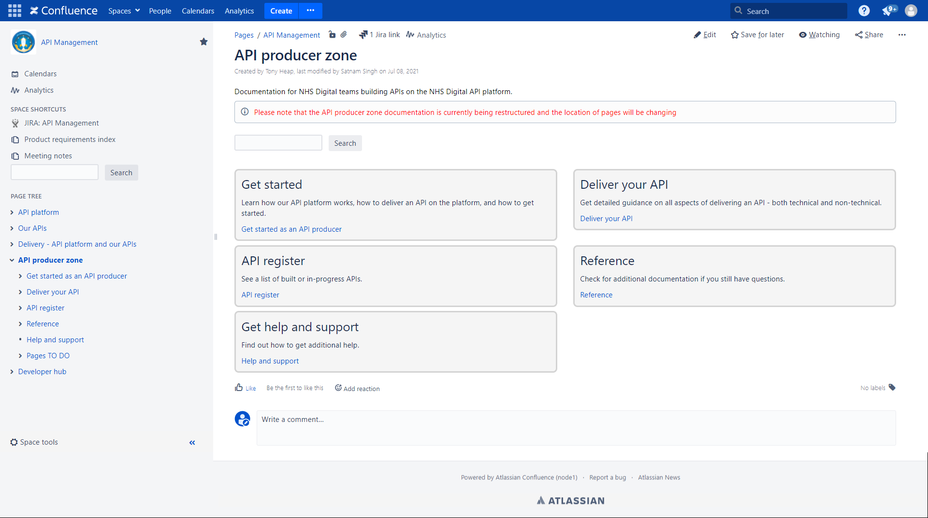
API producer guidance
API producer zone
Self-service guidance
In NHSD Confluence
Open access
  for NHSD people
https://nhsd-confluence.digital.nhs.uk/display/APM/API+producer+zone

Slide 25
API delivery process
All APIs will be built to the API Delivery Process
  Inception
  Discovery
  Alpha
  Beta
The APIM tribe will provide “light touch” governance
  Including stage quality gates

Slide 26
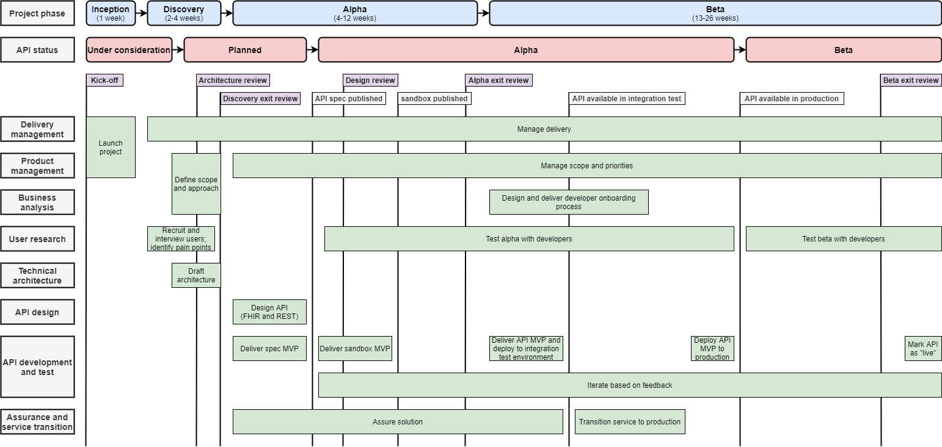
API delivery process – more detail

Slide 27
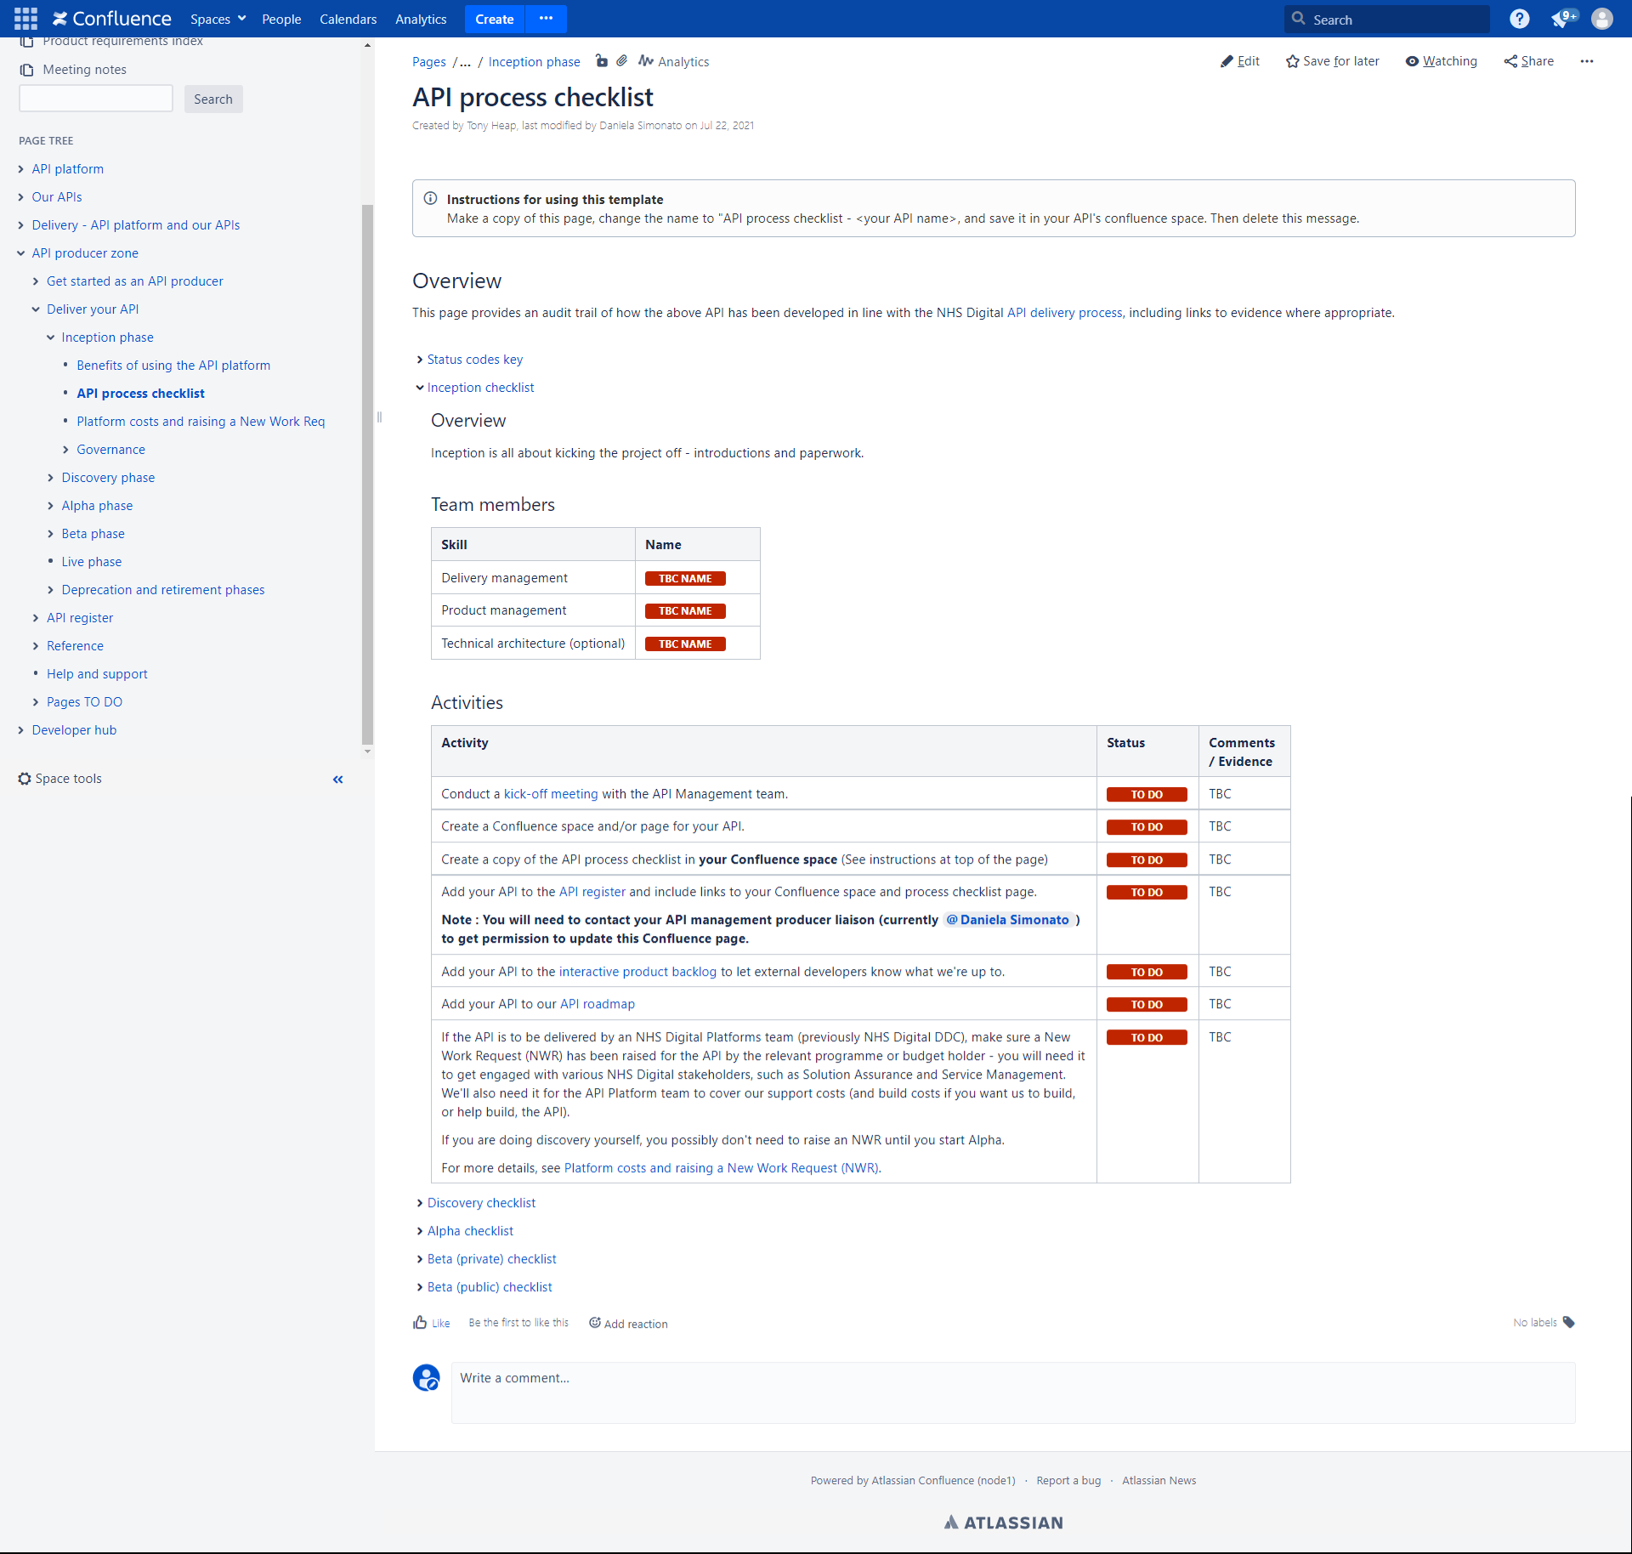
API process checklist
Step-by-step guide
Track progress as you go
Feeds directly into our quality gates

Slide 28
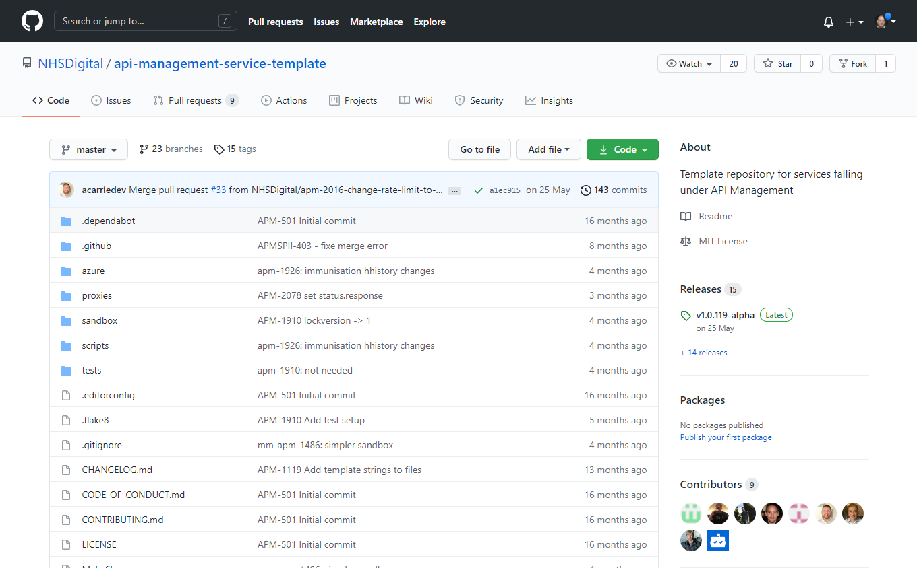
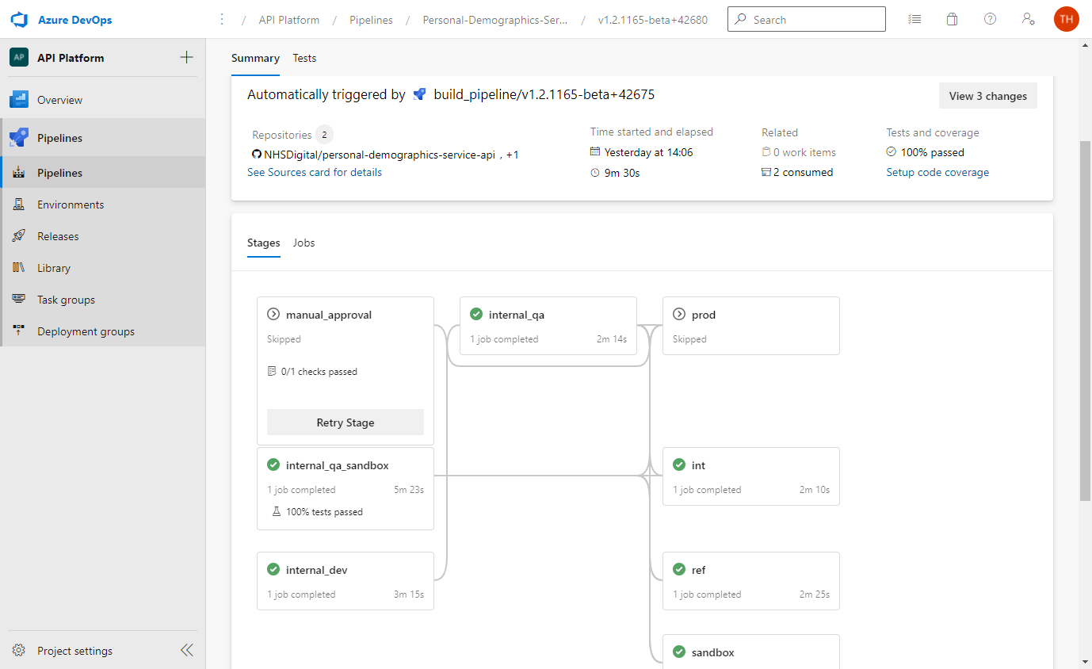
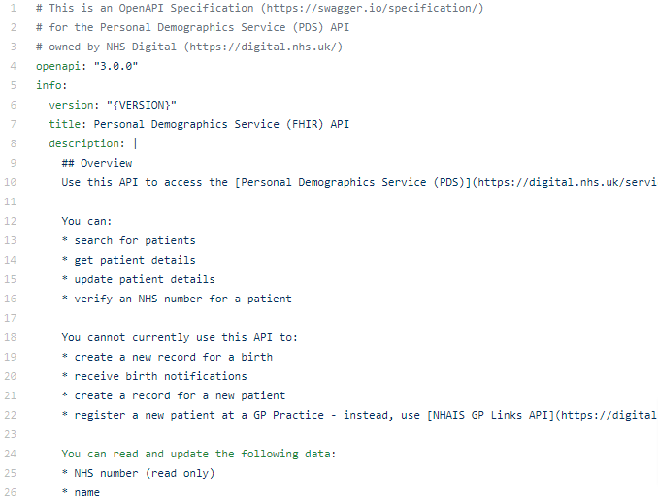
Source code, CI/CD, environments
Template GitHub repo for source code
Path-to-live environments and CI/CD pipeline
API spec easy to create using OAS
OAS file
GitHub repo
Azure DevOps for CI-CD

Slide 29
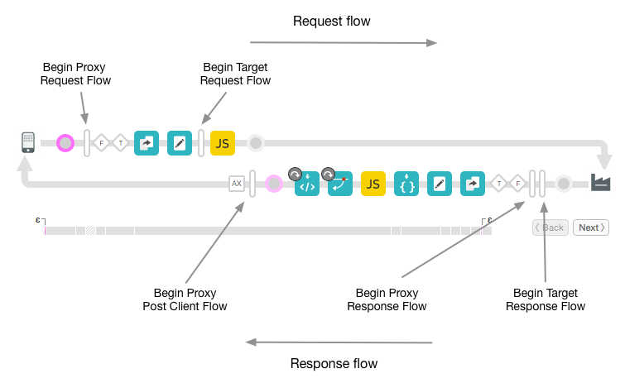
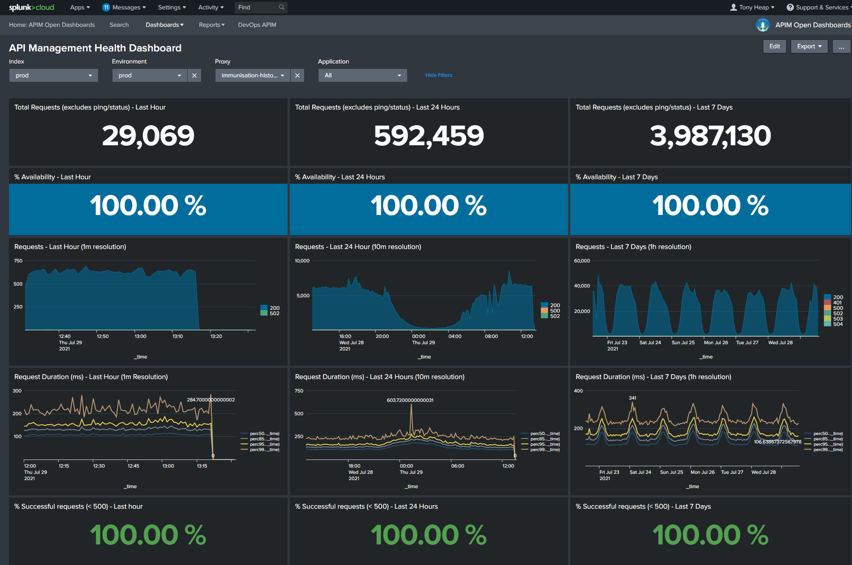
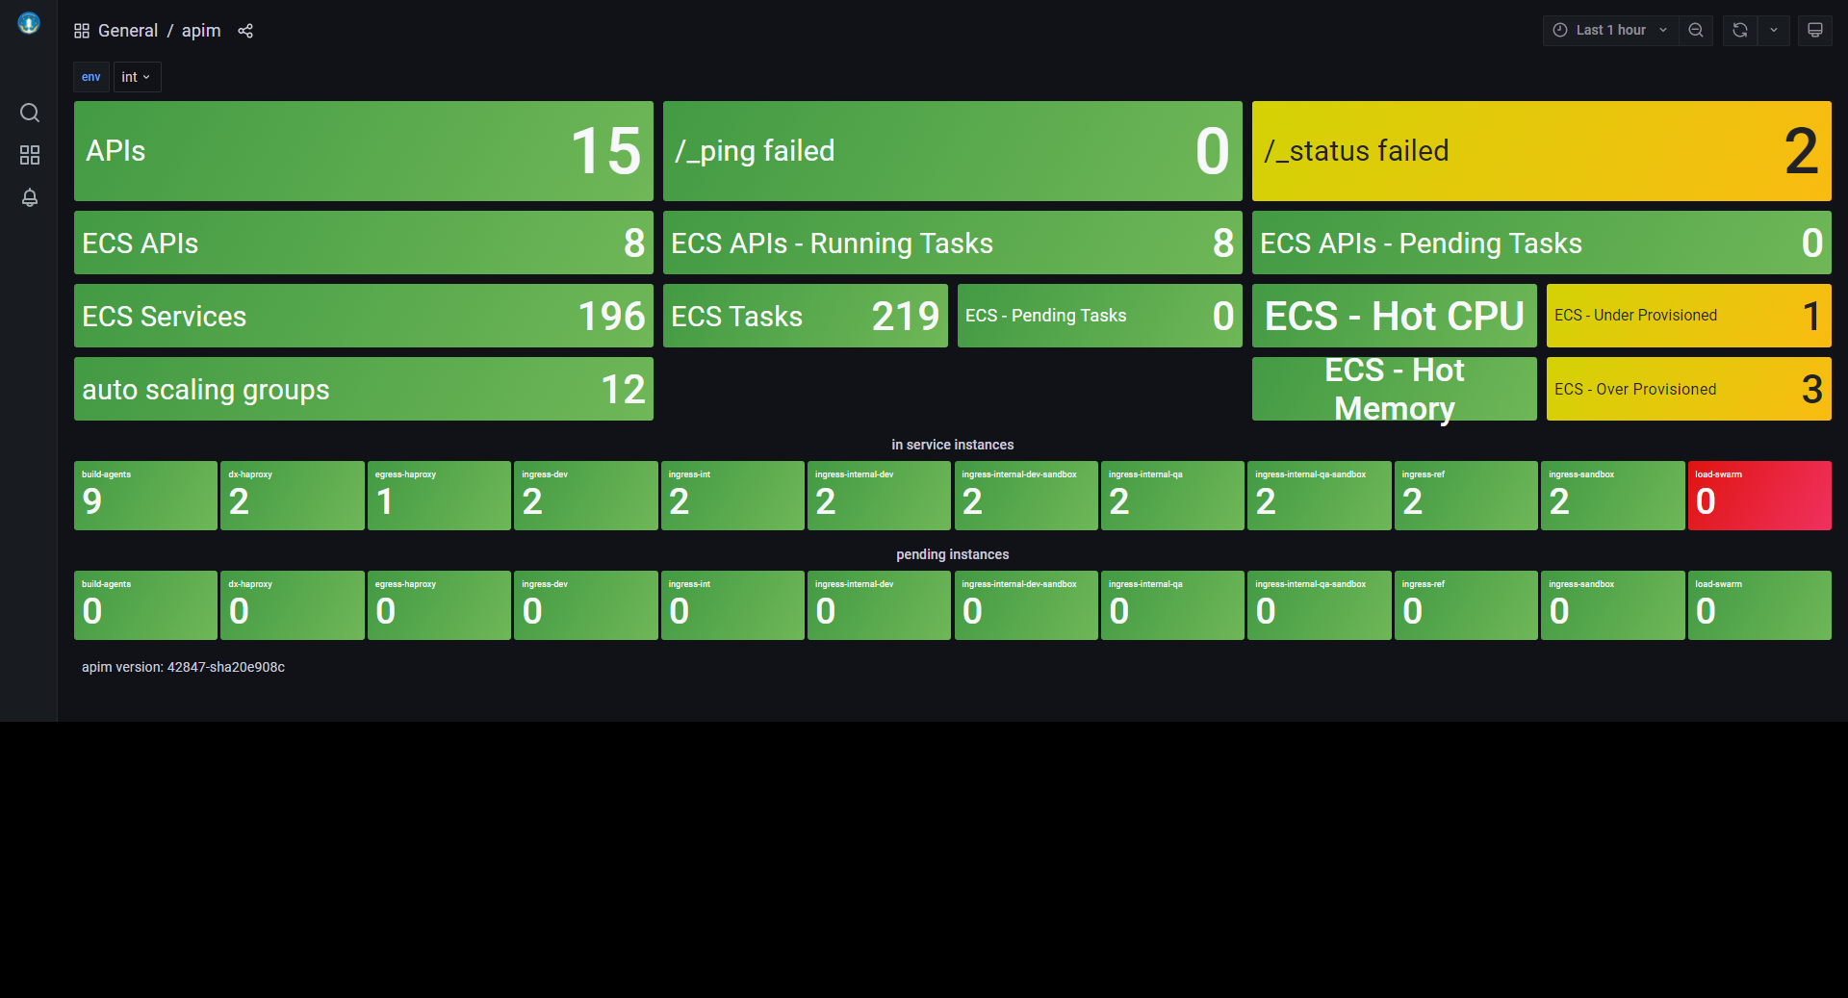
Plug-n-play capabilities
Security
  including NHS CIS2 and NHS login
Logging and analytics
Monitoring and alerting
Rate limiting

Slide 30
Other features for API producers
Reduced assurance burden
  APIs have more security & data validation baked in
Help and support from API Management
  Tech and non-tech

Slide 31
Next steps
Learn more:
  https://nhsd-confluence.digital.nhs.uk/display/APM/API+producer+zone
Engage:
  Arrange kick-off session

