Slide 1
CancerStats 2: Overview of available statistics
Last updated: September 2022

Slide 2
Introduction to CancerStats 2 (CS2)

Slide 3
Introduction to CancerStats 2
CancerStats 2 is the main platform for CancerStats data available to logged in users
Only Incidence and Mortality data remains on CancerStats 1, whereas CancerStats 2 contains Prevalence data, as well as a wide range of bespoke reports
It allows trusts to view reports based on the data they send into NCRAS and compare their data nationally, locally and internally
It helps cancer services identify data issues and any areas that can be improved
MDTs can view trends in the data sent for their site
CCGs & Alliances can monitor their regional conformance and data quality
For this presentation we have used London (or a geography in London) as an example

Slide 4
Accessing CancerStats 2
Requires an N3 connection to access the website
To sign up please click here: Create new account | CancerStats (ndrs.nhs.uk)
It is best to use Google Chrome, Mozilla Firefox or Microsoft Edge with CancerStats 2
Users must adhere to information governance rules to protect patient identification if onwards sharing CancerStats data involving small numbers.

Slide 5
The different data levels of CancerStats 2
Level 1 – operational feedback
Tables that show if NCRAS has received the correct data, in the correct format and within the timescales for NHS trusts.
Level 2 – raw data feedback
Reports of basic record counts that are regularly updated with new submissions. They are utilised by the NCRAS Registration teams.
Rapid Cancer Registration Dataset (RCRD)
Primarily based on submissions to Cancer Outcomes and Services Dataset (COSD) but incorporates other datasets e.g. Cancer Wating Times. Designed to be a faster version of Level 3 data but may miss or falsely report some of the newly diagnosed cancers because of data quality and completeness limitations. There is a monthly quality report available.

Slide 6
The different data levels of CancerStats 2
Level 3 – more comprehensive and time-lagged version of RCRD
Includes different datasets produced by the NCRAS Registration Teams that are linked together at patient pathway and tumour level (of which patients may have multiple). The data is from many different feeds of information from NHS trusts. Most of the reports have been quality assured by the Registration team; usually biannually, but the national audits are done annually.
Level 2 data shouldn’t be used to replicate patient pathway numbers from the RCRD and Level 3 data. It should be used to understand submitted provider data and overall volume of activity.

Slide 7
COSD Reports

Slide 8
COSD Reports
NHS England Staging Dashboard - Indicator of whether cases are discussed at MDT and reported with a full stage
Level 1: Data Submissions - Indicator of whether submissions are made in the required format and timelines
Level 2: Data Completeness - Completeness of key data items, including meeting benchmarks, submitted by providers
Level 3: Curated data (2013-2019) - Allows the user to create bespoke analysis of incidence and staging data using selections/filters based on cancer registration records
Pathology - Submitted pathology counts by Trust
Monthly Feedback Report - Allows the user to see the completeness of monthly COSD submissions from trusts broken down into key metrics
Site Specific COSD - Age analyses of haematological cancers/sarcomas, including for children, teenagers and young adults

Slide 9
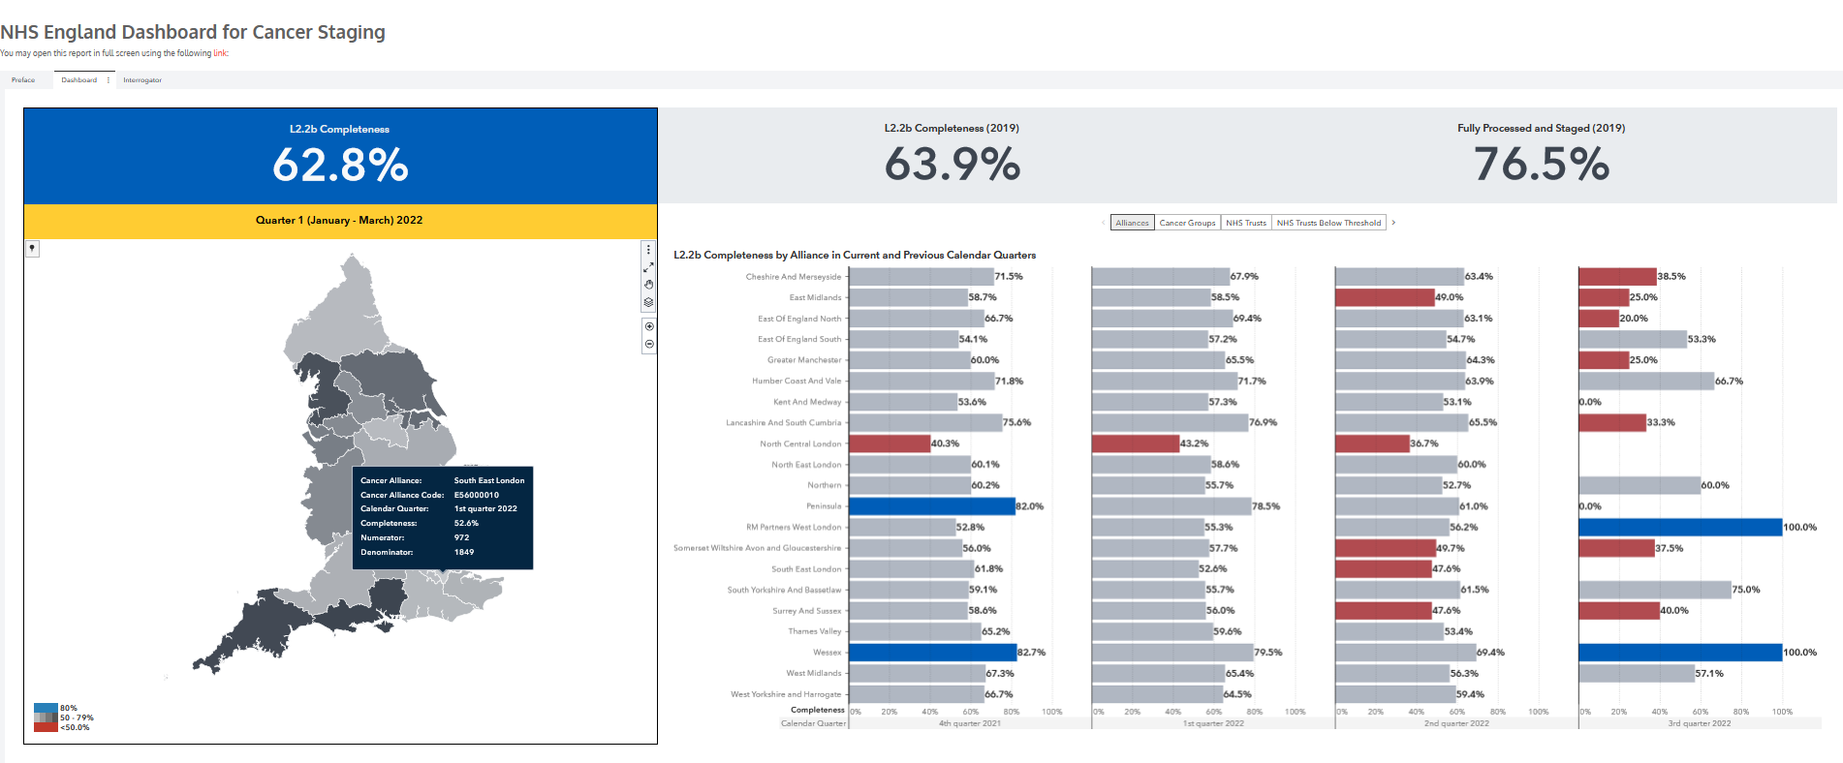
NHS England Dashboard for Cancer Staging, South East London 2022
Selections: dashboard, interrogator (date, cancer group)
Outputs: geography (dashboard), completeness by trust (interrogator), completeness by trust and cancer group (interrogator)

Slide 10
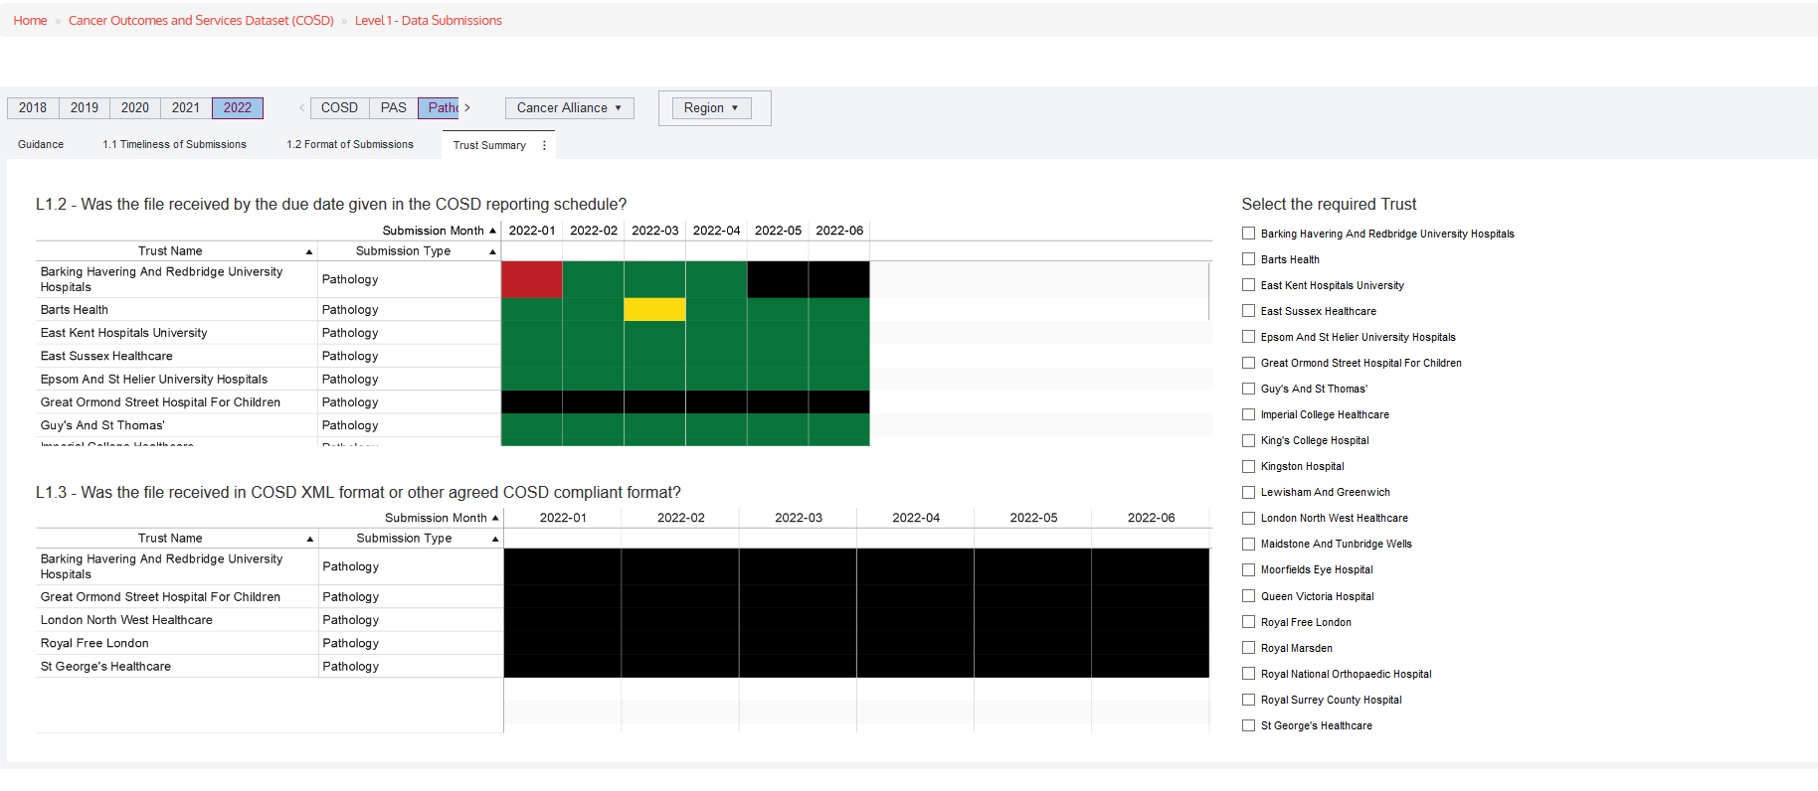
Level 1 Data Submissions: London 2022
Selections: year, dataset, geography
Outputs: timeliness of submissions, format of submissions, trust summary
For L1.1 - Timeliness
Received on time
Received 1 day late
Received 2 or more days late
Not yet received
For L1.2 - Format
COSD-compliant format
Not COSD compliant format
Not yet received
N/A

Slide 11
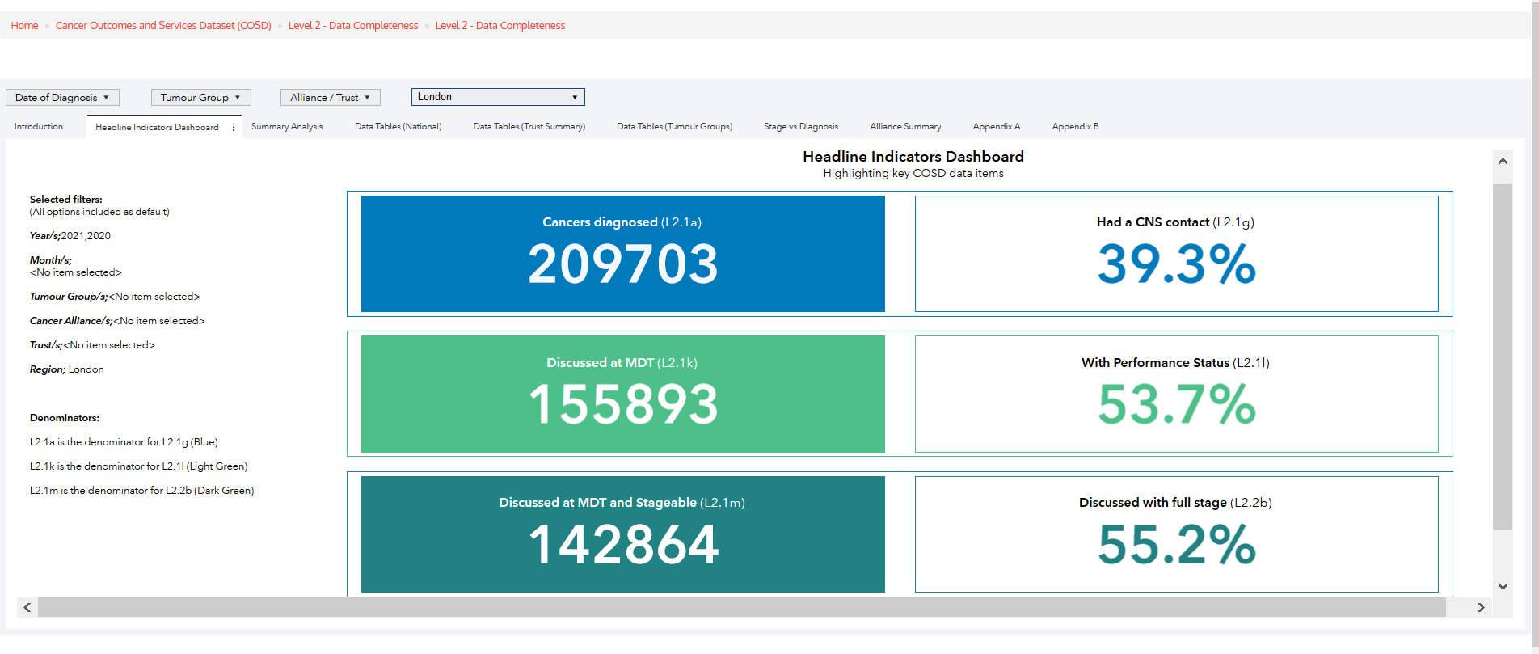
Level 2 Headline Indicators, London 2021
Selections: date, tumour group, geography
Outputs: headline indicators dashboard, summary analysis, data tables (national/trust summary/tumour groups), stage vs diagnosis, alliance summary

Slide 12
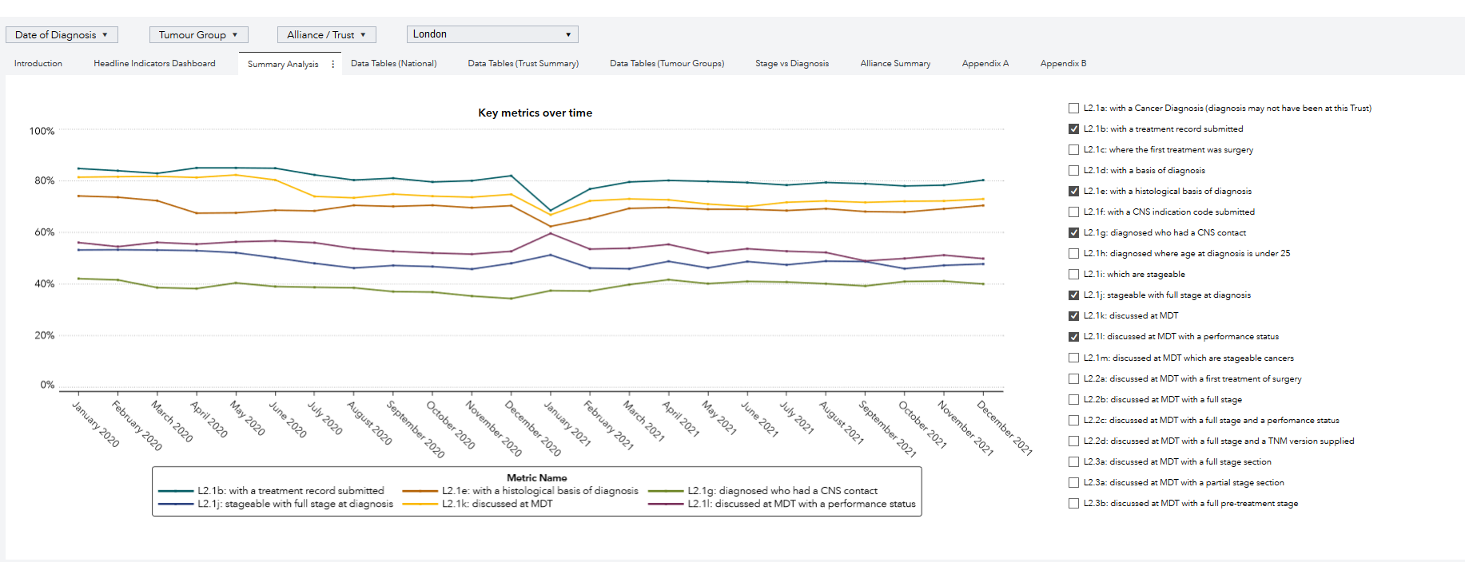
Level 2 Data Completeness, London 2021
Selections: date, tumour group, geography, data field, key metrics
Outputs: summary analysis, data tables (national, trust and tumour group), stage vs diagnosis, alliance summary, appendix A & B
Summary analysis shows the % completeness for all the COSD Conformance Framework Measures (these can be selected from the checklist on the right hand side).

Slide 13
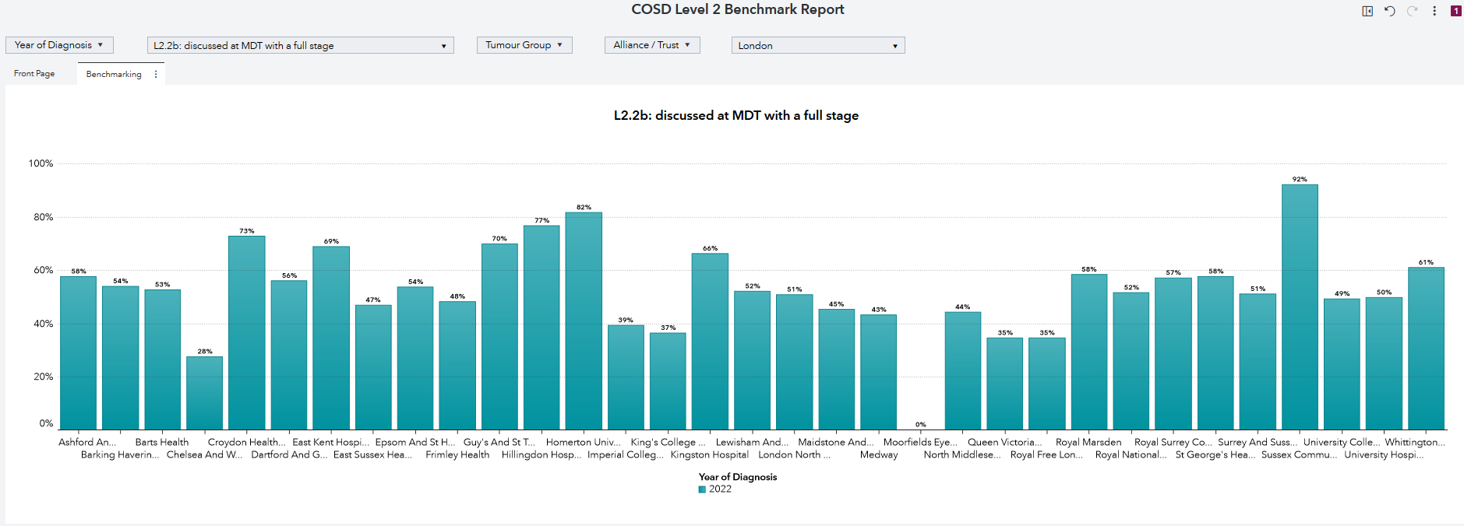
Level 2 Benchmark Report, London 2022
Selections: date, metric, tumour group, geography, data field, key metrics
Outputs: front page, benchmarking (by multiple years, one year, tumour group and alliance)

Slide 14
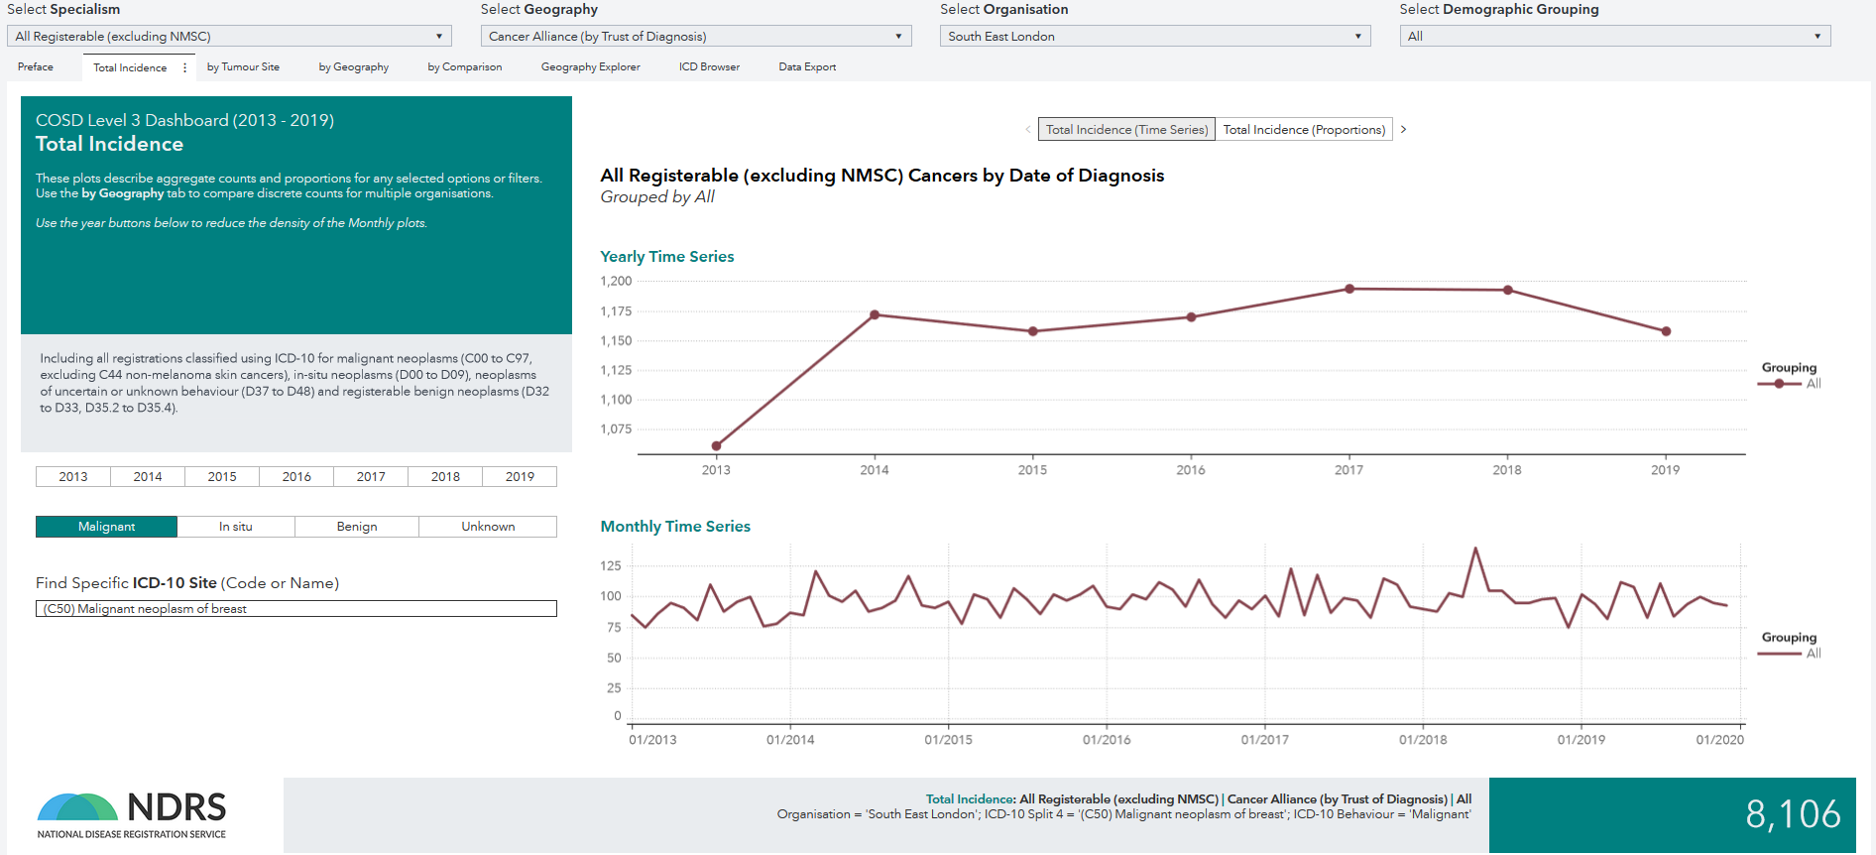
Level 3: Total Incidence of Metastatic Breast cancer, South East London 2013-2019
Selections: specialism, geography, demographic grouping, date, type of cancer, ICD-10 Site, time series/proportion
Outputs: total incidence, tumour site, geography, comparison, geography explorer, ICD browser

Slide 15
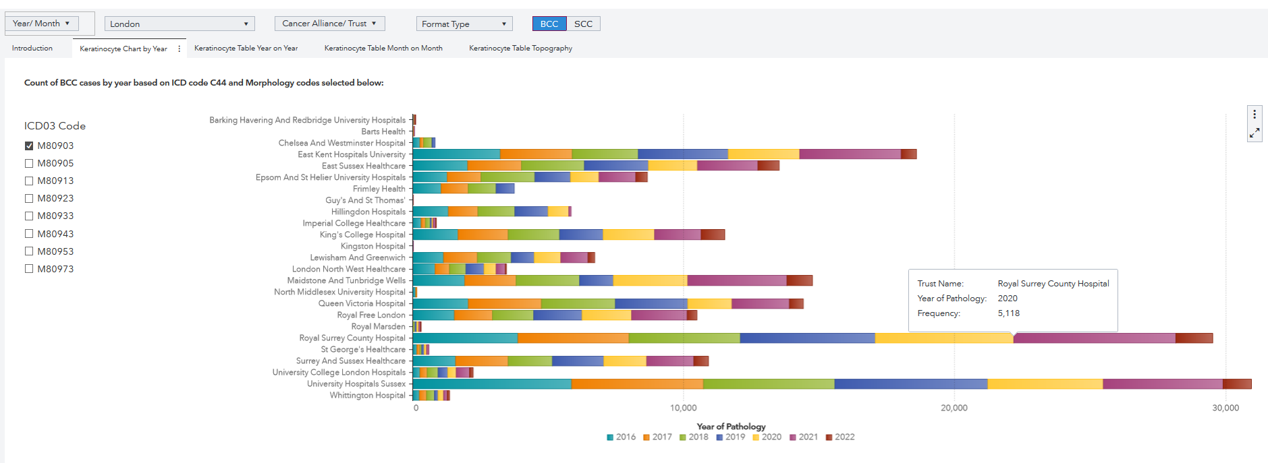
Count of Keratinocytes by year, London 2016-2022
Selections: date, geography, format type, BCC/SCC, ICD03 code
Outputs: keratinocyte chart by year, keratinocyte table year on year, keratinocyte table month on month , keratinocyte table topography

Slide 16
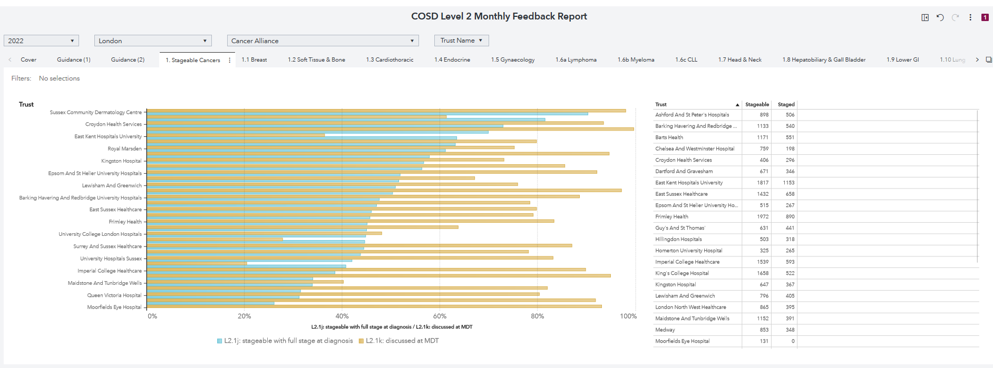
Monthly feedback report on stageable cancers, London 2022
Selections: date, geography, trust name
Outputs: guidance, stageable cancers, breast, soft tissue & bone, cardiothoracic, endocrine, gynaecology, lymphoma, myeloma, CLL, head & neck, hepatobiliary & gall bladder, lung, melanoma skin, non-melanoma skin…

Slide 17
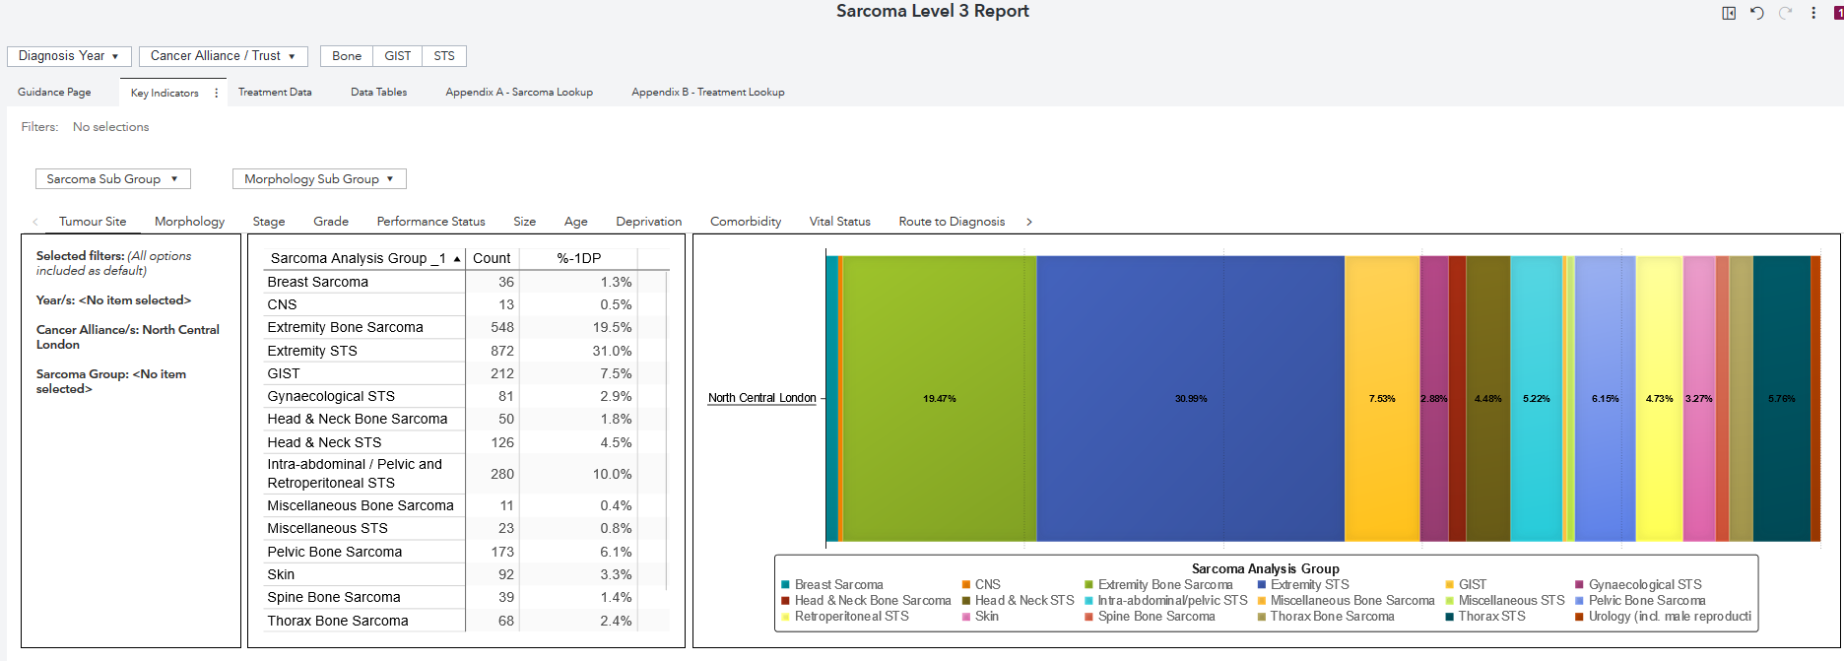
Sarcoma staging by age for people diagnosed in 2013-2018
Selections: year of diagnosis, geography, tumour site, morphology, age group
Outputs: stage by age, performance status by age, CNS by age, morphology by age

Slide 18
Audits

Slide 19
Audit reports available in CancerStats 2
National Audit of Breast Cancer in Older Patients (NABCOP)
Data Completeness (Cancer Alliance and Trust-level; 2014-2021)
Quarterly Report of completeness (Cancer Alliance; 2019-2021)
National Prostate Cancer Audit (NPCA)
Quarterly Report of completeness (PDF, 2018-2021)
Data Completeness (Region, Cancer Alliance and Trust-level; 2016-2019)
Data Completeness COSD (Region, Cancer Alliance and Trust-level, 2018-2021)

Slide 20
Audit reports available in CancerStats 2
Ovarian Cancer Audit Feasibility Pilot (OCAFP)
Data Completeness (Region, Cancer Alliance, Trust-level, 2018-2021)
Geographic Variability in Cancer Treatment (Cancer Alliance, 2016-2019)
Short Term Mortality (Trust-level, 2013-2018)
Variability in Cancer Treatment by Trust (Stage, Trust-level 2016-2018)
All audits utilise data routinely collected through COSD, but may also collect some additional data items

Slide 21
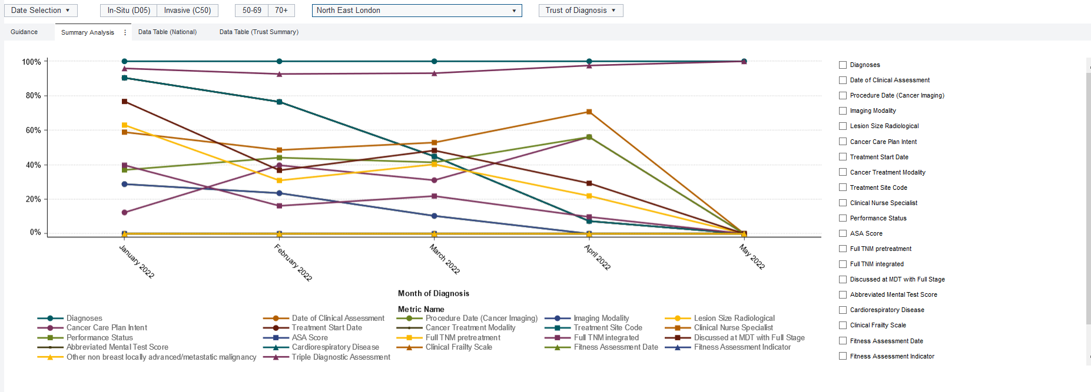
NABCOP Completeness, North East London 2022
Selections: date, in-situ/invasive, age, geography, key metrics
Outputs: summary analysis, data table (national)/(trust)
Notes:
AC: If this is for London could filter the data to London trusts?

Slide 22
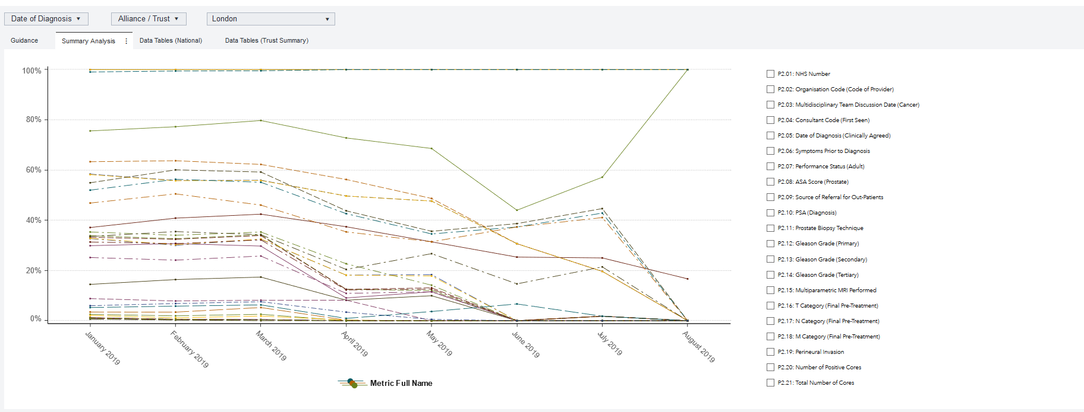
NPCA Data Completeness, London 2019
Selections: date of diagnosis, Alliance/Trust, geography, key metrics
Outputs: summary analysis, data tables (National/Trust summary)
Summary analysis shows the % completeness for all the NPCA metrics (these can be selected from the checklist on the right-hand side).

Slide 23
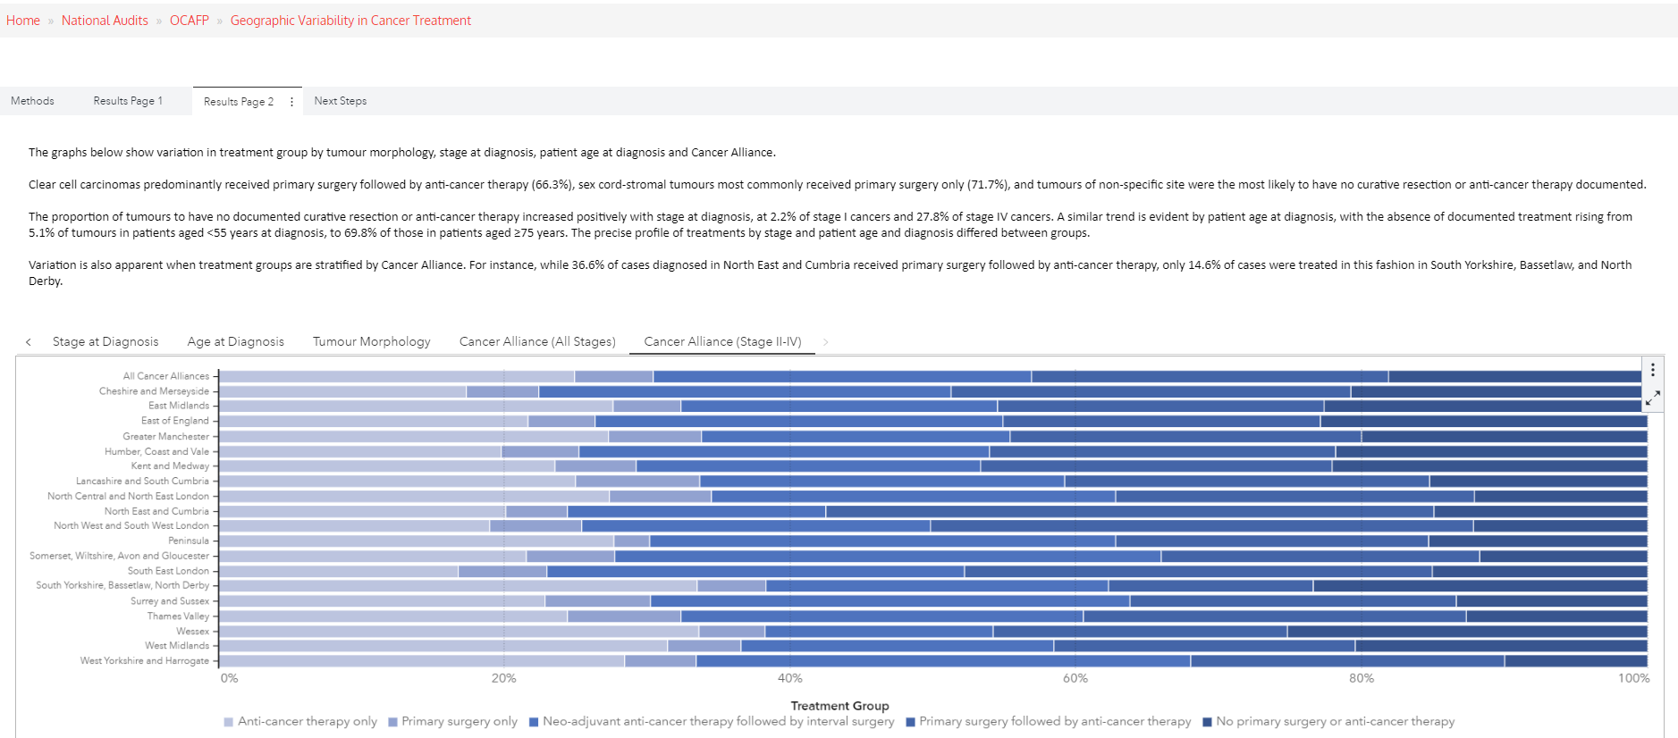
OCAFP: Geographic variability in cancer treatment
Outputs: stage, age, tumour morphology, cancer alliance (all stages/stage II-IV)

Slide 24
Radiotherapy Dataset (RTDS)

Slide 25
RTDS Reports
“The RTDS standard has required all NHS Acute Trust providers of radiotherapy services in England to collect and submit standardised data monthly against a nationally defined data set since 2009. The purpose of the standard is to collect consistent and comparable data across all NHS Acute Trust providers of radiotherapy services in England in order to provide intelligence for service planning, commissioning, clinical practice and research.
RTDS will continue to provide intelligence to underpin the strategic objectives for radiotherapy services defined in the National Radiotherapy Implementation Group report "Radiotherapy Services in England" (2012) and NHS England/Cancer Research UK "Vision for Radiotherapy 2014-2024". Clinical input into the analysis of radiotherapy data will be secured through the National Cancer Registration and Analysis Service (NCRAS) and NHS England's Radiotherapy clinical reference group.”

Slide 26
RTDS Reports
RTDS Network and Region reporting - Number of radiotherapy episodes by site of treatment
Events (Attendances, Episodes and Prescriptions) - Number of radiotherapy treatment events measured as attendances, episodes and prescriptions
Radiotherapy machines (Attendances, working day profile) - Describes different radiotherapy machines usage levels
Treatment codes (HRG) - Describes attendances by HRG code
QIPP (Quality, Innovation, Production and Prevention) - Describes number of attendances by QIPP

Slide 27
RTDS Reports
RTDS Quality Dashboard - Describes proportion of patients treated by different treatment type and their waiting times
Intensity-Modulated Radiation Therapy (IMRT) - Describes number of IMRT use
COVID-19 Dashboard - Provides a suite of metrics of radiotherapy activity during the COVID-19 pandemic
Population Estimates - Yearly population estimates for each radiotherapy provider from 2009

Slide 28
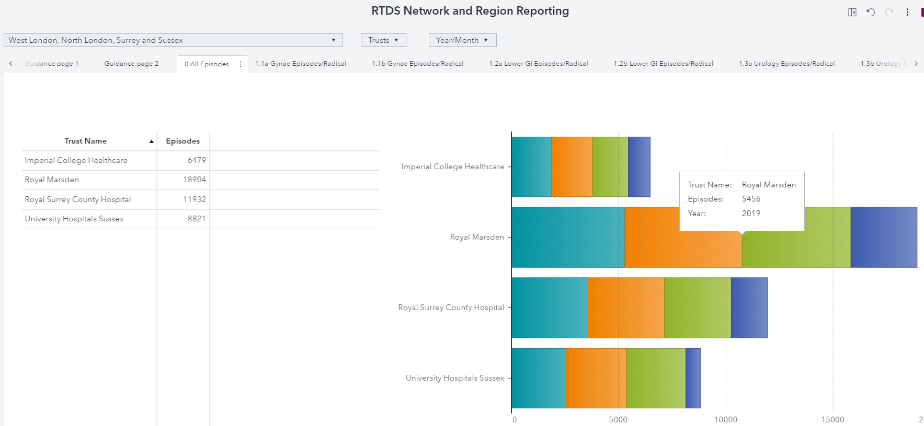
RTDS Network and Region Reporting, London
Inputs: geography, date
Outputs: all episodes, gynae/lower GI/urology/brain & CNS/skin/head & neck/lung/upper GI/breast/haematology/sarcoma (episodes & radical)

Slide 29
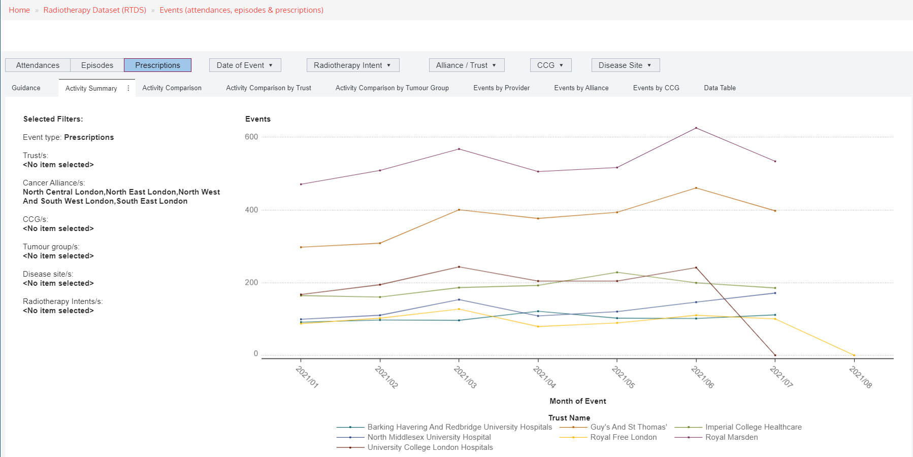
RTDS Events, London 2021
Inputs: attendances/episodes/prescriptions, date, radiotherapy intent, geography disease site
Outputs: activity summary, activity comparison (by itself, trust/tumour group), events (provider, alliance, CCG), data table

Slide 30
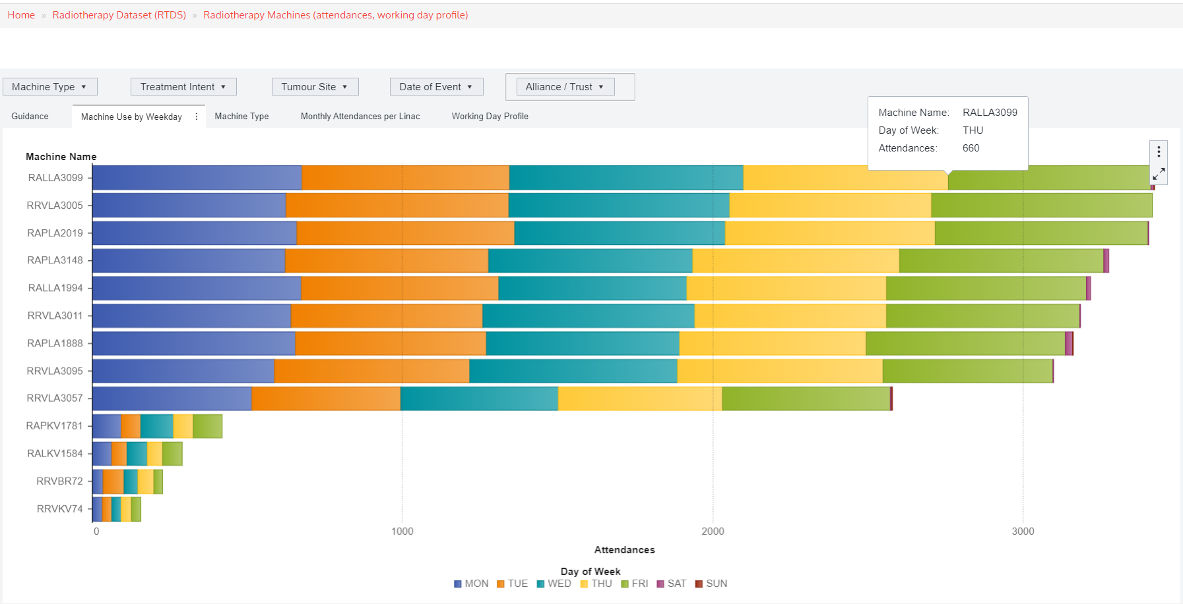
RTDS Radiotherapy Machine Use by Weekday, North Central London
Inputs: machine type, treatment intent, tumour site, date, alliance/trust
Outputs: machine use by weekday, machine type, monthly attendances per linac, working day profile

Slide 31
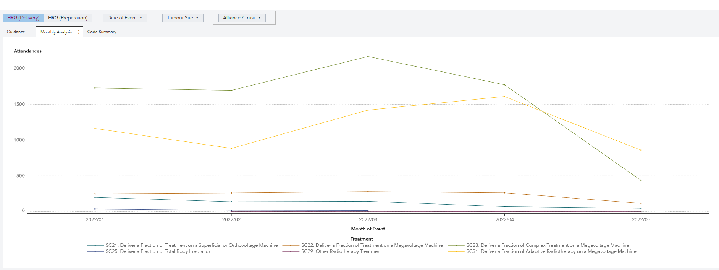
RTDS Treatment codes (HRG), North Central London 2022
Inputs: HRG (delivery/preparation), date, tumour site, alliance/trust
Outputs: monthly analysis, code summary

Slide 32
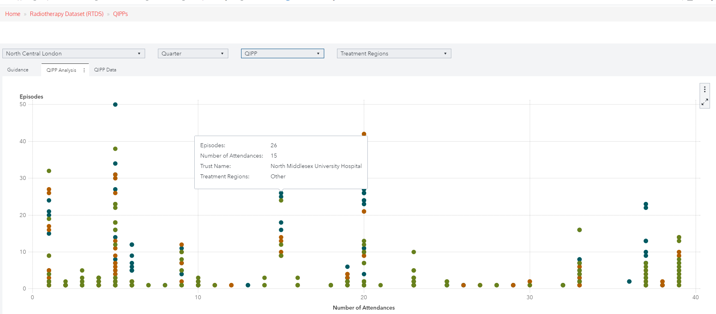
RTDS QIPPs, North Central London
Inputs: alliance, quarter, QIPP, treatment regions
Outputs: QIPP analysis, QIPP data
Trust A

Slide 33
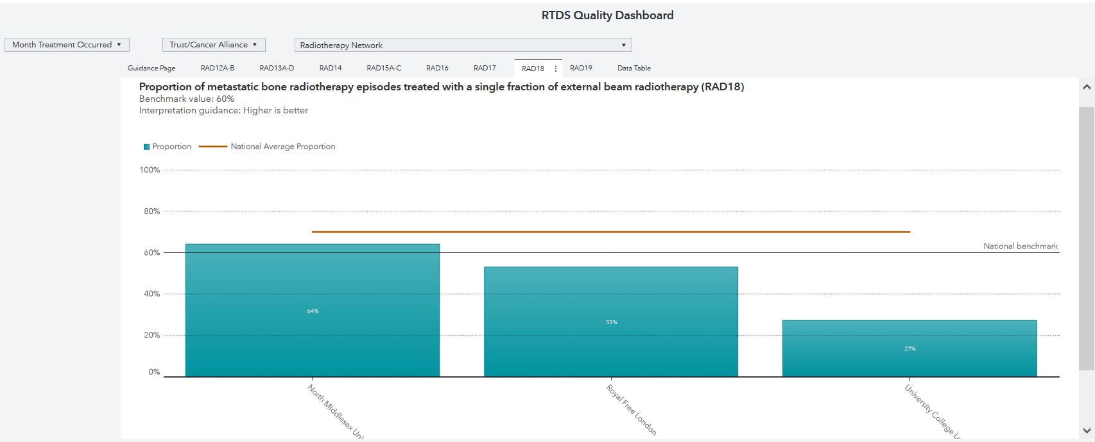
RTDS Quality Dashboard: Bone Radiotherapy Episodes 2021, North Central London
Inputs: month, trust/alliance, radiotherapy network
Outputs: RAD12A-B, RAD13A-D, RAD14, RAD15-C, RAD16, RAD17, RAD18, RAD19, data table

Slide 34
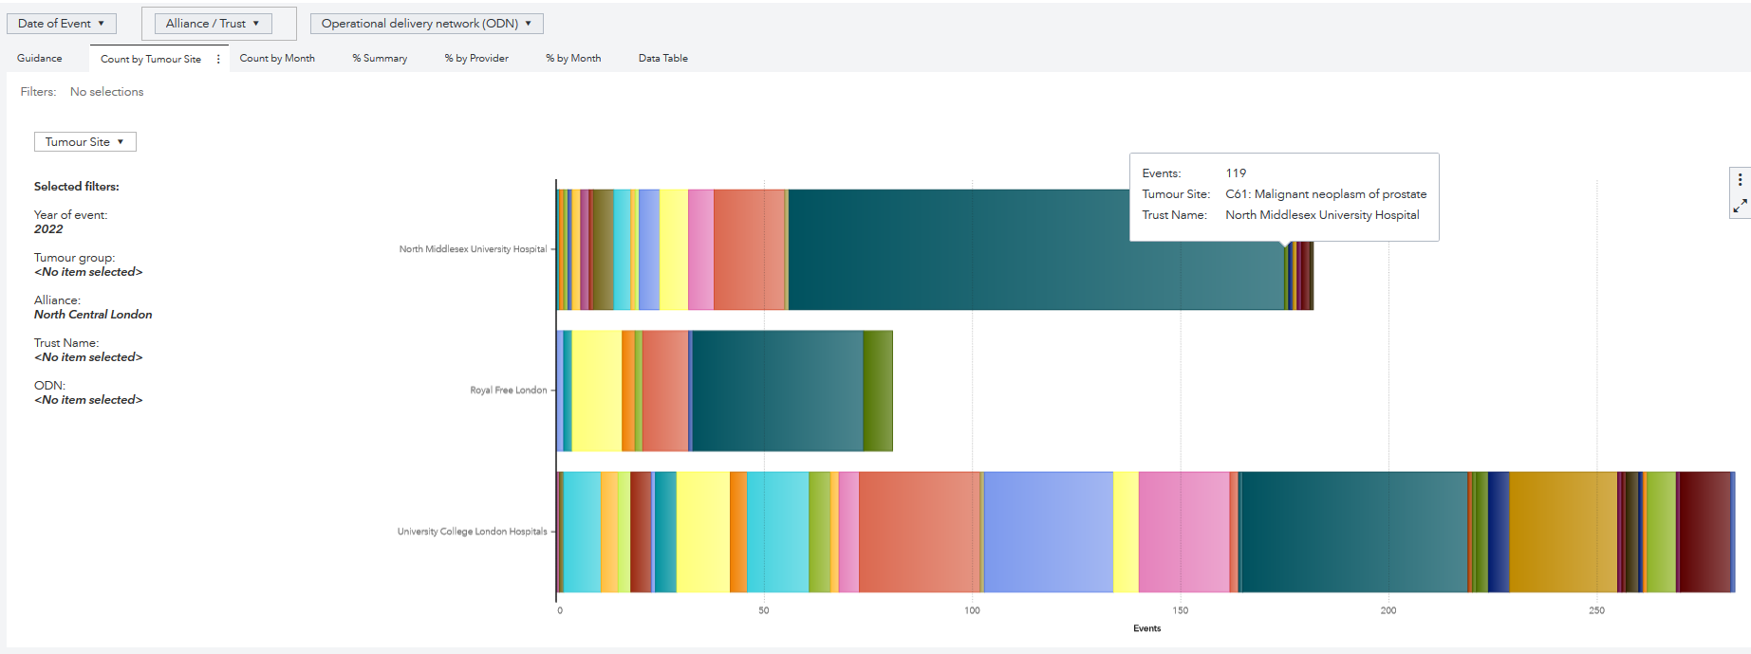
Intensity-Modulated Radiation Therapy tumour site count 2022, North Central London
Inputs: date, alliance/trust, operational delivery network, tumour site
Outputs: count by tumour site, count by month, % month, % by provider, % by month, data table

Slide 35
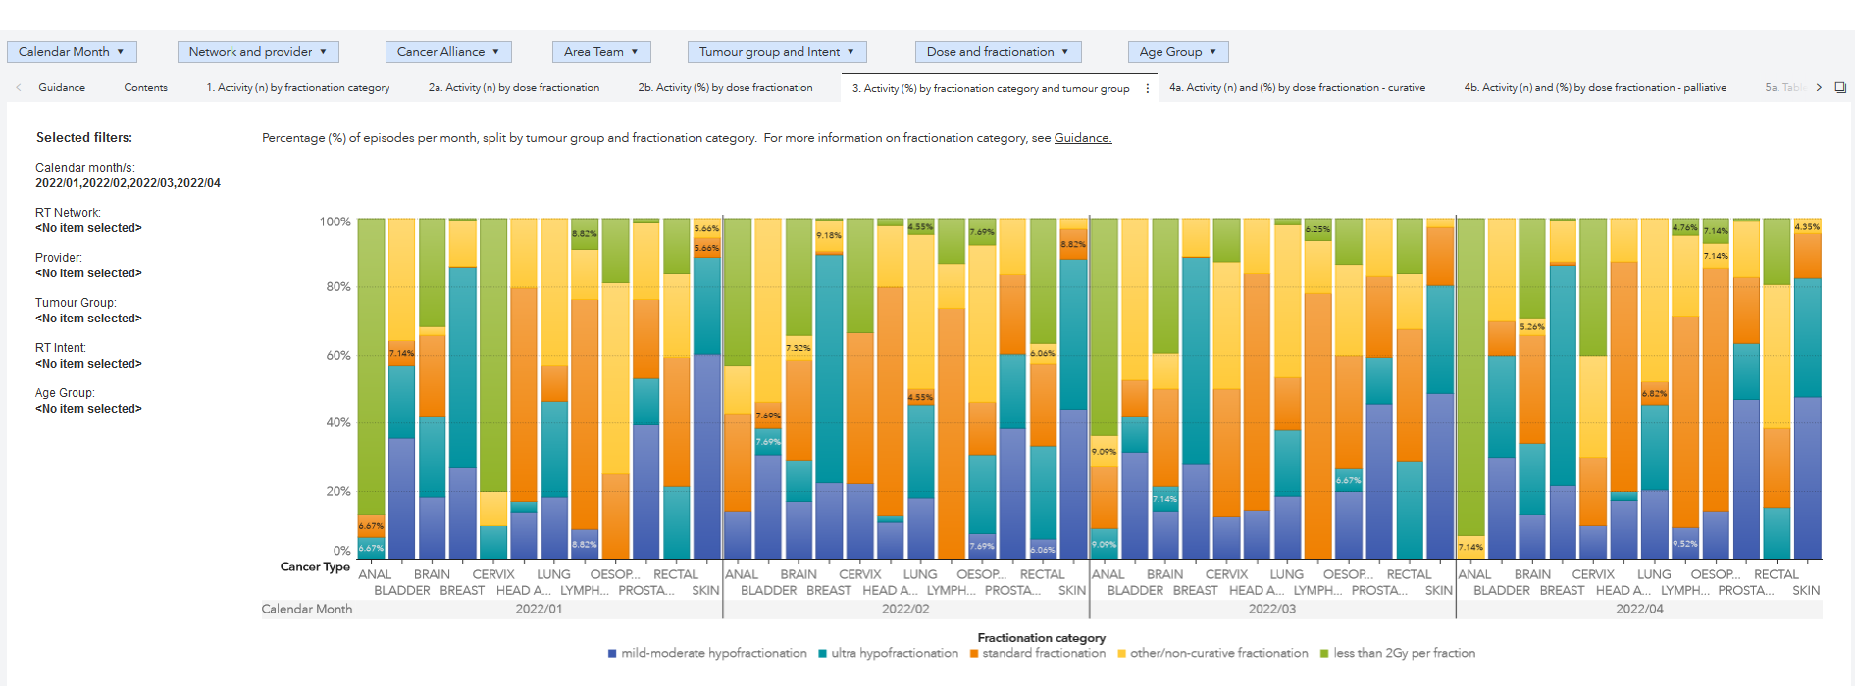
RTDS COVID-19 Dashboard activity by fractionation category and tumour group, London 2022
Inputs: month, network & provider, alliance, area team, tumour group & intent, dose & fraction, age group
Outputs: activity (n) by: fractionation category/dose fractionation/schedules/age group(table/chart), activity (%) by: fractionation category & tumour group,/schedules,/age group, activity (% & n) by: dose fraction (curative/palliative)

Slide 36
Systemic Anti-Cancer Therapy (SACT)

Slide 37
SACT Reports
“The Systemic Anti-Cancer Therapy dataset is the national mandatory collection of systemic anti-cancer therapy activity from all NHS England chemotherapy providers.
It has been designed to:
Provide a clear picture of patterns of systemic anti-cancer therapy, including chemotherapy, being given across England.
Support patients and their clinical teams in choosing appropriate treatments and care.
Understand patterns of service provision and support rational clinical decision making to improve patient care.
The SACT dataset collects information reported routinely by NHS trusts on the treatment of malignant disease in secondary care in England. It relates to all cancer patients, both adult and paediatric, in acute inpatient, day-case and outpatient settings and delivery in the community. It covers systemic anti-cancer treatment for all solid and haematological malignancies, including patients in clinical trials.”

Slide 38
SACT Reports
Core Targets Reports (Coverage, Deadlines, Data Completeness Targets, v3 Compliance) - Measures Trust performance on data reporting
Data quality & completeness (Region & Trust-level) - Measures Trust performance against requirement for data completeness and data quality for certain data items
Dose banding (Region & Trust-level) - Describes SACT drugs administered inside/outside national dose banding
CTYA Data Report (Region & Trust-level) - Report on children, teenagers and young adults receiving systemic anti-cancer therapy

Slide 39
SACT Reports
Haematology Reporting Suite (Region & Trust-level) - Measures drug usage, drug levels and treatment outcomes for haematological cancers
Treatment Activity Reporting Suite (Region & Trust-level) - Measures regimens, regimen activity and regimen intent by region/trust
Cancer Drugs Fund (Region & Trust-level) - Measure CDF application, SACT activity and treatment timeliness by drug and date. Measures ‘Performance Status’ and height & weight data completeness
Covid-19 Dashboard (Region, Cancer Alliance & Trust-level) - Provides a suite of metrics of SACT activity relevant to the COVID-19 pandemic

Slide 40
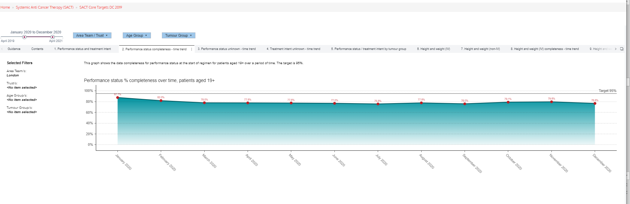
Performance status completeness, London 2019
Selections: date, geography, age group, tumour group
Outputs: performance status & treatment intent, performance status completeness (time trend), performance status unknown (time trend), treatment intent unknown (time trend), performance status/treatment intent by tumour group, height & weight completeness (non-IV/IV): time trend, tumour group

Slide 41
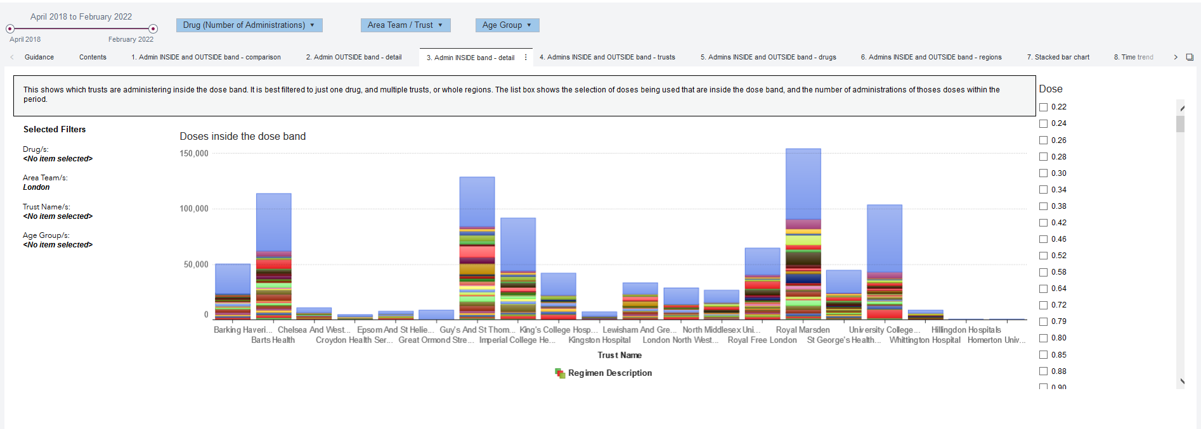
National Dose Banding, London 2022
Selections: date, drug, geography, age group, dose
Outputs: drug comparison inside/outside band, admin outside/inside band, inside/outside band by trust/drugs/regions…

Slide 42
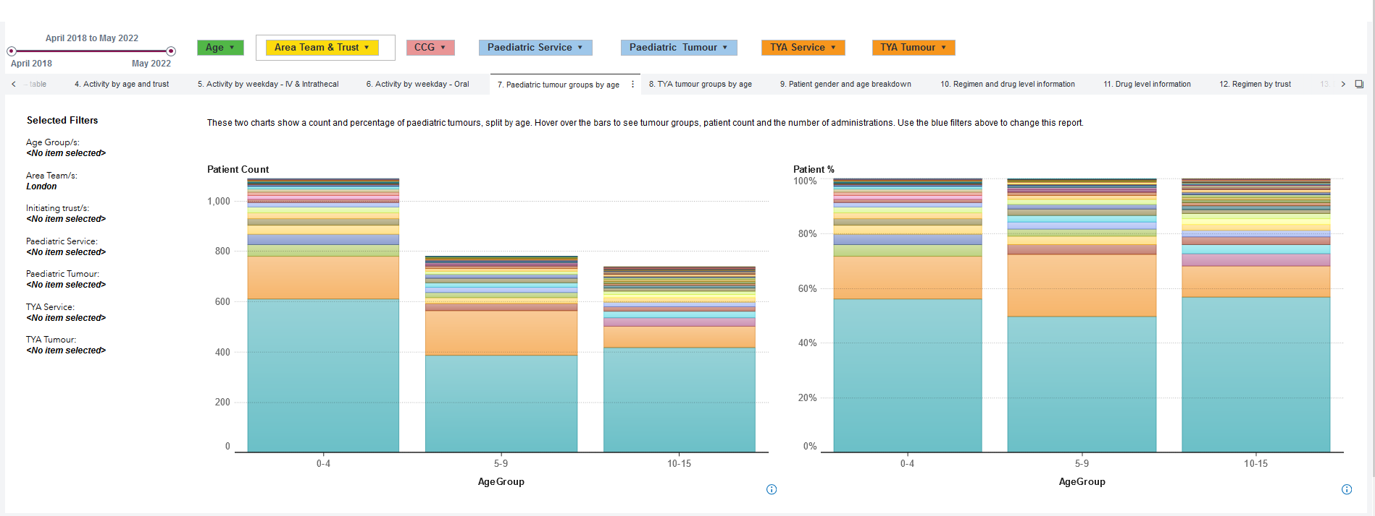
CTYA paediatric tumour groups by age, London 2018-2022
Selections: date, drug, age, geography, paediatric/TYA service, paediatric/TYA tumour
Outputs: count: patient, tumour, admin & regimen, activity: organisation (charts & table), age & trust, weekday (IV & intrathecal/oral), tumour groups by age (paediatric / TYA), patient gender & age breakdown, regimen & drug level information….

Slide 43
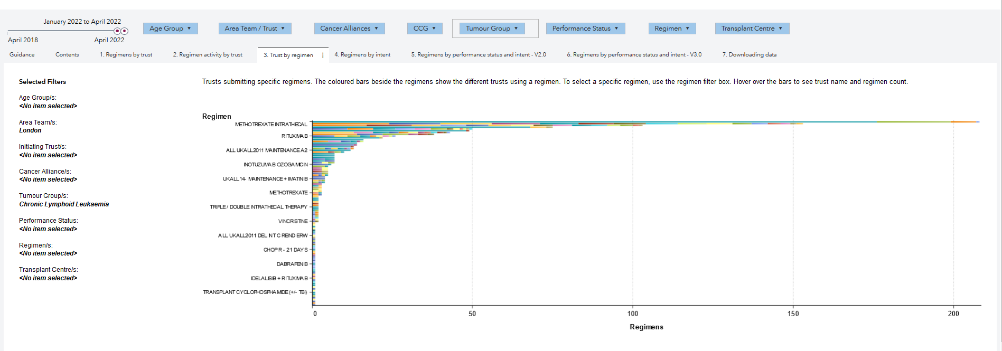
Regimen for Chronic Lymphoid Leukaemia, South East London 2022
Selections: date, age group, geography, tumour group, performance status, regimen, transplant centre
Outputs: regimens: trust, intent, performance status & intent (V2.0/V3.0), Regimen activity by trust, trust by regimen, downloading data

Slide 44
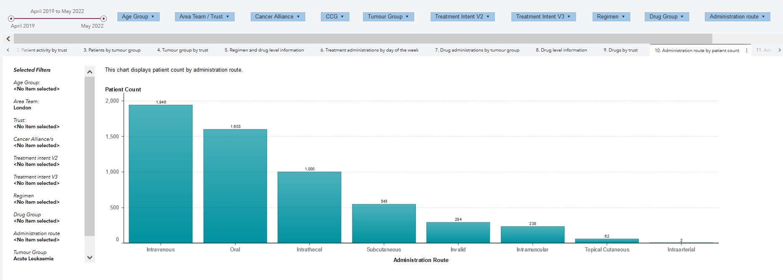
Administration route by patient count for Acute Leukaemia, London 2019-2022
Selections: date, age group, geography, tumour group, treatment intent (V2/V3), regimen, drug group, administration route, transplant centre
Outputs: activity (patient, tumour, regimen & administration), patient activity by trust, patients by tumour group, tumour group by trust, regimen & drug level information, treatment administrations: day of the week, tumour group, drug level information, drugs by trust….

Slide 45
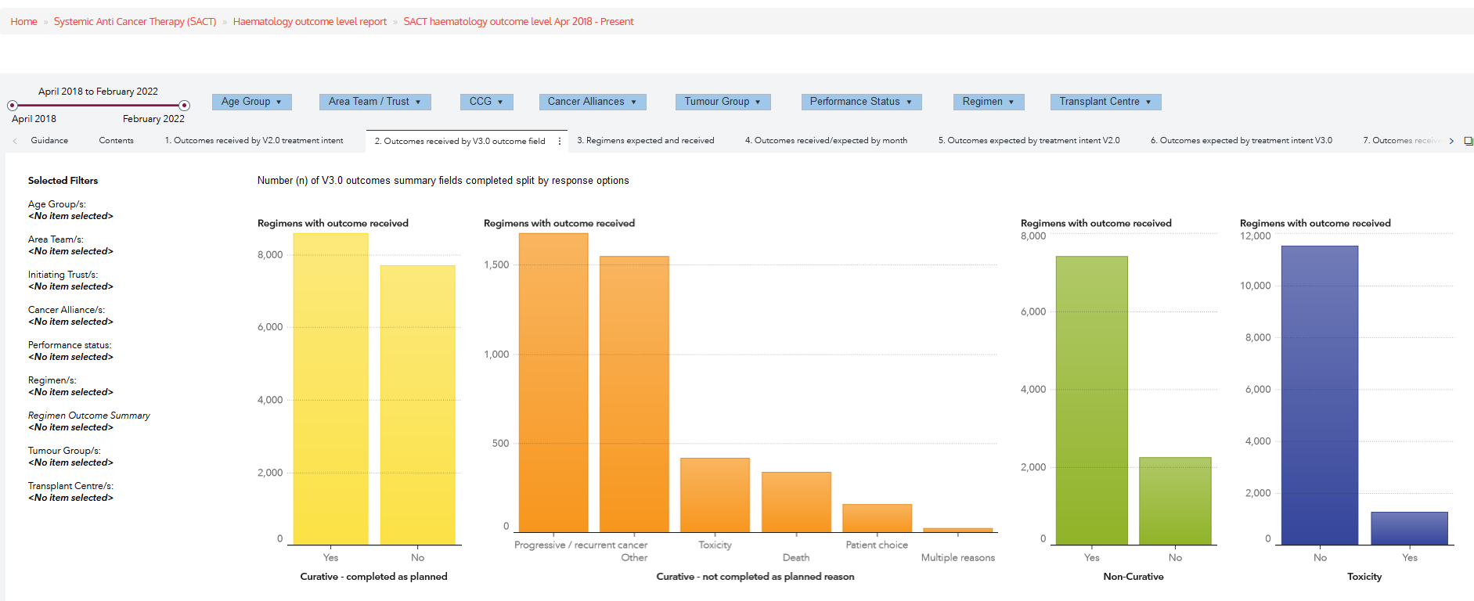
Haematology outcomes received by V3.0 outcome field, 2018-2022
Selections: date, age group, geography, tumour group, performance status, regimen, transplant centre
Outputs: outcomes received: V2.0 treatment intent, V3.0 outcome field, regimens expected & received, outcomes received/expected by month, outcomes expected by treatment intent V2.0…

Slide 46
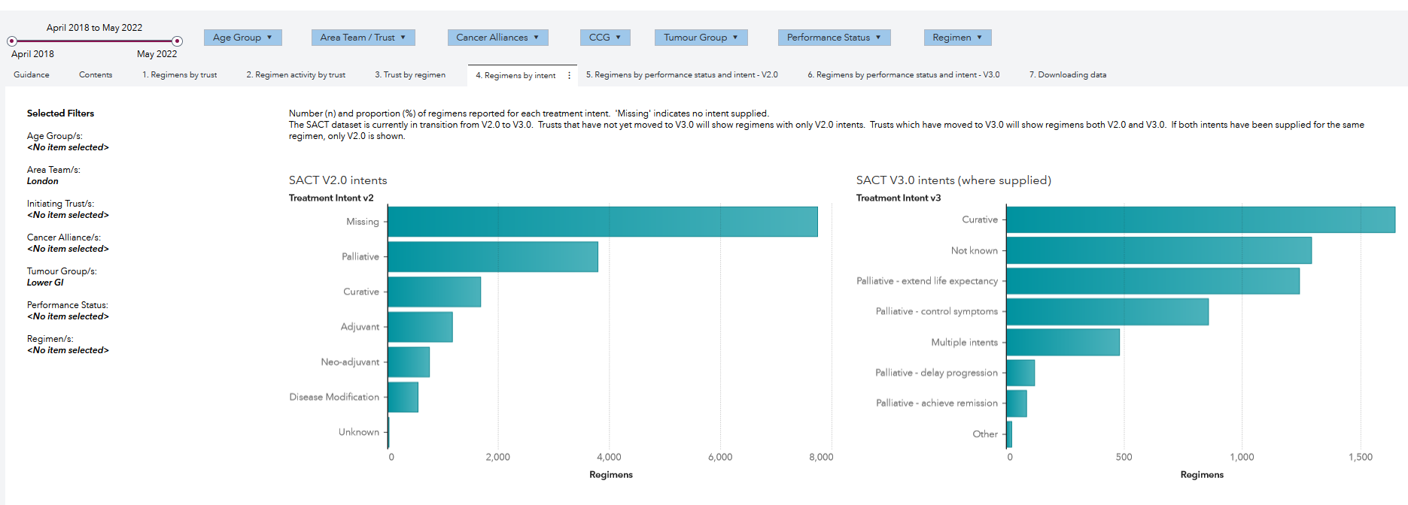
SACT reporting suite, Regimen for the Lower GI in London 2018-2022
Selections: date, age group, geography, tumour group, performance status, regimen, Outputs: regimens: trust, intent, performance status & intent (V2.0/V3.0), Regimen activity by trust, trust by regimen, downloading data

Slide 47
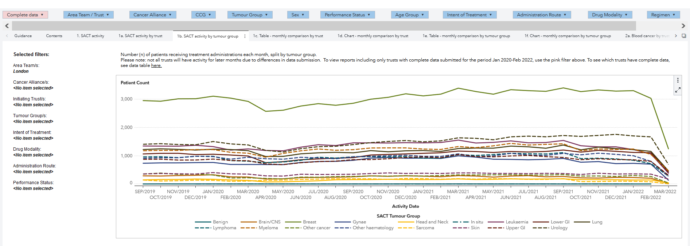
SACT activity by tumour group during COVID-19, London
Selections: data completeness, geography, tumour group, sex, performance status, age group, intent of treatment, administration route, drug modality, regimen, drug
Outputs: SACT activity (trust/tumour group), monthly comparison by trust (table/chart), monthly comparison by tumour group (table/chart), blood cancer (trust/tumour group)…

Slide 48
CASCADE

Slide 49
CASCADE
Incidence
Mortality
Prevalence
  Patient level (Alliance, CCG, STP, England)
  Tumour level (Alliance, CCG, STP, England)
The Incidence and Mortality data is only available on CancerStats 1 and you can create an account for it here.

Slide 50
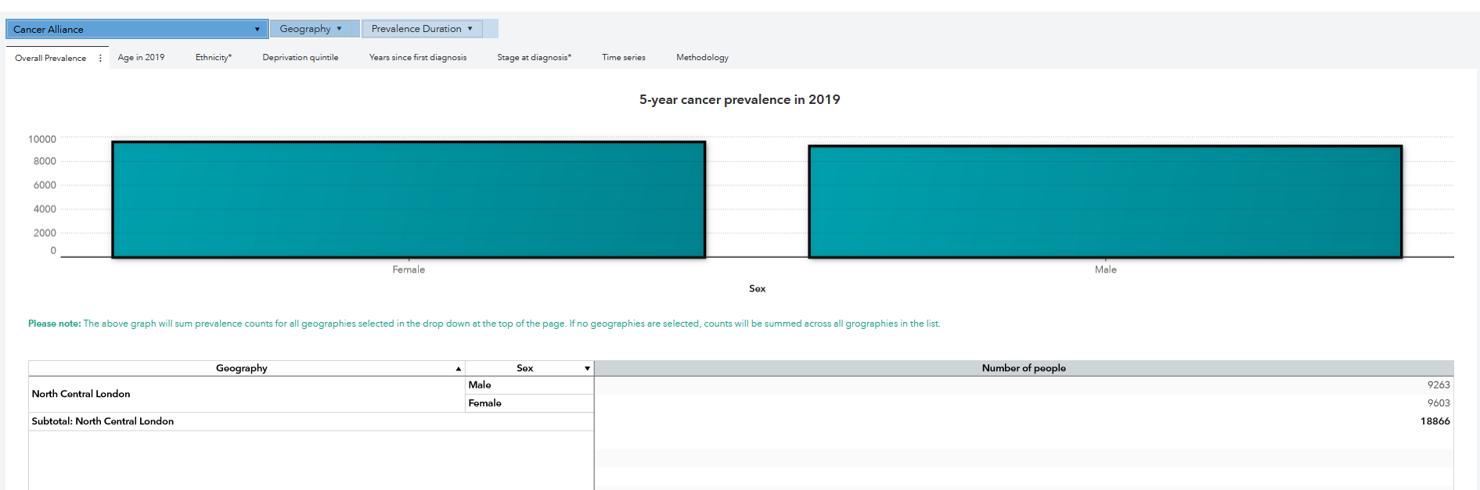
CASCADE Prevalence patient level, North Central London 2019
Selections: geography
Outputs: overall prevalence, age in 2019, years since diagnosis, deprivation quintile, stage at diagnosis, ethnicity, methodology

Slide 51
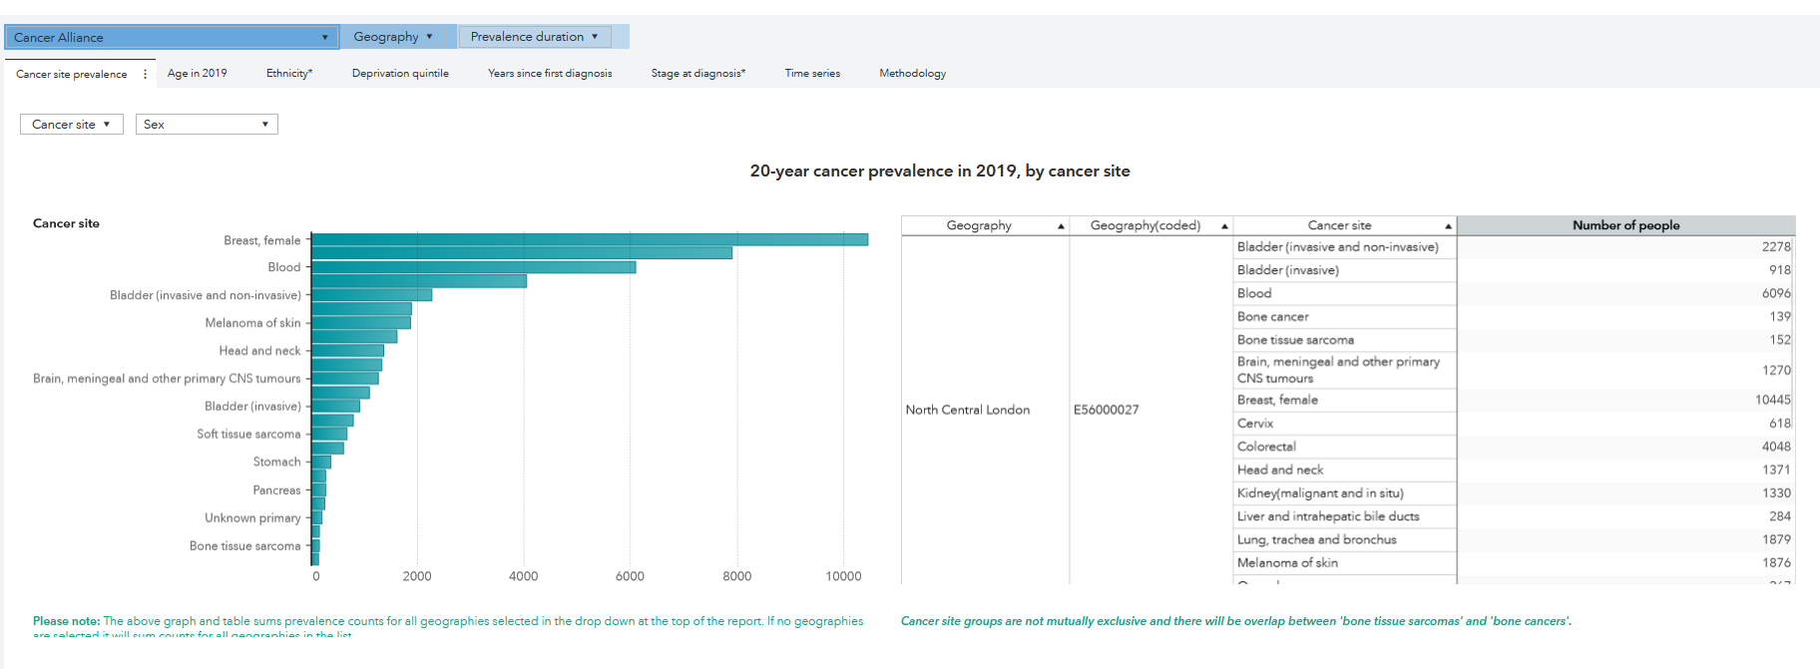
CASCADE Prevalence tumour level, London 2019
Selections: geography. cancer site, sex
Outputs: overall tumour group prevalence, age in 2019, ethnicity, deprivation, time since diagnosis, methodology

Slide 52
Life After Prostate Cancer (LAPCD)

Slide 53
LAPCD
The LAPCD reports summarise over 100 questions in the LAPCD patient questionnaire alongside response rates
The questions ‘assessed a variety of health and quality of life domains, including urinary, bowel and sexual function; psychological and emotional well-being; and social difficulties. Additional items covered treatments received, socio-demographic characteristics and the patient perspective i.e. decision regret and patient empowerment.’
Data are available at Trust, National and UK level
  Report: Gives results of all questions with categorised answers
    Report 1 (survey, 2015-2016)
    Report 2 (survey, 2017-2018) was a follow up to survey 1 respondents
  Survey Results: Gives results of all scored questions

Slide 54
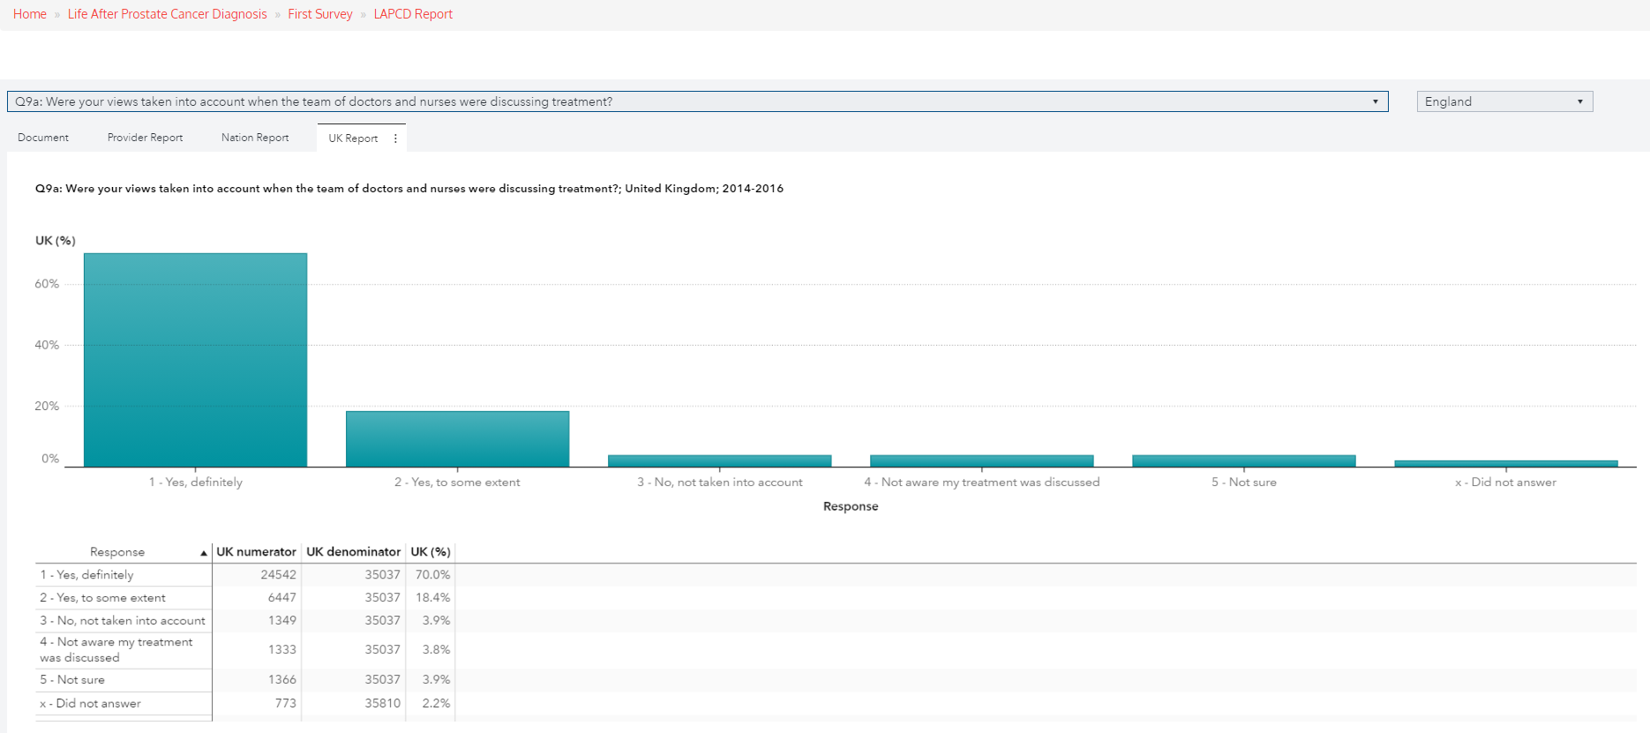
LAPCD: Report 1 National Level, 2017
Selections: 85+ survey qs (health-related QoL, functional outcomes, emotional wellbeing, social difficulties) country
Outputs: provider, nation and UK level data (numerator, denominator, response rate.

Slide 55
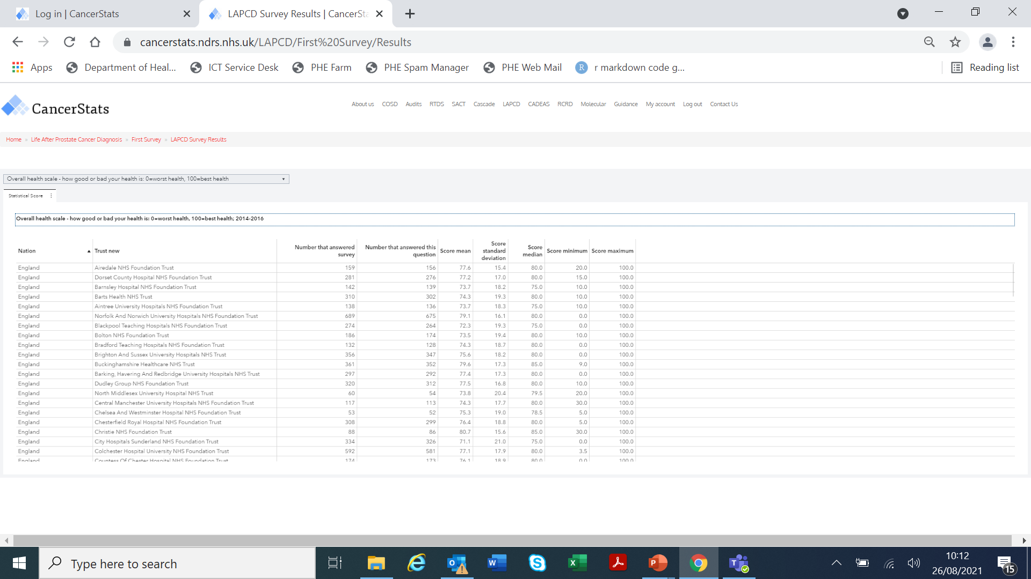
LAPCD: Scored questions summary
Selections: question where the response is scored on a scale (0-100)
Outputs: trust-level summary score

Slide 56
CADEAS

Slide 57
CADEAS
The Cancer Alliance Data Evidence and Analysis Service (CADEAS) aims to produce a series of reports on cancer metrics for Cancer Alliances
These reports are intended to help Cancer Alliances identify variation and make evidence-based decisions for their cancer transformation programmes
CCG and STP-level data is also provided for certain cancer metrics
Trust-level data should be included later this year

Slide 58
CADEAS cancer metrics on CancerStats 2
Section 1: Metric and tumour search - Allows you to search for specific metrics/tumours and directs you to the metric specific webpage
Section 2: Summary Grids - Summary data tables of cancer metrics presented in reports (Alliance, CCG)
Section 3: Prevention and contextual - Population data, Obesity & smoking prevalence: metadata, cross-sections and trends (Alliance, STP, CCG),
Smoking prevalence inequalities: metadata, cross-sections, trends (Alliance, STP)
Section 4: Faster Diagnosis - Two week wait & 62-day wait: metadata, cross-sections and trends (Alliance, STP, CCG).
  Diagnostic waiting times / Timing and treatment modality of 62-day pathway / inpatient procedures : metadata, cross-section and trends (Alliance, STP, CCG)

Slide 59
CADEAS cancer metrics on CancerStats 2
Section 5: Early diagnosis - Early-stage diagnoses & emergency presentations: metadata, cross-sections and trends (Alliance, STP, CCG).
Screening uptake & coverage statistics: metadata, cross-sections and trends (Alliance, STP, CCG)
Section 6: Treatment - Directs to the Chemotherapy, Radiotherapy and Timing & treatment modality of 62-day pathway data
Section 7: Outcomes - Survival index cross-section, One year net survival / Under 75 mortality: metadata, distribution, cross-section and trends (All Alliance, STP & CCG)
One-year survival by tumour, One-year net survival by deprivation slope index of inequality (Cross-section, Trends), One-year net survival by ethnicity (All Alliance)
CPES questions, results and cross-sections (CCG & some by STP & Alliance), Overall patient experience by deprivation (Alliance), Overall patient experience by deprivation slope index of inequality (Alliance)

Slide 60
CADEAS cancer metrics on CancerStats 2
Section 8: Living With and Beyond Cancer - Directs to Living with and Beyond bladder, cervical, ovarian & womb cancer pilots
NHS England Staging Dashboard
Feedback

Slide 61
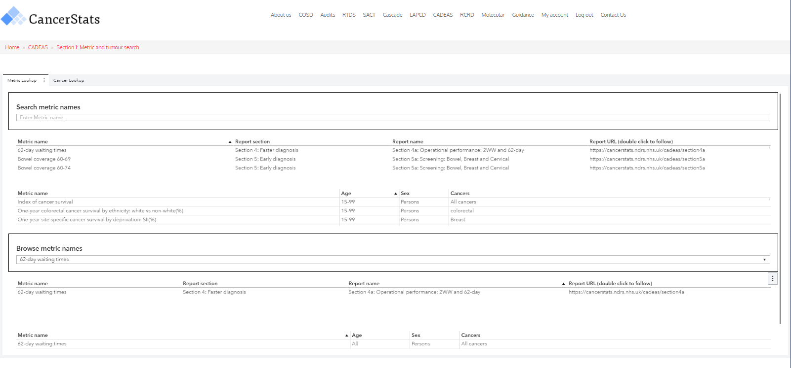
Section 1 Metric search
Selections: metric either by searching or browsing
Outputs: report section, name and URL

Slide 62
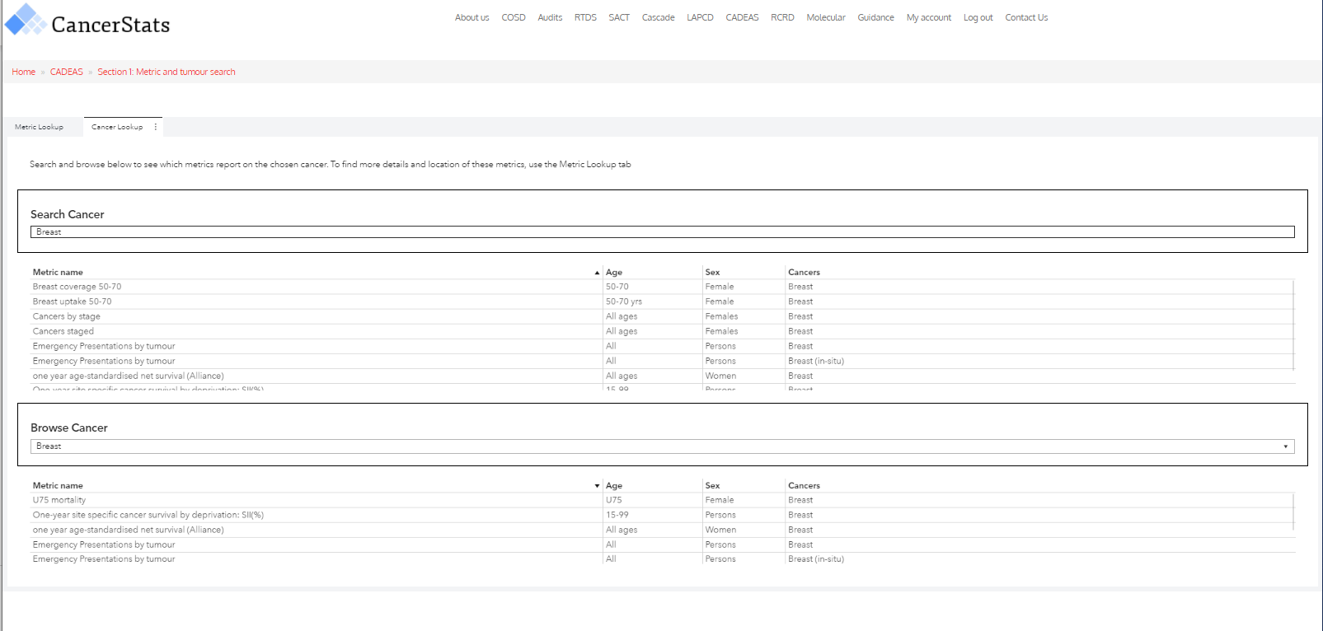
Section 1 Tumour search, breast cancer
Selections: tumour either by searching or browsing
Outputs: metric name, age, sex

Slide 63
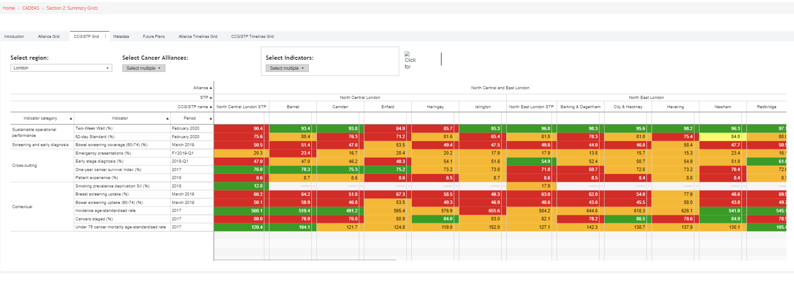
Section 2 CCG/STP Summary Grid, London
Selections: geography, indicator
Outputs: alliance grid, CCG/STP grid, metadata, future plans, alliance timelines, CCG/STP timelines

Slide 64
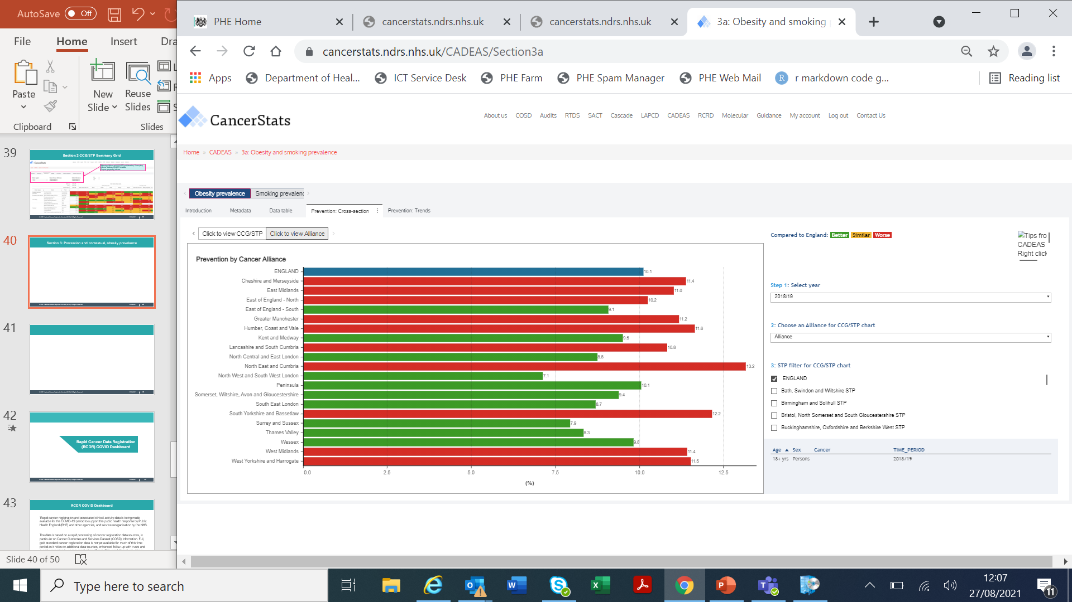
Section 3a: Prevention and contextual, obesity prevalence 2018-2019
Selections: year, alliance/CCG/ STP performance
Outputs: metadata, data table, prevention (cross section/ & trends), geography

Slide 65
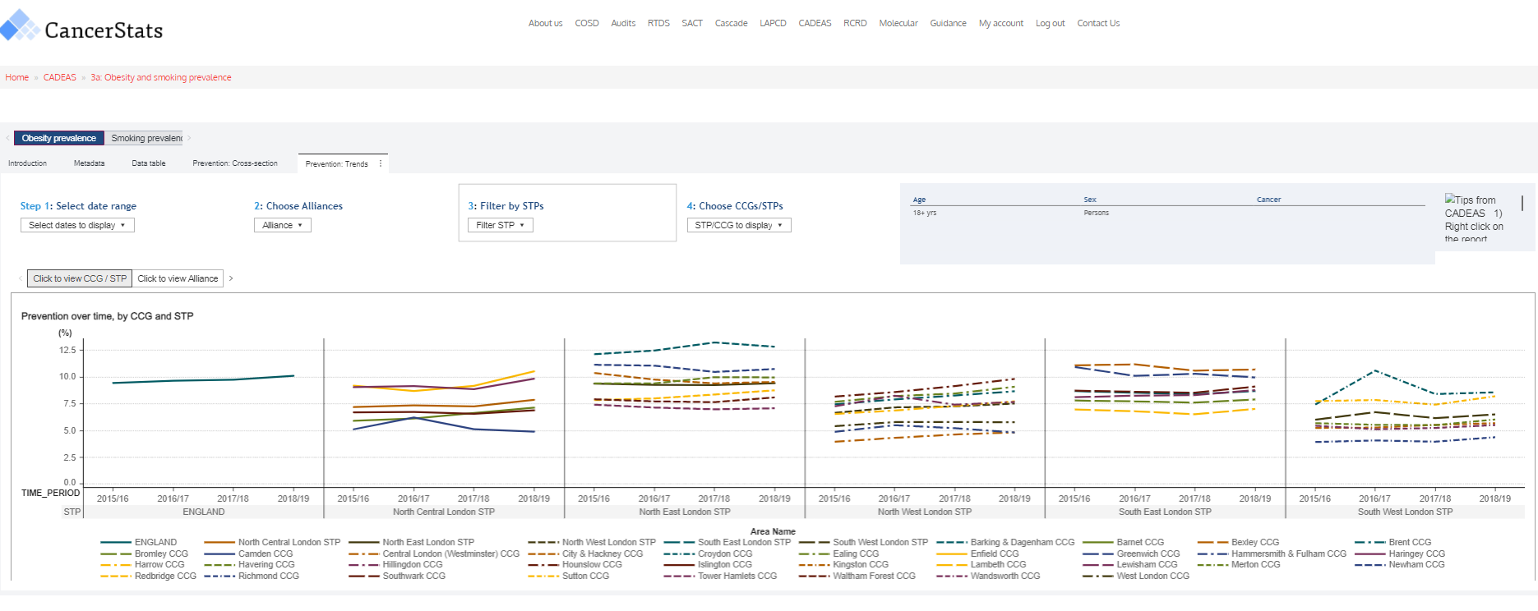
Section 3a: Prevention and contextual, smoking prevalence in London 2015-2019
Selections: prevention metric, year, geography
Outputs: obesity prevalence, smoking prevalence (cross-section & trends)

Slide 66
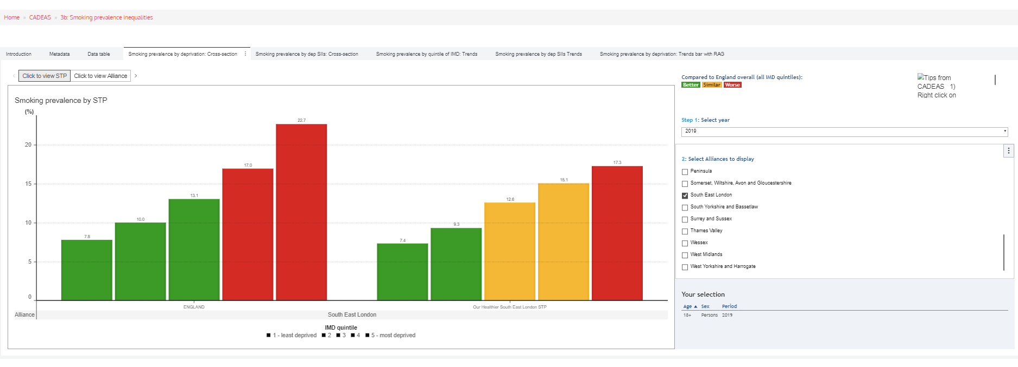
Section 3b: Smoking prevalence inequalities, National and South East London 2019
Selections: deprivation metric, year, geography Outputs: smoking prevalence by deprivation (cross-section & trends bar with RAG), smoking prevalence by deprivation slope index of inequality (SII) (cross-section/trends), smoking prevalence by quintile of IMD (trends)

Slide 67
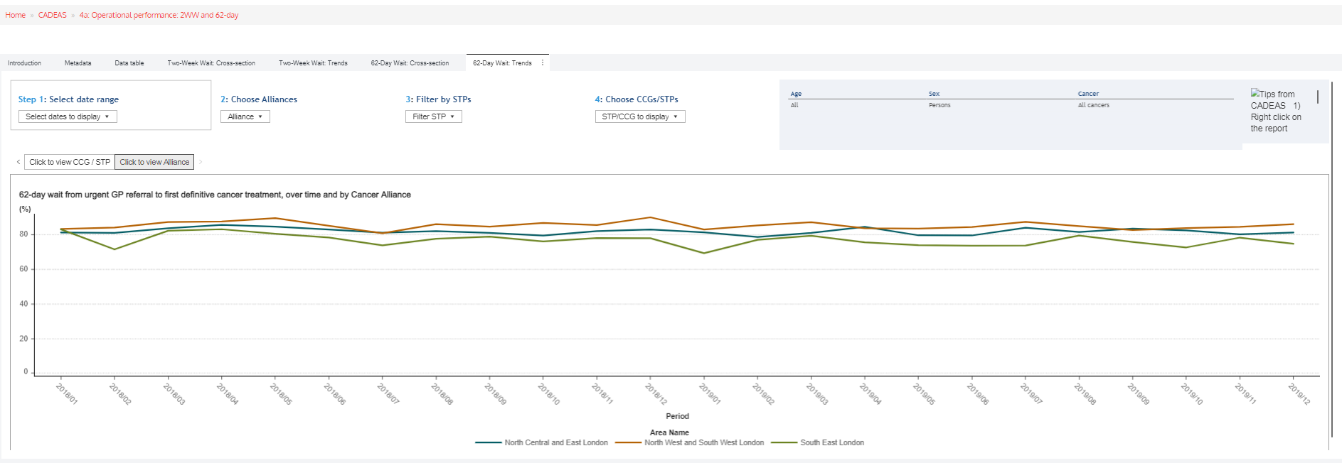
Section 4a: 62 Day wait trends, London 2018-2019
Selections: waiting time (cross-section & trend), geography
Outputs: Metadata, Data table, TWW and 62 Day Wait (cross-section & trends)

Slide 68
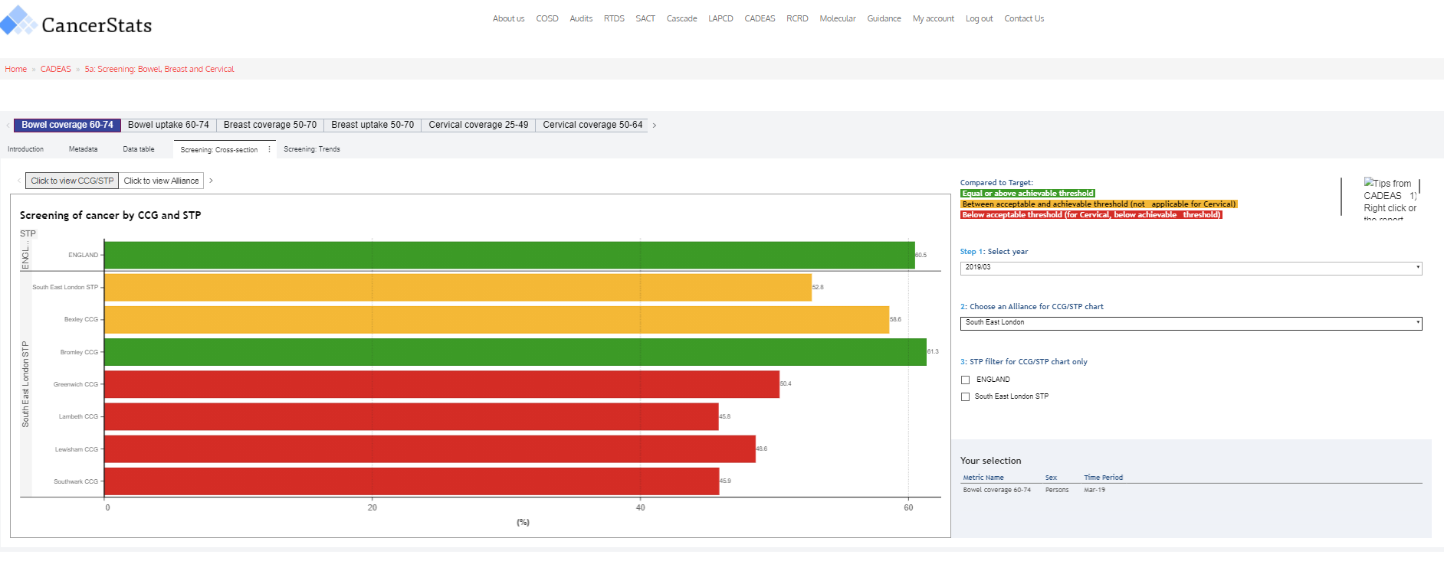
Section 5a: Bowel coverage 60-74, South East London 2019
Selections: screening programme metric, geography
Outputs: metadata, data table, screening cross-section/tends

Slide 69
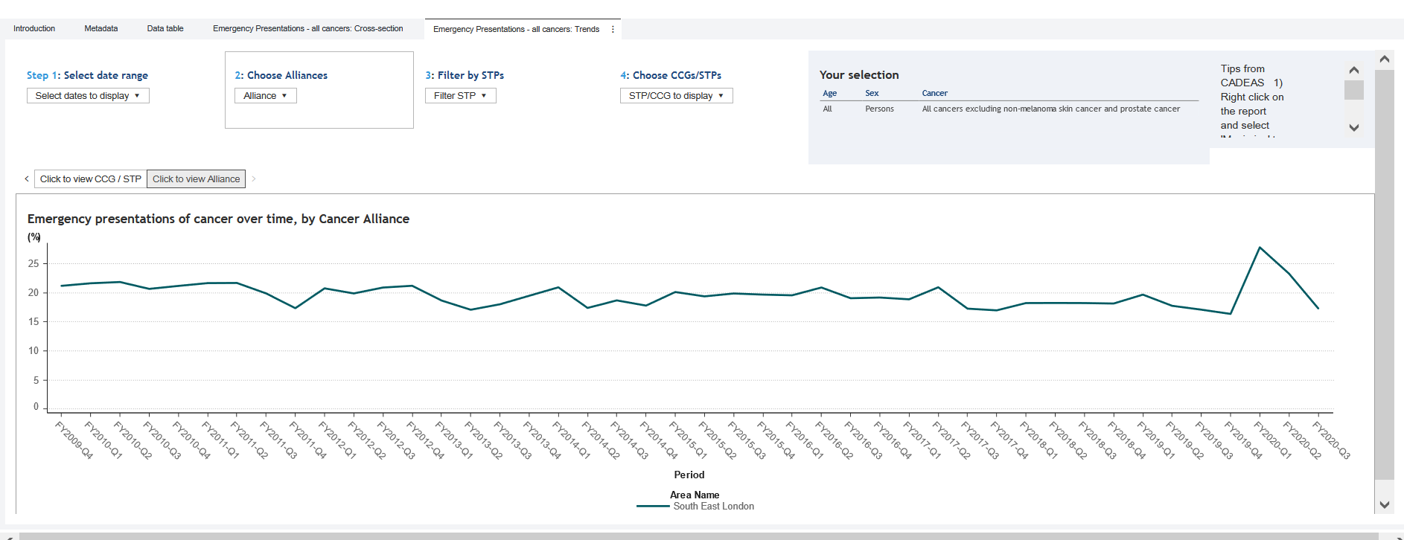
Section 5c: Emergency presentations, South East London 2009-2020
Selections: dates, geography
Outputs: rate of emergency admissions (cross-section & trends)

Slide 70
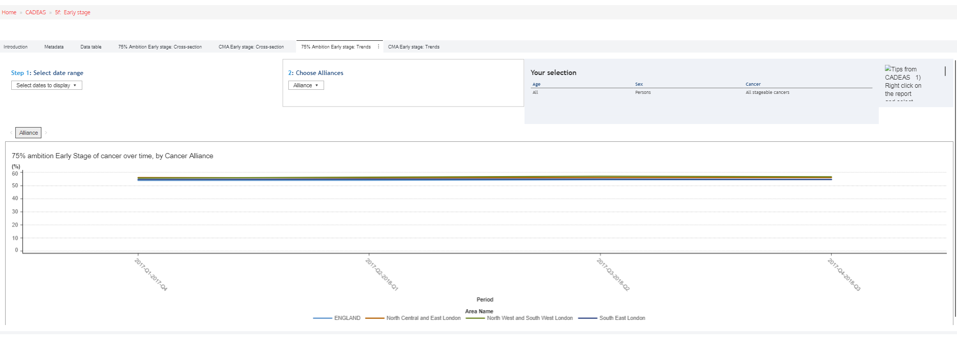
Section 5f: 75% ambition early stage trends, London 2018
Selections: date, geography
Outputs: 75% ambition early stage (cross-section & trends), CMA Early stage (cross-section & trends)

Slide 71
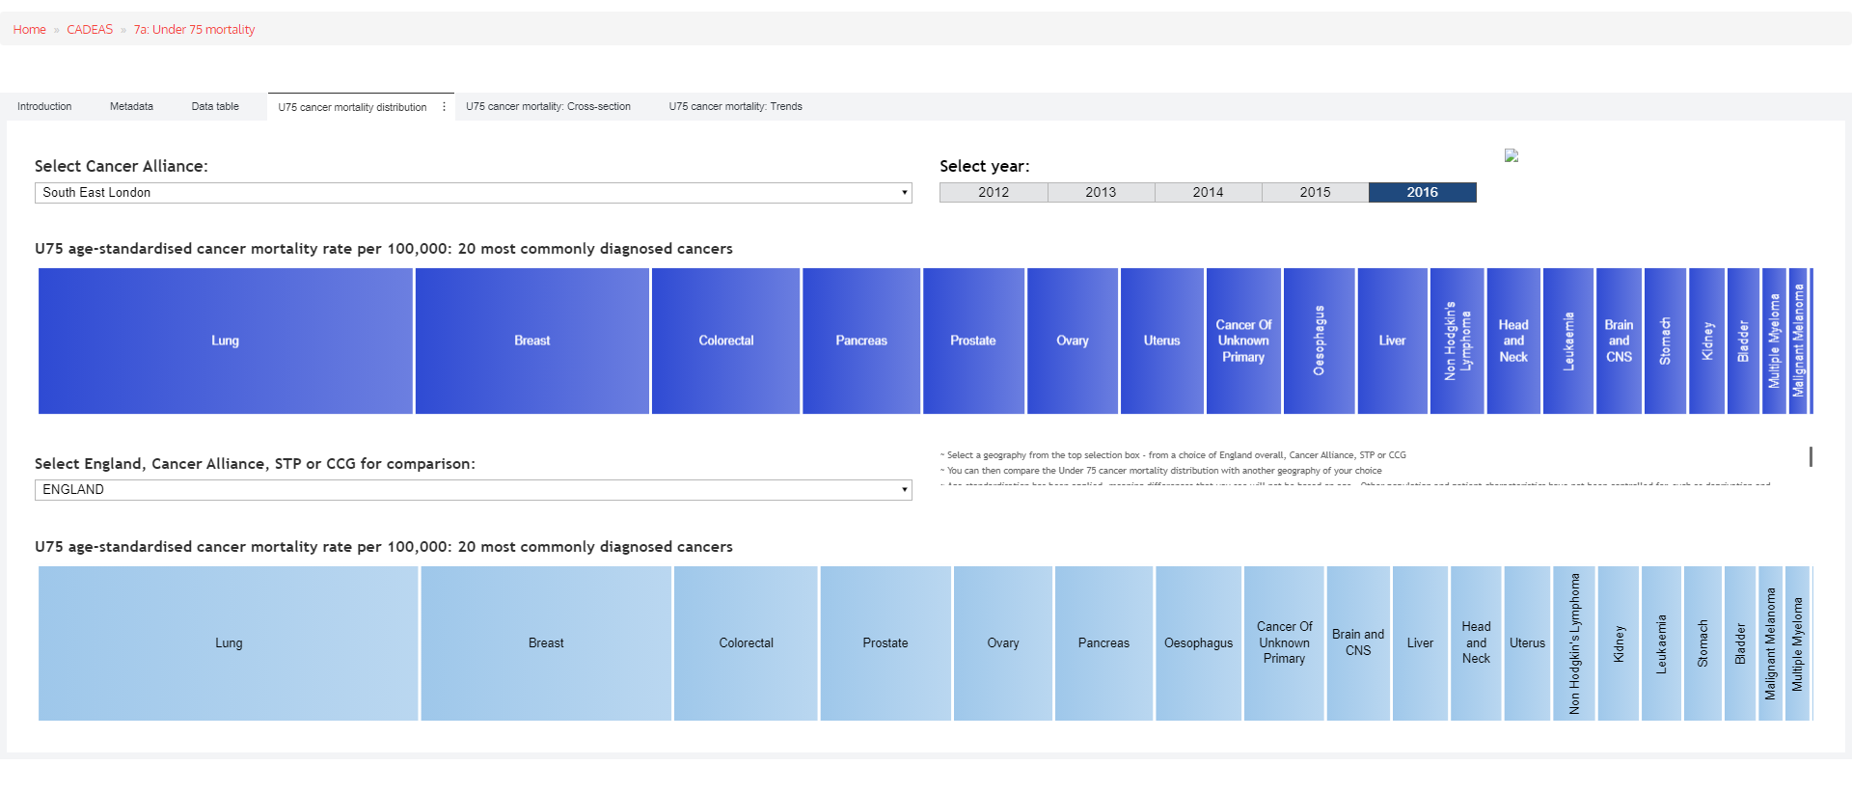
Section 7a: Under 75 mortality distribution, SE London compared to England 2016
Selections: geography, year
Outputs: mortality distribution, mortality rates (cross-section & trends)

Slide 72
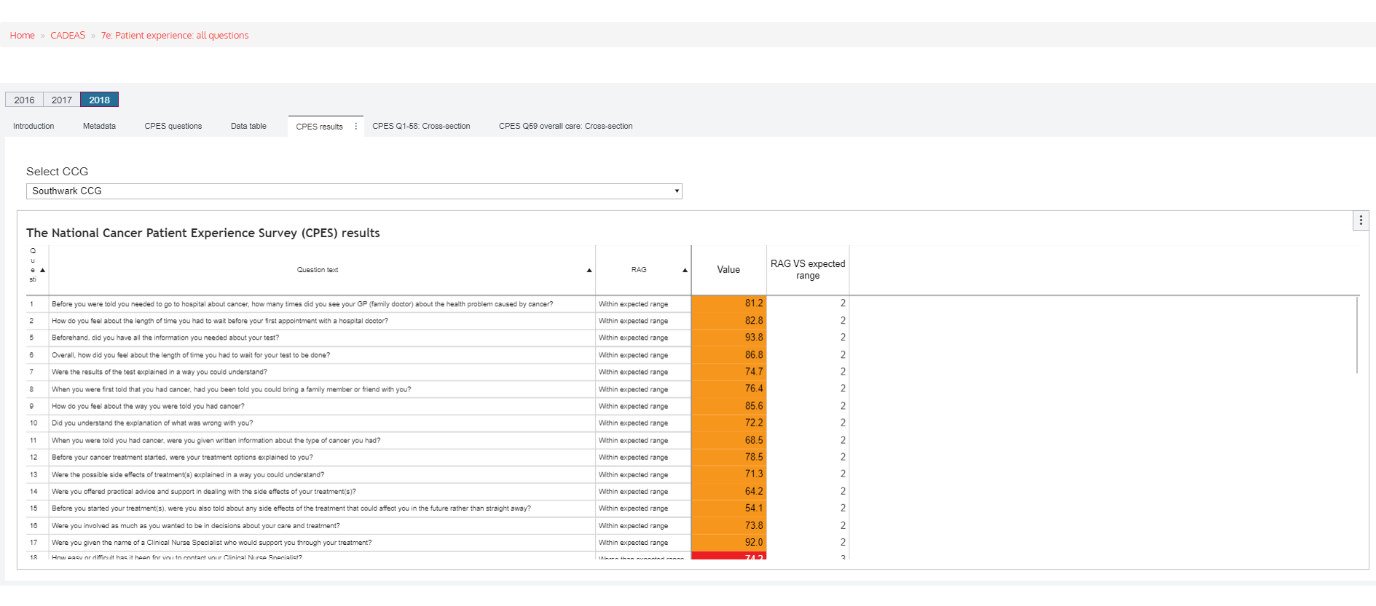
Section 7e: Patient experience survey results at CCG level, Southwark
Selections: year, geography
Outputs: CPES results, CPES Q1-68: cross-section, CPES Q69 overall care: cross-section

Slide 73
NHS England Dashboard for Cancer Staging, South East London 2022
Selections: dashboard, interrogator (date, cancer group)
Outputs: geography (dashboard), completeness by trust (interrogator), completeness by trust and cancer group (interrogator)

Slide 74
Rapid Cancer Registration Dataset (RCRD)

Slide 75
RCRD COVID Dashboard
“The Rapid Cancer Registration Dataset contains proxy tumour registrations and some associated events on the cancer patient pathway (e.g. surgery, radiotherapy and chemotherapy) from January 2019 to the most recently available data on cancer diagnoses.
The data is based on a rapid processing of cancer registration data sources, in particular on Cancer Outcomes and Services Dataset (COSD) information. Full, gold standard cancer registration data is not yet available for much of this time period as it relies on additional data sources, enhanced follow-up with trusts and expert processing by cancer registration officers. This rapid dataset provides a quicker, indicative source of cancer data.”

Slide 76
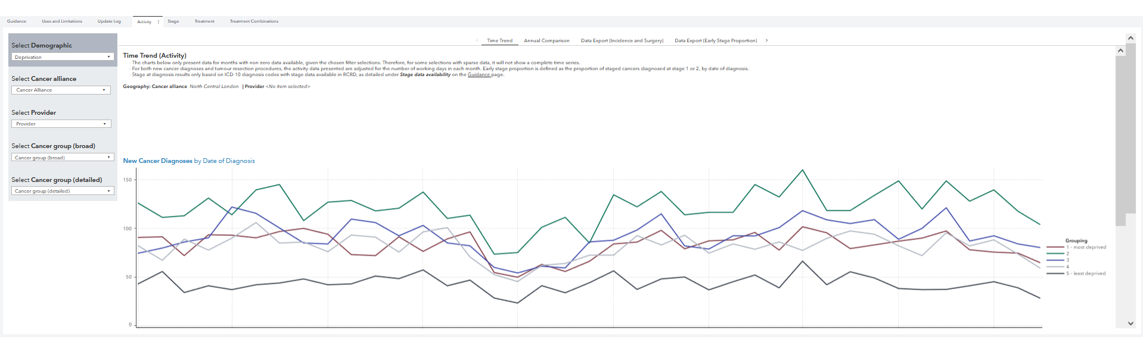
RCRD Time trend for activity broken down by deprivation, North Central London 2021
Selections: activity, stage, treatment, treatment combinations, demographic, geography, provider, cancer group (broad), cancer group (detailed)
Outputs: activity (time trend, annual comparison, data export (incidence and surgery), data export (early-stage proportion), stage (time trend, stage proportions by year), treatment (treatment proportions, time to treatment (proportion of cases/proportion of treatment), data export (treatment/time to treatment), treatment combinations (independent, combination, data export (independent treatment/treatment combinations)

Slide 77
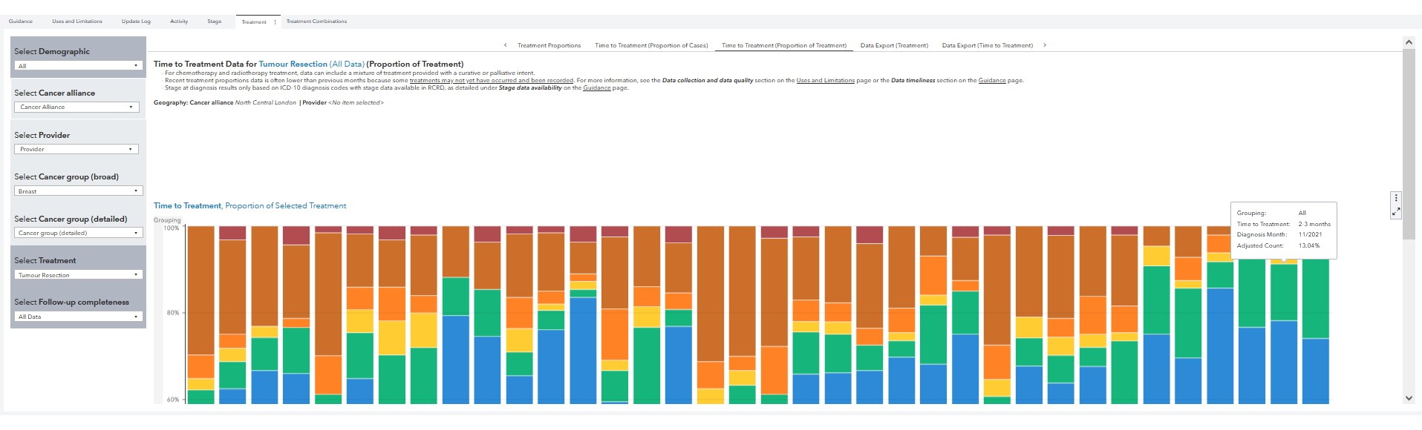
RCRD time to treatment (proportion of treatment) for tumour resection of breast cancer, North Central London
Selections: activity, stage, treatment, treatment combinations, demographic breakdown, year, cancer alliance, provider, cancer group (broad & detailed), treatment, follow-up completeness
Outputs: treatment proportions, time to treatment (proportion of cases/proportion of treatment), data export (treatment/time to treatment)

Slide 78
Molecular

Slide 79
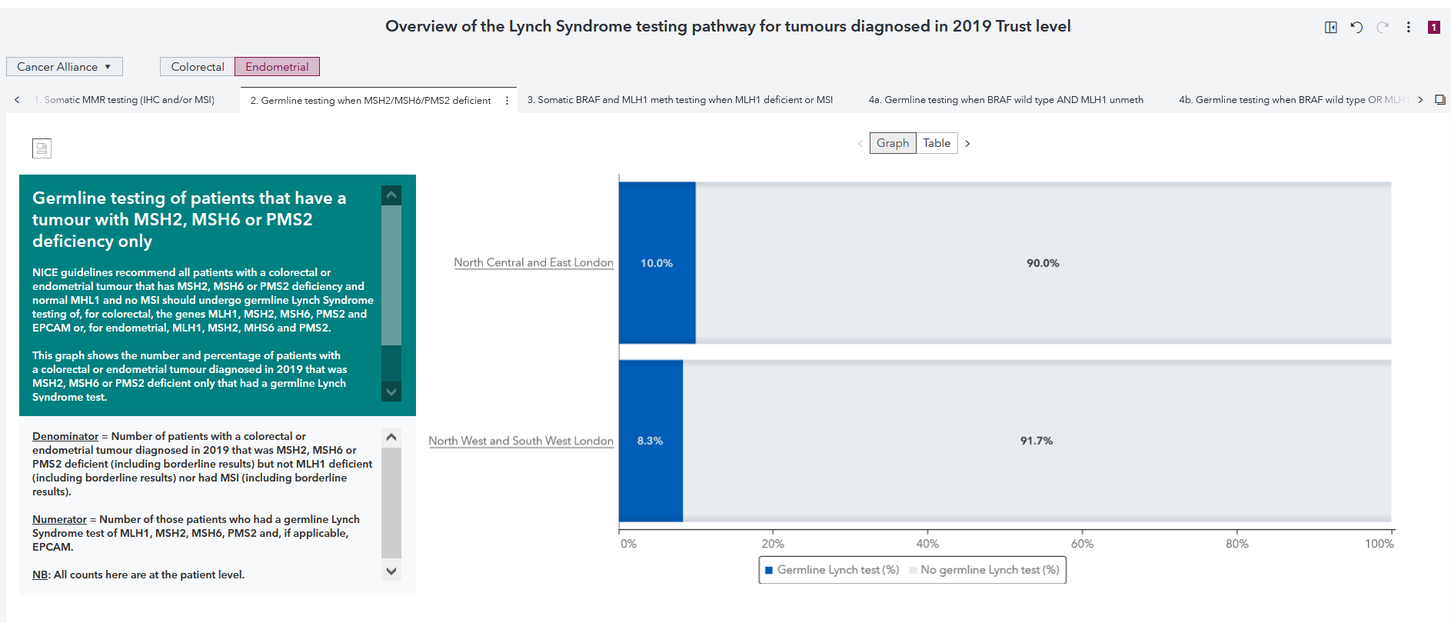
Lynch Syndrome Dashboard: Germline testing for Endometrial cancer when MSH2/MSH6/PMS2 deficient, London Cancer Alliances
Selections: cancer alliance, colorectal/endometrial, graph/table
Outputs: Somatic MMR testing (IHC and/or MSI), Germline testing when MSH2/MSH6/OMS2 deficient, Somatic BRAF and MLH1 meth testing when MLH1 deficient when MLH1 deficient or MSI, Germline testing when BRAF wild type and MLH1 unmeth, Germline testing when BRAG wild type or MLH1 unmeth

Slide 80
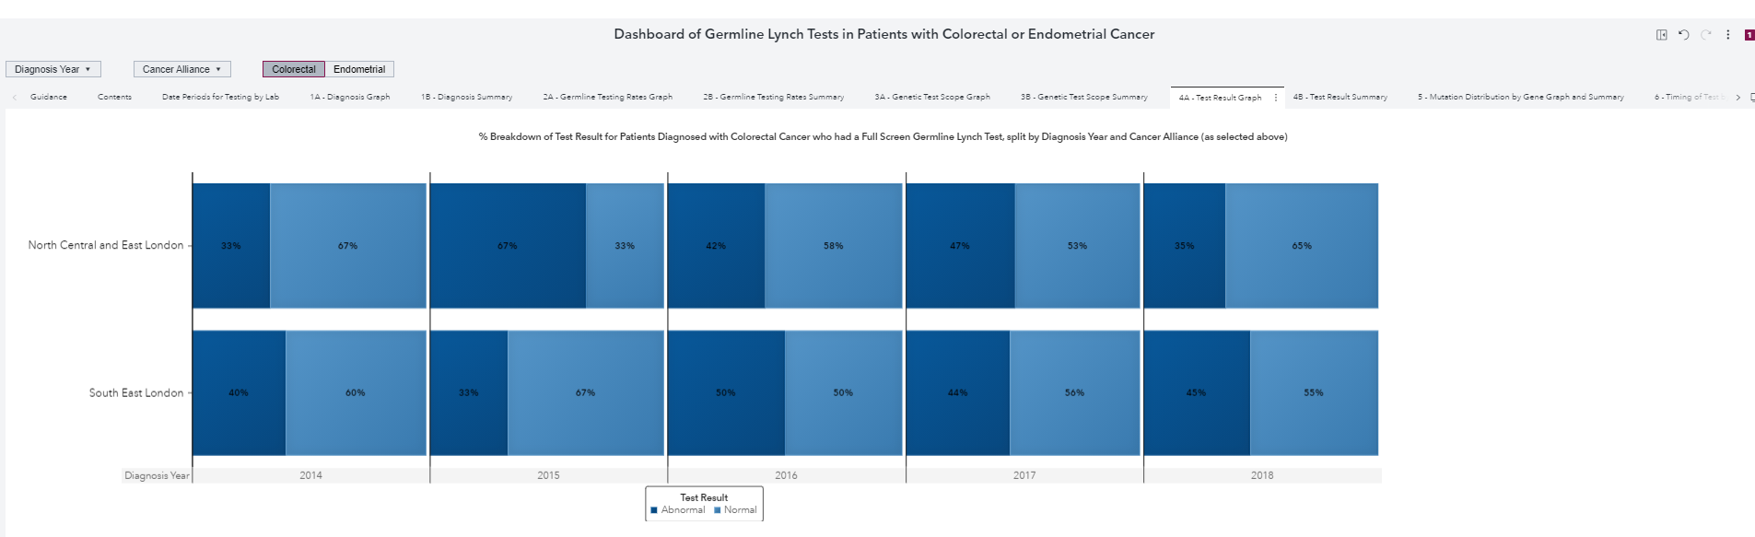
Lynch Syndrome Dashboard: test result graph for Colorectal cancer patients in South East, North Central and East London
Selections: year (diagnosis & test), cancer alliance, colorectal/endometrial
Outputs: date periods for testing by lab, diagnosis graph, diagnosis summary, germline testing rates graph, germline testing rates summary, genetic test scope graph, genetic test scope summary, test result graph, test result summary, mutation distribution by gene graph and summary…

Slide 81
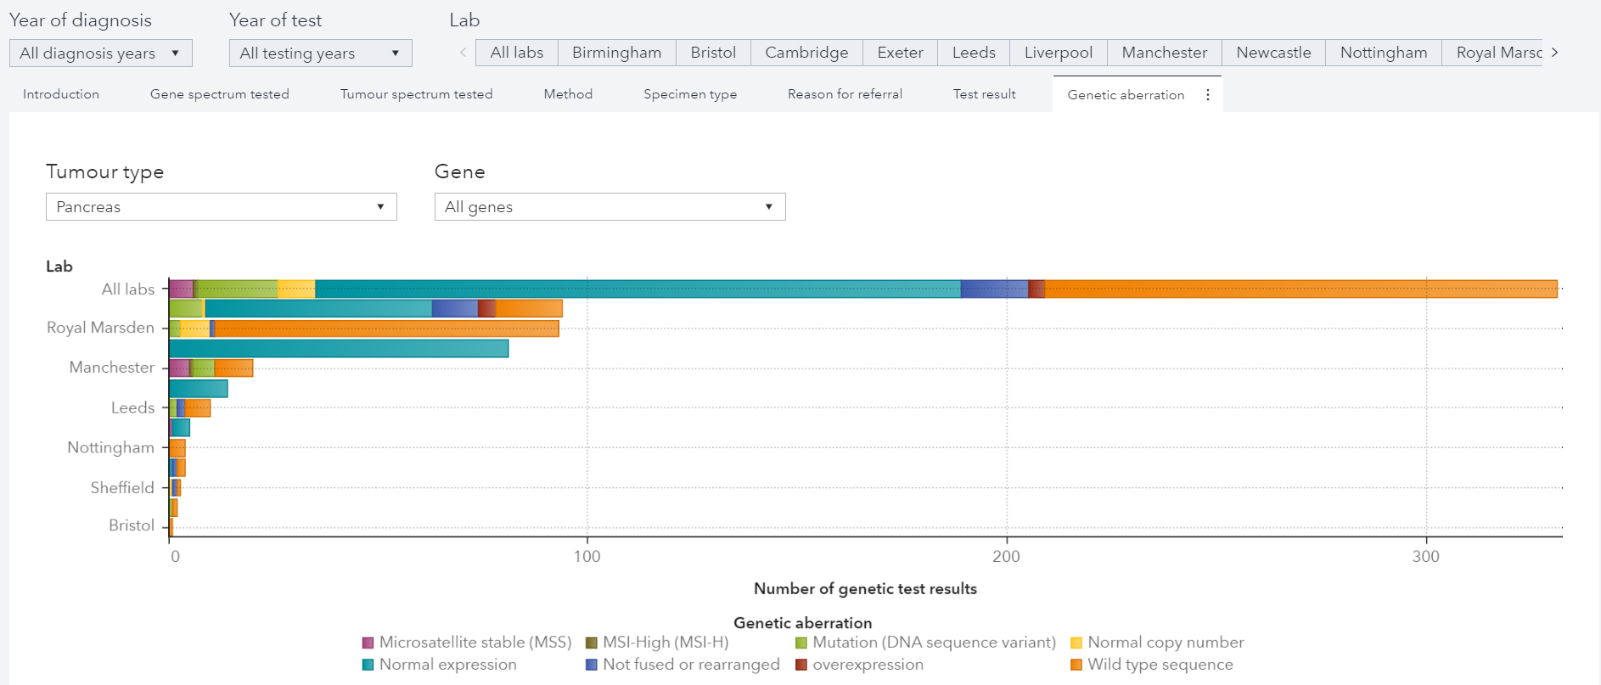
Somatic Molecular Report: Genetic aberration for Pancreas cancer
Selections: year (diagnosis & test), laboratory, tumour type, gene
Outputs: gene & tumour spectrum tested, method, specimen type, reason for referral, test result, genetic aberration

Slide 82
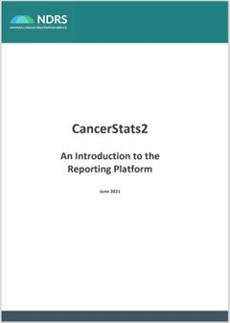

Platform Guidance Document
Link to the CS2 Guidance Document

