Slide 1

National Disease Registration Service
(NDRS)
Urological tumours
Prostate
v3 December 2025
Notes:
Welcome to this NDRS training module on Urological tumours - Prostate This module is designed to help Cancer Administration staff gain a better understanding of these tumours and the terminology used by the clinical teams.

Slide 2

Agenda
Introduction
Prostate tumours
Summary
Acknowledgements
This module may be paused at any time
Notes:
We’re going to give you a brief introduction to Urological tumours including some of the symptoms that patients might experience. We’ll look at the anatomy & physiology of the Urological system and will then go through diagnosis & treatment options. This module can be paused at any time.

Slide 3
Introduction
In this section we will cover:
  Types of Urological tumour
Notes:
Firstly, we’ll look at the various types of Urological tumour…

Slide 4
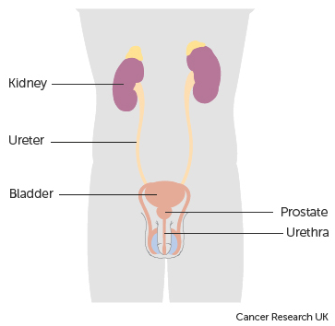
Urology
There are two main types of Urological tumours:
Prostate tumours
Urinary Tract tumours. These tumours are subdivided into:
  Kidney tumours (excludes Renal Pelvis)
  Tumours of the Renal Pelvis, Ureter, Bladder & Urethra
Notes:
Urological tumours are divided into tumours of the Prostate and tumours of the Urinary Tract. Urinary tract tumours are further classified as either Kidney or Renal Pelvis, Ureter, Bladder & Urethra. This module covers tumours of the Prostate.

Slide 5
Prostate
In this section we will cover:
  Causes and Risk Factors
  Signs and Symptoms
  Anatomy & Physiology
  Regional Lymph Nodes
  Diagnosis
In this section we will cov:
  Morphology & Topography
  Grade
  Stage
  Treatment
Notes:
We’ll start off by looking at the causes and risk factors …

Slide 6
Prostate – Causes & Risk Factors
  Increasing age
  Ethnic origin
  Family History of Prostate, Breast or Ovarian Cancer
  Lynch syndrome (a hereditary condition that also increases the risk of bowel cancer)
  Obesity
Notes:
The risk of prostate tumours increases with age. They are less common in men of Asian origin but more common where there is a family history of certain other conditions or where the patient is extremely overweight

Slide 7
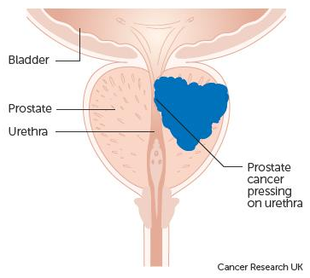
Prostate – Signs & Symptoms
Patients with an early prostate tumour may not present with symptoms. Smaller tumours are unlikely to compress and narrow the urethra
The urinary symptoms are not specific to prostate cancer, non cancer conditions such as benign prostatic hyperplasia (BPH) and prostatitis can also present with similar symptoms
Notes:
Symptoms tend to occur only once the tumour has started to narrow the urethra. However, some benign conditions may also cause the same symptoms…

Slide 8
Prostate – Signs & Symptoms
  Changes in urine flow including pain
  Dribbling of urine
  Urinary urgency or frequency
  Nocturia (waking up to urinate at night)
  Urinary retention
  Urinary incontinence
  Pain from bone metastases
  Weight loss
  Loss of libido
Notes:
… which might include pain on urinating, frequent urination or waking up at night to urinate.

Slide 9
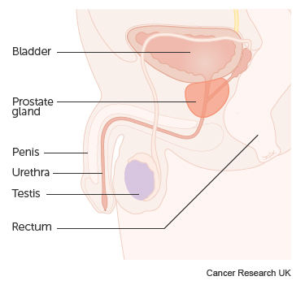
Prostate – Anatomy & Physiology
The prostate gland is about the size of a walnut and located at the base of the bladder
It can be divided anatomically either by lobes or zones, and is generally described as having two lobes, left and right although for COSD, laterality does not apply
The prostate is surrounded by a capsule which consists of a band of fibromuscular connective tissue
The prostate surrounds the urethra as it leaves the bladder
Notes:
Roughly the size of a walnut and located at the base of the bladder, the prostate is usually described as having two lobes: one on the left, one on the right. These lobes wrap around the urethra as it exits the bladder. It should be noted that although there are two lobes, there is only one prostate so laterality does not apply for the purposes of COSD.

Slide 10
Prostate – Anatomy & Physiology
The function of the prostate is to produce and secrete a fluid that constitutes about 25% of the volume of the semen
The growth and function of the prostate is dependent on the male hormone testosterone which is produced mainly by the testes, although small quantities are produced by the adrenal glands
Notes:
The prostate secretes fluid that makes up a quarter of the volume of semen. This function depends on testosterone levels in the body

Slide 11

Prostate – Regional Lymph Nodes
The regional or local lymph nodes associated with the prostate are the nodes within the pelvis below the bifurcation of the common iliac arteries
  Pelvic lymph nodes
  Hypogastric lymph nodes (situated near the internal iliac lymph nodes)
  Obturator lymph nodes (situated near the external iliac lymph nodes)
  Iliac lymph nodes
  Sacral lymph nodes (situated near the sacrum at the base of the spine)
http://training.seer.cancer.gov/ss_module08_lymph_leuk/lymph_unit02_sec02_reg_lns.html
Notes:
Regional lymph nodes for the prostate include the Pelvic, iliac and sacral lymph nodes

Slide 12
Prostate - Diagnosis
YES
Biopsy
(US guided / Template / MRI guided)
Bone Scan
PSA Test
and
DRE
Metastases suspected that may alter treatment plan?
MRI / CT Scan
NO
Treatment
Notes:
The diagnostic process usually starts with a Prostate Specific Antigen test (or PSA test) as well as a Digital Rectal Examination. Imaging, which may include an MRI or ultrasound, normally follows, generally with a biopsy. If mets are suspected, the patient may undergo a bone scan

Slide 13
Prostate – Diagnosis - Prostate Specific Antigen
Prostate Specific Antigen (PSA) is a protein produced in the prostate and can be detected in the blood
Elevated PSA levels in the blood can give an indication of problems in the prostate, but is not always cancer. A number of benign conditions can cause PSA level to rise, such as prostatitis and benign prostatic hyperplasia (BPH)
If a patient is found to have a raised PSA, it is not diagnostic for prostate cancer but can give an indication that further investigations are necessary
In patients diagnosed with prostate cancer, PSA testing can be used to monitor the patient
Notes:
PSA is detected via a blood test. Higher levels of PSA indicate that further investigation is needed but are not necessarily an indication of a tumour.

Slide 14
Prostate – Diagnosis - Digital Rectal Examination (DRE)
Digital rectal exams involve the examination of the prostate through the rectal wall and are used in conjunction with other tests to diagnose problems with the prostate
Enlarged
Hardened
Lumpy
The results from DRE are also an important component to staging invasive prostate tumours
Notes:
DREs are used to assess the size, palpability and smoothness of the prostate and are important in the staging process.

Slide 15
Prostate – Diagnosis - Imaging
Ultrasound Scan
  Used to guide prostate biopsies.
MRI Scan
  Used for assessment of local spread of the tumour, and may also include information on nodal involvement. Sometimes used for targeted biopsies.
CT Scan
  Used when MRI is not possible.
  Used to assess nodal involvement and distant metastasis.
Bone Scan
  Used to check for bone metastasis as bone is the most common site of distant spread.
Notes:
Several types of imaging may be utilised and these may include a trans-rectal ultrasound to guide a biopsy. MRIs may also be used to guide biopsies as well as to assess nodal involvement. Bone scans are used where mets are suspected

Slide 16
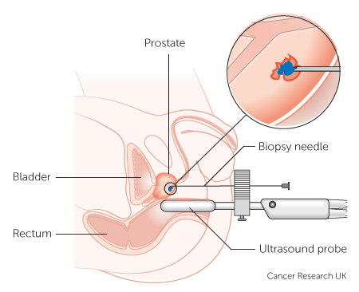
Prostate – Diagnosis - Biopsy
The most definitive diagnostic test is a biopsy. There are different techniques to biopsy the prostate:
Transrectal US guided biopsy
Transrectal US guided biopsy using prior MRI data (also known as a fusion biopsy)
Template biopsy
Notes:
The definitive test for malignancy is a biopsy. Biopsies may be guided by Ultrasound, with or without MRI imaging, or by use of a template

Slide 17
Prostate – Morphology & Topography - Invasive
Assigning a tumour site for a primary prostate cancer is very simple as all are assigned the same topography: C61X
The morphology of the majority of invasive tumours arising in the prostate is adenocarcinoma – M81403
Notes:
All invasive tumours of the prostate are ICD10 coded as C61X. Most invasive tumours are adenocarcinomas.

Slide 18
Prostate – Morphology & Topography - Invasive
Another invasive morphology, transitional cell carcinoma cannot arise in the prostate. If this morphology is found in the prostate, this will have arisen in the prostatic urethra or the bladder and spread into the prostate. In this instance the primary cancer would be recorded as:
C68.0 – Urethra
C68.1 – Paraurethral gland
C68.8 – Overlapping lesion of urinary organs
C68.9 – Urinary organ, unspecified
Notes:
If the pathology report reveals transitional cell carcinoma, the tumour cells will not have originated in the prostate. These will be a metastatic deposit from a different primary tumour and the ICD10 code in the pathway will need to reflect this.

Slide 19
Prostate – Morphology & Topography – In Situ
  Once diagnosed, an in situ prostate tumour is classified as D07.5
  While your clinical team may request that D07.5 in-situ stomach tumours are recorded, these do not currently require a COSD submission from your cancer data management system – NDRS obtains this data direct from pathology laboratories
  The final digit of the ICD-O-3 morphology code describes the behaviour – see the NDRS training module: What is Cancer?
Notes:
If the pathology comes back as in-situ, this is coded as D07.5. It should be noted that while your clinical team may request that non-invasive tumours are also recorded, these do not currently need a COSD submission from your cancer data management system – NDRS obtains this data direct from the pathology labs

Slide 20

Prostate – Grade
The Gleason score (grade) will ALWAYS have at least two components and may include a third:
Each component is a grade between
one and five, ie.:
3 + 4
The most common grade seen in the
Pathology sample is listed first (in this
instance 3) followed by the next most
common grade (here it’s 4)
Notes:
Prostate tumours are graded using the Gleason system, which will always have at least two component numbers and may sometimes have three. These numbers describe the appearance of the tumour cells under the microscope: The higher the number, the more abnormal the cells appear. The position of the number in the score indicates how common that level of abnormality is within the sample – the most common grade is listed first.

Slide 21
Prostate – Stage
Invasive prostate tumours are staged as follows:
      For diagnosis dates up to 31st December 2025 use UICC TNM v8
      For diagnosis dates from 1st January 2026 use UICC TNM v9
Please note that the TNM version must be accurately recorded – if you are unable to amend the version on your cancer data management system, please refer to your line manager
If, after 1st January 2026, your cancer data management system has not been amended to include TNM v9 please record the TNM v9 stage and add the following statement to the Primary Diagnosis Subsidiary Comment field:
  Patient staged using TNM9 not TNM8 as per CR2070
Notes:
Invasive prostate tumours are staged using the appropriate UICC TNM version

Slide 22
Prostate – Stage
For details on recording stage, please see the NDRS training module KPI-TNM Staging 101, available on this link: https://digital.nhs.uk/ndrs/data/cancer-data-training-materials
TNM stage should be recorded for all invasive tumours
Notes:
For details on recording stage please refer to the NDRS training module KPI-TNM Staging 101

Slide 23
Prostate – Stage – Pre-Treatment
MRI / DRE
T stage
PATHOLOGY FROM BIOPSY*
*not all cases – clinical assessment also needed
N stage
TRUSS / MRI
Option 1: Clinical
Judgement
M stage
Option 2: If metastatic deposits are suspected, further imaging may be carried out for a clinical (radiological) pre-treatment M stage: CT / Bone Scan / Other
Notes:
Most patients will undergo a non-surgical 1st treatment meaning the pathway must have a pre-treatment stage recorded. It’s derived by the clinical team, based on physical examination, imaging – in some cases, a biopsy - and any other relevant examinations. Where there is no suspicion of metastatic deposits, it’s expected that the clinical team would direct administrators to record M0

Slide 24
Prostate – Stage – Integrated
Pathology from EXCISION (T) / NODES (N)
T stage
Previous TRUSS / MRI
N stage
Option 1: Clinical
Judgement
M stage
Option 2: If metastatic deposits are suspected, further imaging may be carried out for a final integrated M stage: CT / Bone Scan / Other
Notes:
While surgery for prostate tumours is rarer, the Integrated stage is determined following surgery as the 1st treatment. This is determined from the integration of the pathological T & N stage and any other information collected such as metastasis which is usually arrived at by clinical means. Again, where there’s no suspicion of mets, it’s expected that the clinical team would direct administrators to record M0

Slide 25
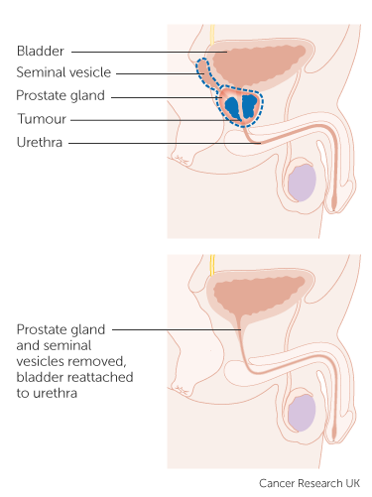
Prostate – Treatment - Surgery
Prostatectomy
The excision of the entire prostate gland, local nodes and nearby organs with a curative intent
Patients with a fast growing locally advanced tumour that needs radical treatment can be offered a prostatectomy, provided that they are fit enough for major surgery
There are significant side effects to prostatectomy which has to be considered before a decision for surgery to be made
Notes:
If Surgery is required, it may be in the form of a radical prostatectomy, where both the prostate and seminal vesicles are removed…

Slide 26
Prostate – Treatment - Surgery
Transurethral Resection of Prostate (TURP)
TURP removes part of the prostate tissue that is pressing against the upper part of the urethra and restricting the flow of urine
Usually TURP will not cure the patient, but can relieve symptoms of a prostate tumour
TURP may be the only treatment required for non-invasive or early stage invasive tumours
Notes:
… or in some instances a TURP will be offered. This surgery doesn’t usually cure the patient but will relieve pressure on the urethra, allowing urine to pass more easily.

Slide 27
Prostate – Treatment – Hormone Therapy
The prostate is affected by the testosterone levels in the blood, this can be manipulated to treat/manage prostate tumours
Hormones to reduce the level of testosterone in the blood which can slow the development of a prostate tumour
There are different types of drugs that reduce testosterone levels and they are
  Luteinising hormone blockers
  Anti-androgens
Notes:
Many patients are given hormone therapy to reduce the amount of testosterone in the body. This can slow the growth of a tumour but won’t cure it

Slide 28

Prostate – Treatment - Radiotherapy
External Beam Radiotherapy
High energy X rays are able to damage tumour cells, preventing them from growing
Can be used to treat the whole prostate, regional lymph nodes with a curative intent
Patients with bone metastasis can receive radiotherapy to relieve pain
Notes:
External beam radiotherapy may be offered with curative intent. For advanced cases where a curative treatment is not possible, the patient may undergo radiotherapy to bone mets to relieve symptoms

Slide 29
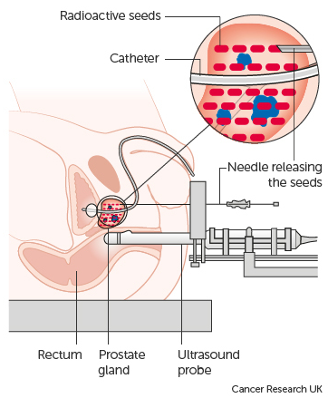
Prostate – Treatment - Radiotherapy
Brachytherapy
Rather than external sources of radiation, a radioactive source is inserted into the body
Low Dose (pictured) - Small radioactive metal seeds are inserted into the tumour to release over a period of time
High Dose – Small tubes of radioactive material is inserted into the testicles or rectum, they are removed once the correct dose has been achieved
Notes:
Brachytherapy is where a radioactive source is inserted into the body. The radiation destroys nearby cancer cells whilst minimising damage to surrounding tissue. In low dose brachytherapy, small pieces of radioactive metal are permanently inserted into the tumour, whereas for high dose brachytherapy the radioactive source is only temporarily inserted.

Slide 30
Prostate – Treatment – Active Surveillance
Active Surveillance
May be offered where the patient has a very early stage tumour that is slow-growing or where the patient has declined or wishes to delay other active treatments
Regular PSA checks
Periodic DRE
Multiparametric MRI
The treatment plan may change if the tumour progresses
For the purposes of COSD, Active Surveillance is recorded as Active Monitoring
Notes:
Patients may be offered Active Surveillance if their tumour is either at an early stage or if they wish to decline or delay other active treatments. This would involve regular PSA checks & DREs, and potentially a specialised type of MRI. If the tumour progresses, the treatment plan may change.

Slide 31
Prostate – Treatment – Watchful Waiting
Watchful waiting
May be offered where the patient has an advanced but asymptomatic tumour or a localised tumour where co-morbidities preclude other active treatments
Regular PSA checks
The treatment plan may change if the tumour progresses
For the purposes of COSD, Watchful Waiting is also recorded as Active Monitoring
Notes:
Patients with advanced prostate cancer but no symptoms may be offered Watchful Waiting as a treatment option, which involves only PSA checks at a longer interval. This may also be offered to patients with a localised tumour as well as other health conditions that would prevent more radical treatment options. For the purposes of COSD, both Active Surveillance & Watchful Waiting would be recorded as Active Monitoring

Slide 32
Summary
Notes:
To summarise…

Slide 33
Summary
Risk factors for prostate tumours include increased age, ethnicity and a family history of certain other cancers
The symptoms of prostate tumours can be the same as those of other benign conditions. Symptoms include difficulty urinating, waking up at night to urinate and frequent urination
Investigations usually start with a PSA test and a DRE and may include imaging with/without a biopsy.
If a tumour is diagnosed it may be invasive, in situ or of unknown or uncertain behaviour. While all invasive tumours must be recorded, non-invasive tumours do not need to be recorded on a cancer data management system for the purposes of COSD - NDRS obtains these records directly from pathology laboratories
Notes:
Risk factors for prostate tumours include increased age, ethnicity and a family history of specified cancers

Slide 34
Summary
Risk factors for prostate tumours include increased age, ethnicity and family history of certain other cancers
The symptoms of prostate tumours can be the same as those of other benign conditions. Symptoms include difficulty urinating, waking up at night to urinate and frequent urination
Investigations usually start with a PSA test and a DRE and may include imaging with/without a biopsy.
If a tumour is diagnosed it may be invasive, in situ or of unknown or uncertain behaviour. While all invasive tumours must be recorded, non-invasive tumours do not need to be recorded on a cancer data management system for the purposes of COSD - NDRS obtains these records directly from pathology laboratories
Notes:
Patients may present with difficulty urinating, waking up at night needing to urinate or needing to urinate more often but these can also be symptoms of benign conditions

Slide 35
Summary
Risk factors for prostate tumours include increased age, ethnicity and family history of certain other cancers
The symptoms of prostate tumours can be the same as those of other benign conditions. Symptoms include difficulty urinating, waking up at night to urinate and frequent urination
Investigations usually start with a PSA test and a DRE and may include imaging with/without a biopsy
If a tumour is diagnosed it may be invasive, in situ or of unknown or uncertain behaviour. While all invasive tumours must be recorded, non-invasive tumours do not need to be recorded on a cancer data management system for the purposes of COSD - NDRS obtains these records directly from pathology laboratories
Notes:
A PSA test and DRE are common diagnostic tests which are usually followed with imaging and probably a biopsy

Slide 36
Summary
Risk factors for prostate tumours include increased age, ethnicity and family history of certain other cancers
The symptoms of prostate tumours can be the same as those of other benign conditions. Symptoms include difficulty urinating, waking up at night to urinate and frequent urination
Investigations usually start with a PSA test and a DRE and may include imaging with/without a biopsy
If a tumour is diagnosed it may be invasive, in situ or of unknown or uncertain behaviour. While all invasive tumours must be recorded, non-invasive tumours do not need to be recorded on a cancer data management system for the purposes of COSD - NDRS obtains these records directly from pathology laboratories
Notes:
If a tumour is diagnosed, it may or may not be invasive. All invasive tumours must be recorded in your cancer data management system and while the clinical team might request that non-invasive tumours are recorded, these do not need to be recorded for the purposes of COSD – NDRS obtains these records directly from the pathology labs

Slide 37
Summary
Additional guidance on recording COSD data including morphology, topography, staging and recording a diagnosis can be found at: https://digital.nhs.uk/ndrs/data/cancer-data-training-materials
Staging data sheets can also be downloaded from the NDRS website for clinical use: https://digital.nhs.uk/ndrs/data/cancer-data-training-materials/staging-sheets
Notes:
Additional training modules as well as Staging sheets for clinical use may be downloaded from the NDRS website.

Slide 38
Summary
If in any doubt as to whether you should be recording a diagnosis, please refer to the latest COSD User Guide, Appendices A, B & C
For guidance on the required staging system, please refer to the latest COSD User Guide, Appendix E
https://digital.nhs.uk/ndrs/data/data-sets/cosd#downloads
Notes:
Do please remember, guidance is available on our website. You can download the COSD User Guide by clicking on this link and selecting the COSD version appropriate to your trust.

Slide 39

Acknowledgements
Many thanks to Cancer Research UK for the use of their images within this training module.
Notes:
We’d like to thank Cancer Research UK for the use of their images within this training module.

Slide 40
Questions?
East Midlands: Simon Cairnes – simon.cairnes@nhs.net
Eastern: Marianne Mollett – marianne.mollett@nhs.net
London & South East: Katrina Sung – katrina.sung@nhs.net
London & South East: Karen Graham– karen.graham36@nhs.net
North West: Paul Stacey – p.stacey@nhs.net
Northern & Yorkshire: Rachael Mann – rachaelmann@nhs.net
Oxford: Gemma Feeney – gemma.feeney@nhs.net
South West: James Withers – james.withers@nhs.net
West Midlands: Gemma Feeney – gemma.feeney@nhs.net
Notes:
If you have any questions on the information contained within this module or about COSD in general, do please feel free to email your regional Data Liaison Manager

