Slide 1

National Disease Registration Service
(NDRS)
Urological tumours
Urinary Tract – Kidney
v3 December 2025
Notes:
Welcome to this NDRS training module on tumours of the Kidney which has been designed to help Cancer Administration staff gain a better understanding of these tumours and the terminology used by the clinical teams.

Slide 2

Agenda
Introduction
Urinary Tract - Kidney (excludes Renal Pelvis)
Summary
Acknowledgements
This module may be paused at any time
Notes:
In this module we’ll give you a brief introduction to Kidney tumours including some of the symptoms that patients might experience. We’ll look at the anatomy & physiology of the renal system and will then go through diagnosis & treatment options. This module can be paused at any time.

Slide 3
Introduction
In this section we will cover:
  Types of Urological tumour
Notes:
Firstly, we’ll look at the various types of Urological tumour…

Slide 4
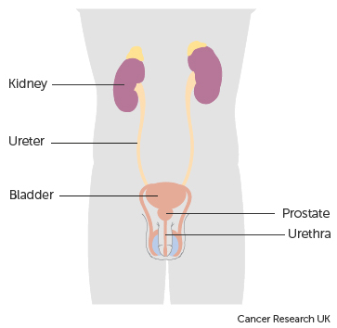
Urology
There are two main types of Urological tumours:
Prostate tumours
Urinary Tract tumours. Theses tumours are subdivided into:
  Kidney tumours (excludes Renal Pelvis)
  Tumours of the Ureter (includes Renal Pelvis), Bladder & Urethra
Notes:
Urological tumours are divided into tumours of the Prostate and tumours of the Urinary Tract. Urinary tract tumours are further classified as either Kidney or Ureter, Bladder & Urethra. This module covers tumours of the Kidney.

Slide 5
Urinary Tract - Kidney (excludes Renal Pelvis)
In this section we will cover:
  Causes and Risk Factors
  Signs and Symptoms
  Anatomy & Physiology
  Regional Lymph Nodes
  Diagnosis
In this section we will cov:
  Morphology
  Topography
  Grade
  Stage
  Treatment
Notes:
We’ll start off by looking at the causes and risk factors …

Slide 6
Kidney – Causes & Risk Factors
Obesity
Smoking
Family history
Kidney disease / dialysis patients
Previous radiotherapy treatment for testicular or cervical cancer
High blood pressure
History of thyroid cancer
Type 1 diabetes
Non-steroidal anti-inflammatory drugs
Notes:
Risk factors for a kidney tumour include being very overweight, smoking and existing kidney disease

Slide 7
Kidney – Signs & Symptoms
The most common kidney cancer is Renal Cell Carcinoma. Renal Cell Carcinomas normally present with haematuria (blood in the urine), while other symptoms can include:
Lump / mass in the kidney region
Anaemia (lack of red blood cells leading to reduced oxygen levels in the blood)
Hypercalcaemia (raised calcium levels in the blood)
Haematuria (blood in the urine)
High blood pressure
High temperature, night sweats, tiredness
Urinary symptoms with pain, burning, frequency etc.
Painful spasms in the ureters or bladder caused by blood clots
Notes:
Most kidney tumours are renal cell carcinomas. Symptoms of a renal cell carcinoma might include blood in the urine, anaemia or a mass in the area of the kidneys

Slide 8
Kidney – Signs & Symptoms
Wilms tumours (Nephroblastoma) are most common in children. These frequently present as a painless swelling of the abdomen. However, other symptoms may include:
Bleeding inside the tumour causing pain
Haematuria (blood in the urine)
High blood pressure
Fever
Loss of appetite
Weight loss
Notes:
Wilms tumours are most common in children, whose symptoms may include pain, fever or a loss of appetite

Slide 9
Kidney – Anatomy & Physiology
The kidneys are two bean shaped organs that are part of the urinary system, positioned along the spinal column with one kidney either side of the spine just under the ribcage. The right kidney usually sits slightly lower than the left
You may be familiar with the term “renal” which simply means “relating to the kidneys”
Notes:
Part of the system that filters the blood and generates waste product in the form of urine, the kidneys sit just underneath the ribcage on either side of the spine.

Slide 10
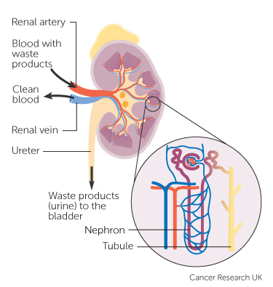
Kidney – Anatomy & Physiology
Each kidney has two distinct regions:
  The outer functional area consisting of the cortex and medulla
  The inner renal pelvis where urine is collected
Within the medulla, networks of tubes called nephrons filter the blood. As blood passes through the nephrons all unwanted waste is taken away. Chemicals that your body needs are kept or returned to the bloodstream
Notes:
The outer part of the kidney filters the blood, removing waste products and producing urine to be collected in the renal pelvis

Slide 11
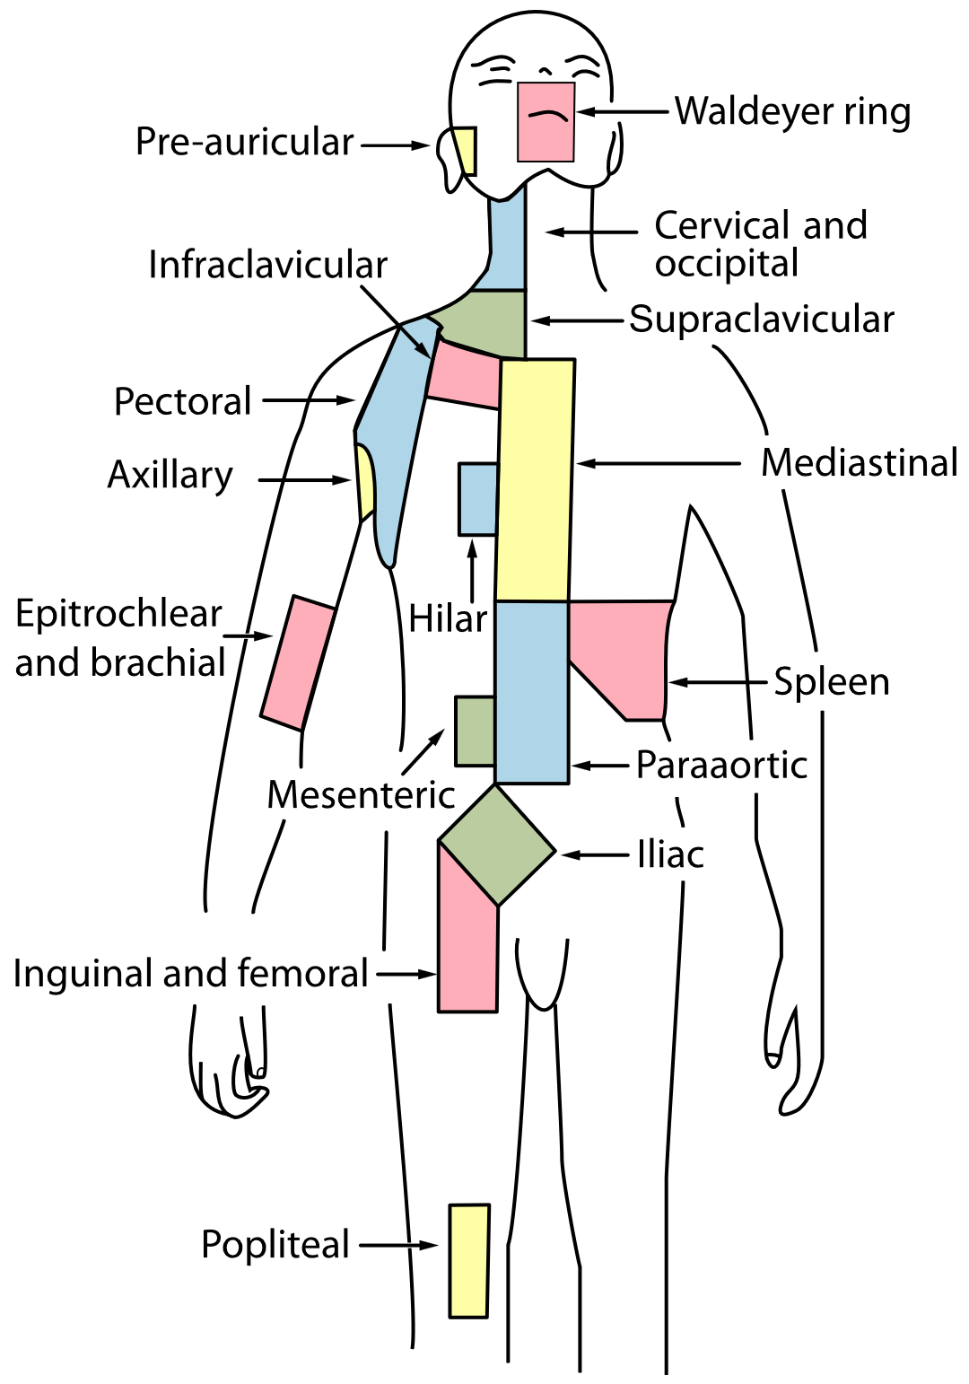
Kidney – Regional Lymph Nodes
The regional or local lymph nodes associated with the kidneys are
Hilar lymph nodes
Abdominal para-aortic lymph nodes
Paracaval lymph nodes (near the diaphragm)
Notes:
The regional lymph nodes for kidney tumours are the hilar, abdominal-para-aortic and paracaval nodes.

Slide 12
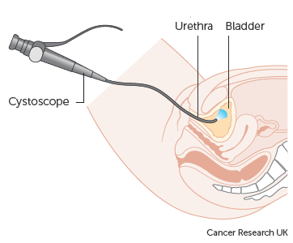
Kidney – Diagnosis
About half of all patients diagnosed with kidney cancer will have haematuria. A urine sample will be tested for evidence of haematuria
Imaging tests are to ensure that any blood in the urine is not coming from the bladder or another part of the urinary tract
Cystoscopy (pictured)
Renal Ultrasound
CT Urogram
Notes:
Where blood is found in the urine, imaging will be conducted to rule out involvement of other parts of the urinary system … such as the bladder or ureter. An ultrasound or CT Urogram might be used to view the functionality of the urinary system and could highlight any areas that might indicate a lesion.

Slide 13
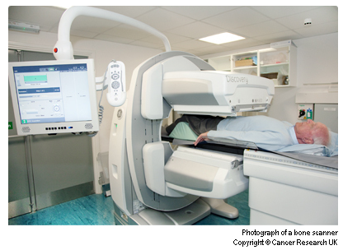
Kidney – Diagnosis
If a lesion is observed in imaging, biopsy samples may be taken from the kidney. Histological confirmation is very important, as different morphological types can have differing prognosis and treatment options.
The tests to look for the extent of any spread from the primary kidney cancer may include
CT scan
MRI scan
Bone scan (pictured)
Chest X-ray
Notes:
If imaging does show a lesion on a kidney, a biopsy may be taken to determine the type and behaviour of any tumour. Further imaging may then be used to determine the extent of spread

Slide 14
Kidney – Morphology
The majority of invasive tumours arising in the kidney (excluding renal pelvis) are Renal Cell Carcinoma which have several ICD-O-3 morphological types including (but not limited to):
Clear Cell Renal Cell Carcinoma - M8310/3
Papillary Renal Cell Carcinoma – M8260/3
Chromophobe Renal Cell Carcinoma - M8270/3
Carcinoma of the collecting ducts - M8319/3
Sarcomatoid or Pseudosarcomatous Carcinoma - M8033/3
Renal Cell Carcinoma NOS – M8312/3
Occurring mainly in children, the morphology code for a Wilms tumour (Nephroblastoma) is M8960/3
Morphology code or description would normally be found on the pathology report
Notes:
Most invasive renal tumours are renal cell carcinomas, which may be classified under a range of ICD-O-3 morphology codes, some of which are shown here … Also shown is the morphology code for Wilms tumours. Morphology code or description can normally be found in the pathology report

Slide 15
Kidney – ICD10 Topography
Invasive tumours of the kidney (excluding renal pelvis) are ICD10 coded as: C64X. All invasive tumours must be recorded
Carcinoma in-situ of the kidney are ICD10 coded as D09.1 – Carcinoma in-situ of other and unspecified urinary organs
Carcinoma of uncertain or unknown behaviour of the kidney is ICD10 coded as D41.0
A COSD record is not required for D09.1 or D41.0 - NDRS obtains these records directly from pathology laboratories
Notes:
All invasive tumours of the kidney (excluding renal pelvis) are ICD10 coded as C64X and must be recorded in your cancer data management system. Non-invasive kidney tumours do not require a COSD record – NDRS obtains the information on these tumours direct from the path labs

Slide 16
Kidney – Grade – Renal Cell Carcinoma
1
2
3
4
Most Differentiated
Least Differentiated
Fuhrman grade is a specific grading system for renal cell carcinoma
As with many grading systems, it classifies tumours based on how closely the cells resemble normal, functioning cells. For more details on grade and differentiation, please see the NDRS training module: What is Cancer? https://digital.nhs.uk/ndrs/data/cancer-data-training-materials
Wilms tumours are not graded using this system.
Notes:
Renal Cell carcinomas are graded using the Fuhrman system. A Grade 1 – or Well Differentiated – cell will closely resemble normal cells and may still be able to carry out some of the functions of a normal cell. A Grade 5 cell will look very different to a normal cell and have much less functionality

Slide 17
Kidney – Stage – Renal Cell Carcinoma
Invasive renal tumours (excluding Wilms) are staged as follows:
      For diagnosis dates up to 31st December 2025 use UICC TNM v8
      For diagnosis dates from 1st January 2026 use UICC TNM v9
Please note that the TNM version must be accurately recorded – if you are unable to amend the version on your cancer data management system, please refer to your line manager
If, after 1st January 2026, your cancer data management system has not been amended to include TNM v9 please record the TNM v9 stage and add the following statement to the Primary Diagnosis Subsidiary Comment field:
  Patient staged using TNM9 not TNM8 as per CR2070
Notes:
Invasive tumours other than Wilms tumours are staged using the appropriate UICC TNM version.

Slide 18
Kidney – Stage – Renal Cell Carcinoma
For details on recording stage, please see the NDRS training module KPI-TNM Staging 101, available on this link: https://digital.nhs.uk/ndrs/data/cancer-data-training-materials
TNM stage should be recorded for all invasive non-Wilms tumours
Notes:
For details on recording stage please refer to the NDRS training module KPI-TNM Staging 101

Slide 19
Kidney – Stage – Wilms Tumour (Nephroblastoma)
Wilms tumours are staged after surgery using the following system for the purposes of COSD:
Stage 1
Stage 2
Stage 3
Stage 4
Stage 5
Tumour is limited to the kidney and completely resected.
Tumour is completely resected, and there is no evidence of tumour at or beyond the margins of resection but the tumour extends beyond the kidney.
There is residual tumour following surgery that is confined to the abdomen.
There are distant metastases (lung, liver, bone, brain), or lymph node metastases outside the abdominopelvic region.
Involvement of both kidneys is present at diagnosis.
Notes:
Wilms tumours are staged post-surgery using a numeric system. A patient with bilateral tumours is automatically stage 5.

Slide 20
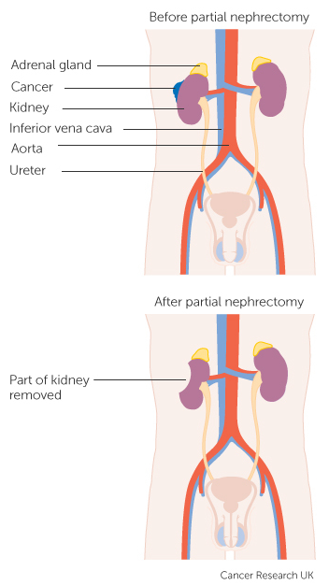
Kidney – Treatment – Renal Cell Carcinoma
Surgery
Partial / Full (Radical) Nephrectomy
Surgical excision of the kidney and regional lymph nodes is the most effective treatment for early stage tumours
Some later stage tumours may be also be treated with surgery if they are assessed as resectable
Partial nephrectomy illustrated
Notes:
Surgery to remove all or part of the kidney is called a nephrectomy. Nephrectomies are often the most effective treatment for early stage tumours … although they may also be carried out for some later stage tumours if deemed to be resectable

Slide 21

Kidney – Treatment – Renal Cell Carcinoma
Targeted Treatments & Immunotherapy
Targeted treatments or immunotherapy will either specifically affect the tumour cells or highlight them to the patient’s own immune system. These treatments may be offered to slow the growth of the tumour depending on several factors:
The type of the tumour
The grade of the tumour
The stage of the disease
Notes:
Targeted treatments work by specifically affecting the cells in the tumour. Immunotherapy works by highlighting tumour cells to the body’s own immune system, helping it to attack the cancer cells. These treatments may be offered depending on the type, grade and stage of the disease.

Slide 22


Kidney – Treatment – Renal Cell Carcinoma
Chemotherapy & Radiotherapy
Most primary kidney tumours are resistant to both chemotherapy and radiotherapy. These treatments are rarely used to treat primary kidney cancer
Sarcomatoid Renal Cell Carcinoma is an exception and chemotherapy is used
Chemotherapy & Radiotherapy can be used to treat spread beyond the kidney and for palliative treatment
Notes:
Chemotherapy is not usually a first line treatment for most renal cell carcinomas. It may be offered for sarcomatoid sub-types or as palliative treatment in combination with Radiotherapy

Slide 23
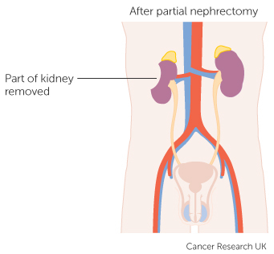
Kidney – Treatment – Wilms Tumour
Chemotherapy, Surgery & Radiotherapy
The first treatment for Wilms tumour (Nephroblastoma) is usually chemotherapy, to shrink the tumour to make surgical excision easier
All patients will have either full or partial nephrectomy as part of the treatment for Wilms tumour
  For patients with tumour spread beyond the kidneys, they may be given radiotherapy after surgery to ensure as many tumour cells are killed as possible
Notes:
Wilms tumours are normally treated with chemotherapy as a first line treatment. The intent is usually to shrink the tumour for surgical removal. Radiotherapy may also be offered to kill any residual cancer cells after surgery

Slide 24
Summary
Notes:
In summary…

Slide 25
Summary
Risk factors for renal tumours include Obesity, smoking, existing kidney disease and high blood pressure
The symptoms of renal cell carcinomas might include blood in the urine, pain around the kidneys or a palpable mass. Nephroblastomas may present with pain, loss of appetite and weight loss
Investigations may include a cystoscopy, renal ultrasound or CT Urogram
If a tumour is diagnosed it may be invasive, in situ or of unknown or uncertain behaviour. While all invasive tumours must be recorded, non-invasive tumours do not need to be recorded on a cancer data management system for the purposes of COSD - NDRS obtains these records directly from pathology laboratories
Notes:
Risk factors for renal tumours may include obesity, existing kidney disease and high blood pressure

Slide 26
Summary
Risk factors for renal tumours include Obesity, smoking, existing kidney disease and high blood pressure
The symptoms of renal cell carcinomas might include blood in the urine, pain around the kidneys or a palpable mass. Wilms tumour patients may present with pain, loss of appetite and weight loss
Investigations may include a cystoscopy, renal ultrasound or CT Urogram
If a tumour is diagnosed it may be invasive, in situ or of unknown or uncertain behaviour. While all invasive tumours must be recorded, non-invasive tumours do not need to be recorded on a cancer data management system for the purposes of COSD - NDRS obtains these records directly from pathology laboratories
Notes:
Renal cell carcinomas may present with blood in the urine or a palpable mass in the region of the kidneys. Signs of a Wilms tumour might include loss of appetite and weight loss

Slide 27
Summary
Risk factors for renal tumours include Obesity, smoking, existing kidney disease and high blood pressure
The symptoms of renal cell carcinomas might include blood in the urine, pain around the kidneys or a palpable mass. Wilms tumour patients may present with pain, loss of appetite and weight loss
Investigations may include a cystoscopy, renal ultrasound or CT Urogram
If a tumour is diagnosed it may be invasive, in situ or of unknown or uncertain behaviour. While all invasive tumours must be recorded, non-invasive tumours do not need to be recorded on a cancer data management system for the purposes of COSD - NDRS obtains these records directly from pathology laboratories
Notes:
Initial investigations may include a cystoscopy, renal ultrasound or CT Urogram

Slide 28
Summary
Risk factors for renal tumours include Obesity, smoking, existing kidney disease and high blood pressure
The symptoms of renal cell carcinomas might include blood in the urine, pain around the kidneys or a palpable mass. Wilms tumour patients may present with pain, loss of appetite and weight loss
Investigations may include a cystoscopy, renal ultrasound or CT Urogram
If a tumour is diagnosed it may be invasive, in situ or of unknown or uncertain behaviour. While all invasive tumours must be recorded, non-invasive tumours do not need to be recorded on a cancer data management system for the purposes of COSD - NDRS obtains these records directly from pathology laboratories
Notes:
If a tumour is diagnosed, it may or may not be invasive. All invasive tumours must be recorded in your cancer data management system and while the clinical team might request that non-invasive kidney tumours are also recorded, these do not need to be recorded for the purposes of COSD – NDRS obtains these records directly from the path labs

Slide 29
Summary
Additional guidance on recording COSD data including morphology, topography, staging and recording a diagnosis can be found at: https://digital.nhs.uk/ndrs/data/cancer-data-training-materials
Staging data sheets can also be downloaded from the NDRS website for clinical use: https://digital.nhs.uk/ndrs/data/cancer-data-training-materials/staging-sheets
Notes:
Additional training modules as well as Staging sheets for clinical use may be downloaded from the NDRS website.

Slide 30
Summary
If in any doubt as to whether you should be recording a diagnosis, please refer to the latest COSD User Guide, Appendices A, B & C
For guidance on the required staging system, please refer to the latest COSD User Guide, Appendix E
https://digital.nhs.uk/ndrs/data/data-sets/cosd#downloads
Notes:
Do please remember, guidance is available on our website. You can download the COSD User Guide by clicking on this link and selecting the COSD version appropriate to your trust.

Slide 31

Acknowledgements
Many thanks to Cancer Research UK for the use of their images within this training module.
Notes:
We’d like to thank Cancer Research UK for the use of their images within this training module.

Slide 32
Questions?
East Midlands: Simon Cairnes – simon.cairnes@nhs.net
Eastern: Marianne Mollett – marianne.mollett@nhs.net
London & South East: Katrina Sung – katrina.sung@nhs.net
London & South East: Karen Graham– karen.graham36@nhs.net
North West: Paul Stacey – p.stacey@nhs.net
Northern & Yorkshire: Rachael Mann – rachaelmann@nhs.net
Oxford: Gemma Feeney – gemma.feeney@nhs.net
South West: James Withers – james.withers@nhs.net
West Midlands: Gemma Feeney – gemma.feeney@nhs.net
Notes:
If you have any questions on the information contained within this module or about COSD in general, do please feel free to email your regional Data Liaison Manager

