Slide 1

National Disease Registration Service
(NDRS)
Urological tumours
Urinary Tract – Renal Pelvis, Ureter, Bladder & Urethra
v4 December 2025
Notes:
Welcome to this NDRS training module on tumours of the Renal Pelvis, Ureter, Bladder and Urethra which has been designed to help Cancer Administration staff gain a better understanding of these tumours and the terminology used by the clinical teams.

Slide 2

Agenda
Introduction
Urinary Tract – Renal Pelvis, Ureter, Bladder & Urethra
Summary
Acknowledgements
This module may be paused at any time
Notes:
We’re going to give you a brief introduction to Urological tumours including some of the symptoms that patients might experience. We’ll look at the anatomy & physiology of the Urological system and will then go through diagnosis & treatment options. This module can be paused at any time.

Slide 3
Introduction
In this section we will cover:
  Types of Urological tumour
Notes:
Firstly, we’ll look at the various types of Urological tumour…

Slide 4
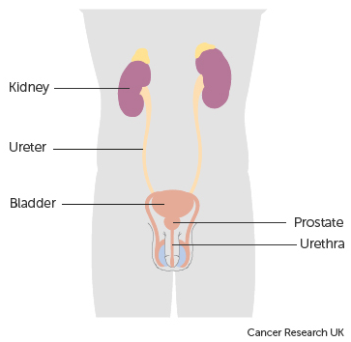
Urology
There are two main types of Urological tumours:
Prostate tumours
Urinary Tract tumours. These tumours are subdivided into:
  Kidney tumours (excludes Renal Pelvis)
  Tumours of the Renal Pelvis, Ureter, Bladder & Urethra
Notes:
… which are divided into tumours of the Prostate and tumours of the Urinary Tract. Urinary tract tumours are further classified as either Kidney or Renal Pelvis, Ureter, Bladder & Urethra. This module covers tumours of the Renal Pelvis, Ureter, Bladder and urethra.

Slide 5
Urinary Tract – Renal Pelvis, Ureter, Bladder & Urethra
In this section we will cover:
  Causes and Risk Factors
  Signs and Symptoms
  Anatomy & Physiology
  Regional Lymph Nodes
  Diagnosis
In this section we will cov:
  Morphology & Topography
  Grade
  Stage
  Treatment
Notes:
We’ll start off by looking at the causes and risk factors …

Slide 6
Urinary Tract – Causes & Risk Factors
The most common preventable risk factor for bladder cancer is smoking
Other causes and risks associated with urinary tract tumours include:
Aryl-amines (chemicals found in certain foods, dyes and other substances)
Ethnic background
Early menopause or bilateral oophorectomy (removal of the ovaries)
Bladder stones
Type 2 diabetes
Renal papillary necrosis (where certain areas of the kidney die)
Previous cancer treatment
Family history
Notes:
The main preventable risk factor for a bladder tumour is smoking. Other risks for urinary tract tumours include early menopause, bladder stones, type 2 diabetes or previous cancer treatments

Slide 7
Urinary Tract – Signs & Symptoms
The most common symptom of urinary tract cancer is haematuria with around 80% of patients presenting with evidence of blood in the urine .
Haematuria (blood in the urine – macroscopic haematuria can be seen with the naked eye, microscopic haematuria can only be seen under a microscope)
Dysuria (painful or difficult urination)
Obstruction
Notes:
Urinary tract tumours may present with blood in the urine, difficulty urinating or an obstruction in the urinary system

Slide 8
Urinary Tract – Anatomy & Physiology
The renal pelvis is the enlarged, funnel shaped upper end of the ureter that is almost completely enclosed within the kidney
The ureter connects the renal pelvis to the bladder, the organ which acts as a collection point for urine. The bladder sits behind the pubic bone at the bottom of the pelvic cavity
The urethra is a muscular tube extending from the bladder to the exterior, which transports urine from the bladder to the exterior of the body
Notes:
The renal pelvis is the top part of the ureter and is almost completely enclosed within the kidney. Urine is collected within the renal pelvis and then travels down the ureter to the bladder. Urine is then released via the urethra.

Slide 9
Urinary Tract – Anatomy & Physiology
The walls of the urinary tract consist of three main layers of tissues. From the inside, these are:
Transitional epithelium or urothelium
Submucosa (including the lamina propria)
Muscularis propria
Notes:
The urothelium (also known as the transitional epithelium) makes up the innermost layer of the urinary tract. Next to this is the submucosa and on the outside is a layer of muscular tissue.

Slide 10
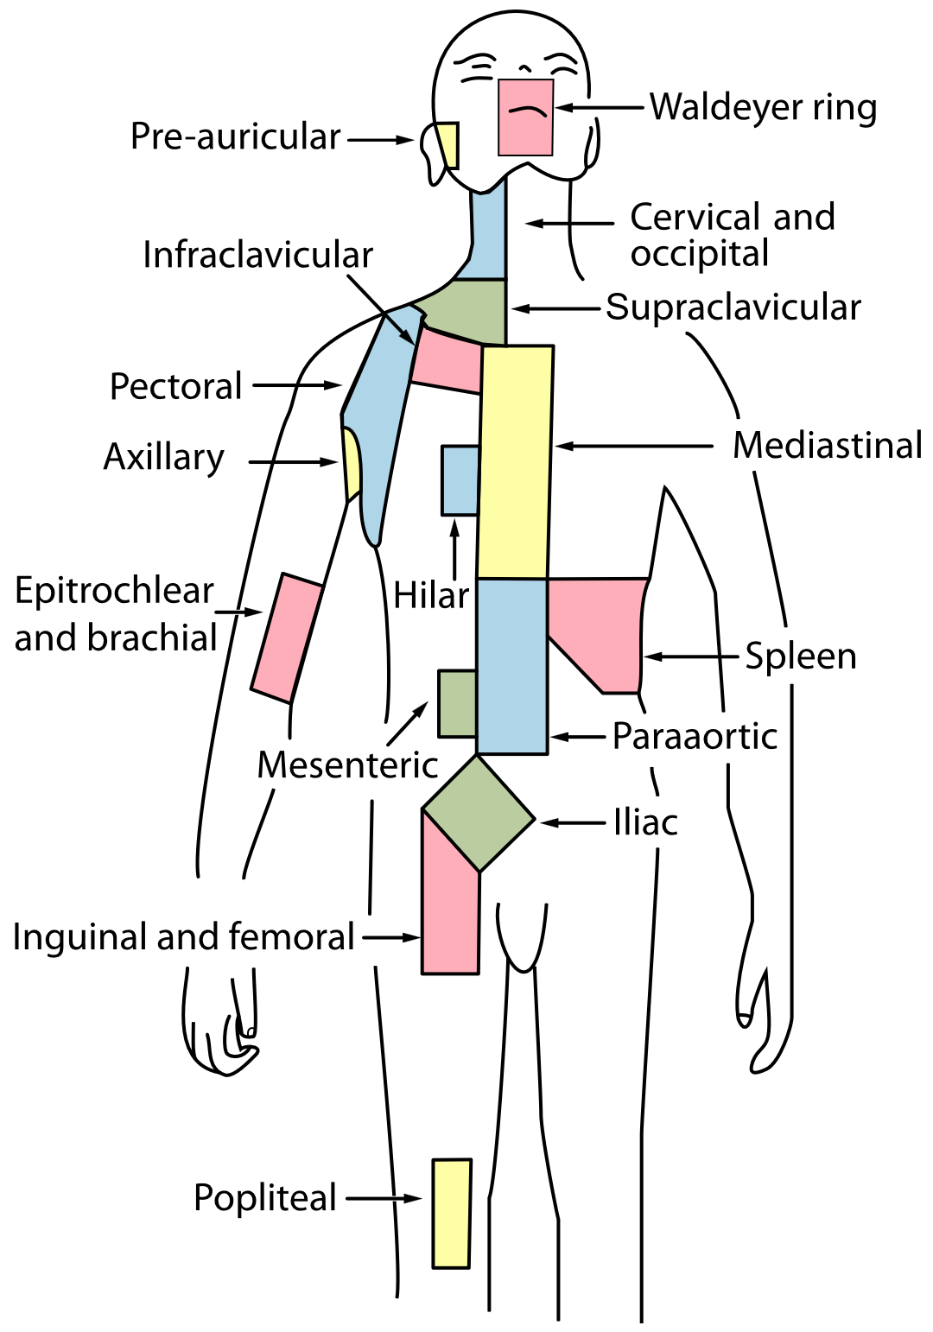
Renal Pelvis & Ureter – Regional Lymph Nodes
Renal hilar lymph nodes
Abdominal para-aortic lymph nodes
Paracaval lymph nodes (next to the vena cava blood vessel)
Intrahepatic lymph nodes (in the liver)
Notes:
During an MDT, clinical teams will often make reference to particular groups of regional lymph nodes. This may indicate that the stage of the cancer has been determined. The regional lymph nodes for tumours of the renal pelvis or ureter are listed here…

Slide 11
Bladder – Regional Lymph Nodes
Hypogastric lymph nodes (near internal iliac nodes)
Obturator lymph nodes (near external iliac nodes)
External iliac lymph nodes
Presacral lymph nodes (near the base of the spine)
Lymph nodes along the common iliac artery
Notes:
… for the bladder, here…

Slide 12
Urethra – Regional Lymph Nodes
Inguinal lymph nodes
Pelvic nodes lymph nodes
Notes:
… and finally for the urethra, here.

Slide 13


Urinary Tract – Diagnosis
Patients that have a suspected urinary tract cancer may have a urine test to identify blood or malignant cells
An ultrasound scan can examine the urinary tract to identify any blockages
An intravenous urogram (IVU) (also known as an intravenous pyelogram or IVP) is a radiological procedure with a contrast medium introduced through a vein. The contrast medium highlights any blockages or abnormal structures on x-ray imaging such as filling defects in the bladder
Notes:
Where blood is found in the urine, imaging will be carried out to rule out involvement of other parts of the urinary system. An ultrasound or Intravenous Pyelogram might be used to assess the functionality of the kidneys, ureters and bladder.

Slide 14
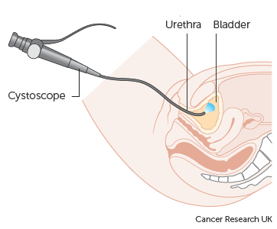
Urinary Tract – Diagnosis
CT urogram (CTU) also uses a contrast medium but with CT imaging to identify the source of blood in urine
Cystoscopy is an endoscopic procedure that examines the inside the urinary tract via the urethra. It is also possible to biopsy abnormal areas during the procedure
A biopsy is the only way to confirm the specific type of tumour, this is important because different types and behaviours of tumours will require different treatment
Notes:
Other diagnostic test options include a CT Urogram, cystoscopy or biopsy.

Slide 15
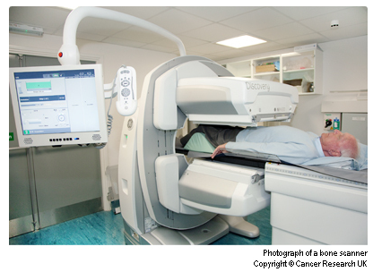
Urinary Tract – Diagnosis
Once a urinary tract cancer has been diagnosed, further investigations will be needed to assess the extent of any spread from the primary cancer.
  Glomerular filtration rate test (an assessment of how well the kidneys make urine)
  Bone scan
  PET scan
  CT scan or MRI scan
Notes:
In the event of a tumour being diagnosed, further testing will be needed to assess any spread. This may include a bone scan or other imaging

Slide 16

Urinary Tract – Morphology
Morphology code or description would normally be found on the pathology report
Invasive Tumours
Urothelial carcinoma (also known as transitional cell carcinoma or TCC) is the most common type of urinary tract tumour arising from the transitional cells of the lining of the urinary tract
  TCCs are normally defined as M8120/3
  The (very rare) spindle cell variant is M8122/3
Notes:
The most common type of tumour is a urothelial carcinoma, which would occur in the innermost layer of the urinary tract.

Slide 17
Urinary Tract – Morphology
Other types of invasive bladder cancer:
  Squamous cell carcinoma (SCC) – M8070/3
  Adenocarcinoma that arises in the mucus producing cells of the bladder lining and accounts for about 2% of all bladder cancers – M8140/3
  Sarcoma that arise in the muscle tissues of the bladder rather than the bladder lining – M8800/3
Notes:
Bladder tumours may also occur as Squamous cell carcinoma, Adenocarcinoma or sarcoma.

Slide 18
Urinary Tract – ICD10 Topography, invasive
  Renal Pelvis – C65X
  Ureter – C66X
  Bladder:
  Trigone – C67.0
  Dome – C67.1
  Lateral wall – C67.2
  Anterior wall – C67.3
  Posterior wall – C67.4
  Bladder neck – C67.5
  Ureteric orifice – C67.6
  Urachus – C67.7
  Overlapping bladder – C67.8
  Bladder unspecified – C67.9
  Urethra – C68.0
  Paraurethral gland – C68.1
  Overlapping urinary organs – C68.8
  Urinary organs unspecified – C68.9
Notes:
All invasive ICD10 codes must be recorded in your cancer data management system.

Slide 19
Urinary Tract – Morphology & ICD10 Topography, non-invasive
Some urothelial tumours are classified as non-invasive carcinoma. These include superficial tumours which are limited to the lining of the bladder that frequently recur but rarely metastasise. These must be recorded in your cancer data management system
These would be coded as:
Non-invasive papillary transitional cell carcinoma of the bladder
pTa (all grades): ICD10 coded to D09.0, morphology M8130/2
Carcinoma In-situ (flat) of the bladder
pTis: ICD10 coded to D09.0, morphology M8120/2
Notes:
Some non-invasive tumours of the urinary tract also need to be recorded. These include pTa bladder tumours and in-situ carcinomas of the bladder…

Slide 20
Urinary Tract – Morphology & ICD10 Topography, non-invasive
Non-invasive carcinomas may also occur in the renal pelvis, ureter and urethra. The ICD10 codes listed here also need to be recorded in your cancer data management system
  Neoplasm of uncertain or unknown behaviour of renal pelvis – D41.1
  Neoplasm of uncertain or unknown behaviour of ureter – D41.2
  Neoplasm of uncertain or unknown behaviour of urethra– D41.3
  If supplied in the pathology report, the morphology code for these tumours may show a behaviour code of /1 or the description would indicate “uncertain or unknown behaviour”. For more details on morphology coding please see the NDRS training module: What is cancer?
Notes:
… as well as these tumours of uncertain or unknown behaviour of other urinary organs.

Slide 21
Urinary Tract – Morphology & ICD10 Topography, non-invasive
In-situ tumours may also occur in the renal pelvis, ureter and urethra:
  Carcinoma in-situ of other and unspecified urinary organs – D09.1
  If supplied in the pathology report, the morphology code for these tumours may show a behaviour code of /2 or the description would indicate “in-situ”. For more details on morphology coding please see the NDRS training module: What is cancer?
  However, D09.1 does not require a record from your cancer management system for the purposes of COSD. NDRS obtains data on these tumours direct from the pathology laboratories
Notes:
Any in-situ carcinomas of renal pelvis, ureter or urethra are all coded to D09.1 in ICD10. Please be aware that a COSD record is not required for D09.1, NDRS obtains data on these tumours direct from the pathology labs.

Slide 22
Urinary Tract – Grade
Invasive
Invasive cancers are graded by the standard numerical system
Non-Invasive
PUNLMP (Papillary urothelial neoplasm of low malignant potential)
Grade 1 – Well differentiated
Grade 2 – Moderately differentiated
Grade 3 – Poorly differentiated
Grade 2 – Moderately differentiated
Grade 3 – Poorly differentiated
Low grade
High grade
Grade 1 – Well differentiated
Notes:
Invasive urological tumours are graded on the degree of differentiation. A Grade 1 – or Well Differentiated – cell will more closely resemble normal cells and may still be able to perform some of the functions of a normal cell. A Grade 3 cell will look very different to a normal cell and have much less functionality. Non-invasive tumours may be graded using different systems such as High or Low grade depending on the tumour

Slide 23
Urinary Tract – Stage
Invasive tumours are staged as follows:
      For diagnosis dates up to 31st December 2025 use UICC TNM v8
      For diagnosis dates from 1st January 2026 use UICC TNM v9
Please note that the TNM version must be accurately recorded – if you are unable to amend the version on your cancer data management system, please refer to your line manager
If, after 1st January 2026, your cancer data management system has not been amended to include TNM v9 please record the TNM v9 stage and add the following statement to the Primary Diagnosis Subsidiary Comment field:
  Patient staged using TNM9 not TNM8 as per CR2070
Notes:
Invasive tumours are staged using the appropriate UICC TNM version

Slide 24
Urinary Tract – Stage
For details on recording stage, please see the NDRS training module KPI-TNM Staging 101, available on this link (account required): https://digital.nhs.uk/ndrs/data/cancer-data-training-materials
TNM stage should be recorded for all invasive tumours
Notes:
For details on recording Stage please refer to the NDRS training module KPI-TNM Staging 101

Slide 25
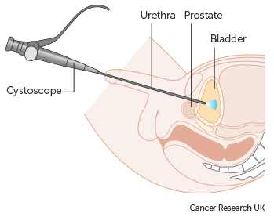
Urinary Tract – Treatment – Surgery
Surgery is the most common treatment for all urinary tract tumours, although the type and extent of the surgery will depend on factors such as the location, behaviour, stage and grade of the cancer
Early bladder tumours are usually treated with TURBT (Trans Urethral Resection of Bladder Tumour)
A TURBT is normally carried out using a cystoscope
Surgical instruments are passed down the cystoscope to remove the tumour
Notes:
For early stage urinary tract tumours, surgery is often the first treatment. In the case of an early stage bladder tumour, the surgery may take the form of a TURBT, or Trans Urethral Resection of Bladder Tumour, which is carried out via a cystoscope

Slide 26
Urinary Tract – Treatment – Surgery
For more advanced or aggressive cancers, removal of part or all of the urinary tract is likely to be performed
  Partial cystectomy
  Radical cystectomy (removal of the entire bladder)
  Nephro-ureterectomy (removal of the kidney, the associated ureter and part of the bladder)
Notes:
Where a tumour is more advanced or aggressive, the partial or complete removal of the affected organ may be needed.

Slide 27
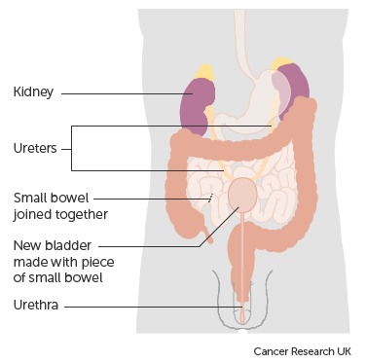
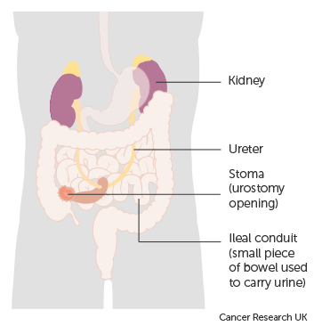
Urinary Tract – Treatment – Surgery
If the bladder has been removed, the patient will require either a reconstruction (often utilising part of either the small or large bowel) or an abdominal opening called a stoma, usually leading to an external urine bag
Notes:
If the bladder has been completely removed, either an internal reconstruction or a stoma may be necessary.

Slide 28

Urinary Tract – Treatment – Chemotherapy
Chemotherapy can be administered in different ways depending on the behaviour, stage and location of the cancer
Intravesical therapy is a type of treatment where drugs are put directly into the bladder via a catheter, reducing the risk of recurrence of early bladder cancers
BCG immunotherapy or chemotherapy are used. The drugs will affect the cells that line the bladder, with little or no effect on cells beyond the bladder lining, therefore intravesical therapy is used only for in-situ and early bladder cancers
Notes:
Chemotherapy administration may vary depending on the type, stage and location of the tumour. For some early stage bladder tumours, it may be administered directly into the bladder. This method is called intravesical therapy and has little effect on cells beyond the bladder lining

Slide 29
Urinary Tract – Treatment – Chemotherapy
Systemic chemotherapy is used for advanced cancers outside the bladder
Chemotherapy and radiotherapy at the same time has been shown to work better than radiotherapy on its own for some people
Notes:
Where intravesical therapies are not appropriate, systemic chemotherapy may be offered, sometimes in conjunction with radiotherapy

Slide 30

Urinary Tract – Treatment – Radiotherapy
Radiotherapy can be used with a curative intent and can have similar results to surgical treatments. However Radiotherapy is not a recommended treatment for patients where:
The morphology is squamous cell bladder cancer
The patient has carcinoma in-situ in much of the bladder as well as invasive carcinoma
The disease did not respond well to initial chemotherapy
The cancer is blocking both of the ureters
Notes:
Radiotherapy can show similar results to surgery for some cancers, however it does not work well for SCCs, extensive in-situ tumours or where initial chemotherapy did not produce a good response. Nor would it be normally be offered where both ureters are blocked.

Slide 31
Summary
Notes:
In summary …

Slide 32
Summary
The main risk factor for bladder tumours is smoking. Other urinary tract tumour risk factors include exposure to certain chemicals, bladder stones, prior cancer treatment or type 2 diabetes
The symptoms of a urinary tract tumour may include blood in the urine, pain or difficulty on urinating or a urinary obstruction
Investigations may include an ultrasound, CT Urogram, biopsy, bone scan or MRI
If a tumour is diagnosed it may be invasive, in situ or of unknown or uncertain behaviour. While all invasive tumours and the non-invasive tumours listed in this module must be recorded, other non-invasive tumours do not need to be recorded on a cancer data management system for the purposes of COSD - NDRS obtains these records directly from pathology laboratories
Notes:
The primary – and preventable – risk factor for bladder tumours is smoking. Other risk factors for tumours of the urinary tract include bladder stones, prior cancer treatment and type 2 diabetes.

Slide 33
Summary
The main risk factor for bladders tumours is smoking. Other urinary tract tumour risk factors include exposure to certain chemicals, bladder stones, prior cancer treatment or type 2 diabetes
The symptoms of a urinary tract tumour may include blood in the urine, pain or difficulty on urinating or a urinary obstruction
Investigations may include an ultrasound, CT Urogram, biopsy, bone scan or MRI
If a tumour is diagnosed it may be invasive, in situ or of unknown or uncertain behaviour. While all invasive tumours and the non-invasive tumours listed in this module must be recorded, other non-invasive tumours do not need to be recorded on a cancer data management system for the purposes of COSD - NDRS obtains these records directly from pathology laboratories
Notes:
Symptoms of a Urinary tract tumour might include blood in the urine or an obstruction

Slide 34
Summary
The main risk factor for bladders tumours is smoking. Other urinary tract tumour risk factors include exposure to certain chemicals, bladder stones, prior cancer treatment or type 2 diabetes
The symptoms of a urinary tract tumour may include blood in the urine, pain or difficulty on urinating or a urinary obstruction
Investigations may include an ultrasound, CT Urogram, biopsy, bone scan or MRI
If a tumour is diagnosed it may be invasive, in situ or of unknown or uncertain behaviour. While all invasive tumours and the non-invasive tumours listed in this module must be recorded, other non-invasive tumours do not need to be recorded on a cancer data management system for the purposes of COSD - NDRS obtains these records directly from pathology laboratories
Notes:
Investigations would normally include an ultrasound but may also include a CT Urogram, biopsy or other imaging

Slide 35
Summary
The main risk factor for bladders tumours is smoking. Other urinary tract tumour risk factors include exposure to certain chemicals, bladder stones, prior cancer treatment or type 2 diabetes
The symptoms of a urinary tract tumour may include blood in the urine, pain or difficulty on urinating or a urinary obstruction
Investigations may include an ultrasound, CT Urogram, biopsy, bone scan or MRI
If a tumour is diagnosed it may be invasive, in situ or of unknown or uncertain behaviour. While all invasive tumours and the non-invasive tumours specified in this module must be recorded, other non-invasive tumours do not need to be recorded on a cancer data management system for the purposes of COSD - NDRS obtains these records directly from pathology laboratories
Notes:
If a tumour is diagnosed, it may or may not be invasive. All invasive tumours must be recorded in your cancer data management system as well as those non-invasive tumours listed for submission in this module

Slide 36
Summary
Additional guidance on recording COSD data including morphology, topography, staging and recording a diagnosis can be found at: https://digital.nhs.uk/ndrs/data/cancer-data-training-materials
Staging data sheets can also be downloaded from the NDRS website for clinical use: https://digital.nhs.uk/ndrs/data/cancer-data-training-materials/staging-sheets
Notes:
Additional training modules as well as Staging sheets for clinical use may be downloaded from the NDRS website.

Slide 37
Summary
If in any doubt as to whether you should be recording a diagnosis, please refer to the latest COSD User Guide, Appendices A, B & C
For guidance on the required staging system, please refer to the latest COSD User Guide, Appendix E
https://digital.nhs.uk/ndrs/data/data-sets/cosd#downloads
Notes:
Do please remember, guidance is available on our website. You can download the COSD User Guide by clicking on this link and selecting the COSD version appropriate to your trust.

Slide 38

Acknowledgements
Many thanks to Cancer Research UK for the use of their images within this training module.
Notes:
We’d like to thank Cancer Research UK for the use of their images within this training module.

Slide 39
Questions?
East Midlands: Simon Cairnes – simon.cairnes@nhs.net
Eastern: Marianne Mollett – marianne.mollett@nhs.net
London & South East: Katrina Sung – katrina.sung@nhs.net
London & South East: Karen Graham– karen.graham36@nhs.net
North West: Paul Stacey – p.stacey@nhs.net
Northern & Yorkshire: Rachael Mann – rachaelmann@nhs.net
Oxford: Gemma Feeney – gemma.feeney@nhs.net
South West: James Withers – james.withers@nhs.net
West Midlands: Gemma Feeney – gemma.feeney@nhs.net
Notes:
If you have any questions on the information contained within this module or about COSD in general, do please feel free to email your regional Data Liaison Manager

