Slide 1

National Disease Registration Service
(NDRS)
Upper Gastrointestinal tumours
Pancreatic
V4 December 2025
Notes:
Welcome to this NDRS training module on Upper gastrointestinal tumours - Pancreatic. This module is designed to help Cancer Administration staff gain a better understanding of these tumours and the terminology used by the clinical teams.

Slide 2

Agenda
Introduction
Pancreatic tumours
Summary
Acknowledgements
This module may be paused at any time
Notes:
In this module we’ll give you a brief introduction to Upper GI tumours including some of the symptoms that patients might experience. We’ll look at the anatomy & physiology of the Upper GI system and will then go through diagnosis & treatment options. This module can be paused at any time.

Slide 3
Introduction
In this section we will cover:
  Types of Upper GI tumour
Notes:
Firstly, we’ll look at the various types of Upper GI tumour…

Slide 4
Upper GI - Introduction
  Oesophagus
  Stomach
  Pancreas
  Liver
  Gall Bladder
  Small Intestine
Notes:
The Upper gastrointestinal tract consists of the Oesophagus, Stomach, Duodenum and small intestine. The Liver, Gall Bladder and Pancreas also play a significant role in the digestion of food. Training modules are available for Oesophageal, Stomach and Pancreatic tumours. This module covers Pancreatic tumours

Slide 5
Pancreatic
In this section we will cover:
  Causes and Risk Factors
  Signs and Symptoms
  Anatomy & Physiology
  Regional Lymph Nodes
  Diagnosis
In this section we will cov:
  Morphology
  Topography
  Grade
  Stage
  Treatment
Notes:
We’ll start off by looking at the causes and risk factors for pancreatic tumours…

Slide 6
Pancreatic – Causes & Risk Factors
The causes and risks associated with pancreatic cancer are
Increasing age
Smoking
Chronic Pancreatitis
Diabetes
Obesity
Family History
Notes:
… which include increased age, diabetes and obesity. A family history of pancreatic tumours will also increase the risk.

Slide 7
Pancreatic – Signs & Symptoms
Pancreatic cancer may not cause any symptoms for a long time.
Jaundice (yellowing of the skin and eyes)
Back and abdominal pain
Weight loss
Notes:
Pancreatic tumours often cause no symptoms in the early stages. Symptoms of more advanced disease may include jaundice and weight loss.

Slide 8
Pancreatic – Anatomy & Physiology
The pancreas lies in the left mid abdomen below the diaphragm and behind the stomach in the loop of the duodenum.
The two functions of the pancreas are:
Exocrine (secreted through a duct)
produce digestive juices
Endocrine (secreted directly into the bloodstream)
produce multiple hormones, one of which is insulin
Notes:
The pancreas is a leaf-shaped organ that lies below the diaphragm, near the stomach and duodenum. It makes digestive juices that enter the duodenum through a duct, as well as secreting various hormones directly into the bloodstream. One of the hormones it secretes is insulin which controls blood sugar levels

Slide 9
Pancreatic – Anatomy & Physiology
The pancreatic duct extends the whole length of the pancreas
The Ampulla of Vater is formed where the pancreatic duct and common bile duct meet and is the duct through which bile and pancreatic juices enter the duodenum
Notes:
The Ampulla of Vater is where the pancreatic duct and the common bile duct - from the gallbladder - converge, just prior to joining with the duodenum

Slide 10
Pancreatic – Regional Lymph Nodes
The regional lymph nodes for the pancreas are the peripancreatic lymph nodes, which can be subdivided as:
  Anterior (in front of the pancreas)
  Posterior (behind the pancreas)
  Inferior (just below the pancreas)
  Superior (just above the pancreas)
  Splenic hilum (between the pancreas and the spleen)
  Infrapyloric and Subpyloric (near the pylorum of the stomach)
  Coeliac (on the coeliac artery)
Notes:
Regional lymph nodes for the pancreas are known as the peripancreatic nodes meaning literally “around the pancreas”.

Slide 11
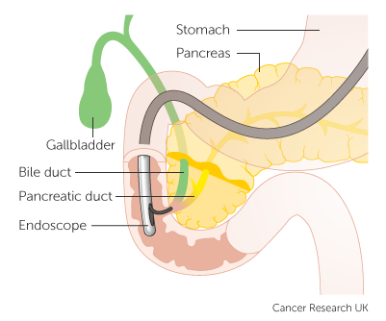
Pancreatic - Diagnosis
Trans Abdominal ultrasound
CA 19-9 and CEA blood markers
Scans - CT scan and/or MRI. PET-CT (if metastatic deposits suspected)
Endoscopic Ultrasonography
Endoscopic Retrograde Cholangio-Pancreatography (ERCP - pictured)
MRI / MRCP (Magnetic Resonant Cholangio-Pancreatography)
Biopsy
Laparoscopy (if metastatic deposits suspected)
Notes:
Diagnosis of a pancreatic tumour might include blood tests, radiological imaging, endoscopic procedures and biopsies.

Slide 12
Pancreatic - Morphology
The most common type of tumour to occur in the pancreas is Pancreatic Ductal Adenocarcinoma which accounts for 90% of all pancreatic tumours
Arise within the exocrine tissue of the cells lining the ducts of the pancreas
More rarely, neuroendocrine tumours can occur – various morphology codes (please refer to the Neuroendocrine – Key Points training module: https://digital.nhs.uk/ndrs/data/cancer-data-training-materials )
Notes:
Around 90% of pancreatic tumours are Ductal Adenocarcinomas. These usually arise in the lining of the pancreatic duct. Neuroendocrine tumours are relatively rare.

Slide 13
Pancreatic – Topography - Invasive
  Invasive tumours of the pancreas are classified as:
    C25.0 – Head of pancreas
    C25.1 – Body of pancreas
    C25.2 – Tail of pancreas
    C25.3 – Pancreatic duct
    C25.4 – Endocrine pancreas (including Islets of Langerhans)
    C25.5 – Other parts of pancreas (including Neck of pancreas)
    C25.8 – Overlapping lesion of pancreas
    C25.9 – Pancreas, unspecified
All invasive ICD10 codes must be recorded
Notes:
The ICD10 codes for Invasive tumours of the pancreas are shown here… All invasive tumours must be recorded in your cancer data management system…

Slide 14
Pancreatic – Topography – In Situ
  Once diagnosed, an in situ pancreatic tumour is classified as D01.7
  While your clinical team may request that D01.7 in-situ stomach tumours are recorded, these do not currently require a COSD submission from your cancer data management system – NDRS obtains this data direct from pathology laboratories
Notes:
… while the ICD10 code for an in-situ pancreatic tumour is D01.7

Slide 15
Pancreatic – Topography – Unknown or Uncertain Behaviour
  Once diagnosed, a pancreatic tumour of unknown or uncertain behaviour is classified as D37.7
  While your clinical team may request that D37.7 stomach tumours are recorded, these do not currently require a COSD submission from your cancer data management system – NDRS obtains this data direct from pathology laboratories
Notes:
Some tumours are determined to be of unknown or uncertain behaviour. A pancreatic tumour of unknown or uncertain behaviour is coded as D37.7. It should be noted that while your clinical team may request that non-invasive tumours are also recorded, these do not currently require a COSD submission from your cancer data management system – NDRS obtains this data direct from the pathology labs

Slide 16
Pancreatic – Grade
Grade 1
Tumours look very similar to the normal tissue and have the best prognosis
Grade 2
Tumours are formed of cells that somewhat resemble normal tissue but have more abnormal features than Grade 1
Grade 3
Tumours have very abnormal cells and the worst prognosis
Notes:
The grade of tumours is determined by their similarity to normal tissue and the extent of abnormal features

Slide 17
Pancreatic – Stage
Pancreatic tumours (neuroendocrine) are staged using the European Neuroendocrine Tumour Society TNM (ENETS) version
Pancreatic carcinoma is staged as follows:
      For diagnosis dates up to 31st December 2025 use UICC TNM v8
      For diagnosis dates from 1st January 2026 use UICC TNM v9
Please note that the TNM version must be accurately recorded – if you are unable to amend the version on your cancer data management system, please refer to your line manager
For non-neuroendocrine tumours if, after 1st January 2026, your cancer data management system has not been amended to include TNM v9 please record the TNM v9 stage and add the following statement to the Primary Diagnosis Subsidiary Comment field:
  Patient staged using TNM9 not TNM8 as per CR2070
Notes:
Carcinomas within the pancreas are staged using the appropriate UICC TNM version. However, neuroendocrine tumours are staged using the ENETS version of TNM. Please ensure the version is correctly recorded in your cancer management system

Slide 18
Pancreatic – Stage
If in doubt as to which staging system to use, please see the latest COSD User Guide, Appendix E (link to the download page in the Summary)
For details on recording stage, please see the NDRS training module KPI-TNM Staging 101
https://digital.nhs.uk/ndrs/data/cancer-data-training-materials
TNM stage should be recorded for all invasive tumours
Notes:
For more details please refer to the NDRS training module KPI-TNM Staging 101

Slide 19
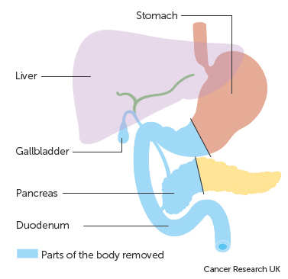
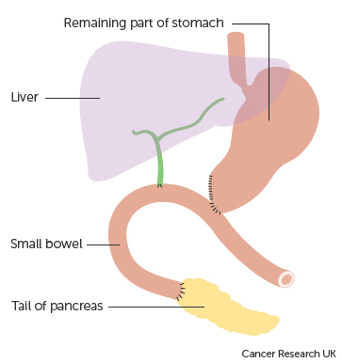
Pancreatic – Treatment - Surgery
Curative Surgery
Pancreaticoduodenectomy (Whipple's resection) – removes the head of the pancreas, the gallbladder, the lower part of the stomach and part of the duodenum
Notes:
A common form of surgery for a tumour in the pancreatic duct or the head of the pancreas is a Whipples resection in which part of the pancreas is retained and reattached.

Slide 20
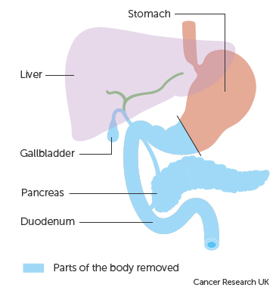
Pancreatic – Treatment - Surgery
Curative Surgery
Pylorus Preserving Pancreaticoduodenectomy (PPPD) – preserves the bottom section of the stomach
Total Pancreatectomy (pictured) - removes the lower portion of the stomach, the entire pancreas, the gallbladder and part of the duodenum
Distal Pancreatectomy - removes the tail and all or part of the body of the pancreas, depending on tumour location but leaves the head of the pancreas
Notes:
Other forms of surgery include a Pylorus Preserving Pancreaticoduodenectomy which is similar to a Whipples resection but unlike a Whipples does not remove the lower part of the stomach. Alternatively the surgeon may choose to perform a pancreatectomy, either total or distal, although pancreatectomies are relatively rare. Patients who have undergone pancreatectomy may require medications to preserve digestive function and possibly insulin to regulate their blood sugar.

Slide 21
Pancreatic – Treatment - Surgery
Palliative Surgery
Hepaticojejunostomy (surgery that connects the hepatic duct from the liver to the middle part of the small intestine)
Choledochojejunostomy (surgery that connects the common bile duct from the gall bladder to the middle part of the small intestine)
Gastrojejunostomy (surgery that connects the stomach directly to the middle part of the small intestine)
Duodenal stent
Notes:
Other surgeries may be offered to relieve symptoms if the cancer is too advanced to be curable. These may include a stent in the duodenum to relieve severe constipation or one of several forms of bypass surgery.

Slide 22

Pancreatic - Treatment - Radiotherapy
Radiotherapy is not often used in the treatment of pancreatic cancer
Palliative radiotherapy can be used to treat advanced disease to relieve symptoms
Notes:
Radiotherapy is rarely used in the treatment of the cancer itself although it may be used to relieve symptoms in advanced disease.

Slide 23

Pancreatic – Treatment - Chemoradiotherapy
Palliative chemotherapy can be given in combination with radiotherapy to relieve symptoms
Notes:
Radiotherapy may be given in conjunction with chemotherapy as a palliative treatment

Slide 24
Pancreatic – Treatment - Chemotherapy
Adjuvant chemotherapy is commonly given to patients after surgery to help lower the risk of the recurrence and to ensure all cancer cells have been removed
Chemotherapy can be used for patients with an inoperable tumour to try and shrink it
Notes:
Chemotherapy alone is often given post-operatively to ensure removal of as much tumour tissue as possible. It may also be used where surgery is not possible.

Slide 25
Summary
Notes:
To summarise…

Slide 26
Summary
Risk factors for pancreatic tumours include increased age, smoking, obesity and existing diabetes
Pancreatic tumours often show no symptoms in the early stages. Signs of a later stage disease can include jaundice and weight loss
Investigations may range from a simple blood test and radiological examination through to endoscopy, solid tissue biopsies and possibly surgery
If a tumour is diagnosed it may be invasive, in situ or of unknown or uncertain behaviour. While all invasive tumours must be recorded, in situ tumours and tumours of uncertain or unknown behaviour do not need to be recorded on a cancer data management system for the purposes of COSD - NDRS obtains these records directly from pathology laboratories
Notes:
Increased age, smoking and obesity are all among the risk factors for pancreatic tumours.

Slide 27
Summary
Risk factors for pancreatic tumours include increased age, smoking, obesity and existing diabetes
Pancreatic tumours often show no symptoms in the early stages. Signs of a later stage disease can include jaundice and weight loss
Investigations may range from a simple blood test and radiological examination through to endoscopy, solid tissue biopsies and possibly surgery
If a tumour is diagnosed it may be invasive, in situ or of unknown or uncertain behaviour. While all invasive tumours must be recorded, in situ tumours and tumours of uncertain or unknown behaviour do not need to be recorded on a cancer data management system for the purposes of COSD - NDRS obtains these records directly from pathology laboratories
Notes:
An early stage pancreatic tumour may not show any symptoms. Later stage disease may present with jaundice or weight loss.

Slide 28
Summary
Risk factors for pancreatic tumours include increased age, smoking, obesity and existing diabetes
Pancreatic tumours often show no symptoms in the early stages. Signs of a later stage disease can include jaundice and weight loss
Investigations may range from a simple blood test and radiological examination through to endoscopy, solid tissue biopsies and possibly surgery
If a tumour is diagnosed it may be invasive, in situ or of unknown or uncertain behaviour. While all invasive tumours must be recorded, in situ tumours and tumours of uncertain or unknown behaviour do not need to be recorded on a cancer data management system for the purposes of COSD - NDRS obtains these records directly from pathology laboratories
Notes:
Investigations may range from a simple blood test through to surgery

Slide 29
Summary
Risk factors for pancreatic tumours include increased age, smoking, obesity and existing diabetes
Pancreatic tumours often show no symptoms in the early stages. Signs of a later stage disease can include jaundice and weight loss
Investigations may range from a simple blood test and radiological examination through to endoscopy, solid tissue biopsies and possibly surgery
If a tumour is diagnosed it may be invasive, in situ or of unknown or uncertain behaviour. While all invasive tumours must be recorded, in situ tumours and tumours of uncertain or unknown behaviour do not need to be recorded on a cancer data management system for the purposes of COSD - NDRS obtains these records directly from pathology laboratories
Notes:
If a tumour is diagnosed, it may or may not be invasive. All invasive tumours must be recorded in your cancer data management system and while the clinical team might request that in situ tumours and tumours of unknown or uncertain behaviour are recorded, these do not need to be recorded for the purposes of COSD – NDRS obtains these records directly from the pathology labs

Slide 30
Summary
Additional guidance on recording COSD data including morphology, topography, staging and recording a diagnosis can be found at: https://digital.nhs.uk/ndrs/data/cancer-data-training-materials
Staging data sheets can also be downloaded from the NDRS website for clinical use: https://digital.nhs.uk/ndrs/data/cancer-data-training-materials/staging-sheets
Notes:
Additional training modules as well as Staging sheets for clinical use may be downloaded from the NDRS website.

Slide 31
Summary
If in any doubt as to whether you should be recording a diagnosis, please refer to the latest COSD User Guide, Appendices A, B & C
For guidance on the required staging system, please refer to the latest COSD User Guide, Appendix E
https://digital.nhs.uk/ndrs/data/data-sets/cosd#downloads
Notes:
Do please remember, guidance is available on our website. You can download the COSD User Guide by clicking on this link and selecting the COSD version appropriate to your trust.

Slide 32

Acknowledgements
Many thanks to Cancer Research UK for the use of their images within this training module.
Notes:
We’d like to thank Cancer Research UK for the use of their images within this training module.

Slide 33
Questions?
East Midlands: Simon Cairnes – simon.cairnes@nhs.net
Eastern: Marianne Mollett – marianne.mollett@nhs.net
London & South East: Katrina Sung – katrina.sung@nhs.net
London & South East: Karen Graham– karen.graham36@nhs.net
North West: Paul Stacey – p.stacey@nhs.net
Northern & Yorkshire: Rachael Mann – rachaelmann@nhs.net
Oxford: Gemma Feeney – gemma.feeney@nhs.net
South West: James Withers – james.withers@nhs.net
West Midlands: Gemma Feeney – gemma.feeney@nhs.net
Notes:
If you have any questions on the information contained within this module or about COSD in general, do please feel free to email your regional Data Liaison Manager

