Slide 1

National Disease Registration Service
(NDRS)
Upper Gastrointestinal tumours
Oesophageal
v5 December 2025
Notes:
Welcome to this NDRS training module on Upper gastrointestinal tumours – Oesophageal, which has been designed to help Cancer Administration staff gain a better understanding of these tumours and the terminology used by the clinical teams.

Slide 2

Agenda
Introduction
Oesophageal tumours
Summary
Acknowledgements
This module may be paused at any time
Notes:
In this module we’ll give you a brief introduction to Upper GI tumours including some of the symptoms that patients might experience. We’ll look at the anatomy & physiology of the upper GI system and will then go through diagnosis & treatment options. This module can be paused at any time.

Slide 3
Introduction
In this section we will cover:
  Types of Upper GI tumour
Notes:
Firstly, we’ll look at the various types of Upper GI tumour…

Slide 4
Upper GI - Introduction
  Oesophagus
  Stomach
  Pancreas
  Liver
  Gall Bladder
  Small Intestine
Notes:
The Upper GI tract consists of the Oesophagus, Stomach, Duodenum and small intestine. The Liver, Gall Bladder and Pancreas also play a significant role in the digestion of food. Training modules are available for Oesophageal, Stomach and Pancreatic tumours. This module covers Oesophageal tumours

Slide 5
Oesophageal
In this section we will cover:
  Causes and Risk Factors
  Signs and Symptoms
  Anatomy & Physiology
  Regional Lymph Nodes
  Diagnosis
In this section we will cov:
  Morphology
  Topography
  Grade
  Stage
  Treatment
Notes:
We’re going to start with Causes & Risk factors…

Slide 6
Oesophageal – Causes & Risk Factors
Most common causes & risk factors:
  Smoking
  High body mass index (BMI)
  Gastro-oesophageal reflux
  A low intake of fruit and vegetables
Notes:
… which include Smoking, being overweight, Gastric reflux and having a diet low in fruit & vegetables. However, there are some risks which are tumour-specific…

Slide 7
Oesophageal – Causes & Risk Factors
Squamous Cell Carcinoma
Smoking
Alcohol
Deprivation
Use of betel quid (a mix of nuts and tobacco for chewing)
Diet
Drinking very hot liquid
Tylosis (a rare inherited disorder that causes thickening of the skin)
Plummer-Vinson syndrome (tissue growths that partially block the oesophagus)
Untreated achalasia (muscular dysfunction issues in the oesophagus)
Notes:
… for instance, a link has been shown between squamous cell carcinomas and certain lifestyle or environmental factors. These include smoking, alcohol and deprivation. Some pre-existing medical conditions are also thought to be a risk factor for oesophageal SCCs including Plummer-Vinson syndrome and any untreated muscular dysfunction of the oesophagus…

Slide 8
Oesophageal – Causes & Risk Factors
Adenocarcinoma
Gastro-oesophageal reflux disease (GORD)
Barrett’s oesophagus (pre-cancerous cellular abnormality)
Obesity
Notes:
… while Gastro-oesophageal reflux, Barrett’s oesophagus and obesity are thought to be risk factors for Adenocarcinomas

Slide 9
Oesophageal – Signs & Symptoms
Symptoms may include:
Dysphagia (difficulty swallowing)
Pain or discomfort in the throat or back or chest pain unrelated to eating
Indigestion
Weight loss
Hoarseness or chronic cough
Haematemesis (vomiting blood)
Haemoptysis (coughing up blood)
Notes:
Symptoms may include difficulty swallowing, indigestion, a chronic cough and either vomiting- or coughing blood

Slide 10
Oesophageal – Anatomy & Physiology
The oesophagus is the first part of the digestive tract and its function is to transport food from the mouth into the stomach using peristalsis (muscle contractions from top to bottom)
It is a long muscular tube with sphincters at both ends, it is about 25 cm long and there are three distinct regions
  Upper third
  Middle third
  Lower third
The region where the oesophagus joins the stomach is called the gastro oesophageal junction (GOJ)
Notes:
The function of the oesophagus is to transport food to the stomach which it does by a process of muscular contraction after swallowing a mouthful of food. The oesophagus is classified as either Upper, Middle or Lower third. The point at which the oesophagus meets the Stomach is referred to as the Gastro-Oesophageal Junction, or GOJ

Slide 11
Oesophageal – Anatomy & Physiology
Upper Third
  The lining of the upper and middle third of the oesophagus are lined with squamous epithelial cells.
  The lower oesophagus is more likely to be lined with glandular epithelium due to exposure to stomach acid and bile.
  The majority of oesophageal malignancies arise in the lower third.
Squamous
Epithelium
Middle Third
Squamous
Epithelium
Lower Third
Glandular
Epithelium
Notes:
The Upper and Middle Oesophagus are lined with squamous epithelial cells. The Lower third is lined with glandular epithelial cells. Most malignancies arise in the Lower third.

Slide 12
Oesophageal – Anatomy & Physiology
The wall of the oesophagus is made up of four layers of tissue
Mucosa (the innermost section)
  Epithelium, lamina propria, muscularis propria
Submucosa
  Connective tissue, blood vessels and glands
Muscularis propria
  Circular and longitudinal muscle
Adventitia (the outer layer)
  Connective tissue
Notes:
Four distinct layers make up the tissue of the oesophagus. From the inside, these are the Mucosa, Submucosa, an outer muscle layer and finally, a covering layer of connective tissue.

Slide 13
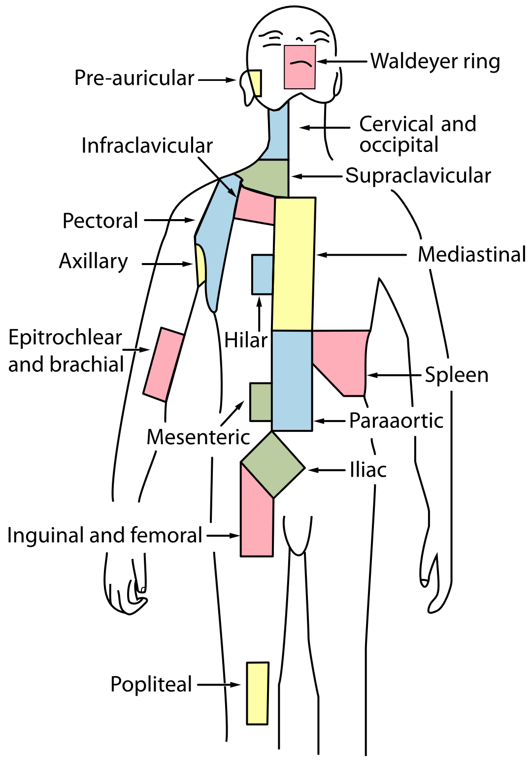
Oesophageal – Regional Lymph Nodes
Regional lymph nodes of the oesophagus include all nodes in the oesophageal drainage area excluding supraclavicular lymph nodes.
Internal jugular (near the jugular vein)
Upper and lower cervical
Paraoesophageal (near the oesophagus)
Mediastinal
Left gastric (near the left gastric aorta, at the top of the stomach)
Coeliac axis (near the pancreas)
http://training.seer.cancer.gov/ss_module08_lymph_leuk/lymph_unit02_sec02_reg_lns.html
Notes:
During an MDT, clinical teams will often make reference to particular groups of regional lymph nodes. This may indicate that the stage of the cancer has been determined. Regional lymph nodes for the oesophagus include: the cervical, para-oesophageal and left gastric nodes.

Slide 14
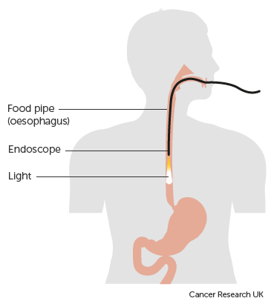
Oesophageal – Diagnosis
Endoscopy is the main diagnostic test for oesophageal tumours
Biopsies are usually taken during an endoscopic procedure if an abnormal lesion is seen in order to confirm the histology of the lesion
A barium swallow shows up the outline of the internal wall and any abnormal lesions in the oesophagus including any fistula which may be present
Notes:
Oesophageal tumours are usually diagnosed with endoscopy and biopsy. A barium swallow just before the endoscopy will highlight any abnormal areas for the camera

Slide 15
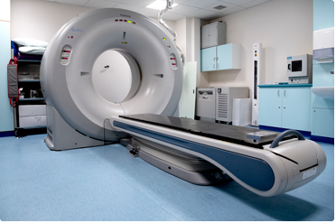
Oesophageal – Diagnosis
If cancer is diagnosed further tests may be carried out and these could include:
  Endoscopic Ultrasound Scan
  CT scan
  PET- CT scan
  Laparoscopy (keyhole surgery to place a camera inside the body)
Notes:
Further tests may be required to determine the extent of a cancerous tumour. These might include radiological examination or keyhole surgery

Slide 16
Oesophageal – Morphology
There are two main types of invasive oesophageal tumour and these arise in the epithelial cells:
  Squamous Cell Carcinoma (SCC) –M8070/3
  Adenocarcinoma – M8140/3
There are other rarer types of invasive tumour which can occur in the oesophagus, including:
  Adenosquamous carcinoma – M8560/3
  Small cell carcinoma – M8041/3
  Melanoma – various morphology codes
  Neuroendocrine tumours – various morphology codes (please refer to the Neuroendocrine – Key Points training module: https://digital.nhs.uk/ndrs/data/cancer-data-training-materials )
  Gastrointestinal stromal tumour (GIST), malignant – M8936/3
    (please note: all GISTs are to be reported as malignant M8936/3 in accordance with the WHO Classification of Tumour series, 5th edition and as such would be C coded in ICD10)
Notes:
Squamous Cell Carcinoma and Adenocarcinoma are the most common invasive tumours of the oesophagus. However, other types that might arise include Small Cell, Melanoma and GIST

Slide 17
Oesophageal – Topography - Invasive
  Invasive tumours of the oesophagus are classified as:
    C15.0 – Cervical part of the oesophagus
    C15.1 – Thoracic part of the oesophagus
    C15.2 – Abdominal part of the oesophagus
    C15.3 – Upper third of the oesophagus
    C15.4 – Middle third of the oesophagus
    C15.5 – Lower third of the oesophagus
    C15.8 – Overlapping lesion of the oesophagus
    C15.9 – Oesophagus, unspecified
All invasive ICD10 codes must be recorded
Notes:
The ICD10 codes for Invasive tumours of the oesophagus are shown here…

Slide 18
Oesophageal – Topography - Invasive
  Invasive tumours of the cardia, including tumours of the gastro-oesophageal junction (GOJ) are classified as:
    C16.0 – Cardia (including cardiac orifice, cardio-oesophageal junction, gastro-oesophageal junction and oesophagus & stomach)
All invasive ICD10 codes must be recorded
Notes:
… while the ICD10 code for an invasive tumour of the GOJ is C16.0 … All invasive tumours must be recorded in your cancer data management system.

Slide 19
Oesophageal – Topography – In Situ
  Once diagnosed, an in situ oesophageal tumour is classified as D00.1
  While your clinical team may request that D00.1 in-situ oesophageal tumours are recorded, these do not currently require a COSD submission from your cancer data management system – NDRS obtains this data direct from pathology laboratories
Notes:
The ICD10 code for an in-situ oesophageal tumour is D00.1. It should be noted that while your clinical team may request that in-situ tumours are recorded, these do not currently require a COSD submission from your cancer data management system – NDRS obtains this data direct from the pathology labs

Slide 20
Oesophageal - Siewerts Classification
Type I
Adenocarcinoma of distal part of the oesophagus located between 1- 5 cm above the GOJ
Type II
Adenocarcinoma of the cardia, tumour located between 1 cm above and 2 cm below the GOJ
Type III
Adenocarcinoma located between 2 – 5 cm below GOJ
Notes:
MDT co-ordinators may hear clinicians referring to ‘Siewert classification’ which is an anatomical classification and must not be confused with TNM staging or grade. Siewert classification refers to the location of the tumour in relation to the Gastro-oesophageal junction

Slide 21
Oesophageal – Grade
Grade 1
Tumours look very similar to the normal tissue and have the best prognosis
Grade 2
Tumours are formed of cells that somewhat resemble normal tissue but have more abnormal features than Grade 1
Grade 3
Tumours have very abnormal cells and the worst prognosis
Notes:
The grade of tumours is determined by their similarity to normal tissue and the extent of abnormal features

Slide 22
Oesophageal – Stage
Invasive oesophageal tumours, including GISTs, are staged and recorded as follows:
      For diagnosis dates up to 31st December 2025 use UICC TNM v8
      For diagnosis dates from 1st January 2026 use UICC TNM v9
Please note that the TNM version must be accurately recorded – if you are unable to amend the version on your cancer data management system, please refer to your line manager
If, after 1st January 2026, your cancer data management system has not been amended to include TNM v9 please record the TNM v9 stage and add the following statement to the Primary Diagnosis Subsidiary Comment field:
  Patient staged using TNM9 not TNM8 as per CR2070
Notes:
Invasive Oesophageal tumours, including GISTs, are staged using the appropriate UICC TNM version

Slide 23
Oesophageal – Stage
For details on recording stage, please see the NDRS training module KPI-TNM Staging 101, available on this link: https://digital.nhs.uk/ndrs/data/cancer-data-training-materials
TNM stage should be recorded for all invasive tumours
Notes:
For more details please refer to the NDRS training module KPI-TNM Staging 101

Slide 24
Oesophageal – Treatment - Surgery
Surgery is the preferred treatment for early cancers
Partial oesophagectomy
Total oesophagectomy
Oesophagogastrectomy
Endoscopic mucosal resection – removal of the lining of the oesophagus
Notes:
Treatment for oesophageal cancers is usually a combination of surgery, chemotherapy and radiotherapy. However, the patient’s general health is a factor in determining treatment, because whilst surgery is the preferred treatment for smaller tumours, oesophageal surgery is a major undertaking with only a third of patients being suitable. The type of surgery will depend on the size and location of the tumour as some tumours may only a partial resection ….

Slide 25
Oesophageal – Treatment - Surgery
Surgery is the preferred treatment for early cancers
Partial oesophagectomy
Total oesophagectomy
Oesophagogastrectomy
Endoscopic mucosal resection – removal of the lining of the oesophagus
Notes:
… while others may need a total resection of the oesophagus.

Slide 26
Oesophageal – Treatment - Surgery
Surgery is the preferred treatment for early cancers
Partial oesophagectomy
Total oesophagectomy
Oesophagogastrectomy
Endoscopic mucosal resection – removal of the lining of the oesophagus
Notes:
Tumours at the GOJ may require the removal of both the lower part of the oesophagus and the upper part of the stomach.

Slide 27
Oesophageal – Treatment - Surgery
Surgery is the preferred treatment for early cancers
Partial oesophagectomy
Total oesophagectomy
Oesophagogastrectomy
Endoscopic mucosal resection – removal of the lining of the oesophagus
Notes:
Occasionally a tumour may be at a very early stage and linked only to the most superficial mucus-producing layer of the oesophageal lining. An endoscopic mucosal resection might be offered for in situ tumours.

Slide 28

Oesophageal – Treatment - Radiotherapy
Radiotherapy is a radical treatment, sometimes used if surgery is not an option
Radiotherapy can be given as a neo-adjuvant treatment to shrink the tumour prior to surgery
Radiotherapy is usually external beam and if given with the aim of cure, a course of treatment is usually over 4 to 6 weeks
Notes:
Where surgery is not an option, radiotherapy may be offered, normally in the form of external beam radiation. It can also be used as a neo-adjuvant treatment to shrink the tumour prior to surgery

Slide 29

Oesophageal – Treatment - Chemoradiotherapy
Chemotherapy and radiotherapy are sometimes given concurrently as neo- adjuvant treatment or instead of surgery
This has been shown to be effective in treating both adenocarcinomas and squamous cell carcinomas prior to surgery
Notes:
Chemoradiotherapy is sometimes given as a neo-adjuvant treatment prior to surgery or instead of surgery. It’s been shown to be an effective treatment for both SCC and Adenocarcinomas

Slide 30
Oesophageal – Treatment - Chemotherapy
Neo-adjuvant treatment to reduce the size of a large tumour prior to surgery
Adjuvant treatment post surgery to reduce the risk of recurrence
Palliative treatment in place of surgery for advanced tumours where surgery is not appropriate or when the patient is not fit enough to undergo surgery
Notes:
Chemotherapy alone may be used both before and after surgery. In the case of advanced cancers or where the patient is not fit for surgery, it may be offered to relieve symptoms.

Slide 31
Summary
Notes:
To summarise…

Slide 32
Summary
Risk factors for oesophageal tumours include increased age, smoking, obesity and gastro-oesophageal reflux
Signs of an oesophageal tumour can include indigestion, difficulty swallowing and weight loss
Investigations usually include endoscopy and biopsy and may require radiological imaging
If a tumour is diagnosed it may or may not be invasive. While all invasive tumours must be recorded, non-invasive tumours do not need to be recorded on a cancer data management system for the purposes of COSD - NDRS obtains these records directly from pathology laboratories
Notes:
Risk factors include increased age, smoking, being very overweight and gastric reflux

Slide 33
Summary
Risk factors for oesophageal tumours include increased age, smoking, obesity and gastro-oesophageal reflux
Signs of an oesophageal tumour can include indigestion, difficulty swallowing and weight loss
Investigations usually include endoscopy and biopsy and may require radiological imaging
If a tumour is diagnosed it may or may not be invasive. While all invasive tumours must be recorded, non-invasive tumours do not need to be recorded on a cancer data management system for the purposes of COSD - NDRS obtains these records directly from pathology laboratories
Notes:
Signs of a tumour might include indigestion, difficulty swallowing and weight loss

Slide 34
Summary
Risk factors for oesophageal tumours include increased age, smoking, obesity and gastro-oesophageal reflux
Signs of an oesophageal tumour can include indigestion, difficulty swallowing and weight loss
Investigations usually include endoscopy and biopsy and may require radiological imaging
If a tumour is diagnosed it may or may not be invasive. While all invasive tumours must be recorded, non-invasive tumours do not need to be recorded on a cancer data management system for the purposes of COSD - NDRS obtains these records directly from pathology laboratories
Notes:
Endoscopy and biopsy are usually used to diagnose a tumour

Slide 35
Summary
Risk factors for oesophageal tumours include increased age, smoking, obesity and gastro-oesophageal reflux
Signs of an oesophageal tumour can include indigestion, difficulty swallowing and weight loss
Investigations usually include endoscopy and biopsy and may require radiological imaging
If a tumour is diagnosed it may or may not be invasive. While all invasive tumours must be recorded, non-invasive tumours do not need to be recorded on a cancer data management system for the purposes of COSD - NDRS obtains these records directly from pathology laboratories
Notes:
If a tumour is diagnosed, it may or may not be invasive. All invasive tumours must be recorded in your cancer data management system and while the clinical team might request that non-invasive tumours are also recorded, these do not need to be recorded for the purposes of COSD – NDRS obtains these records directly from the pathology labs

Slide 36
Summary
Additional guidance on recording COSD data including morphology, topography, staging and recording a diagnosis can be found at: https://digital.nhs.uk/ndrs/data/cancer-data-training-materials
Staging data sheets can also be downloaded from the NDRS website for clinical use: https://digital.nhs.uk/ndrs/data/cancer-data-training-materials/staging-sheets
Notes:
Additional training modules as well as Staging sheets for clinical use may be downloaded from the NDRS website.

Slide 37
Summary
If in any doubt as to whether you should be recording a diagnosis, please refer to the latest COSD User Guide, Appendices A, B & C
For guidance on the required staging system, please refer to the latest COSD User Guide, Appendix E
https://digital.nhs.uk/ndrs/data/data-sets/cosd#downloads
Notes:
Do please remember, guidance is available on our website. You can download the COSD User Guide by clicking on this link and selecting the COSD version appropriate to your trust.

Slide 38

Acknowledgements
Many thanks to Cancer Research UK for the use of their images within this training module.
Notes:
We’d like to thank Cancer Research UK for the use of their images within this training module.

Slide 39
Questions?
East Midlands: Simon Cairnes – simon.cairnes@nhs.net
Eastern: Marianne Mollett – marianne.mollett@nhs.net
London & South East: Katrina Sung – katrina.sung@nhs.net
London & South East: Karen Graham– karen.graham36@nhs.net
North West: Paul Stacey – p.stacey@nhs.net
Northern & Yorkshire: Rachael Mann – rachaelmann@nhs.net
Oxford: Gemma Feeney – gemma.feeney@nhs.net
South West: James Withers – james.withers@nhs.net
West Midlands: Gemma Feeney – gemma.feeney@nhs.net
Notes:
If you have any questions on the information contained within this module or about COSD in general, do please feel free to email your regional Data Liaison Manager

