Slide 1

National Disease Registration Service
(NDRS)
Lower / Upper GI
Hepatobiliary tumours
v6 December 2025
Notes:
Welcome to this NDRS training module on tumours of the Hepatobiliary system which has been designed to help Cancer Administration staff gain a better understanding of the diseases and the terminology used by the clinical teams.

Slide 2

Agenda
Hepatobiliary – Liver & Gallbladder
Summary
Acknowledgements
This module may be paused at any time
Notes:
We’re going to give you a brief introduction to tumours of the hepatobiliary system – sometimes known as HPB - including some of the symptoms that patients might experience. We’ll look at the anatomy & physiology and will then go through diagnosis & treatment options. This module can be paused at any time.

Slide 3
Lower / Upper GI
Hepatobiliary
In this section we will cover:
  Causes and Risk Factors
  Signs and Symptoms
  Anatomy & Physiology
  Regional Lymph Nodes
  Diagnosis
In this section we will cov:
  Morphology
  ICD10 coding
  Grade
  Stage
  Treatment
Notes:
We’ll start off by looking at the causes and risk factors …

Slide 4
Hepatobiliary – Causes & Risk Factors
 | Liver | Bile ducts & Gallbladder
Smoking / other oral tobacco use | X | X
Alcohol | X | X
Increasing age | X | X
Cirrhosis / non-alcoholic fatty liver disease | X
Obesity | X | X
Family history | X | X
Viral infections | X
Gallstones and inflammation | X | X
Ethnicity |  | X
Liver flukes (parasitic worms) | X
Notes:
Whilst not exhaustive, this table covers many of the risk factors associated with HPB tumours. These include tobacco use, alcohol and family history

Slide 5
Hepatobiliary – Signs & Symptoms
Weight loss
Jaundice (yellowing of the skin and eyes)
Itching
Nausea
Swollen, painful abdomen
A lump in the right side of the abdomen
Notes:
Unexplained weight loss, jaundice, nausea or a swollen abdomen can all be signs of an HPB tumour

Slide 6
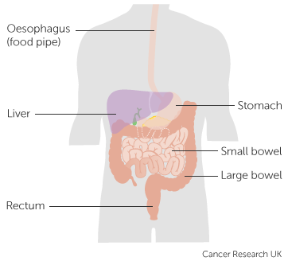
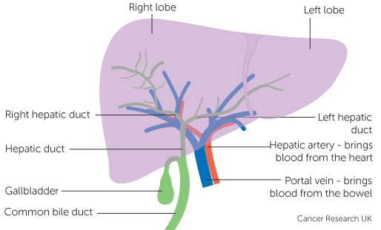
Hepatobiliary – Anatomy & Physiology
The hepatobiliary system is comprised of the liver, the bile ducts, the gallbladder and the ampulla of Vater
Notes:
The HPB system consists of the Liver, the gallbladder including associated bile ducts … plus the ampulla of Vater. The liver sits below the right lung, underneath the diaphragm and is protected by the ribcage.

Slide 7
Hepatobiliary – Anatomy & Physiology
The portal vein brings nutrient rich blood from the gastro-intestinal tract up to the liver
In the liver, the carbohydrates and fats are converted to energy for later use
The liver also makes bile, a substance that aids in the digestion of food and the absorption of nutrients
Bile can be stored in the gallbladder for later release into the bowel or released directly into the bowel
Notes:
Nutrient rich blood from the bowel is brought to the liver via the portal vein. Once in the liver, the nutrients are extracted from the blood and carbohydrates & fats are converted into energy. The liver also produces bile to help the body digest the food and absorb the nutrients it contains.

Slide 8
Hepatobiliary – Anatomy & Physiology - Liver
The liver is divided into two lobes, left and right. Each lobe is divided into four smaller segments. Every segment has its own blood supply and biliary drainage system
Within the liver, cells known as hepatocytes secrete bile which is collected in a network of bile ducts for transportation to either the duodenum or to the gallbladder
Notes:
Special cells within the liver - called hepatocytes - secrete the bile. This drains through a network of ducts for delivery either direct to the duodenum - for immediate use - or to the gallbladder for storage.

Slide 9
Hepatobiliary – Anatomy & Physiology
The liver also:
Makes proteins, some of which are used in the process of blood clotting
Makes cholesterol, used in the formation of cell walls
Breaks down harmful substances in the blood, including alcohol, many drugs and waste products from the normal bodily processes
Notes:
Other functions of the liver include the manufacture of proteins as well the breakdown of harmful substances in the blood, such as waste products from the normal bodily functions

Slide 10
Hepatobiliary – Anatomy & Physiology - Liver
A healthy liver has the ability to repair itself if part of it has to be removed. However, tumours are often accompanied by other liver disease such as cirrhosis which may make a surgical resection impossible if the liver is to continue functioning. We cannot survive without a functioning liver
Notes:
An otherwise healthy liver can repair itself after a resection … but tumours are often not the only issue. Concurrent liver disease may make a surgical resection impossible as an unhealthy liver cannot repair itself.

Slide 11
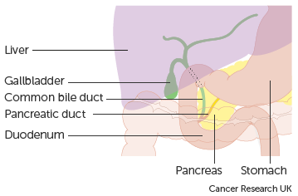
Hepatobiliary – Anatomy & Physiology – Gallbladder
The gallbladder is a small pear-shaped organ hat sits in the peritoneum below the liver. Its primary function is to store and concentrate the bile produced in the liver
The gallbladder can store up to 50ml of bile which may be up to 10 times more concentrated than when it left the liver, increasing its ability to affect fats in the digestive tract
Up to 8cm long and approx. 2.5cm wide, it has no muscular layer and the walls are generally less than 2mm thick. Patients can survive without a gallbladder
Notes:
The gallbladder has a maximum capacity of around 50 ml. Bile that goes into the gallbladder for storage becomes much more concentrated than when it was freshly produced.

Slide 12

Hepatobiliary – Regional Lymph Nodes
Liver:
Hilar
Hepatic (along the hepatic artery)
Periportal (along the portal vein)
Inferior phrenic (underneath the liver)
Caval (near the vena cava blood vessel)
Intrahepatic bile duct – Left:
Hilar
Gastrohepatic (between the liver and the stomach)
Intrahepatic bile duct – Right:
Hilar (common bile duct, hepatic artery, portal vein & cystic duct)
Periduodenal (next to the top of the small intestine)
Peripancreatic (next to the pancreas)
http://training.seer.cancer.gov/ss_module08_lymph_leuk/lymph_unit02_sec02_reg_lns.html
Notes:
During an MDT, clinical teams will often make reference to particular groups of regional lymph nodes. This may indicate that the stage of the cancer has been determined. The lymph nodes considered regional for the liver and intrahepatic bile ducts are listed here…

Slide 13
Hepatobiliary – Regional Lymph Nodes
Perihilar bile ducts:
Hilar
Peri-choledochal nodes in the hepatoduodenal ligament
Gallbladder and other extrahepatic bile ducts:
Hepatic hilus (including nodes along the common bile duct, common hepatic duct, hepatic artery, portal vein and cystic duct)
Coeliac – near the coeliac artery in the abdomen
Superior mesenteric artery
http://training.seer.cancer.gov/ss_module08_lymph_leuk/lymph_unit02_sec02_reg_lns.html
Notes:
… and the regional lymph nodes for the gallbladder and extrahepatic bile ducts are listed here

Slide 14
Hepatobiliary – Regional Lymph Nodes
Ampulla of Vater:
Common bile duct
Common hepatic artery
Portal vein
Pyloric
Infrapyloric
Subpyloric
Proximal mesenteric
Coeliac
Posterior pancreaticoduodenal
Anterior pancreaticoduodenal
Superior mesenteric vein
Right lateral wall of superior mesenteric artery
http://training.seer.cancer.gov/ss_module08_lymph_leuk/lymph_unit02_sec02_reg_lns.html
Notes:
… and the Ampulla of Vater here.

Slide 15
Hepatobiliary – Diagnosis - Liver
Blood tests – Liver Function Tests (LFTs) & Full Blood Count (FBC)
Ultrasound scan
CT scan
MRI scan
Biopsy
Laparoscopy – examination of the abdominal cavity under general anaesthesia using keyhole surgical techniques
Notes:
Where a liver tumour is suspected, blood tests are usually carried out to determine liver function and full blood counts. Imaging and a biopsy may also be needed. In some cases a laparoscopy under general anaesthesia may be carried out

Slide 16
Hepatobiliary – Diagnosis – Gallbladder
Blood tests – Liver Function Tests (LFTs), Full Blood Count (FBC), Urea & electrolytes, Tumour markers
Ultrasound scan
CT scan
Endoscopic Ultrasound
MRI scan / MRCP (Magnetic Resonance Cholangio Pancreatography)
Biopsy (for solid tissue samples) / FNA (Fine Needle Aspiration – for fluid samples)
ERCP (Endoscopic Retrograde Cholangio Pancreatography) – an endoscope is inserted through the mouth, through the stomach and as far as the bile ducts. The endoscope can release contrast medium for x-rays or take a biopsy sample
Cholangiography – x-rays of the liver and bile ducts using contrast medium
Laparoscopy – examination of the abdominal cavity under general anaesthesia using keyhole surgical techniques
Notes:
Blood tests may also be part of the diagnostic process for gallbladder tumours, along with imaging, biopsies and laparoscopic examination

Slide 17

Hepatobiliary – Morphology – Liver & Intrahepatic bile ducts
The liver is a common organ in which to find secondary tumours – these would have an ICD-O-3 morphology code ending in /6 and must not be recorded as primary tumours. Invasive primary liver tumours include:
Hepatocellular carcinoma – M8170/3
Hepatocellular carcinoma, fibrolamellar – M8171/3
Hepatocellular & Cholangiocarcinoma, combined – M8180/3
Angiosarcoma / Haemangiosarcoma – M9120/3
Hepatoblastoma – M8970/3
Kupffer cell sarcoma – M9124/3
Cholangiocarcinoma, may occur in the bile ducts both within and external to the liver – M8160/3
Notes:
It should be noted that some other cancers will commonly metastasize to the liver. Metastatic – or secondary - deposits will be noted on any relevant pathology reports. These must not be recorded as primary tumours. Invasive primary tumours of the liver and intrahepatic bile ducts include hepatocellular carcinoma, hepatoblastoma and cholangiocarcinoma.

Slide 18
Hepatobiliary – Morphology – Gallbladder & Extrahepatic bile ducts
Invasive tumours of the gallbladder and extrahepatic bile ducts include:
Cholangiocarcinoma – M8160/3
Bile duct cystadenocarcinoma – M8161/3
Adenocarcinoma – M8140/3
Klatskins tumour – M8162/3
(also known as a Hilar- or Perihilar-cholangiocarcinoma)
Notes:
Cholangiocarcinoma can also affect the extrahepatic bile ducts. Other tumour types found in the gallbladder and bile ducts include adenocarcinoma and Klatskins tumours

Slide 19
Hepatobiliary – Morphology – Ampulla of Vater
The ampulla of vater is where the bile ducts meets the pancreatic duct. Invasive tumours of the ampulla of vater include:
Adenocarcinoma NOS – M8140/3
Adenocarcinoma, intestinal type – M8144/3
Adenocarcinoma, pancreatobiliary type – M8163/3
Neuroendocrine (carcinoid) tumour – M8240/3
Notes:
Tumours sited at the ampulla of vater may be adenocarcinomas or neuroendocrine tumours

Slide 20

Hepatobiliary – ICD10 coding – Liver & Intrahepatic bile ducts - Invasive
Liver cell carcinoma - C22.0
Intrahepatic bile duct carcinoma – C22.1
Hepatoblastoma – C22.2
Angiosarcoma of liver – C22.3
Other sarcomas of liver – C22.4
Other specified carcinomas of liver – C22.7
Liver, unspecified - C22.9
Notes:
The ICD10 codes for tumours of the liver and intrahepatic bile ducts are shown here. While the morphology codes do still need to be recorded, the ICD10 codes will, in many cases, specify the type of tumour as well as the location…

Slide 21
Hepatobiliary – ICD10 coding – Gallbladder and Other parts of biliary tract - Invasive
Gallbladder – C23X
Extrahepatic bile duct – C24.0
Ampulla of Vater – C24.1
Overlapping lesion of biliary tract – C24.8
Biliary tract, unspecified – C24.9
X – top level code only
Notes:
… while the codes for the gallbladder and other parts of the biliary tract indicate just the location of the tumour.

Slide 22
Hepatobiliary – ICD10 coding – Non-invasive
Tumours may also be non-invasive:
Carcinoma in-situ of liver, gallbladder and bile ducts – D01.5
Neoplasm of uncertain or unknown behaviour: connective and other soft tissue – D48.1
Neoplasm of uncertain or unknown behaviour, unspecified – D48.9
While your clinical team may request that these D coded tumours are recorded, these do not currently require a COSD submission from your cancer data management system. NDRS obtains data on these tumours direct from pathology laboratories
Notes:
ICD10 codes for non-invasive tumours for the liver and biliary system are shown here. It should be noted that while the clinical team may request that these non-invasive tumours are recorded, we don’t require a COSD record from your cancer data management system. We collect data on these tumours direct from the path labs

Slide 23
Hepatobiliary – Grade
Grade 1 – Well differentiated: Tumours look very similar to the normal tissue and retain a degree of functionality. Grade 1 tumours have the best prognosis
Grade 2 – Moderately differentiated: Tumours are formed of cells that somewhat resemble the normal tissue and retain limited functionality.
Grade 3 – Poorly differentiated: Tumours have very abnormal cells with little or no functionality.
Grade 4 – Undifferentiated / anaplastic: The tumour cells have no similarity to normal cells. Grade 4 tumours have the worst prognosis
Notes:
The grade of HPB tumours is assessed under a microscope by comparing the appearance of tumour cells to normal healthy cells. The higher the grade, the less similar they appear and the lower the functionality of the tumour cells.

Slide 24
Hepatobiliary – Prognostic indicator - BCLC
The Barcelona Clinic Liver Cancer (BCLC) system is an additional prognostic indicator for hepatocellular carcinomas that combines the size and spread of the cancer with liver function and performance status
0 – Very early stage. Single nodule, less than or equal to 2cm, preserved liver function, PS 0
A – Early stage. 3 nodules or less, each 3cm or less, preserved liver function, PS 0
B – Intermediate stage. Multinodular, preserved liver function, PS 0
C – Advanced stage. Portal invasion and/or extrahepatic spread, preserved liver function, PS 1-2
D – Terminal stage. Any tumour burden, end stage liver function, PS 3-4
Hepatocellular carcinomas also require a UICC TNM stage
Notes:
The Barcelona prognostic indicator is an additional classification system for hepatocellular carcinomas. It looks at tumour characteristics as well as liver function and performance status. The resulting indicator group can then be combined with patient characterisation and treatment options to allow clinicians to estimate survival.

Slide 25
Hepatobiliary – Stage - TNM
Neuroendocrine (carcinoid) tumours are staged using UICC TNM, ENETS version
Hepatoblastoma in CTYA patients are staged using the Pretext staging system (including any annotation factors):
Notes:
Neuroendocrine tumours are staged using UICC TNM, ENETS version. Hepatoblastoma in CTYA patients are staged using the PRETEXT staging system

Slide 26
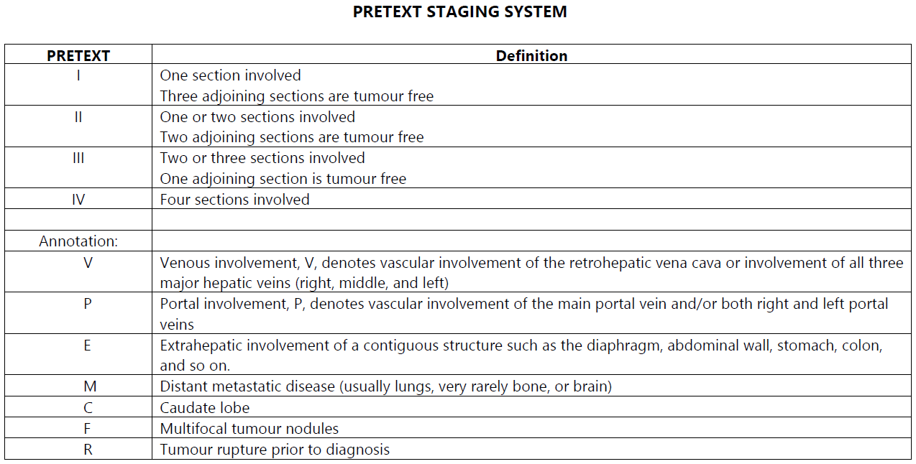
Hepatobiliary – CTYA Hepatoblastoma – Pretext Stage
Notes:
… which for ease is included here.

Slide 27
Hepatobiliary – Stage - TNM
Other invasive primary liver tumours, including hepatocellular carcinomas, are staged as follows:
      For diagnosis dates up to 31st December 2025 use UICC TNM v8
      For diagnosis dates from 1st January 2026 use UICC TNM v9
    Trusts are encouraged to also submit the Barcelona (BCLC) prognostic indictor for hepatocellular carcinomas
Please note that the UICC TNM version must be accurately recorded – if you are unable to amend the version on your cancer data management system, please refer to your line manager
If, after 1st January 2026, your cancer data management system has not been amended to include TNM v9 please record the TNM v9 stage and add the following statement to the Primary Diagnosis Subsidiary Comment field:
  Patient staged using TNM9 not TNM8 as per CR2070
Notes:
All other invasive neoplasms - including hepatocellular carcinomas - are staged using the appropriate UICC TNM version. Trusts are encouraged to also submit the Barcelona prognostic indicator for hepatocellular carcinomas.

Slide 28
Hepatobiliary – Stage - TNM
For details on recording stage, please see the NDRS training module KPI-TNM Staging 101, available on this link: https://digital.nhs.uk/ndrs/data/cancer-data-training-materials
Staging data sheets detailing the specific staging requirements can also be downloaded from the NDRS website for clinical use: https://digital.nhs.uk/ndrs/data/cancer-data-training-materials/staging-sheets
Notes:
For more details on recording stage, please see the NDRS training module KPI-TNM Staging 101 and the relevant staging data sheets, available on the NDRS website.

Slide 29
Hepatobiliary – Treatment – Liver & Intrahepatic bile ducts - Surgery
Surgery to resect the liver may be offered where:
The cancer is early stage
Is in only one area of the liver
Has not invaded the blood vessels
Where the remaining liver tissue is functioning well
Where the tumour is unresectable, the patient may be put on the waiting list for a liver transplant from a donor if fit enough and if specific transplant criteria are met
To be a suitable replacement, the tissue type of a donor liver must be a close match to the patient
Notes:
Where the cancer is early stage and other pre-surgical criteria are met, a resection or a lobectomy may be offered. If the tumour is not resectable or where the remaining liver tissue has poor functionality, the patient may be placed on the waiting list for a liver transplant

Slide 30
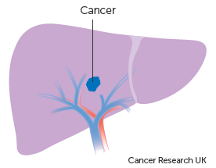
Hepatobiliary – Treatment – Liver & Intrahepatic bile ducts – Percutaneous ethanol injection
Percutaneous ethanol injection (PEI) involves one or more injections of pure alcohol directly into liver tumours
The tumour cells are dehydrated by the alcohol, killing them
This treatment is suitable for use on stage 1 hepatocellular carcinoma and may be offered where the patient is not fit for surgery or to control the cancer while the patient awaits a liver transplant
Notes:
Some early stage hepatocellular carcinomas may be treated using ethanol injections directly into the tumour. This dehydrates and kills the cancer cells.

Slide 31

Hepatobiliary – Treatment – Liver & Intrahepatic bile ducts – Chemotherapy (TACE)
Trans arterial chemoembolisation (TACE) uses high dose chemotherapy drugs which are fed directly into the artery that supplies the liver
Small particles are then injected into the artery to block off the blood supply to the tumour, starving it of oxygen and nutrients while the high dose chemotherapy kills cancer cells
TACE may be offered as a neo-adjuvant treatment prior to surgery, instead of surgery or as a holding treatment until surgery can be carried out
Patients suffering from jaundice would not be offered this treatment
Notes:
Chemotherapy, in the form of a trans arterial chemoembolisation – or TACE – may be offered as a neo-adjuvant treatment, as an alternative to surgery or as a holding treatment until such time as surgery can be performed. This treatment would not be offered to patients who are suffering from jaundice

Slide 32
Hepatobiliary – Treatment – Liver & Intrahepatic bile ducts – Thermal ablation
Heat can be used to destroy tumour cells in the liver using a process known as ablation. The heat can be generated either by using Radiofrequency ablation (RFA) or Microwave ablation (MWA)
Thermal ablation involves the insertion of one or more needle electrodes directly into the tumour. An electrical current is passed through the electrodes at specific frequencies, either as RFA or MWA, which produce heat as they travel from the electrode to special “earthing” pads on the patient’s skin
Thermal ablation may be offered if the tumour position makes it unresectable, where the patient is not fit for surgery or where the patient is awaiting a transplant
Notes:
Ablation means destruction. Thermal ablation of liver tumours involves the insertion of electrodes directly into the tumour site after which a specified frequency of electrical current is applied. The electrical current travels through the tumour towards a special earthing pad on the patient’s skin, destroying cells as it travels.

Slide 33

Hepatobiliary – Treatment – Liver & Intrahepatic bile ducts – Radiotherapy
Radiotherapy is not normally used as a primary treatment for liver tumours. It can be used to control the tumour size or as a palliative treatment to control symptoms.
Radiotherapy may be applied as external beam radiotherapy, stereotactic body radiotherapy/stereotactic ablative radiotherapy (SBRT/SABR) or as selective internal radiotherapy (SIRT). SIRT is also known as radioembolisation
SBRT/SABR is a type of targeted radiotherapy where multiple beams of radiation are tightly focused on the tumour. This is usually offered for hepatocellular carcinoma where the patient is not suitable for thermal ablation and the tumour is small
SIRT involves the insertion of radioactive beads into the artery that feeds the liver. These lodge in the smaller blood vessels within the liver and emit radiation to destroy cells. SIRT may be offered for more advanced hepatocellular carcinomas
Notes:
Radiotherapy is normally used to control tumour size or as a palliative treatment. It can be administered either externally or by insertion of small radioactive beads directly into the artery that supplies the liver

Slide 34
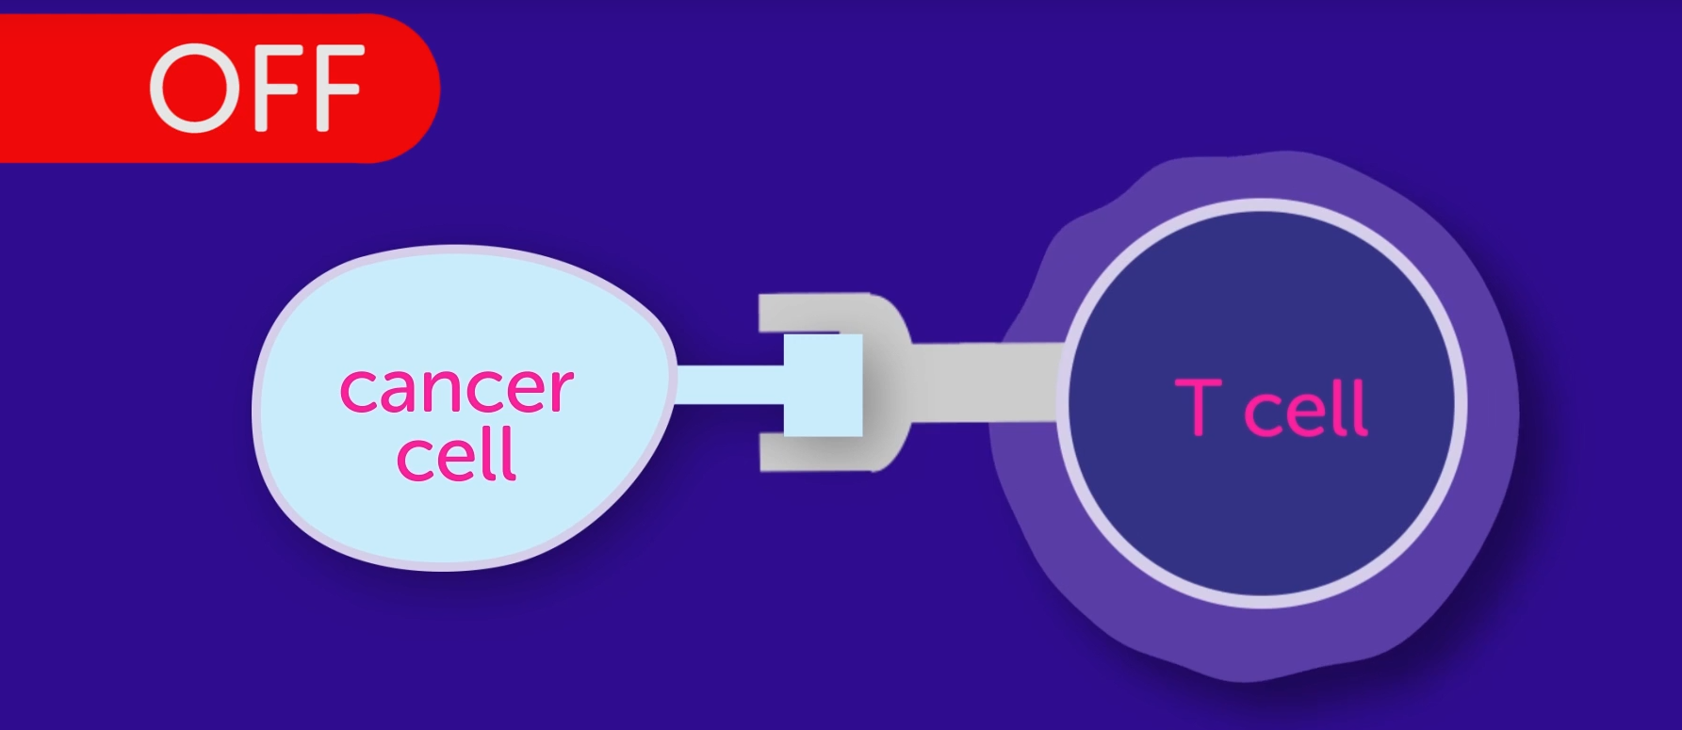
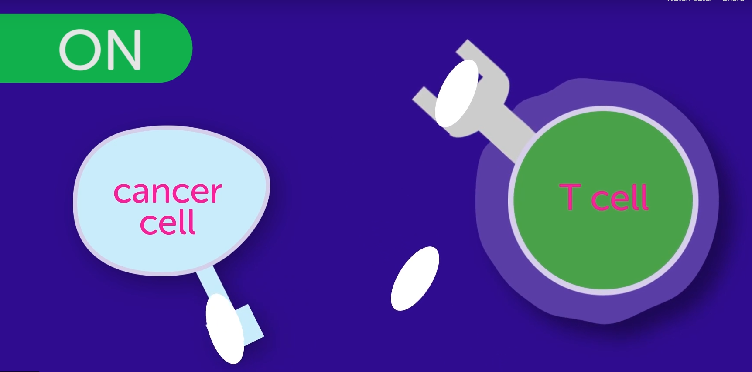
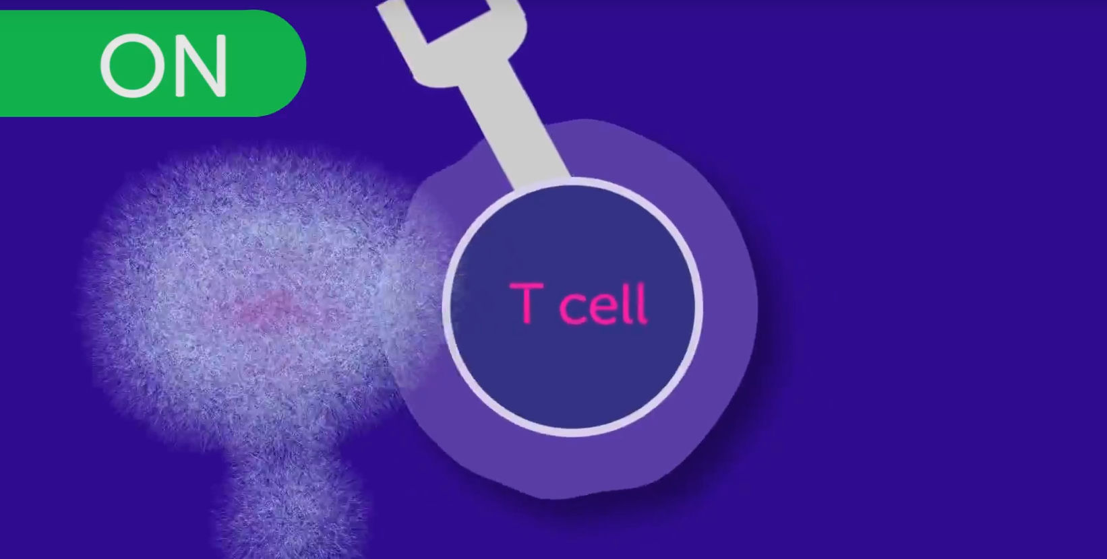
Hepatobiliary – Treatment – Liver & Intrahepatic bile ducts – Immunotherapy
Immunotherapy may be offered where:
Surgery is not possible
No other systemic treatment has been used
The patient is fit enough
Liver function is good
The cancer is an advanced stage hepatocellular carcinoma
Liver cancer may be treated with a type of immunotherapy called checkpoint inhibitors. Check point inhibitors are a monoclonal antibody drug:
Cancer cells have proteins on their surface called checkpoints – these are able to turn off the T cells in the immune system allowing the cancer cells to go undetected
Checkpoint inhibitors block the proteins on the cancer cell and the receptors on the T cell, enabling the T cell to recognise and destroy the cancer cell
Monoclonal antibody drugs will have a name ending in -mab
Notes:
Later stage hepatocellular carcinoma patients may be offered immunotherapy of a type known as a checkpoint inhibitor. Checkpoint inhibitors help T cells to recognise cancer cells that can then be destroyed

Slide 35
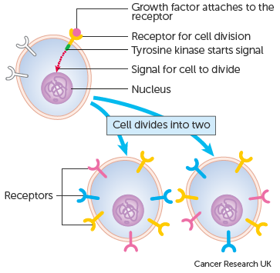
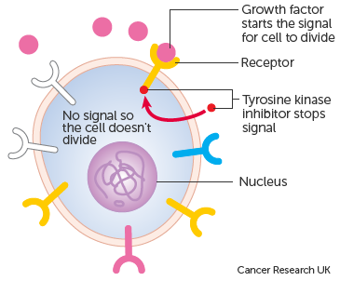
Hepatobiliary – Treatment – Liver & Intrahepatic bile ducts – Targeted treatments
Targeted treatments (sometimes called biological treatments) may be an alternative to immunotherapy for patients meeting the same criteria. The targeted treatments used for liver tumours are a type of small-molecule inhibitor. The treatments act to prevent tumour growth
When certain growth factors within the body attach to a receptor on the surface of a cancer cell, the base of the receptor releases a chemical that instructs the cell to divide into two new cells
The targeted treatments aim to block these chemical signals from the base of the receptor
Many of the targeted treatments for liver tumours also act to prevent the tumour developing its own blood supply
Small-molecule inhibitors will have a drug name ending in -nib
Notes:
Targeted treatments may be an alternative to immunotherapy for the same patient cohort. The targeted treatments used for hepatocellular carcinoma block chemical signals within the cancer cells that would otherwise instruct them to divide. This prevents tumour growth

Slide 36
Hepatobiliary – Treatment – Gallbladder & Extrahepatic bile ducts - Surgery
Surgery may be offered depending on the type, stage and location of the tumour
Where the tumour has not spread beyond the gallbladder it may be excised in an operation called a simple cholecystectomy. This is often performed laparoscopically (keyhole surgery)
If the tumour has spread to the entire gallbladder, an open or extended cholecystectomy may be needed. In this surgery, the gallbladder, surrounding lymph nodes, part of the liver closest to the gallbladder and tissue from the excision site of any prior keyhole surgery is removed
Notes:
Patients with a gallbladder tumour may be offered surgery depending on the type, location and stage of the tumour. A simple cholecystectomy may be performed if the cancer is early stage, while more advanced cases may require open surgery … plus the removal of surrounding tissue…

Slide 37
Hepatobiliary – Treatment – Gallbladder & Extrahepatic bile ducts - Surgery
If the cancer has spread beyond the gallbladder, a radical resection may be performed which would include lymph nodes from surrounding organs as well as those listed under an open cholecystectomy
It may also be necessary to partly or completely excise nearby organs such as the duodenum, pancreas or stomach
If the tumour is very late stage, a stent may be surgically implanted to open the bile duct and relieve symptoms of pain
Notes:
… as well as the lymph nodes and potentially other organs in their entirety. Where the cancer is particularly advanced, the palliative insertion of a biliary stent may relieve pain caused by a blocked bile duct

Slide 38
Hepatobiliary – Treatment – Gallbladder & Extrahepatic bile ducts - Radiotherapy
Radiotherapy may be offered as an adjuvant treatment after surgery
Radiotherapy may also be offered palliatively where the cancer is too advanced to be surgically removed. This may slow the spread of the cancer and relieve symptoms
Notes:
Post –surgical radiotherapy may be offered to kill any residual cancer cells. Radiotherapy may also be used palliatively.

Slide 39
Hepatobiliary – Treatment – Gallbladder & Extrahepatic bile ducts - Chemotherapy
Chemotherapy is sometimes offered prior to surgery in order to shrink the tumour
Chemotherapy may be offered as an adjuvant treatment
Chemotherapy may also be offered as a palliative treatment to control symptoms
Notes:
Chemotherapy may be offered ….as an adjuvant treatment to shrink a tumour prior to surgery … or as a palliative treatment

Slide 40
Summary
Notes:
In summary …

Slide 41
Summary
The main risk factors for tumours of the hepatobiliary system are tobacco use, alcohol and increasing age
Signs of hepatobiliary tumours can include weight loss, jaundice and nausea
Investigations may include blood tests, imaging and biopsies
All invasive tumours must be recorded
Stage must be recorded for all stageable cancers. Stage edition for neuroendocrine / carcinoid tumours must be recorded as ENETS
Treatment is determined depending on the type, location and stage of the tumour – this could include any of the standard treatment modalities or may require other treatments such as thermal ablation, immunotherapy or targeted treatments
Notes:
Tobacco use, alcohol and age are all risk factors for hepatobiliary tumours

Slide 42
Summary
The main risk factors for tumours of the hepatobiliary system are tobacco use, alcohol and increasing age
Signs of hepatobiliary tumours can include weight loss, jaundice and nausea
Investigations may include blood tests, imaging and biopsies
All invasive tumours must be recorded
Stage must be recorded for all stageable cancers. Stage edition for neuroendocrine / carcinoid tumours must be recorded as ENETS
Treatment is determined depending on the type, location and stage of the tumour – this could include any of the standard treatment modalities or may require other treatments such as thermal ablation, immunotherapy or targeted treatments
Notes:
Weight loss and jaundice may indicate a possible tumour

Slide 43
Summary
The main risk factors for tumours of the hepatobiliary system are tobacco use, alcohol and increasing age
Signs of hepatobiliary tumours can include weight loss, jaundice and nausea
Investigations may include blood tests, imaging, biopsies and possibly exploratory keyhole surgery
All invasive tumours must be recorded
Stage must be recorded for all stageable cancers. Stage edition for neuroendocrine / carcinoid tumours must be recorded as ENETS
Treatment is determined depending on the type, location and stage of the tumour – this could include any of the standard treatment modalities or may require other treatments such as thermal ablation, immunotherapy or targeted treatments
Notes:
Diagnostic investigations will usually include imaging and perhaps biopsies but may also include blood tests or laparoscopic surgery

Slide 44
Summary
The main risk factors for tumours of the hepatobiliary system are tobacco use, alcohol and increasing age
Signs of hepatobiliary tumours can include weight loss, jaundice and nausea
Investigations may include blood tests, imaging, biopsies and possibly exploratory keyhole surgery
All invasive tumours must be recorded
Stage must be recorded for all stageable cancers. Stage edition for neuroendocrine / carcinoid tumours must be recorded as ENETS
Treatment is determined depending on the type, location and stage of the tumour – this could include any of the standard treatment modalities or may require other treatments such as thermal ablation, immunotherapy or targeted treatments
Notes:
All invasive tumours must be recorded

Slide 45
Summary
The main risk factors for tumours of the hepatobiliary system are tobacco use, alcohol and increasing age
Signs of hepatobiliary tumours can include weight loss, jaundice and nausea
Investigations may include blood tests, imaging, biopsies and possibly exploratory keyhole surgery
All invasive tumours must be recorded
Stage must be recorded for all stageable cancers. Stage edition for neuroendocrine (carcinoid) tumours must be recorded as ENETS
Treatment is determined depending on the type, location and stage of the tumour – this could include any of the standard treatment modalities or may require other treatments such as thermal ablation, immunotherapy or targeted treatments
Notes:
A full TNM stage must be recorded for all stageable tumours. If the tumour is neuroendocrine, please ensure that the stage edition is recorded as ENETS

Slide 46
Summary
The main risk factors for tumours of the hepatobiliary system are tobacco use, alcohol and increasing age
Signs of hepatobiliary tumours can include weight loss, jaundice and nausea
Investigations may include blood tests, imaging, biopsies and possibly exploratory keyhole surgery
All invasive tumours must be recorded
Stage must be recorded for all stageable cancers. Stage edition for neuroendocrine (carcinoid) tumours must be recorded as ENETS
Treatment is determined depending on the type, location and stage of the tumour – this could include any of the standard treatment modalities or may require other treatments such as thermal ablation, immunotherapy or targeted treatments
Notes:
… and the treatment offered depends on the type, location and stage of the tumour and will sometimes require a combination of approaches

Slide 47
Summary
Additional guidance on recording COSD data including morphology, topography, staging and recording a diagnosis can be found at: https://digital.nhs.uk/ndrs/data/cancer-data-training-materials
Staging data sheets can also be downloaded from the NDRS website for clinical use: https://digital.nhs.uk/ndrs/data/cancer-data-training-materials/staging-sheets
Notes:
Additional training modules as well as Staging sheets for clinical use may be downloaded from the NDRS website.

Slide 48
Summary
If in any doubt as to whether you should be recording a diagnosis, please refer to the latest COSD User Guide, Appendices A & B
For guidance on the required staging system, please refer to the latest COSD User Guide, Appendix E
https://digital.nhs.uk/ndrs/data/data-sets/cosd#downloads
Notes:
Do please remember, guidance is available on our website. You can download the COSD User Guide by clicking on this link and selecting the COSD version appropriate to your trust.

Slide 49

Acknowledgements
Many thanks to Cancer Research UK for the use of their images within this training module.
Notes:
We’d like to thank Cancer Research UK for the use of their images within this training module.

Slide 50
Questions?
East Midlands: Simon Cairnes – simon.cairnes@nhs.net
Eastern: Marianne Mollett – marianne.mollett@nhs.net
London & South East: Katrina Sung – katrina.sung@nhs.net
London & South East: Karen Graham– karen.graham36@nhs.net
North West: Paul Stacey – p.stacey@nhs.net
Northern & Yorkshire: Rachael Mann – rachaelmann@nhs.net
Oxford: Gemma Feeney – gemma.feeney@nhs.net
South West: James Withers – james.withers@nhs.net
West Midlands: Gemma Feeney – gemma.feeney@nhs.net
Notes:
If you have any questions on the information contained within this module or about COSD in general, do please feel free to email your regional Data Liaison Manager

