Slide 1

National Disease Registration Service
(NDRS)
Haematology – Myeloma
v4 August 2024
Notes:
Welcome to this NDRS training module on Haematology – Myeloma, which has been designed to help Cancer Administration staff gain a better understanding of Myeloma, the terminology used by the clinical teams and where to find guidance on the codes to use.

Slide 2

Agenda
Introduction
Myeloma
Summary
Acknowledgements
This module may be paused at any time
It is advised that this module is viewed in conjunction with Haematology – An Introduction, and the searchable PDF: Haematology Appendix A, Classification
Notes:
We’re going to give you a brief introduction to Myeloma including some of the symptoms that patients might experience. We’ll then look at the diagnosis & treatment options. This module can be paused at any time. A PDF of these slides is also available for reference.

Slide 3
Myeloma
In this section we will cover:
  Causes & Risk Factors
  Signs & Symptoms
  Diagnosis
In th:
  ICD10 Classification & Morphology
  Stage
  Treatment
Notes:
We’ll start off by looking at Causes & Risk factors…

Slide 4
Myeloma – Causes & Risk Factors
Age – more common in people over 40
Gender – slightly more common in men than in women
Obesity – overweight and obese people have a higher risk of myeloma
MGUS - Monoclonal Gammopathy of Undetermined Significance (a rare precursor condition relating to a protein in the blood)
Family history
Impaired immune system
Notes:
… which for plasma cell neoplasms such as Myeloma include Age, body weight and an impaired immune system

Slide 5
Myeloma – Signs & Symptoms
Anaemia (reduced red blood cell count)
Neutropenia (reduced neutrophil count, neutrophils are a type of white blood cell and form part of the immune system)
Thrombocytopenia (low platelet count reducing the blood’s ability to form clots in order to seal wounds)
Bone pain
Fractures (may be due to reduced calcium levels in the bones)
Hypercalcaemia (high calcium levels in the blood)
Kidney failure
Repeated infections, especially chest infections
Notes:
Myeloma often presents with symptoms including anaemia, bone fractures and repeated infections, especially chest infections

Slide 6


Myeloma - Diagnosis
Full blood count
Skeletal survey
Bone marrow sample
Blood Immunoglobulin levels (a group of proteins in the blood
Paraprotein measurement (a particular type of immunoglobulin)
Serum calcium (serum forms part of the blood)
Creatinine (to determine kidney function)
Albumin (a protein made by the liver)
Beta-2 microglobulin (a small protein normally found on the surface of cells including some white blood cells, which is sometimes found in blood or urine)
Urine and blood light chain levels (part of the antibodies, an element of the immune system)
Notes:
The diagnosis of myeloma often requires a number of blood and urine tests which might look at cell counts or the levels of various proteins, as well as radiological imaging of the skeleton.

Slide 7
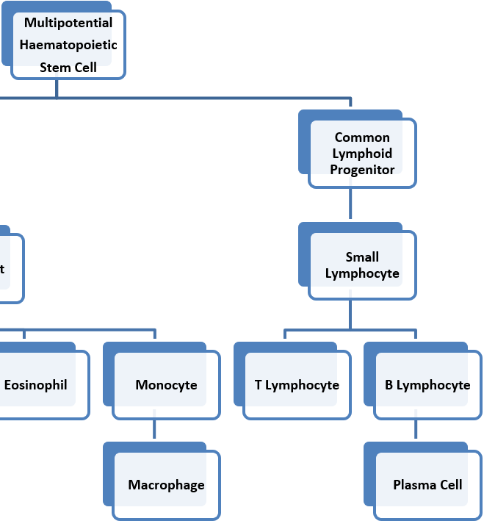
Myeloma – ICD10 Classification & Morphology
Myeloma and other plasma cell neoplasm develop from plasma cells which are descended from B lymphocytes
Plasma cells secrete Immunoglobulins (certain types of proteins) or antibodies which circulate in the blood and can be detected in a blood sample to help determine the specific type of neoplasm
Notes:
Myeloma is a form of plasma cell neoplasm, meaning it’s derived from the lymphoid cell line. Certain types of protein are secreted by plasma cells which can be detected by a blood test to help determine the specific neoplasm type.

Slide 8
Myeloma – ICD10 Classification & Morphology
Types of Plasma Cell Neoplasm
Myeloma affects multiple places in the body where bone marrow is normally active in an adult i.e. within the bones of the spine, skull, pelvis, ribs and the areas around the shoulders and hips
Solitary plasmacytoma of bone SPB (a single malignant plasma cell tumour occurring in the bone)
Extramedullary plasmacytoma EMP (arises in tissue other than bone, most EMPs are in the head and neck area)
Notes:
Myeloma affects multiple areas of active bone marrow in the body … whereas solitary plasmacytomas occur singly. Extramedullary plasmacytomas arise outside the skeletal structure

Slide 9
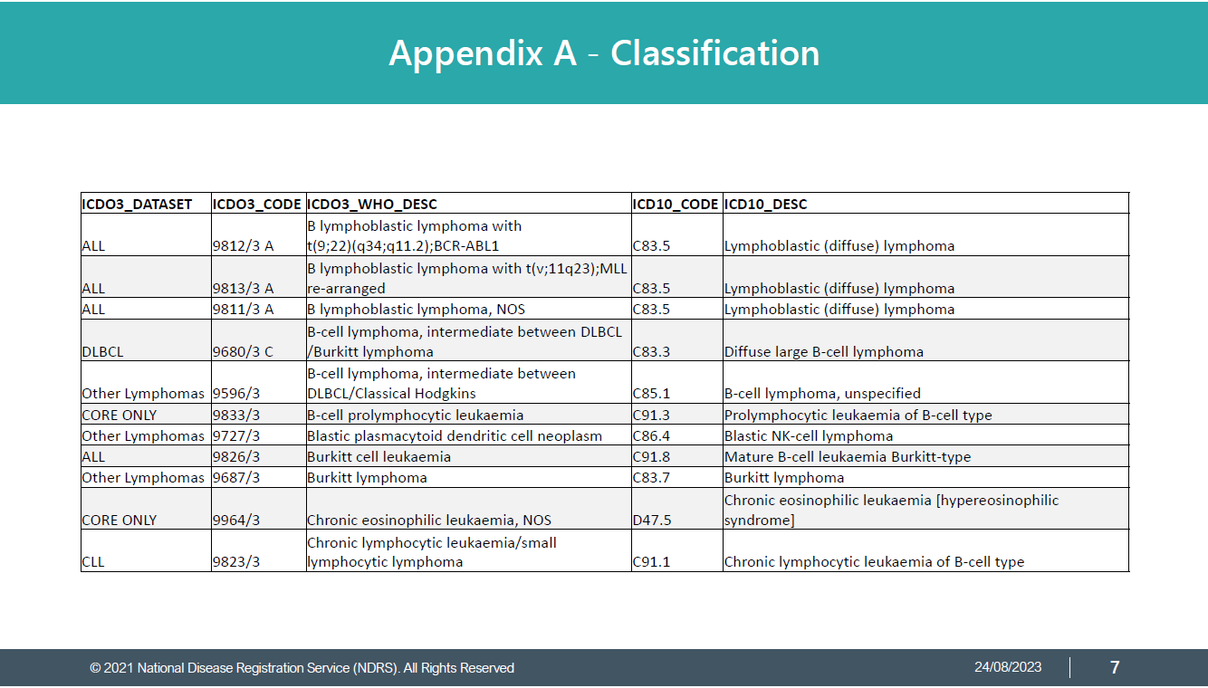
Myeloma – ICD10 Classification & Morphology
The ICD10 code and ICD-O-3 morphology will vary depending on the specific diagnostic test results – always refer to the clinical team for guidance on the exact diagnosis description
Please refer to the searchable reference list provided in the searchable PDF: Haematology – Appendix A, Classifications for the relevant ICD-O-3 morphology & ICD10 codes to use
Notes:
Both the ICD10 code and the ICD-O-3 morphology code may vary depending on the particular type of neoplasm. Your clinical team will provide an exact diagnosis description which will enable you to determine the relevant codes from the searchable PDF reference list contained in Appendix A, Classification. Instructions on downloading this are included in the Summary.

Slide 10
Myeloma - Stage
Myeloma is staged using the International Staging System (ISS) or the Revised International Staging System (R-ISS) for Myeloma. R-ISS is currently recordable for COSD. ISS is derived from Beta2 Microglobulin and Albumin lab results. R-ISS uses additional data (Chromosomal Abnormalities & Lactate Dehydrogenase)
ISS R-ISS
Stage 1
Stage 2
Stage 3
Beta 2 M less than 3.5 and Albumin greater than 34
Beta 2 M less than 3.5 and albumin less than 35, OR Beta 2 M 3.5 - 5.5
Beta 2 M greater than 5.5
Stage 1
Stage 2
Stage 3
Beta-2 microglobulin ≤3.5 g/dL and albumin ≥3.5 g/dL. Standard risk CA by iFISH. Normal LDH
Does not meet the criteria for Stage 1 or Stage 3.
Beta-2 microglobulin of ≥5.5 g/dL, and either High risk CA by iFISH or high LDH
Notes:
The Revised International Staging System … or R-ISS … is recordable for COSD versions 9 & 10.

Slide 11
Myeloma - Stage
All Site-specific stage MUST have the below data items completed to enable to the stage to be reported to the Registry
Reported Date
Reporting Organisation
Notes:
It’s important that the reported date and reporting organisation are also recorded to ensure that the site-specific stage is included in the COSD submission

Slide 12
Myeloma – Smouldering myeloma
Where a diagnosis of smouldering / asymptomatic myeloma is made, this may be based on raised serum or urinary monoclonal protein levels and therefore include patients who do not have a positive bone marrow
As the R-ISS stage includes a FISH assessment for chromosomal abnormalities performed on the bone marrow, it may not be possible to assign an R-ISS stage to some patients with smouldering or asymptomatic myeloma
Where smouldering / asymptomatic myeloma is diagnosed there is currently no specific morphology code for it in ICD-O-3. To differentiate this form of myeloma, please note the diagnosis as smouldering / asymptomatic in the Primary Diagnosis Subsidiary Comment field in your cancer data management system
Notes:
A smouldering / asymptomatic myeloma diagnosis may be made where the patient does not have bone marrow involvement. This means it may not be possible to stage the disease using R-ISS. Where smouldering / asymptomatic myeloma is diagnosed, please note this in the Primary Diagnosis Subsidiary Comment field in your cancer data management system.

Slide 13

Myeloma – Treatment - Chemotherapy
Drug therapy is the main form of treatment for haematological disease
By combining drugs which act in different ways against the malignant cells, the effectiveness of the chemotherapy can be improved and may reduce the risk of chemotherapy resistance to a single drug
Notes:
Chemotherapy is a common treatment for myeloma, often using different drugs in combination

Slide 14
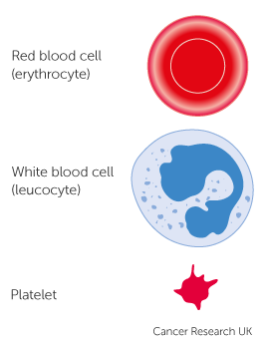
Myeloma – Treatment – Stem Cell Transplants
Stem cells are normally found in the bone marrow with small numbers found in the blood
Bone marrow transplants (BMT) and peripheral blood stem cell transplants (PBSCT) are intensive treatments that may be used to treat people with leukaemia, myeloma or lymphoma
The purpose of a stem cell transplant is to replace abnormal cells with healthy cells developed from the donor stem cells
Notes:
Some patients may be offered a stem cell transplant, the purpose of which is to replace the abnormal cells with healthy versions that will develop from the new stem cells

Slide 15

Myeloma – Treatment – Stem Cell Transplants
Chemotherapy and/or radiotherapy are used prior to the transplant with the aim of killing malignant cells and (if donor cells are being used in the transplant) suppress the patient’s immune system, preventing rejection of the transplant
Stem cell transplants can be:
Autologous transplant (using the patient’s own stem cells)
Allogeneic transplant (using donor stem cells)
Notes:
Prior to the transplant, chemotherapy, sometimes in combination with radiotherapy, will be used to destroy the malignant cells. Where donor cells are used, the patient’s immune system may need to be suppressed to prevent rejection.

Slide 16
Summary
Notes:
In summary…

Slide 17
Summary
There are over several different types of plasma cell neoplasms, one of which is myeloma
Diagnosing myeloma relies on a wide range of tests which may include blood tests, urine tests and imaging
Myeloma is staged for COSD version 9 in R-ISS
Treatment for myeloma is usually chemotherapy but sometimes a stem cell transplant is offered. This would require chemotherapy and/or radiotherapy prior to the transplant
Notes:
Myeloma is a form of plasma cell neoplasm

Slide 18
Summary
There are over several different types of plasma cell neoplasms, one of which is myeloma
Diagnosing myeloma relies on a wide range of tests which may include blood tests, urine tests and imaging
Myeloma is staged for COSD version 9 in R-ISS
Treatment for myeloma is usually chemotherapy but sometimes a stem cell transplant is offered. This would require chemotherapy and/or radiotherapy prior to the transplant
Notes:
The diagnostic pathway may include multiple blood and urine tests as well as imaging

Slide 19
Summary
There are over several different types of plasma cell neoplasms, one of which is myeloma
Diagnosing myeloma relies on a wide range of tests which may include blood tests, urine tests and imaging
Myeloma is staged for COSD version 9 using the R-ISS system – please ensure that the staging date and organisation are also recorded
Treatment for myeloma is usually chemotherapy but sometimes a stem cell transplant is offered. This would require chemotherapy and/or radiotherapy prior to the transplant
Notes:
COSD version 9 requires the use of R-ISS staging for myeloma

Slide 20
Summary
There are over several different types of plasma cell neoplasms, one of which is myeloma
Diagnosing myeloma relies on a wide range of tests which may include blood tests, urine tests and imaging
Myeloma is staged for COSD version 9 using the R-ISS system – please ensure that the staging date and organisation are also recorded
Treatment for myeloma is usually chemotherapy but sometimes a stem cell transplant is offered. This would require chemotherapy and/or radiotherapy prior to the transplant
Notes:
Myeloma is normally treated with chemotherapy but a stem cell transplant may be offered

Slide 21
Summary
The classification of Haematological disease is complex and relies on multiple factors. Your clinical team will be able to provide you with the exact diagnosis description. The Haematology Appendix A, Classification will guide you on the codes to record for ICD10 and ICD-O-3 morphology
If a Haematological disease is diagnosed it may or may not be classified as malignant. While all haematological malignancies must be recorded, please refer to the COSD User Guide (Haematology section) for the list of D or E coded conditions that must also be recorded
Notes:
Haematology classification is complicated and usually relies on a number of test results to allow the clinical team to provide you with an exact diagnosis description. The searchable PDF: Haematology Appendix A, Classification will guide you to the correct ICD10 diagnosis- and ICD-O-3 morphology-codes for that diagnosis.

Slide 22
Summary
The classification of Haematological disease is complex and relies on multiple factors. Your clinical team will be able to provide you with the exact diagnosis description. The Haematology Appendix A, Classification will guide you on the codes to record for ICD10 and ICD-O-3 morphology
If a Haematological disease is diagnosed it may or may not be classified as malignant. All diseases listed in the Haematology Appendix A, Classification are recordable for COSD
Notes:
Not all haematological conditions are C coded as malignant in ICD10. While all C coded haematological disease must be recorded, please refer to the Haematology section of the COSD user guide for the other conditions that require a COSD record.

Slide 23
Summary
Additional guidance on recording COSD data including morphology, topography, staging and recording a diagnosis can be found at: https://digital.nhs.uk/ndrs/data/cancer-data-training-materials
For Haematology, this includes an Introduction plus disease specific modules for Leukaemia and Lymphoma as well as a searchable PDF: Haematology - Appendix A, Classification
Staging data sheets can also be downloaded from the NDRS website for clinical use: https://digital.nhs.uk/ndrs/data/cancer-data-training-materials/staging-sheets
Notes:
Additional training modules as well as Staging sheets for clinical use may be downloaded from the NDRS website.

Slide 24
Summary
For guidance on the required staging system, please refer to the latest COSD User Guide, Appendix E
https://digital.nhs.uk/ndrs/data/data-sets/cosd#downloads
Notes:
Do please remember, guidance is available on our website. You can download the COSD User Guide by clicking on this link and selecting the COSD version appropriate to your trust.

Slide 25

Acknowledgements
Many thanks to Cancer Research UK for the use of their images within this training module.
Notes:
We’d like to thank Cancer Research UK for the use of their images within this training module.

Slide 26
Questions?
East Midlands: Simon Cairnes – simon.cairnes@nhs.net
Eastern: Marianne Mollett – marianne.mollett@nhs.net
London & South East: Katrina Sung – katrina.sung@nhs.net
London & South East: Karen Graham– karen.graham36@nhs.net
North West: Paul Stacey – p.stacey@nhs.net
Northern & Yorkshire: Rachael Mann – rachaelmann@nhs.net
Oxford: Gemma Feeney – gemma.feeney@nhs.net
South West: James Withers – james.withers@nhs.net
West Midlands: Gemma Feeney – gemma.feeney@nhs.net
Notes:
If you have any questions on the information contained within this module or about COSD in general, do please feel free to email your regional Data Liaison Manager

