Slide 1

National Disease Registration Service
(NDRS)
Haematology – Lymphoma
v6 December 2025
Notes:
Welcome to this NDRS training module on Haematology – Lymphoma which has been designed to help Cancer Administration staff gain a better understanding of Lymphoma… the terminology used by the clinical teams …and where to find guidance on the correct codes.

Slide 2

Agenda
Introduction
Lymphoma
Summary
Acknowledgements
This module may be paused at any time
It is advised that this module is viewed in conjunction with Haematology – An Introduction, and the searchable PDF: Haematology Appendix A, Classification
Notes:
We’re going to give you a brief introduction to Lymphoma including some of the symptoms that patients might experience. We’ll then look at the diagnosis & treatment options. This module can be paused at any time. A PDF of these slides is also available for reference.

Slide 3
Lymphoma
In this section we will cover:
  Types of Lymphoma
  Causes & Risk Factors
  Signs & Symptoms
  Diagnosis
In th:
  ICD10 Classification & Morphology
  Stage
  Grade - NHL
  Treatment
Notes:
We’ll start off by looking at the various types of Lymphoma…

Slide 4
Lymphoma – Types of Lymphoma
Lymphoma occurs in several forms and these are sometimes referred to using an acronym. Broadly, these are:
  HL – Hodgkins Lymphoma - There are several different sub-types, including:
    Classical – several sub-types including Nodular sclerosing Lymphoma
    NLPHL – Nodular Lymphocyte Predominant Hodgkin Lymphoma
  NHL – Non-Hodgkins Lymphoma - There are over 30 different sub-types, including:
    DLBCL – Diffuse Large B Cell Lymphoma
    Follicular Lymphoma
Notes:
…. which, broadly speaking, fall under either Hodgkins lymphoma or non-hodgkins lymphoma. However, there are many different sub-types.

Slide 5
Lymphoma – Causes & Risk Factors
There are no specific causes and risks identified to explain the development of lymphomas although some lymphomas are known to be associated with viral and bacterial infections, including:
Epstein-Barr virus
Human T-lymphocytotropic virus type 1 (HTLV-1)
Hepatitis C
Helicobacter pylori
Notes:
While no specific causes have been identified for most lymphomas, risk factors for some lymphomas include bacterial or viral infections…

Slide 6
Lymphoma – Causes & Risk Factors
Another potential risk factor is any impairment to the immune system. This may include:
Autoimmune conditions
Previous organ transplant recipient requiring immunosuppressant drugs
Previous history of cancer
Human immunodeficiency virus/acquired immune deficiency syndrome (HIV/AIDS)
Notes:
… as well as a compromised immune system

Slide 7
Lymphoma – Signs & Symptoms
Painless lump or swelling often in the neck, axilla or groin
Fever
Excessive sweating (especially at night)
Loss of appetite
Unexplained weight loss
Fatigue
Persistent itching
Cough and/or breathlessness
Enlarged tonsils, liver or spleen
Alcohol may cause pain in affected lymph nodes
Notes:
Patients may present with painless swelling, unexplained weight loss or night sweats

Slide 8

Lymphoma - Diagnosis
Two thirds of lymphomas arise in lymph nodes, one third are extranodal (outside the lymph nodes).
Lymphomas can be localised to the lymphatic tissue of any organ.
http://training.seer.cancer.gov/ss_module08_lymph_leuk/lymph_unit02_sec02_reg_lns.html
Notes:
Most lymphomas arise in the lymph nodes while roughly a third are extranodal

Slide 9



Lymphoma - Diagnosis
A number of tests may be carried out to diagnose a lymphoma including:
  Clinical examination
  Full blood count
  Liver function tests (LFTs)
  Chest x-ray
  Ultrasound
  CT scan
  Biopsy of lymph node
Notes:
Diagnosis of lymphomas usually requires a range of tests including blood tests, imaging and biopsies

Slide 10
Lymphoma - Diagnosis
Further tests may be required to refine the diagnosis of lymphoma after the diagnosis has been made from a biopsy
This will assess the extent of involvement of other lymph nodes or organs in the body and determine the likely prognosis
Notes:
To determine the exact type and extent of the lymphoma, further tests may be needed…

Slide 11
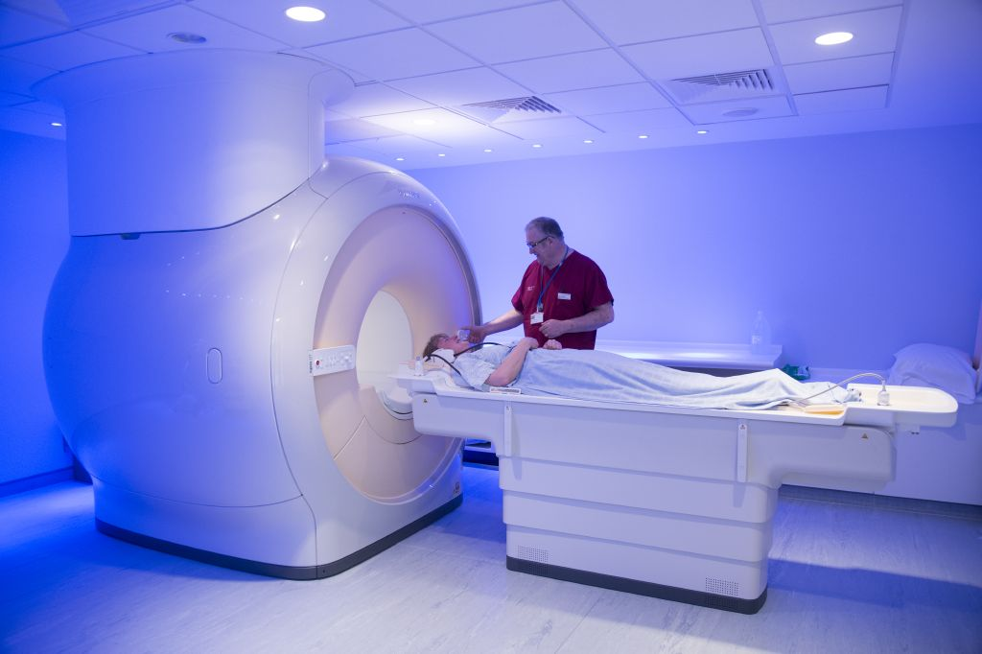
Lymphoma - Diagnosis
The results will help the Multidisciplinary Team decide on the best treatment for the patient. Tests may include:
    Immunophenotyping, Cytogenetics, Molecular Biology of the Lymphoma cells from the biopsy
    Lactate dehydrogenase levels (LDH – a type of protein in the blood)
    Bone marrow aspirate and trephine biopsy
    PET-CT scan
    MRI scan
Notes:
… which may include immunophenotyping or further imaging

Slide 12
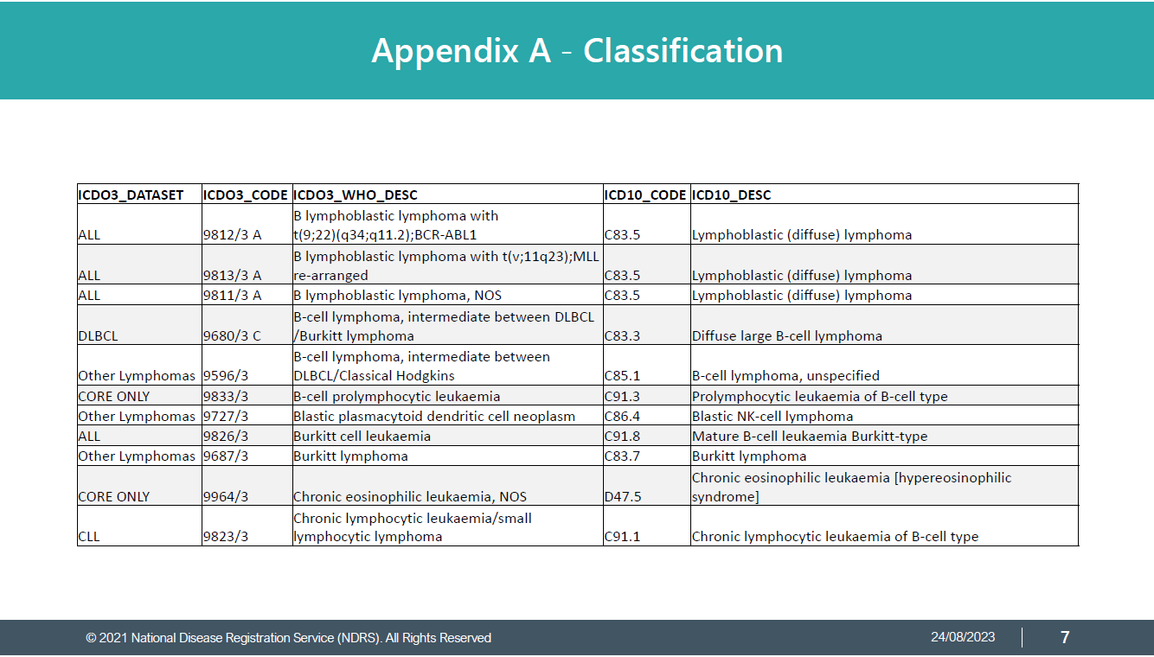
Lymphoma – ICD10 Classification & Morphology
Hodgkin lymphoma – ICD10 code: Variable
The ICD10 topography code may vary depending on the specific diagnostic test results
Always refer to the clinical team for guidance on the exact diagnosis.
Please refer to the searchable reference list provided in: NDRS PDF: Haematology – Appendix A, Classifications for the relevant ICD10 code to use
Notes:
The ICD10 code may vary depending on the exact type of Lymphoma. Your clinical team will provide an exact diagnosis description which will enable you to determine the relevant codes from the searchable PDF reference list contained in Appendix A, Classification. Instructions on downloading this are included in the Summary.

Slide 13
Lymphoma – ICD10 Classification & Morphology
Hodgkin lymphoma – ICD10 code: Variable
Some examples of descriptions & ICD-O-3 Morphology codes are:
Nodular sclerosis – M9663/3
Mixed cellularity – M9652/3
Lymphocyte-rich – M9651/3
Notes:
…and like the ICD10 topography code, the ICD-O-3 morphology code may also vary depending on the exact type.

Slide 14
Lymphoma – ICD10 Classification & Morphology
The ICD-O-3 morphology will also vary depending on the specific diagnostic test results – always refer to the clinical team for guidance on the exact diagnosis description
Please refer to the searchable reference list provided in the PDF: Haematology – Appendix A, Classifications for the relevant ICD-O-3 morphology codes to use
Notes:
Always refer to your clinical team and the searchable reference list in Appendix A for the correct description and morphology codes to record.

Slide 15
Lymphoma – ICD10 Classification & Morphology
Non-Hodgkin lymphoma – ICD10 code variable
NHL can start in any of the three major types of lymphocytes: B cells, T cells or NK (natural killer) cells. About 85% of NHL cases start in B cells
NHL is classified into more than 30 different subtypes
The ICD10 code and ICD-O-3 morphology will vary depending on the specific diagnostic test results – always refer to the clinical team for guidance on the exact diagnosis
Please refer to the searchable reference list provided in the PDF: Haematology – Appendix A, Classifications for the relevant ICD10 & ICD-O-3 morphology codes to use
Notes:
Non-Hodgkins Lymphoma has more than 30 different sub-types. Again, always refer to your clinical team and Appendix A for the correct ICD10 and ICD-O-3 codes to use

Slide 16
Lymphoma – Stage – Hodgkin Lymphoma in children and all adult lymphomas (not including primary cutaneous Lymphoma)
The Ann Arbor Staging Classification is used to summarise the extent of the lymphoma for all lymphomas in adults and for Hodgkin lymphomas in children with the exception of primary cutaneous lymphomas
Depending on your cancer data management system, you may be able to enter the stage grouping directly or it may be necessary to enter the individual test results to enable the system to calculate the stage
One region of lymph nodes, or spleen or thymus or Waldeyer's ring enlarged
Two regions of lymph nodes enlarged on the same side of diaphragm
Lymph nodes enlarged on both sides of diaphragm
IV
Disease outside lymph nodes e.g. liver, bone marrow
I
II
III
Notes:
With the exception of primary cutaneous lymphomas, all Lymphomas in adults and Hodgkin Lymphomas in children are staged using the Ann Arbor staging system.

Slide 17
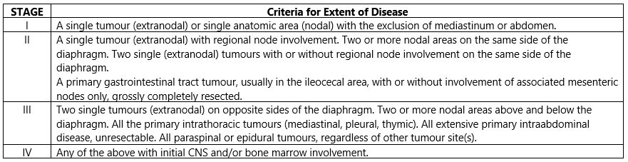
Lymphoma – Stage – Non-Hodgkin Lymphoma in children
The Murphy St Jude Classification is used for all Non-Hodgkin Lymphomas in children to summarise the extent of the lymphoma:
Notes:
…whereas Non-Hodgkin Lymphomas in children are staged using the Murphy St Jude staging system.

Slide 18
Lymphoma – Stage – Primary cutaneous lymphoma
Primary cutaneous lymphomas, as well as mycosis fungoides & Sezary syndrome diagnosed from 1st January 2026 must be staged using UICC TNM v9
Please note that the TNM version must be accurately recorded – if you are unable to specify TNM v9 the version in your cancer data management system due to account access or other issues, please refer to your line manager
If, after 1st January 2026, your cancer data management system has not been amended to include TNM v9 please record the TNM v9 stage and add the following statement to the Primary Diagnosis Subsidiary Comment field:
  Patient staged using TNM9 not TNM8 as per CR2070
Notes:
For all primary cutaneous lymphomas diagnosed from 1st January 2026, please record a stage in UICC TNM v9

Slide 19
Lymphoma - Stage
All site-specific stage MUST have the below data items completed to enable to the stage to be reported to the Registry
Reported Date
Reporting Organisation
Notes:
It’s important that the reported date and reporting organisation are also recorded to ensure that the site-specific stage is included in the COSD submission

Slide 20
Lymphoma – Grade - NHL
Grading of lymphomas can vary depending on the type of lymphoma:
Non-Hodgkin Lymphomas (NHL) are the more common type of intestinal lymphoma and they include MALT lymphoma, DLBCL and follicular lymphoma (among others).
Indolent (low grade, slow growing)
Aggressive (high grade, fast growing
For other types of lymphoma, please refer to your clinical team
It should be noted that for follicular lymphoma, the ICD10 code will vary according to the grade of the disease
Notes:
The grading system used for lymphomas will depend on the type of lymphoma. Non-Hodgkin Lymphoma grading is shown here. For other types of lymphoma, please refer to your clinical team.

Slide 21
Lymphoma –Treatment - Surgery
For most haematological malignancies, surgery is not appropriate as the disease is systemic.
Surgery is not a usual form of treatment for lymphomas however if a lymphoma is confined to an organ or one region of lymph nodes then the organ or lymph nodes may be removed
Surgery to provide a biopsy sample (often excision of a lymph node) is usually part of the diagnostic pathway for lymphoma
Some localised lymphomas (skin, brain, stomach) may require surgery as part or all of treatment
Notes:
While surgery is not usually appropriate for haematological disease, where a lymphoma is organ confined, excision may be suitable and offer a curative treatment. Surgical excision of lymph nodes is often part of the diagnostic process

Slide 22

Lymphoma –Treatment- Chemotherapy
Drug therapy is the main form of treatment for haematological disease
By combining drugs which act in different ways against the malignant cells, the effectiveness of the chemotherapy can be improved and may reduce the risk of chemotherapy resistance to a single drug
Notes:
Chemotherapy is a common treatment for lymphoma, often using different drugs in combination

Slide 23
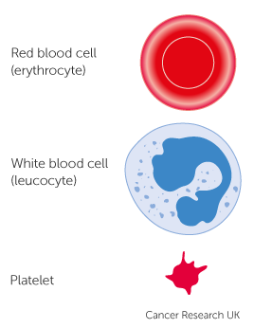
Lymphoma –Treatment – Stem Cell Transplants
Stem cells are normally found in the bone marrow with small numbers found in the blood
Bone marrow transplants (BMT) and peripheral blood stem cell transplants (PBSCT) are intensive treatments that may be used to treat people with leukaemia, myeloma or lymphoma
The purpose of a stem cell transplant is to replace abnormal cells with healthy cells developed from the donor stem cells
Notes:
Some patients may be offered a stem cell transplant, the purpose of which is to replace the abnormal cells with healthy versions that will develop from the new stem cells

Slide 24

Lymphoma –Treatment – Stem Cell Transplants
Chemotherapy and/or radiotherapy are used prior to the transplant with the aim of killing malignant cells and (if donor cells are being used in the transplant) suppress the patient’s immune system, preventing rejection of the transplant
Stem cell transplants can be:
Autologous transplant (using the patient’s own stem cells)
Allogeneic transplant (using donor stem cells)
Notes:
Prior to the transplant, chemotherapy, sometimes in combination with radiotherapy, will be used to destroy the malignant cells. Where donor cells are used, the patient’s immune system may need to be suppressed to prevent rejection.

Slide 25
Summary
Notes:
In summary…

Slide 26
Summary
There are over 30 different sub-types of lymphoma but they are broadly categorised as Hodgkin and Non-Hodgkin Lymphoma
Diagnosing lymphoma relies on a wide range of tests which may include blood tests, imaging and surgical excision of lymph nodes
Lymphomas are staged using the Ann Arbor system
Treatment for lymphoma is usually chemotherapy but sometimes a stem cell transplant is offered. This would require chemotherapy and/or radiotherapy prior to the transplant. Surgery may be offered for organ-confined lymphoma
Notes:
While there are numerous specific types of lymphoma, they are broadly categorised as Hodgkin and non-Hodgkin

Slide 27
Summary
There are over 30 different sub-types of lymphoma but they are broadly categorised as Hodgkin and Non-Hodgkin Lymphoma
Diagnosing lymphoma relies on a wide range of tests which may include blood tests, imaging and surgical excision of lymph nodes
Lymphomas are staged using the Ann Arbor system
Treatment for lymphoma is usually chemotherapy but sometimes a stem cell transplant is offered. This would require chemotherapy and/or radiotherapy prior to the transplant. Surgery may be offered for organ-confined lymphoma
Notes:
The diagnostic process requires multiple tests, potentially including surgical excision of lymph nodes.

Slide 28
Summary
There are over 30 different sub-types of lymphoma but they are broadly categorised as Hodgkin and Non-Hodgkin Lymphoma
Diagnosing lymphoma relies on a wide range of tests which may include blood tests, imaging and surgical excision of lymph nodes
Hodgkin lymphomas in children and all lymphomas in adults are staged using the Ann Arbor system. Non-Hodgkin lymphomas in children are staged using the Murphy St Jude system - please ensure that the staging date and organisation are also recorded
Treatment for lymphoma is usually chemotherapy but sometimes a stem cell transplant is offered. This would require chemotherapy and/or radiotherapy prior to the transplant. Surgery may be offered for organ-confined lymphoma
Notes:
Non-Hodgkin lymphoma in children requires a different staging system to that used in adults

Slide 29
Summary
There are over 30 different sub-types of lymphoma but they are broadly categorised as Hodgkin and Non-Hodgkin Lymphoma
Diagnosing lymphoma relies on a wide range of tests which may include blood tests, imaging and surgical excision of lymph nodes
Hodgkin lymphomas in children and all lymphomas in adults are staged using the Ann Arbor system. Non-Hodgkin lymphomas in children are staged using the Murphy St Jude system - please ensure that the staging date and organisation are also recorded
Treatment for lymphoma is usually chemotherapy but sometimes a stem cell transplant is offered. This would require chemotherapy and/or radiotherapy prior to the transplant. Surgery may be offered for organ-confined lymphoma
Notes:
Chemotherapy is the usual treatment although stem cell transplants may be offered. Surgery might be suitable for organ-confined lymphomas

Slide 30
Summary
The classification of Haematological disease is complex and relies on multiple factors. Your clinical team will be able to provide you with the exact diagnosis description. The Haematology Appendix A, Classification will guide you on the codes to record for ICD10 and ICD-O-3 morphology
If a Haematological disease is diagnosed it may or may not be classified as malignant. While all haematological malignancies must be recorded, please refer to the COSD User Guide (Haematology section) for the list of D or E coded conditions that must also be recorded
Notes:
Haematology classification is complicated and usually relies on a number of test results to allow the clinical team to provide you with an exact diagnosis description. The searchable PDF: Haematology Appendix A, Classification will guide you to the correct ICD10 diagnosis- and ICD-O-3 morphology-codes for that diagnosis.

Slide 31
Summary
The classification of Haematological disease is complex and relies on multiple factors. Your clinical team will be able to provide you with the exact diagnosis description. The Haematology Appendix A, Classification will guide you on the codes to record for ICD10 and ICD-O-3 morphology
If a Haematological disease is diagnosed it may or may not be classified as malignant. While all haematological malignancies must be recorded, please refer to the COSD User Guide (Appendix C) for the list of D or E coded conditions that must also be recorded
Notes:
Not all haematological conditions are C coded as malignant in ICD10. While all C coded haematological disease must be recorded, please refer to Appendix C of the COSD user guide for the other conditions that require a COSD record.

Slide 32
Summary
Additional guidance on recording COSD data including morphology, topography, staging and recording a diagnosis can be found at: https://digital.nhs.uk/ndrs/data/cancer-data-training-materials
For Haematology, this includes an Introduction plus disease specific modules for Leukaemia and Myeloma as well as a searchable PDF: Haematology - Appendix A, Classification
Staging data sheets can also be downloaded from the NDRS website for clinical use: https://digital.nhs.uk/ndrs/data/cancer-data-training-materials/staging-sheets
Notes:
Additional training modules as well as Staging sheets for clinical use may be downloaded from the NDRS website.

Slide 33
Summary
For guidance on the required staging system, please refer to the latest COSD User Guide, Appendix E
https://digital.nhs.uk/ndrs/data/data-sets/cosd#downloads
Notes:
Do please remember, guidance is available on our website. You can download the COSD User Guide by clicking on this link and selecting the COSD version appropriate to your trust.

Slide 34

Acknowledgements
Many thanks to Cancer Research UK for the use of their images within this training module.
Notes:
We’d like to thank Cancer Research UK for the use of their images within this training module.

Slide 35
Questions?
East Midlands: Simon Cairnes – simon.cairnes@nhs.net
Eastern: Marianne Mollett – marianne.mollett@nhs.net
London & South East: Katrina Sung – katrina.sung@nhs.net
London & South East: Karen Graham– karen.graham36@nhs.net
North West: Paul Stacey – p.stacey@nhs.net
Northern & Yorkshire: Rachael Mann – rachaelmann@nhs.net
Oxford: Gemma Feeney – gemma.feeney@nhs.net
South West: James Withers – james.withers@nhs.net
West Midlands: Gemma Feeney – gemma.feeney@nhs.net
Notes:
If you have any questions on the information contained within this module or about COSD in general, do please feel free to email your regional Data Liaison Manager

