Slide 1

National Disease Registration Service
(NDRS)
Haematology – Leukaemia
v4 August 2024
Notes:
Welcome to this NDRS training module on Haematology – Leukaemia, which has been designed to help Cancer Administration staff gain a better understanding of Leukaemia, the terminology used by the clinical teams and where to find guidance on the correct codes.

Slide 2

Agenda
Introduction
Leukaemia
Summary
Acknowledgements
This module may be paused at any time
It is advised that this module is viewed in conjunction with Haematology – An Introduction, and the searchable PDF: Haematology Appendix A, Classification
Notes:
We’re going to give you a brief introduction to Leukaemia including some of the symptoms that patients might experience. We’ll then look at the diagnosis & treatment options. This module can be paused at any time. A PDF of these slides is also available for reference.

Slide 3
Leukaemia
In this section we will cover:
  Types of Leukaemia
  Causes & Risk Factors
  Signs & Symptoms
  Diagnosis
In th:
  Morphology
  ICD10 Classification
  Stage
  Treatment
Notes:
Firstly, we’ll look at some of the types of leukaemia…

Slide 4
Leukaemia – Types of Leukaemia
Leukaemia occurs in several forms and these are often referred to using an acronym. These may include:
  AML – Acute Myeloid Leukaemia
  ALL – Acute Lymphoblastic Leukaemia
  CML – Chronic Myeloid Leukaemia
  CLL – Chronic Lymphocytic Leukaemia
Notes:
Leukaemia occurs in a number of forms, many of which are referred to using acronyms including AML, ALL, CML and CLL.

Slide 5
Leukaemia – Causes & Risk Factors
Radiation exposure
Smoking
Chemical exposure
Genetics – some inherited conditions increase the risk of leukaemia
Blood disorders – including myelodysplastic syndrome or myeloproliferative disorders
Autoimmune conditions – including rheumatoid arthritis and ulcerative colitis
Age – depending on the type of leukaemia it may be more common in older or younger people
Notes:
Whilst the cause of most leukaemias is not fully known, some risk factors have been identified. These include radiation exposure, smoking, autoimmune conditions and age

Slide 6
Leukaemia – Signs & Symptoms
Some signs and symptoms apply to all types of leukaemia:
Fatigue
Pain
Breathlessness on exertion
Notes:
Leukaemias often present with fatigue, pain and breathlessness…

Slide 7
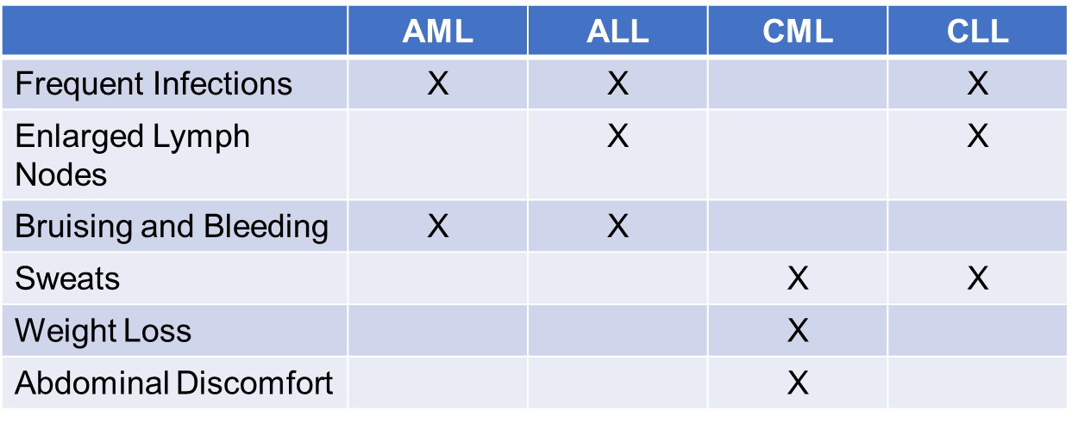
Leukaemia – Signs & Symptoms
Symptoms specific to a particular type of malignancy include:
Notes:
… while some symptoms are specific to the type of leukaemia involved.

Slide 8
Leukaemia – Diagnosis
The diagnosis of leukaemia usually requires a combination of multiple tests. These may include:
Full blood count (FBC)
Bone marrow aspirate and bone marrow trephine biopsy
Immunophenotype on marrow or blood cells (a process that uses antibodies to identify cells based on the types of antigens or markers on the surface of the cells)
Cytogenetics on marrow or blood (the examination of the structure and function of chromosomes)
Molecular markers on marrow or blood
Lumbar puncture (for ALL)
Ultrasound (sometimes for CML and CLL)
Notes:
In order to reach a diagnosis of Leukaemia, a range of tests is usually needed. These might include a full blood count, bone marrow aspirate or a bone marrow trephine. Sometimes, other tests are required such as immunophenotyping

Slide 9

Leukaemia – Morphology
In acute leukaemia, the abnormalities are due to immature blood cells or blasts - cells which are not able to function normally
There is a rapid growth and progression of these useless cells preventing the formation of healthy blood cells and, without treatment, the patient may die within days or a few weeks
In chronic leukaemia the blood cells will develop into mature cells but are abnormal in form and unable to function well
Notes:
Leukaemias are sometimes classified as Acute, where the abnormalities in the blood cells are very severe. Untreated, the patient may die in a short space of time. In Chronic leukaemia, the cellular abnormalities are less pronounced, meaning the blood cells can retain partial functionality

Slide 10
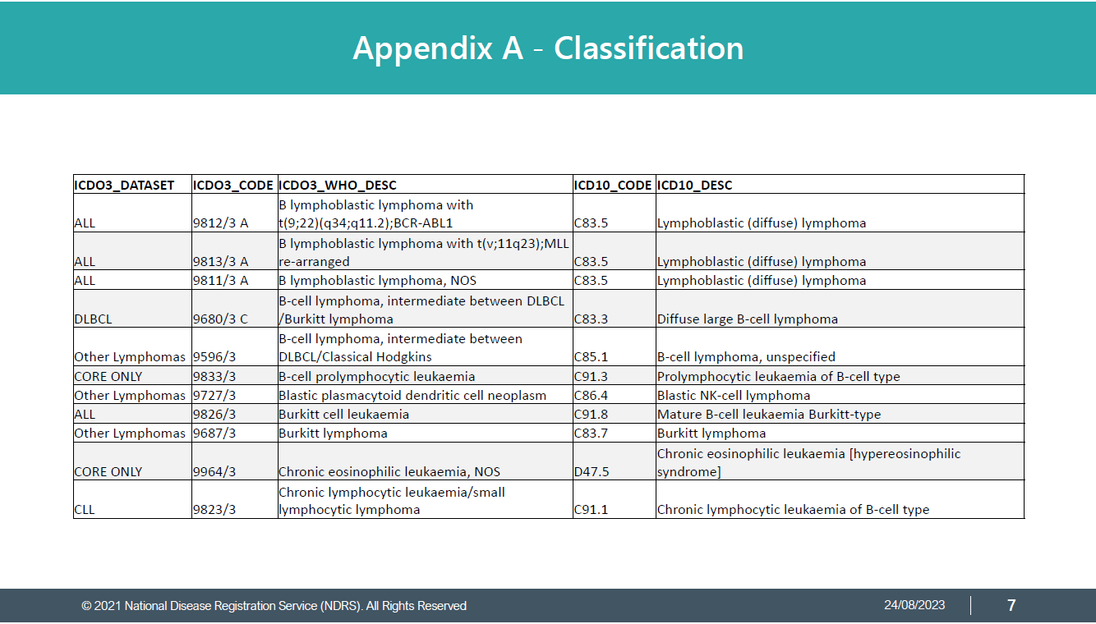
Leukaemia – Morphology
The ICD-O-3 morphology code may vary depending on the specific diagnostic test results
Always refer to the clinical team for guidance on the exact diagnosis.
Please refer to the searchable reference list provided in: NDRS PDF: Haematology – Appendix A, Classifications for the relevant ICD-O-3 morphology code to use
Notes:
Leukaemias have specific morphology codes. Your clinical team will provide an exact diagnosis description which will enable you to determine the relevant codes from the searchable PDF reference list contained in Appendix A, Classification. Instructions on downloading this are included in the Summary.

Slide 11
Leukaemia – ICD10 Classification
There are many types of leukaemia but the main types are grouped by the white blood cell type from which it arises i.e. myeloid cells or lymphoid cells
Within each category, the behaviour of the leukaemia is subdivided into acute or chronic. Broadly, the diseases are classified in their main groups :
Myeloid
Acute myeloid leukaemia
Chronic myeloid leukaemia
Lymphoid
Acute lymphoblastic leukaemia
Chronic lymphocytic leukaemia
Notes:
While there are many subtypes of leukaemia, broadly speaking they are classified according to cell type and severity. However…

Slide 12
Leukaemia – ICD10 Classification
However, the ICD10 code may also vary depending on the specific diagnostic test results
Always refer to the clinical team for guidance on the exact diagnosis description
Please refer to the searchable reference list provided in: NDRS PDF: Haematology – Appendix A, Classifications for the relevant ICD10 code to use
Notes:
… like the morphology code, the ICD10 code may vary depending on the exact type. Always refer to your clinical team and the searchable reference list in Appendix A.

Slide 13
Leukaemia - Stage
Most types of leukaemia are not stageable
Only Chronic Lymphocytic Leukaemia (CLL) is staged using the Binet system. Binet stage is derived from multiple diagnostic test results:
  Platelet count
  Hb (haemoglobin count)
  Lymphadenopathy (enlarged lymph nodes)
  Hepatomegaly (enlarged liver)
  Splenomegaly (enlarged spleen)
Notes:
Leukaemia is not generally stageable, the exception being CLL which is staged. Binet staging for CLL relies on a number of factors, including platelet count and the presence of an enlarged liver or spleen

Slide 14
Leukaemia – Stage - Binet
The Binet stage is supplied by the clinical team
For more details, please see the latest COSD User Guide (link in the summary). Depending on your cancer data management system, you may be able to enter the stage grouping directly or it may be necessary to enter the individual test results to enable the system to calculate the stage
Stage A
Stage B
Stage C
If Platelet count > 99 x 10⁹/L and Hb >99 and 0, 1 or 2 areas of organ enlargement (number of lymph node groups plus score 1 for hepatomegaly, 1 for splenomegaly)
If Platelet count> 99 and Hb>99 and 3, 4 or 5 areas of organ enlargement
If Hb<100 or platelet count <100
Notes:
Depending on your cancer management system, you may be able to enter the stage as supplied by your clinical team or it may be necessary to enter individual parameters to enable the system to calculate the stage

Slide 15
Leukaemia - Stage
All Site-specific stage MUST have the below data items completed to enable to the stage to be reported to the Registry
Reported Date
Reporting Organisation
Notes:
It’s important that the reported date and reporting organisation are also recorded to ensure that the site specific stage is included in the COSD submission

Slide 16

Leukaemia –Treatment- Chemotherapy
Drug therapy is the main form of treatment for haematological disease
By combining drugs which act in different ways against the malignant cells, the effectiveness of the chemotherapy can be improved and may reduce the risk of chemotherapy resistance to a single drug
Notes:
Chemotherapy is the usual treatment for leukaemia, often using different drugs in combination

Slide 17
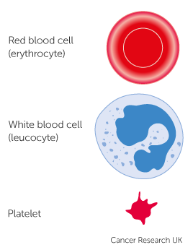
Leukaemia –Treatment – Stem Cell Transplants
Stem cells are normally found in the bone marrow with small numbers found in the blood
Bone marrow transplants (BMT) and peripheral blood stem cell transplants (PBSCT) are intensive treatments that may be used to treat people with leukaemia, myeloma or lymphoma
The purpose of a stem cell transplant is to replace abnormal cells with healthy cells developed from the donor stem cells
Notes:
Some patients may be offered a stem cell transplant, the purpose of which is to replace the abnormal cells with healthy versions that will develop from the new stem cells

Slide 18

Leukaemia –Treatment – Stem Cell Transplants
Chemotherapy and/or radiotherapy are used prior to the transplant with the aim of killing malignant cells and (if donor cells are being used in the transplant) suppress the patient’s immune system, preventing rejection of the transplant
Stem cell transplants can be:
Autologous transplant (using the patient’s own stem cells)
Allogeneic transplant (using donor stem cells)
Notes:
Prior to the transplant, chemotherapy, sometimes in combination with radiotherapy, will be used to destroy the patient’s malignant cells. Where donor cells are used, the patient’s immune system may need to be suppressed to prevent rejection.

Slide 19
Summary
Notes:
In summary…

Slide 20
Summary
There are many sub-types of leukaemia but he most common types are categorised as AML, CML, ALL or CLL tests which may include blood tests, bone marrow biopsies or imaging
Once diagnosed, most forms of leukaemia are not stageable with the exception of CLL which uses the Binet staging system
Treatment for leukaemia is usually chemotherapy but sometimes a stem cell transplant is offered
Notes:
Leukaemias are broadly categorised as AML, CML, ALL or CLL

Slide 21
Summary
There are many sub-types of leukaemia but he most common types are categorised as AML, CML, ALL or CLL
Diagnosing leukaemia relies on a wide range of tests which may include blood tests, bone marrow biopsies or imaging
Once diagnosed, most forms of leukaemia are not stageable with the exception of CLL which uses the Binet staging system
Treatment for leukaemia is usually chemotherapy but sometimes a stem cell transplant is offered
Notes:
Diagnostic tests for leukaemia may include blood tests and bone marrow biopsies

Slide 22
Summary
There are many sub-types of leukaemia but he most common types are categorised as AML, CML, ALL or CLL
Diagnosing leukaemia relies on a wide range of tests which may include blood tests, bone marrow biopsies or imaging
Once diagnosed, most forms of leukaemia are not stageable with the exception of CLL which uses the Binet staging system - please ensure that the staging date and organisation are also recorded
Treatment for leukaemia is usually chemotherapy but sometimes a stem cell transplant is offered
Notes:
Only CLL requires a stage to be recorded. Other types of leukaemia are not considered stageable

Slide 23
Summary
There are many sub-types of leukaemia but he most common types are categorised as AML, CML, ALL or CLL
Diagnosing leukaemia relies on a wide range of tests which may include blood tests, bone marrow biopsies or imaging
Once diagnosed, most forms of leukaemia are not stageable with the exception of CLL which uses the Binet staging system - please ensure that the staging date and organisation are also recorded
Treatment for leukaemia is usually chemotherapy but sometimes a stem cell transplant is offered. This would require chemotherapy and/or radiotherapy prior to the transplant
Notes:
Chemotherapy is the usual treatment for leukaemia although stem cell transplants may be offered

Slide 24
Summary
The classification of Haematological disease is complex and relies on multiple factors. Your clinical team will be able to provide you with the exact diagnosis description. The Haematology Appendix A, Classification will guide you on the codes to record for ICD10 and ICD-O-3 morphology
If a Haematological disease is diagnosed it may or may not be classified as malignant. While all haematological malignancies must be recorded, please refer to the COSD User Guide (Haematology section) for the list of D or E coded conditions that must also be recorded
Notes:
Haematology classification is complicated and usually relies on a number of test results to allow the clinical team to provide you with an exact diagnosis description. The searchable PDF: Haematology Appendix A, Classification will guide you to the correct ICD10 diagnosis- and ICD-O-3 morphology-codes for that diagnosis.

Slide 25
Summary
The classification of Haematological disease is complex and relies on multiple factors. Your clinical team will be able to provide you with the exact diagnosis description. The Haematology Appendix A, Classification will guide you on the codes to record for ICD10 and ICD-O-3 morphology
If a Haematological disease is diagnosed it may or may not be classified as malignant. While all haematological malignancies must be recorded, please refer to the COSD User Guide (Haematology section) for the list of D or E coded conditions that must also be recorded
Notes:
Not all haematological conditions are C coded as malignant in ICD10. While all C coded haematological disease must be recorded, please refer to the Haematology section of the COSD user guide for the other conditions that require a COSD record.

Slide 26
Summary
Additional guidance on recording COSD data including morphology, topography, staging and recording a diagnosis can be found at: https://digital.nhs.uk/ndrs/data/cancer-data-training-materials
For Haematology, this includes an Introduction plus disease specific modules for Lymphoma and Myeloma as well as a searchable PDF: Haematology - Appendix A, Classification
Staging data sheets can also be downloaded from the NDRS website for clinical use: https://digital.nhs.uk/ndrs/data/cancer-data-training-materials/staging-sheets
Notes:
Additional training modules as well as Staging sheets for clinical use may be downloaded from the NDRS website.

Slide 27
Summary
If in any doubt as to whether you should be recording a haematology diagnosis, please refer to the latest COSD User Guide, Appendix C
For guidance on the required staging system, please refer to the latest COSD User Guide, Appendix E
https://digital.nhs.uk/ndrs/data/data-sets/cosd#downloads
Notes:
Do please remember, guidance is available on our website. You can download the COSD User Guide by clicking on this link and selecting the COSD version appropriate to your trust.

Slide 28

Acknowledgements
Many thanks to Cancer Research UK for the use of their images within this training module.
Notes:
We’d like to thank Cancer Research UK for the use of their images within this training module.

Slide 29
Questions?
East Midlands: Simon Cairnes – simon.cairnes@nhs.net
Eastern: Marianne Mollett – marianne.mollett@nhs.net
London & South East: Katrina Sung – katrina.sung@nhs.net
London & South East: Karen Graham– karen.graham36@nhs.net
North West: Paul Stacey – p.stacey@nhs.net
Northern & Yorkshire: Rachael Mann – rachaelmann@nhs.net
Oxford: Gemma Feeney – gemma.feeney@nhs.net
South West: James Withers – james.withers@nhs.net
West Midlands: Gemma Feeney – gemma.feeney@nhs.net
Notes:
If you have any questions on the information contained within this module or about COSD in general, do please feel free to email your regional Data Liaison Manager

