Slide 1

National Disease Registration Service
(NDRS)
Haematology – An Introduction
v3 August 2024
Notes:
Welcome to this NDRS training module on Haematology – An Introduction, which is designed to help Cancer Administration staff gain a better understanding of Haematological diseases, the terminology used by the clinical teams and where to find guidance on the codes to use.

Slide 2

Agenda
Introduction to Haematology
Which Conditions to Record
Summary
Acknowledgements
This module may be paused at any time
Additional modules are available for:
Leukaemia
Lymphoma
Myeloma
Notes:
We’re going to give you a brief introduction to the circulatory system and Haematological diseases. We’ll then look at guidance on recording them in your cancer data management system. This module should be used in conjunction with the disease-specific training modules for Leukaemia, Lymphoma and Myeloma, as well as the reference PDF: Haematology - Appendix A, Classification. This module can be paused at any time.

Slide 3
Introduction
In this section we will cover:
  Types of Haematological Disease
  The Circulatory System
  The Lymphatic System
  The Cardiovascular System
  Haematopoesis – how blood cells develop
Notes:
Firstly, we’ll look at the various types of Haematological disease

Slide 4

Types of Haematological Disease
Haematological malignancies can be classed into four main categories
Leukaemia – malignancy of the leucocytes that results in abnormal bone marrow & blood
Lymphoma – malignancy of the lymphocytes, white blood cells that are also part of the body’s immune response system
Plasma cell neoplasms – plasma cells are a particular type of lymphocyte
Myelodysplastic Syndromes (MDS), Myeloproliferative Neoplasms (MPN) and MDS/MPN – diseases of immature myeloid blood cells within the bone marrow
Notes:
The four main categories of Haematological disease are Leukaemia, Lymphoma, Plasma cell neoplasms and Myelodysplastic or Myeloproliferative neoplasms

Slide 5
The Circulatory System
Lymphatic System
Heart
Blood vessels
Blood
Lymph nodes
Lymph vessels
Lymph
Cardiovascular System
Notes:
We’ll now look at the circulatory system, which is comprised of the Lymphatic system, containing Lymph fluid…

Slide 6
The Circulatory System
Lymphatic System
Lymph nodes
Cardiovascular System
Heart
Lymph vessels
Lymph
Blood vessels
Blood
Notes:
… and the cardiovascular system containing blood

Slide 7
The Circulatory System
Transport
The blood system maintains a continuous flow of blood through the body delivering oxygen in red cells, nutrients and hormones to organs and body tissues. At the same time, it removes carbon dioxide and other waste products produced by the body from peripheral tissues
Protection
The lymphatic system protects the body from disease by producing white blood cells which fight infections and destroy bacteria.
Regulation
The cardiovascular system has a vital role in maintaining homeostasis (a state of balance between the bodily systems). It acts as a regulator of temperature, fluid & electrolyte balance and pH regulation through the action of components in the blood
The blood also protects by producing cells called platelets to coagulate the blood after injury thereby sealing a wound
Notes:
The circulatory system as a whole performs three main functions, the first of which is transport. By transporting blood around the system, a constant exchange of oxygen for carbon dioxide and other waste products is maintained…

Slide 8
The Circulatory System
Transport
The blood system maintains a continuous flow of blood through the body delivering oxygen in red cells, nutrients and hormones to organs and body tissues. At the same time, it removes carbon dioxide and other waste products produced by the body from peripheral tissues
Protection
The lymphatic system protects the body from disease by producing white blood cells which fight infections and destroy bacteria.
Regulation
The cardiovascular system has a vital role in maintaining homeostasis (a state of balance between the bodily systems). It acts as a regulator of temperature, fluid & electrolyte balance and pH regulation through the action of components in the blood
The blood also protects by producing cells called platelets to coagulate the blood after injury thereby sealing a wound
Notes:
The second function is protection: White blood cells fight infections, while platelets allow the blood to clot in order to close wounds…

Slide 9
The Circulatory System
Transport
The blood system maintains a continuous flow of blood through the body delivering oxygen in red cells, nutrients and hormones to organs and body tissues. At the same time, it removes carbon dioxide and other waste products produced by the body from peripheral tissues
Protection
The lymphatic system protects the body from disease by producing white blood cells which fight infections and destroy bacteria.
Regulation
The cardiovascular system has a vital role in maintaining homeostasis (a state of balance between the bodily systems). It acts as a regulator of temperature, fluid & electrolyte balance and pH regulation through the action of components in the blood
The blood also protects by producing cells called platelets to coagulate the blood after injury thereby sealing a wound
Notes:
… and the final function is regulation. Temperature, fluid-&-electrolyte balance and pH are all regulated via the blood.

Slide 10
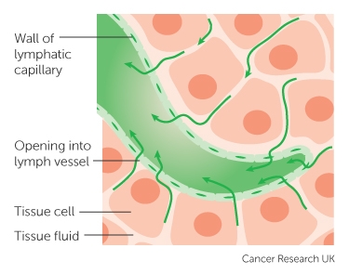
The Lymphatic System
Lymph vessels follow a very similar path to that of blood vessels that helps fluids move around within the body
Lymph is clear, watery fluid which is found throughout the body and seeps out through the capillary walls flowing around all the cells picking up fats, bacteria, and other unwanted materials
Notes:
The lymphatic system goes all over the body, in much the same way as blood vessels. The lymph fluid seeps from the tissue cells of the body into the lymph vessels, taking unwanted materials with it.

Slide 11
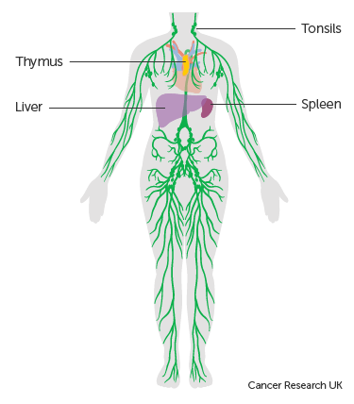
The Lymphatic System
Lymph nodes are the lymphatic system’s filters. There are approximately 600-800 lymph nodes in the human body
Lymph nodes consist of lymphoid tissues. They filter the lymph (the fluid in the lymphatic system) and also help to produce lymphocytes, which recognise abnormal cells and respond by producing antibodies to attack
Notes:
The lymph nodes, of which there may be up to 800 in an adult human, are primarily filters although they also help in the production of Lymphocytes.

Slide 12

The Lymphatic System
Lymph nodes are distributed throughout the body and generally occur in groups along the larger lymphatic vessels. Some of the named groups are shown here
Bundles of lymphatic cells can also be found in tissues and organs other than lymph nodes, meaning that, although rare, organ-confined lymphoma is possible
http://training.seer.cancer.gov/ss_module08_lymph_leuk/lymph_unit02_sec02_reg_lns.html
Notes:
The nodes are distributed throughout the body, mostly along the main lymphatic vessels. Areas of lymphatic tissue are sometimes also found outside the lymphatic system meaning that organ-confined lymphoma is possible

Slide 13
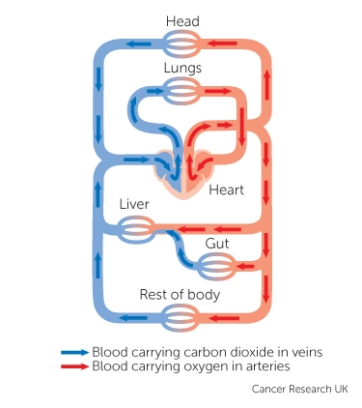
The Cardiovascular System
The heart weighs about 250gms and it beats between 60 - 80 times per minute in a healthy adult
There are two types of blood vessels:
  Arteries transport oxygenated blood and nutrients to the tissues of the body.
  Veins carry carbon dioxide and waste products away from the tissues of the body
Notes:
In the cardiovascular system the heart pumps oxygenated blood into the arteries, while the veins carry the de-oxygenated blood, plus waste products, back towards the heart

Slide 14
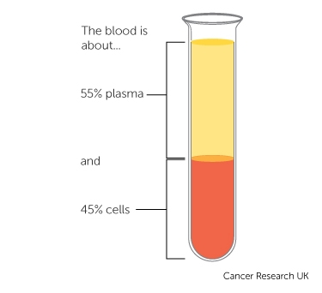
The Cardiovascular System
Blood has different components:
Plasma consists mainly of water but also contains proteins, hormones, organic salts, glucose and fat particles
Red blood cells transports oxygen from the lungs to the cells of the body
White blood cells form part of the immune system
Platelets help the blood to clot
Notes:
A surprisingly low percentage of the blood is actual blood cells, less than half. The rest is comprised of water, proteins, fats and other materials

Slide 15
Haematopoesis
There are different types of marrow within the bones: red and yellow
Blood cells are manufactured within the red bone marrow. Different types of blood cells are produced to perform specialised functions in the blood
Haematopoesis is the term for the production, multiplication and specialisation of the blood cells
White blood cells (part of the immune system)
Red blood cells (these carry oxygen to the tissues of the body)
Platelets (clotting cells)
Notes:
Haematopoesis is the term for the production and specialisation of blood cells within the red bone marrow. Some blood cells make up part of the immune system, while others carry oxygen or form clots to assist in wound healing.

Slide 16
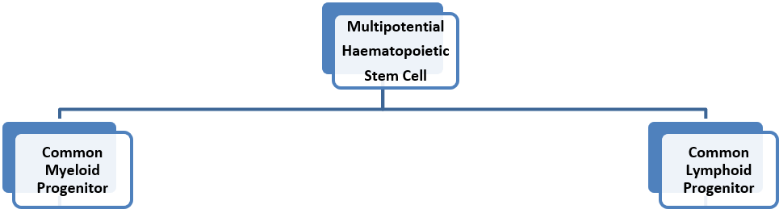
Haematopoesis – Stem Cells
Within the red marrow, when a stem cell divides into two, one copy remains as a stem cell while the other becomes a progenitor cell – a cell that goes on to make other specialised cells
This progenitor cell will be committed to either the myeloid or lymphoid line
Notes:
All blood cells within the red bone marrow have their roots in a very specific type of stem cell. Whenever one of these stem cells divides into two, one of the resulting cells will be a progenitor cell. This progenitor cell uses the same method when dividing and will go on to make either myeloid or lymphoid cells, depending on the line it’s been committed to. Some cells are formed directly from the progenitor cells…

Slide 17
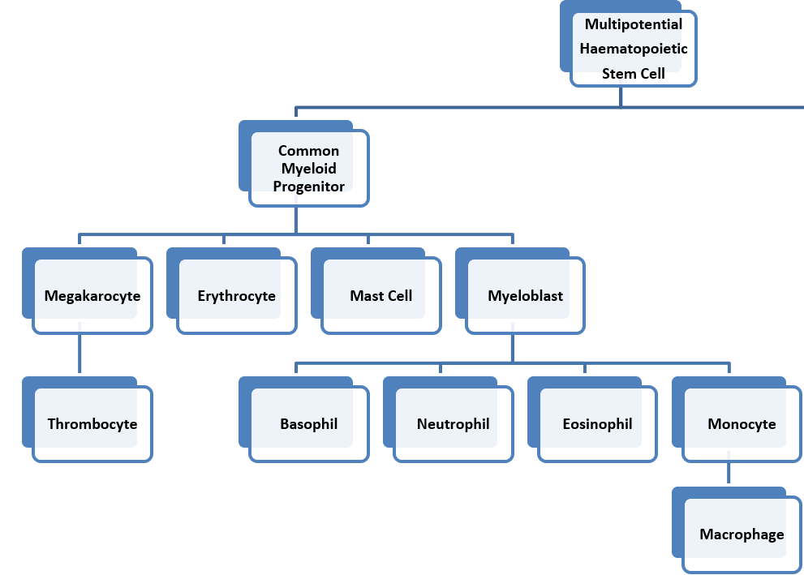
Haematopoesis – Myeloid Cells
The myeloid stem cell line produces a range of myeloid white blood cells
It also produces:
Red blood cells (also known as erythrocytes)
Megakaryocytes which are in turn the precursors to platelets (thrombocytes)
Notes:
… such as red blood cells, sometimes called erythrocytes, which are only one cell division away from the myeloid progenitor cell. Other specialised cells can take multiple steps to manufacture…

Slide 18
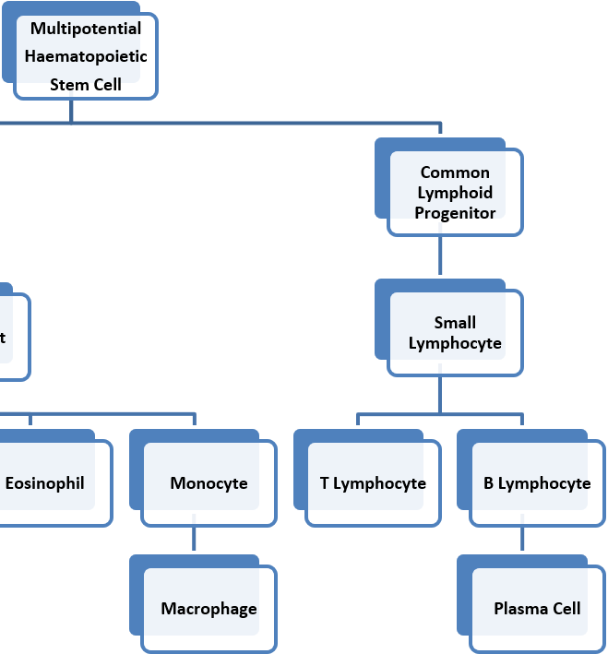
Haematopoesis – Lymphoid Cells
The lymphoid stem cell produces two types of lymphoid white blood cells:
T lymphocytes (which include natural killer or NK cells)
B lymphocytes (which can also differentiate into Plasma cells)
Notes:
.. for instance, B lymphocytes, which themselves may produce plasma cells when they divide.

Slide 19
Haematopoesis
Two different cell lines means two morphological groups of malignancies
All myeloid malignancies are derived from the myeloid cell line and all lymphoid and plasma cell malignancies are derived from lymphoid cell line
Myeloid Neoplasms
Myeloid leukaemia
Myelodysplastic syndromes
Lymphoid Neoplasms
Lymphoblastic and lymphocytic leukaemia
Lymphoma
Plasma cell neoplasms (including Myeloma)
Myeloproliferative neoplasms
Notes:
Myeloid neoplasms are specific to the Myeloid line of cells while Lymphoid neoplasms will only occur in Lymphoid cells. It should be noted that Myeloma is a disease of the plasma cells and as such is classified as a Lymphoid neoplasm. Leukaemias may occur in either cell line. For more information on Haematological disease, please see the disease-specific training modules for Leukaemia, Lymphoma and Myeloma

Slide 20
Recording Haematological Disease
In this section we will cover:
  Codes to Use
  Which Conditions to Record
Notes:
So how are these diseases recorded in your cancer data management system?

Slide 21
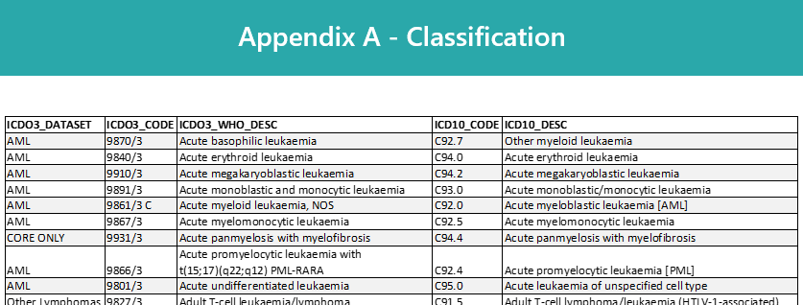
Recording Haematological Disease -
Codes to Use
Haematological diseases are classified based on their particular morphologies. Your clinical team will be able to give you the exact diagnosis description
We have provided a document to help you accurately record these diseases, available as a PDF only: Haematology – Appendix A, Classification
This may be downloaded from: https://digital.nhs.uk/ndrs/data/cancer-data-training-materials
Notes:
Exact classification of Haematological disease uses ICD-O-3 morphology. Always refer to your clinical team for the correct diagnosis description. The description will be listed in Haematology – Appendix A, Classification, available as a searchable PDF to download. This Appendix will provide you with both ICD10 codes and the relevant ICD-O-3 morphology codes to use.

Slide 22
Recording Haematological Disease -
Which Conditions to Record
If in any doubt as to whether you should be recording a haematology diagnosis, please refer to the latest COSD User Guide, Appendix C
For guidance on the required staging system, please refer to the latest COSD User Guide, Appendix E
https://digital.nhs.uk/ndrs/data/data-sets/cosd#downloads
Notes:
For guidance on which conditions require a COSD record, please ensure you have access to the COSD User guide. You can download the User Guide by clicking on this link and selecting the COSD version appropriate to your trust.

Slide 23
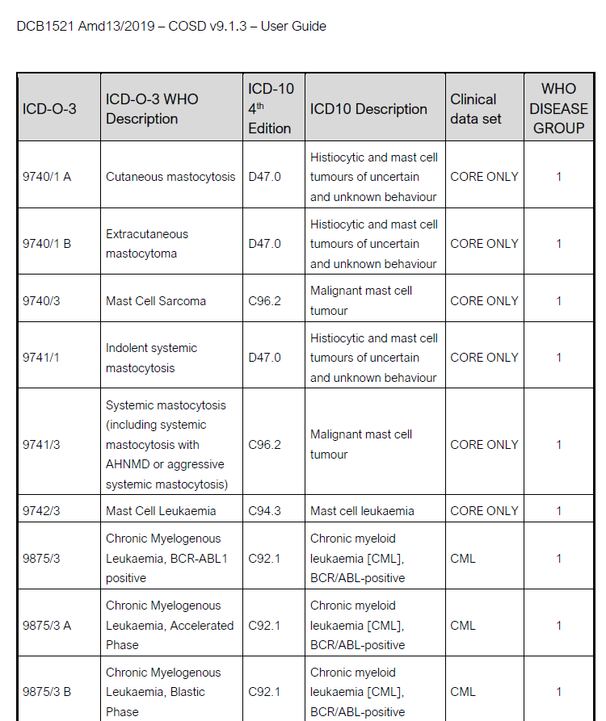
Recording Haematological Disease -
Which Conditions to Record
In addition to all C coded Haematological malignancies, Appendix C of the COSD User Guides list a further 18 conditions that are D/E coded in ICD 10
All listed Haematology C/D/E ICD 10 codes require a COSD submission which must include the ICD-O-3 morphology code
Notes:
As well as all C coded conditions, Haematology requires a COSD record for certain D coded, and one E coded condition which are listed in the COSD User Guide, Appendix C. Please bear in mind that the ICD-O-3 morphology code must be included in the COSD record.

Slide 24
Recording Haematological Disease -
Which Conditions to Record
Remember:
There is no clash with CWT – The addition of a D/E code diagnosis for Haematology will exclude the pathway from any CWT targets and the CWT submission.
If in doubt, check the CWT / COSD guidance.
Notes:
Your cancer management system will automatically exclude these additional COSD diagnoses from the CWT submission so there is no clash between CWT and COSD.

Slide 25
Summary
Notes:
To Summarise…

Slide 26
Summary
Haematological diseases fall into four main categories: Leukaemia, Lymphoma, Plasma Cell Neoplasms and Myelodysplastic / Myeloprolilferative disorders
Blood cells are manufactured in the red bone marrow. These cells will belong to either the Myeloid line or the Lymphoid line
The Myeloid line includes some types of white blood cells, red blood cells and platelets. Myelodysplastic / Myeloproliferative disorders always appear in cells of the Myeloid line
The Lymphoid line includes specific types of white blood cells: T cells (some of which are Natural Killer cells) and B cells. Lymphomas and plasma cell neoplasms always appear in cells of the Lymphoid line
Leukaemias may appear in cells of either line
Notes:
Haematological diseases fall into one of four main categories: Leukaemia, Lymphoma, Plasma Cell neoplasms or Myelodysplastic / Myeloprolilferative disorders

Slide 27
Summary
Haematological diseases fall into four main categories: Leukaemia, Lymphoma, Plasma Cell Neoplasms and Myelodysplastic / Myeloproliferative disorders
Blood cells are manufactured in the red bone marrow. These cells will belong to either the Myeloid line or the Lymphoid line
The Myeloid line includes some types of white blood cells, red blood cells and platelets. Myelodysplastic / Myeloproliferative disorders always appear in cells of the Myeloid line
The Lymphoid line includes specific types of white blood cells: T cells (some of which are Natural Killer cells) and B cells. Lymphomas and plasma cell neoplasms always appear in cells of the Lymphoid line
Leukaemias may appear in cells of either line
Notes:
Blood cells will belong either to the Myeloid line or the Lymphoid line

Slide 28
Summary
Haematological diseases fall into four main categories: Leukaemia, Lymphoma, Plasma Cell Neoplasms and Myelodysplastic / Myeloproliferative disorders
Blood cells are manufactured in the red bone marrow. These cells will belong to either the Myeloid line or the Lymphoid line
The Myeloid line includes some types of white blood cells, red blood cells and platelets
The Lymphoid line includes specific types of white blood cells: T cells (some of which are Natural Killer cells) and B cells. Lymphomas and plasma cell neoplasms (including myeloma) always appear in cells of the Lymphoid line
Leukaemias may appear in cells of either line
Notes:
Myeloid neoplasms will always appear in myeloid cells, Lymphomas will always appear in lymphoid cells while Leukaemias may arise in either cell line.

Slide 29
Summary
The classification of Haematological disease is complex and relies on multiple factors. Your clinical team will be able to provide you with the exact diagnosis description. The Haematology Appendix A, Classification will guide you on the codes to record for ICD10 and ICD-O-3 morphology
must also be recorded
Notes:
Haematology classification is complicated and usually relies on a number of test results to allow the clinical team to provide you with an exact diagnosis description. The searchable PDF: Haematology Appendix A, Classification will guide you to the correct ICD10 diagnosis- and ICD-O-3 morphology-codes for that diagnosis.

Slide 30
Summary
The classification of Haematological disease is complex and relies on multiple factors. Your clinical team will be able to provide you with the exact diagnosis description. The Haematology Appendix A, Classification will guide you on the codes to record for ICD10 and ICD-O-3 morphology
If a Haematological disease is diagnosed it may or may not be classified as malignant. Please refer to the COSD User Guide (Appendix C) for the full list of conditions that must be recorded
Notes:
Not all haematological conditions are C coded as malignant in ICD10. Please refer to the COSD user guide, Appendix C for the full list of conditions to record

Slide 31
Summary
Additional guidance on recording COSD data including morphology, topography, staging and recording a diagnosis can be found at: https://digital.nhs.uk/ndrs/data/cancer-data-training-materials
For Haematology, this includes disease specific modules for Leukaemia, Lymphoma and Myeloma as well as a searchable PDF: Haematology - Appendix A, Classification
Staging data sheets can also be downloaded from the NDRS website for clinical use: https://digital.nhs.uk/ndrs/data/cancer-data-training-materials/staging-sheets
Notes:
Additional training modules as well as Staging sheets for clinical use may be downloaded from the NDRS website.

Slide 32
Summary
If in any doubt as to whether you should be recording a haematology diagnosis, please refer to the latest COSD User Guide, Appendix C
For guidance on the required staging system, please refer to the latest COSD User Guide, Appendix E
https://digital.nhs.uk/ndrs/data/data-sets/cosd#downloads
Notes:
Do please remember, guidance is available on our website. You can download the COSD User Guide by clicking on this link and selecting the COSD version appropriate to your trust.

Slide 33

Acknowledgements
Many thanks to Cancer Research UK for the use of their images within this training module
Notes:
We’d like to thank Cancer Research UK for the use of their images within this training module.

Slide 34
Questions?
East Midlands: Simon Cairnes – simon.cairnes@nhs.net
Eastern: Marianne Mollett – marianne.mollett@nhs.net
London & South East: Katrina Sung – katrina.sung@nhs.net
London & South East: Karen Graham– karen.graham36@nhs.net
North West: Paul Stacey – p.stacey@nhs.net
Northern & Yorkshire: Rachael Mann – rachaelmann@nhs.net
Oxford: Gemma Feeney – gemma.feeney@nhs.net
South West: James Withers – james.withers@nhs.net
West Midlands: Gemma Feeney – gemma.feeney@nhs.net
Notes:
If you have any questions on the information contained within this module or about COSD in general, do please feel free to email your regional Data Liaison Manager

