Slide 1

National Disease Registration Service
(NDRS)
Gynaecological tumours – Cervical
v3 June 2024
Notes:
Welcome to this NDRS training module on Gynaecological Tumours - Cervical. This module is designed to help Cancer Administration staff gain a better understanding of these tumours and the terminology used by the clinical teams.

Slide 2

Agenda
Introduction
Cervical tumours
Summary
Acknowledgements
This module may be paused at any time
Notes:
In this module we’ll give you a brief introduction to gynaecological tumours including some of the symptoms that patients with a cervical tumour might experience. We’ll look at the anatomy & physiology of the female reproductive system and will then go through the diagnosis & treatment. Remember, this module can be paused at any time.

Slide 3
Introduction
In this section we will cover:
  Types of Gynaecological tumour
Notes:
Firstly, we’ll look at the various types of Gynaecological tumour…

Slide 4
Types of Gynaecological tumour
There are many systems within the gynaecological system that can give rise to different tumour types
  Ovaries
  Cervix
  Uterus & Endometrium
  Vagina
  Vulva
  Fallopian tubes
  Placenta
  This module covers tumours of the Cervix
Notes:
Tumours may arise in any part of the female reproductive system. Training modules are available for Ovarian, Cervical and Uterine tumour sites. This module covers Cervical tumours

Slide 5
Cervical tumours
In this section we will cover:
  Causes and Risk Factors
  Signs and Symptoms
  Anatomy & Physiology
  Regional Lymph Nodes
  Diagnosis
In this section we will cov:
  Morphology
  Topography
  Grade
  Stage
  Treatment
Notes:
In this section, we’ll start by looking at the causes and risk factors for cervical tumours…

Slide 6
Cervical – Causes & Risk Factors
  Age – more common in women under 45
  Human papilloma virus (HPV) – certain strains
  Human immunodeficiency virus (HIV)
  Sexually transmitted infections (STIs)
  Smoking
  The contraceptive pill
  Number of children and when
  Family history
  Previous cancer
Notes:
Cervical tumours are more common in women under the age of 45. Other risk factors include particular strains of the Human Papilloma Virus, smoking and the use of hormonal contraceptives

Slide 7

Cervical – Signs & Symptoms
Most common symptoms:
  Bleeding in between a period
  Bleeding and pain after sex
  Bleeding after the menopause
  Pain after sex
Notes:
Some early cervical tumours are asymptomatic but for those that do display symptoms, the most common include: bleeding between periods, pain during or after sex and post-menopausal bleeding

Slide 8
Cervical – Anatomy & Physiology
The cervix is at the base of the cervical canal, beneath the uterus, and forms the opening which leads into the upper part of the vagina
The area at the base of the cervical canal is called the endocervix
The area below this, on the cusp of the cervical opening and the outer part of the cervix is known as the ‘transformation zone’; malignancy is most likely to occur in this region
The area on the protruding part of the cervix at the top of the vagina, is called the ectocervix (or exocervix)
Notes:
The cervix is the opening between the cervical canal - which lies at the base of the uterus - and the vagina. Malignancy is most common on the very edge of this opening, which is known as the transformation zone

Slide 9

Cervical – Regional Lymph Nodes
The regional lymph nodes for the Cervix are:
Paracervical nodes (near the cervix)
Parametrial nodes (in the tissue around the uterus)
Hypogastric nodes - obturator (in the groin) and internal iliac nodes
  Common and external iliac nodes
  Presacral nodes (in front of the base of the spine)
  Lateral sacral nodes (also at the base of the spine)
  Para-aortic nodes (located near the aorta, the main artery in the body)
http://training.seer.cancer.gov/ss_module08_lymph_leuk/lymph_unit02_sec02_reg_lns.html
Notes:
During an MDT, clinicians may mention specific groups of regional lymph nodes as either displaying or not displaying lymphadenopathy – which means enlarged lymph nodes. If these groups of lymph nodes are mentioned, it may indicate that the clinical team have determined the stage of the cancer. Regional lymph nodes for cervical tumours include the paracervical, iliac and para-aortic nodes.

Slide 10
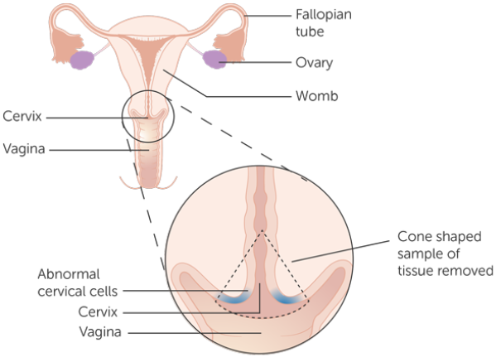
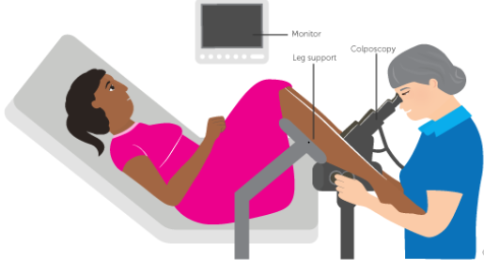
Cervical - Diagnosis
Patients can be diagnosed by one or more of the following methods:
  Internal pelvic examination (further diagnostics required)
  Cervical screening for HPV +/- smear test (further diagnostics required)
  Colposcopy +/- biopsy
  Large loop excision of the transformation zone (LLETZ)
  Cone biopsy
Colposcopy procedure
Notes:
Diagnostic methods might include a screening examination, colposcopy or a LLETZ procedure

Slide 11
Cervical - Diagnosis
Cervical Screening
Over 3 million women were screened in the UK (2015 - 2016)
The test is offered to women in the age group 24½-64 who will receive an automatic invitation to attend their GP practice
After their first cervical screen women will receive an invitation every:
  3 years between the ages 24½-49
  5 years between the ages 50-64
An invitation will also be sent to women aged 65 and over if a woman has not had a test since the age of 50 or if there has recently been an abnormal result
Notes:
Cervical Screening is offered to all women between the ages of 24½ and 64. Women over the age are 65 may be invited if they have not been screened after the age of 50 or if they have recently had an abnormal result.

Slide 12
Cervical - Morphology
CIN (cervical intraepithelial neoplasia)
CIN is a pre-cancerous condition of abnormal cells within the epithelial layer of the cervix. CIN is graded from 1 to 3 with CIN3 being the most abnormal and is equivalent to in situ carcinoma
In CIN3 or severe dysplasia the abnormality involves the full thickness of the epithelium and is curable if it is diagnosed and treated
High grade CGIN (cervical glandular intraepithelial neoplasia) is an in-situ adenocarcinoma which is often diagnosed at the same time as CIN3; it has the potential to turn malignant/invasive if it is left undetected
Early stromal invasion (ESI) can be diagnosed at the same time as CIN3 or high grade CGIN; this is an indication that the tumour has become invasive (and as an invasive tumour, it would need to be recorded in your cancer data management system as a C code in ICD10). For morphology, unless the pathology report indicates otherwise:
CIN3 with ESI – record morphology as invasive Squamous cell carcinoma - M8070/3
CGIN with ESI – record morphology as invasive Adenocarcinoma - M8140/3
Notes:
CIN or Cervical Intraepithelial Neoplasia is a precancerous cell abnormality, graded 1 to 3. In CIN3 the abnormality involves the full thickness of the epithelium but is nonetheless curable if treated. High grade CGIN is often diagnosed at the same time as CIN3 and has the potential to become malignant if untreated. Early stromal invasion indicates that a tumour has become invasive.

Slide 13
Cervical - Morphology
Stages of Cervical Intraepithelial Neoplasia (CIN)
Notes:
Once cellular abnormality extends below the basement membrane the tumour is deemed to be invasive.

Slide 14
Cervical - Morphology
There are two main types of invasive cervical cancer:
  Squamous cell carcinoma (SCC)- M8070/3
  Adenocarcinoma - M8140/3
Squamous cell carcinoma is the most common type. SCCs mainly occur in the transformation zone
Notes:
The two main types of invasive cervical cancer are Squamous cell carcinoma (or SCC) and Adenocarcinoma. The most common type, SCCs occur mainly in the transformation zone…

Slide 15
Cervical - Morphology
Adenocarcinoma also arises mainly in the transformation zone. It is less common than squamous cell carcinoma
Less common types are:
Adenosquamous carcinoma – M8560/3
Small cell carcinoma, NOS - M8041/3
Clear cell carcinoma – M8310/3
Notes:
… as do adenocarcinomas. Less common types of tumour include Adenosquamous, small cell and clear cell carcinomas.

Slide 16
Cervical – Topography - Invasive
Invasive cervical malignancy is classified as
C53.0 – Endocervix
C53.1 – Exocervix
C53.8 – Overlapping lesion of cervix uteri
C53.9 – Cervix uteri, unspecified
All invasive cervical cancers must be recorded on your cancer data management system
Notes:
ICD10 codes for invasive cancers of the cervix are shown here…

Slide 17
Cervical – Topography – In Situ
In-situ cervical tumours are classified as
D06.0 – Endocervix
D06.1 – Exocervix
D06.7 – Overlapping lesion of cervix uteri
D06.9 – Cervix uteri, unspecified
The ICD10 code D06 includes CIN III with or without mention of severe dysplasia. It should be noted that while your clinical team may request that D06 in-situ cervical tumours are recorded, these do not currently require a COSD submission from your cancer data management system
Notes:
… and ICD10 codes for in-situ tumours are shown here. D06 includes CINiii with or without mention of severe dysplasia.

Slide 18
Cervical – Topography – Unknown or Uncertain Behaviour
Cervical tumours of unknown or uncertain behaviour are classified as:
D39.9 – Female genital organ, unspecified
It should be noted that while your clinical team may request that D39.9 tumours of unknown or uncertain behaviour are recorded, these do not currently require a COSD submission from your cancer data management system
Notes:
If the tumour is deemed to be of uncertain or unknown behaviour, it’s ICD10 coded as D39.9 … It should be noted that while your clinical team may request that both in-situ and borderline tumours are recorded, these do not currently require a COSD submission from your cancer data management system. NDRS obtains these records directly from pathology labs

Slide 19
Cervical - Grade
Invasive tumour grade is reported as:
  Well differentiated Grade 1
  Moderately differentiated Grade 2
  Poorly differentiated Grade 3
Notes:
Grading of invasive cervical tumours is based on the level of cell differentiation within the tumour.

Slide 20
Cervical - Stage
Cervical cancer is staged using FIGO staging system which can be based on clinical examination +/- pathological findings
Please refer to the NDRS Training Module: FIGO Staging for Gynaecology
Notes:
Cervical tumours are staged using the FIGO staging system. A link to detailed guidance on recording the FIGO stage is included in the summary

Slide 21
Cervical - Treatment
For in-situ and some very early invasive cervical cancers a small operation to remove the tumour cells is the only treatment that is required.
The most common procedures for in situ and early invasive cancers are:
  Large Loop Excision of Transformation Zone (LLETZ)
  Cone biopsy (pictured)
Notes:
In situ and some very early stage cancers can be treated with a relatively simple surgical procedure. Usually, this would be either a LLETZ or a cone biopsy.

Slide 22
Cervical – Treatment - Surgery
Surgery
For some stage 1 invasive cervical cancers it may be possible to remove the cancer entirely by a procedure called a radical trachelectomy. This treatment is more extensive than a cone biopsy but retains the uterus and enough cervical tissue that may allow the patient to become pregnant and have a baby afterwards
A radical trachelectomy removes part of the cervix and the upper part of the vagina. This may only be offered for small stage 1 tumours where the patient wishes to maintain fertility
Notes:
Some patients with a small stage 1 tumour might be offered a radical trachelectomy. This surgery removes part of the cervix and the upper part of the vagina but may still allow the patient to have children later.

Slide 23
Cervical – Treatment - Surgery
Surgery
For larger cervical tumours, the usual surgery offered is called a radical hysterectomy
During a radical hysterectomy, the surgeon will remove the womb/uterus, cervix, top of the vagina, surrounding tissues and pelvic lymph nodes
Some patients with very early cancer may have a simple hysterectomy which removes the uterus and cervix only
In pre-menopausal women the ovaries are left in place but usually removed if post-menopausal
Notes:
Larger Cervical tumours may require a hysterectomy which might be simple or radical, depending on the stage of the tumour. Removal of the ovaries is normally decided according the menopausal status of the patient.

Slide 24
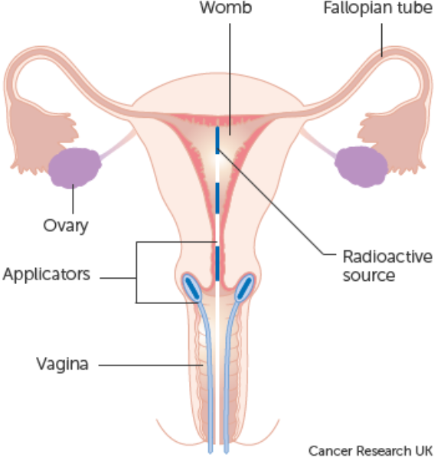
Cervical – Treatment - Radiotherapy
Radiotherapy is sometimes used in the treatment of cervical cancer:
  Adjuvant radiotherapy
  Recurrence
It can be delivered in different ways:
  Brachytherapy delivered directly into the vagina via an applicator. A high dose is given to the top of the vagina, but only a low dose to surrounding tissues
  External beam is used to treat early cervical cancer
Notes:
Radiotherapy is normally used either as an adjuvant treatment or in the treatment of recurrent cervical cancer. The radiotherapy may be delivered as Brachytherapy – where the radioactive source is placed within the body – or as External beam radiation.

Slide 25


Cervical – Treatment - Chemotherapy
Chemoradiotherapy is a combination of chemotherapy and radiotherapy treatments administered at the same time
This type of therapy is usually given if the cervical cancer is stage 1B2, up to stage 4A
Brachytherapy is normally given after a course of chemoradiotherapy
Chemoradiotherapy may also be given as an adjuvant treatment if tumour cells are found in the regional lymph nodes
  Chemotherapy on its own can be given for advanced and recurrent cervical cancer
Notes:
Chemoradiotherapy uses a combination of chemotherapy and external beam radiation treatment. Brachytherapy may then be administered after a course of chemoradiotherapy. Chemotherapy alone may be given for advanced or recurrent cases.

Slide 26
Summary
Notes:
To summarise…

Slide 27
Summary
There are multiple possible risk factors for cervical tumours. These include: age, genetic risk, some HPV strains (a known cause), previous cancers and prior hormone treatments
Some cervical tumours show no symptoms. Those that do may cause: bleeding between periods, painful sex or post menopausal bleeding
Investigations may include a simple examination of the cervix, biopsy of the cells or excision in a surgical procedure such as a LLETZ or cone biopsy
If a tumour is diagnosed it may be invasive, in situ or of unknown or uncertain behaviour. In situ tumours and tumours of uncertain or unknown behaviour do not need to be recorded on a cancer data management system for the purposes of COSD - NDRS obtains these records directly from pathology laboratories
Notes:
Risk factors for cervical tumours include the patient’s age and their genetic risk. Some variants of the human papilloma virus are known to cause cervical cancer

Slide 28
Summary
There are multiple possible risk factors for cervical tumours. These include: age, genetic risk, some HPV strains (a known cause), previous cancers and prior hormone treatments
Some cervical tumours show no symptoms. Those that do may cause: bleeding between periods, painful sex or post menopausal bleeding
Investigations may include a simple examination of the cervix, biopsy of the cells or excision in a surgical procedure such as a LLETZ or cone biopsy
If a tumour is diagnosed it may be invasive, in situ or of unknown or uncertain behaviour. In situ tumours and tumours of uncertain or unknown behaviour do not need to be recorded on a cancer data management system for the purposes of COSD - NDRS obtains these records directly from pathology laboratories
Notes:
While some cervical tumours are asymptomatic, some cause unusual bleeding or painful sex

Slide 29
Summary
There are multiple possible risk factors for cervical tumours. These include: age, genetic risk, some HPV strains (a known cause), previous cancers and prior hormone treatments
Some cervical tumours show no symptoms. Those that do may cause: bleeding between periods, painful sex or post menopausal bleeding
Investigations may include a simple examination of the cervix, biopsy of the cells or excision in a surgical procedure such as a LLETZ or cone biopsy
If a tumour is diagnosed it may be invasive, in situ or of unknown or uncertain behaviour. In situ tumours and tumours of uncertain or unknown behaviour do not need to be recorded on a cancer data management system for the purposes of COSD - NDRS obtains these records directly from pathology laboratories
Notes:
Investigations may require a smear test or potentially a LLETZ or cone biopsy

Slide 30
Summary
There are multiple possible risk factors for cervical tumours. These include: age, genetic risk, some HPV strains (a known cause), previous cancers and prior hormone treatments
Some cervical tumours show no symptoms. Those that do may cause: bleeding between periods, painful sex or post menopausal bleeding
Investigations may include a simple examination of the cervix, biopsy of the cells or excision in a surgical procedure such as a LLETZ or cone biopsy
If a tumour is diagnosed it may be invasive, in situ or of unknown or uncertain behaviour. While all invasive tumours must be recorded, gynaecological in situ tumours and tumours of uncertain or unknown behaviour do not need to be recorded on a cancer data management system for the purposes of COSD - NDRS obtains these records directly from pathology laboratories
Notes:
If a tumour is diagnosed, it may or may not be invasive. All invasive tumours must be recorded in your cancer data management system and while the clinical team might request that in situ tumours and tumours of unknown or uncertain behaviour are recorded, these do not need to be recorded for the purposes of COSD – NDRS obtains these records directly from the pathology labs

Slide 31
Summary
Additional guidance on recording COSD data including morphology, topography, staging and recording a diagnosis can be found at: https://digital.nhs.uk/ndrs/data/cancer-data-training-materials
Staging data sheets can also be downloaded from the NDRS website for clinical use: https://digital.nhs.uk/ndrs/data/cancer-data-training-materials/staging-sheets
Notes:
Additional training modules as well as Staging sheets for clinical use may be downloaded from the NDRS website.

Slide 32
Summary
If in any doubt as to whether you should be recording a diagnosis, please refer to the latest COSD User Guide, Appendices A, B & C
For guidance on the required staging system, please refer to the latest COSD User Guide, Appendix E
https://digital.nhs.uk/ndrs/data/data-sets/cosd#downloads
Notes:
Do please remember, guidance is available on our website. You can download the COSD User Guide by clicking on this link and selecting the COSD version appropriate to your trust.

Slide 33

Acknowledgements
Many thanks to Cancer Research UK for the use of their images within this training module
Notes:
We’d like to thank Cancer Research UK for the use of their images within this training module.

Slide 34
Questions?
East Midlands: Simon Cairnes – simon.cairnes@nhs.net
Eastern: Marianne Mollett – marianne.mollett@nhs.net
London & South East: Katrina Sung – katrina.sung@nhs.net
London & South East: Karen Graham– karen.graham36@nhs.net
North West: Paul Stacey – p.stacey@nhs.net
Northern & Yorkshire: Rachael Mann – rachaelmann@nhs.net
Oxford: Gemma Feeney – gemma.feeney@nhs.net
South West: James Withers – james.withers@nhs.net
West Midlands: Gemma Feeney – gemma.feeney@nhs.net
Notes:
If you have any questions on the information contained within this module or about COSD in general, do please feel free to email your regional Data Liaison Manager

