Slide 1

National Disease Registration Service
(NDRS)
Breast tumours
v8 December 2025
Notes:
Welcome to this NDRS training module on Breast tumours, which has been designed to help Cancer Administration staff gain a better understanding of these tumours and the terminology used by the clinical teams.

Slide 2

Agenda
Breast tumours
Summary
Acknowledgements
This module may be paused at any time
Notes:
In this module we’ll look at the some facts about breast tumours, the anatomy & physiology of the breast … and the diagnosis & treatment of both invasive and non-invasive tumours. Remember, this module can be paused at any time.

Slide 3
Breast
In this section we will cover:
  Causes and Risk Factors
  Signs and Symptoms
  Anatomy & Physiology
  Regional Lymph Nodes
  Diagnosis
  Topography
In this section we will cov:
  Morphology
  Receptor status
  Grade
  Stage
  NPI
  Treatment
Notes:
We’re going to start with Causes and Risk factors.

Slide 4
Breast – Causes & Risk Factors
Being female – only 5% of breast cancers occur in men
Age
  Early or late menarche (onset of puberty)
  Contraceptive pill and/or HRT
  No children or having them late
  Diet high in fats
Approximately 5–10% of breast cancers are thought to be caused by an abnormal gene
Notes:
While a small percentage of breast cancers arise in men, roughly 95% of breast cancer cases are in women …. and older women have a higher risk of developing the disease. Other risk factors include previous hormone treatments, not having had children and a high level of dietary fats.

Slide 5
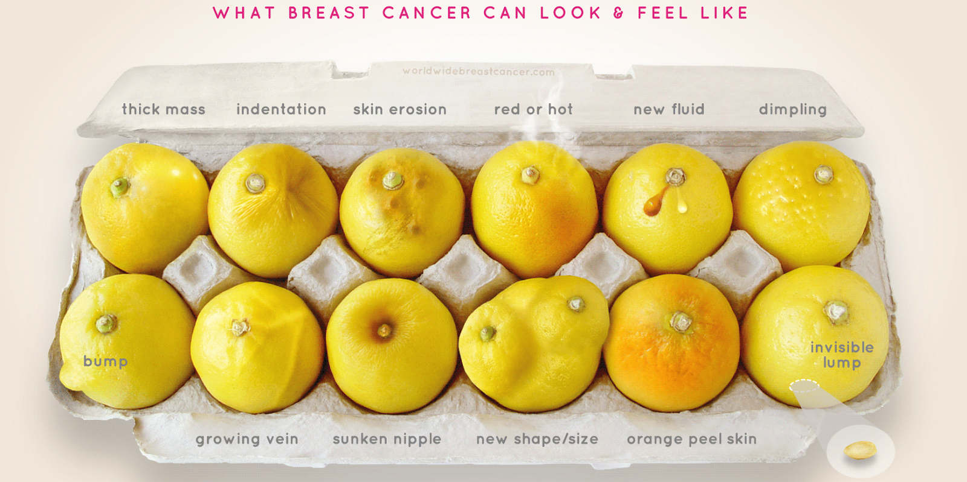
Breast – Signs & Symptoms
About 30% of women have no symptoms and are detected by screening however, any of the following changes should be checked by a doctor:
Notes:
Whilst screening can detect the asymptomatic breast cancers, any changes should be checked by a doctor – in particular, those shown here which include changes to the breast’s … appearance, skin, shape, size or temperature

Slide 6
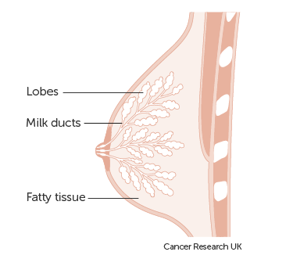
Breast – Anatomy & Physiology
The breasts form soft protuberances on the anterior chest overlying the pectoral muscles and are made up of fat, connective tissue and gland tissue divided into lobes
A network of ducts spreads from the lobes towards the nipple
Notes:
The breasts are made up of fat, connective tissue and milk glands which are divided into lobes. A network of ducts lead from the lobes to the nipple.

Slide 7
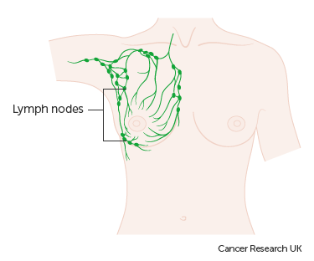
Breast – Regional Lymph Nodes
The Sentinel node is the first lymph node into which any cancer cells will migrate from a tumour
The majority of lymph flows into the axillary lymph nodes therefore these are the most likely site of spread
Local or regional lymph nodes used to classify the N stage are always Ipsilateral (on the same side as the primary tumour)
If lymph node involvement is Contralateral (on the opposite side of the body to the primary tumour) this may indicate a second primary tumour and/or distant metastases
Notes:
Local or regional lymph nodes are deemed to be ipsilateral - meaning on the same side of the body as the primary tumour. Any lymph node involvement on the opposite side to the tumour may be indicative of distant mets or a second primary tumour

Slide 8

Breast – Regional Lymph Nodes
Ipsilateral (on the same side as the primary tumour) lymph nodes are considered regional:
Axillary lymph nodes - likely sentinel node site
Internal mammary lymph nodes – adjacent to the sternum
Supraclavicular lymph nodes
Infraclavicular lymph nodes
http://training.seer.cancer.gov/ss_module08_lymph_leuk/lymph_unit02_sec02_reg_lns.html
Notes:
During an MDT, clinical teams will often make reference to particular groups of regional lymph nodes. This may indicate that the stage of the cancer has been determined. Regional lymph nodes would be the axillary, internal mammary, supraclavicular or infraclavicular nodes on the same side as the primary tumour

Slide 9
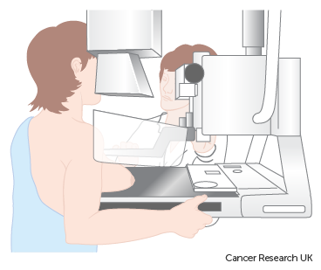
Breast - Diagnosis
During a Triple Assessment several tests are done in one visit. Tests include:
  Clinical examination
  Imaging - Mammogram and/or Ultrasound (US)
  Cytology and or Fine Needle Aspiration (FNA)
Notes:
During a triple assessment to diagnose breast tumours, multiple tests are performed in the same visit

Slide 10
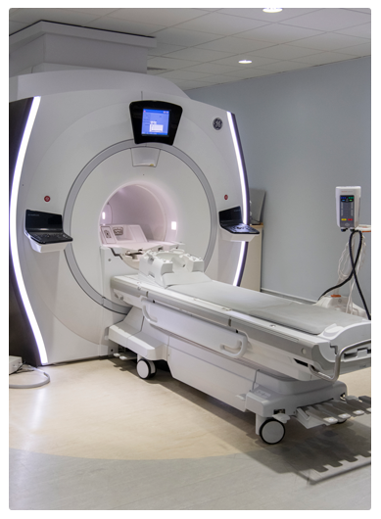
Breast - Diagnosis
If metastatic spread is suspected, further tests may be carried out. These may be in the form of:
  Lymph node Ultrasound with biopsy
  Liver Ultrasound
  CT
  MRI
  Bone Scan
Notes:
If mets are suspected, there may be further imaging and potentially, biopsies

Slide 11
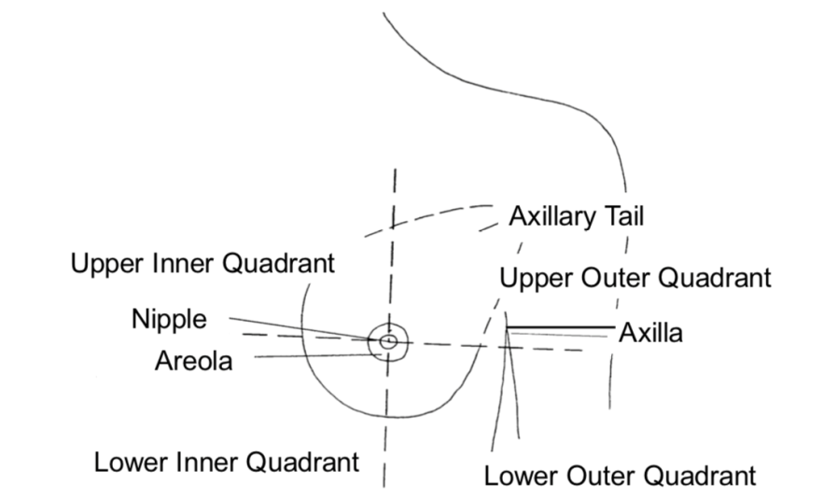
Breast - Topography
The breast is divided into four quadrants plus the axillary tail and the nipple
Invasive tumours are coded as C50.*
The final digit (*) represents the exact location of the tumour
Notes:
For the purposes of classifying invasive cancers, the breast is split into four quadrants plus the axillary tail and the nipple. Invasive tumours are classified as C50 …

Slide 12
Breast - Topography
C50 denotes invasive breast cancer. The fourth digit is the location
Nipple & areola Central
C50.0: C50.1:
Notes:
…plus a final digit that denotes the exact location, which might be in the middle of the breast…

Slide 13
Breast - Topography
C50 denotes invasive breast cancer. The fourth digit is the location
Upper Inner Lower Inner
Quadrant (UIQ) Quadrant (LIQ)
C50.2: C50.3:
Notes:
… towards the centre of the body…

Slide 14
Breast - Topography
C50 denotes invasive breast cancer. The fourth digit is the location
Upper Outer Lower Outer
Quadrant (UOQ) Quadrant (LOQ)
C50.4: C50.5:
Notes:
… towards the arm…

Slide 15
Breast - Topography
C50 denotes invasive breast cancer. The fourth digit is the location
Axillary Tail Overlapping
C50.6: C50.8:
Notes:
… towards the armpit, overlapping the boundaries of the breast regions…

Slide 16
Breast - Topography
C50 denotes invasive breast cancer. The fourth digit is the location
Unspecified
C50.9:
C50.9 would be used where there are multiple tumours of the same morphology in the same breast but in different areas of the breast
For single instances of other tumours please use the ICD10 code that corresponds to the exact location of the tumour
Notes:
… or not specified. This code is applicable where there are multiple tumours of the same morphological type in the same breast - but in different regions. Where a patient has a single tumour in the breast, please use the exact ICD10 code that corresponds to the location of the primary tumour.

Slide 17
Breast – Topography
Where a patient has a single primary tumour in both the left and the right breast, each breast will require its own pathway.
Similarly, where there are multiple tumours of differing morphologies in the same breast, each tumour will require its own pathway
For each tumour please use the ICD10 code that corresponds to the exact location of the tumour
Notes:
If a patient is diagnosed with a primary tumour in each breast, each breast will require a separate pathway. Similarly, where there are multiple tumours in one breast but the morphology differs, each tumour will require its own pathway and exact ICD10 code.

Slide 18
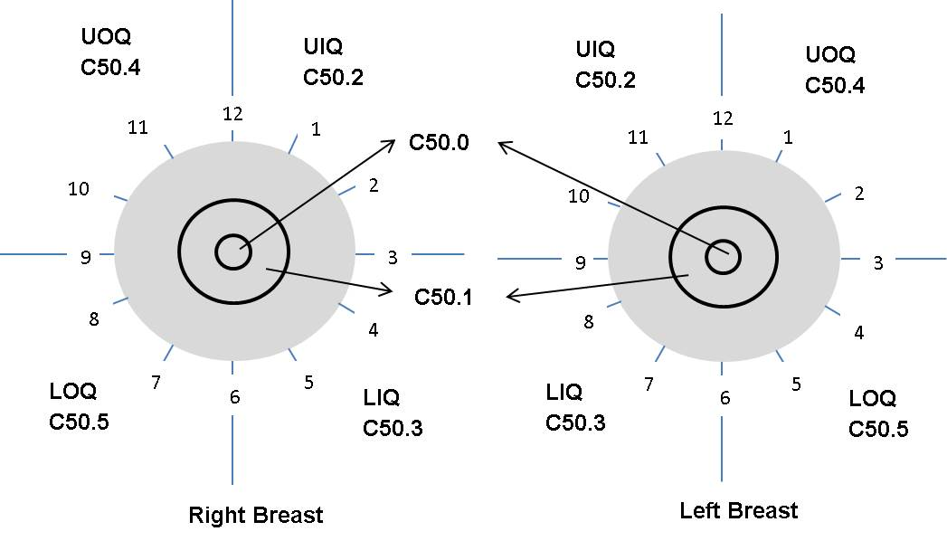
Breast - Topography
Some clinicians may use a 12 hour “clock face” description when describing the location of a tumour. This would be interpreted with the patient facing you
  Please note that laterality should be considered when translating a “clock face” description into ICD10. 4 o’clock in the right breast is not coded to the same site as 4 o’clock in the left breast
Notes:
Some clinicians may use the “Clock face” approach when describing the location of a tumour. Please be aware that laterality is important with the clock face description as a 4 o’clock description would translate to different ICD10 codes for left and right breasts

Slide 19
Breast – Topography – Metastatic New Primary Cancers, Recurrences & Progressions
When recording a diagnosis that includes nodal or distant metastases – which may be a new primary cancer, a recurrence or a progression – if the primary tumour site is identified as a breast cancer, the primary ICD10 code must be recorded relevant to the site of the primary tumour, not any metastases. For most breast cancers, this would be C50
  In many cases, the primary tumour may be identified in the histology report for a metastatic tumour
  Details of the site and type of metastases must be recorded under Mets at Diagnosis (i.e. Brain, Lung, Liver, Lymph nodes etc., certainty and whether it’s Local / Regional / Distant) for all cases. If the site is Other, please provide details
    Refer to slide 8 of this module for a list of regional lymph nodes for breast cancers – other lymph nodes are considered distant
  For new primary diagnoses of a known primary tumour with distant metastases, please record an M stage of M1
Notes:
When recording a metastatic breast cancer, which may be a new primary cancer with mets, a recurrence or a progression, it’s important to record the primary ICD10 code correctly. Where the primary tumour has been identified as a breast cancer – this would be detailed in the pathology report - the primary ICD10 code would always be relevant to the primary cancer, not to the metastasis. Details of the site and type of the metastases would need to be recorded under Mets at Diagnosis instead. If recording a new primary diagnosis of a known primary with distant mets, please record an M stage of M1

Slide 20
Breast – Topography – Metastatic New Primary Cancers, Recurrences & Progressions
  Recurrences & progressions do not require a stage for the purposes of COSD
    A guidance sheet on recording a breast cancer recurrence can be downloaded from https://digital.nhs.uk/ndrs/data/cancer-data-training-materials
For the purposes of COSD, where the primary tumour site is not known, ICD10 codes C76-C80 inclusive may be used as the primary ICD10 code as appropriate. Staging is not required for these ICD10 codes for the purposes of COSD
Notes:
If recording a breast cancer recurrence, a guidance sheet can be downloaded from the NDRS website. Where the primary tumour site is unknown, a secondary tumour ICD10 code, such as C80, may be used instead. Secondary tumour ICD10 codes, recurrences and progressions do not require a stage for the purposes of COSD.

Slide 21
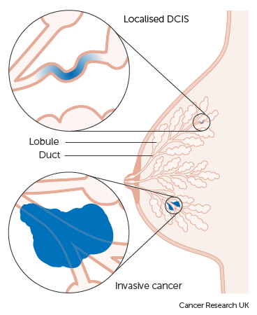
Breast – Morphology – Invasive
  Invasive Carcinoma no special type (NST) - M8500/3, sometimes called Infiltrating Ductal Carcinoma – these account for approx. 70% of invasive breast tumours
  Invasive cancer is where the cancer cells have gone through the lining of the ducts
  When cancer cells are viewed under a microscope, particular abnormalities are classified a Special Type
  Most invasive ductal cancers have no special features and are therefore morphologically classified as:
  no special type (NST) or not otherwise specified (NOS)
Notes:
Invasive carcinomas of no special type account for around 70% of invasive breast tumours.

Slide 22
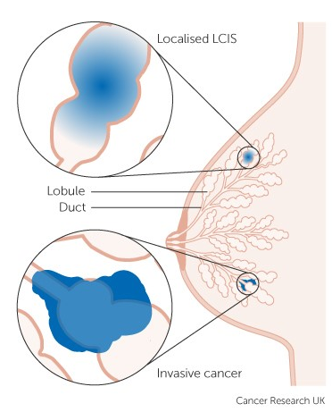
Breast – Morphology – Invasive
  Invasive Lobular Carcinoma – M8520/3
  These are another common morphological type of breast cancer, accounting for around 15% of invasive breast tumours
Notes:
Roughly 15% of invasive breast tumours are Lobular carcinomas

Slide 23
Breast – Morphology – Invasive - Pagets Disease
  Pagets disease of the breast – M8540/3
  Pagets disease and infiltrating duct carcinoma of the breast – M8541/3
  Pagets disease and intraductal carcinoma of the breast – M8543/3
  This may be an indication of an underlying in-situ or invasive ductal malignancy depending on the morphology code
  The cancer cells travel along the ducts of the breast and a tumour develops around the nipple and areola
  All instances of Pagets Disease are ICD10 coded to C50 (with the appropriate final digit to indicate location), regardless of the morphology of any associated tumour
Notes:
Pagets disease is found in around 4% of cases. Pagets may also involve a tumour behind the nipple which may be invasive or in situ, but all instances of Pagets Disease are classified under the relevant C50 code in ICD10.

Slide 24
Breast – Morphology – Invasive - Rare Morphologies
  Rare invasive morphologies of breast tumours can include:
  Mucinous adenocarcinoma – M8480/3 - produces mucin, a glycoprotein
  Tubular adenocarcinoma – M8211/3 - the tumour forms tube-like glands
  Lymphoma of the breast – ICD10 coded & morphology coded to the appropriate lymphoma
  Basal-like carcinoma – morphology coded as an invasive carcinoma NST – M8500/3
  Malignant Phyllodes tumour – M9020/3 - a tumour of the stromal cells of the breast
Notes:
Other rare morphologies of invasive breast cancer include Lymphoma of the breast … which should always be coded to the relevant lymphoma in ICD10 … Basal–like and malignant Phyllodes tumours.

Slide 25
Breast – Morphology – Inflammatory Breast Cancer
  Inflammatory carcinoma – this is normally a clinical diagnosis and as such would not be expected to include a morphology code
  This rare form of cancer develops when cancer cells block the smallest lymph channels in the breast causing fluid to be retained
  Symptoms are very similar to those of mastitis (an infection in the breast) and may include the breasts feeling hot, firm or swollen
Notes:
Up to 5% of breast cancers are inflammatory cancers, meaning the cancer cells have blocked the drainage ducts for lymph fluid. This can lead to the breast becoming hot and swollen

Slide 26
Breast – Topography & Morphology – In Situ
  Ductal Carcinoma In Situ (DCIS) – M8500/2
  This is where some of the cells within the lining of the ducts have started to become abnormal
  This may be described as pre invasive cancer or intra-ductal
  If not treated this may become an invasive cancer
  DCIS is ICD10 coded as: D05.1
  SNOMED CT codes correct at the time of publication – please refer to the SNOMED CT browser for the current morphologic abnormality code: https://termbrowser.nhs.uk/
Notes:
In situ breast tumours are ICD10 coded according to the morphology of the tumour. Ductal in situ tumours are coded as D05.1…

Slide 27
Breast – Topography & Morphology – In Situ
  Lobular Carcinoma In Situ (LCIS) - M8520/2
  This is where some of the cells within the breast lobules have started to become abnormal
  There is an increased risk of developing invasive breast cancer after an LCIS diagnosis
  LCIS is ICD10 coded as D05.0
  SNOMED CT codes correct at the time of publication – please refer to the SNOMED CT browser for the current morphologic abnormality code: https://termbrowser.nhs.uk/
Notes:
… while lobular in situ tumours are D05.0

Slide 28
Breast – Diagnosis – Receptor Status
ER
ER receptor status – Oestrogen receptor status
ER testing is routinely carried out in the UK
PR
Progesterone receptor status
This can also indicate a hormone driven tumour although status is not always reported
Notes:
Whether or not the tumour cells have receptors for certain hormones can indicate the likely effectiveness of specific treatments. One of those hormones is oestrogen, another is progesterone…

Slide 29
Breast – Diagnosis – Receptor Status
These tests will confirm if the patients tumour is likely to respond to certain drugs, hormone or biological therapies
The Allred score is a method of determining how strongly ER/PR expressive the tumour is:
  0 - 1 Negative 2 - 3 Weakly positive
  4 - 5 Positive 6 - 8 Strongly positive
Notes:
… which together are used to calculate the Allred score that indicates how well a hormonal or biological therapy might work

Slide 30
Breast – Diagnosis – Receptor Status
HER2
HER2/ erbB2 receptor status
Some breast cancers have high numbers of receptors for the protein HER2 (human epidermal growth factor 2)
This assesses whether a tumour has an over proliferation of receptor cells. A positive result will mean the patient could be treated with a targeted / hormone treatment
Notes:
Human Epidermal Growth Factor 2 (or HER2) receptors are abundant in some tumours. These tumours are more likely to respond well to treatments that are targeted to block the receptors

Slide 31
Breast – Diagnosis - Grade
Professors Elston & Ellis modified the Bloom-Richardson system for grading invasive breast cancer. This modified version assesses:
Tubule formation - the % of cancer cells that have formed tube shapes
Nuclear pleomorphism - how different the nuclei of the cancer cells are from those in normal cells
Mitotic count - the % of cancer cells currently dividing
This grading system has been shown to be a better predictor of outcome than differentiation alone. Disease is defined as grades 1-3
Notes:
Breast tumours are graded using a system that looks at specific elements of the tumour cells. Grade 1 (or Low grade) cells look much more like normal breast cells than grade 3 (or High grade) cells

Slide 32
Breast – Stage
Invasive breast tumours must be staged and recorded as follows:
      For diagnosis dates up to 31st December 2025 use UICC TNM v8
      For diagnosis dates from 1st January 2026 use UICC TNM v9
Please note that the TNM version must be accurately recorded – if you are unable to amend the version on your cancer data management system, please refer to your line manager
If, after 1st January 2026, your cancer data management system has not been amended to include TNM v9 please add the following statement to the Primary Diagnosis Subsidiary Comment field: Patient staged using TNM9 not TNM8 as per CR2070
In the UK, clinicians prefer to assign an NPI prognostic score for breast cancers. However, it is vital we get the Final Pre-Treatment and/or Final Integrated Stage in UICC TNM stage. TNM stage should be recorded for all invasive tumours
Notes:
While clinicians prefer to use NPI when making treatment decisions for breast cancer patients, invasive breast tumours must be staged using the appropriate UICC TNM version for the purposes of COSD.

Slide 33
Breast – Stage
For details on recording stage, please see the NDRS training module KPI-TNM Staging 101, available on this link: https://digital.nhs.uk/ndrs/data/cancer-data-training-materials
Staging sheets for clinical use may be downloaded here: https://digital.nhs.uk/ndrs/data/cancer-data-training-materials/staging-sheets
Notes:
For details on recording Stage please refer to the NDRS training module: KPI-TNM Staging 101

Slide 34
Breast – Stage
When recording stage for breast patients, please be aware:
  micro-invasion would only be added to a pathologically determined T1 tumour where applicable – pT1(mi)
  micro-metastases would only be added to a pathologically determined N1 where applicable - pN1(mi)
When recording stage for Paget’s disease of the breast:
  If the background tumour is invasive, record the stage according to the stage findings for the background tumour
  In all other circumstances, record the stage for the Paget’s as TisN0M0
Notes:
Please be aware that, where applicable, micro-invasion is only recordable for a pathologically determined T1 tumour and micro-mets are only recordable for a pathologically determined N1 stage. Also, when recording the stage for Paget’s disease, the stage is normally determined by the background tumour.

Slide 35
Breast – Final Pre-Treatment TNM
Mammogram +/- Clinical examination
T category
Ultrasound
N category
Option 1: Clinical
Judgement
M category
Option 2 - If metastatic deposits are suspected, further imaging may be carried out for a clinical (radiological) pre-treatment M stage: CT / PET / Other
Notes:
Some patients will undergo a non-surgical 1st treatment such as hormones or chemotherapy, meaning the pathway must have a pre-treatment stage recorded. It’s derived by the clinical team, based on physical examination, imaging – in most cases, a biopsy - plus any other relevant examinations. Where there is no suspicion of metastatic deposits, it’s expected that the clinical team would direct administrators to record M0. It should be noted that if a patient has an M1 stage, but the T and N stages are not available, we will accept M1 as a complete stage.

Slide 36
Breast – Integrated TNM
Pathology from EXCISION (T) / ANS (N)
T category
Previous Ultrasound
N category
Option 1: Clinical
Judgement
M category
Option 2 - If metastatic deposits are suspected, further imaging may be carried out for a final integrated M stage: CT / PET / Other
Notes:
The Integrated stage is determined following surgery as the 1st treatment. This is determined from the integration of the pathological T & N stage and any other information collected such as metastasis which is usually arrived at by clinical means. Again, where there’s no suspicion of mets, it’s expected that the clinical team would direct administrators to record M0.

Slide 37
Breast – Nottingham Prognostic Indicator
This is a pathological classification used by clinicians to determine prognosis following surgery for breast cancer. The NPI value is calculated by using the following:
  Size of the tumour in centimetres (S)
  Grade (G)
  Number of lymph nodes positive (N)
NPI = [0.2 x S]+ N +G
While NPI is used by some clinical teams, the Nottingham Prognostic Indicator is not required for COSD
Notes:
The Nottingham Prognostic Indicator is a pathological classification to help clinical teams assess the patient’s outlook after surgery

Slide 38
Breast - Treatment
The main treatments for breast cancer are surgery, radiotherapy, hormone therapy, chemotherapy and biological therapy type treatments
One or all of these treatments may be prescribed depending on:
Menopausal status
Morphology of cancer
Size of tumour
Stage - is the tumour localised or metastatic?
Grade - high grade means a more aggressive tumour
Receptor status i.e. ER, PR & HER
Patient’s general health
Notes:
Breast cancers may be treated using several approaches depending on a number of factors including the fitness of the patient, the type of cancer, the stage and the grade. A patient may be treated neo-adjuvantly… for instance, hormones, radiotherapy or chemotherapy may be used to downstage a tumour prior to surgery. These treatments may also be given after surgery

Slide 39
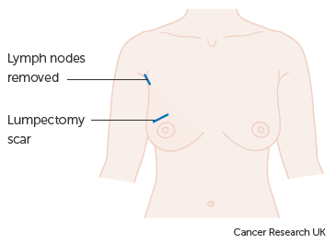
Breast – Treatment – Surgery – Breast Conserving
Excision Biopsy
Only classed as first treatment if the whole tumour was removed by the biopsy
Lumpectomy / Wide Local Excision
Removes the breast lump with some surrounding tissue. Often lymph glands are also removed
Excision of duct
Removal of the end of all the milk ducts (total duct excision) or less common is the removal of a single milk duct (microdochectomy)
Notes:
Some surgeries will leave the breast largely intact. These might include an excision biopsy if it’s removed the entire tumour … or a wide local excision.

Slide 40
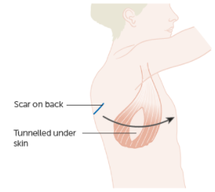
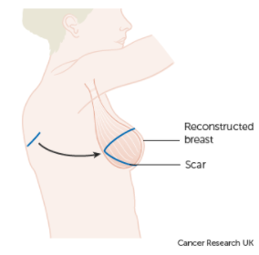
Breast – Treatment – Surgery – Breast Conserving
Quadrantectomy & mini flap
Removal of a quarter of the breast tissue. This surgery leaves a dent, therefore muscle and fatty tissue is brought from the back to help reshape the breast. This is known as a latissimus dorsi flap, a reconstruction method that may also be used after a mastectomy
Notes:
More radical breast conserving surgery might remove a larger part of the breast but include a procedure to reconstruct it ….

Slide 41
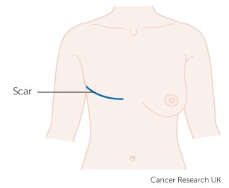
Breast – Treatment – Surgery – Mastectomy
Radical Mastectomy
Removal of the whole breast plus the two muscles behind and lymph nodes
Standard (Simple) Mastectomy
Removal of the breast tissue and most of the skin
Skin-Sparing Mastectomy
Removal of the whole breast, but most of the skin covering the breast is left
Notes:
… or the entire breast might be removed. Mastectomies may be radical, simple or skin sparing which allows for reconstruction by any one of a number of methods.

Slide 42

Breast – Treatment - Chemotherapy
Used for early stage invasive cancer to remove any cells remaining
Used for advance stage cancer to destroy or damage the cells
Neo-adjuvant chemotherapy may be given prior to surgery to shrink the tumour
Notes:
Chemotherapy may be used for any stage of breast cancer where the morphology is likely to respond to the drugs used…

Slide 43

Breast – Treatment - Radiotherapy
Adjuvant Radiotherapy
to reduce the chance of recurrence
Neo-adjuvant
treatment prior to surgery to down-stage the tumour
Notes:
… and External beam radiotherapy may be used both before or after surgery

Slide 44
Breast – Treatment – Other Options
Hormonal
Used for cases where the tumour is reliant on the presence of growth hormones
Can provide a higher chance of treatment success with fewer side effects for suitable patients
Immunotherapy
Used for cases where there is a genetic link to the specific tumour (for instance, BRCA positive)
Can provide a higher chance of treatment success with fewer side effects for suitable patients
Only applicable to a small percentage of cases at present
Notes:
Other treatment options might include hormones or immunotherapy where the tumour has specific receptors on its cells.

Slide 45
Summary
Notes:
In summary…

Slide 46
Summary
Risk factors for breast tumours include gender, age and previous hormonal treatments
Signs and symptoms may include changes to the appearance, feel or temperature of the breast
Investigations usually include a mammogram, ultrasound and biopsy
While TNM stage is not clinically relevant, it must be recorded for the purposes of COSD
Treatments can include surgery, chemotherapy, radiotherapy, hormones and immunotherapy, depending on the particular features of the tumour
Notes:
Most breast tumours occur in women, making gender a risk factor. Other risk factors include increasing age and prior use of hormonal contraceptives or HRT

Slide 47
Summary
Risk factors for breast tumours include gender, age and previous hormonal treatments
Signs and symptoms may include changes to the appearance, feel or temperature of the breast
Investigations usually include a mammogram, ultrasound and biopsy
While TNM stage is not clinically relevant, it must be recorded for the purposes of COSD
Treatments can include surgery, chemotherapy, radiotherapy, hormones and immunotherapy, depending on the particular features of the tumour
Notes:
Any changes in the appearance, feel or temperature of the breast should be investigated as possible signs of a tumour

Slide 48
Summary
Risk factors for breast tumours include gender, age and previous hormonal treatments
Signs and symptoms may include changes to the appearance, feel or temperature of the breast
Investigations usually include a mammogram, ultrasound and biopsy
While TNM stage is not clinically relevant, it must be recorded for the purposes of COSD
Treatments can include surgery, chemotherapy, radiotherapy, hormones and immunotherapy, depending on the particular features of the tumour
Notes:
Most diagnostic pathways start with a mammogram, ultrasound and - if deemed necessary - a biopsy

Slide 49
Summary
Risk factors for breast tumours include gender, age and previous hormonal treatments
Signs and symptoms may include changes to the appearance, feel or temperature of the breast
Investigations usually include a mammogram, ultrasound and biopsy
While clinicians may prefer to use NPI, TNM must be recorded for the purposes of COSD
Treatments can include surgery, chemotherapy, radiotherapy, hormones and immunotherapy, depending on the particular features of the tumour
Notes:
Although the clinical teams prefer to use the Nottingham Prognostic Indicator, a TNM stage at diagnosis must be recorded for the purposes of COSD

Slide 50
Summary
Risk factors for breast tumours include gender, age and previous hormonal treatments
Signs and symptoms may include changes to the appearance, feel or temperature of the breast
Investigations usually include a mammogram, ultrasound and biopsy
While clinicians may prefer to use NPI, TNM must be recorded for the purposes of COSD
Treatments can include surgery, chemotherapy, radiotherapy, hormones and immunotherapy, depending on the particular features of the tumour and the fitness of the patient
Notes:
Depending on the characteristics of the tumour and the fitness of the patient, treatments may range from hormones to surgery

Slide 51
Summary
Additional guidance on recording COSD data including morphology, topography, staging and recording a diagnosis can be found at: https://digital.nhs.uk/ndrs/data/cancer-data-training-materials
Staging data sheets can also be downloaded from the NDRS website for clinical use: https://digital.nhs.uk/ndrs/data/cancer-data-training-materials/staging-sheets
Notes:
Additional training modules as well as Staging sheets for clinical use may be downloaded from the NDRS website.

Slide 52
Summary
If in any doubt as to whether you should be recording a diagnosis, please refer to the latest COSD User Guide, Appendices A, B & C
For guidance on the required staging system, please refer to the latest COSD User Guide, Appendix E
https://digital.nhs.uk/ndrs/data/data-sets/cosd#downloads
Notes:
Do please remember, guidance is available on our website. You can download the COSD User Guide by clicking on this link and selecting the COSD version appropriate to your trust.

Slide 53

Acknowledgements
Many thanks to Cancer Research UK for the use of their images within this training module.
Notes:
We’d like to thank Cancer Research UK for the use of their images within this training module.

Slide 54
Questions?
East Midlands: Simon Cairnes – simon.cairnes@nhs.net
Eastern: Marianne Mollett – marianne.mollett@nhs.net
London & South East: Katrina Sung – katrina.sung@nhs.net
London & South East: Karen Graham– karen.graham36@nhs.net
North West: Paul Stacey – p.stacey@nhs.net
Northern & Yorkshire: Rachael Mann – rachaelmann@nhs.net
Oxford: Gemma Feeney – gemma.feeney@nhs.net
South West: James Withers – james.withers@nhs.net
West Midlands: Gemma Feeney – gemma.feeney@nhs.net
Notes:
If you have any questions on the information contained within this module or about COSD in general, do please feel free to email your regional Data Liaison Manager

