Slide 1

National Disease Registration Service
(NDRS)
Tumours of the Brain & Central Nervous System
v5 December 2025
Notes:
Welcome to this NDRS training module on Tumours of the Brain and Central Nervous System. This module is designed to help Cancer Administration staff gain a better understanding of these tumours and the terminology used by the clinical teams.

Slide 2

Agenda
Brain and Spinal Cord
  Introduction
  Anatomy & Physiology
  Diagnosis
  Treatment
Summary
Acknowledgements
This module may be paused at any time
Notes:
We’re going to give you a brief introduction to these tumours including some of the symptoms that patients might experience. We’ll look at the anatomy & physiology of the brain & spinal cord and then go through the diagnosis and treatment options. Remember, this module can be paused at any time.

Slide 3
Brain & CNS - Introduction
In this section we will cover:
  Causes and risk factors
  Signs and symptoms
Notes:
We’re going to look first at the causes and risk factors

Slide 4
Causes & Risk Factors – Brain & CNS
Causes of brain tumours are mostly unknown but there are a few known risk factors:
Age – more common in children and older adults, depending on the tumour type
Obesity – increased risk of meningioma
Radiation – previous exposure to ionising radiation
Family History and Genetics – some genetic syndromes increase the risk of brain tumours
Notes:
The cause of many Brain & CNS tumours is largely unknown but some known risk factors include: age, being very overweight, and prior exposure to medical radiation. Certain genetic syndromes have also been linked with brain and CNS tumours.

Slide 5
Signs & Symptoms - Brain
Intracranial pressure
  Headaches in the morning
  Seizures / Fits
  Nausea and vomiting
  Personality changes
  Memory defect
  Intellectual impairment
  Drowsiness / lethargy
Notes:
In the case of brain tumours, intracranial pressure alone may cause a number of symptoms. The skull is a finite space and additional tissue within that space can often put pressure on other brain structures. Symptoms can include headaches, seizures, personality changes and memory problems.

Slide 6
Signs & Symptoms - Brain
Intracranial pressure
Tumour Location
  Headaches in the morning
  Seizures / Fits
  Nausea and vomiting
  Personality changes
  Memory defect
  Intellectual impairment
  Drowsiness / lethargy
  Unilateral Weakness
  Visual disturbances
  Language problems
  Co-ordination problems
  Vertigo
  Difficulty swallowing
  Problems with smelling and hearing
Notes:
Presenting symptoms may give clues about the location of the tumour as different parts of the brain deal with different processes.

Slide 7
Signs & Symptoms – Spinal Cord
Back and neck pain
Numbness
Tingling and weakness in either the arms or legs
Cauda equina syndrome (dysfunction of multiple lumbar and sacral nerve roots at the base of the spine)
Clumsiness
Difficulty in walking
Incontinence - loss of control of the bladder and bowel
Notes:
In the Spinal cord, signs of a possible tumour may include numbness, tingling sensations in the limbs, difficulty walking or a loss of bladder or bowel control

Slide 8
Brain & CNS - Anatomy & Physiology
In this section we will cover:
  The Nervous System
  The Brain
  The Spinal Cord
Notes:
It’s helpful to have an understanding of how the Brain and spinal cord function.

Slide 9
The Nervous System
The nervous system is the major controlling, regulatory, and communicating system in the body
Together with the endocrine system, the nervous system is responsible for regulating and maintaining homeostasis (a state of balance within the body’s systems)
Through its receptors, the nervous system keeps us in touch with our environment, both external and internal
Notes:
The nervous system receives and sends information that helps it to keep our bodily systems in a state of balance

Slide 10
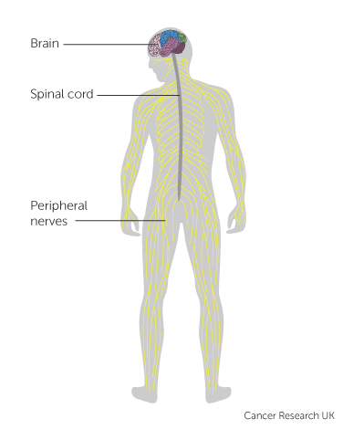
The Nervous System
Central Nervous System (CNS) consists of the brain and spinal cord
Peripheral Nervous System (PNS) consists of all the sensory nerves that feed information to the spinal cord and brain from the rest of the body and motor nerves which carry messages to other parts of the body from the brain and spinal cord
Notes:
It’s classified as either the Central Nervous System – which is comprised of the brain and spinal cord – or the Peripheral Nervous System – which describes the nerves in the rest of the body.

Slide 11
The Brain
The brain is comprised of :
The Cerebrum (Forebrain)
The Cerebellum (Hindbrain)
The Brainstem
Notes:
Broadly speaking, the brain is composed of three major parts: The cerebrum or forebrain, the cerebellum, also known as the hindbrain, and the brainstem.

Slide 12
The Brain
The Cerebrum is split into two hemispheres:
The Left Hemisphere controls the right side of the body
The Right hemisphere controls the left side of the body
The area of the brain that joins the hemispheres is called the Corpus Callosum
Notes:
The Cerebrum is split into two halves, left and right. Each half controls the opposite side of the body. The central portion of the brain that connects these halves is called the Corpus Callosum.

Slide 13
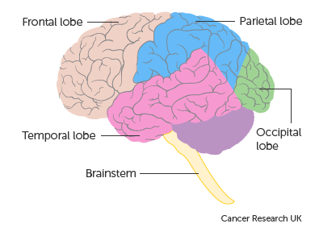
The Brain
Each hemisphere of the Cerebrum
contains four lobes:
Frontal lobe
Speech
Problem solving
Personality
Emotional processing
Movement initiation
Notes:
Each half of the Cerebrum is made up of four lobes. The Frontal lobe is where we deal with emotions and it’s also connected to our personalities and our problem solving abilities

Slide 14
The Brain
Each hemisphere of the Cerebrum
contains four lobes:
Temporal lobe
Sounds
Memory storage
Language processing
Notes:
The Temporal lobe is where memories are stored and where we make sense of language

Slide 15
The Brain
Each hemisphere of the Cerebrum
contains four lobes:
Parietal lobe
Touch
Temperature
Pain
Object recognition
Sensory perception & integration
Notes:
While the role of the Parietal lobe includes the processing of touch, temperature and pain …

Slide 16
The Brain
Each hemisphere of the Cerebrum
contains four lobes:
Occipital lobe
Visual processing
Notes:
… and the Occipital lobe processes visual input

Slide 17
The Brain
At the back of the brain is the Cerebellum
Balance
Posture
Co-ordination
Notes:
Behind the Cerebrum, the Cerebellum, or hindbrain, controls things like our sense of balance and our co-ordination…

Slide 18
The Brain
The Brain Stem is located at the base of the brain
Breathing
Heartbeat
Blood pressure
Coughing
Swallowing
Notes:
…while the Brain Stem controls the autonomic functions – the functions that usually happen without any conscious input – for instance, breathing and keeping the heart beating. It also controls functions such as coughing and swallowing

Slide 19
The Brain
Ventricles
Four interconnected chambers in the brain, filled with cerebrospinal fluid (CSF)
  Lateral ventricles (two) - located in each hemisphere of the cerebrum
  Third ventricle - a narrow cavity superior to the hypothalamus and between the right and left halves of the thalamus
  Fourth ventricle - lies between the brain stem and the cerebellum
  The Choroid plexus is a separate structure within the ventricles which produces the cerebrospinal fluid
Notes:
In the central portion of the brain, above the brainstem, lie the ventricles which are filled with cerebrospinal fluid, sometimes called CSF. CSF is produced by the Choroid plexus, a separate structure within the ventricles.

Slide 20
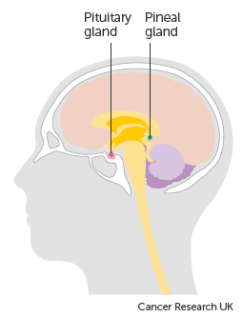
The Brain
Deep within the brain are the Pituitary gland and the Pineal gland
  The Pituitary gland affects growth, metabolic rate, egg / sperm production
  The Pineal gland produces melatonin which regulates sleep
Notes:
In front of the ventricles, the Pituitary gland controls growth, metabolism and the production of egg cells or sperm cells. Located just behind the ventricles, the Pineal gland is responsible for regulating our sleep cycle.

Slide 21
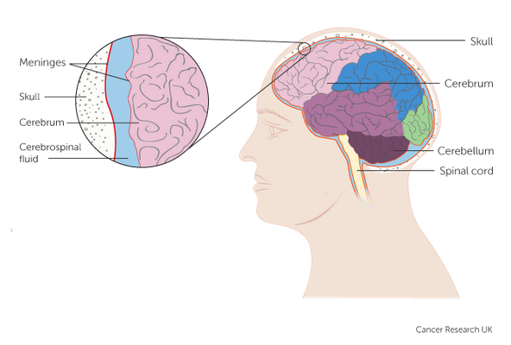
The Brain
Meninges
A membrane covering the brain and spinal cord and it is composed of three layers:
  Dura Mater - outermost layer
  Arachnoid Mater - the middle layer
  Pia Mater - innermost layer
  Between the Arachnoid and Pia Mater, the subarachnoid space contains cerebrospinal fluid (CSF)
  Tentorium - A specific fold of the meninges, which separates the cerebellum from the cerebrum
Notes:
The brain is covered by a multi-layered membrane called the meninges. The Dura Mater is the outermost layer with the Arachnoid Mater and the Pia Mater underneath. CSF fills the space between the Arachnoid Mater and the Pia Mater and one of the functions of the CSF is to act as a cushion for the brain within the sub-arachnoid space.

Slide 22
The Spinal Cord
The Spinal Cord is continuous with the brain stem and extends from the foramen magnum at the base of the skull to the level of the first lumbar vertebra
It is divided into 31 segments with each segment giving rise to a pair of spinal nerves
Notes:
The brain stem extends down the spine, where it’s referred to as the spinal cord. The spinal cord gives rise to multiple pairs of spinal nerves which in turn branch out to form the rest of the peripheral nervous system.

Slide 23
Brain & CNS - Diagnosis
In this section we will cover:
  Investigations
  Morphology
  Topography
  Stage
  Grade
Notes:
We’ll now look at the diagnostic process

Slide 24
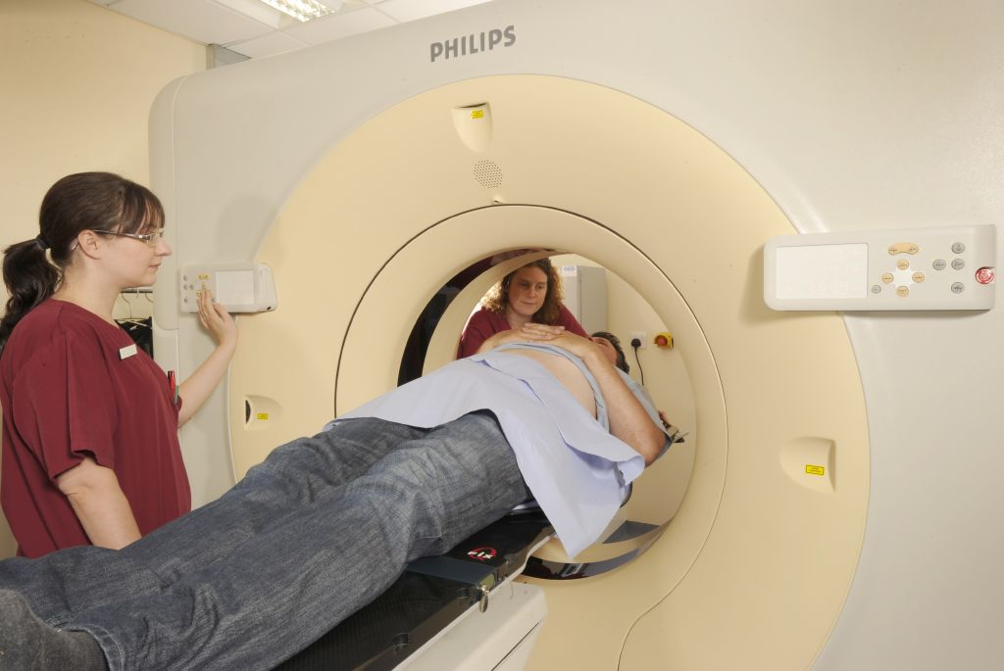
Investigations – Brain & CNS
X-ray
CT scan
MRI scan
PET/CT scan
Biopsy
Cytology – Cerebrospinal Fluid (CSF) via Lumbar puncture
Molecular testing
Notes:
Investigations for suspected Brain or Spinal Cord tumours will usually include radiological examinations: such as X-rays or scans. Diagnosis of a tumour may require solid tissue samples from a biopsy or fluid samples for cytology. Molecular testing may also be used, both as part of the diagnostic process and to determine the most appropriate treatment.

Slide 25
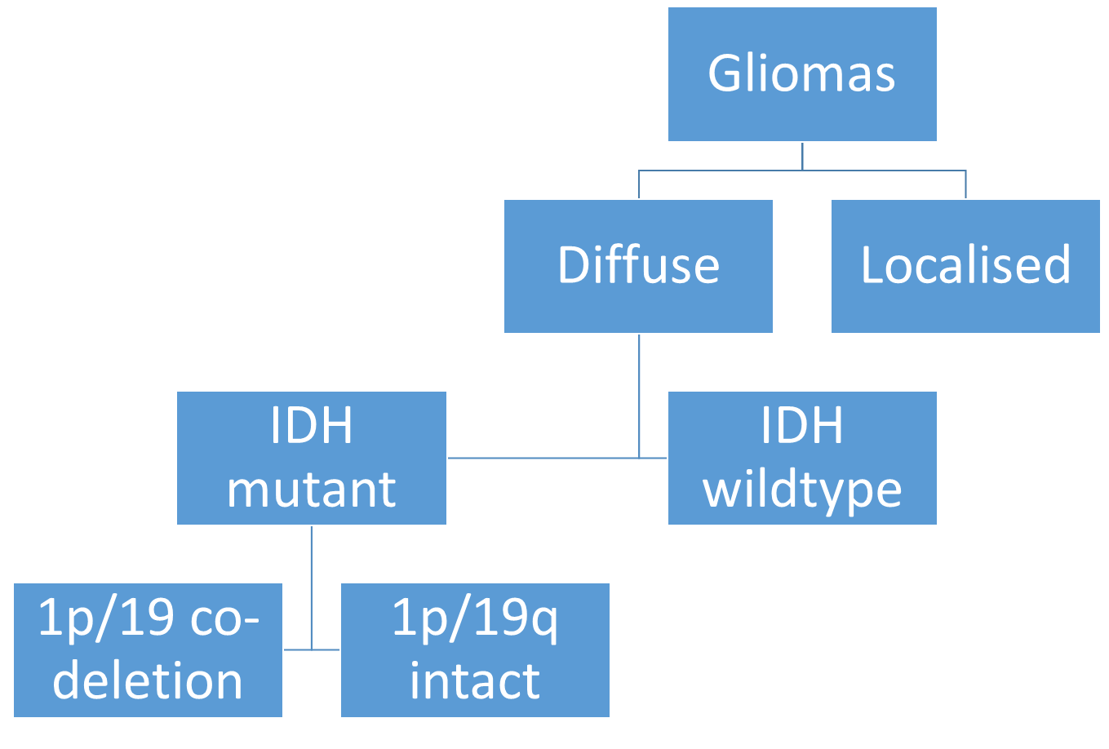
Morphology
There are nearly 100 different types of brain tumours which are generally named after the type of cell they develop in
Most brain tumours develop from the cells that support the nerve cells of the brain called glial cells – glioma. There are many sub-types of glial cell and the tumours are often defined according to their specific cell characteristics or cell mutations:
Astrocytic tumours (Astrocytoma)
Oligodendrogliomas
Mixed gliomas
Ependymomas
Notes:
There are almost 100 different types of brain tumours, too many to list here. Many of these tumours develop from glial cells – the cells that support the nerve cells within the brain. Glial cells are further divided into sub-types and as tumours are often named after the cells in which they’ve arisen, gliomas may have more specific names such as Oligodendroglioma or Astrocytoma. In some cases, the grade of the tumour may also affect the name: for instance, a grade 4 astrocytoma is usually referred to as a glioblastoma multiforme.

Slide 26
Morphology - Brain & CNS
Other cells within the brain and CNS give rise to different types of tumours. These include:
  Meningiomas – in the cells of the Meninges
  Neurilemmoma (Schwannoma) – Schwann cells: fatty cells on the outside of nerves
  Ganglioneuroma - Ganglion cells
  Embryonal tumours – in cells that are left over from our developmental stage in utero (these can include medulloblastomas and atypical teratoid/rhabdoid tumours)
  Primary cerebral (or central nervous system) Lymphoma – started with Lymphocytes within the brain (or spinal cord)
  Choroid plexus tumours – in the area of the brain ventricles where cerebrospinal fluid is formed
Due to the range of possible types / subtypes of tumour it’s not possible to list all morphology codes here. Please refer to the pathology report and your clinical team as well as the SNOMED CT Browser: https://termbrowser.nhs.uk/
Notes:
Tumours arising in other cell types include meningiomas, embryonal tumours (such as medulloblastomas) and primary cerebral or CNS lymphoma. When recording morphology, always refer to the pathology report.

Slide 27
Topography – Brain - Invasive ICD10
Meninges
C70.0 - Cerebral Meninges
C70.1 - Spinal Meninges
C70.9 - Meninges NOS
Endocrine & related structures
C75.1 - Pituitary gland
C75.2 - Craniopharyngeal duct
C75.3 - Pineal gland
Primary cerebral or CNS Lymphoma
Coded to the relevant Lymphoma ICD10 code
Brain
C71.0 - Cerebrum
C71.1 - Frontal lobe
C71.2 - Temporal lobe
C71.3 - Parietal lobe
C71.4 - Occipital lobe
C71.5 - Ventricle, NOS (excludes fourth ventricle)
C71.6 - Cerebellum, NOS
C71.7 - Brain stem / fourth ventricle / Infratentorial NOS
C71.8 - Overlapping lesion of brain
C71.9 - Brain, NOS
Notes:
With the exception of primary brain or central nervous system Lymphoma, ICD10 disease codes for Brain & CNS tumours are topographical - they describe where the tumour is. An ICD10 code prefix of C also indicates that the tumour is invasive. When assigning the ICD10 code for registrable Invasive tumours of the Brain, meninges or cranial endocrine & related structures, these are the relevant codes. Primary lymphoma of the brain or central nervous system would be ICD10 coded to the relevant lymphoma.

Slide 28
Topography – Benign ICD10
Meninges
D32.0 - Cerebral Meninges
D32.1 - Spinal Meninges
D32.9 - Meninges NOS
Endocrine & related structures
D35.2 - Pituitary gland
D35.3 - Craniopharyngeal duct
D35.4 - Pineal gland
Brain
D33.0 – Brain, supratentorial
  Cerebral ventricle
  Cerebrum
  All lobes
D33.1 – Brain, infratentorial
  Brain stem
  Cerebellum
  Fourth ventricle
D33.2 – Brain, unspecified
Notes:
… whereas D prefix codes for Benign tumours of the same areas are shown here…

Slide 29
Topography – Central Nervous System
Spinal Cord, Cranial Nerves, and other parts of the Central Nervous System - Invasive
C72.0 - Spinal cord
C72.1 - Cauda equina
C72.2 - Olfactory nerve
C72.3 - Optic nerve
C72.4 - Acoustic nerve
C72.5 - Cranial nerve, NOS
C72.8 - Overlapping lesion of brain and central nervous system
C72.9 - Nervous system, NOS
Primary cerebral or CNS Lymphoma
Coded to the relevant Lymphoma ICD10 code
Spinal Cord, Cranial Nerves, and other parts of the Central Nervous System - Benign
D33.3 - Cranial nerves
D33.4 - Spinal cord
D33.7 – Other specified parts of Central Nervous System
D33.9 – Central Nervous System, unspecified
Notes:
… and the codes for both Invasive and Benign spinal cord and CNS tumours are listed here.

Slide 30
Topography – Brain & CNS - Non-invasive ICD10
Meninges
D42.0 - Cerebral Meninges
D42.1 - Spinal Meninges
D42.9 - Meninges NOS
Endocrine & related structures
D44.3 - Pituitary gland
D44.4 - Craniopharyngeal duct
D44.5 - Pineal gland
Brain & Central Nervous System
D43.0 – Brain, supratentorial
D43.1 – Brain, infratentorial
D43.2 – Brain, unspecified
D43.3 – Cranial nerves
D43.4 – Spinal cord
D43.7 – Other parts of Central Nervous System
D43.9 – Central Nervous System, unspecified
Notes:
Tumours may also be classified as Uncertain or Unknown behaviour or, depending on the location and tumour behaviour, in-situ. These are also D prefixed in ICD10. Please note that all Brain & CNS ICD10 codes shown in this module are registrable for COSD and would need a COSD record in your cancer management system.

Slide 31
Stage – Brain & CNS
Most tumours of the brain and central nervous system are not considered to be stageable in TNM. The tumours that are stageable with an M0-M4 Chang stage are:
Central nervous system germ cell tumours (these include germinomas and non-germinomas. Non-germinomas of the CNS include the sub-categories: embryonal carcinomas, endodermal sinus/yolk sac tumours and specific teratomas)
CNS embryonal tumours, NOS
Atypical teratoid/rhabdoid tumours (ATRT)
Pineoblastoma
Ependymoma
Notes:
Most tumours of the brain and CNS are not considered to be stageable in TNM v8. The tumours listed here are stageable with the Chang staging system.

Slide 32
Stage – Brain & CNS
Medulloblastoma
  for diagnosis dates up to 31st December 2025 a Chang stage is required
  for diagnosis dates from 1st January 2026, either a TNM v9 stage or a Chang stage may be submitted
    Please note that the TNM version must be accurately recorded – if you are unable to amend the version on your cancer data management system, please refer to your line manager
    If, after 1st January 2026, your cancer data management system has not been amended to include TNM v9 please record the TNM v9 stage and add the following statement to the Primary Diagnosis Subsidiary Comment field:
    Patient staged using TNM9 not TNM8 as per CR2070
Notes:
For diagnosis dates from 1st January 2026 Medulloblastomas may be staged with either a Chang stage or UICC TNM v9.

Slide 33
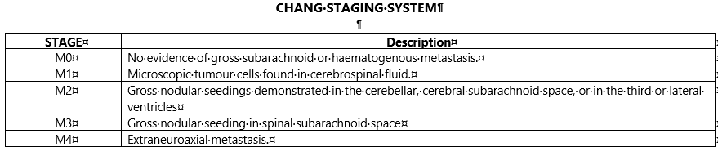
Stage – Brain & CNS
An M0-M4 Chang stage should be recorded for all Chang-stageable tumours. A staging data sheet for Brain & CNS - Chang Stage may be downloaded from: https://digital.nhs.uk/ndrs/data/cancer-data-training-materials/staging-sheets
Notes:
A Brain & CNS Chang staging sheet (for clinical use) may be downloaded from the link shown.

Slide 34
Grade – Brain & CNS
World Health Organization (WHO) grading system.
Captures not just differentiation and biological behaviour, but also prognostic factors, acting as guidance for treatment plans.
Grades I & II are LOW GRADE
Grade I
Slow growing
Less likely to recur
Grade II
Slow growing
Can be infiltrative & may recur.
Grades III & IV are HIGH GRADE
Grade III
Malignant needing surgery
Grade IV
Highly malignant
Can progress rapidly
Notes:
Grade is assigned to a tumour based on the World Health Organisation grading system. Grades I and II are LOW grade…

Slide 35
Grade – Brain & CNS
World Health Organization (WHO) grading system.
Captures not just differentiation and biological behaviour, but also prognostic factors, acting as guidance for treatment plans.
Grades I & II are LOW GRADE
Grade I
Slow growing
Less likely to recur
Grade II
Slow growing
Can be infiltrative & may recur
Grades III & IV are HIGH GRADE
Grade III
Malignant
Faster growing
Grade IV
Malignant
Very rapid growth
Notes:
… while grades III and IV are HIGH grade.

Slide 36
Brain & CNS - Treatment
In this section we will cover:
  Surgery
  Radiotherapy
  Chemotherapy
  Palliative
Notes:
Treatment for Brain and CNS tumours varies depending on the type, size and location of the tumour.

Slide 37
Surgery – Brain & CNS
Surgery
Surgery can remove brain & CNS tumours, but it’s very difficult to remove all tumour cells due to the delicate nature of tissues. Surgical treatments tend to be conservative to prevent serious side effects
If it’s not possible to totally remove a brain tumour surgery may relieve symptoms to ensure a better quality of life for the patient
Notes:
While surgery can remove tumours of the brain & central nervous system, it’s difficult to remove all tumour cells without destroying surrounding tissue. However, removal of a brain tumour may relieve symptoms related to pressure inside the skull.

Slide 38

Radiotherapy – Brain & CNS
Radiotherapy
Radiotherapy improves survival for high grade brain & CNS tumours. It can prove curative for tumours such as medulloblastoma and germinoma, but not in others such as glioma
Radiosurgery gives a very high dose of radiation to a very small precise area
Proton beam therapy is very good at treating some skull base and children’s brain tumours
Notes:
Radiotherapy can improve survival and even prove curative for some types of Brain & CNS tumour. Radiosurgery uses high dose radiation in a tightly controlled beam to minimise damage to the surrounding healthy tissue.

Slide 39
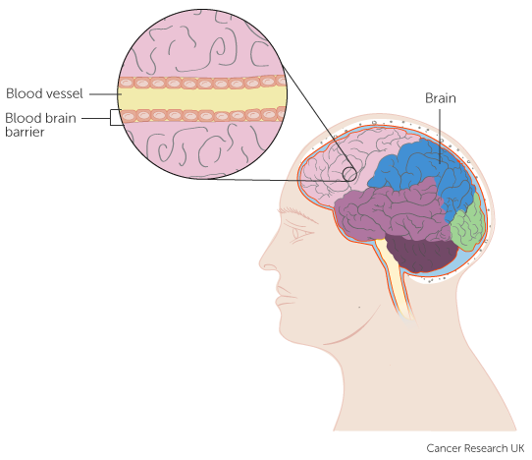

Chemotherapy – Brain
Chemotherapy
It can be difficult to treat brain tumours with chemotherapy because the brain is protected by the blood-brain barrier which only allows certain substances through from the blood to the brain tissues. Only a few chemotherapy drugs can get across the blood-brain barrier and chemotherapy is most commonly given for high grade tumours
Notes:
For the treatment of brain tumours, the choice of available Chemotherapy is limited. This is because many types of chemotherapy are unable to cross the blood-brain barrier within the blood vessels.

Slide 40
Chemotherapy
Chemotherapy
Adjuvant chemotherapy given at the time of the primary treatment may improve survival in patients with gliomas; however, response rates are usually low
Chemotherapy drugs in gel wafers can be place inside the brain following debulking surgery. The gel dissolves over time slowly releasing the chemotherapy drug directly into the brain
Notes:
One way of delivering chemotherapy is to insert a gel wafer containing the drug directly into the brain after debulking surgery.

Slide 41
Palliative
Palliative
For some patients with advanced tumours no treatment is offered other than symptomatic care
Many symptoms associated with brain tumours are associated with intracranial pressure:
  A shunt may be inserted in order to relieve intracranial pressure
  Steroids are commonly prescribed to control symptoms but are not classified as ‘treatment’ to the tumour
Notes:
Some tumours are so advanced that only Palliative treatment is offered to relieve symptoms. This may include a shunt to relieve intracranial pressure or steroids.

Slide 42
In Summary
Notes:
To summarise…

Slide 43
Summary
The cause of many brain / CNS tumours is not known but age group, obesity, medical radiation and genetics are a factor in some
Different parts of the brain control different bodily functions which may be specifically affected by the presence of a tumour. The bulk of a tumour will usually cause intracranial pressure to increase, leading to a worsening of symptoms
Notes:
Age, obesity, medical radiation or genetics are thought to be contributory factors in some brain and CNS tumours.

Slide 44
Summary
The cause of many brain / CNS tumours is not known but age group, obesity, medical radiation and genetics are a factor in some
Different parts of the brain control different bodily functions which may be specifically affected by the presence of a tumour. The presence of a tumour will usually cause intracranial pressure to increase, leading to a worsening of symptoms
Notes:
Even if benign, the presence of a tumour may cause pressure within the skull.

Slide 45
Summary
Brain / CNS tumours are normally diagnosed using radiological examination +/- tissue histology and/or fluid cytology. Molecular testing may also be used
Most Brain & CNS tumours are not considered stageable, but certain specified morphologies of tumour require a Chang stage
Some brain / CNS tumours are treated with surgery. This may be to debulk the tumour, but complete removal can be difficult due to the risk of damage to surrounding tissue
Radiotherapy works well with some tumours and may be applied in the form of high dose Radiosurgery
The range of Chemotherapy available is limited due to the effect of the blood-brain barrier. Some Chemotherapy drugs can be inserted directly into the brain in the form of a gel wafer
For advanced tumours no active treatment is offered, only Palliative treatment to improve the patient’s symptoms
Notes:
Radiology is a common diagnostic tool for Brain & CNS tumours although histology, cytology and molecular testing are also used.

Slide 46
Summary
Brain / CNS tumours are normally diagnosed using radiological examination +/- tissue histology and/or fluid cytology. Molecular testing may also be used
Most Brain & CNS tumours are not considered stageable, but certain specified morphologies of tumour require a Chang stage
Some brain / CNS tumours are treated with surgery. This may be to debulk the tumour, but complete removal can be difficult due to the risk of damage to surrounding tissue
Radiotherapy works well with some tumours and may be applied in the form of high dose Radiosurgery
The range of Chemotherapy available is limited due to the effect of the blood-brain barrier. Some Chemotherapy drugs can be inserted directly into the brain in the form of a gel wafer
For advanced tumours no active treatment is offered, only Palliative treatment to improve the patient’s symptoms
Notes:
While most brain & CNS tumours are not considered stageable, some tumour types require a Chang Stage

Slide 47
Summary
Brain / CNS tumours are normally diagnosed using radiological examination +/- tissue histology and/or fluid cytology. Molecular testing may also be used
Most Brain & CNS tumours are not considered stageable, but certain specified morphologies of tumour require a Chang stage
Some brain / CNS tumours are treated with surgery. This may be to debulk the tumour, but complete removal can be difficult due to the risk of damage to surrounding tissue
Radiotherapy works well with some tumours and may be applied in the form of high dose Radiosurgery
The range of Chemotherapy available is limited due to the effect of the blood-brain barrier. Some Chemotherapy drugs can be inserted directly into the brain in the form of a gel wafer
For advanced tumours no active treatment is offered, only Palliative treatment to improve the patient’s symptoms
Notes:
Surgery may be used to debulk a tumour but there is a risk of damage to surrounding tissue.

Slide 48
Summary
Brain / CNS tumours are normally diagnosed using radiological examination +/- tissue histology and/or fluid cytology. Molecular testing may also be used
Most Brain & CNS tumours are not considered stageable, but certain specified morphologies of tumour require a Chang stage
Some brain / CNS tumours are treated with surgery. This may be to debulk the tumour, but complete removal can be difficult due to the risk of damage to surrounding tissue
Radiotherapy works well with some tumours and may be applied in the form of high dose Radiosurgery
The range of Chemotherapy available is limited due to the effect of the blood-brain barrier. Some Chemotherapy drugs can be inserted directly into the brain in the form of a gel wafer
For advanced tumours no active treatment is offered, only Palliative treatment to improve the patient’s symptoms
Notes:
Some tumours respond well to radiotherapy but not all.

Slide 49
Summary
Brain / CNS tumours are normally diagnosed using radiological examination +/- tissue histology and/or fluid cytology. Molecular testing may also be used
Most Brain & CNS tumours are not considered stageable, but certain specified morphologies of tumour require a Chang stage
Some brain / CNS tumours are treated with surgery. This may be to debulk the tumour, but complete removal can be difficult due to the risk of damage to surrounding tissue
Radiotherapy works well with some tumours and may be applied in the form of high dose Radiosurgery
The range of Chemotherapy available is limited due to the effect of the blood-brain barrier. Some Chemotherapy drugs can be inserted directly into the brain in the form of a gel wafer
For advanced tumours no active treatment is offered, only Palliative treatment to improve the patient’s symptoms
Notes:
The blood-brain barrier limits the chemotherapy types available for use with Brain tumours. Certain types of chemotherapy gel wafers can be inserted directly into the brain where appropriate.

Slide 50
Summary
Brain / CNS tumours are normally diagnosed using radiological examination +/- tissue histology and/or fluid cytology. Molecular testing may also be used
Most Brain & CNS tumours are not considered stageable, but certain specified morphologies of tumour require a Chang stage
Some brain / CNS tumours are treated with surgery. This may be to debulk the tumour, but complete removal can be difficult due to the risk of damage to surrounding tissue
Radiotherapy works well with some tumours and may be applied in the form of high dose Radiosurgery
The range of Chemotherapy available is limited due to the effect of the blood-brain barrier. Some Chemotherapy drugs can be inserted directly into the brain in the form of a gel wafer
For advanced tumours no active treatment is offered, only Palliative treatment to improve the patient’s symptoms
Notes:
Where the tumour is advanced it might be the case that no active treatment is offered to the patient. Palliative treatment may be offered instead to control symptoms.

Slide 51
Summary
If in any doubt as to whether you should be recording a diagnosis, please refer to the latest COSD User Guide, Appendices A, B & C
For guidance on the required staging system, please refer to the latest COSD User Guide, Appendix E
https://digital.nhs.uk/ndrs/data/data-sets/cosd#downloads
Notes:
Do please remember, guidance is available on our website. You can download the COSD User Guide by clicking on this link and selecting the COSD version appropriate to your trust.

Slide 52

Acknowledgements
Many thanks to Cancer Research UK for the use of their images within this training module.
Notes:
We’d like to thank Cancer Research UK for the use of their images within this training module.

Slide 53
Questions?
East Midlands: Simon Cairnes – simon.cairnes@nhs.net
Eastern: Marianne Mollett – marianne.mollett@nhs.net
London & South East: Katrina Sung – katrina.sung@nhs.net
London & South East: Karen Graham– karen.graham36@nhs.net
North West: Paul Stacey – p.stacey@nhs.net
Northern & Yorkshire: Rachael Mann – rachaelmann@nhs.net
Oxford: Gemma Feeney – gemma.feeney@nhs.net
South West: James Withers – james.withers@nhs.net
West Midlands: Gemma Feeney – gemma.feeney@nhs.net
Notes:
If you have any questions on the information contained within this module or about COSD in general, do please feel free to email your regional Data Liaison Manager

