Slide 1

National Disease Registration Service
(NDRS)
Neuroendocrine neoplasms - Key Points
v3 December 2025
Notes:
Welcome to this NDRS training module on neuroendocrine neoplasms, which has been designed to help Cancer Administration staff gain a better understanding of the neoplasms, data requirements and terminology used by the clinical teams.

Slide 2

Agenda
It should be noted that this training module is intended as an addendum to the individual site-specific modules. As such it provides additional information relevant to neuroendocrine neoplasms for particular sites
It is recommended that all users ensure they go through the Overview & Morphology sections before proceeding to the required site-specific pages
Neuroendocrine neoplasms
  Overview
  Morphology (general)
  Example locations of neuroendocrine neoplasms
Acknowledgements
This module may be paused at any time
Notes:
In this module we’ll briefly look at the sites where neuroendocrine neoplasms may arise and provide relevant information on recording specific diseases. Users are advised to ensure they’ve been through the overview and morphology sections before proceeding to the required site-specific pages.

Slide 3
Neuroendocrine neoplasms
In this section we will cover:
  Neuroendocrine overview
  Neuroendocrine morphology (general)
  Common neuroendocrine locations:
    Lung
    Stomach
    Pancreas
    Small intestine
    Large intestine, appendix & rectum
    Skin
    Adrenal glands
    Pituitary gland
    Prostate
    Other possible sites
      Breast
      Uterine
      Extra-adrenal paraganglioma
Notes:
We’ll start with an overview of neuroendocrine neoplasms …

Slide 4
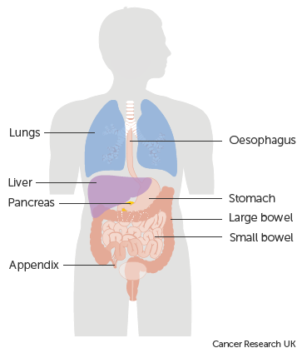
Neuroendocrine - Overview
The neuroendocrine system is comprised of nerves and glands. The glands make hormones that are released directly into the bloodstream
Neuroendocrine cells occur in most organs of the body. The hormones they release control the actions of other cells
  The function of neuroendocrine cells depends on their location in the body. For instance:
  Neuroendocrine cells in the lungs produce hormones to regulate the flow of both air and blood
  Neuroendocrine cells in the gut produce hormones that regulate the production of digestive enzymes
Notes:
Neuroendocrine cells occur in most organs in the body. They produce hormones that regulate the functions of the cells around them.

Slide 5
Neuroendocrine - Overview
Neoplasm is a term that means “new, abnormal tissue growth”
Neuroendocrine neoplasms (NENs) are broadly categorised according to the grade and in some cases the location:
  Well differentiated malignant neoplasms are defined as neuroendocrine tumours (NETs). These are generally grade 1 or grade 2. Some Gastrointestinal & Pancreatic grade 3 neoplasms are also defined as NETs
  Poorly differentiated malignant neoplasms are defined as neuroendocrine carcinomas (NECs). These include small cell neuroendocrine carcinoma and large cell neuroendocrine carcinoma.
Notes:
Neuroendocrine neoplasms, sometimes called NENs, can be broadly classified as either low-grade - these are known as neuroendocrine tumours or NETs – or high grade – which are known as neuroendocrine carcinomas or NECs

Slide 6
Neuroendocrine - Overview
  Neuroendocrine neoplasms are also categorised as either functioning or non-functioning NENs:
    Functioning NENs produce hormones
    Non-functioning NENs either do not produce hormones or they produce hormones that do not generate symptoms
Notes:
NENs can also be categorised as functioning or non-functioning

Slide 7
Neuroendocrine - Overview
Around 50% of primary neuroendocrine neoplasms arise in the gastrointestinal system:
  Stomach
  Small & large intestine
  Pancreas
  Rectum
Notes:
About 50% of neuroendocrine neoplasms occur in the gastro-intestinal system…

Slide 8
Neuroendocrine - Overview
Approximately 20% of NENs arise in the lungs
The remaining 30% of primary NENs may arise elsewhere in the body, including:
  Appendix
  Skin
  Prostate
  Uterus
  Adrenal, parathyroid & pituitary glands
Notes:
… while 20% arise in the lungs. The remaining 30% occur in other parts of the body, including the appendix, skin or prostate

Slide 9
Neuroendocrine - Overview
Some patients with a NEN may present with Carcinoid Syndrome, which happens when the NEN produces excessive amounts of hormones. This is more common when the NEN has arisen in the small intestine
  Symptoms of Carcinoid Syndrome can include flushed skin, diarrhoea, fatigue and fluid retention
  For this reason, some NENs were historically referred to as carcinoid tumours
Notes:
Some NEN patients with a functioning neoplasm may also experience a set of symptoms known as Carcinoid syndrome, caused by excessive hormone production

Slide 10
Neuroendocrine - Morphology
ICD-O-3 morphology codes of NENs may include:
  Neuroendocrine carcinoma, NOS – M8246/3
  Large cell neuroendocrine carcinoma – M8013/3
  Small cell neuroendocrine carcinoma – M8041/3
  Grade 1 NET / typical carcinoid tumour – M8240/3
  Grade 2 NET / atypical carcinoid tumour – M8249/3
  Merkel cell carcinoma – M8247/3
  Extra-adrenal paraganglioma – M8693/3
  Phaeochromocytoma, malignant – M8700/3
Notes:
While this list is not exhaustive, many of the neuroendocrine morphologies you may come across are detailed here. Please be aware that some morphology codes have multiple descriptions attributed to them – if your cancer management system allows it, please use the morphology code from the pathology report as a search term (with or without the “/” as appropriate to the system)

Slide 11
Neuroendocrine - Lung
Neuroendocrine neoplasms of the lung are:
  Carcinoid and Atypical carcinoid (neuroendocrine tumours)
  Small cell carcinoma and Large cell neuroendocrine carcinoma (neuroendocrine carcinomas)
  Neuroendocrine neoplasms of the Lung are staged as follows:
      For diagnosis dates up to 31st December 2025 use UICC TNM v8
      For diagnosis dates from 1st January 2026 use UICC TNM v9
  Please note that the TNM version must be accurately recorded – if you are unable to amend the version on your cancer data management system, please refer to your line manager
Notes:
NENs of the lung are staged using the same staging system used for other Lung tumours. This means that for all Lung tumours with a diagnosis date up to 31st December 2025, UICC TNM v8 should be used. For diagnosis dates from 1st January 2026, please stage using UICC TNM v9

Slide 12
Neuroendocrine - Lung
  For details on recording Lung tumours, including NENs, please refer to the Lung training module, available here:
  https://digital.nhs.uk/ndrs/data/cancer-data-training-materials
Notes:
For more details on recording Lung tumours, including NENs, please refer to the Lung training module.

Slide 13
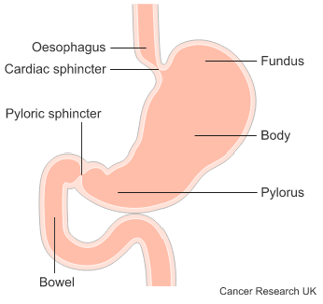
Neuroendocrine – Stomach
Although NENs are rare, many arise in the gastrointestinal system
Around 5% of NENs occur in the stomach
Stomach NENs can be associated with chronic atrophic gastritis (a long-lasting inflammation of the stomach)
  The risk of developing a stomach NEN is higher for people with the inherited syndrome multiple endocrine neoplasia 1 (MEN1)
Notes:
Many NENs arise in the gastrointestinal system and around 5% occur in the stomach. Risk factors for stomach NENs include chronic atrophic gastritis and the inherited MEN1 syndrome.

Slide 14
Neuroendocrine - Stomach
NENs of the stomach are staged using UICC TNM version ENET (sometimes called version “E”, depending on your cancer data management system)
If your cancer data management system does not allow you to define the TNM version in use, please ensure that your line manager / system administrator is made aware that the staging version needs to be defined as version ENET / E for each patient diagnosed with a NEN of the stomach
  A neuroendocrine staging data sheet for NENs of the foregut (including the stomach / gastric) is available for clinical use here: https://digital.nhs.uk/ndrs/data/cancer-data-training-materials/staging-sheets
Notes:
Stomach NENs are staged using UICC TNM version ENET (sometimes labelled as version E). If you’re not able to amend the staging version for individual patients, please ensure that your system administrator is made aware of any patient with a stomach NEN.

Slide 15
Neuroendocrine - Stomach
  For details on recording stomach tumours, including NENs, please refer to the Upper GI – Stomach training module, available here:
  https://digital.nhs.uk/ndrs/data/cancer-data-training-materials
Notes:
Details on recording stomach tumours, including NENs, can be found in the relevant training module on the NDRS website.

Slide 16
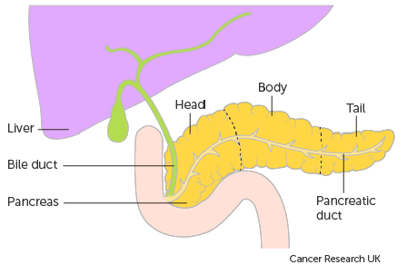
Neuroendocrine – Pancreas
  NENs of the pancreas are very rare
  Neuroendocrine neoplasms of the pancreas are broadly grouped into either functioning or non-functioning NENs:
    Functioning NENs produce hormones
    Non-functioning NENs either do not produce hormones or they produce hormones that do not generate symptoms
  Most NENs of the pancreas are non-functioning tumours
Notes:
Most NENs of the pancreas are non-functioning, meaning that they either don’t produce hormones at all or the hormones they do produce don’t generate symptoms

Slide 17
Neuroendocrine – Pancreas
  Functioning NENs of the pancreas include:
    Insulinoma – M8151/3
    Gastrinoma – M8153/3
    Somatostatinoma – M8156/3
    Glucagonoma – M8152/3
    VIPoma – M8155/3
      (where VIP stands for vasoactive intestinal peptide)
Notes:
Functional NENs of the pancreas include Insulinomas and Gastrinomas.

Slide 18
Neuroendocrine – Pancreas
NENs of the pancreas are staged using UICC TNM version ENET (sometimes called version “E”, depending on your cancer data management system)
  If your cancer data management system does not allow you to define the TNM version in use, please ensure that your line manager / system administrator is made aware that the staging version needs to be defined as version ENET / E for each patient diagnosed with a NEN of the pancreas
  A neuroendocrine staging data sheet for NENs of the foregut / hindgut (including pancreas) is available for clinical use here: https://digital.nhs.uk/ndrs/data/cancer-data-training-materials/staging-sheets
Notes:
Pancreatic NENs are staged using UICC TNM version ENET (sometimes labelled as version E). If you’re not able to amend the staging version for individual patients, please ensure that your system administrator is made aware of any patient with a pancreatic NEN.

Slide 19
Neuroendocrine – Pancreas
  For details on recording pancreatic tumours, including NENs, please refer to the Upper GI – Pancreatic training module, available here:
  https://digital.nhs.uk/ndrs/data/cancer-data-training-materials
Notes:
Details on recording pancreatic tumours, including NENs, can be found in the relevant training module on the NDRS website.

Slide 20
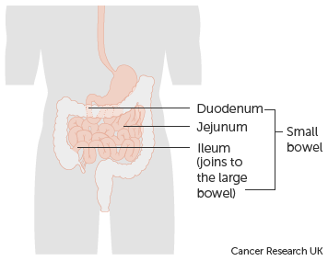
Neuroendocrine – Small intestine
About 40% of small intestine tumours are found to be neuroendocrine neoplasms
Small intestine NENs are more common in men than in women
  Having a family history of cancer is a risk factor for all types of NEN, including those in the small intestine
  No other risk factors have been identified for this type of NEN
Notes:
Around 40% of neoplasms in the small intestine are determined to be neuroendocrine in nature.

Slide 21
Neuroendocrine – Small intestine
NENs of the small intestine are staged using UICC TNM version ENET (sometimes called version “E”, depending on your cancer data management system)
If your cancer data management system does not allow you to define the TNM version in use, please ensure that your line manager / system administrator is made aware that the staging version needs to be defined as version ENET / E for each patient diagnosed with a NEN of the small intestine
Neuroendocrine staging data sheets for NENs of the foregut / midgut & hindgut are available for clinical use here: https://digital.nhs.uk/ndrs/data/cancer-data-training-materials/staging-sheets
Notes:
NENs of the small intestine are staged using UICC TNM version ENET (sometimes labelled as version E). If you’re not able to amend the staging version for individual patients, please ensure that your system administrator is made aware of any patient with a NEN of the small intestine.

Slide 22
Neuroendocrine – Small intestine
  For details on recording small intestine tumours, including NENs, please refer to the Lower/Upper GI - Small intestine training module, available here:
  https://digital.nhs.uk/ndrs/data/cancer-data-training-materials
Notes:
Details on recording neoplasms of the small intestine, including NENs, can be found in the relevant training module on the NDRS website.

Slide 23
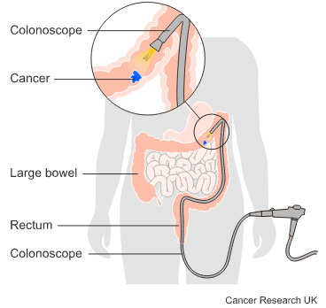
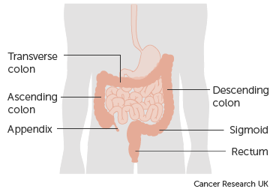
Neuroendocrine – Large intestine, appendix & rectum
About 20% of NENs arise in the large intestine or the rectum
Most NENs of the large intestine are diagnosed in patients between 55 and 65 years of age
Some very early stage NENs of the large intestine or rectum may be suitable for an endoscopic resection
Later stage NENs may require a different surgical approach or a different treatment modality
Notes:
Around 20% of primary NENs occur in the large intestine or rectum. Some very early stage NENs can be treated with an endoscopic surgical approach

Slide 24
Neuroendocrine – Large intestine, appendix & rectum
NENs of the large intestine, appendix & rectum are staged using UICC TNM version ENET (or “E”)
If your cancer data management system does not allow you to define the TNM version in use, please ensure that your line manager / system administrator is made aware that the staging version needs to be defined as version ENET / E for each patient diagnosed with a NEN
A neuroendocrine staging data sheet for NENs of the midgut & hindgut is available for clinical use here: https://digital.nhs.uk/ndrs/data/cancer-data-training-materials/staging-sheets
Notes:
NENs of the large intestine, appendix or rectum are staged using UICC TNM version ENET (sometimes labelled as version E). If you’re not able to amend the staging version for individual patients, please ensure that your system administrator is made aware of any patient with a NEN of the large intestine, appendix or rectum.

Slide 25
Neuroendocrine – Large intestine, appendix & rectum
  For details on recording large intestine, appendiceal and rectal tumours, including NENs, please refer to the Lower GI – Colorectal & anal training module, available here:
  https://digital.nhs.uk/ndrs/data/cancer-data-training-materials
Notes:
Details on recording neoplasms of the large intestine, appendix or rectum, including NENs, can be found in the relevant training module on the NDRS website.

Slide 26
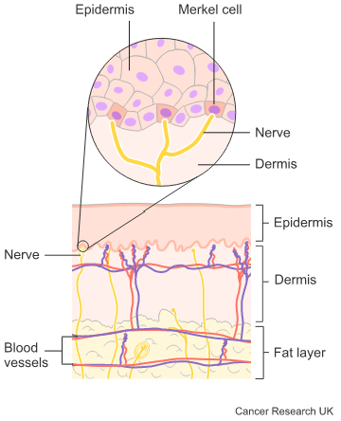
Neuroendocrine – Skin
Merkel cell carcinomas (MCCs) are aggressive neuroendocrine carcinomas that arise in the skin. Merkel cells are located near the nerve endings and help us respond to touch
  Merkel cell carcinomas are very rare
  Risk factors for MCCs include:
      UVA exposure
      Weakened immune system
      Merkel cell polyoma virus
  Unlike most skin cancers, merkel cell carcinomas develop rapidly
Notes:
Merkel cells are found next to the nerve endings in our skin. Merkel cell carcinomas are aggressive, rapidly growing neuroendocrine carcinomas (NECs) that mainly occur in areas exposed to higher levels of UVA radiation, such as the face, neck and arms.

Slide 27
Neuroendocrine – Skin
  Merkel cell carcinomas are ICD10 coded to the relevant C44 code depending on the location
  The ICD-O-3 morphology code for a merkel cell carcinoma is M8247/3
Merkel cell carcinomas are staged as follows:
      For diagnosis dates up to 31st December 2025 use UICC TNM v8
      For diagnosis dates from 1st January 2026 use UICC TNM v9
  Please note that the TNM version must be accurately recorded – if you are unable to amend the version on your cancer data management system, please refer to your line manager
Notes:
They are ICD10 coded as C44. Merkel cell carcinomas are staged using the relevant UICC TNM version which, for diagnosis dates up to and including 31st December 2025 is UICC TNM v8. For diagnosis dates from 1st January 2026, these tumours should be staged in and recorded as UICC TNM v9.

Slide 28
Neuroendocrine – Skin
A staging data sheet for Merkel cell carcinomas is available for clinical use here: https://digital.nhs.uk/ndrs/data/cancer-data-training-materials/staging-sheets
  For details on recording tumours of the skin, including Merkel cell carcinomas, please see the Skin training module, available here: https://digital.nhs.uk/ndrs/data/cancer-data-training-materials
Notes:
Further details on recording skin neoplasms can be found in the Skin training module on the NDRS website.

Slide 29
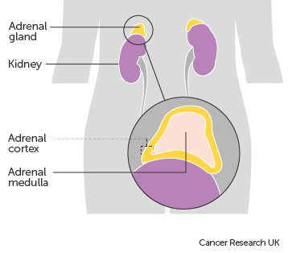
Neuroendocrine – Adrenal glands
Phaeochromocytomas are rare neuroendocrine neoplasms of the adrenal glands
They start in the inner part of the adrenal gland (the medulla)
All phaeochromocytomas are considered to be malignant and must be recorded on your cancer data management system
  Phaeochromocytomas are ICD10 coded to C74.1
  The ICD-O-3 morphology code for a phaeochromocytoma is M8700/3
Notes:
Adrenal glands can develop a NEN known as a phaeochromocytoma. Like many NENs, these are rare. All phaeochromocytomas are considered malignant and must be recorded in your cancer data management system.

Slide 30
Neuroendocrine – Adrenal glands
  Phaeochromocytomas are not currently considered stageable
  They are often treated with surgery although other treatment modalities may be offered depending on size & spread of the neoplasm as well as the general health of the patient. These include:
      Radioactive iodine treatment containing a chemical called MIBG (if the neoplasm is MIBG sensitive)
      DOTATATE treatment. The drug DOTATATE is also attached to a radioactive substance (if the neoplasm is DOTATATE sensitive)
      External beam radiotherapy
      Chemotherapy
      Radiofrequency ablation
Notes:
Phaeochromocytomas are not considered to be stageable. While they are often treated with surgery, other treatment modalities may be offered such as radioactive iodine, DOTATATE or external beam radiotherapy.

Slide 31
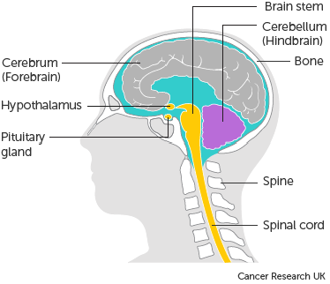
Neuroendocrine – Pituitary gland
Pituitary neuroendocrine neoplasms have historically been called pituitary adenomas, but more recently the WHO has proposed calling them PitNET (pituitary neuroendocrine tumour)
All PitNETs are considered to be malignant
      Invasive neoplasms of the pituitary gland are ICD10 coded to C75.1
Notes:
All pituitary NENs, or PitNETs, are considered to be malignant. PitNETs must be recorded under the ICD10 code C75.1 in your cancer data management system

Slide 32
Neuroendocrine – Pituitary gland
Neuroendocrine neoplasms of the pituitary gland are not considered stageable
For details on recording tumours of the brain and central nervous system, including NENs, please refer to Brain & CNS training module, available here:
  https://digital.nhs.uk/ndrs/data/cancer-data-training-materials
Notes:
PitNETs are not considered to be stageable. For more information on recording neoplasms of the brain and central nervous system, please see the NDRS training module: Brain & CNS, available on our website.

Slide 33
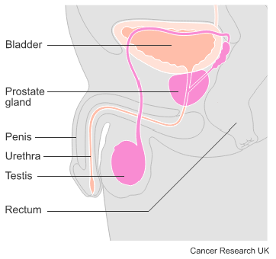
Neuroendocrine – Prostate
Neuroendocrine neoplasms of the prostate are rare – less than 2% of all prostate neoplasms
NENs of the prostate may arise without a prior history of prostate cancer or they may develop in the later stages of non-neuroendocrine prostate cancer following hormone or taxane-based therapy
  Where a NEN has arisen after hormone therapy or taxane-based therapy for a non-neuroendocrine prostate cancer, this would be recorded as a transformation diagnosis
  NENs of the prostate are less likely to result in a raised PSA
Notes:
About 2% of prostate cancer diagnoses are neuroendocrine neoplasms. These can arise either as new primary cancers without a prior history of prostate cancer, or as a response to hormone or taxane-based therapies for an existing prostate cancer. Prostate NENs tend not to result in a raised PSA

Slide 34
Neuroendocrine – Prostate
Neuroendocrine neoplasms of the prostate are ICD10 coded to C61X
ICD-O-3 morphology will be detailed on the pathology report
Most prostatic NENs have a mixed morphology of small cell carcinoma and adenocarcinoma – M8045/3
Pure neuroendocrine neoplasms of the prostate are not considered stageable
  New primary prostatic NENs of mixed morphology are staged as follows:
      For diagnosis dates up to 31st December 2025 use UICC TNM v8
      For diagnosis dates from 1st January 2026 use UICC TNM v9
Notes:
NENs are ICD10 coded to C61X with the relevant ICD-O-3 morphology code – this should be detailed on the pathology report. It should be noted that only new primary prostatic NENs of mixed morphology are considered stageable

Slide 35
Neuroendocrine – Prostate
  Please note that the TNM version must be accurately recorded – if you are unable to amend the version on your cancer data management system, please refer to your line manager
  A staging data sheet for neoplasms of the prostate is available for clinical use here:
    https://digital.nhs.uk/ndrs/data/cancer-data-training-materials/staging-sheets
  For details on recording prostate neoplasms, including NENs, please refer to the Urology– Prostate training module, available here:
    https://digital.nhs.uk/ndrs/data/cancer-data-training-materials
Notes:
For more information on recording neoplasms of the prostate, including NENs, please see the Prostate training module.

Slide 36
Neuroendocrine – Other sites
Some other sites where neuroendocrine neoplasms may arise include:
  Breast
    Neuroendocrine carcinomas of the breast are staged as follows:
        For diagnosis dates up to 31st December 2025 use UICC TNM v8
        For diagnosis dates from 1st January 2026 use UICC TNM v9
  Please note that the TNM version must be accurately recorded – if you are unable to amend the version on your cancer data management system, please refer to your line manager
If, after 1st January 2026, your cancer data management system has not been amended to include TNM v9 please record the TNM v9 stage and add the following statement to the Primary Diagnosis Subsidiary Comment field:
  Patient staged using TNM9 not TNM8 as per CR2070
Notes:
You may also come across neuroendocrine carcinomas in the breast, which would need to be staged using the appropriate standard version of UICC TNM staging …

Slide 37
Neuroendocrine – Other sites
Some other sites where neuroendocrine neoplasms may arise include:
  Uterus
    Neuroendocrine carcinomas of the uterus are staged using the FIGO staging system specific to uterine tumours
Notes:
… the uterus which would need to be staged using the FIGO staging system ….

Slide 38
Neuroendocrine – Other sites
Other sites where neuroendocrine neoplasms may arise include:
  Extra-adrenal paragangliomas
    These unstageable neuroendocrine neoplasms form in the same type of cells as phaeochromocytomas but while phaeochromocytomas are specific to the adrenal glands, paragangliomas form elsewhere in the body
    Paragangliomas can cause similar symptoms to phaeochromocytomas
    Paragangliomas are ICD10 coded to:
      Malignant neoplasm of the carotid body – C75.4
      Malignant neoplasm of the aortic body and other paraganglioma – C75.5
    Morphology coding for:
      Middle ear paraganglioma – M8690/3
      Aortic body paraganglioma – M8691/3
      Carotid body paraganglioma – M8692/3
      Extra-adrenal paraganglioma - M8693/3
Notes:
…or extra-adrenal paragangliomas (which are not considered to be stageable). Paragangliomas form in the paraganglia that are situated near blood vessels and nerves throughout the body. Please pay particular attention to the location of the paraganglioma when selecting the correct ICD10 and morphology codes.

Slide 39
Neuroendocrine – Other sites
  While neuroendocrine neoplasms are rare, it should be noted that neuroendocrine cells can be found throughout the body meaning the potential exists for neuroendocrine neoplasms to arise anywhere
  The most common sites have been detailed in this module
Notes:
It should be noted that while NENs are rare, they can arise anywhere that neuroendocrine cells exist. This module deals only with the most commonly occurring neuroendocrine neoplasms

Slide 40

Acknowledgements
Many thanks to Cancer Research UK for the use of their images within this training module.
Notes:
We’d like to thank Cancer Research UK for the use of their images within this training module.

Slide 41
Questions?
East Midlands: Simon Cairnes – simon.cairnes@nhs.net
Eastern: Marianne Mollett – marianne.mollett@nhs.net
London & South East: Katrina Sung – katrina.sung@nhs.net
London & South East: Karen Graham– karen.graham36@nhs.net
North West: Paul Stacey – p.stacey@nhs.net
Northern & Yorkshire: Rachael Mann – rachaelmann@nhs.net
Oxford: Gemma Feeney – gemma.feeney@nhs.net
South West: James Withers – james.withers@nhs.net
West Midlands: Gemma Feeney – gemma.feeney@nhs.net
Notes:
If you have any questions on the information contained within this module or about COSD in general, do please feel free to email your regional Data Liaison Manager

