Slide 1

National Disease Registration Service
(NDRS)
Children, Teenagers & Young Adults (CTYA) Key Points
v2 July 2024
Notes:
Welcome to this NDRS training module on tumours in Children, Teenagers and Young Adults, which has been designed to help Cancer Administration staff gain a better understanding of these tumours, the data requirements and the terminology used by the clinical teams.

Slide 2

Agenda
Children, Teenagers & Young Adults (CTYA)
  Overview
  Diseases of CTYA patients
Acknowledgements
This module may be paused at any time
Notes:
In this module we’ll briefly look at the sites where CTYA disease may arise and provide relevant information on recording specific diseases. This module can be paused at any time.

Slide 3
CTYA
In this section we will cover:
  CTYA Overview
  Brain & CNS
  Lymphoma
  Leukaemia
  Wilms tumour
  Neuroblastoma
  Hepatoblastoma
  Retinoblastoma
  Osteosarcoma
  Soft Tissue Sarcoma
Notes:
We’ll start with an overview of CTYA disease…

Slide 4
CTYA - Overview
What constitutes a CTYA condition? As detailed in the COSD guidance:
A patient is considered as part of the CTYA cohort if they are under the age of 25 at diagnosis
  A patient is considered to be a young adult if they are aged 19-24 inclusive at diagnosis
  A patient is considered to be a teenager if they are aged 16-18 inclusive at diagnosis
  A patient is considered to be a child if they are aged 0 to 15 inclusive at diagnosis (under 16)
Notes:
.. The first criteria being the age ranges at which a patient is considered to be a young adult, teenager or child.

Slide 5
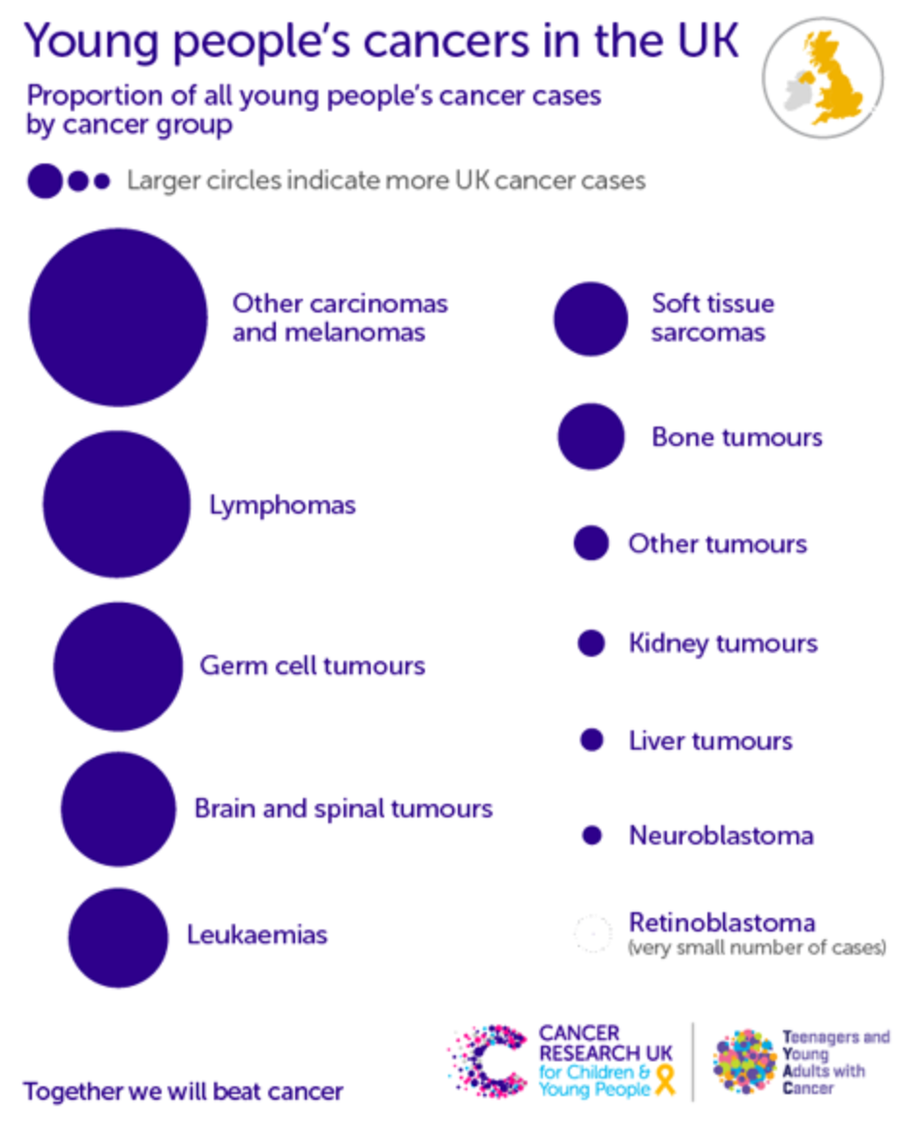
CTYA - Overview
CTYA may encompass many different types of cancer
Where possible, this module will direct you to the relevant training resource for the cancer site
Where no site-specific resource exists, basic information will be supplied, including ICD 10 coding, morphology coding and the relevant staging system (where applicable)
Notes:
CTYA may encompass cancers in many different body sites. Where possible, links will be provided to the site-specific training. Where this isn’t possible, basic information will be provided on recording the disease.

Slide 6
CTYA - Overview
Some cancers of children, teenagers and young adults, although still rare, are more common than others. These include:
  Tumour of the brain / central nervous system
  Lymphoma
  Some types of Leukaemia
  Wilms tumour, sometimes called a nephroblastoma (tumour of the kidney)
  Neuroblastoma (commonly found in the abdomen, nasal cavity or adrenal glands)
  Hepatoblastoma (tumour of the liver)
  Retinoblastoma (tumour of the eye)
  Osteosarcoma (tumour of the bone)
  Soft tissue sarcoma
Notes:
While cancers in children, teenagers and young adults are still rare, when they do arise those cancers are likely to be on this list … which we’ll now look at in order

Slide 7
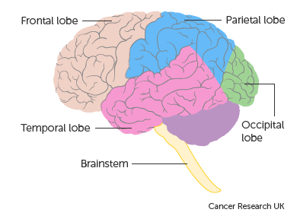
CTYA – Brain & Central Nervous System
For instructions on recording Brain & CNS tumours, please see the training module Brain & Central Nervous System, available here: https://digital.nhs.uk/ndrs/data/cancer-data-training-materials
All tumours listed within the Brain & CNS training module must be recorded in your cancer data management system, both invasive and non-invasive
Most brain tumours are not staged, however, medulloblastomas and specified other tumours are staged using the Chang staging system. A staging data sheet for clinical use (Brain & CNS – Chang Stage) may be downloaded here: https://digital.nhs.uk/ndrs/data/cancer-data-training-materials/staging-sheets
Notes:
Recording of brain and central nervous system tumours is covered in a site-specific module available on the NDRS website. Please be aware that although most brain tumours are not considered stageable, medulloblastomas and other specified tumours do require a Chang stage. A Chang stage data sheet for clinical use may be downloaded at the link shown…

Slide 8
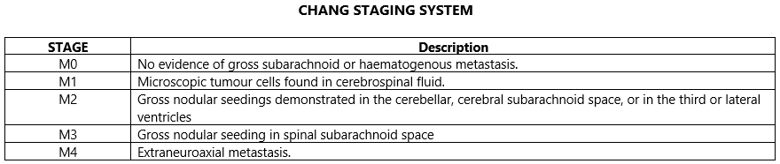
CTYA – Brain & Central Nervous System
Chang Stage:
Notes:
… but is included here for information

Slide 9

CTYA – Lymphoma
For specific instructions on recording Lymphomas, please see the training module Haematology Lymphoma, available here: https://digital.nhs.uk/ndrs/data/cancer-data-training-materials
Non-Hodgkin Lymphomas in children are staged using the Murphy St Jude classification
Hodgkin Lymphomas in children are staged using the Ann Arbor staging system
Morphology must be recorded for all Haematological conditions
http://training.seer.cancer.gov/ss_module08_lymph_leuk/lymph_unit02_sec02_reg_lns.html
Notes:
Lymphomas are covered in the Lymphoma training module. Please note that staging systems may vary depending on the type of lymphoma and the age of the patient…

Slide 10
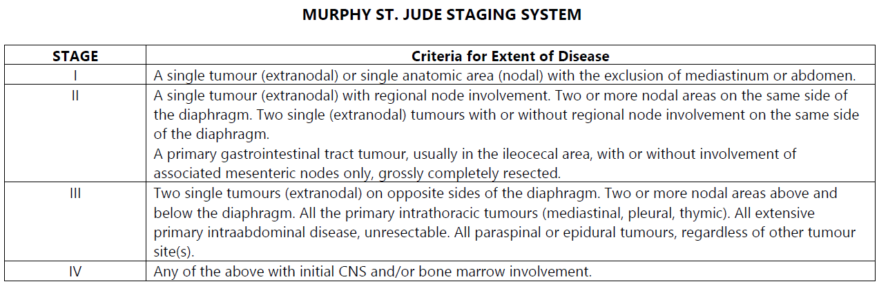
CTYA – Lymphoma
Murphy St Jude classification
http://training.seer.cancer.gov/ss_module08_lymph_leuk/lymph_unit02_sec02_reg_lns.html
Notes:
… meaning that a non-Hodgkin lymphoma in a child would be staged using the Murphy St Jude system…

Slide 11
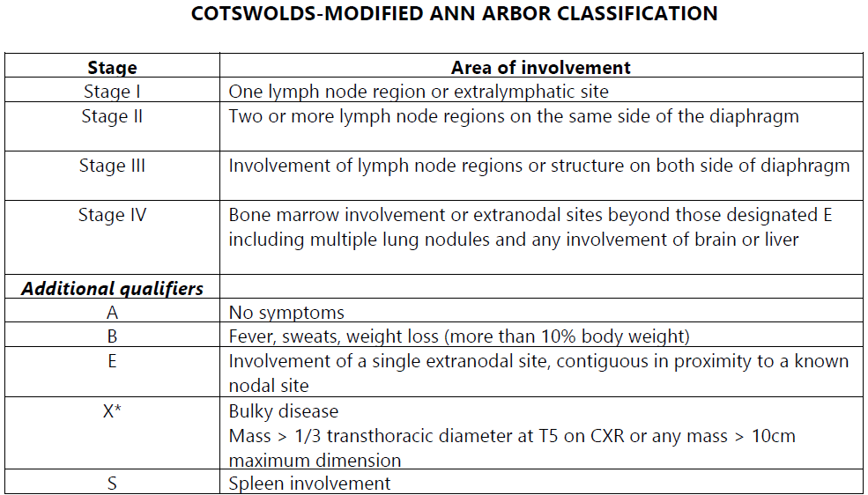
CTYA – Lymphoma
Ann Arbor staging system
http://training.seer.cancer.gov/ss_module08_lymph_leuk/lymph_unit02_sec02_reg_lns.html
Notes:
… while a Hodgkin lymphoma would be staged using the Ann Arbor staging system

Slide 12
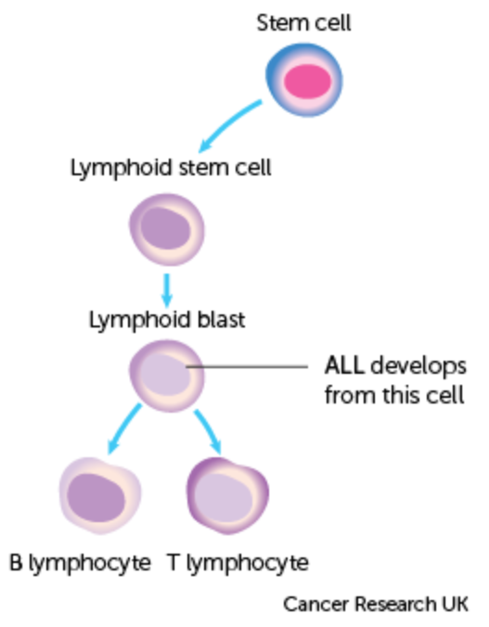
CTYA - Leukaemia
Leukaemias developed in childhood may include Childhood Acute Lymphocytic Leukaemia (Childhood ALL) and Juvenile myelomonocytic leukaemia (JMML)
For specific instructions on recording Leukaemia, please see the training module Haematology Leukaemia, available here: https://digital.nhs.uk/ndrs/data/cancer-data-training-materials
Most leukaemias are not considered stageable with the exception of chronic lymphocytic leukaemia (CLL)
Notes:
Leukaemias also have their own training module. Most leukaemias are not considered stageable with the exception of chronic lymphocytic leukaemia.

Slide 13
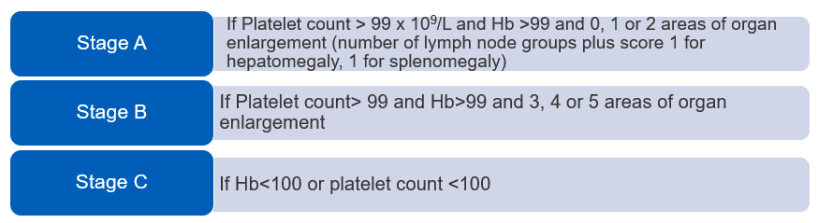
CTYA - Leukaemia
Binet Stage for CLL
Notes:
While CLL in children is extremely rare, the Binet stage for CLL is shown here for information

Slide 14
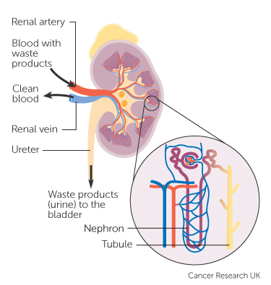
CTYA – Wilms tumour
For instructions on recording Wilms tumours, please see the training module Urology - Kidney, available here: https://digital.nhs.uk/ndrs/data/cancer-data-training-materials
Wilms tumours are staged using the Wilms staging system. A staging data sheet for clinical use may be downloaded here: https://digital.nhs.uk/ndrs/data/cancer-data-training-materials/staging-sheets
Notes:
Wilms tumours are covered in the Urology – Kidney training module. A Wilms staging data sheet is available at the link shown …

Slide 15
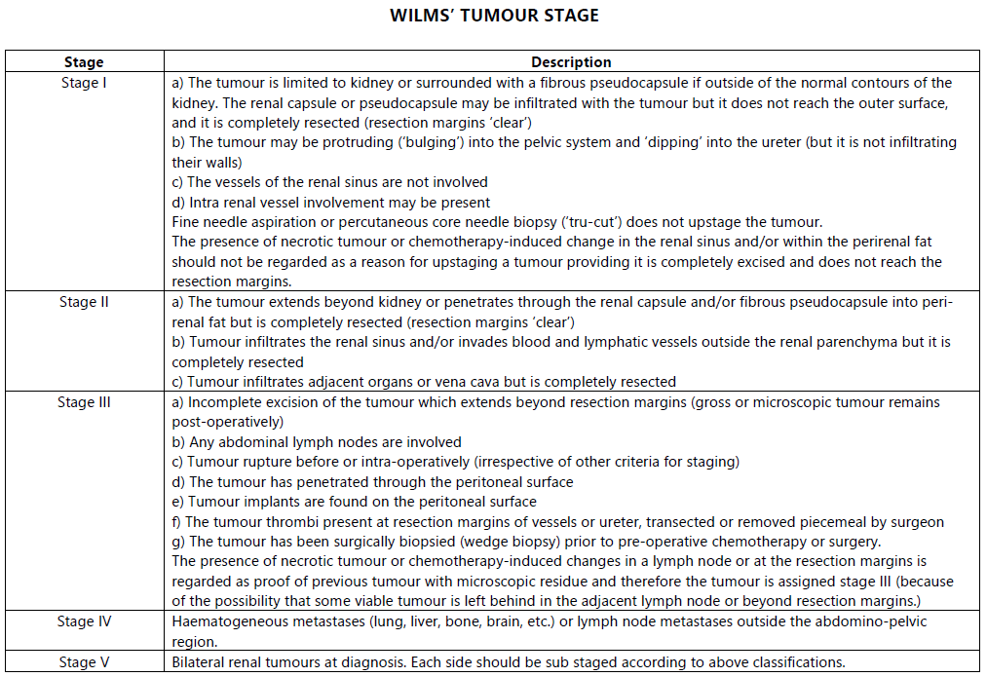
CTYA – Wilms tumour
Wilms stage
Notes:
… but is also included here for ease.

Slide 16
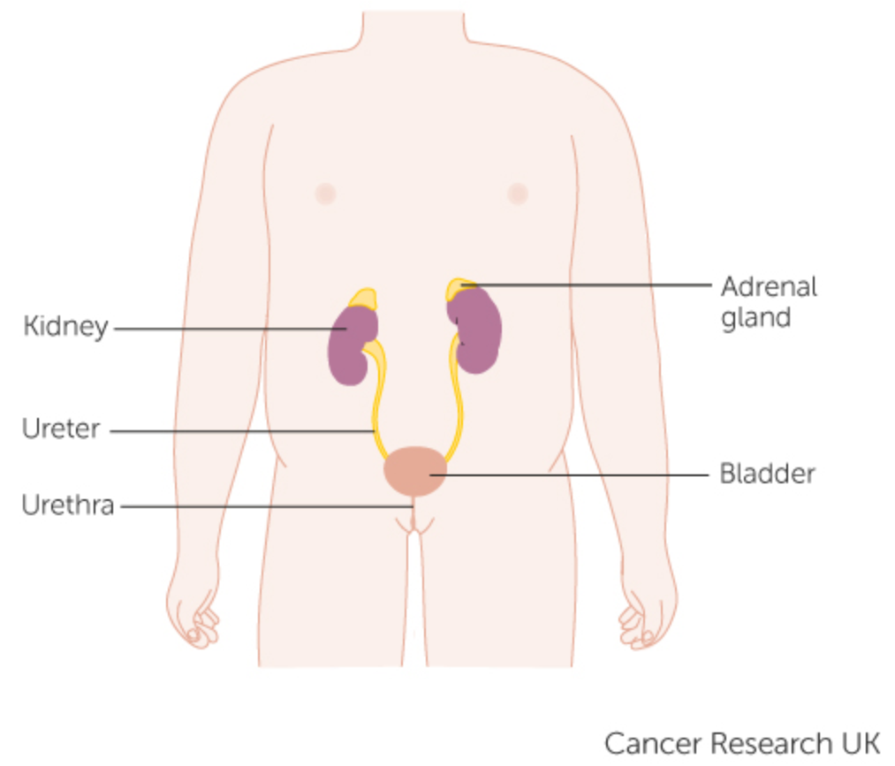
CTYA - Neuroblastoma
Neuroblastomas mostly affect children under the age of 5 but can sometimes develop in older children, teenagers and adults
A neuroblastoma may develop anywhere in the body but commonly occurs in the adrenal glands or at the back of the abdomen. Neuroblastoma may also occur in the nasal cavity
Morphology for neuroblastomas:
  Neuroblastoma, NOS – M9500/3
  Neuroblastoma, olfactory – M9522/3
Notes:
Neuroblastomas may develop anywhere in the body but tend to present in the adrenal glands, in the tissue at the back of the abdomen or in the nasal cavity. Morphology codes are shown here…

Slide 17
CTYA - Neuroblastoma
A neuroblastoma would be recorded in ICD10 using the relevant code for that body area. This includes:
  Malignant neoplasm of adrenal gland, medulla – C74.1
  Malignant neoplasm of other and ill-defined sites, abdomen – C76.2
  Malignant neoplasm of nasal cavity – C30.0
Neuroblastomas are staged using the International Neuroblastoma Risk Group Staging System (INRGSS). A staging data sheet for clinical use may be downloaded here: https://digital.nhs.uk/ndrs/data/cancer-data-training-materials/staging-sheets
Notes:
… and the relevant topographical ICD 10 codes are shown here. All neuroblastomas must be recorded in your cancer management system and require an International Neuroblastoma Risk Group stage. A Neuroblastoma staging sheet for clinical use may be downloaded from the link shown…

Slide 18
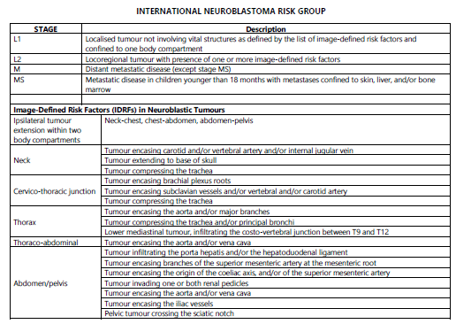
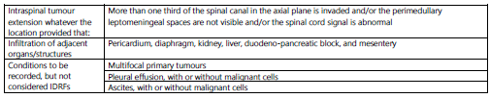
CTYA - Neuroblastoma
The International Neuroblastoma Risk Group Staging System (INRGSS):
Notes:
… but is included here for information

Slide 19
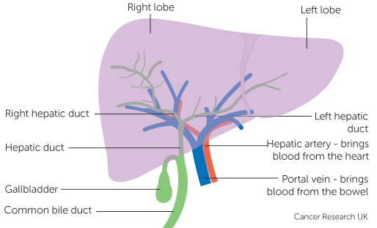
CTYA - Hepatoblastoma
For instructions on recording hepatoblastoma, please see the training module Lower / Upper GI - Hepatobiliary, available here: https://digital.nhs.uk/ndrs/data/cancer-data-training-materials
Hepatoblastomas in children, teenagers and young adults are staged using the Pretext Staging System. A staging data sheet for clinical use may be downloaded here: https://digital.nhs.uk/ndrs/data/cancer-data-training-materials/staging-sheets
Notes:
Recording of hepatoblastomas is covered in the HPB training module. Hepatoblastomas in children, teenagers and young adults require a PRETEXT stage.

Slide 20
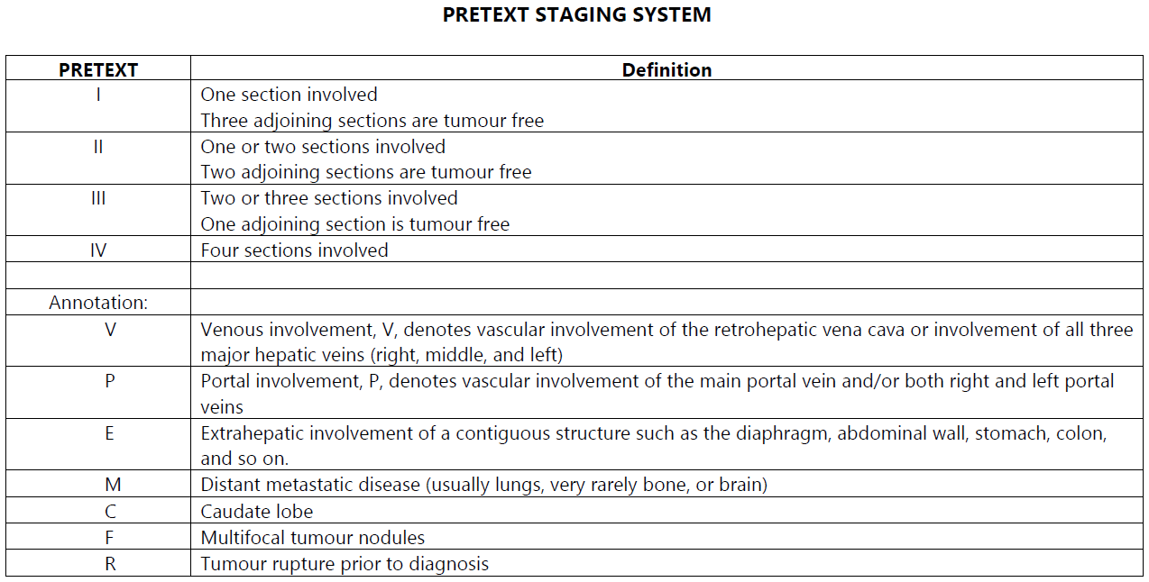
CTYA - Hepatoblastoma
Notes:
Where applicable, any annotation must be recorded for Pretext staging in addition to the stage

Slide 21
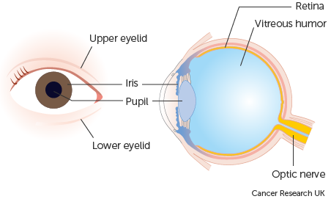
CTYA - Retinoblastoma
Retinoblastomas develop in the retina inside the eye. They arise in immature cells that should have gone on to form part of the retina (retinoblasts). For more details on recording tumours of the Eye, please see the relevant training module: https://digital.nhs.uk/ndrs/data/cancer-data-training-materials
Retinoblastoma are ICD10 coded to:
  Malignant neoplasm of eye and adnexa, retina – C69.2
SNOMED CT code with the ICD-O-3 morphology code in brackets:
  Retinoblastoma, NOS – M9510/3
  Retinoblastoma, differentiated – M9511/3
  Retinoblastoma, undifferentiated – M9512/3
  Retinoblastoma, diffuse – M9513/3
  Retinoblastoma, spontaneously regressed – M9514/3
The exact morphology coding may be detailed on the pathology report
Notes:
Retinoblastomas develop inside the eye. Morphological type may vary but they are always ICD10 coded to C69.2

Slide 22
CTYA - Retinoblastoma
Retinoblastomas are staged using the TNM staging system. A Retinoblastoma TNM staging data sheet for clinical use may be downloaded here:
https://digital.nhs.uk/ndrs/data/cancer-data-training-materials/staging-sheets
Retinoblastomas must also be assessed using the appropriate assessment systems:
Intraocular Classification of Retinoblastoma Assessment (ICRB)
Post-treatment / extraocular assessment: International Staging System for Retinoblastoma Assessment (ISSRA)
Notes:
All retinoblastomas must be staged using UICC TNM v8. A Retinoblastoma staging sheet can be downloaded at the link shown.

Slide 23
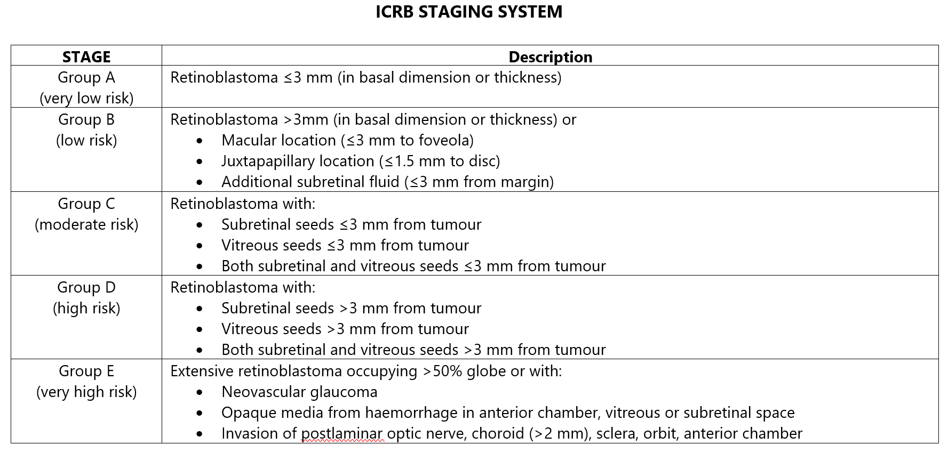
CTYA - Retinoblastoma
Intraocular Classification of Retinoblastoma assessment (ICRB)
Notes:
Retinoblastomas are also assessed for risk grouping using the ICRB system.

Slide 24
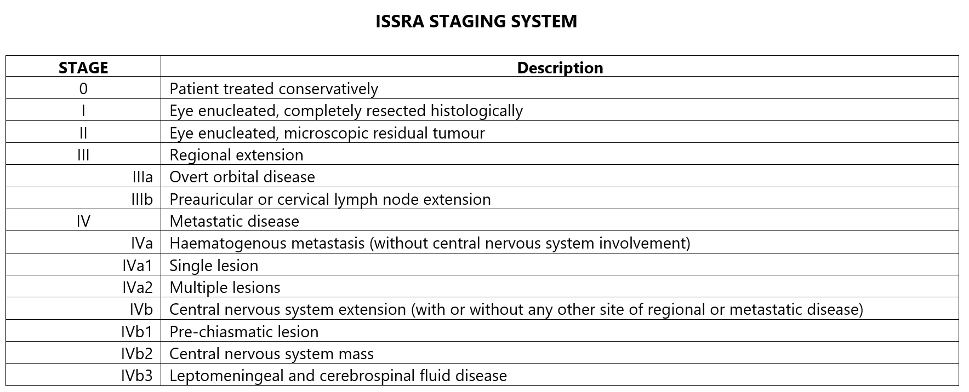
CTYA - Retinoblastoma
Post-treatment / extraocular assessment: International Staging System for Retinoblastoma Assessment (ISSRA)
Notes:
After treatment, Retinoblastomas will need an ISSRA classification.

Slide 25
CTYA - Osteosarcoma
For instructions on recording Osteosarcomas, please see the training module Sarcoma, available here: https://digital.nhs.uk/ndrs/data/cancer-data-training-materials
Osteosarcomas are staged using the TNM staging system. A Bone TNM staging data sheet (for clinical use) may be downloaded here: https://digital.nhs.uk/ndrs/data/cancer-data-training-materials/staging-sheets
Notes:
The recording of Osteosarcomas is covered in the Sarcoma training module. A staging data sheet for Bone tumours may be downloaded at the link shown.

Slide 26
CTYA – Soft Tissue Sarcoma
For instructions on recording Soft Tissue Sarcomas, please see the training module Sarcoma, available here:
https://digital.nhs.uk/ndrs/data/cancer-data-training-materials
Stageable soft tissue sarcomas are staged using the TNM staging system. A Rhabdomyosarcoma and Other Soft Tissue Sarcomas TNM staging data sheet (for clinical use) may be downloaded here:
https://digital.nhs.uk/ndrs/data/cancer-data-training-materials/staging-sheets
Notes:
Details on recording soft tissue sarcomas can also be found in the Sarcoma training module. While not all soft tissue sarcomas are stageable, those that are will require a TNM stage. A Rhabdomyosarcoma and other soft tissue sarcomas staging sheet is available at the link shown.

Slide 27
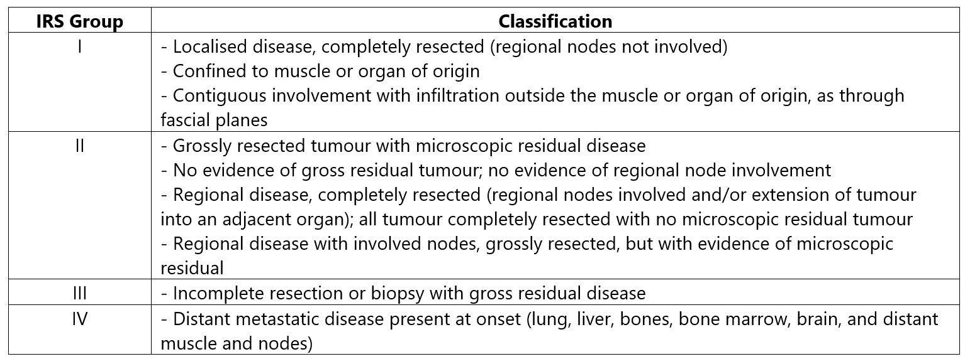
CTYA – Soft Tissue Sarcoma
In addition to a TNM stage, rhabdomyosarcomas will require an Intergroup Rhabdomyosarcoma Studies group classification:
A determination of favourable or unfavourable site is also required:
Notes:
Rhabdomyosarcoma also require an IRS Group classification as well as a determination of favourable or unfavourable disease site.

Slide 28

Acknowledgements
Many thanks to Cancer Research UK for the use of their images within this training module.
Notes:
We’d like to thank Cancer Research UK for the use of their images within this training module.

Slide 29
Questions?
East Midlands: Simon Cairnes – simon.cairnes@nhs.net
Eastern: Marianne Mollett – marianne.mollett@nhs.net
London & South East: Katrina Sung – katrina.sung@nhs.net
London & South East: Karen Graham– karen.graham36@nhs.net
North West: Paul Stacey – p.stacey@nhs.net
Northern & Yorkshire: Rachael Mann – rachaelmann@nhs.net
Oxford: Gemma Feeney – gemma.feeney@nhs.net
South West: James Withers – james.withers@nhs.net
West Midlands: Gemma Feeney – gemma.feeney@nhs.net
Notes:
If you have any questions on the information contained within this module or about COSD in general, do please feel free to email your regional Data Liaison Manager

