Slide 1

The National Disease Registration & Analysis Service (NDRS)
Data Collection for
Recurrences, Progressions & Transformations
v1 March 2025
Notes:
Welcome to this NDRS training module, which has been designed as a guide to data collection for non-primary pathways.

Slide 2
Background
2008
A commitment made in the ‘Cancer Strategy, Improving Outcomes: a Strategy for Cancer’ to pilot collection of recurrence data
2011
Announcement that data on recurrence and metastatic cancers should be collected via CWT
2013
COSD launch: Data collection for Primary and Non-Primary cancer (recurrence, progression and transformations)
2015
The ‘Cancer Strategy for England, Achieving World Class Cancer Outcomes’ Re-enforced the collection of data for recurrent cancers
2024
Launch of the NAoMe National Audit of Metastatic Breast Cancer
Notes:
First, a little background. In 2008, a commitment was made to pilot the collection of recurrence data. It took a while for this to actually come about but in 2013, COSD was launched to enable collection of data for both primary and non-primary cancers. The Cancer strategy for England reinforced the collection of recurrent cancers in 2015 and in 2024 the new national audit of metastatic breast cancers was launched…

Slide 3





Headlines in 2024
2024
https://www.bcna.org.au/latest-news/bcna-news/making-metastatic-breast-cancer-count/
April
‘The First ever publication of secondary breast cancer data met with concerns around absence of critical data’
https://breastcancernow.org/about-us/media/press-releases/first-ever-publication-of-secondary-breast-cancer-data-met-with-concerns-around-absence-of-critical-data/
April
Lack of information on numbers of people with metastatic breast cancer
‘Even though 20-30% of patients with early breast cancer experience relapse, relapse is not typically recorded by most cancer registries. Therefore, the number of patients living with metastatic breast cancer is not known. Meeting the needs of an under-measured patient population is difficult, as a result, feelings of abandonment and isolation are common among those living with the condition. ’
https://crukcambridgecentre.org.uk/news/lancet-commission-breast-cancer-publishes-recommendations-change
Notes:
... the only problem is, in too many cases, the data simply isn’t there. Not just in the UK …

Slide 4


Headlines in 2024
October
‘The number of survivors of breast cancer is growing, but the number of women experiencing metastatic recurrence is unknown due to a lack of international guidelines for the registration and analysis of recurrence data and support for cancer registries to routinely collect this important data item’
https://www.iarc.who.int/news-events/collecting-long-term-outcomes-in-population-based-cancer-registry-data-the-case-of-breast-cancer-recurrence/
May
Kat Southwell METUPUK Blog:
‘Since recording of MBC data was made mandatory but never adhered to in 2013, just shy of 130,000 women will have died of metastatic breast cancer’
Kat stated ‘We are only counted when we are dead’
https://metupuk.org.uk/2024/05/data-collection-for-metastatic-breast-cancer-we-are-only-counted-when-we-are-dead-kat-southwell/
Notes:
… but internationally. In her blog for METUPUK Kat Southwell wrote:
Since recording of MBC data was made mandatory (but never adhered to) in 2013, just shy of 130,000 women will have died of metastatic breast cancer. She also noted: We are only counted when we are dead.

Slide 5
Everyone’s talking about ‘metastatic patients’
Metastatic cancer
  This is where a cancer spreads from where it has started
Metastasis
  The process by which the cancer cells spread
Type
  Local – Cancer has returned in the original tumour site
  Regional – Cancer has spread to regional lymph nodes
  Distant – Cancer that has spread from its original location to other parts of the body it is known as late-stage cancer, Stage 4 cancer or M1 (TNM1)
If a disease changes from an in-situ tumour or non-invasive lesion (including non-invasive urothelial carcinoma) to a new primary invasive lesion, this must be recorded as a new malignant primary diagnosis of cancer
Notes:
The term “metastatic patient” only applies to patients whose primary malignant cancer has spread, either in the form of a recurrence after a cancer-free period, or in the form of spread to other locations for an existing cancer

Slide 6


Definitions of non-primary cancers
Progression
Where a patient is living with a cancer diagnosis and there is a change to the spread of cancer
Notes:
A Recurrence indicates the reappearance of a malignant cancer where the patient had previously been told their cancer was no longer detectable.
A Progression diagnosis indicates that their existing cancer has spread since it was originally diagnosed.
Haematology, Brain/CNS and Sarcoma are the cancer sites where transformations are mainly diagnosed.
A transformation is recorded where there is a change in the cancer type (morphology) or possibly the ICD10 code (this might occur in Haematology).
These are all types of non-primary pathway

Slide 7
Recording a Diagnosis - Primary vs Non-primary
New Primary Diagnosis
Progression
Transformation
Recurrence
Is the original diagnosis on your system?
Yes
No
Option 2 Non-Primary Pathway
Option 1 Primary Pathway
New Primary – Create a new record and include diagnostic data items:
Primary ICD 10
Tumour Laterality
Primary Diagnosis date
Progression – Add progression details on the existing original diagnosis:
Date of progression
Metastatic type (local regional or distant)
Metastatic site
Transformation – Add transformation details on the existing original diagnosis:
Date of transformation
Recurrence
Progression
Transformation
Create a new record for recurrence and include:
The date of the non-primary diagnosis
Note: this the diagnosis date of the recurrence
Original Primary ICD 10 diagnosis
Metastatic Type (local, regional or distant)
Metastatic Site
Create a new record for progression and include:
The date of the non-primary diagnosis
Note: this the diagnosis date of the progression
Progression ICD
Note: this the ICD 10 of the original diagnosis
Metastatic Type (local, regional or distant)
Metastatic Site
Create a new record for transformation and include:
The date of the non-primary diagnosis
Note: this the diagnosis date of the transformation
Morphology ICD 03 Transformation
OR
Morphology SNOMED transformation
Notes:
So how do you go about recording these progressions, transformations and recurrences? This graphic is included in the COSD user guide to help you decide. It details the options for recording both primary and non-primary pathways and we’re going to go through it step-by-step.

Slide 8
Recording a Diagnosis - Primary vs Non-primary
New Primary Diagnosis
Progression
Transformation
Is the original diagnosis on your system?
Yes
No
Option 2 Non-Primary Pathway
Option 1 Primary Pathway
New Primary – Create a new record and include diagnostic data items:
Primary ICD 10
Tumour Laterality
Primary Diagnosis date
Progression – Add progression details on the existing original diagnosis:
Date of progression
Metastatic type (local regional or distant)
Metastatic site
Transformation – Add transformation details on the existing original diagnosis:
Date of transformation
Notes:
If a patient presents with a progression or a transformation, you must first determine if the original primary diagnosis is already on your cancer management system. If it is, record any progression or transformation on the original primary pathway.

Slide 9
Recording a Diagnosis - Primary vs Non-primary
New Primary Diagnosis
Progression
Transformation
Is the original diagnosis on your system?
Yes
No
Option 2 Non-Primary Pathway
Option 1 Primary Pathway
New Primary – Create a new record and include diagnostic data items:
Primary ICD 10
Tumour Laterality
Primary Diagnosis date
Progression – Add progression details on the existing original diagnosis:
Date of progression
Metastatic type (local regional or distant)
Metastatic site
Transformation – Add transformation details on the existing original diagnosis:
Date of transformation
Progression
Create a new record for progression and include:
The date of the non-primary diagnosis
Note: this the diagnosis date of the progression
Progression ICD
Note: this the ICD 10 of the original diagnosis
Metastatic Type (local, regional or distant)
Metastatic Site
Notes:
But if a patient’s original primary pathway is not on your cancer management system, record any progression on a new non-primary pathway. The progression details needed include the ICD10 code of the primary cancer and the type & site of the metastases. Most cancer systems will automatically classify this as a non-primary pathway when a progression diagnosis is selected.

Slide 10
Recording a Diagnosis - Primary vs Non-primary
New Primary Diagnosis
Progression
Transformation
Is the original diagnosis on your system?
Yes
No
Option 2 Non-Primary Pathway
Option 1 Primary Pathway
New Primary – Create a new record and include diagnostic data items:
Primary ICD 10
Tumour Laterality
Primary Diagnosis date
Progression – Add progression details on the existing original diagnosis:
Date of progression
Metastatic type (local regional or distant)
Metastatic site
Transformation – Add transformation details on the existing original diagnosis:
Date of transformation
Progression
Transformation
Create a new record for progression and include:
The date of the non-primary diagnosis
Note: this the diagnosis date of the progression
Progression ICD
Note: this the ICD 10 of the original diagnosis
Metastatic Type (local, regional or distant)
Metastatic Site
Create a new record for transformation and include:
The date of the non-primary diagnosis
Note: this the diagnosis date of the transformation
Morphology ICD 03 Transformation
OR
Morphology SNOMED transformation
Notes:
Similarly, where the patient’s original primary pathway is not on your cancer management system, a transformation will need to be recorded on it’s own non-primary pathway. Details needed will include the date of the transformation and the morphology. Again, classification as a non-primary pathway is automatic in most systems.

Slide 11
Recording a Diagnosis - Primary vs Non-primary
New Primary Diagnosis
Progression
Transformation
Recurrence
Is the original diagnosis on your system?
Yes
No
Option 2 Non-Primary Pathway
Option 1 Primary Pathway
New Primary – Create a new record and include diagnostic data items:
Primary ICD 10
Tumour Laterality
Primary Diagnosis date
Progression – Add progression details on the existing original diagnosis:
Date of progression
Metastatic type (local regional or distant)
Metastatic site
Transformation – Add transformation details on the existing original diagnosis:
Date of transformation
Recurrence
Progression
Transformation
Create a new record for recurrence and include:
The date of the non-primary diagnosis
Note: this the diagnosis date of the recurrence
Original Primary ICD 10 diagnosis
Metastatic Type (local, regional or distant)
Metastatic Site
Create a new record for progression and include:
The date of the non-primary diagnosis
Note: this the diagnosis date of the progression
Progression ICD
Note: this the ICD 10 of the original diagnosis
Metastatic Type (local, regional or distant)
Metastatic Site
Create a new record for transformation and include:
The date of the non-primary diagnosis
Note: this the diagnosis date of the transformation
Morphology ICD 03 Transformation
OR
Morphology SNOMED transformation
Notes:
A recurrence is always recorded on a separate non-primary pathway. Details required will include the date of the recurrence diagnosis and the type & site of metastases.

Slide 12
Non-Primary Dataset
All Non-Primary:
Date of Non-Primary Cancer Diagnosis (Clinically Agreed)
Original Primary Diagnosis (ICD)
Metastatic Type
Metastatic Site
Palliative Care Specialist Seen Indicator
Method of Detection
Transformations:
Morphology (ICD-O-3) Transformation
Morphology (SNOMED) Transformation
SNOMED Version Current (Transformation)
Notes:
The non-primary dataset includes certain basic data items that apply to all types of non-primary pathway…

Slide 13
Non-Primary Dataset
All Non-Primary:
Date of Non-Primary Cancer Diagnosis (Clinically Agreed)
Original Primary Diagnosis (ICD)
Metastatic Type
Metastatic Site
Palliative Care Specialist Seen Indicator
Method of Detection
Transformations:
Morphology (ICD-O-3) Transformation
Morphology (SNOMED) Transformation
SNOMED Version Current (Transformation)
Local
Regional
Distant
Notes:
… which includes the metastatic type, which might be local to the original cancer, in the same region as the original cancer – this would mean in the regional lymph nodes, or in a distant location…

Slide 14
Non-primary dataset
Brain
All Non-Primary
Date of Non-Primary Cancer Diagnosis (Clinically Agreed)
Original Primary Diagnosis (ICD)
Metastatic Type
Metastatic Site
Palliative Care Specialist Seen Indicator
Method of Detection
Transformations:
Morphology (ICD-O-3) Transformation
Morphology (SNOMED) Transformation
SNOMED Version Current (Transformation)
Liver
Unknown Metastatic
Skin
Distant Lymph Node
Bone
Bone Marrow
Regional Lymph Nodes
Other Metastatic Site
Notes:
… the metastatic site – are the metastatic deposits in specific organs, regional or distant lymph nodes or somewhere else?...

Slide 15
Non-primary dataset
All non-primary
Date of Non-Primary Cancer Diagnosis (Clinically Agreed)
Original Primary Diagnosis (ICD)
Metastatic Type
Metastatic Site
Palliative Care Specialist Seen Indicator
Method of Detection
Transformations
Morphology (ICD-O-3) Transformation
Morphology (SNOMED) Transformation
SNOMED Version Current (Transformation)
Histology
Flow
Molecular
Clinical Exam
Notes:
… and how were the metastases found?

Slide 16
How to identify the non primary patients
Findings of recurrences from these sources are low
Histology
Histopathology / Lab
Flow
MDT
Molecular
Treatment
Imaging
Notes:
Histological identification of non-primary diagnoses is uncommon …

Slide 17
How to identify the non primary patients
For patients discussed at MDT are they reported correctly with a recurrence
Histopathology / Lab
MDT
Not all patients are referred to the MDT
Treatment
Imaging
Notes:
…and not all patients are referred to MDT – we know this but for those that are, are they being reported correctly?

Slide 18
How to identify the non primary patients
Look at subsequent treatment processes
Histopathology / Lab
Surgery
MDT
Radiotherapy
Treatment
SACT
Imaging
Specialist Palliative Treatment
Notes:
Where patients on existing pathways have a subsequent treatment, is this subsequent treatment in response to disease progression and is this progression being recorded?

Slide 19
How to identify the non primary patients
Histopathology / Lab
MDT
Do you have recurrence flags in imaging?
Treatment
Imaging
Most recurrence and progressions are confirmed by imaging
Notes:
A lot of recurrences and progression will however be confirmed by imaging…

Slide 20
New: Cancer flag in imaging dataset DID’s
This is a pilot data item that would be part of the imaging dataset
The CANCER INDICATION CODE (IMAGING) flags that a cancer (or the suspicion of a cancer) has been found and requires further investigation.
01 Confirmation of primary cancer
02 Suspected primary cancer
03 Confirmation of cancer recurrence
04 Suspected cancer recurrence
Notes:
Planned for release in 2026 there will be a new data item in the Diagnostic Imaging Dataset – this dataset is submitted direct from radiology systems … in the meantime, are the imaging reports that indicate progression being flagged and recorded?

Slide 21

How to identify the non primary patients
In 2024
Top providers (7) – report between 15% and 29% of their overall COSD submissions on non-primary pathways
103 (76%) are reporting under 6%
Referral for new or recurrence
Under follow-up (outpatients)
Incidental finding
Notes:
The top 7 providers in the country reported between 15 and 29% of their diagnoses as non-primary pathways in 2024 … but ¾ of providers reported less than 6% of their total diagnoses as non-primary pathways.

Slide 22
How to identify the non primary patients
In 2024
Top providers (7) – report between 15% and 29% of there overall COSD submissions on non-primary pathways
103 (76%) are reporting under 6%
Cancer Management System
CWT
COSD
Referral for new or recurrence
Under follow-up (outpatients)
Incidental finding
Notes:
Where a patient is referred in for a suspected new primary cancer that turns out to be a recurrence, these are more likely to be recorded because the “suspected cancer” pathway is already in the system…

Slide 23
How to identify the non primary patients
In 2024
Top providers (7) – report between 15% and 29% of there overall COSD submissions on non-primary pathways
103 (76%) are reporting under 6%
Cancer Management System
CWT
COSD
Referral for new or recurrence
Under follow-up (outpatients)
Is there a system for notifying either the MDT or your Cancer Services Administration?
Incidental finding
Notes:
… but what happens where a patient is under out-patient follow up OR there’s an incidental finding? Is there a robust system in place to capture these non-primary diagnoses?

Slide 24
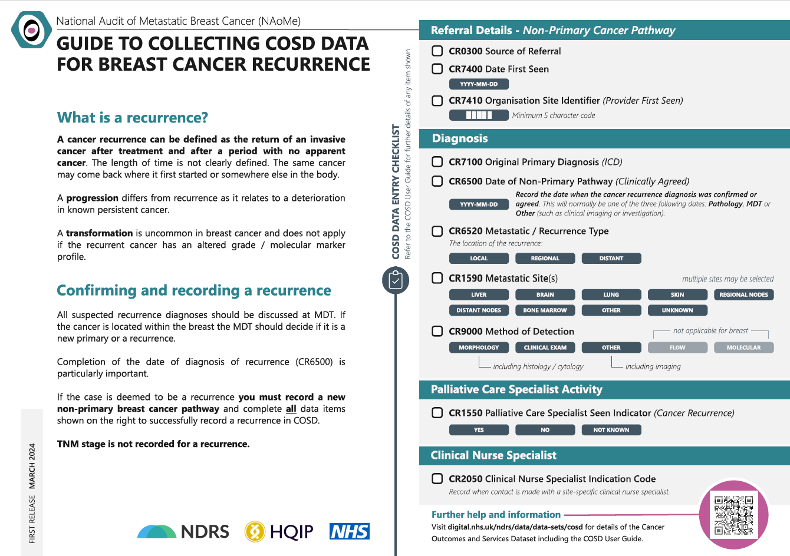
Tools to support you – Breast and other solid tumour sites
https://digital.nhs.uk/ndrs/data/cancer-data-training-materials
Notes:
Where recurrences are found, we have a tool to help you with the recording. This downloadable PDF was put together for recurrences in Breast cancer but in truth can be applied to recurrences for all solid tumour sites and is available to download from our training modules page

Slide 25
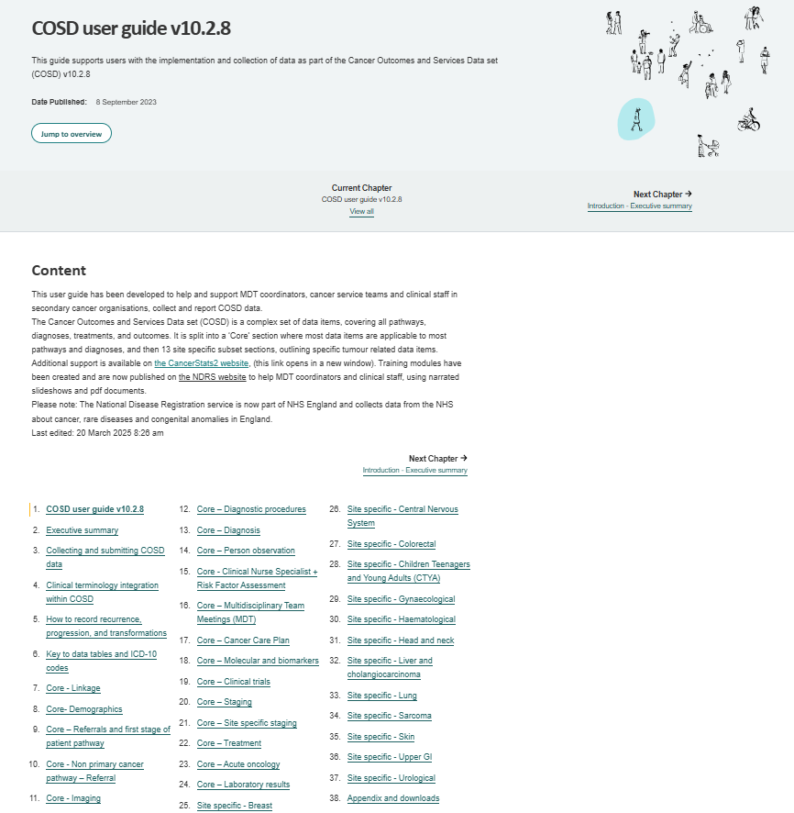
Tools to support you
COSD User Guide (online):
https://digital.nhs.uk/ndrs/data/data-sets/cosd/cosd-user-guide-v10
Notes:
There’s also help available in the COSD guidance…

Slide 26


Tools to support you
COSD User Guide (online):
https://digital.nhs.uk/ndrs/data/data-sets/cosd/cosd-user-guide-v10
Notes:
… specifically in sections 5 and 10 which guide administrators through the necessary data items…

Slide 27
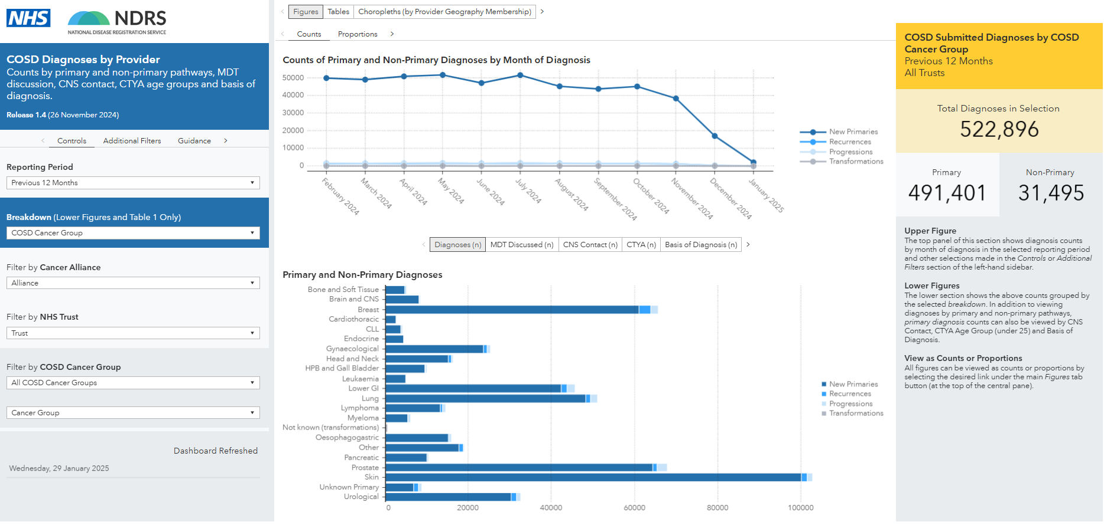
Tools to support you
CancerStats:
https://cancerstats.ndrs.nhs.uk/
Notes:
…we also have feedback for you – types of diagnosis are shown in the Diagnoses dashboard on Cancerstats. If you want to know what your data looks like but don’t have a CancerStats account – go to the link shown and sign up…

Slide 28
Tools to support you
Your Regional Data Liaison Manager:
East Midlands & West Yorkshire: Simon Cairnes – simon.cairnes@nhs.net
Eastern: Marianne Mollett – marianne.mollett@nhs.net
London & South East: Katrina Sung – katrina.sung@nhs.net
North West: Paul Stacey – p.stacey@nhs.net
Northern & Yorkshire: Rachael Mann – rachaelmann@nhs.net
Oxford: Gemma Feeney – gemma.feeney@nhs.net
South West: James Withers – james.withers@nhs.net
West Midlands: Gemma Feeney – gemma.feeney@nhs.net
Notes:
… and don’t forget that NDRS is a resource too! We’re here to help.

Slide 29
Wrapping Up
Over recent years the focus for Trusts has been improving stage data
  10 years ago, it was said what you are achieving wouldn’t be possible
We need to show the same commitment with recording recurrences and progressions
We don’t how many people are living with metastatic cancer
It can take years of data before trends, something meaningful, can be identified
For every year we don’t collect this well, it means another year where this work can’t even begin
Notes:
Trust focus in the last few years has been on improving stage, something that was not, at the time, universally accepted as possible – but you went and did it anyway, demonstrating extraordinary commitment to the gathering of accurate data on new primary cancers. We’re now being asked to demonstrate that same level of commitment for non-primary pathways because we genuinely don’t know how many people are living with metastatic cancer. Accumulating a meaningful amount of data takes years: the sooner we start getting the data in, the sooner we can work with it.

Slide 30
Let’s change this statement
Data collection for metastatic breast cancer,
“we are only counted when we are dead”
– Kat Southwell – METUPUK
Notes:
We can change this.

