Slide 1


National Disease Registration Service
(NDRS)
COSD for Clinical Nurse Specialist Teams
v1 October 2024
Notes:
Welcome to this NDRS training module on COSD for Clinical Nurse Specialist teams. This module can be paused at any time.

Slide 2

Agenda
The National Disease Registration Service
COSD data collection for CNS Teams
CancerStats II – Feedback on submitted data
Summary
This module may be paused at any time
Notes:
In this module we’re going to look at what data we need from Clinical Nurse Specialists and their team members, why we need it, specific elements of the COSD dataset that we ask you to enter and the feedback available to you.

Slide 3
The National Disease Registration Service
In this section we will cover:
The National Disease Registration Service
Data feeds
What the data is used for
Why measure personalised care activity in cancer?
Notes:
We’re going to start off with a brief run through of what NDRS is and why we need the data

Slide 4
The National Disease Registration Service (NDRS)
The National Disease Registration Service is part NHS England. Our purpose is to collect and quality-assure high-quality, timely data on a wide range of diseases and provide robust surveillance to monitor and detect changes in health and disease in the population.
The service includes:
The National Cancer Registration & Analysis Service (NCRAS)
The National Congenital Anomaly & Rare Disease Registration Service (NCARDRS)
The Retinoblastoma Register
Supporting Genetic Requests
Notes:
The National Disease Registration Service collects and collates data on a number of diseases which allows for monitoring and detection of changes to the health of the population

Slide 5
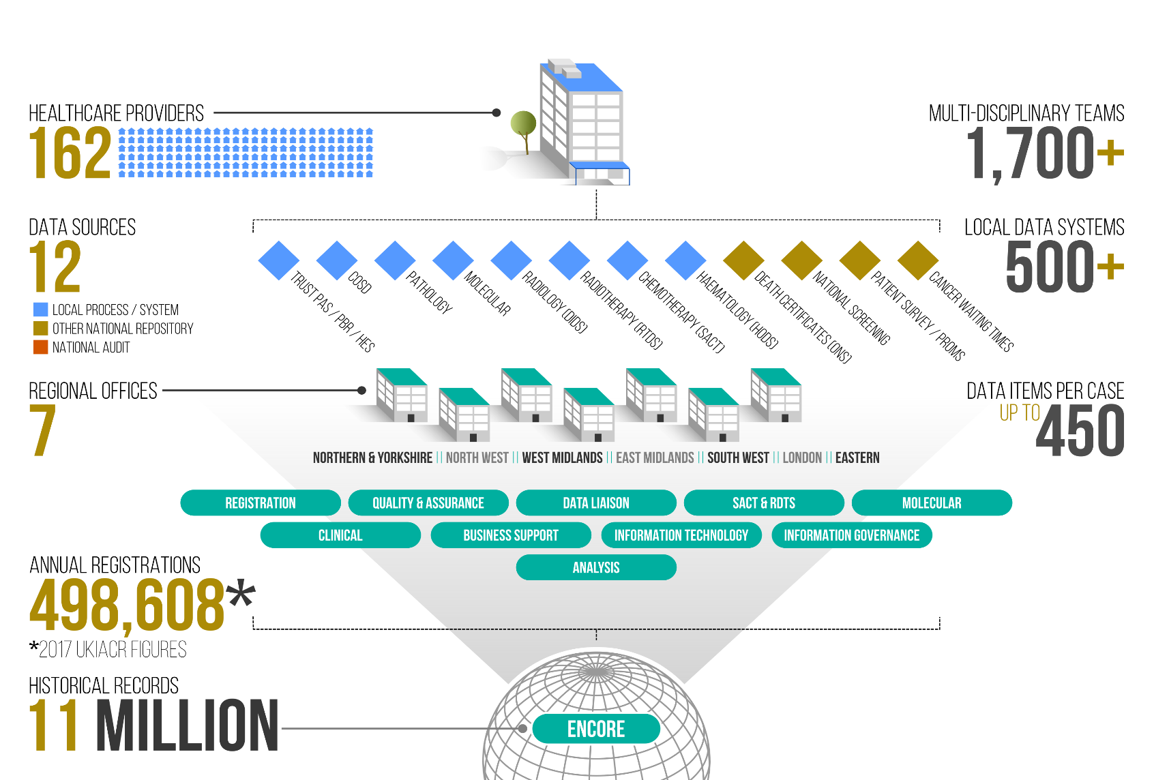
Data Feeds
Notes:
We collect data from all NHS hospitals in England and from other organisations such as the Office for National Statistics, which allows us to make around half a million registrations every year.

Slide 6
What the data is used for
Cancerdata
www.cancerdata.nhs.uk
Fingertips
https://fingertips.phe.org.uk
CancerStats – HSCN only
https://cancerstats.ndrs.nhs.uk
NDRS website
https://digital.nhs.uk/ndrs
Predict tools
https://breast.predict.nhs.uk/
https://prostate.predict.nhs.uk/
National Audits via NATCAN
Research & Campaigns – Be Clear on Cancer
Charities
Strategic Review
International Comparison
Clinical Services Quality Measures
Notes:
What do we use it for? Actually, quite a lot… and this list is not exhaustive. Please be assured: the data you collect is important and is used.

Slide 7



























Partner Organisations
Notes:
… in many cases by our partner organisations.

Slide 8
Why measure Personalised Care activity in cancer?
Personalised Care and Support Plans, Holistic Needs Assessments and End of Treatment Summaries must be offered to everyone by 2021 – need to measure if this is on track or not
Personalised Care and Support Plans (PCSP) are a headline Long Term Plan indicator
Gain greater insight, for example:
  What proportion of people take up offer of PCSP/HNA?
  Do PCSP/HNA/EOTS improve outcomes?
  What staff are involved?
  Are there cancer type differences?
  Physical activity status
Notes:
But why do we specifically measure personalised care activity for cancer patents? In part, because PCSPs are one of the Long Term Plan indicators and of course it leads to greater understanding of the patient’s pathway.

Slide 9
COSD data collection for
Clinical Nurse Specialist Teams
In this section we will cover:
What is COSD
Core Personalised Interventions
Finding the Guidance
CNS referral
Patient Presentation
HNA / PCSP
EOTS
Notes:
The specific data we ask Clinical Nurse Specialist teams to collect is part of the COSD dataset…

Slide 10
What is COSD? - Cancer Outcomes and Services Dataset
CWT is mainly about timeliness of service delivery
COSD is all about the broader picture. It’s about the patient and their cancer:
  Is this a primary cancer, a recurrence or a progression?
  If it’s a primary cancer, how far has the cancer progressed at the point of diagnosis (what is the stage of the cancer)?
  How well is the patient at the point of diagnosis (what is the performance status of the patient)?
  What investigations were carried out?
  Has the patient seen a Clinical Nurse Specialist?
  Are there genetic elements to the cancer?
  Exactly what treatment was given?
Notes:
… and COSD has a broad remit, gathering data about the cancer, the patient and the service they receive.

Slide 11
Core Personalised Care Interventions in COSD
Personalised Care and Support Plan (PCSP) based on Holistic Needs Assessment (HNA)
Ensures people’s physical, practical, emotional, social needs are met and that resources are targeted to those who need them most
End of Treatment Summary (EOTS)
Completed by secondary care and given to the patient & GP. Provides detailed summary of treatment, potential side effects, signs and symptoms of recurrence and contact details to address any concerns
Physical Activity Assessment
An assessment of the physical activity level currently being achieved by the individual.
Part of Health & Wellbeing Information and Support.
Notes:
For CNS teams, the key areas of focus in COSD are the HNA & Personalised Care and Support Plan, the End of Treatment Summary and the Physical Activity Assessment

Slide 12
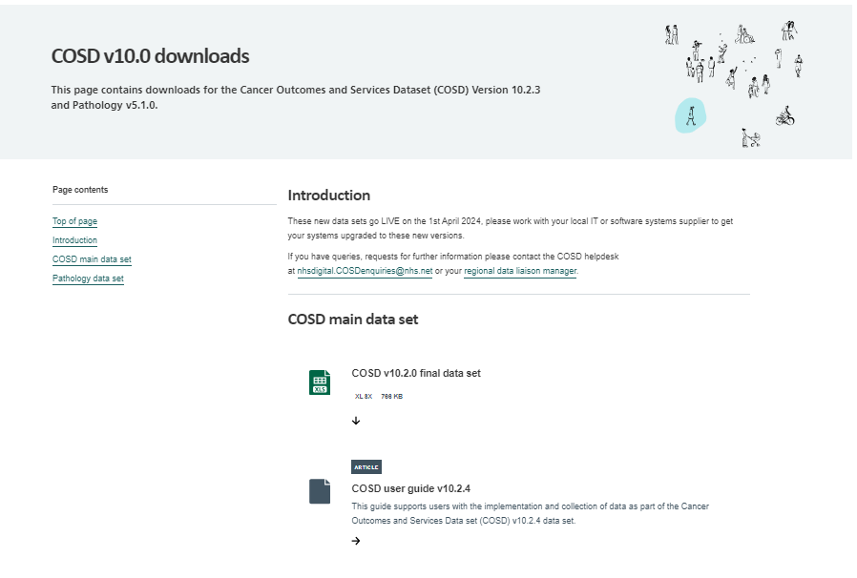
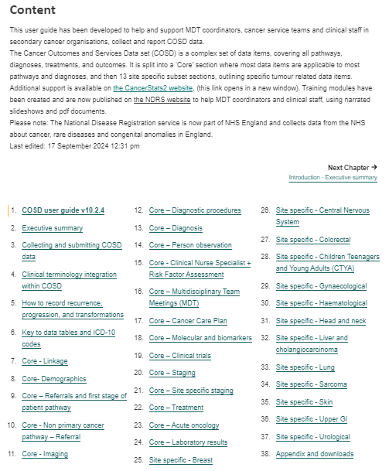
Finding the Guidance
https://digital.nhs.uk/ndrs/data/data-sets/cosd#downloads
Notes:
Details on this key data for CNS’ can be found in the COSD User guide. We advise always going to the website to open the latest published guide. It should be noted that all data items referred to in this module relate to COSD v10.

Slide 13

CNS Team specific data items in COSD
CNS Indication Code
Patient Presentation
Holistic Needs Assessment
Personalised Care and Support Plan
End of Treatment Summaries
Notes:
We’ll start with the CNS Indication Code…

Slide 14
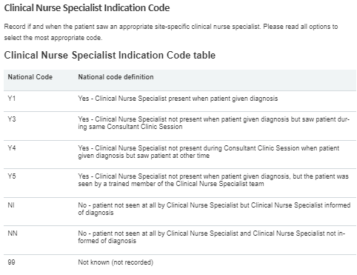
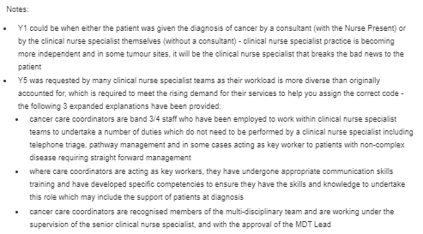
CNS Referral section - CNS Indication Code
Notes:
… where there are several options for a Yes answer, ranging from the CNS being present when the patient is given their diagnosis… to the patient being seen by another trained member of the CNS team. There are also two options for No depending on whether or not the CNS is aware of the diagnosis. This would be recorded as part of the CNS Initial Referral.

Slide 15
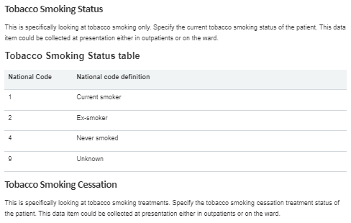
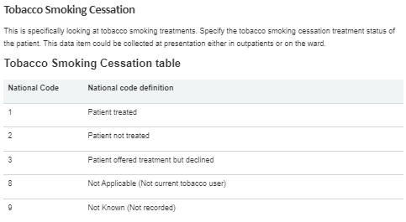
Patient Presentation section - Tobacco Use
Notes:
As well as the CNS Indication code, other information is required if available (not necessarily collected by the CNS Team as data within the Patient Presentation section may be collected by any clinical team member). This includes smoking status and smoking cessation. Please be aware that these data items apply only to Tobacco smoking.

Slide 16
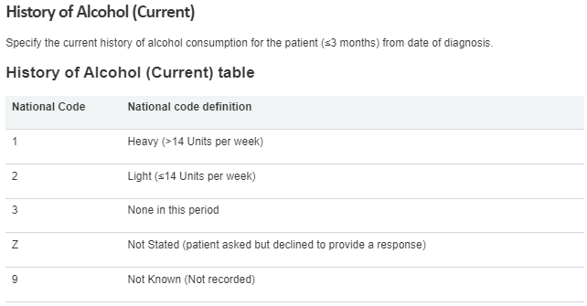
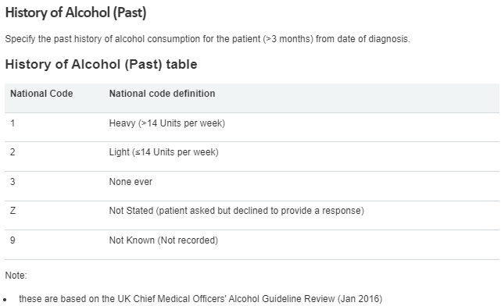
Patient Presentation section - Alcohol use
Notes:
Other pertinent information, also in the Patient Presentation section, includes Alcohol consumption, both current and historic, …

Slide 17
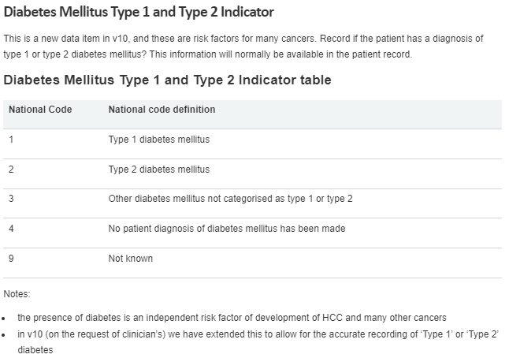
Patient Presentation section - Diabetes indicator
Notes:
… information on the patient’s diabetic status, …

Slide 18
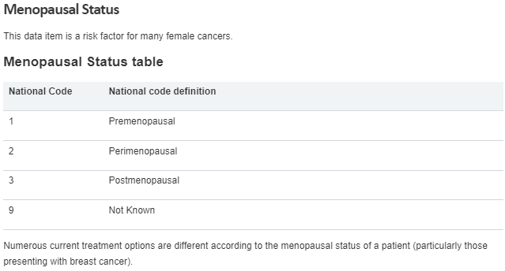
Patient Presentation section - Menopausal Status
Notes:
… menopausal status where applicable, …

Slide 19
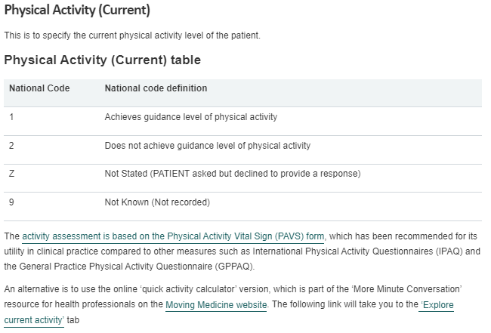
Patient Presentation section – Physical Activity (current)
Notes:
… and the patient’s current level of physical activity.

Slide 20
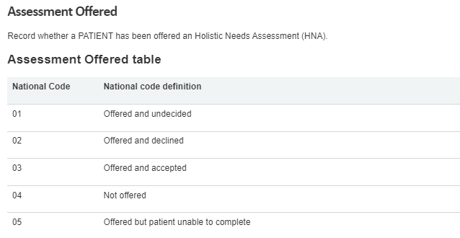
Living With and Beyond Cancer - HNA
Notes:
It’s important to capture the offer of personalised care, whether the HNA occurs or not. Equally, it may be clinically appropriate not to offer an HNA.

Slide 21
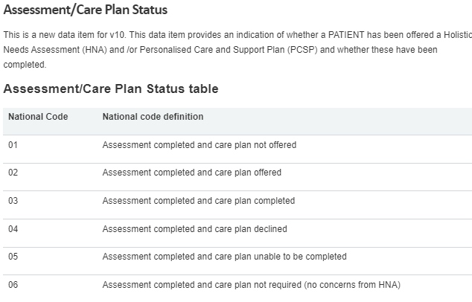
Living With and Beyond Cancer – HNA/PCSP
Notes:
The Assessment/Care Plan Status captures what happens as part of the HNA and PCSP process once the initial offer of the HNA has been made and the HNA completed. If the offer of an HNA is declined or the assessment is not completed, this data item will not apply.

Slide 22
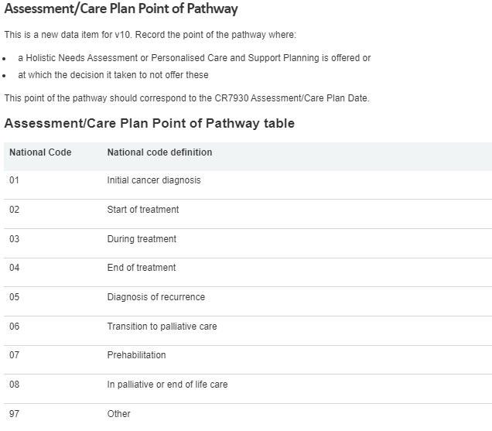
Living With and Beyond Cancer – HNA / PCSP
Notes:
You’re asked to enter the point of pathway for the HNA/PCSP…

Slide 23


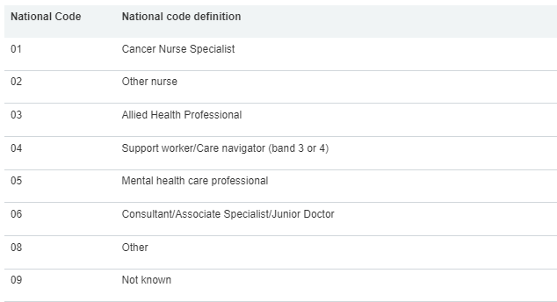
Living With and Beyond Cancer – HNA / PCSP
Notes:
… as well as the staff role. HNA staff role and PCSP staff role are entered separately.

Slide 24
Individual Treatments – End of Treatment Summary
End of Treatment Summary
  Date completed
Notes:
You’re also asked to enter the End of Treatment Summary which applies where a particular trust has had direct involvement in the patient’s treatment. This data is entered on the individual treatments and the only data item necessary for the COSD dataset is the date the EOTS is completed.

Slide 25
CancerStats II – Feedback on submitted data
In this section we will cover:
Living With and Beyond Cancer
COSD – CNS Contacts
Notes:
You can get feedback on your data from our CancerStats ii website…

Slide 26
Living With and Beyond Cancer - Reports
End of Treatment Summary Analysis
HNA Data Completeness
PCSP Data Completeness
Notes:
… where reports are available for three key areas under Living With and Beyond Cancer …

Slide 27
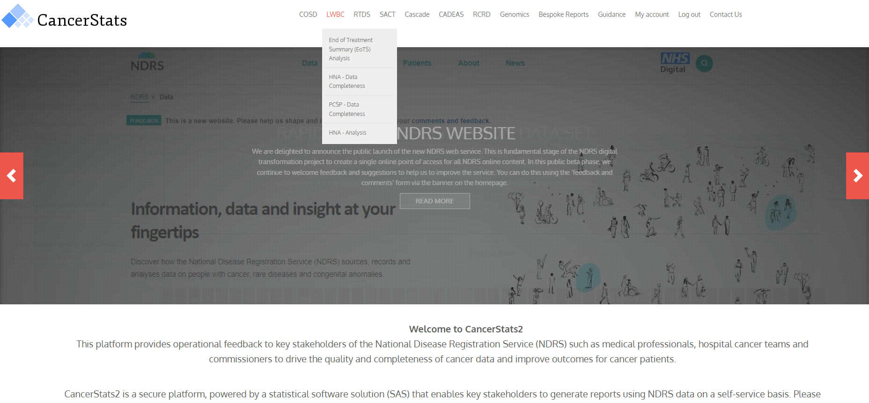
Living With and Beyond Cancer
Notes:
… You’ll find feedback reports for End of Treatment Summaries, HNAs and PCSPs at Level 2 (Raw data, as submitted by the trusts). In here you can check your data, you can compare your data to that at other trusts or you can compare data at the level of individual cancer groups …

Slide 28
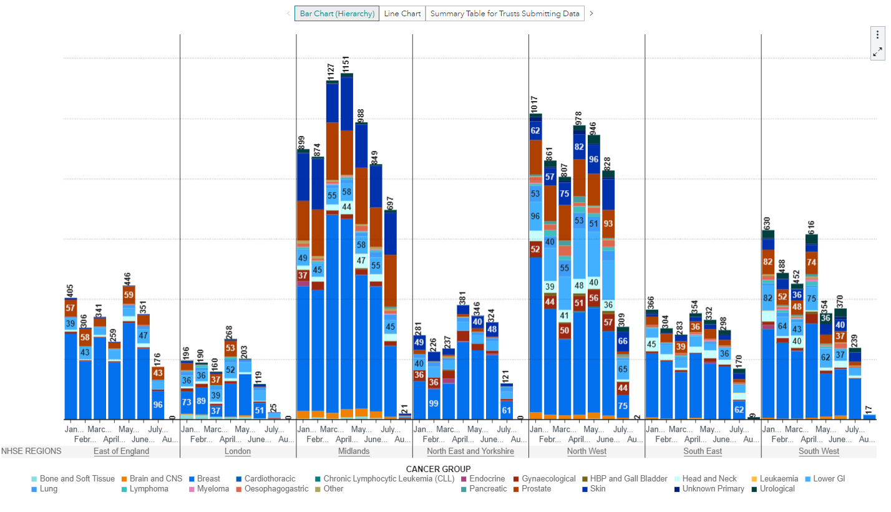
Living With and Beyond Cancer – End of Treatment Summary
Notes:
Shown here are the End of Treatment Summary dates collected in a given time period. These can be split by NHS region, cancer alliance or displayed for a specific trust. Individual images or the numbers behind them can be downloaded by clicking on the three dots on any graphic.

Slide 29
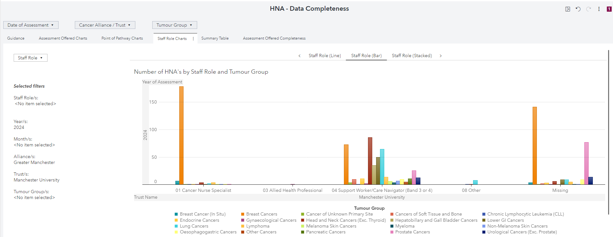
Living With and Beyond Cancer - HNA
Notes:
The HNA data completeness reports cover assessments being offered, point of pathway and staff role involved (as shown here) …

Slide 30
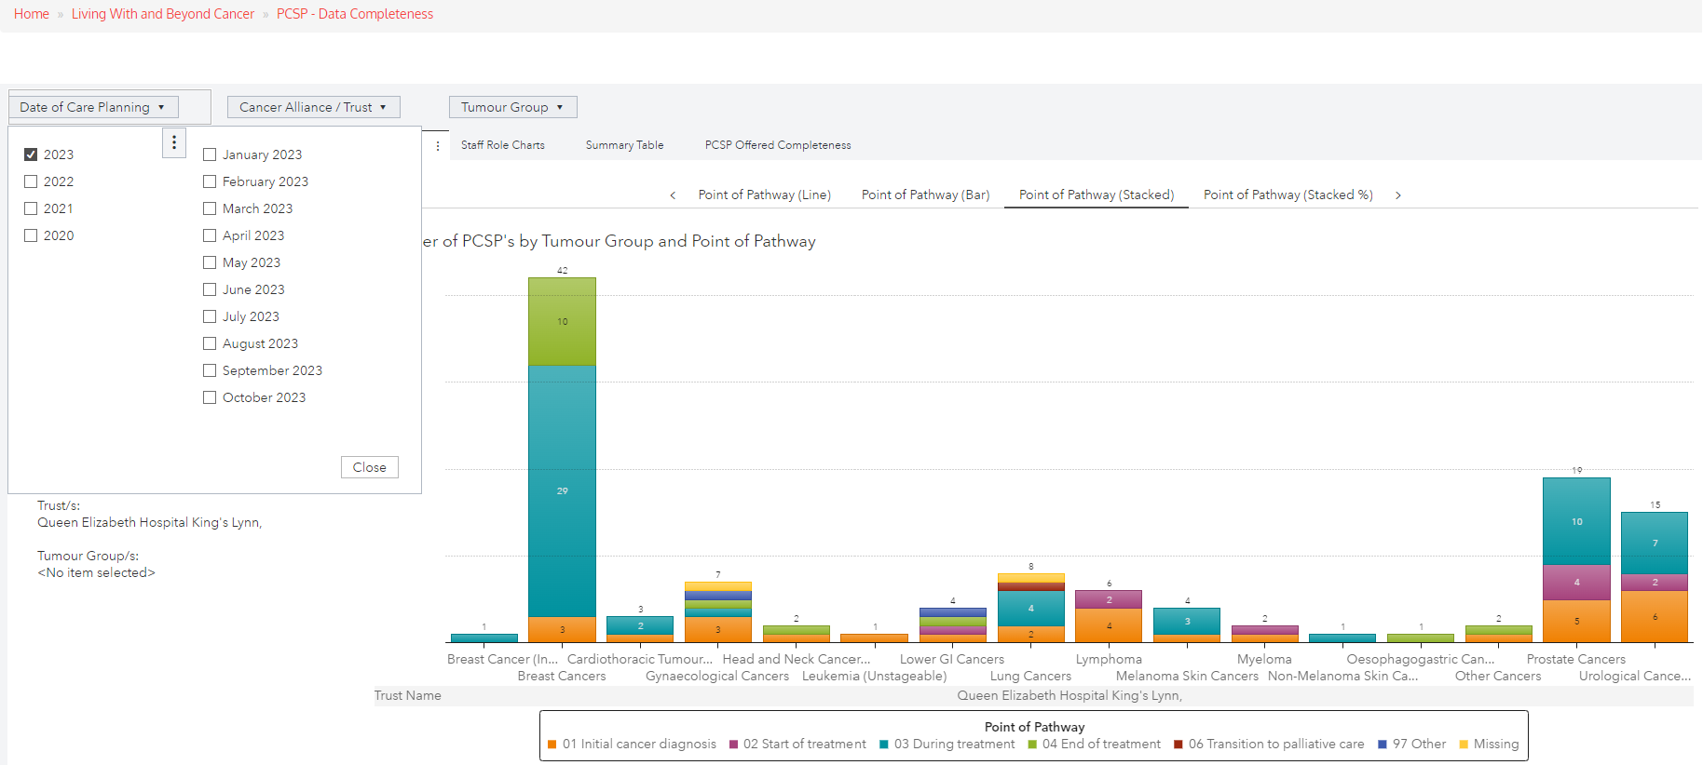
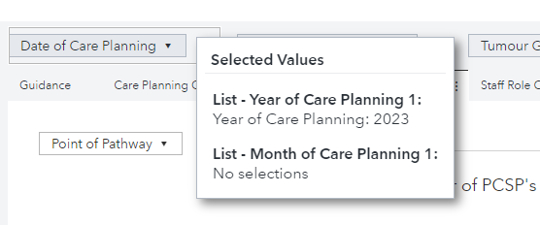
Living With and Beyond Cancer - PCSP
Notes:
… with similar reports being available for PCSPs. For all reports, make sure you’ve selected the dates / Cancer Alliance / Trust you want. Be aware that you can specify particular tumour sites and at the same time choose different options for displaying the data. Hovering over any drop-down will tell you which filters have been applied.

Slide 31
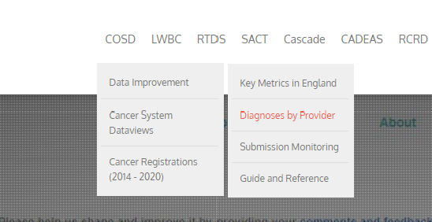
COSD - CNS Contacts vs Total diagnoses
The COSD Diagnoses by Provider dashboard:
Notes:
Another useful graphic can be found on the Diagnoses by Provider dashboard, located in the COSD section of CancerStats …

Slide 32
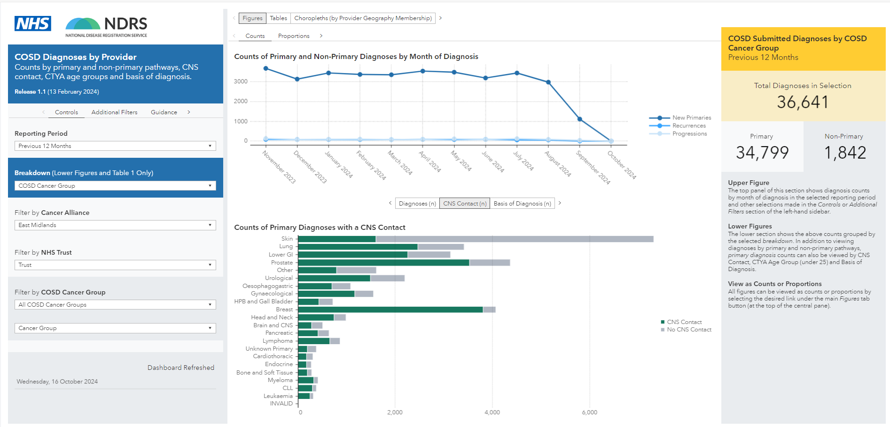
COSD - CNS Contacts vs Total Diagnoses
Notes:
… as this shows actual CNS contacts against total diagnoses, split by cancer group. You can select a specific Cancer Alliance (as shown) or you can specify an individual trust.

Slide 33
Summary
Notes:
In summary…

Slide 34
Summary
Personalised Care and Support Plan (PCSP) based on Holistic Needs Assessment (HNA)
Ensures people’s physical, practical, emotional, social needs are met and that resources are targeted to those who need them most
End of Treatment Summary (EOTS)
Completed by secondary care and given to the patient & GP. Provides detailed summary of treatment, potential side effects, signs and symptoms of recurrence and contact details to address any concerns
Physical Activity Assessment
An assessment of the physical activity level currently being achieved by the individual.
Part of Health & Wellbeing Information and Support.
Notes:
The data that you and your team add to your cancer data management system matters. National reporting looks at the holistic approach within the healthcare system but if it’s not recorded and recorded somewhere where the data can be used, it won’t be available for national reporting.

Slide 35
Summary
Your data is not collected in isolation
  Part of a much bigger data picture
Data isn’t useful unless it reflects what is happening in reality
  Enables review of the past
  Monitoring of the present
  Planning for the future
You can access these dashboards
  https://cancerstats.ndrs.nhs.uk
  Click on Create new account to sign up
Notes:
Having accurate data available allows for national assessment of past activity, maintenance of current activity and planning for future activity. You can sign up for a CancerStats account at the link shown…

Slide 36
Summary
Notes:
… where you can find a suite of reports, making it easy to see how complete your data is.

Slide 37
Questions?
East Midlands: Simon Cairnes – simon.cairnes@nhs.net
Eastern: Marianne Mollett – marianne.mollett@nhs.net
London & South East: Katrina Sung – katrina.sung@nhs.net
London & South East: Karen Graham– karen.graham36@nhs.net
North West: Paul Stacey – p.stacey@nhs.net
Northern & Yorkshire: Rachael Mann – rachaelmann@nhs.net
Oxford: Gemma Feeney – gemma.feeney@nhs.net
South West: James Withers – james.withers@nhs.net
West Midlands: Gemma Feeney – gemma.feeney@nhs.net
Notes:
If you have any questions on the information contained within this module or about COSD in general, do please feel free to email your regional Data Liaison Manager

