Slide 1

National Disease Registration Service
(NDRS)
Diagnosing Cancer
v3 August 2024
Notes:
Welcome to this NDRS training module on Diagnosing Cancer.

Slide 2

Agenda
Initial presentation
Diagnostic tests
Notes:
In this module we’re going to look at how patients present for treatment and how their cancer might be diagnosed. Remember, the module may be paused at any time.

Slide 3
Initial Presentation
Notes:
First we’re going to look at the ways in which patients might present to secondary care.

Slide 4
Initial Presentation
Most people will experience symptoms for which they will seek advice from their GP who may carry out preliminary tests
A small proportion of patients will present at accident and emergency departments with acute symptoms that may result in investigations for cancer
Patients may also be under the care of other health care professionals for a non-cancer condition when symptoms suspicious of cancer are picked up and referred for further investigations
For certain tumour sites, such as breast, colorectal and cervix where there is a screening programme, abnormal screening test results may result in patients being referred for further investigations
Notes:
Most people will present via their GP… some will present via A&E … and some will be referred from other clinical teams. Patients may also be referred after an abnormal screening result for certain tumour sites.

Slide 5

GP – Medical History
The patient’s medical history will be noted because it’s important to detail past medical complaints, current co-morbidities and symptoms, as these may indicate a specific disease for which a specific test needs to be performed
Family history will also be noted as this can also indicate an hereditary risk of a disease
Notes:
GPs would normally include the patient’s medical history and any family history of cancer or related conditions … as there may be a risk of hereditary disease.

Slide 6
GP – Physical Examination
The GP will then perform a physical examination (PE) also known a clinical examination
Routine examination will usually be carried out to assess the patient’s general health including liver, kidney, heart and other organ function. Examinations may include:
          blood pressure
          pulse rate
          temperature
Visual observation and/or palpation of any lumps or abnormal swellings, noting the size and location of the swelling and the presence of potential metastases
The part of the body which is examined would depend on the specific symptoms of a patient at presentation such as:
      digital rectal examination (DRE)
      pelvic examination
Notes:
The GP would normally examine the patient to determine their general health … as well as noting any obvious abnormal symptoms on the referral.

Slide 7



Screening Programme
For many cancers, early detection of cancer greatly increases the chances for successful treatment and early detection of cancer relies on education to encourage people to seek help for any symptoms they may develop and screening
Screening targets a healthy population in order to identify individuals who may develop or already have cancer, but do not yet have symptoms
The cancer screening programmes of England are nationally co-ordinated and these are aimed at detecting early disease in:
  breast
  cervix
  large bowel
Notes:
Screening aims to detect cancer before the patient becomes symptomatic. Screening programmes are in place for Breast, Cervix and Large Bowel cancers.

Slide 8
Breast Screening Programme
Breast screening is a method of detecting breast cancer at a very early stage which are too small to be felt either by the woman herself or by a doctor
Women aged between 50 and 71 years are invited for a mammogram every 3 years
Mammograms can detect small changes in breast tissue, which can be an early indication of breast cancer
Notes:
Breast screening is used to detect very small changes in the breast tissue which are too small to be detected by touch. Invitations for breast screening are sent to women aged 50 to 71…

Slide 9
Cervical Screening Programme
The aim of cervical screening is to prevent cancer by detecting and treating early abnormalities which, if left untreated, could lead to cancer in the cervix
Women aged 24½ - 64 years are invited for cervical screening:
        women aged 24½ – 49 years are invited every 3 years
        women aged 50 – 64 years are invited every 5 years
A sample of cells is taken from the surface of the cervix. The sample is checked for high-risk HPV and, if found, the cells are examined under a microscope for early abnormalities
Liquid based cytology (LBC) is the method used to prepare cell samples for microscopic examination
Notes:
…while Cervical screening invitations are sent to women between the ages of 24½ and 64. Cervical screening looks for early abnormalities in the cervix including high risk HPV, which, when treated promptly, can prevent them becoming cancerous.

Slide 10
Bowel Screening Programme
Bowel cancer screening aims to detect bowel cancer at an early stage in people with no symptoms when treatment is more likely to be effective and it can also detect polyps which are a precursor to bowel cancer. These can be easily removed therefore reducing the risk of bowel cancer developing
The NHS Bowel Cancer Screening Programme now offers screening every two years to men and women aged 56 to 74 years and on request every two years from the age of 75
Faecal immunochemical home test (FIT) kit is a simple laboratory test which examines faecal samples for the presence of blood
This test cannot diagnose bowel cancer, but a positive result will usually indicate further investigations are needed
Notes:
Bowel screening aims to detect cancer and polyps before the person is showing any symptoms. Everyone between the ages of 56 and 74 is invited to use a home test kit that detects tiny amounts of blood in the stool. Whilst blood does not necessarily mean cancer, a positive test result usually indicates that further investigations are needed.

Slide 11
Diagnostic Tests
Notes:
We’ll now look at some of the tests that may be used to diagnose cancer.

Slide 12

Common Radiological Investigations
X-ray
Ultrasound (USS)
Computed Tomography (CT)
Positron Emission Tomography (PET)
Magnetic Resonance Imaging (MRI)
Bone Scan
Notes:
There are many different types of radiological examination. Each has its own advantages depending on the type of tissue the clinical team want to look at.

Slide 13

X-Ray
X-rays are a quick, cheap and painless method of making an initial assessment
X-rays use small doses of radiation to take pictures of the inside of your body. These can diagnose both skeletal and soft tissue abnormalities caused by cancer and other medical conditions
The main limitation of X-rays is that they are two dimensional
Notes:
X-rays are often used for an initial assessment. Whilst X-rays are easy to perform, they are limited in that they are only two-dimensional.

Slide 14
X-Ray: Mammogram
A mammogram is an X-ray examination of the breast. It’s used to detect and diagnose breast disease in women who either have breast problems, such as a lump, as well as being the test used in the national breast screening programme when very early non-symptomatic cancers can be identified
A mammogram cannot prove that an abnormal area is cancerous but can raise a significant suspicion of cancer
Notes:
Mammograms are x-rays examination of the breast tissue. They are used to detect areas of change in the breast, sometimes before the patient has experienced any symptoms.

Slide 15
X-Ray: Contrast Mediums
Barium Investigations
Barium is a radio-opaque contrast medium which means that X-rays cannot pass through it. It is used to examine the digestive tract
The radiologist can move the patient around, moving the barium into the best position in the digestive tract
Images are produced using a special form of X-ray called fluoroscopy allowing the procedure to be viewed immediately on a monitor so that the flow of the barium can be witnessed. Plain X-rays can also be taken at intervals when necessary
There are various methods for the barium to be delivered depending on what needs to be examined:
  barium swallow (to examine the oesophagus and stomach)
  barium enema (to examine the large bowel or colon)
Notes:
Contrast mediums are sometimes used to make the images more informative. For instance, X-rays cannot pass through Barium which can be used to improve the contrast in the examination of the digestive tract.

Slide 16
X-Ray: Contrast Mediums
Intravenous Pyelogram (IVP) and Intravenous Urogram (IVU)
Common tests using a contrast medium to examine the urinary tract, i.e., kidneys, ureters and bladder
A dye is injected into the blood stream usually via a vein in the arm and this circulates around the body and is filtered through the kidneys where it shows up on X-ray
X-rays are taken at intervals of up to an hour until all the dye has passed through the kidneys, demonstrating any abnormalities
Cancers can be visualised as filling defects (gap in the area that would normally fill with dye)
Notes:
Pyelograms and Urograms look at the function of the kidneys, ureters and bladder. In each case, a dye is injected into the blood stream and this is filtered by the kidneys. X-rays are then taken at intervals to visualise the dye as it passes through the kidneys and bladder.

Slide 17

Ultrasound
Ultrasound scans are images based on the reflection of sound waves from tissues
An ultrasound scan does not use X-rays and is entirely safe
High frequency sound waves are transmitted into the body and they ‘bounce’ back at various speeds depending on the density of the tissue. A computer analyses the sound waves and creates an image
Notes:
Ultrasound scans use high frequency sound waves to produce an image. They pose no radiological risk to the patient.

Slide 18
Ultrasound
Mainly used for soft tissue imaging such as blood vessels or breast and is extremely efficient at diagnosing the difference between a simple cyst and a tumour
Ultrasound scans are also used to guide some surgical procedures such as needle biopsies
Notes:
Ultrasound imaging is most effective when looking at soft tissue and is often used to guide surgery or biopsies.

Slide 19
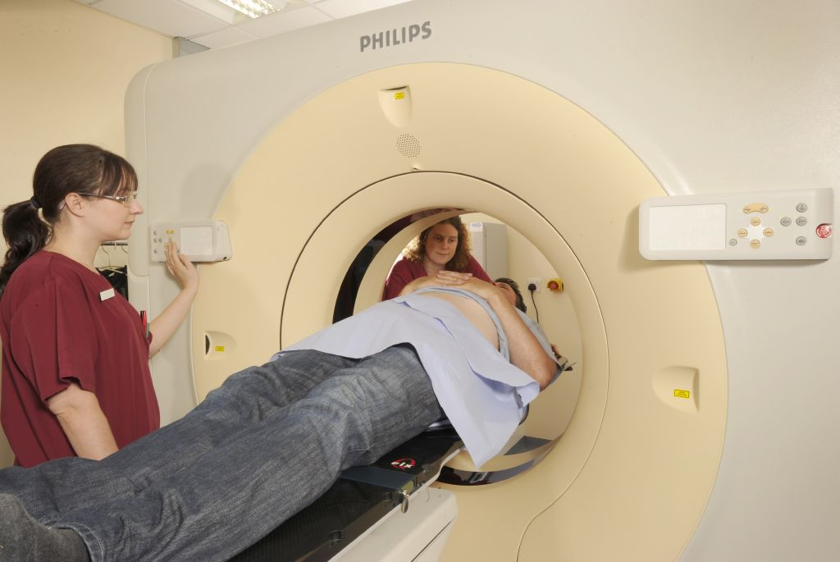
Computed Tomography (CT)
The CT scanner uses X-rays to visualise cross sections of the body, the computer is then able to piece these together to build a 3D image
The scanner itself looks like a large doughnut and the patient lies on a bed which moves slowly through the scanner to allow images to be taken at different angles
Notes:
A CT scan combines X-rays with computer imaging to build a 3 dimensional image.

Slide 20
Computed Tomography (CT)
During a scan a series of X-rays are taken of an area of the body and the X-ray source is rotated round in many different directions. The patient is also moved so that it speeds up the whole procedure, for example a CT scan of the thorax will take less than 30 seconds
A contrast medium dye is often injected which shows up as white areas and makes the scan clearer, allowing the radiologist to tell the difference between blood vessels and other structures
Notes:
The scanner uses a movable X-ray source to take images from many angles. Contrast medium may also be used to enhance the image.

Slide 21
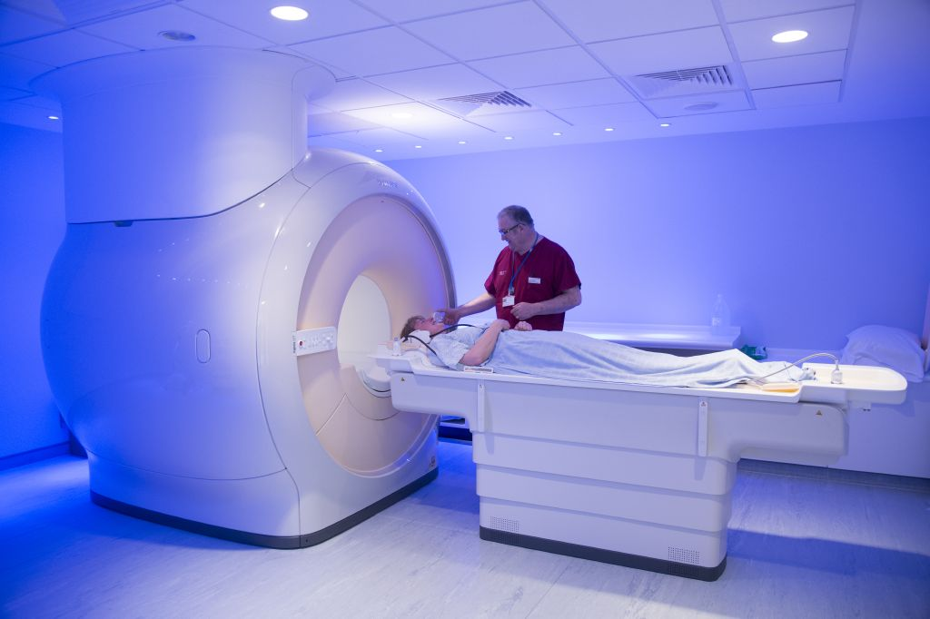
Magnetic Resonance Imaging (MRI)
An MRI scan uses magnetism to produce detailed images of organs and structures inside the body, a single scan produces pictures from all angles, producing a three-dimensional image
Due to the strong magnetic field associated with MRI, patients with metallic implants such as pacemakers or pins may not be suitable for MRI
It has many uses and is often used to diagnose and stage cancer but can also be used to monitor response to treatment and excision margins
Notes:
An MRI scanner uses a strong magnetic field in conjunction with a computer to generate a 3 dimensional image. Patients with metallic implants may not be suitable for an MRI.

Slide 22
Magnetic Resonance Imaging (MRI)
For some tissue types and organs (such as brain and soft tissues) MRI may produce more informative images than CT
For early cancers MRI may be better than a CT scan at indicating depth of tumour spread, e.g., in the cervix or bladder
Whilst patients are being scanned, they are required to remain very still, any movement would result in an unclear image. Organs that are in constant movement such as the lungs and heart are not usually suitable for MRI
Notes:
MRIs may produce more informative images of soft tissues but require the patient to be very still. Because of this, MRIs are not suitable for imaging of constantly moving organs such as the lungs and heart.

Slide 23
Positron Emission Topography (PET)
PET is a radiological procedure which can show how bodily tissues and organs are functioning
A radioactive substance tracer is injected into the patient about 30 minutes before the scan, to allow time for the tracer to be taken up by the body
The most common tracer used is called Fluorodeoxyglucose (FDG-18) which is a radioactive glucose molecule, when injected it travels to where glucose is used for energy such as the heart or tumours that are rapidly growing
FDG-18 can identify areas where glucose is being used (PET avid), identifying areas of high energy consumption. In areas where this is not expected, it has the potential to identify tumours before any anatomical changes can be seen using other imaging methods
As well as being a diagnostic tool PET is also used to monitor the effects of treatments or progression of the disease
Notes:
Positron Emission Topography can give a clearer picture of bodily tissues and organ function. By using a radioactive glucose tracer that is more likely to be taken up in rapidly growing or highly active cells, unexpected areas of tracer take-up may be identified as potential tumours or metastases.

Slide 24

PET-CT
PET scans are usually combined with a CT. This gives the advantages of both the CT and PET scan by showing the structure of organs and any abnormal activity of cells at the same time, therefore revealing important information about the cancer
A PET-CT may be used to diagnose and/or stage a cancer
Notes:
PET-CTs combine the advantages of both imaging types and can be used to diagnose or stage a cancer.

Slide 25
Bone Scan
Bone scans looks for any abnormalities within the skeletal system
The patient will have a radioactive substance injected (radionuclide) into the blood stream a few hours before the scan
This radionuclide is then taken up by abnormal areas (hotspots) in the bones and subsequently are highlighted on the image produced
Can be used to diagnose primary bone cancer or bone metastases and to monitor effects of cancer treatment (such as in breast cancer patients on hormone therapy, which can cause loss in bone density)
Notes:
A bone scan requires the patient to be injected with a radioactive substance. This radioactive substance is absorbed by abnormal areas in the bone which show as hotspots on the imaging.

Slide 26
Endoscopy
Endoscopy is a procedure that used to examine the interior of bodily cavities or hollow organs, endoscopes have a camera and light so that the results can be displayed instantly on screen
During the procedure, it may also be possible to take a biopsy from an area where an abnormality has been identified
Minimally invasive surgery will use endoscopic techniques such as laparoscopy to guide surgical procedures to avoid large incisions
Endoscopes are named after the body region that they are designed to examine:
  cystoscope (bladder)
  bronchoscope (lungs)
  gastroscope (stomach)
  colonoscope (colon)
  laparoscope (abdomen)
  endoscopic retrograde cholangiopancreatography (ERCP) (biliary tract)
Notes:
Endoscopes are comprised of a light and a small camera on a flexible probe. Some types of endoscope also have the facility to take biopsies

Slide 27
Endoscopy
Endoscopy is a procedure that used to examine the interior of bodily cavities or hollow organs, endoscopes have a camera and light so that the results can be displayed instantly on screen
During the procedure, it may also be possible to take a biopsy from an area where an abnormality has been identified
Minimally invasive surgery will use endoscopic techniques such as laparoscopy to guide surgical procedures to avoid large incisions
Endoscopes are named after the body region that they are designed to examine:
  cystoscope (bladder)
  bronchoscope (lungs)
  gastroscope (stomach)
  colonoscope (colon)
  laparoscope (abdomen)
  endoscopic retrograde cholangiopancreatography (ERCP) (biliary tract)
Notes:
Endoscopes vary depending on the body area they are designed to be used for: So for instance, a cystoscope is designed to be used in the bladder.

Slide 28

Pathological Confirmation
Pathological confirmation of a malignancy should always be sought where possible as this will give information about the characteristics of the tumour, which will be useful for treatment planning
Depending on the type and location of the tumour to be sampled, there are various types of samples and methods to obtain them:
  Cytology samples
  Histology samples
Notes:
Pathological confirmation is the best way to be sure of a cancer diagnosis. Pathological confirmation may come from either Cytology or Histology.

Slide 29
Pathological Confirmation: Cytology
Cytology is the microscopic examination of individual cells and cell clusters
Exfoliation
  cervix
  skin
Washings
  bronchial
  bladder
  abdominal
Aspiration
  fine needle aspiration (FNA)
  bone marrow aspiration
  cerebrospinal fluid aspiration
The extracted cells are examined microscopically. Different dyes may be used to identify cells of interest
  C1 Unsatisfactory preparation
  C2 Benign
  C3 Atypical
Probably benign but cancer cannot be excluded
  C4 Suspicious
Possibly malignant but not diagnostic of cancer
  C5 Malignant
The lesion should be biopsied to confirm the exact tumour behaviour and type
Notes:
Cytology involves examination of individual cells and cell clusters – these are normally in a fluid medium

Slide 30
Pathological Confirmation: Cytology
Cytology is the microscopic examination of individual cells and cell clusters
Exfoliation
  cervix
  skin
Washings
  bronchial
  bladder
  abdominal
Aspiration
  fine needle aspiration (FNA)
  bone marrow aspiration
  cerebrospinal fluid aspiration
The extracted cells are examined microscopically
Different dyes may be used to identify cells of interest
C1 Unsatisfactory preparation
C2 Benign
C3 Atypical
Probably benign but cancer cannot be excluded
  C4 Suspicious
Possibly malignant but not diagnostic of cancer
  C5 Malignant
The lesion should be biopsied to confirm the exact tumour behaviour and type
Notes:
Cytology samples are classified on a C scale from C1 to C5. Histology is advised where a suspicion of cancer is indicated.

Slide 31
Pathological Confirmation: Histology
Histology is the microscopic examination of tissues
Tissue can be obtained by biopsy or surgical excision of a tumour
The extracted tissues are examined under the microscope, with the use of specific dyes any abnormalities are identified
A biopsy sample can confirm the presence of a tumour and specific details:
  tumour types
  behaviour
  grade
  stage
Immunohistochemistry staining on tumour histology can be used to assess if a tumour will respond to certain treatments (ie; HER2 testing for breast cancer)
Genomic tests can identify mutations in certain genes that are known to cause cancer and indication of effective treatments
Notes:
Histology involves examination of tissue taken from a solid tumour. Histology can confirm various aspects of the tumour and give an indication of tumour response to specific treatments.

Slide 32
Summary
If in any doubt as to whether you should be recording a diagnosis, please refer to the latest COSD User Guide, Appendices A, B & C
The COSD User Guide may be found in this section of our website:
  https://digital.nhs.uk/ndrs/data/data-sets/cosd#downloads
Notes:
Do please remember, guidance is available on our website. You can download the COSD User Guide by clicking on this link and selecting the COSD version appropriate to your trust.

Slide 33

Acknowledgements
Many thanks to Cancer Research UK for the use of their images within this training module.
Notes:
And finally, we’d like to thank Cancer Research UK for the use of their images within this training module.

Slide 34
Questions?
East Midlands: Simon Cairnes – simon.cairnes@nhs.net
Eastern: Marianne Mollett – marianne.mollett@nhs.net
London & South East: Katrina Sung – katrina.sung@nhs.net
London & South East: Karen Graham– karen.graham36@nhs.net
North West: Paul Stacey – p.stacey@nhs.net
Northern & Yorkshire: Rachael Mann – rachaelmann@nhs.net
Oxford: Gemma Feeney – gemma.feeney@nhs.net
South West: James Withers – james.withers@nhs.net
West Midlands: Gemma Feeney – gemma.feeney@nhs.net
Notes:
If you have any questions on the information contained within this module or about COSD in general, do please feel free to email your regional Data Liaison Manager

