Slide 1

National Disease Registration Service
(NDRS)
Background to Cancer data
v3 June 2024
Notes:
Welcome to this NDRS training module on background information when collecting cancer data.

Slide 2
Background information for the collection of Cancer Data
Notes:
This module has been compiled to assist cancer data administration staff and may be paused at any point. Today, we’re going to look at what shapes the Cancer Data Management systems that you use …

Slide 3

Agenda
Types of Cancer database dataset being recorded
What is the National Disease Registration Service (NDRS)?
What happens to the data?
What the data is used for
Notes:
… which will enable you to get a feel for why you’re asked to enter those data items: essentially, what it’s all about …

Slide 4

Types of Cancer database dataset
Cancer Waiting Times
– an NHSE dataset. Please refer to the latest NHSE CWT User Guide for details
CWT is mainly about timeliness of service delivery:
  When was the patient referred?
  When was the patient first seen?
  When was the patient informed of the diagnosis?
  When did the patient agree treatment?
  When was the patient treated?
  CWT relates to NHS referrals (for suspicion of cancer – 2WW) and NHS treatments (if the patient is diagnosed with a CWT registerable cancer, regardless of NHS/non-NHS referral route).
  CWT requires submissions for most invasive cancers and selected non-invasive tumours.
  CWT data is submitted to NHS Digital on a monthly basis.
Notes:
… which in the case of Cancer Waits is TIME. It’s about dates for each stage of the pathway and whether the trust has met its targets. And it only relates to NHS referrals or NHS Treatments for a narrowly defined list of cancerous conditions…

Slide 5

Types of Cancer database dataset
Cancer Outcomes & Services Dataset
– an NDRS dataset. Please refer to the latest COSD User Guide for details:
https://digital.nhs.uk/ndrs/data/data-sets/cosd#downloads
COSD is all about the broader picture. It’s about the patient and their cancer:
  Is this a primary cancer, a recurrence or a progression?
  If it’s a primary cancer, how far has the cancer progressed at the point of diagnosis (what is the stage of the cancer)?
  How well is the patient at the point of diagnosis (what is the performance status of the patient)?
  What investigations were carried out?
  Has the patient seen a Clinical Nurse Specialist?
  Are there genetic elements to the cancer?
  Exactly what treatment was given?
COSD relates to any patient with a COSD registerable cancer (NHS or private).
COSD registerable cancers include more non-invasive cancers than are required by CWT
COSD is submitted to NCRAS on a monthly basis
Notes:
… whereas the NDRS Cancer Outcomes & Services Dataset has a much broader remit. It’s about the patient and the type of cancer (whether it’s new / returned / worsening). It’s about the patient when they’re diagnosed and the service they receive. COSD applies to any patient with a registerable cancer (even if privately treated at your trust) and to a wider range of cancers – we include many D coded “pre-cancer” conditions in our registration process over and above the cancers that CWT reports on.

Slide 6
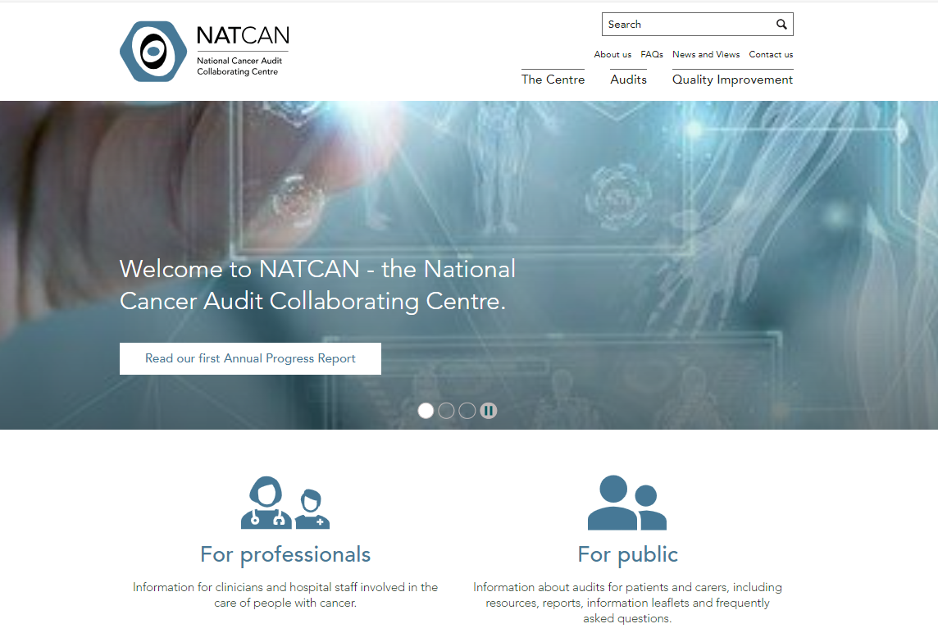
Types of Cancer database dataset
National Audits via NATCAN ( https://www.natcan.org.uk/ )
National Lung Cancer Audit (NLCA)
National Prostate Cancer Audit (NPCA)
National Oesophagogastric Cancer Audit (NOGCA)
National Bowel Cancer Audit (NBOCA)
National Kidney Cancer Audit (NKCA)
National Pancreatic Cancer Audit (NPaCA)
National Audit of Primary Breast Cancer (NAoPri)
National Audit of Metastatic Breast Cancer (NNAoMe)
National Ovarian Cancer Audit (NOCA)
National Non Hodgkin Lymphoma Audit (NNHLA)
The audit teams at NATCAN use many different data sources, including COSD and registration data
Notes:
And then there’s National Audits. These audits do not require a separate submission as much of the data is already part of the regular COSD submission. NATCAN uses both COSD data and registry data to prepare the audits.

Slide 7



What is NDRS?
NDRS
NCARDRS
NCRAS
Notes:
The National Disease Registration Service (NDRS) encompasses both the National Congenital Anomalies And Rare Disease Registration Service (NCARDRS) and the National Cancer Registration and Analysis Service (NCRAS). In this cancer module, NDRS and NCRAS may be considered to be interchangeable.

Slide 8
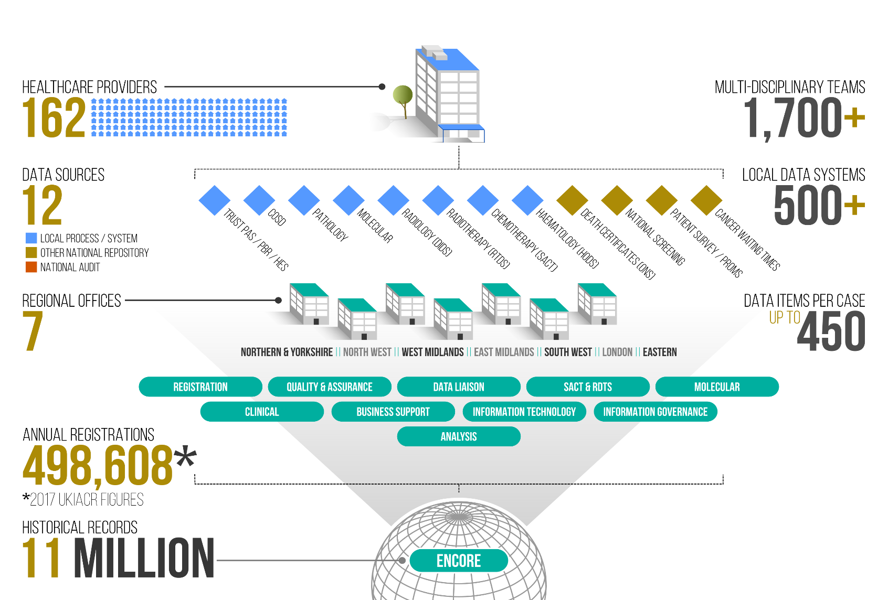
What is NDRS?
Notes:
NDRS has the responsibility for collating the various cancer data feeds from hospitals in England. That data is then combined with other sources to create up to half a million tumour registrations every year.

Slide 9

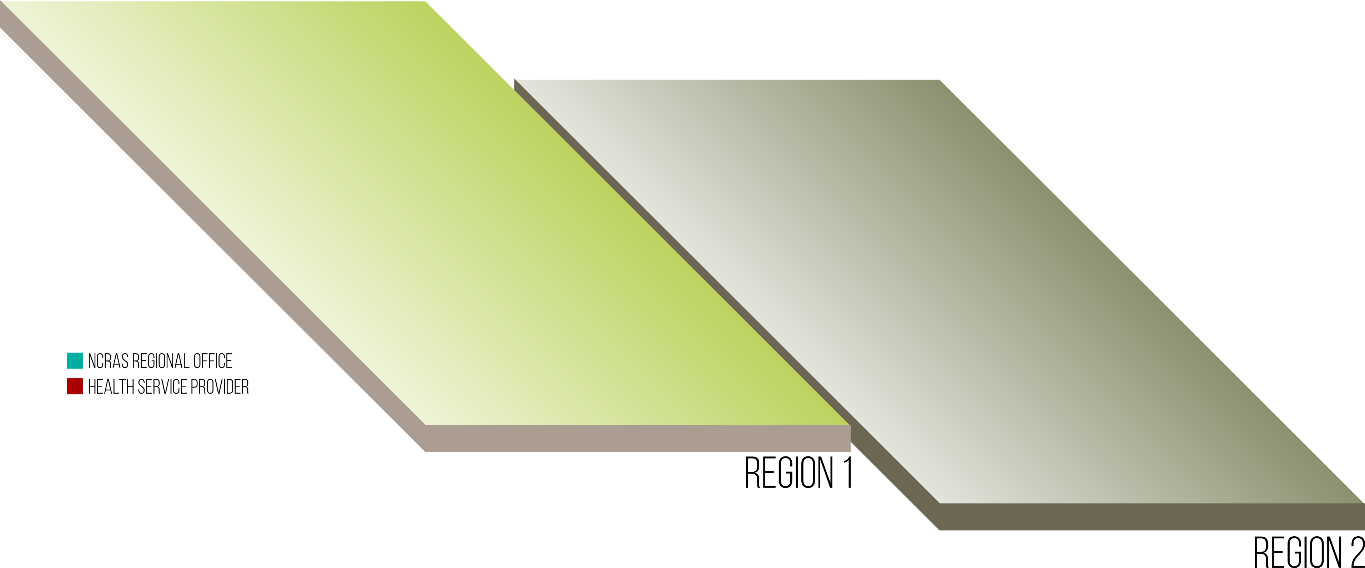


What happens to the data?
Patient Pathway Illustration
Notes:
We’re going to look now at a patient pathway illustration involving multiple hospitals and regions

Slide 10




What happens to the data?
Patient Pathway Illustration
Patient referred and a series of investigations performed.
Data generated at diagnostic centre.
Submissions made to NCRAS office in Region 1.
Notes:
In this example, the patient has their diagnostic investigations carried out at their local trust in Region 1. Data submissions are made to the Region 1 NCRAS office

Slide 11

What happens to the data?
Patient Pathway Illustration
Further investigations at Specialist Centre.
MDT discussion and treatment.
Data generated and submissions made to NCRAS office in Region 1.
Notes:
Further investigations are carried out at a specialist centre in the same region. Again, the submission is made to the Region 1 office…

Slide 12

What happens to the data?
Patient Pathway Illustration
Further investigations at Oncology Centre.
MDT discussion and treatment.
Data generated and submissions made to NCRAS office in Region 1.
Notes:
… as it is when the patient attends an oncology centre in Region 1.

Slide 13

What happens to the data?
Patient Pathway Illustration
Further investigations at Oncology Centre.
MDT discussion and treatment.
Data generated and submissions made to NCRAS office in Region 2.
Notes:
The patient then attends a provider in Region 2. The data is generated at that provider and this is submitted to the Region 2 NCRAS office.

Slide 14
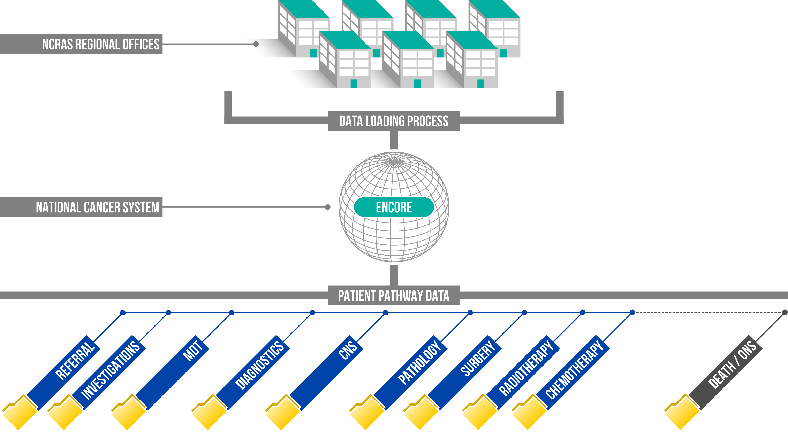
What happens to the data?
Notes:
The data from every region is loaded into a national registry system each month. Records from all regions are then passed to whichever Regional NCRAS office covers the patient’s registered GP practice. Needless to say it’s a huge and complex operation to turn all of these separate data submissions – some from the individual… and potentially multiple … trusts, some from other national organisations … into a cohesive cancer pathway for every diagnosis. These pathways run from the date of diagnosis to the day the patient dies. To accomplish this…

Slide 15

What happens to the data?
EnCORE
National System
Pre existing Diagnosis
New Condition
Recurrence
Non-melanoma
auto-process
Notes:
… for the most part, somebody has to read every piece of data we get and make sense of it. This of course takes time. Level 3 data (which is to say fully processed registry data) generally takes around a year, in part because we wait for the pathway to happen fully before processing.

Slide 16
What the data is used for
National Audits – via NATCAN
Research & Campaigns – Be Clear on Cancer
Charities
Strategic Review
International Comparison
Clinical Services Quality Measures
Cancerdata
www.cancerdata.nhs.uk
Fingertips
https://fingertips.phe.org.uk
CancerStats – HSCN only
https://cancerstats.ndrs.nhs.uk
Predict tools
https://breast.predict.nhs.uk/
https://prostate.predict.nhs.uk/
Notes:
What do we use it for? Actually, quite a lot… I’m not going to go through all of these but I am going to touch on two that stand out for me…

Slide 17
What the data is used for
National Audits – via NATCAN
Research & Campaigns – Be Clear on Cancer
Charities
Strategic Review
International Comparison
Clinical Services Quality Measures
Cancerdata
www.cancerdata.nhs.uk
Fingertips
https://fingertips.phe.org.uk
CancerStats – HSCN only
https://cancerstats.ndrs.nhs.uk
Predict tools
https://breast.predict.nhs.uk/
https://prostate.predict.nhs.uk/
Notes:
… National Audits and Be Clear on Cancer.

Slide 18
What the data is used for
National Audits via NATCAN
( https://www.natcan.org.uk/ )
The NATCAN audits use data that is part of the COSD dataset as well as data from other sources
No additional submission is required for the audits
As the audits use COSD data, please ensure that information relating to the audits is entered into your cancer data management system in a timely fashion
Notes:
NATCAN makes use of COSD data and registry data to generate their various audit reports. Accordingly, COSD data that relates to national audits should be entered into your cancer data registration system in a timely manner.

Slide 19
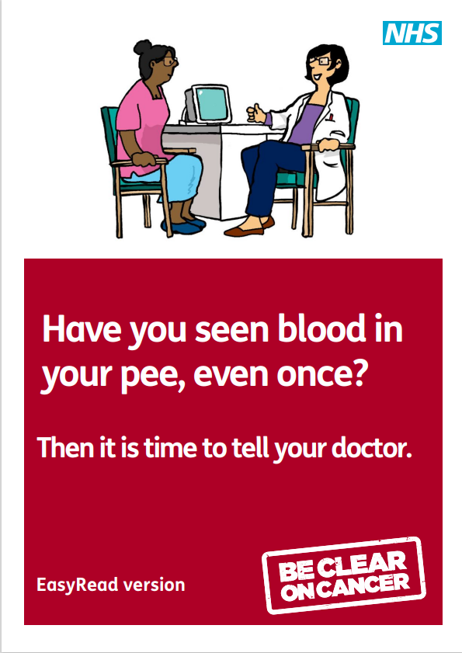
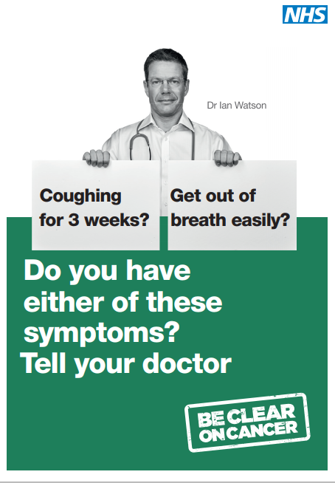

What the data is used for
Notes:
We know that early diagnosis is key to a wider range of treatment options and a better prognosis for most cancers. But for an early diagnosis, patients have to present at an early stage. Leaflets are relatively cheap to produce, TV ads less so. The Be Clear on Cancer TV ads target those sites where later stage presentations are more common and outcomes tend to be worse. These decisions on which cancer sites to target are based on Registry data. Trust data. So if an MDT Co-Ordinator is looking for a stage for the patient, this is one of the reasons why.

Slide 20
In Summary
CWT is an NHSE dataset concerned mainly with time
COSD is an NDRS dataset with a much broader remit and wider applications
Audit data is collected to analyse the treatments of particular cancers in detail
NDRS has responsibility for collecting and collating cancer data from every hospital trust in England, including the data that you record
.
Notes:
To Summarise: CWT is an NHSE dataset which focuses on time.

Slide 21
In Summary
CWT is an NHSE dataset concerned mainly with time
COSD is an NDRS dataset with a much broader remit and wider applications
Audit data is collected to analyse the treatments of particular cancers in detail
NDRS has responsibility for collecting and collating cancer data from every hospital trust in England, including the data that you record
.
Notes:
COSD has a broader remit and wider applications

Slide 22
In Summary
CWT is an NHSE dataset concerned mainly with time
COSD is an NDRS dataset with a much broader remit and wider applications
Audit data is collected to analyse the treatments of particular cancers in detail
NDRS has responsibility for collecting and collating cancer data from every hospital trust in England, including the data that you record
.
Notes:
Audit data is used to analyse and compare the treatments of specific cancers

Slide 23
In Summary
CWT is an NHSE dataset concerned mainly with time
COSD is an NDRS dataset with a much broader remit and wider applications
Audit data is collected to analyse the treatments of particular cancers in detail
NDRS has responsibility for collecting and collating cancer data from every hospital trust in England, including the data that you record
.
Notes:
NDRS has the legal responsibility for collecting the data that you record

Slide 24
In Summary
CWT is an NHSE dataset concerned mainly with time
COSD is an NDRS dataset with a much broader remit and wider applications
Audit data is collected to analyse the treatments of particular cancers in detail
NDRS has responsibility for collecting and collating cancer data from every hospital trust in England, including the data that you record
The data is used to promote earlier diagnosis, analyse cancer outcomes and to make decisions on future patient care
Notes:
This data is used to encourage the public to seek medical help sooner, to examine cancer outcomes *and* to make decisions on future patient care

Slide 25
Questions?
East Midlands: Simon Cairnes – simon.cairnes@nhs.net
Eastern: Marianne Mollett – marianne.mollett@nhs.net
London & South East: Katrina Sung – katrina.sung@nhs.net
London & South East: Karen Graham– karen.graham36@nhs.net
North West: Paul Stacey – p.stacey@nhs.net
Northern & Yorkshire: Rachael Mann – rachaelmann@nhs.net
Oxford: Gemma Feeney – gemma.feeney@nhs.net
South West: James Withers – james.withers@nhs.net
West Midlands: Gemma Feeney – gemma.feeney@nhs.net
Notes:
If you have any questions on the information contained within this module or about COSD in general, do please feel free to email your regional Data Liaison Manager

