Slide 1
Women’s Smoking Status at Time of Delivery (SATOD)
Changes to data submission
Presented by:
Kate Parkyn, Sharon Thandi, Sarah Lewis
Maternity Analysis Team, NHS England
Notes:
Standard title slide

Slide 2
Agenda
Background and outline
Reconciliation work for SATODv1 and SATODv2
Technical guidance for MSDS recording

Slide 3
Background and outline
Kate Parkyn

Slide 4

Smoking and pregnancy
Smoking increases the risk of pregnancy complications, such as stillbirth, miscarriage, preterm birth, low birthweight and sudden infant death syndrome¹.
It is important to be able to monitor smoking rates throughout pregnancy, so appropriate support can be provided to pregnant women.
Part of the NHS Long Term Plan to reduce smoking during pregnancy².
“Smokers are nearly a third more likely to suffer a miscarriage and double the likelihood of stillbirth compared to those who don’t smoke².”
1
2
NHS England » Saving babies’ lives version three: a care bundle for reducing perinatal mortality
NHS England » Smokefree pregnancies

Slide 5

Data collection 1: Smoking At Time of Delivery (SATOD)
In 2005/06 a women's smoking status at time of delivery (SATOD) data collection was set up in England. This moved from the Department of Health to the precursor to NHS Digital in 2011-12.
Sub Integrated Care Boards (Sub-ICBs) are required to submit data on smoking status at time of delivery every three months. Sub-ICBs replaced Clinical Commissioning Groups (CCGs) in 2022.
Submission of four aggregate numbers:
number of maternities (number of pregnant women not babies)
number of women known to be smokers at the time of delivery
number of women known to be non-smokers at the time of delivery
number of women whose smoking status was not known at the time of delivery

Slide 6

Data collection 2: Maternity Services Dataset (MSDS)
In 2015 the Maternity Services Dataset (MSDS) was launched in England. The latest version (2.0) has been in use since April 2019.
Trusts are required to submit patient-level data on activity carried out by Maternity Services relating to a mother and baby/ies, every month. This is activity from the point of the first booking appointment until they’re discharged from maternity services
Aggregate numbers are not submitted and instead are calculated from the record-level data.

Slide 7
Existing published metrics
The two existing published metrics for smoking status at time of delivery were:
Smoking At Time Of Delivery (SATOD) (SATOD data)
Smoking at Delivery Clinical Quality Improvement Metric (CQIM) (MSDS data)
SATOD (SATOD) | Smoking at Delivery CQIM (MSDS)
Self-reported smoking status by pregnant woman | Self-reported smoking status by pregnant woman, recorded using SNOMED clinical codes
Aggregate collection = totals only | Person-level data
Submitted by sub-ICBs | Submitted by Trusts
Collected and published quarterly | Collected and published monthly

Slide 8

Objective
Retire the existing SATOD collection and use MSDS as the data source for statistics on Women’s Smoking Status at the time of Delivery.
Aims:
Reduce burden on data submitters
Reduce duplication
Increase the potential for additional breakdowns to be included from MSDS, such as demographic information and changes throughout the pregnancy

Slide 9

Creation of SATOD v2 using MSDS
Aligned CQIM Smoking at Delivery metric produced from MSDS, with the logic of the long-standing SATOD metric.
Created a new metric produced from MSDS but aligned with SATOD.
Details agreed with working group included:
List of accepted SNOMED codes to be used to identify self-declared smoking status
When to allocate an Unknown self-declared Smoking Status
Geography breakdowns and mappings to use
Rounding and suppression to apply

Slide 10

The road ahead
Publish SATOD v1 and SATOD v2 together for a full year and compare.
  Intention to then switch off the SATOD v1 collection by 2025-26.
  MSDS would then become the main source of this information.
    when MSDS-only will align SATOD v2 and CQIMSmokingDelivery etc.
Data quality investigations and reconciliation work ongoing with Trusts and Sub-ICBs.

Slide 11
Results and Reconciliation work
Sharon Thandi

Slide 12
Latest results – Q2 2024/25
SATOD v1
SATOD v2 (MSDS)
6.0% of pregnant women were known to be smokers at the time of delivery
5.6% of pregnant women were known to be smokers at the time of delivery
Published SATODv1 and SATODv2 alongside each other in the Q1 and Q2 2024-25 publications, to allow for direct comparisons to be made. Including a new SATOD v1/v2 comparison tab.
Power BI dashboard, which allows users to view SATOD v1 and SATOD v2 data, and directly compare them

Slide 13
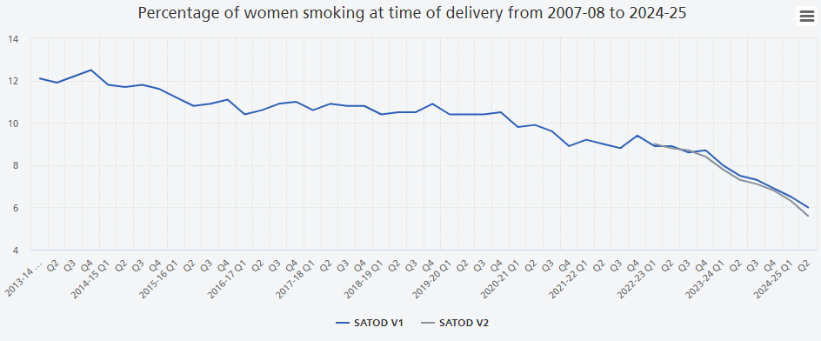
Time series – SATOD v1 and SATOD v2
The time series estimates from both sources are in very close proximity indicating that MSDS is a good replacement as the data source for this publication.
SATOD V2 (MSDS) figures are only available from Q1 of 2022-23 due to data quality issues for earlier quarters.

Slide 14
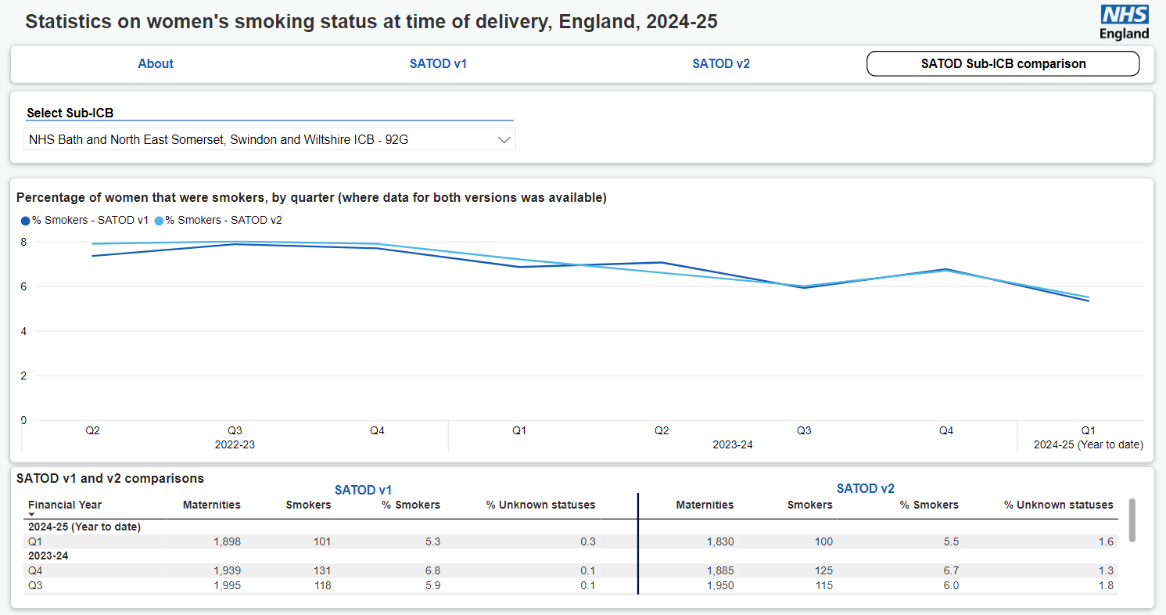
SATOD dashboard

Slide 15
Reconciliation work
Although nationally, the SATOD v1 and SATOD v2 figures are in close alignment – this masks areas where there are large discrepancies.
Data quality reports using data from MSDS have been produced for Q1 2024/25 so far. The Q2 reports are in progress.
The reports that go to Trusts include the number of maternities/smokers/non-smokers/unknowns commissioned into their Trust by sub-ICB/ICB.
The reports that go to sub-ICBs/ICBs include the number of maternities/smokers/non-smokers/unknowns they have commissioned out by the different Trusts.*
These outputs are unsuppressed so Trusts/sub-ICBs/ICBs receive the exact numbers submitted to MSDS in order to help conduct the reconciliation work.
Areas to focus are:
  Discrepancies in the number of maternities submitted (differences of 900+)
  Discrepancies in the % smoking rate (differences of 2%+)
  Large discrepancies in the % of unknown smoking status in MSDS
*We know that staff in CSUs are submitting SATOD v1 data for some areas with information flowing from Trusts and they will have received these reports.

Slide 16
MSDS guidance
Sarah Lewis

Slide 17
Submitting the right data
A self-declared smoking status needs to be recorded for the woman within the birth period (-/+ 3 days of the labour onset date) using a SNOMED clinical code.
Where the birth is towards the end of the month, provisional data from the next month is used to determine smoking status (where applicable).
Where any records do not pass data quality criteria, they are removed from the calculation of this metric.
Note: CO reading is not used in the SATODv2 measure construction.

Slide 18
Data fields to submit
Smoking status codes for the SATODv2 metric should be recorded to MSD302 Care Activity (Labour and Delivery).
It is also acceptable to submit smoking status codes to MSD202 Care Activity (Pregnancy).
Table | Field | What to submit | How it is used | Example
MSD002 GP Practice Registration | OrgCodeGMPMother | The organisation code of the GP Practice that the mother is registered with | To derive the sub-ICB of the mother | A12345
MSD301 Labour and Delivery | LabourOnsetDate | Date when established labour is confirmed | To determine the date the labour started | 01/01/2024
 | CaesareanDate | The date of the caesarean | To determine the date of the caesarean | 01/01/2024
MSD302 Care Activity (Labour and Delivery) | ClinInterDateMother | The date on which a clinical intervention (i.e. recording of the smoking status) took place for the mother | To determine the date the smoking status of the mother was recorded (should be within -/+3 days of the labour onset / caesarean date) | 01/01/2024
 | FindingScheme | The code scheme submitted (e.g. SNOMED CT) | To determine which coding scheme is being used | 04 (SNOMED CT)
 | FindingCode | The relevant smoking status SNOMED code | To record the smoking status of the mother | 8392000 (Non-smoker)

Slide 19
SNOMED codes – which ones to use
Group | SNOMED CT code | Description
Current smoker | 77176002 | Smoker (finding)
Non-smoker | 266919005 | Never smoked tobacco (finding)
 | 8517006 | Ex-smoker (finding)
 | 8392000 | Non-smoker (finding)
 | 40574006 | Current non-smoker but past smoking history unknown (finding)

Slide 20
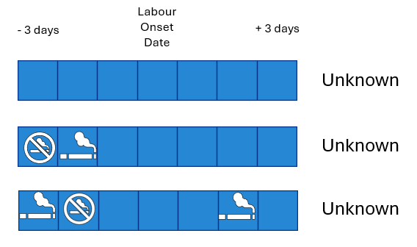
Unknown smoking statuses
If no smoking status code is submitted within the birth period (-/+3 days of the labour start date), then the woman will be assigned an unknown smoking status.
Please ensure within the birth period (-/+3 days of the labour start date), no conflicting information recorded on the smoking status is recorded in MSDS.
  This conflicting information will result in assigning a smoking status of unknown.

Slide 21
Assigning smoking status
Look in MSD302
Yes:
Only one status
Smoking status recorded in MSD302?
Yes:
Multiple conflicting statuses
Use MSD302 status
No
Look in MSD202
Yes:
Only one status
Smoking status recorded in MSD202?
Yes:
Multiple conflicting statuses
Use MSD202 status
No
Assign Unknown smoking status

Slide 22

Useful links
Recording smoking status data in MSDS – Guidance
SATOD publication series
Maternity Technical Output Specification
SATOD v2 Metadata
Full list of accepted SNOMED codes
Maternity monthly publication metadata

Slide 23

Questions from the webinar have been answered in a separate Q&A document
You can contact us at england.maternityanalysis@nhs.net

Slide 24
End slide

