Slide 1
Lung Cancer Screening Data Set v1.0
Expert Reference Group
8 October 2025

Slide 2

LCSDS Expert Reference Group
Agenda

Slide 3
Programme update
Data submission due to begin from July 2026
Allowances will be made for sites with a reason for not being able to submit sooner
Recognise that the lack of an ICT system in some sites means patient-level data may not be possible to submit until it is embedded
All sites will need to submit to this dataset from April 2027
Submission to the current aggregate collection via NECS will continue for:
  at least 3 months from July 2027 for all sites
  April 2027 for sites that are not submitting to the new dataset.
The role of providers and Cancer Alliances is expected to change; providers will submit the data but we are exploring how Cancer Alliances can be supported to validate the data and receive outputs.

Slide 5
User Centred Design (UCD) Engagement
Data submission design work
We are starting work to design the data submission process.
It is very important to have your involvement to help us:
understand your needs and challenges
test and improve designs
Please look out for invitations to participate and get involved!

Slide 6
Lung Cancer Screening Data Set v1.0 – Implementation Roadmap
Date | Milestone
2023 – March 25 | Initial high-level requirements gathering
April – July 2025 | Translation of requirements into detailed data design proposals
July 2025 | First Expert Reference Group (ERG)
August – September 2025 | Public consultations on design proposals; One aimed at providers of screening services; one aimed at patients
October 2025 | Second Expert Reference Group (ERG)
January 2026 | Information Standards Notice published. Supporting documentation includes: ‘Requirements Specification’, ‘Implementation Guidance’ and ‘Technical Output Specification (TOS)’
January – June 2026 | Provider & IT system provider implementation period
March – June 2026 | Additional supporting documentation & webinars led by NHS England
May 2026 | Provider state of readiness questionnaire
1 July 2026 | Start of local data collection for providers with capable IT systems
August 2026 | Start of central submission of data (for July 2026 reporting period)
April 2027 | Full conformance date for ALL providers of lung cancer screening services

Slide 7

Public Consultation Questionnaire
Julia Webb

Slide 8

Lung Cancer Screening Data Set (LCSDS) v1.0 – Public Consultation Questions
The questions within the questionnaire were split into the following sections:
About You
Proposals and Questions for LCSDS Version 1.0
Overlap with the Diagnostic Imaging Data Set (DIDS)
Reporting
Provider – development timescales
System Supplier – development timescales
All development timescales
General Questions
Useful Resources

Slide 9
About You

Slide 10
Summary of 20 responses received online
Organisations

Slide 11
Summary of 20 responses received
Roles

Slide 12

Proposals and Questions for LCSDS Version 1.0

Slide 13
Findings by question - Tables
We asked: How likely will you be able to capture all the mandatory data items only (i.e. partially compliant) when local collection is proposed to commence (currently expected to be July 2026)?
Results are broken down per table:
LCS000 Header – 90%
LCS001 Master Patient Index (MPI) – 90%
LCS002 GP Practice Registration – 85%
LCS003 Finding – 65%
LCS004 Observation – 65%
LCS101 Service Request – 75%
LCS102 Invitation Reminder – 80%
LCS103 Screening Activity – 65%
LCS104 Onward Referral – 75%
LCS201 Care Contact – 75%
LCS202 Care Activity – 65%
LCS203 Coded Scored Assessment (Care Activity) – 50%

Slide 14
Findings by question - Tables
We asked: How likely will you be able to capture all of the data items (i.e. fully compliant) when local data collection is proposed to commence (currently expected to be July 2026)?
Results are broken down per table:
LCS000 Header – 80%
LCS001 Master Patient Index (MPI) – 15%
LCS002 GP Practice Registration – 40%
LCS003 Finding – 45%
LCS004 Observation – 35%
LCS101 Service Request – 55%
LCS102 Invitation Reminder – 65%
LCS103 Screening Activity – 30%
LCS104 Onward Referral – 55%
LCS201 Care Contact – 30%
LCS202 Care Activity – 35%
LCS203 Coded Scored Assessment (Care Activity) – 40%

Slide 15
Findings by question
HEADER - Good results which are expected. This is a mandatory table, without this you would not be able to make a submission.
MASTER PATIENT INDEX – Some responses highlighted that some of the drop-down fields have different options, and therefore some data items are not collected. Results were sufficient, again this is one of the mandatory tables which we would expect providers to be able to submit.
GP PRACTICE REGISTRATION – Some providers indicated that they do not hold start/end dates of a patient’s registration with their GP.
FINDING – Some confusion on what is defined as a ‘clinical finding’, how mappings from SNOMED-CT codes to Smoking Status will be made as there is a large number of SNOMED-CT codes relating to Smoking Status, and that the Smoking Status options differ. Smoking Status has since been removed from this table.
OBSERVATION–Some uncertainty about what is classed as an observation and what this table is used for. We will be providing a user guidance document which will cover off a lot of these questions.
SERVICE REQUEST – Some uncertainly about some data items within this table not needed. This table has since changed and has been split into two separate tables ‘Screening Eligibility’ and ‘Screening Offer’. We consider that if providers can submit this table, along with the Header and MPI tables, they would be making a successful submission.

Slide 16
Findings by question
INVITATION REMINDER – Some respondents indicated that appointments for patients are pre-booked rather than reminders sent and therefore may not be applicable. This table is unique to screening and had a good response rate.
SCREENING ACTIVITY – We have since changed the design of this table based upon your feedback as there was some confusion about what this group was for. Full details will be provided within user guidance.
ONWARD REFERRAL – Some mixed feedback, however it was recognised that this table is useful in linkage from other data sets.
CARE CONTACT– Some confusion with the meaning of this table particularly in screening terms. Key information about the lung health checks and CT scans is held here. Further detail will be provided in user guidance.
CARE ACTIVITY– Similar to Care Contact table, some confusion with what this table will be used for and what activity is expected to be included. We are using terms which are generic across our data sets, full details will be included within user guidance.
CODED SCORED ASSESSMENT (CARE ACTIVITY) – Some confusion with what this table will be used for. This is the table which will be used to capture the lung health check scores, this will be made clearer in user guidance.

Slide 17
Conclusions:
We will be publishing a User Guidance document (as per other data sets) which will outline each table and its individual data items in more detail. This will also assist IT systems in becoming more complaint with SNOMED-CT
The User Guidance document will not only help in compliance, but it will also outline in plain English how the data set should be used and interpreted by users, including providers, system suppliers and other stakeholders. The User Guidance document supports and should be read in conjunction with the Enhanced Technical Output Specification and Data Model. This will be published on the new LCSDS webpages
Results gathered from the survey indicate that those data items which are only partially collected, are still fully compliant with the Information Standards Notice (ISN)

Slide 18
We Asked: Within the Master Patient Index (MPI) table, are you able to collect the following:
Are you able to capture Person Stated Gender Code?
Option | Total | Percent
Yes | 13 | 65.00%
No | 2 | 10.00%
Not Sure | 5 | 25.00%
Not Answered | 0 | 0.00%
Are you able to capture Religious or Other Belief System Affiliation Code?
Option | Total | Percent
Yes | 8 | 40.00%
No | 5 | 25.00%
Not Sure | 7 | 35.00%
Not Answered | 0 | 0.00%
Are you able to capture Person Stated Sexual Orientation Code?
Option | Total | Percent
Yes | 4 | 20.00%
No | 8 | 40.00%
Not Sure | 8 | 40.00%
Not Answered | 0 | 0.00%

Slide 19

We Asked: How do you capture these data items within your system (e.g. ICD-10, SNOMED-CT) etc
Conclusions:
Some of these data items are able to be captured via various means including via hospital systems, local configuration or through PAS or EPR integration.
Some information is entered from GP data pull and checked against national spine
We Said regarding the collection of additional demographic details:
We would not be expecting screening staff to ask some of these specific demographic questions.
These particular data items are ‘Required’ which means that they should only be reported where they are collected, however if they are not submitted, there will be no penalties for not submitting them, particularly if you do not hold this information.
Further to your feedback within the consultation, we feel that there is adequate justification to remove both the religion and sexual orientation data items.

Slide 20
We Asked: Do you use SNOMED-CT for capturing Observations, Findings and Procedures within your system?
Option | Total | Percent
Yes | 6 | 30.00%
No | 10 | 50.00%
Not Sure | 4 | 20.00%
Not Answered | 0 | 0.00%
Conclusions:
SNOMED-CT is not used
Although SNOMED-CT is not being used yet, there are plans to fully integrate it
These options are recorded from a pick list
Some trusts still use CTV3 or ICD-10 because SNOMED-CT is not available

Slide 21
We Said:
SNOMED-CT is mandated for use in clinical systems across the UK and is now the preferred method for clinical terminology.
If this is due to how your existing IT system is set up i.e. SNOMED-CT is currently not used within screening-specific systems, we will be issuing full user guidance to support those providers who do not have a fully SNOMED-CT enabled system.
The ISN required adoption of SNOMED-CT by April 2020. Further information can be found on the NHS England webpages here.

Slide 22
We Asked: Do you have the capability to submit diagnosis of lung cancer within this data set?
Option | Total | Percent
Yes | 9 | 45.00%
No | 8 | 40.00%
Not Sure | 3 | 15.00%
Not Answered | 0 | 0.00%
Conclusions:
Cancer diagnosis can be captured but not linked to SNOMED-CT codes
Diagnosis data can be provided but other providers are responsible for the collection of that data.
Diagnosis of lung cancer for local patients can be recorded on some systems and is available to submit.
Diagnoses are recorded as ICD-10 codes.

Slide 23
We Said:
We should have made this clearer within the consultation, but this is about ‘suspected’ lung cancer, we are not expecting you to have a formal diagnosis of lung cancer in screening.
It may be that any pick lists you are using, are SNOMED-coded from the back end which you may not be able to see.
We will be publishing user guidance which will contain further detailed information

Slide 24
We Asked: How do you currently record Smoking Status within your system?
Option | Total | Percent
Captured via a static value list | 15 | 75.00%
Captured via SNOMED-CT | 4 | 20.00%
Not Answered | 1 | 5.00%
Conclusions:
This is mostly captured via a static value list
In some cases, Smoking Status is captured via both a static value list and via SNOMED-CT
Some SNOMED-CT codes are provided when this is asked during an appointment, however ‘Smoking Status’ is not one of those provided
In some cases this is captured as a free text field or via CTV-3
It is recorded, but there is some uncertainty if it translated to SNOMED-CT

Slide 25
We Said:
Our preference would be to receive this information via SNOMED-CT as it is the nationally approved way of recording clinical codes.
We would also reiterate that any other codes should all be able to be mapped across to the relevant SNOMED-CT codes. Please refer to the SNOMED-CT Browser.
SNOMED-CT is required in order for any new national data set to be approved.

Slide 26
We Asked: We are proposing to make the NHS Number mandatory. Do you foresee any problems with this?
It would also be useful for us to know how many patients on your records currently do not hold an NHS Number?
Conclusions:
NHS number is used as a key identifier within some systems so is already mandatory
All patients in scope are GP registered and therefore have NHS numbers
Patients that do not have an NHS number, cannot be added to IT systems
High response rate indicates that there were no problems with this and are in full support of this being mandatory
NHS number is captured as it is a key identifier

Slide 27
We Asked: Do you record 'overall score' for lung health checks or as 'answers to individual scores’?
Do you have the capability to record this as separate questions?
Conclusions:
This was mixed with about 50% recording as an overall score and 50% recording as separate questions
We Said:
This will be no issue in terms of the design of the data set, however there will be a need to decide which is preferable rather than receiving a mixture, particularly give that not everyone is able to submit overall scores

Slide 28
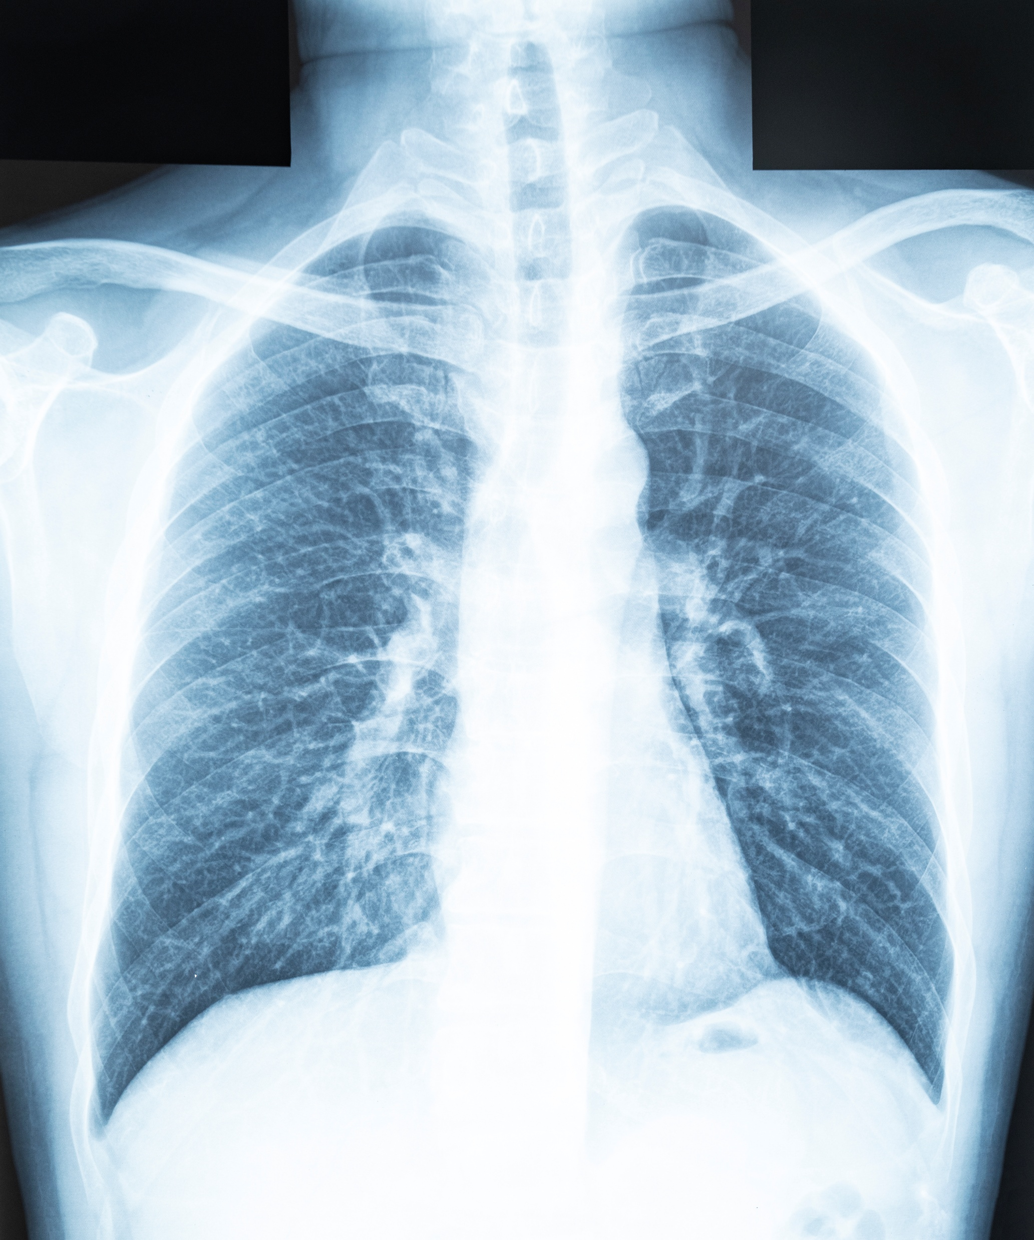
Overlap with the Diagnostic Imaging Data Set (DIDS)

Slide 29
We Asked the following questions about DIDS:
Do you currently submit any information to the Diagnostic Imaging Data Set (DIDS)? Majority of respondents (40%) said ‘No’
Does any of this information include lung cancer screening or scans which take place within the Lung Cancer Screening Programme? Majority of respondents (55%) said ‘No’
Is any of your lung screening activity (i.e. a low dose CT scan) captured using a Radiology Information System? Majority of respondents (40%) said ‘No’
Are your scanners part of a Trust Radiology system? Majority of respondents (40%) said ‘No’
Is any of your screening activity/imaging run and managed within a radiology department? Majority of respondents (40%) said ‘No’

Slide 30
We Said:
We wanted to ask these questions to ascertain if there is any duplication
If anyone does also submit data to DIDS, that information is captured and held within the Radiological Information System (RIS) system, whereas LCS data is held across multiple systems, not just RIS

Slide 31

Reporting

Slide 32
We Asked: Are there any specific reports that you would like to see based on the proposed new data in version 1.0 of the LCSDS?
Coverage and uptake, DNA rates, Attendance Reports, Cancer yield, Diagnosis values, Progression, All QA metrics
Population coverage, service performance and quality assurance. Health inequality related reports, Ability to join up reports with secondary care outcomes.
Demographic information on uptake rate and risk score, lung cancer conversion and lung cancer diagnosis
Nodule surveillance at a patient level - how many nodule scans patients have.
Influence of key lifestyle factors on high risk and lung cancer conversion e.g. current smokers, age, ethnicity, IMD
SNOMED code completion

Slide 33

Development Timescales

Slide 34
We asked Providers: Assuming the Information Standards Notice (ISN) is ready to be published in December 2025, would you anticipate being able to achieve the following timescales:
Collection of the required data from 1 July 2026?
Option | Total | Percent
Yes | 13 | 65.00%
No | 5 | 25.00%
Not Answered | 2 | 10.00%
Submission of the required data from 1 August 2026?
Option | Total | Percent
Yes | 13 | 65.00%
No | 5 | 25.00%
Not Answered | 2 | 10.00%

Slide 35
We asked System Suppliers: Assuming the Information Standards Notice (ISN) is ready to be published in December 2025, would you anticipate your system being ready for providers to collect data from 1 July 2026, and submit data from 1 August 2026?
Option | Total | Percent
Yes | 5 | 25.00%
No | 3 | 15.00%
No Sure | 8 | 40.00%
Not Answered | 4 | 20.00%

Slide 36
Conclusions:
Main issues are being able to commit to timescales without completing a full mapping piece on data warehouse structures against the final version of the dataset which is not yet available.
Some guidance documentation would be beneficial
Dependent on the standards and the capacity of system suppliers

Slide 37
Development Timescales
Following publication of the ISN, when do you anticipate you will be ready to make a submission?
Providers:
General consensus was that providers would be able to make submissions by August/September 2026
Some inability to commit to timescales without completing full mapping data warehouse structures against the final version of the dataset which is not yet available.
Dependant on the standards and the capacity of system suppliers.
System Suppliers:
Clarity is required for some of the tables, e.g. Service request. Scenarios for when more than 1 service requests needed for a patient within the programme, what is in scope for Onward Referral

Slide 38
We Said:
Submitting to the LCSDS is a ‘Should’ (i.e. if you have a capable IT system) from July 2026 until March 2027
Submitting to the LCSDS is a ‘Must’ (i.e. fully compliant) from April 2027
This will give providers a good nine month window in advance of April 2027 and will allow enough time to bed in and then be fully compliant from April 2027
Documentation including a full User Guidance, Data Model and Technical Output Specification will be made available, and published on the NHS England webpages

Slide 39

What type of systems do you supply?

Slide 40
All Development Timescales - Conclusions
Depends on complexity of requirements
Longer lead time would be preferable to enable changes to be made
Unable to commit to timescales without completing a full mapping piece on data warehouse structures against the final version of the dataset which is not yet available.
No concerns.
Not enough information about the data set is available to be able to provide an accurate response.
Entirely dependant on the requirements and availability of the supplier.
Some trusts are yet to set up the programme, therefore will impact on availability of data.

Slide 41
General Questions

Slide 42
General Questions
Do you believe that any of these additions proposed for LCSDS v1.0 will create any unnecessary additional burden?
Option | Total | Percent
Yes | 9 | 45.00%
No | 2 | 10.00%
Not sure | 9 | 45.00%
Not Answered | 0 | 0.00%
Would you be interested in attending the next Expert Reference Group (ERG) session?
Option | Total | Percent
Yes | 17 | 85.00%
No | 3 | 15.00%
Not Answered | 0 | 0.00%

Slide 43

Useful Resources
Further to this consultation, there are some new LCSDS webpages which will contain documentation including the draft Data Model, and the draft Technical Output Specification:
About the Lung Cancer Screening Data Set - NHS England Digital
Lung Cancer Screening Data Set: Implementation tools and guidance - NHS England Digital
Please direct any queries to us: dataset.development@nhs.net

Slide 44

Q&A

