Slide 1
Lung Cancer Screening Patient level data collection
NHS England Lung Cancer Screening Team
February 2026
Notes:
Standard title slide

Slide 2

House-keeping
We’re going to record the first part of this webinar so that we can share it after the session.
We’ll pause the recording after the presentation to answer your questions.
You’re welcome to add questions in the chat as we go and we’ll come back to them.
Notes:
Put the recording on!! Please be aware if you ask questions during the recording you are being recorded!

Slide 3
Introduction
This session follows on from the workshops we ran in the fourth quarter of last year. We’ll reflect on what you told us in those sessions.
Context and more information on the collection approach
Introduce the National Data Submission Portal
Plans for supporting Cancer Alliances
Upcoming opportunities to learn more and get involved

Slide 4
Context
Local data collection will begin from July 2026, with national data submission to start in August 2026
Allowances will be made for areas with a reason for not being able to submit sooner e.g. the lack of an ICT system being embedded
All providers will need to submit to this dataset from April 2027
Submission to the current aggregate collection via NECS will continue for sites until at least April 2027.
The role of providers and Cancer Alliances in the data submission process is expected to change; providers will submit data, but Cancer Alliances will continue to have the same wider programme responsibilities as they currently do e.g performance manage sites' delivery. We will make arrangements to ensure Cancer Alliances have what they need from the data to meet their responsibilities.

Slide 5
Proposed implementation
Monthly collection- rolling submission profile
Submission window opens | Submission window closes | Activity month/ reporting period | Resubmissions which can be sent
1 Aug-26 | 31 Aug-26 | Jul-26 | N/A
1 Sep-26 | 30 Sep- 26 | Aug-26 | July
1 Oct-26 | 31 Oct- 26 | Sep-26 | July, August
1 Nov-26 | 30 Nov- 26 | Oct-26 | July, August, September
1 Dec-26 | 31 Dec- 26 | Nov-26 | July, August, September, October
1 Jan-27 | 31 Jan- 27 | Dec-26 | July, August, September, October, November
1 Feb-27 | 28 Feb- 27 | Jan-27 | July, August, September, October, November, December
1 Mar-27 | 31 Mar- 27 | Feb-27 | July, August, September, October, November, December, January
Data submissions are required each month containing activity data for the preceding month (e.g. in the August submission window you would submit activity data for July)
If no activity occurred, there will be an option to report no activity
Providers can resubmit data for previous months by selecting the relevant activity month in the portal (see screen shot on next page)

Slide 6
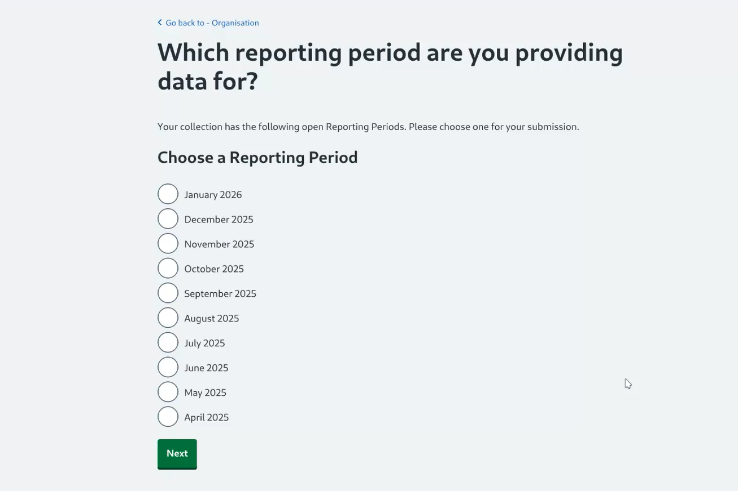
Example screen shot for Mental Health collection

Slide 7
Proposed implementation continued
Submitted files will be validated against the rules in the Enhanced Technical Output Specification (ETOS) (available at Lung Cancer Screening Data Set: Implementation tools and guidance - NHS England Digital)
Record level validation rejections will be applied as opposed to file level rejections
Any records in a given file which pass the ETOS rules will be accepted for onward processing
During the submission window you can make multiple submissions
If providers wish to resubmit a file in a given submission window to rectify earlier rejections, they must resend the entirety of their activity data and not just the corrected records
NHS England will use the ‘last good file’ from the given submission window that passed validation for onward processing at the end of the month
At the end of a submission window, a view of the data that has been successfully submitted for that reporting period (minus any rejected records) can be requested
Submission file format is expected to be XML, but we will be consulting on other options such as JSON

Slide 8
Data submission responsibility
Within the LCSP data collection, providers (i.e. private or NHS, whoever is contracted to deliver the LCSP service) will submit data at 'site' level
For the purposes of this data collection, a 'site' is a geographical area associated with a single delivery model or provider. Cancer Alliances can decide how to define 'sites' in their area.
Further engagement is planned on this proposal with Alliance Project Managers and Analysts
All submitting entities will require an ODS code (many sites may not currently have an ODS code)
Guidance will be shared shortly on how to request ODS codes
Granularity of data submission is at site level, but submissions could be made by the local site or the provider on their behalf

Slide 9
Patient level data submission
National Data Submission Portal (NDSP)

Slide 10
Provider workshop feedback
You told us that you need:
Guidance and communication on how to make timely submissions.
Clear feedback on data quality of submissions.
Clarity on submission content
Support when you don’t have a software system in place
Notes:
ETOS and user guidance – next steps
Data quality – will show the data submissions platform which will give immediate feedback, and then Charlotte will talk about reporting plans
Software systems – Charlotte will give an update

Slide 11

What is the National Data Submission Portal (NDSP)?
A single data submission portal that sits on the National Data Integration Tenant (NDIT) platform
Consistent experience for data submitters
Choice of submission routes
  File upload
  API
  FDP Local Tenant /Healthcare Decision Suite
Consistent data validation
Notes:
NDSP will sit on NDIT
A single data submission portal
Manage everything in one place
Ambition is to eventually consolidate 24+ legacy portals
Choice of submission routes to reduce burden
API, file transfer, file upload, webform and FDP local tenant flows
Consistent data validation
Data Validation Engine (DVE) using shared rules
Collection management
Management information, collection windows, permissions

Slide 12
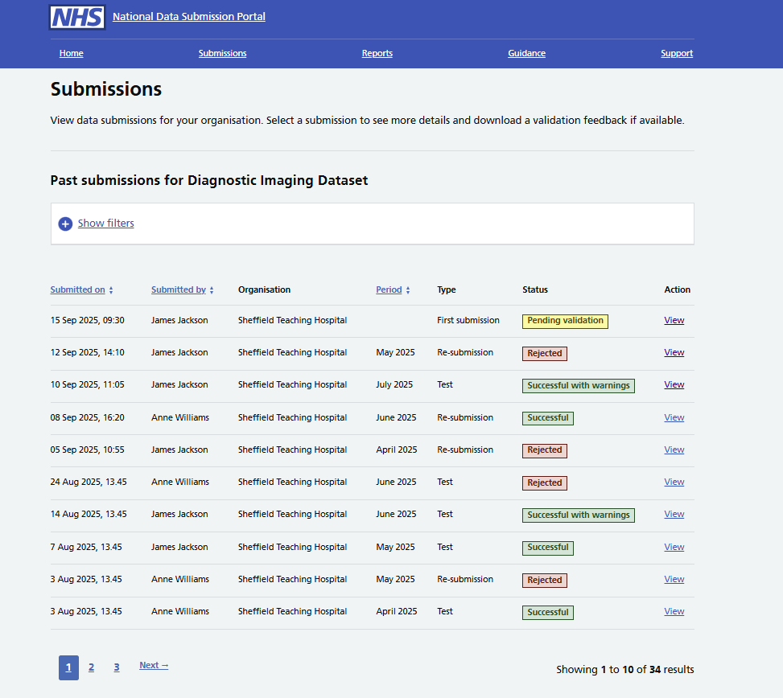
What does the NDSP do?
Enables secure data submissions to NHS England
Provides data validation feedback
Automated reminders:
  Submission window opens
  5 days before deadline
  1 day before deadline
Allows you to view your submissions history
Notes:
NDSP will sit on NDIT
A single data submission portal
Manage everything in one place
Ambition is to eventually consolidate 24+ legacy portals
Choice of submission routes to reduce burden
API, file transfer, file upload, webform and FDP local tenant flows
Consistent data validation
Data Validation Engine (DVE) using shared rules
Collection management
Management information, collection windows, permissions

Slide 13
Where is NDSP up to?
The National Data Submission Portal is a new system.
Currently being rolled out to support collection of the Diagnostic Imaging Data Set 2.0
Over time, NDSP will support multiple collections
Lung Cancer Screening will be the next collection to use NDSP – we will help to shape the portal to meet LCS needs.
Notes:
Plain slide with subhead and bullets

Slide 14
NDSP walkthrough
This walkthrough is showing NDSP configured for the Diagnostic Imaging Dataset collection!
Notes:
Demo the file submission process, submission history and viewing error reports

Slide 15
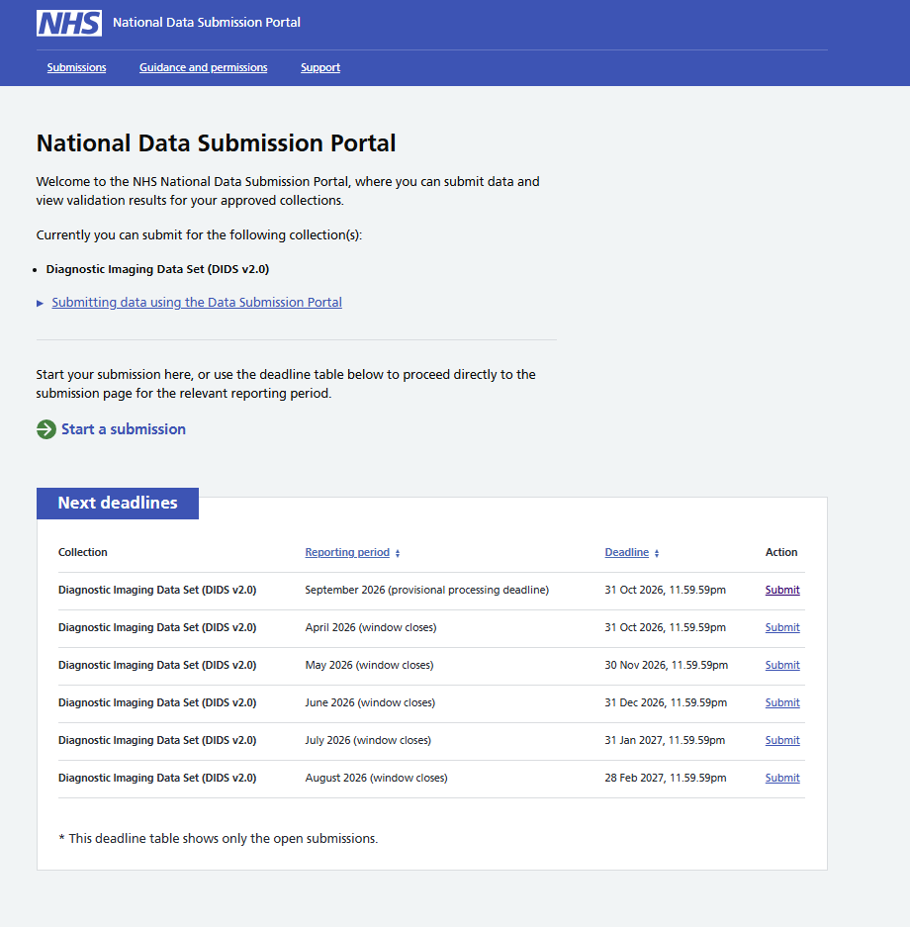
NDSP Home page
Lists the collections you can submit data for.
Shows you upcoming deadlines.
You can start a new submission from this page.

Slide 16
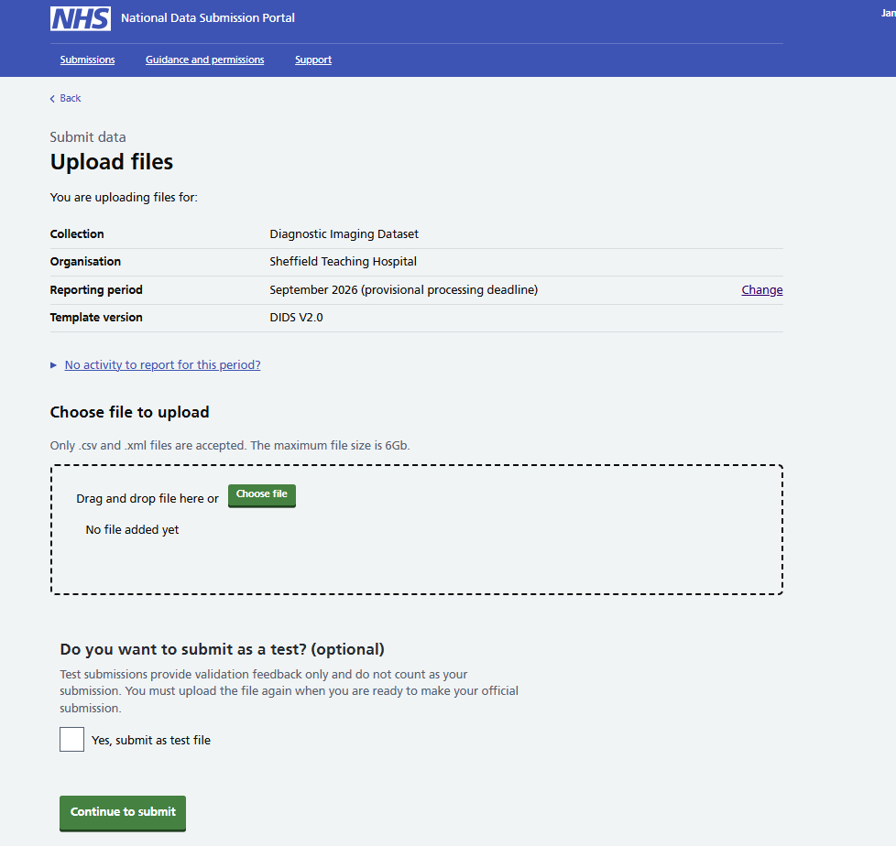
Submitting data – 1
Add the file you want to upload from your computer.

Slide 17
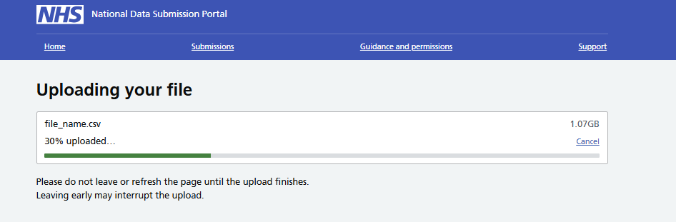
Submitting data – 2

Slide 18
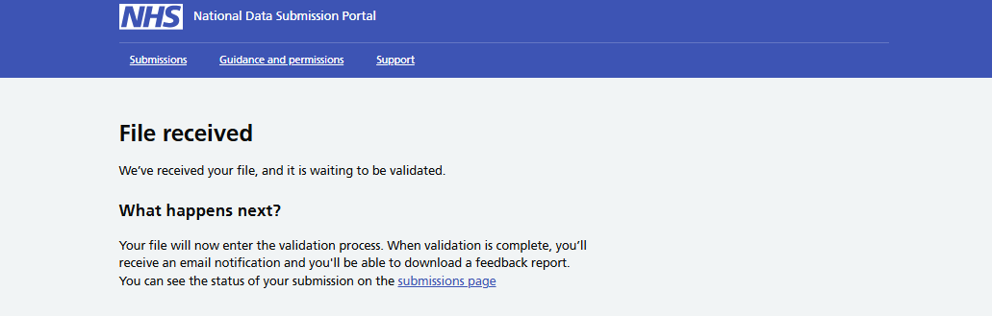
Submitting data – 3

Slide 19
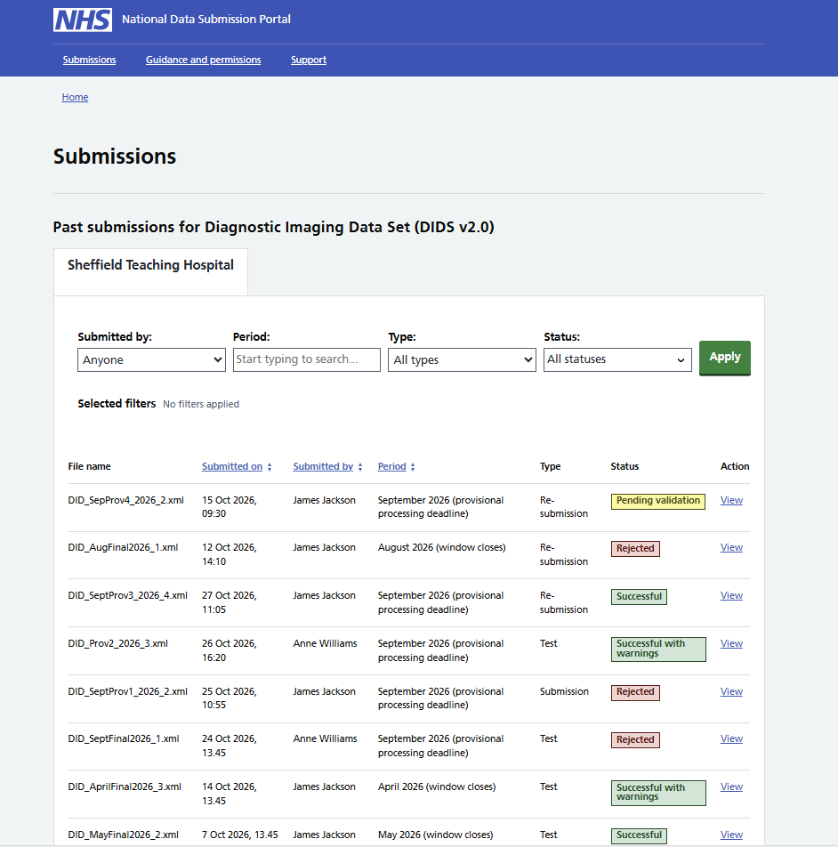
Submissions page
View the status of each submission
Link to get more details on the submission
Shows you all past submissions for this collection within your organisation

Slide 20
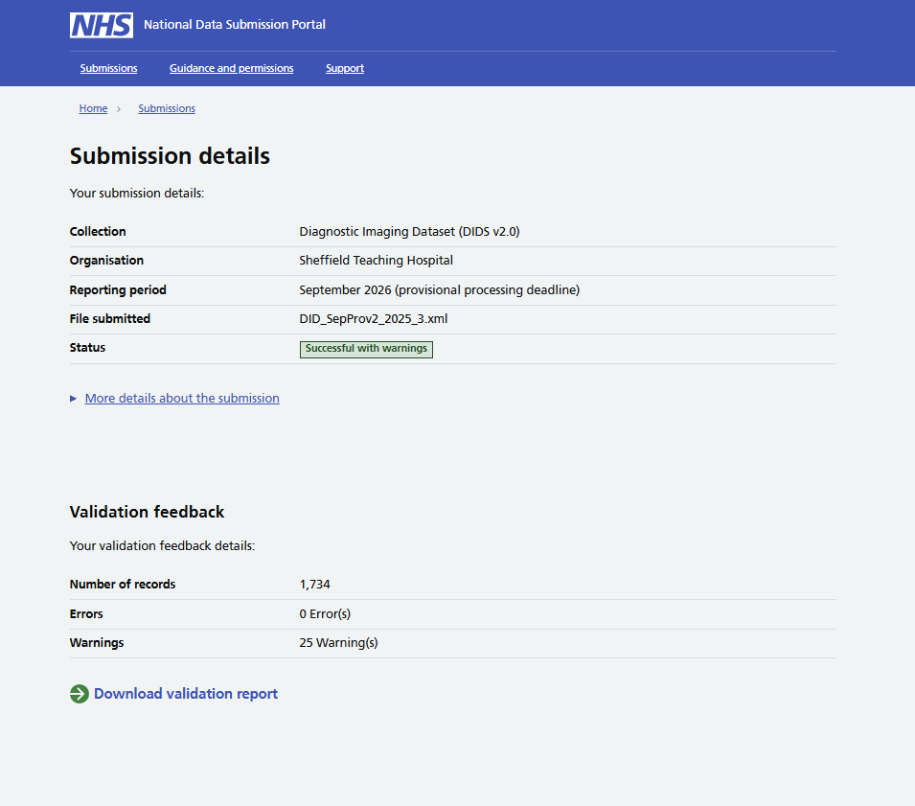
Submissions details
View the status of each submission
Link to get more details on the submission
Shows you all past submissions for this collection within your organisation

Slide 21
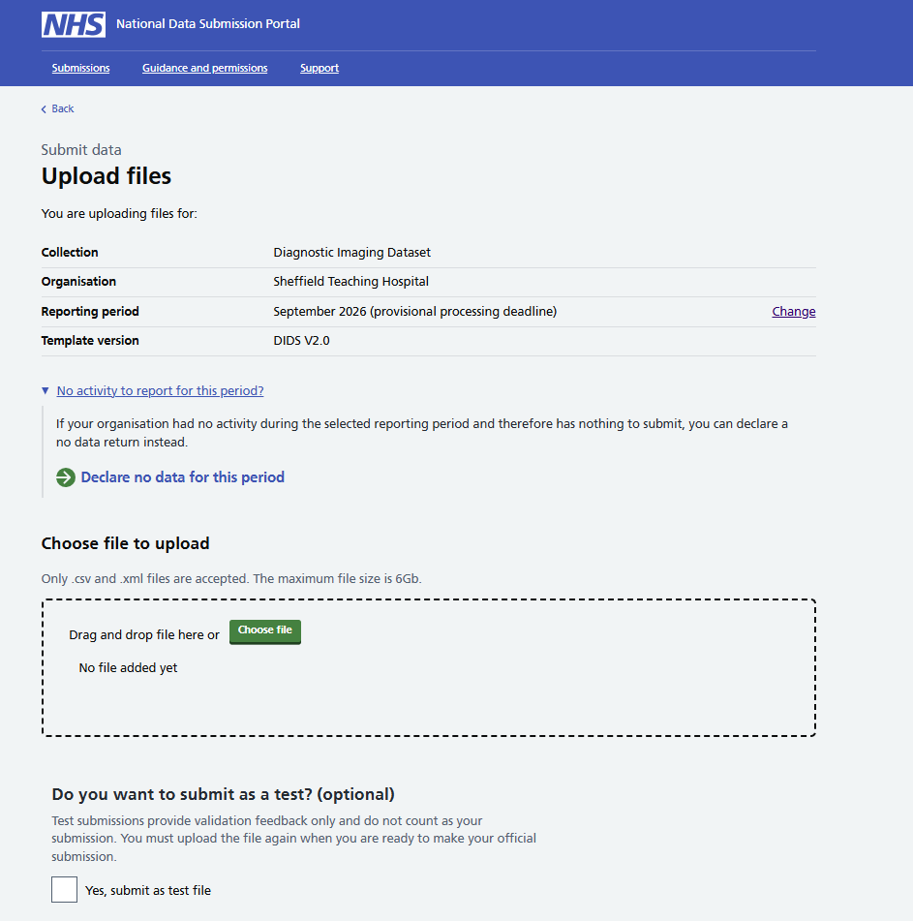
No activity to report?
You can declare no data for a reporting period.
Notes:
Mention the test files feature

Slide 22
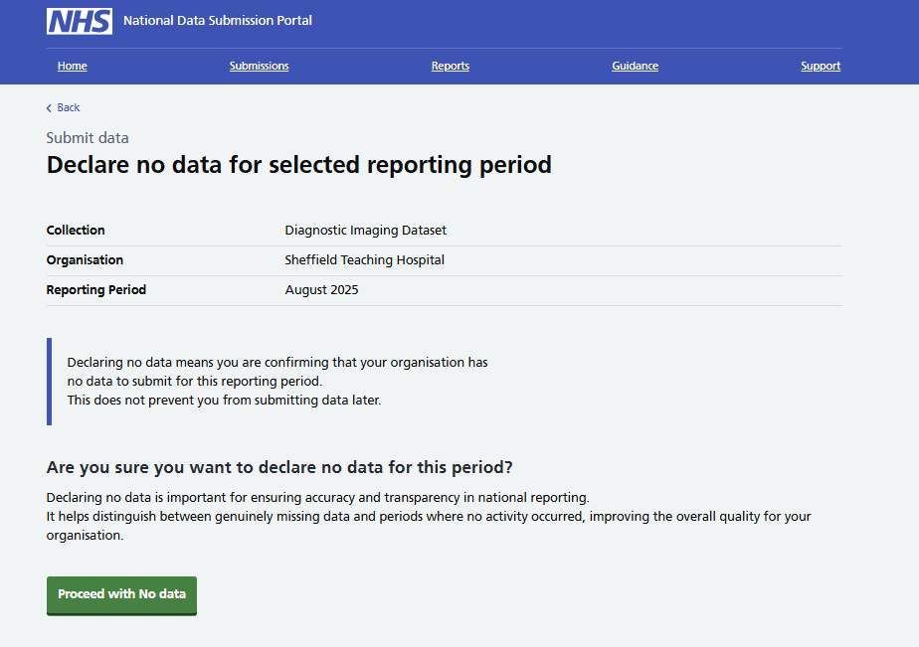
No activity to report - 2

Slide 23
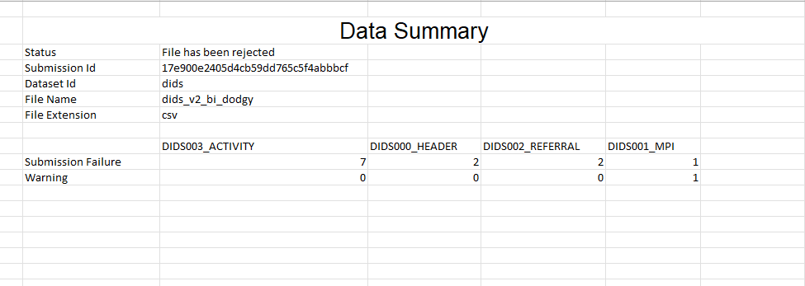
Example data validation report
1. Cover sheet
Notes:
Automated checking of files for errors and warnings – checks against the ETOS

Slide 24
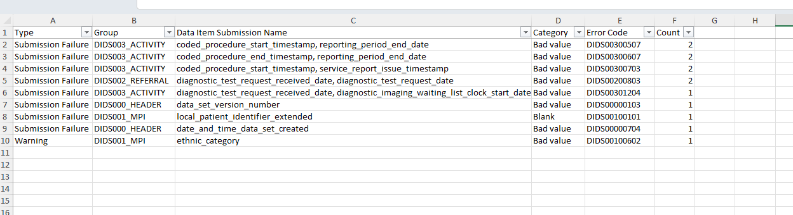
Data validation report
2. Error summary

Slide 25
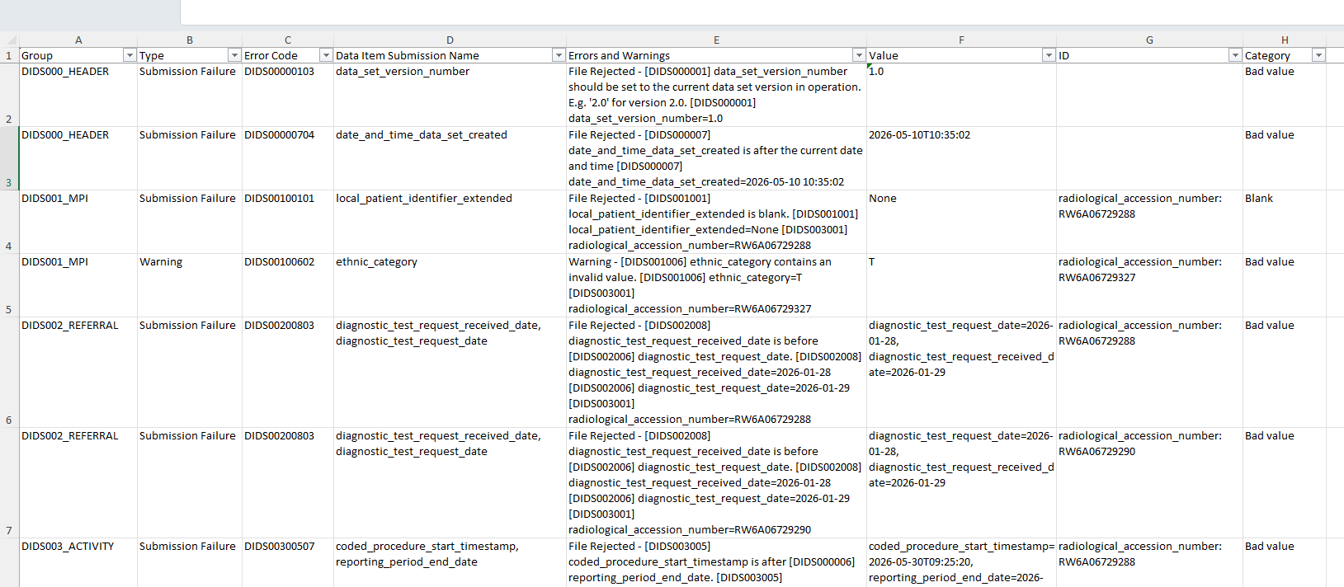
Data validation report
3. Error details

Slide 26
Plans for supporting Cancer Alliances
Notes:
Demo the file submission process, submission history and viewing error reports

Slide 27
Cancer Alliance workshop feedback
Changing to provider data submission should reduce the workload for CA staff who won’t need to collate and submit data.
However, there are concerns about the switch potentially impacting:
  CA ability to support providers in their submission
  CA role in ensuring timely, good quality data
  Ability to report on metrics and KPIs
  Ability to carry out forecasting and quality assurance

Slide 28
Cancer Alliance oversight and reporting
A Cancer Alliance ‘role description’ for the LCSP is being drafted to clearly outline expectations and responsibilities
As a reminder, the Cancer Alliance role is not changing except in relation to the submission of the dataset
We understand that you need access to data on the LCSP. We are working with both the Cancer Programme Analytics teams, and Cancer Alliance analysts to understand these needs, and identify appropriate solutions.

Slide 29
Next steps

Slide 30
Upcoming work
Pre- recorded ETOS walkthrough
User guidance and FAQ pages in progress
Joint session on ETOS and NDSP
Dedicated Information Governance Q&A session
Cancer Alliances reporting and oversight work

Slide 31

Questions
Stop recording!

