Slide 1
Diagnostic Imaging Data Set (DIDS) v2.0
Implementation Webinar 2
Date: 18/11/2025
Time: 10:00am – 11:30am
Presented by:
Chris Turner: Data Design Service, NHSE
Notes:
Standard title slide

Slide 2
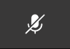
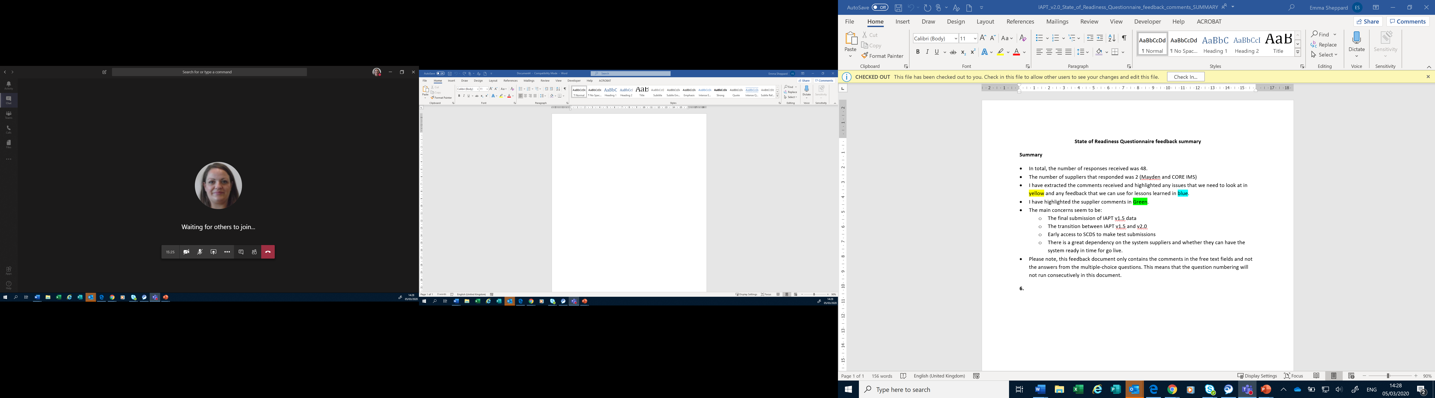
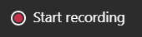
Housekeeping
Welcome and thank you for joining this webinar, the session will begin shortly.
Please note the following housekeeping points:
Please remain on mute throughout the webinar, unless indicated, to avoid disruption and noise interference for other attendees
If you wish to ask a question or raise a query during the webinar, you may do so via the meeting chat function, or by using the “raise your hand” function, all contributions are welcome!
To view the meeting chat, please select the ‘Show conversation’ icon in the Teams control task bar (pictured left)
If we are unable to answer your question due to time constraints, please forward it to dataset.development@nhs.net and we will pick it up via our mailbox
This webinar will be recorded and published. The recording will help us to update and publish the slide pack covering the questions and answers raised and allow people unable to make the webinar the chance to get involved.
Notes:
Plain slide with subhead and bullets

Slide 3

Webinars
This is the second in a series of planned webinars which is relevant to all providers, suppliers and services that are or may be in scope to submit the Diagnostic Imaging Data Set (DIDS).
The slides from the first implementation webinar are available here: Diagnostic Imaging Data Set (DIDS) implementation tools and guidance - NHS England Digital
The target audience for this webinar is:
  All care providers / submitters
  IT system providers
  Other stakeholders with an interest in DIDS data
The focus of this webinar will be primarily to go through each of the data groups and data items in DIDS v2.0.
Future webinar dates:
  11 December 2025
Notes:
Plain slide with subhead and bullets

Slide 4
ISN Publication
DIDS v2.0 was published 23/10/2025
Reminder of documentation:
ISN: DAPB1577: Diagnostic Imaging Data Set - NHS England Digital
Guidance / Support: Diagnostic Imaging Data Set (DIDS) - NHS England Digital
The Information Standard publication includes the Technical Output Specification (TOS) which defines the structure of the data set and data items to be collected.
All Data Group and Data Item definitions can also be found on the NHS Data Model and Dictionary website when published.

Slide 5
DIDS v2.0 Data Set Overview
4 Data Groups
39 Data Items
Of which:
14 are Mandatory
23 are Required
2 are Pilot

Slide 6
DIDS v2.0 Data Groups
Tab Name | Data Group Name | Data Group Submission Name | Data Group Description
DIDS000_HEADER | DIDS Header | DIDSHeader | Header: To carry header details for the submission. DIDS000_Header is a mandatory group and one occurrence must be submitted, the submission file will be rejected if the group is missing. All the data items in this group are mandatory. Any data items left blank will cause the whole file to be rejected.
DIDS001_MPI | DIDS Master Patient Index | DIDSMasterPatientIndex | Master Patient Index: To carry personal details of the patient. DIDS001_MPI is a mandatory group and one occurrence must be submitted, the submission file will be rejected if the group is missing. This group may be used to identify the patient for record linkage. Providers must populate all known data items for the DIDS001_MPI group as they were at the end of the reporting period, even if they are unchanged since the last submission. Do not just provide data for all "changed" data items. Data providers should note that DIDS000, DIDS001, DIDS002 and DIDS003 are mandatory groups that must be included whenever any groups are transmitted.
DIDS002_REFERRAL | DIDS Referral | DIDSReferral | Referral: To carry details of the referral that the patient is subject to. DIDS002_REFERRAL is a mandatory group and one occurrence must be submitted, the submission file will be rejected if the group is missing. Providers must populate all known data items for the DIDS002_REFERRAL group as they were at the end of the reporting period, even if they are unchanged since the last submission. Do not just provide data for all "changed" data items. Data providers should note that DIDS000, DIDS001, DIDS002 and DIDS003 are mandatory groups that must be included whenever any groups are transmitted.
DIDS003_ACTIVITY | DIDS Activity | DIDSActivity | Activity: To carry details of any activity undertaken. DIDS003_ACTIVITY is a mandatory group and one occurrence must be submitted, the submission file will be rejected if the group is missing. Providers must populate all known data items for the DIDS003_ACTIVITY group as they were at the end of the reporting period, even if they are unchanged since the last submission. Do not just provide data for all "changed" data items. Data providers should note that DIDS000, DIDS001, DIDS002 and DIDS003 are mandatory groups that must be included whenever any groups are transmitted.

Slide 7
DIDS v2.0 Data Items
Mandatory data items are shown in bold on the following slides
* Indicates a data item which is an addition in DIDS v2.0 on the following slides
DIDS000 Header
* DATA SET VERSION NUMBER
* ORGANISATION IDENTIFIER (CODE OF PROVIDER)
* ORGANISATION IDENTIFIER (CODE OF SUBMITTING ORGANISATION)
* PRIMARY DATA COLLECTION SYSTEM IN USE
* REPORTING PERIOD START DATE
* REPORTING PERIOD END DATE
* DATE AND TIME DATA SET CREATED
Once per submission in XML
Every row in CSV

Slide 8
DIDS v2.0 Data Items
DIDS001 Master Patient Index
* LOCAL PATIENT IDENTIFIER (EXTENDED)
* ORGANISATION IDENTIFIER (LOCAL PATIENT IDENTIFIER)
NHS NUMBER
NHS NUMBER STATUS INDICATOR CODE
PERSON BIRTH DATE
ETHNIC CATEGORY
*ETHNIC CATEGORY 2021
PERSON STATED GENDER CODE
POSTCODE OF USUAL ADDRESS
GENERAL MEDICAL PRACTICE (PATIENT REGISTRATION)

Slide 9
DIDS v2.0 Data Items
DIDS002 Referral
PATIENT SOURCE SETTING TYPE (DIAGNOSTIC IMAGING)
REFERRER CODE (DIAGNOSTIC IMAGING)
* TREATMENT FUNCTION CODE (REFERRAL FOR DIAGNOSTIC IMAGING)
ORGANISATION IDENTIFIER (REFERRING ORGANISATION)
* SERVICE REQUEST PRIORITY TYPE
DIAGNOSTIC TEST REQUEST DATE
* DIAGNOSTIC TEST REQUEST TIME
DIAGNOSTIC TEST REQUEST RECEIVED DATE
* DIAGNOSTIC TEST REQUEST RECEIVED TIME

Slide 10
DIDS v2.0 Data Items
DIDS003 Activity
RADIOLOGICAL ACCESSION NUMBER
ORGANISATION SITE IDENTIFIER (OF IMAGING)
CODED PROCEDURE (NICIP)
CODED PROCEDURE (SNOMED CT) [CODED PROCEDURE (NICIP) and CODED PROCEDURE (SNOMED CT) are not Mandatory but one, and only one of them, must be populated with a valid code]
* CODED PROCEDURE START TIMESTAMP
* CODED PROCEDURE END TIMESTAMP
* SERVICE REPORT ISSUE TIMESTAMP
* DIAGNOSTIC IMAGING CANCER INDICATION CODE
* GENERAL ANAESTHETIC ADMINISTERED INDICATOR
* REFERRER RADIOLOGY PROCEDURE EVALUATION INDICATOR
* DIAGNOSTIC IMAGING ACTIVITY CATEGORY
* DIAGNOSTIC IMAGING WAITING LIST CLOCK START DATE
* PLANNED DIAGNOSTIC DUE DATE

Slide 11
DIDS v2.0 Data Items – Mandatory Items
DATA SET VERSION NUMBER - (max n2.max n2)
The version number of a Data Set.
ORGANISATION IDENTIFIER (CODE OF PROVIDER) - (min an3 max an6)
ORGANISATION IDENTIFIER (CODE OF PROVIDER) is the ORGANISATION IDENTIFIER of the ORGANISATION acting as a Health Care Provider.
ORGANISATION IDENTIFIER (CODE OF SUBMITTING ORGANISATION) - (min an3 max an6)
ORGANISATION IDENTIFIER (CODE OF SUBMITTING ORGANISATION) is the ORGANISATION IDENTIFIER of the ORGANISATION acting as the physical sender of a Data Set submission.
PRIMARY DATA COLLECTION SYSTEM IN USE - (max an20)
The name of the Primary Data Collection System in use by the Health Care Provider.
REPORTING PERIOD START DATE - (an10 CCYY-MM-DD)
REPORTING PERIOD START DATE is the start date of the REPORTING PERIOD and is used in conjunction with REPORTING PERIOD END DATE to specify the actual period the reported information relates to.
REPORTING PERIOD END DATE - (an10 CCYY-MM-DD)
REPORTING PERIOD END DATE is the end date of the REPORTING PERIOD and is used in conjunction with REPORTING PERIOD START DATE to specify the actual period the reported information relates to.
DATE AND TIME DATA SET CREATED - (an19 YYYY-MM-DDTHH:MM:SS)
DATE AND TIME DATA SET CREATED is the date and time a data set was created.

Slide 12
DIDS v2.0 Data Items – Mandatory Items
LOCAL PATIENT IDENTIFIER (EXTENDED) - (max an20)
LOCAL PATIENT IDENTIFIER (EXTENDED) is used where IT systems have a LOCAL PATIENT IDENTIFIER which is longer than 10 characters and LOCAL PATIENT IDENTIFIER cannot be used for data submission.
ORGANISATION IDENTIFIER (LOCAL PATIENT IDENTIFIER) - (min an3 max an5)
ORGANISATION IDENTIFIER (LOCAL PATIENT IDENTIFIER) is the ORGANISATION IDENTIFIER of the ORGANISATION that assigned the LOCAL PATIENT IDENTIFIER.
PATIENT SOURCE SETTING TYPE (DIAGNOSTIC IMAGING) - (an2)
The type of setting that the PATIENT came from at the time of request for Diagnostic Imaging for use in the Diagnostic Imaging Data Set.
01 | Admitted Patient Care - Inpatient (this Health Care Provider). This National Code is based on INTENDED MANAGEMENT at the time of the DIAGNOSTIC TEST REQUEST.
02 | Admitted Patient Care - Day case (this Health Care Provider). This National Code is based on INTENDED MANAGEMENT at the time of the DIAGNOSTIC TEST REQUEST.
03 | Outpatient (this Health Care Provider)
04 | GP Direct Access
05 | Urgent and Emergency Care Service (this Health Care Provider)
06 | Other Health Care Provider
08 | Screening Programme Setting
98 | Other (not listed)

Slide 13
DIDS v2.0 Data Items – Mandatory Items
RADIOLOGICAL ACCESSION NUMBER - (max an20)
RADIOLOGICAL ACCESSION NUMBER is the unique record number in the local Radiological Information System (RIS) for the Diagnostic Imaging.
ORGANISATION SITE IDENTIFIER (OF IMAGING) - (min an5 max an9)
ORGANISATION SITE IDENTIFIER (OF IMAGING) is the ORGANISATION SITE IDENTIFIER of the ORGANISATION SITE where the Diagnostic Imaging took place.
CODED PROCEDURE START TIMESTAMP - (max an25)
CODED PROCEDURE START TIMESTAMP is the date, time and time zone that the Patient Procedure was started by a CARE PROFESSIONAL.
CODED PROCEDURE END TIMESTAMP - (max an25)
CODED PROCEDURE END TIMESTAMP is the date, time and time zone that the Patient Procedure was completed by a CARE PROFESSIONAL.

Slide 14
Recommended actions to take now
Identify relevant stakeholders in your organisation and make them aware of the DIDS v2.0 requirements as per DAPB1577: Diagnostic Imaging Data Set - NHS England Digital.
Familiarise yourself with the Technical Output Specification (TOS) which contains the new and amended data items for DIDS v2.0.
If you are a care provider, use the DIDS Mapping Guidance from v1.0 to v2.0 to help understand how well your systems align to the data requirements.
If you are a care provider or IT system provider have a look at the validations in the Enhanced Technical Output Specification (ETOS).
Book a place on the next implementation webinar on 11 December where we will go through the validations in the ETOS and XML Schema/CSV format in more detail.

Slide 15
Data Liaison Support
Working through Data Liaison Team support for the DIDS v2.0 implementation.
More information will follow on this.
Introduction to the team.

Slide 16
National Data Submission Portal (NDSP) &
National Data Integration Tenant (NDIT)
Robyn McNally & Sarah Thew
October 2025
Notes:
Standard title slide

Slide 17
The National Data Integration Tenant (NDIT) will be the secure national safe haven for data collection, processing and management for NHS England, including for the processing of identifiable data.

Slide 18
National Data Integration Tenant (NDIT)
NDIT forms a core part of the NHS England’s national data infrastructure, utilising Palantir Foundry technology and tooling.
NHS England remains the data controller or processor for all data within NDIT, following all legal and governance standards.
Over time, NDIT will replace other NHS England data collection, processing and management platforms and products, becoming the single ‘national safe haven for data’.
Notes:
Plain slide with subhead and bullets

Slide 19

What will the National Data Submission Portal (NDSP) be?
A single data submission portal that sits on the NDIT platform
Choice of submission routes
  File upload
  API
  Webform (not applicable for DIDS v2.0)
  FDP Local Tenant (not applicable for DIDS v2.0)
Consistent data validation
Collection management
Notes:
NDSP will sit on NDIT
A single data submission portal
Manage everything in one place
Ambition is to eventually consolidate 24+ legacy portals
Choice of submission routes to reduce burden
API, file transfer, file upload, webform and FDP local tenant flows
Consistent data validation
Data Validation Engine (DVE) using shared rules
Collection management
Management information, collection windows, permissions

Slide 20
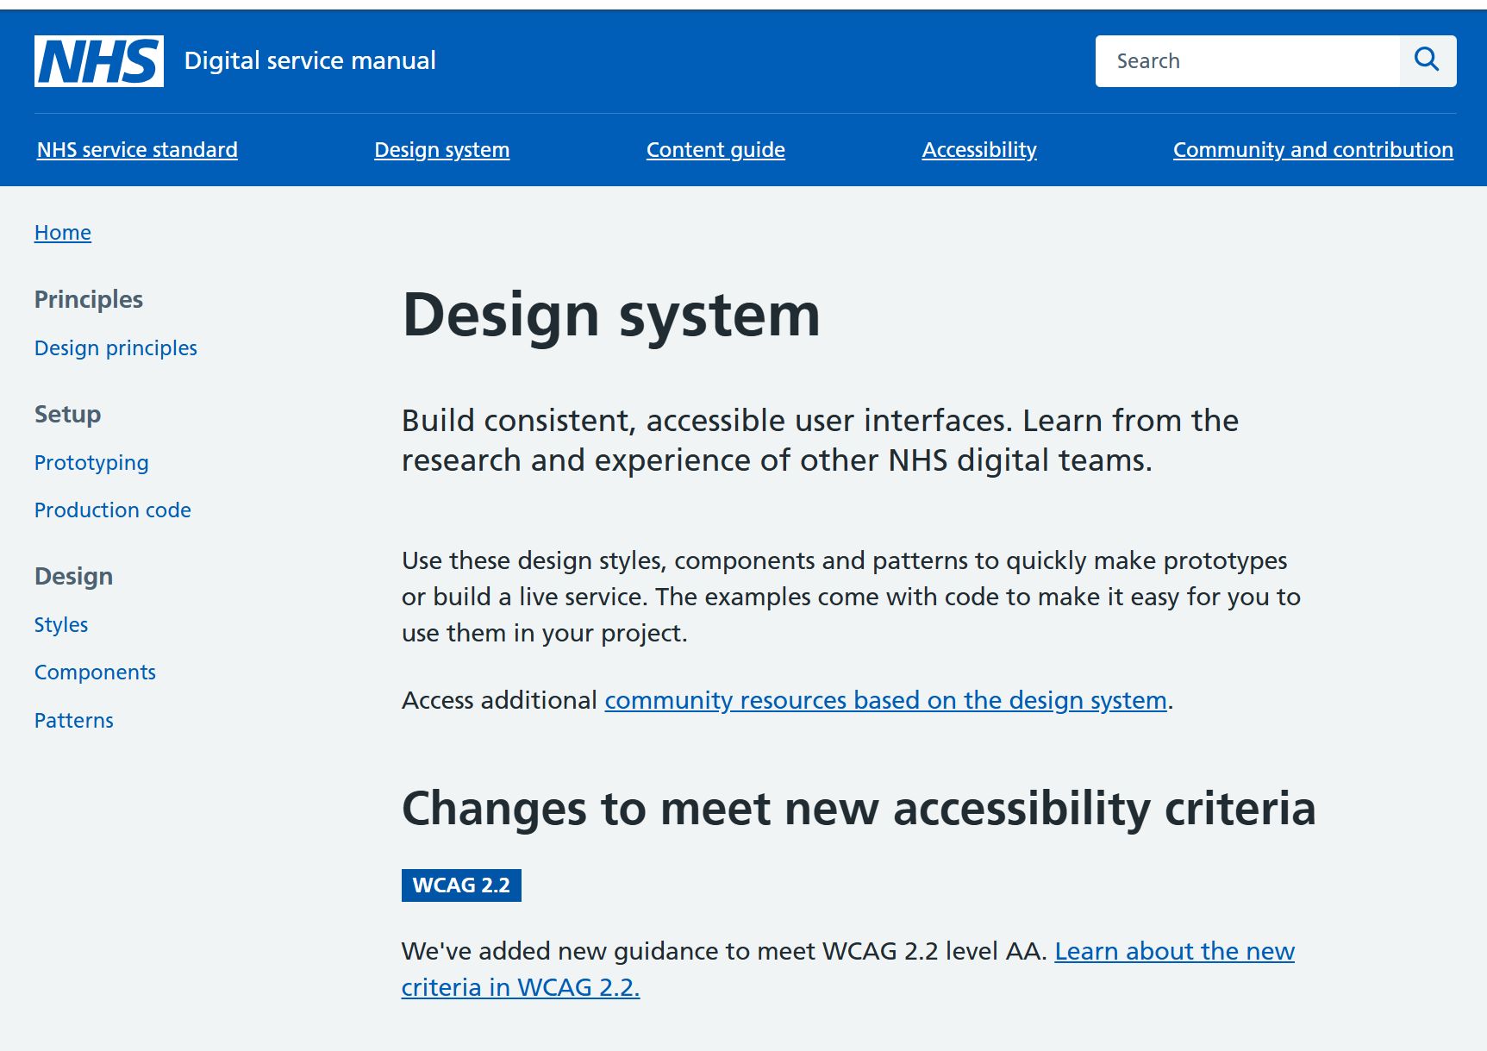
Principles
Accessible
Scalable
Secure
Reusable components
NHS Design System

Slide 21
NDSP for DIDS v2.0 Roadmap
Done | In progress | Next | Before go live
Submission portal File upload | Data validation engine Permissions management | Validation feedback API submission functionality Collection management functionality (for NHSE staff) | Iterations based on user testing Full guidance & training

Slide 22
NDSP demo

Slide 23
User research – call for participants

Slide 24
Help shape the NDIT platform
We have an ongoing user research programme supporting the design and development of NDIT.
It is very important to have your involvement in this work:
  Understanding your needs and challenges
  Testing and improving designs.
Some of you have already started to get involved – thank you!
If you’re interested in participating, look out for our email invitations, or please send me an email: Sarah.thew2@nhs.net
Notes:
Plain slide with subhead and bullets

Slide 25



Questions?
DIDS Webpage: Diagnostic Imaging Data Set (DIDS) - NHS England Digital
Get in touch: dataset.development@nhs.net
Notes:
Plain slide with subhead and bullets

Slide 26
End slide

