Slide 1
Diagnostic Imaging Data Set (DIDS) v2.0
Webinar 3
Date: 03/12/2024
Time: 10:30am – 12:00pm
Presented by:
Chris Turner: Data Design Service, NHSE
Notes:
Standard title slide

Slide 2
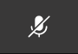
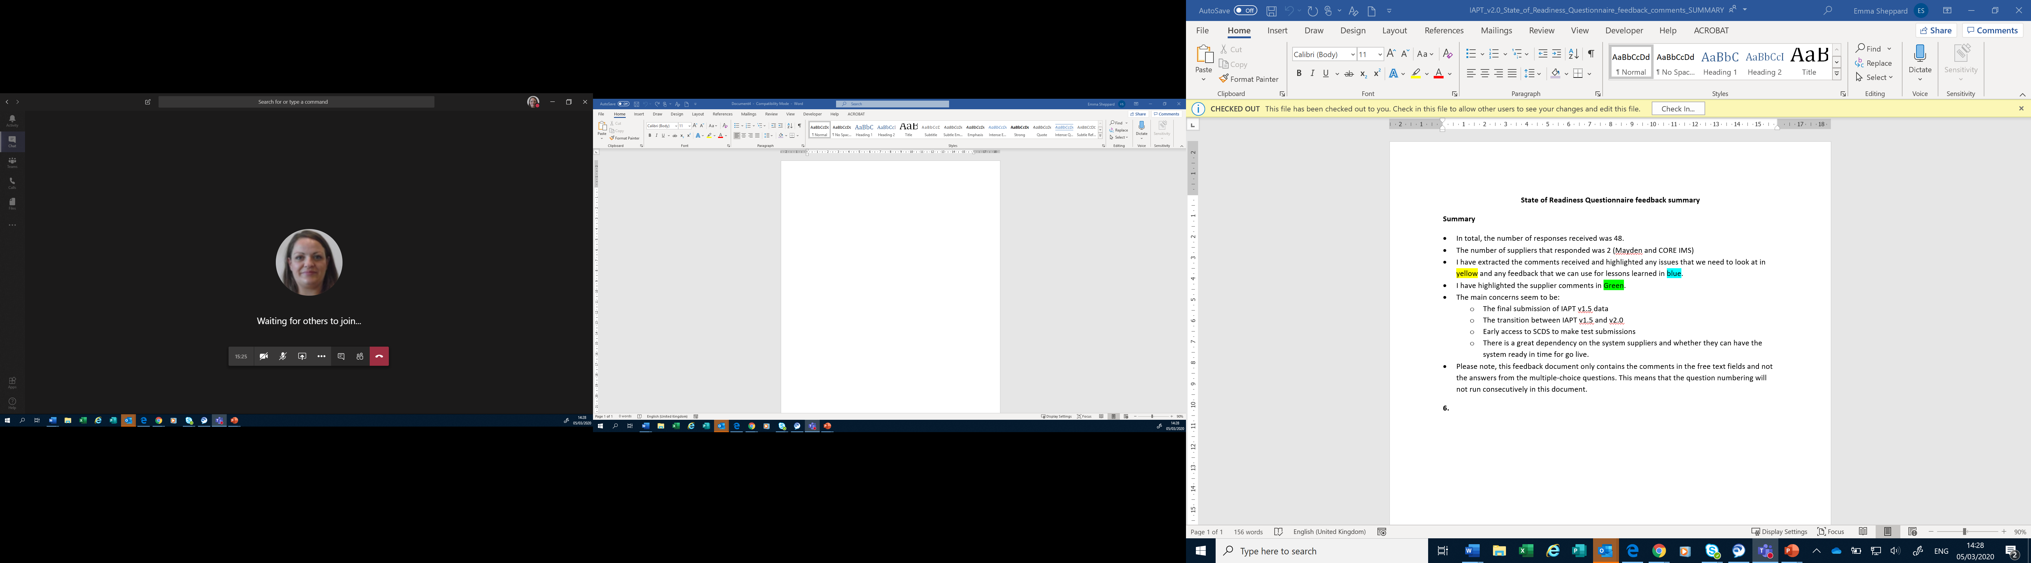
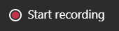
Housekeeping
Welcome and thank you for joining this webinar, the session will begin shortly.
Please note the following housekeeping points:
Please remain on mute throughout the webinar, unless indicated, to avoid disruption and noise interference for other attendees
If you wish to ask a question, raise a query or help us understand better the possible solution to a requirement during the webinar, you may do so via the meeting chat function, or by using the “raise your hand” function, all contributions are welcome!
To view the meeting chat, please select the ‘Show conversation’ icon in the Teams control task bar (pictured left)
If we are unable to answer your question due to time constraints, please forward it to dataset.development@nhs.net and we will pick it up via our mailbox
This webinar will be recorded and published. The recording will help us to update and publish the slide pack covering the questions and answers raised and allow people unable to make the webinar the chance to get involved.
Notes:
Plain slide with subhead and bullets

Slide 3

Consultation Approach
This is the final planned webinar which is relevant to all providers, suppliers and services that are or may be in scope to submit the Diagnostic Imaging Data Set.
The target audience for this webinar is recommended for:
All providers / submitters
IT system suppliers
Users of the data
It may also be relevant for other stakeholders with an interest in DIDS.
The focus of this webinar will be primarily to run through the last of the requirements that have already been through the Expert Reference Group (ERG).
Diagnostic Imaging Data Set v2.0 Public Consultation - NHS England - Citizen Space
Notes:
Plain slide with subhead and bullets

Slide 4
DIDS v2.0 – Development Overview
Overview (Planned Timelines)
Data Alliance Partnership Board (DAPB) process started in January 2024
We previously gave the view of activity potentially collected from 1 April 2025 and indicated that data would be submitted from 1 May 2025 (for v2.0)
DIDS v2.0 overview of timelines (updated):
- Consulting on local collection of activity from 1 October 2025, and,
- Submission of data to NHSE from 1 November 2025.
DIDS v2.0 Information Standards Notice (ISN) – planned to be published by 31 March 2025.
These timelines are subject to potential change following the consultation.
Development Process
30 requirements were gathered for consideration:
  NHSE
  NHS Data Model & Dictionary
  Providers & IT Suppliers
Requirements elaboration undertaken:
Engagement with NHSE, NHS Data Model & Dictionary, Terminology teams and all stakeholders
Series of consultation ERGs and webinars
Requirements planned to be taken forward are in consultation
Online Public Consultation Diagnostic Imaging Data Set v2.0 Public Consultation - NHS England - Citizen Space - closes on 20/12/2024

Slide 5
DIDS v2.0 – Requirements List
The Requirements List is published here: Diagnostic Imaging Data Set (DID) data product - NHS England Digital
DIDS001 - Recording DNAs
* DIDS010 - Other RCR conditions
DIDS012 - Radiation dose
* DIDS013 - RIS Free Text Report
* DIDS026, DIDS028 & DIDS029 - Potential Scope changes / defining a patient / IT system list expansion
* DIDS002 - Current dates to Timestamps (end timestamp effects)
DIDS003 - Additional Timestamps
DIDS004 - Urgency of the request
* DIDS005 - Waiting list v planned waits
* DIDS008 - Addition of main speciality / treatment function of the request code
DIDS011 - Auto-reported flag
DIDS015 - Data Dictionary Changes
DIDS020 - NICIP codes
DIDS023 - ETOS creation
* DIDS024 - General anaesthetic
DIDS030 - Screening service flag in referral
DIDS006 - Measuring complexity
DIDS009 - Publish numbers of interventional procedures
DIDS018 - Paramedic guidance
DIDS019 - Guidance GP scenario
* DIDS021 - Outsourcing
DIDS016 - Clinical Outcome Text same as DIDS013
DIDS027 - Submission window repeat same as DIDS022
DIDS014 - Cancer flag
DIDS017 - Submission method
DIDS022 - Submission window
DIDS025 & DIDS007 - Relational structure / Capture every scan
KEY
Red = Out of scope for v2
Green = Done and presented in webinars
Purple = Satisfied by other requirements
Blue = Satisfied by guidance
Grey = Duplicates of other requirements
Bold = To be covered today / needs follow up
*Proposed solution refined/change since last webinar

Slide 6
DIDS014 – Cancer flag
Alert flag to identify if the imaging showed a suspected or confirmed cancer, recurrence or progression. Also, the inclusion of RCR codes for significant unexpected findings.
Recommendations on alerts and notification of imaging reports | The Royal College of Radiologists (rcr.ac.uk)
Following further elaboration, only data about cancer would flow via the proposed item ‘CANCER INDICATION CODE (DIAGNOSTIC IMAGING)’.
This is planned to be a Pilot item (included in the Information Standard and then enabled when relevant guidance is made available).
01 | Confirmation / Probable primary cancer
02 | Confirmation / Probable recurrent cancer

Slide 7
DIDS017 - Submission method
DIDS has been collected on the same submission system for many years.
DIDS v2.0 is planned to be collected on a different system instead, SDCS Cloud.
SDCS Cloud is a data submission portal to collect data for NHS England. It is a strategic collection mechanism and has been used for a number of years for other national data collections.
There are several changes that users can expect to see from SDCS Cloud compared to the current DIDS Portal for example, a new account will be needed, the authentication process will change and how providers access data quality reports.

Slide 8
DIDS017 - Submission method (Transition to v2.0)
After consideration of the options, we plan to implement a hard-cut over from DIDS v1.0 to DIDS v2.0 by date of activity.
What does this mean?
The explanation on the next slide is based on local collection of activity in v2.0 from 01/10/2025 and submission of this to NHSE from 01/11/2025.

Slide 9
DIDS017 - Submission method (Transition to v2.0)
All activity (i.e. where DIAGNOSTIC TEST DATE <= 30/09/2025) would be submitted in the DIDS v1.0 data set and v1 schema into the DIDS legacy portal.
All activity in DIDS v2.0 (planned to be defined via the data item CODED PROCEDURE END TIMESTAMP) of >= 2025-10-01T00:00:00 +01:00 would be submitted in the DIDS v2.0 data set and v2 schema and to the new collection system from 01/11/2025 onwards.
Providers would be asked to submit activity in DIDS v1.0 to the current timescales (i.e. should submit data within 3 months after the month if which the activity took place) but activity would be able to be submitted up to 6 months after the DIAGNOSTIC TEST DATE through the current ‘Bypass’ process if necessary (i.e. no change from what is in place now).
This means that providers could submit activity where DIAGNOSTIC TEST DATE <= 30/09/2025) in the v1.0 data set and v1 schema into the DIDS legacy portal up to and including 31/03/2026.
From 01/04/2026 then no activity would be able to be submitted in the DIDS v1.0 dataset and v1 schema or to the DIDS legacy portal.
For the period from 01/11/2025 up to and including 31/03/2026, we would allow two routes for submissions (i.e. DIDS legacy portal for v1.0 data and new collection system for v2.0 data) but we would have validation so that the same activity cannot be submitted in both routes.

Slide 10
DIDS017 - Submission method (Transition to v2.0)
DIDS v1 data in v1 schema
DIAGNOSTIC TEST DATE <=30/09/2025
DIDS legacy portal
Submitted up to and including 31/03/2026
DIDS v2.0 data in v2 schema
CODED PROCEDURE END TIMESTAMP >= 2025-10-01T00:00:00 +01:00
DIDS new submission system (planned to be SDCS Cloud)
Submitted from
01/11/2025 onwards

Slide 11
DIDS017 - Submission method (Transition to v2.0)
Do you have any comments or feedback on this?
What could be done to help support a hard cut-over and transition from DIDS v1.0 to DIDS v2.0?

Slide 12
DIDS022 - Submission window
DIDS submission process currently has a manual element to processing submissions after the required time (via the ‘Bypass’ process).
Aim in moving to DIDS v2.0 is to have an automated, more efficient process for the management of the submission window.
To support the sector in the implementation of v2.0, we plan to allow 6 months to submit DIDS v2.0 data for the first 12 months of submissions of DIDS v2.0 as standard (rather than the standard 3 months).
Thereafter, we plan to move to a 3-month submission window for DIDS with no exceptions to allow more timely submission and use of data.

Slide 13
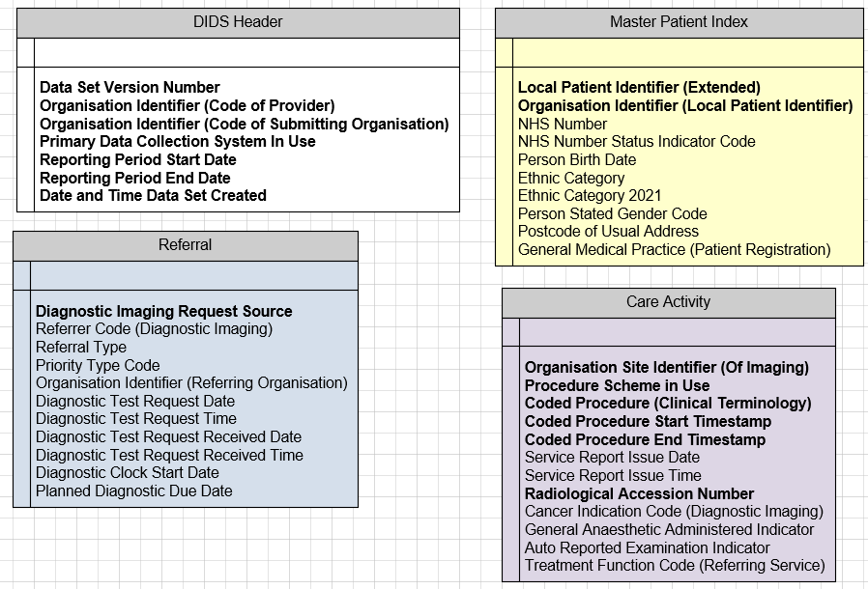
DIDS025 & DIDS007 – Relational structure / Capture all scans
Mandatory = all v1.0 data items (+ direct replacements that were Mandatory)
All Header data items
Local Patient ID (Extended)
Organisation ID (Local Patient ID)
Mandatory data items are shown in bold

Slide 14
DIDS025 & DIDS007 – Relational structure / Capture all scans
The proposal is to remain with a flat structure to better match current RIS structures, less data transformation and reliance on ID creation to link tables together
Current guidance will remain i.e. submit the most complex scan
The proposed structure should allow in the future (if a standard coding list is created) the capture of multiple scans

Slide 15
DIDS030 – Screening service flag in referral
To allow the capture of referrals from a screening programme. This would be added to the data item PATIENT SOURCE SETTING TYPE (DIAGNOSTIC IMAGING) (planned to be renamed to DIAGNOSTIC IMAGING REQUEST SOURCE).
01 - Admitted Patient Care - Inpatient (this Health Care Provider). This National Code is based on INTENDED MANAGEMENT at the time of the DIAGNOSTIC TEST REQUEST.
02 - Admitted Patient Care - Day case (this Health Care Provider). This National Code is based on INTENDED MANAGEMENT at the time of the DIAGNOSTIC TEST REQUEST.
03 - Outpatient (this Health Care Provider)
04 - GP Direct Access
05 - Emergency Care Department (this Health Care Provider)
06 - Other Health Care Provider
08 - Screening Programme
99 - Other

Slide 16
DIDS002 Date / Time Formats & DIDS003
Duration V End Time
For data items DIAGNOSTIC TEST REQUEST DATE, DIAGNOSTIC TEST REQUEST RECEIVED DATE, SERVICE REPORT ISSUE DATE, the TIME is also being requested.
Two data items or 1? Match the RIS
2024-11-21
14:30:23
or
2024-11-21T14:30:23

Slide 17
DIDS005 Clock Start Date
Two new data items are proposed with definitions below:
Aim is to allow better measurement of the time taken from a referral being made to the activity occurring.
DIAGNOSTIC CLOCK START DATE | The DIAGNOSTIC CLOCK START DATE refers to the diagnostic clock start time for a Diagnostic Waiting List referral type (01).
PLANNED DIAGNOSTIC DUE DATE | The PLANNED DIAGNOSTIC DUE DATE refers to the planned date for a Planned Diagnostic referral type (02)

Slide 18
Local Codes mapping to NICIP code
The current DIDS Information Standard published in 2016 makes clear this is an interim process ‘An interim “local codes mapping” service will be provided by NHS Digital which will map local codes into the relevant NICIP code by using a mapping file provided by you’
We understand this feature has only been used by a minority of users.
We plan to discontinue this feature in DIDS v2.0, to allow a focus on other changes and support the new structure of enforcing either NICIP or a SNOMED CT code to be submitted.

Slide 19
CODED PROCEDURE END TIMESTAMP
Paired with CODED PROCEDURE START TIMESTAMP, CODED PROCEDURE END TIMESTAMP will replace DIAGNOSTIC TEST DATE.
CODED PROCEDURE END TIMESTAMP will define what activity is in a month for v2.0.
For example, for ‘April 2026’ activity in DIDS v2.0, would be where the CODED PROCEDURE END TIMESTAMP is:
>=2026-04-01T00:00:00 +01:00, and,
<=2026-04-30T23:59:59 +01:00
This data item is planned to be used (rather than CODED PROCEDURE START TIMESTAMP) to flow activity which has completed.

Slide 20
Tidy up items
Radiological Accession Number (RAN) is NOT being replaced / renamed
Local Patient ID (Extended) and Organisation Identifier (Local Patient ID) are mandatory
DIDS v2.0 used for direct care

Slide 21
DIDS v2.0 used for direct care
Improving how we use data to support the NHS was a key theme highlighted in the Data Saves Lives policy paper. As part of this drive NHSE is seeking to enable where possible all of its data products to meet new and emergent user needs.
Examples include the NHS England Cohorting as a Service, and also our work to support research and innovation to power new medical treatments through the DigiTrials service. As these uses of the data involve actions taken at the individual patient level from a information governance perspective they are considered to be direct care rather than secondary use in their classification.
We are therefore clarifying that these types of use cases maybe applicable to the data we collect going forward in the future within the new information standard for DIDs v2.0.

Slide 22
DIDS data users - transition impact (See 37 – 1st Q)
Due to the switch over of submissions of DIDS data from v1.0 to v2.0, it may not be possible to consistently report on specific data items for the full financial year in which this change will occur.
Do you see any major problems in relation to how you utilise DIDS data because of this?

Slide 23
DIDS data users - transition impact (See 37 – 2nd Q)
To support providers during the switch over to DIDS v2.0:
There will for the first 12-months be an extension to the standard submission window for DIDS v2.0 before finalising reporting activity from any specific month (which will be 6 months as a standard option from the current standard 3 months).
This could result in provisional cuts of data for most recent DIDS activity submitted in this time to be less complete and accurate than is currently the case. This might impact certain analytical insights which can be achieved from the data for this time-period.
Do you see any major problems in relation to how you utilise DIDS data because of this?

Slide 24
Data Items renamed
The following data items have had their names changed since the last webinar, are reflected in the new draft TOS and available for comment in the public consultation.
PATIENT SOURCE SETTING TYPE (DIAGNOSTIC IMAGING) - DIAGNOSTIC IMAGING REQUEST SOURCE
REFERRER CODE - REFERRER CODE (DIAGNOSTIC IMAGING)
PROCEDURE SCHEME IN USE (IMAGING) - PROCEDURE SCHEME IN USE
GENERAL ANAESTHETIC INDICATOR - GENERAL ANAESTHETIC ADMINISTERED INDICATOR
CANCER INDICATION CODE (IMAGING) - CANCER INDICATION CODE (DIAGNOSTIC IMAGING)
AUTO REPORT INDICATOR - AUTO REPORTED EXAMINATION INDICATOR

Slide 25
SDCS Cloud – Summary of main changes expected
New account needed to submit data.
SDCS Cloud requires Two-Factor Authentication (2FA) to login.
New ‘Header’ data will be needed to allow files to be received via SDCS Cloud and processed (this is shown in the TOS).
Validations planned to be undertaken in DPS (Data Processing Service) and schema to submit data will change (for example not expected to have enumeration in it, though expect similar data quality checks to be undertaken as with DIDS data now).
Data submitters will receive data quality reports on submitted data, which will be available from SDCS Cloud.
SDCS Cloud will allow test DIDS submissions before DIDS v2.0 data is submitted, to allow users to assess their data quality.
Expected that users will be able to choose to submit DIDS v2.0 data in either XML or CSV format.

Slide 26
Important information
Previous DIDS v2.0 webinar slides (1 and 2) are available on the NHS England website. (Recordings also on FutureNHS Diagnostic Imaging Data Set (DIDS) Forum).
Technical Output Specification (TOS) is included in the consultation Related documents.
TOS includes proposed data item names, definitions and information such as whether data items are Mandatory, Required, Optional or Pilot. Respondents are advised to read the TOS as part of considering their response to this consultation.
Consultation closes on 20 December 2024. (Please remember to add feedback, such as reasons for your answers in free text boxes as appropriate).
Responses need to be submitted via Citizen Space.
For any queries on/about the consultation please contact: dataset.development@nhs.net

Slide 27



Questions?
DIDS Webpage: https://digital.nhs.uk/data-and-information/data-collections-and-data-sets/data-sets/diagnostic-imaging-dataset-did-data-product
Get in touch: dataset.development@nhs.net
Notes:
Plain slide with subhead and bullets

Slide 28
End slide

