Slide 1
Diagnostic Imaging Data Set (DIDS) v2.0
Implementation Webinar 8
Date: 08/06/2026
Time: 10:00am – 11:00am
Presented by:
John Winter – Data Delivery Lead, NHSE
Chris Turner - Data Design Service, NHSE
Notes:
Standard title slide

Slide 2
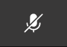
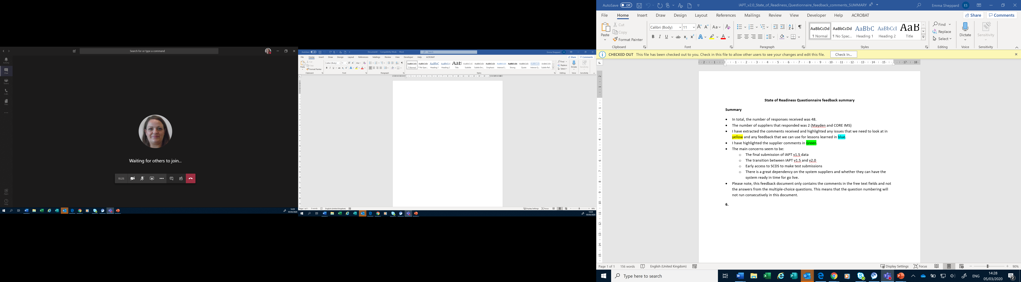
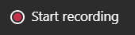
Housekeeping
Welcome and thank you for joining this webinar, the session will begin shortly.
Please note the following housekeeping points:
Please remain on mute throughout the webinar, unless indicated, to avoid disruption and noise interference for other attendees
If you wish to ask a question or raise a query during the webinar, you may do so via the meeting chat function, or by using the “raise your hand” function, all contributions are welcome!
To view the meeting chat, please select the ‘Show conversation’ icon in the Teams control task bar (pictured left)
If we are unable to answer your question due to time constraints, please forward it to dataset.development@nhs.net and it will be picked up via this mailbox
This webinar will be recorded and published. The recording will help us to update and publish the slide pack covering the questions and answers raised and allow people unable to make the webinar the chance to get involved.
Notes:
Plain slide with subhead and bullets

Slide 3
Webinars
This is the eighth in a series of planned webinars which is relevant to all providers, suppliers and services that are or may be in scope to submit the Diagnostic Imaging Data Set (DIDS).
The slides from the first 7 implementation webinars are available here: Diagnostic Imaging Data Set (DIDS) implementation tools and guidance - NHS England Digital
The target audience for this webinar is:
  All care providers / submitters
  IT system providers
  Other stakeholders with an interest in DIDS data
This webinar will include an update on the DIDS v2.0 implementation, an opportunity to raise any implementation queries and an update on NDIT.
Notes:
Plain slide with subhead and bullets

Slide 4
Key updates since April Webinar
National data collection has now commenced via NDSP from 1 June 2026 (a communication was issued on this date).
This has now commenced for both April 2026 and May 2026 reporting periods.
Updates to DIDS v2.0 submission timetable (April 2026 reporting month dates extended by a month due to delay of national collection commencing from 1 May to 1 June 2026).
NHS Data Model and Dictionary updates for DIDS v2.0 now live.
Minor update to information for Sensitive and Legally Restricted codes in response to questions received.
Notes:
Plain slide with subhead and bullets

Slide 5
National data collection commenced
Details of DIDS v2.0 submissions as of 16:00 on 05/06/2026:
Type of Submission | Rejected* | Success** | Total Number of Submissions
Test | 320 | 25 | 345
Submission & Resubmission | 61 | 14 | 75
Total | 381 | 39 | 420
Unique number of submitters = 49
Percentage of expected submitters that have submitted data (total, test and/or live) = 32% (49/155)
Percentage of expected submitters that have submitted non test submissions = 12% (18/155)
Rejected* – the file failed validation and was not accepted (this also includes where the file could not be processed).
Success** – the file passed validation with no errors or warnings (Successful) or the file passed validation, but warnings were found (Successful with warnings).
Test - This file is used only to test whether your data meets validation rules. It does not update or replace a live submission and is not used by NHS England for reporting.
Submission - The first submission of data for a reporting period.
Resubmission - Submission sent after a previous submission for the same reporting period, usually done to correct errors or update data.
Notes:
Plain slide with subhead and bullets

Slide 6
April reporting month – submission timetable
April 2026 and May 2026 reporting months; submission windows are running concurrently.
Dates for submission of April 2026 reporting month have moved back by a month for all three dates.
Dates for the May 2026 reporting month and other months have not changed.
Changes to submission timetable highlighted in yellow:
Activity month/reporting period | Submission window opens | Provisional processing deadline at 11.59.59 pm | Submission window closes at 11.59.59 pm
April 2026 | 1 June 2026 | 30 June 2026 | 30 November 2026
May 2026 | 1 June 2026 | 30 June 2026 | 30 November 2026
June 2026 | 1 July 2026 | 31 July 2026 | 31 December 2026
Notes:
Plain slide with subhead and bullets

Slide 7
NHS Data Model and Dictionary updates
Now published for June 2026.
NHS Data Model and Dictionary website: NHS Data Model and Dictionary
Release History page with a link to DAPB1577 Diagnostic Imaging Data Set (DIDS) v2.0: Release History
Link to the Diagnostic Imaging Data Set page: Diagnostic Imaging Data Set
DIDS v2.0 ETOS will be updated as necessary to include final links (a communication would be issued as and when this takes place - the current ETOS remains in use).

Slide 8
Reminder - Sensitive & Legally Restricted Codes
As per the DIDS v2.0 Data Provision Notice, the below is the list of restricted codes which must be anonymised at source prior to submission of DIDS v2.0 data to NHS England.
For these data, data providers must submit data for DIDS v2.0 with all patient identifiers removed for the data items NHS NUMBER, PERSON BIRTH DATE, POSTCODE OF USUAL ADDRESS and LOCAL PATIENT IDENTIFIER (EXTENDED). This includes submitting a LOCAL PATIENT IDENTIFIER (EXTENDED) given this is a mandatory data item which is in the required format but is not an identifier for a patient.
SNOMED CT concept-ID | SNOMED CT fully specified name
432787004 | Transvaginal ultrasonography for follicle monitoring (procedure)
252939009 | Ultrasound scan for follicle monitoring (procedure)
NICIP short code | NICIP preferred representation display term
UFOTV | US Follicular tracking transvaginal
UFOTA | US Follicular tracking transabdominal
Notes:
Plain slide with subhead and bullets

Slide 9
Reminder - System Conformance Checklist
The DIDS System Conformance Checklist is a tool to help care providers assess how well their local IT systems map to the DIDS v2.0 Technical Output Specification.
It can be found here:
Diagnostic Imaging Data Set (DIDS) implementation tools and guidance - NHS England Digital
Notes:
Plain slide with subhead and bullets

Slide 10
Top 5 validation issues (first week)
Error code DIDS00300701
DIDS00300502
DIDS00300602
DIDS00200302
DIDS00200601
Notes:
Plain slide with subhead and bullets

Slide 11
Timestamp formats
DIDS00300701 | File Rejected - [DIDS003007] service_report_issue_timestamp has an incorrect data format. [DIDS003007] service_report_issue_timestamp=<service_report_issue_timestamp> [DIDS003001] radiological_accession_number=<radiological_accession_number>
DIDS00300502 | File Rejected - [DIDS003005] coded_procedure_start_timestamp has an incorrect data format. [DIDS003005] coded_procedure_start_timestamp=<coded_procedure_start_timestamp> [DIDS003001] radiological_accession_number=<radiological_accession_number>
DIDS00300602 | File Rejected - [DIDS003006] coded_procedure_end_timestamp has an incorrect data format. [DIDS003006] coded_procedure_end_timestamp=<coded_procedure_end_timestamp> [DIDS003001] radiological_accession_number=<radiological_accession_number>
Notes:
Plain slide with subhead and bullets

Slide 12
Reminder – Timestamp Formats
Timestamp formats – Technical Glossary tab of the TOS / ETOS
Timestamps are formatted as "max an25" in the Data Dictionary.
A Timestamp is represented with the components of date, time and either the number of hours offset (plus or minus) from Greenwich Mean Time, or the letter Z to signify that it is the same as Greenwich Mean Time.
For DIDS, offset time is restricted to:
+01:00
+00:00
-00:00
Examples of valid formats are:
2020-08-21T10:15:20+01:00 British Summer Time (GMT + 1 Hour)
2020-08-21T10:15:20+00:00 Greenwich Mean Time
2020-08-21T10:15:20-00:00 Greenwich Mean Time
2020-08-21T09:18:00Z Greenwich Mean Time.
Notes:
Plain slide with subhead and bullets

Slide 13
Treatment Function Code
TREATMENT FUNCTION CODE (REFERRAL FOR DIAGNOSTIC IMAGING)
DIDS00200302 | Warning - [DIDS002003] treatment_function_code_referral_for_diagnostic_imaging contains an invalid value. [DIDS002003] treatment_function_code_referral_for_diagnostic_imaging=<treatment_function_code_referral_for_diagnostic_imaging> [DIDS003001] radiological_accession_number=<radiological_accession_number>
TREATMENT FUNCTION CODE (REFERRAL FOR DIAGNOSTIC IMAGING)
Notes:
Plain slide with subhead and bullets

Slide 14
Diagnostic Test Request Date
DIDS00200601 | File Rejected - [DIDS002006] diagnostic_test_request_date has an incorrect data format. [DIDS002006] diagnostic_test_request_date=<diagnostic_test_request_date> [DIDS003001] radiological_accession_number=<radiological_accession_number>
The date a DIAGNOSTIC TEST REQUEST was made.
Format: an10 CCYY-MM-DD
Notes:
Plain slide with subhead and bullets

Slide 15
Reminder – Activity submitted in a month
Submission months – first three:
April 2026 activity
CODED PROCEDURE END TIMESTAMP
>=2026-04-01T00:00:00+01:00, and,
<=2026-04-30T23:59:59+01:00
May 2026 activity
CODED PROCEDURE END TIMESTAMP
>=2026-05-01T00:00:00+01:00, and,
<=2026-05-31T23:59:59+01:00
June 2026 activity
CODED PROCEDURE END TIMESTAMP
>=2026-06-01T00:00:00+01:00, and,
<=2026-06-30T23:59:59+01:00
Notes:
Plain slide with subhead and bullets

Slide 16
Reminder - User Guidance
Diagnostic Imaging Data Set (DIDS) implementation tools and guidance - NHS England Digital
Notes:
Plain slide with subhead and bullets

Slide 17
Reminder – DIDS v1.0 Activity
DIDS v1.0 covers imaging activity up to and including 31 March 2026.
For this activity, DIDS v1.0 data is still required to be submitted to the legacy DIDS portal as per the DIDS v1.0 timetable.
Notes:
Plain slide with subhead and bullets

Slide 18
NICIP Codes – Useful Pointers
Release Schedule
Latest Release
Notes:
Plain slide with subhead and bullets

Slide 19
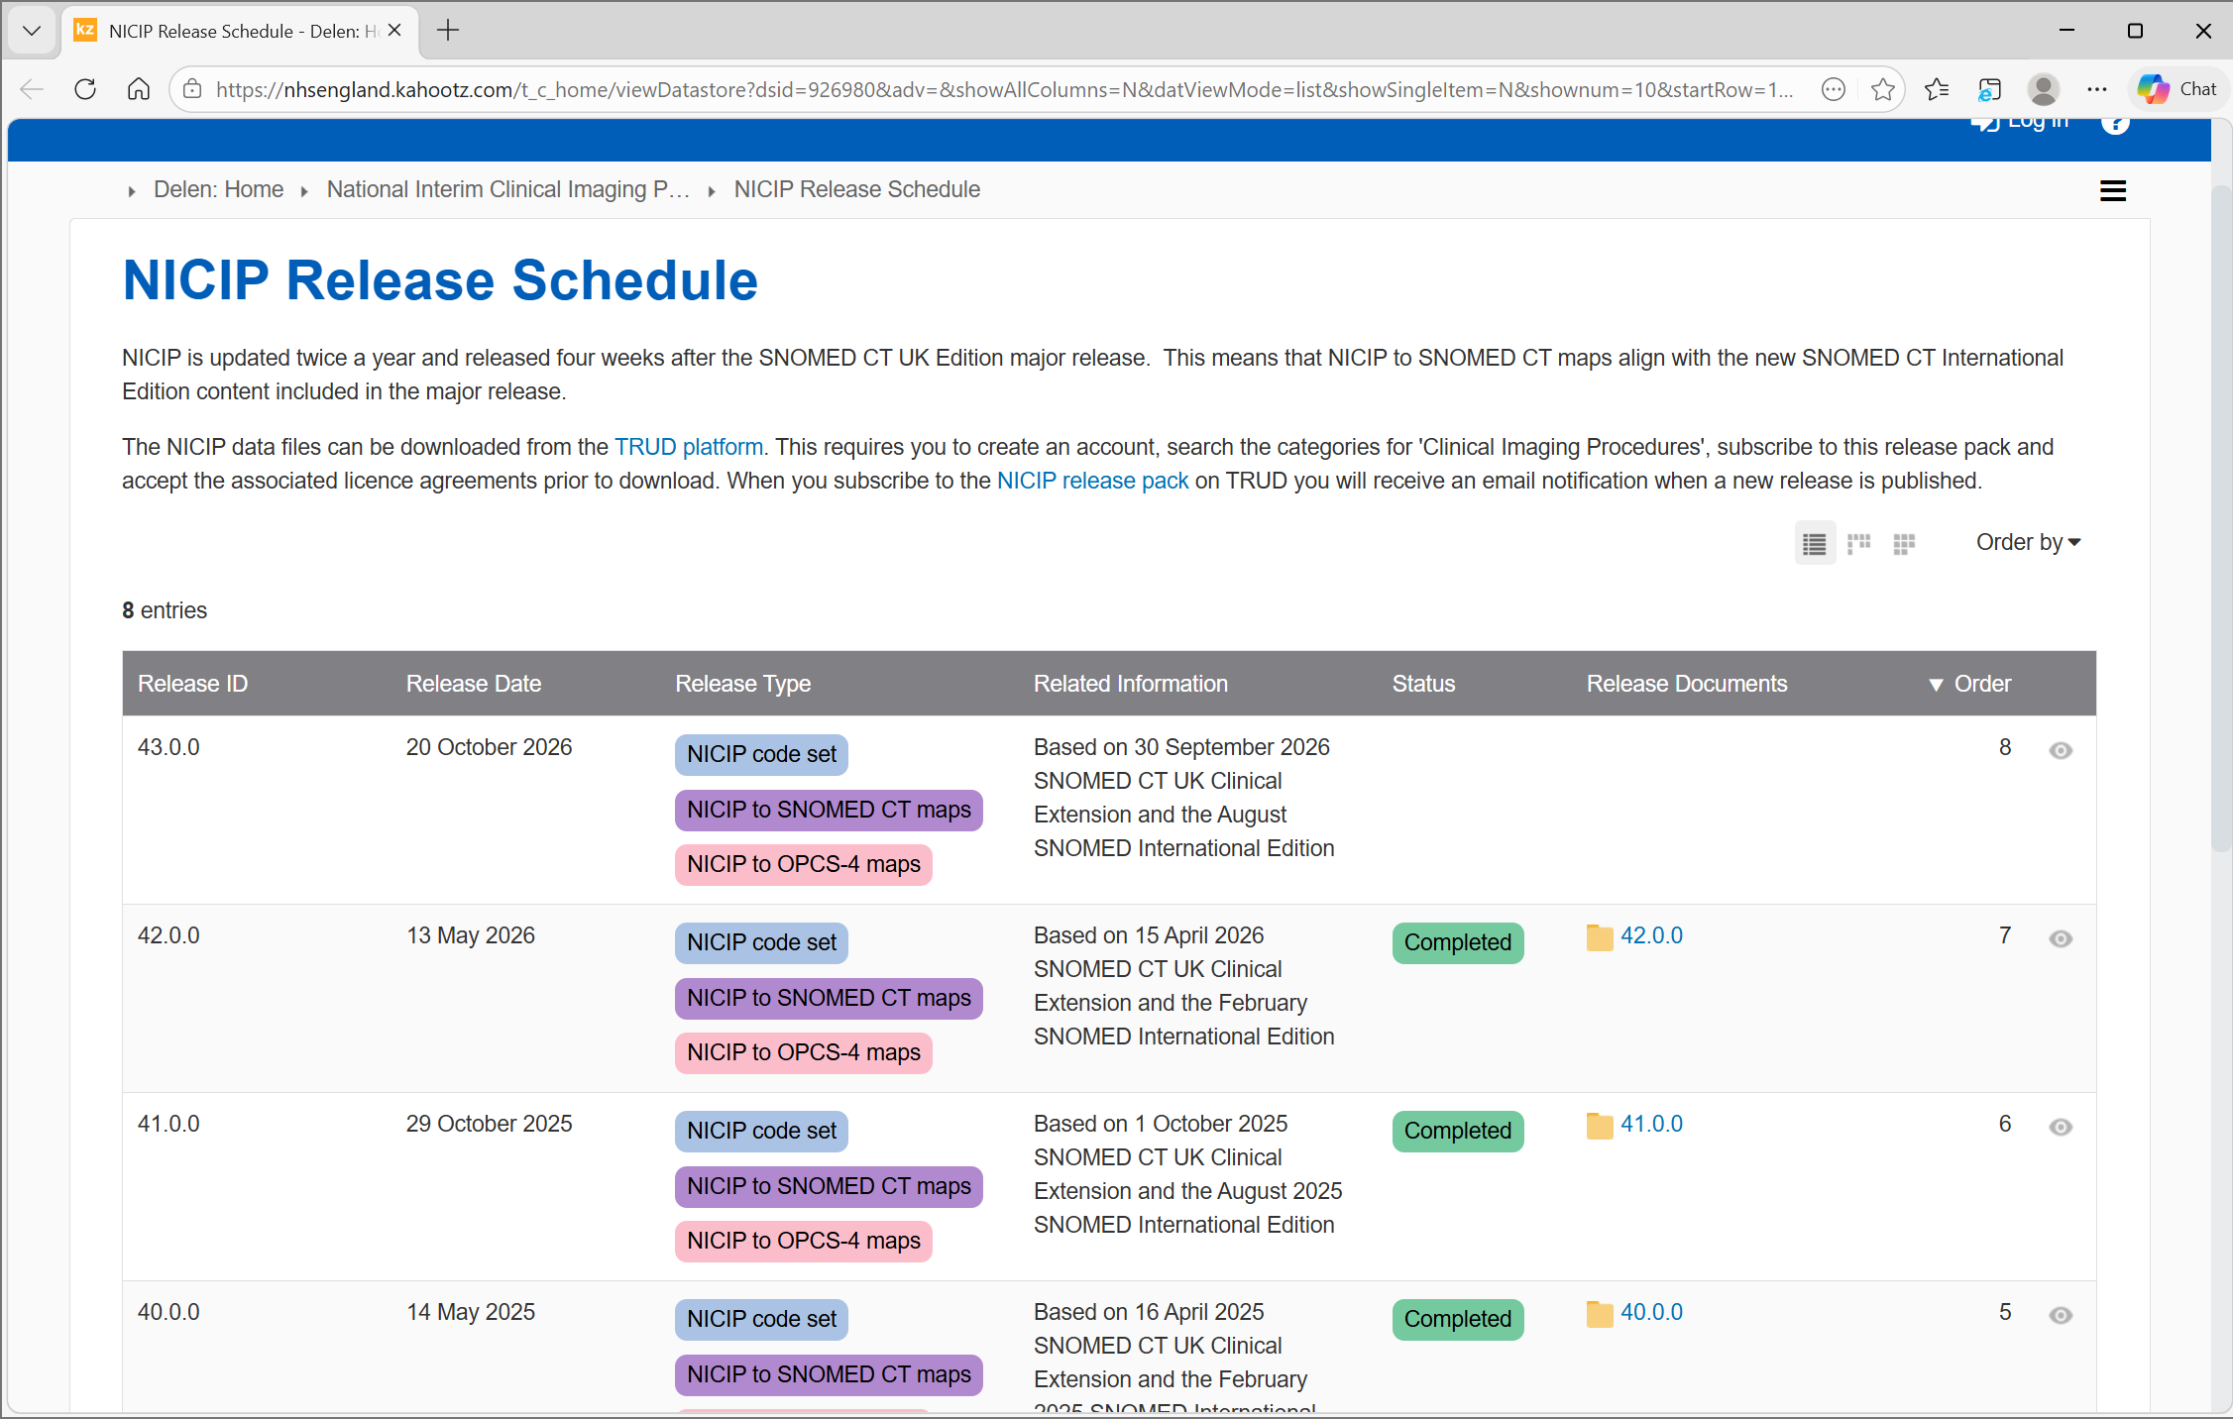
NICIP Codes – Release Schedule
NICIP is updated twice a year (in 2026 release dates are 13 May and 20 October)
Release Schedule on ‘Delen’
Notes:
Plain slide with subhead and bullets

Slide 20
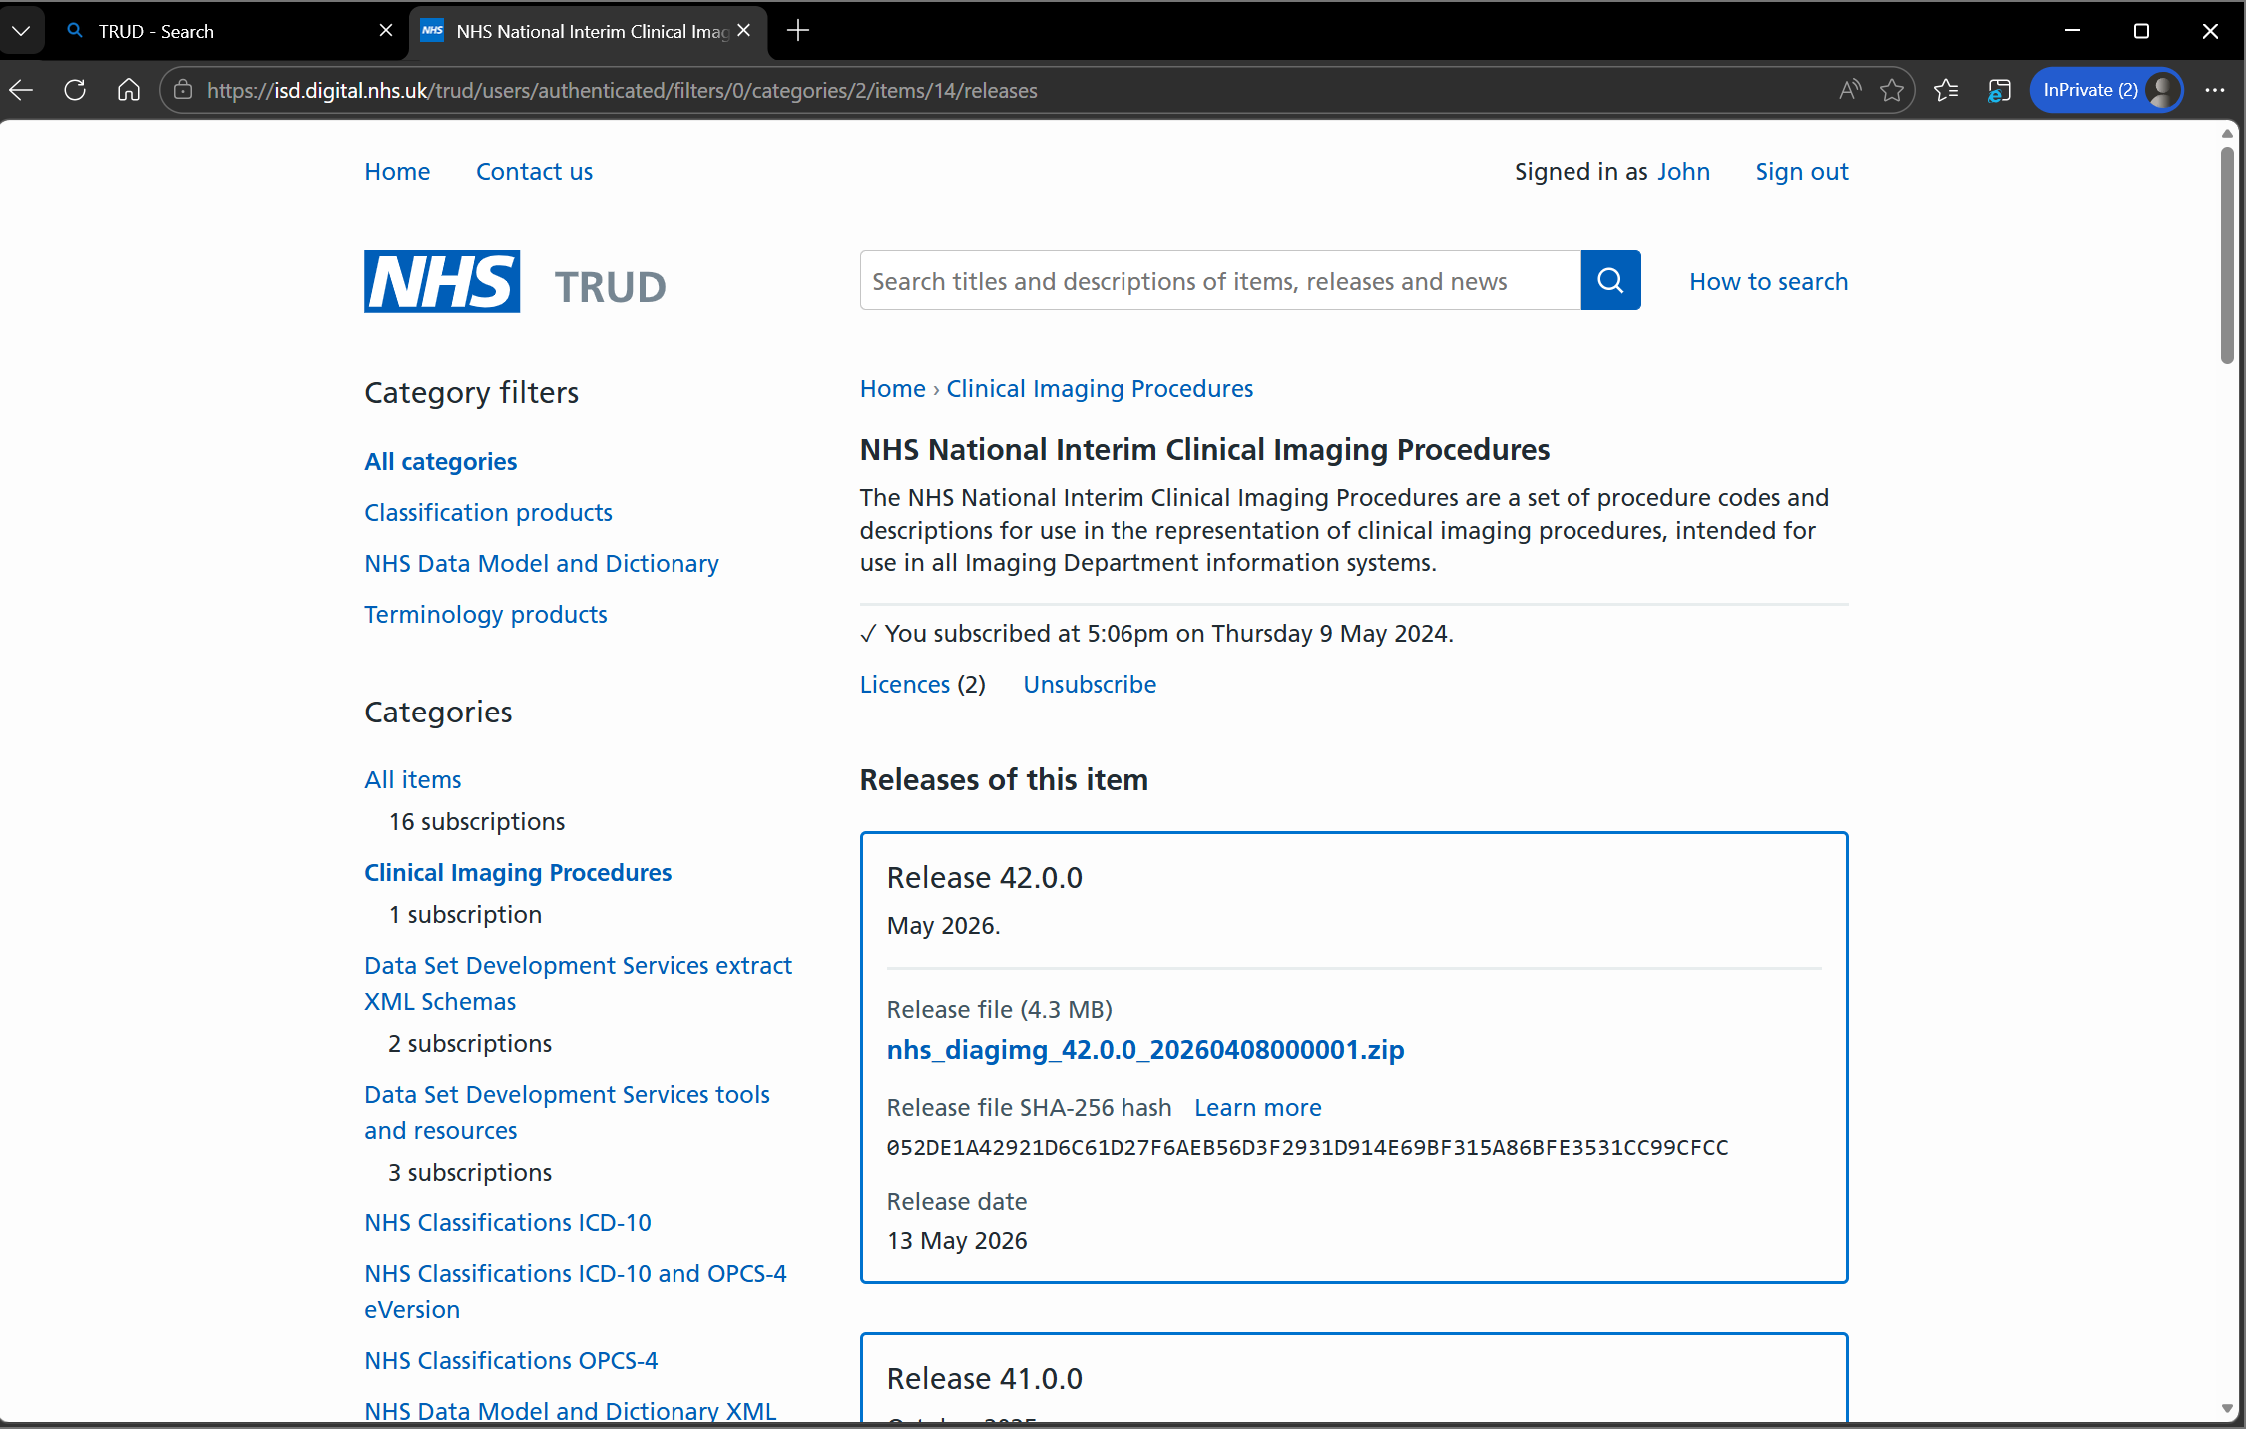
NICIP Codes – Latest Release
Latest NICIP release is 42.0.0 (Release date 13 May 2026)
This is available on TRUD (after subscribing to it)
Notes:
Plain slide with subhead and bullets

Slide 21
SNOMED Codes – Useful Pointers
Release Schedule
Ref Set
Notes:
Plain slide with subhead and bullets

Slide 22
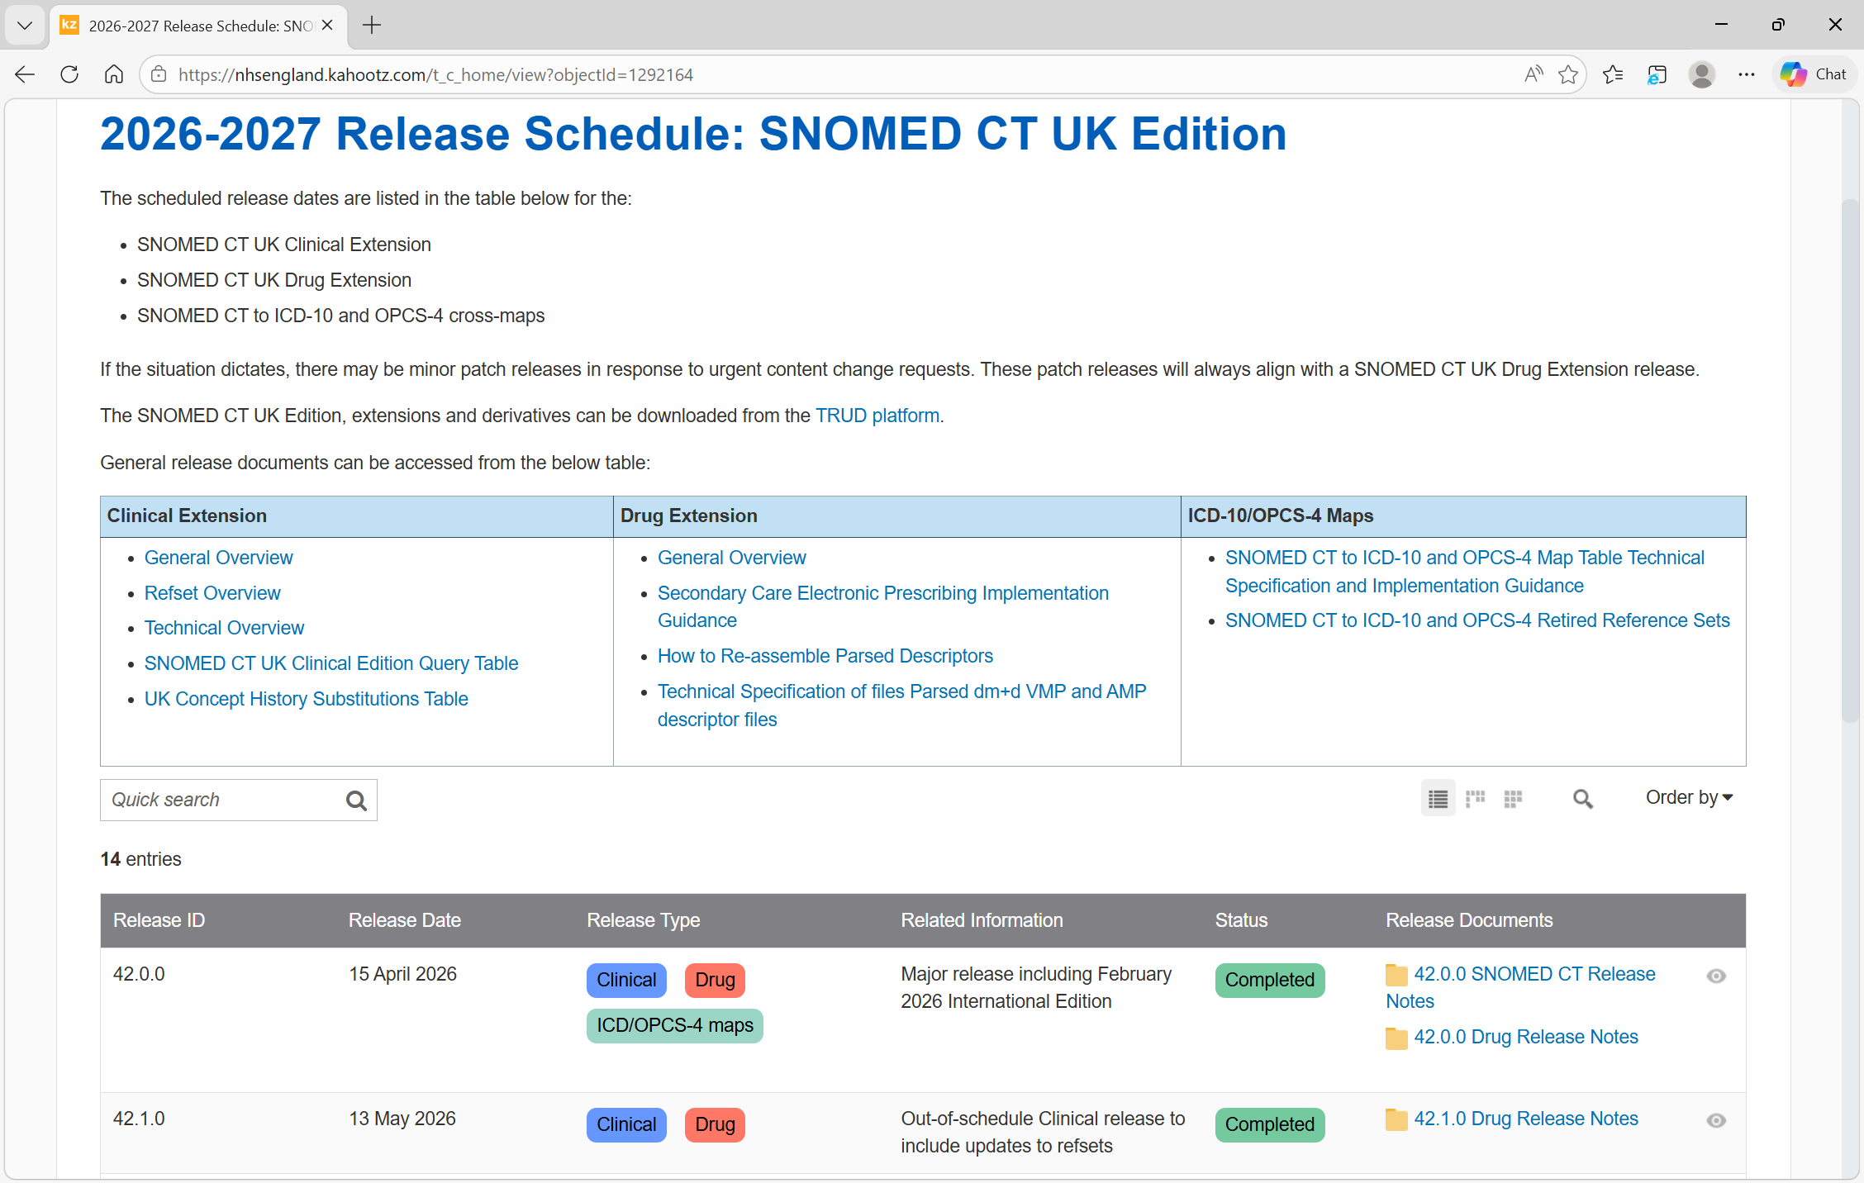
SNOMED Codes – Release Schedule
Release Schedule on ‘Delen’
Notes:
Plain slide with subhead and bullets

Slide 23
SNOMED Codes – Ref Set
Ref Set relevant for DIDS v2.0:
999001111000000105 |United Kingdom diagnostic imaging procedure simple reference set (foundation metadata concept)
Notes:
Plain slide with subhead and bullets

Slide 24
Data Liaison Service Supporting DIDS v2.0
The Data Liaison Service (DLS) is part of the Data Collection and Improvement service in NHS England.
We engage and support care providers by email, Teams and on a 1:1 basis at scale to onboard providers to new or changed data sets and improve data collected nationally.
DLS support has been prioritised to help care providers navigate their onboarding journey with preparatory activities, documentation, guidance and available resources for DIDS v2.0.
Your regional Data Liaison Manager is:
East of England Lynn Steele l.steele2@nhs.net
London Jon Ensor Jonathan.ensor@nhs,net
Midlands Paul Steele p.steele2@nhs.net
North East & Yorkshire Ela Bonsall ela.bonsall1@nhs.net
North West Julie Whittaker Julie.whittaker5@nhs.net
South East Ross Jenkins ross.jenkins1@nhs.net
South West Antoinette Salvador antoinette.salvador@nhs.net
DLS General Queries DLS Mailbox england.dataliaison@nhs.net
Please reach out to your regional Data Liaison Manager for queries or support (or to the DLS Mailbox, if unsure).
Notes:
Plain slide with subhead and bullets

Slide 25
Useful Addresses & Contacts
ISN Docs: DAPB1577: Diagnostic Imaging Data Set - NHS England Digital
Support and Guidance: Diagnostic Imaging Data Set (DIDS) implementation tools and guidance - NHS England Digital
TRUD: Home – NHS TRUD
Data Design Service: dataset.development@nhs.net
NDIT: england.nditprogramme@nhs.net
Data Liaison Service: england.dataliaison@nhs.net
Notes:
Plain slide with subhead and bullets

Slide 26
Actions to take now (if not already)
Read the User Guidance published on the DIDS tools and guidance webpage: Diagnostic Imaging Data Set (DIDS) implementation tools and guidance - NHS England Digital
Familiarise yourself with the Enhanced Technical Output Specification (ETOS) which contains validations NHS England will undertake when DIDS v2.0 data is received.
Care providers - ensure your IT system provider reviews the TOS, ETOS and User Guidance to understand scope and definition of each data item.
Continue local data collection of DIDS v2.0 data from 1 April 2026.
Undertake national data submission of DIDS v2.0 data from 1 June 2026 to NDIT.
Review your data validation reports for data submitted and correct errors/warnings using the ETOS.

Slide 27
Getting started with the National Data Submission Portal
Diagnostics Collections Providers Bi-Monthly User Group
NHS England NDSP team
Notes:
Standard title slide

Slide 28
Agenda
Update on NDSP
Common issues and how to solve them
Notes:
Plain slide with subhead and bullets

Slide 29

What is the National Data Submission Portal (NDSP)?
A single data submission portal that sits on the National Data Integration Tenant (NDIT) platform
Choice of submission routes
  File upload
  API
  Webform (not applicable for DIDS v2.0)
  FDP Local Tenant (not applicable for DIDS v2.0)
Consistent data validation
Collection management
Notes:
NDSP will sit on NDIT
A single data submission portal
Manage everything in one place
Ambition is to eventually consolidate 24+ legacy portals
Choice of submission routes to reduce burden
API, file transfer, file upload, webform and FDP local tenant flows
Consistent data validation
Data Validation Engine (DVE) using shared rules
Collection management
Management information, collection windows, permissions

Slide 30
Getting started

Slide 31
Getting started
Read the guidance for NDSP on our NHS Futures Site
  If you are from outside the NHS and need an invite to join, please contact robyn.mcnally1@nhs.net
If you don’t already have one, get a CIS2 account
  The best route is to contact your Registration Authority or IT helpdesk
Sign in using your CIS2 account and check that you have the correct permissions
  If you don’t, you can complete a permissions request
When you have the correct permissions, you can start submitting
  You can do real or test submissions
Notes:
Plain slide with subhead and bullets

Slide 32
Common issues
And how to fix them

Slide 33
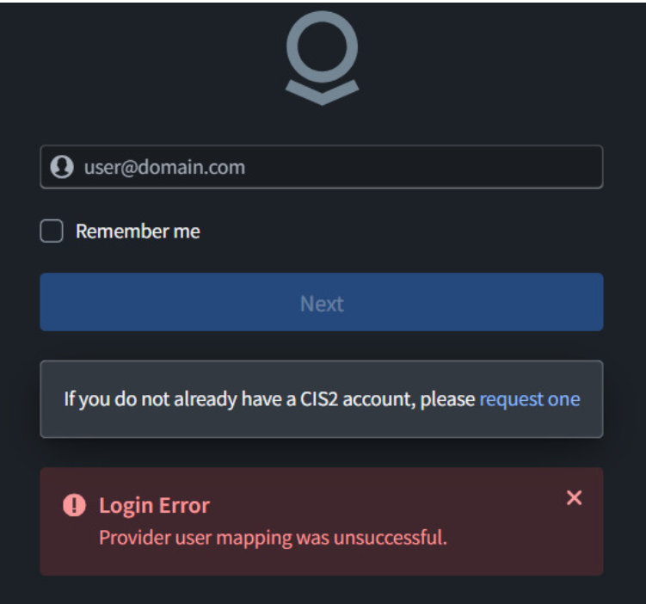
“Provider user mapping was unsuccessful”
If you receive this error, it is because your email address is not correctly set up on your CIS2 account.
To fix this, you should log in to CIS2 and ensure that your email address is correctly linked to your CIS2 account.
  If it is already set up, try un-setting your email address and then re-setting it.
  If you're having trouble with this step, contact your organisation's Registration Authority for help.
Notes:
Plain slide with subhead and bullets

Slide 34
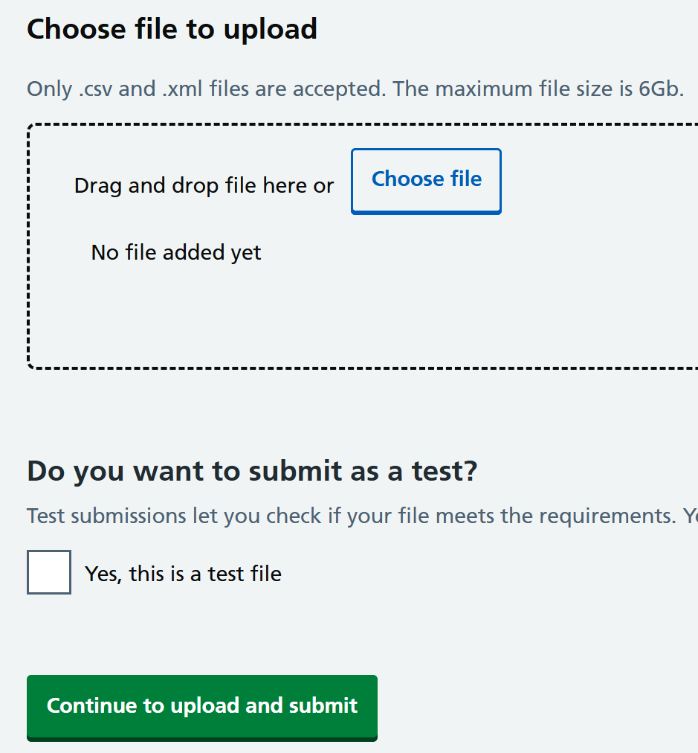
Can’t drag and drop CSV
Many users are receiving an error message when they try to drag and drop a file.
The team are investigating this and will deploy a permanent fix as soon as possible.
Workaround: “choose file” rather than dragging and dropping.
Notes:
Plain slide with subhead and bullets

Slide 35
Incorrect file rejection due to file creation being in the future
Some users are having files rejected for the file being created in the future, when in fact it was created in the recent past (within 1 hour).
The team have identified the issue and will deploy a permanent fix as soon as possible.
Workaround: wait one hour between extracting data and uploading it.
Notes:
Plain slide with subhead and bullets

Slide 36
Where to go for more information on NDSP

Slide 37
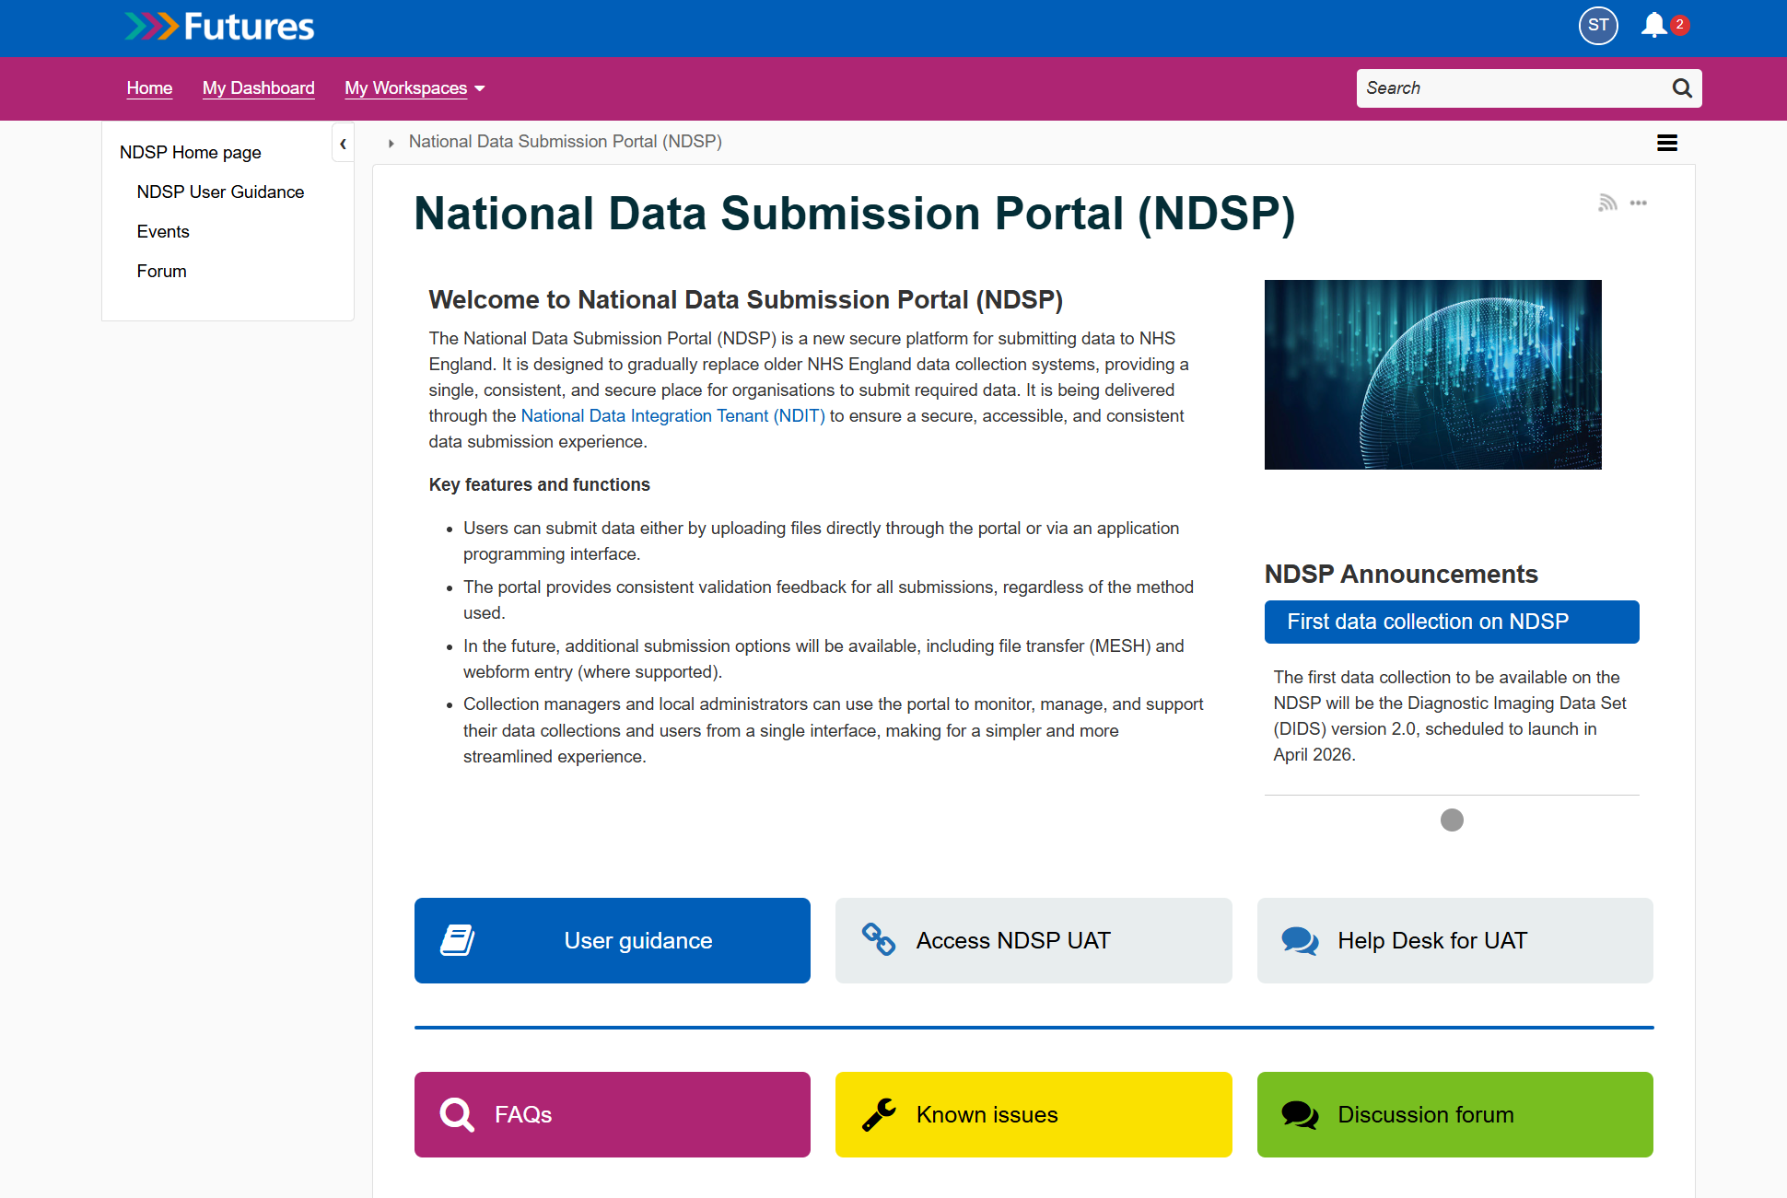
Further support
If you are having problems getting access or using the system you can:
1. Visit our NDSP support pages on NHS Futures
  Including FAQs & Known Issues
2. Email our support inbox for one-to-one support:
ssd.nationalservicedesk@nhs.net
Notes:
Plain slide with subhead and bullets

Slide 38
Share your feedback
Ongoing user research supports the design and development of NDSP and helps us ensure the platform is fit for your purposes.
Fill in our 3 question survey (it is very quick!) | https://feedback.digital.nhs.uk/jfe/form/SV_eS5m8DZXcFRcsR0

Slide 39
Q & A
Notes:
Plain slide with subhead and bullets

Slide 40
Further questions?
DIDS Webpage: Diagnostic Imaging Data Set (DIDS) - NHS England Digital
Get in touch: dataset.development@nhs.net
Notes:
Plain slide with subhead and bullets

