Slide 1
Diagnostic Imaging Data Set (DIDS) v2.0
Implementation Webinar 6
Date: 18/03/2026
Time: 10:00am – 11:30am
Presented by:
Chris Turner: Data Design Service & John Winter – Data Delivery Lead, NHSE
Notes:
Standard title slide

Slide 2
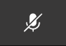
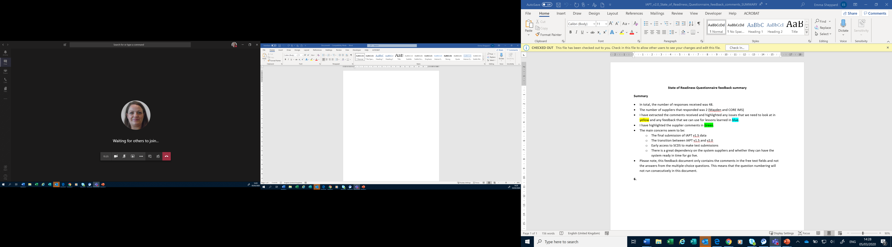
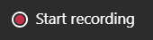
Housekeeping
Welcome and thank you for joining this webinar, the session will begin shortly.
Please note the following housekeeping points:
Please remain on mute throughout the webinar, unless indicated, to avoid disruption and noise interference for other attendees
If you wish to ask a question or raise a query during the webinar, you may do so via the meeting chat function, or by using the “raise your hand” function, all contributions are welcome!
To view the meeting chat, please select the ‘Show conversation’ icon in the Teams control task bar (pictured left)
If we are unable to answer your question due to time constraints, please forward it to dataset.development@nhs.net and we will pick it up via our mailbox
This webinar will be recorded and published. The recording will help us to update and publish the slide pack covering the questions and answers raised and allow people unable to make the webinar the chance to get involved.
Notes:
Plain slide with subhead and bullets

Slide 3

Webinars
This is the sixth in a series of planned webinars which is relevant to all providers, suppliers and services that are or may be in scope to submit the Diagnostic Imaging Data Set (DIDS).
The slides from the first 5 implementation webinars are available here: Diagnostic Imaging Data Set (DIDS) implementation tools and guidance - NHS England Digital
The target audience for this webinar is:
  All care providers / submitters
  IT system providers
  Other stakeholders with an interest in DIDS data
This webinar will include an update on the State of Readiness Questionnaire, frequently asked questions, implementation activities to support readiness and an update on NDIT. We will consider what feedback we get today to inform go-live updates and the need for any other webinars/events.
Notes:
Plain slide with subhead and bullets

Slide 4
State of Readiness Questionnaire
DIDS v2.0 State of Readiness Questionnaire closed 22 February 2026.
76 responses received - thank you to those of you who completed it.
Responses allow NHS England to assess progress in conforming to the DIDS v2.0 changes, provide early assessment of expected data quality/coverage and allow opportunity for NHS England to consider additional support offerings.
Notes:
Plain slide with subhead and bullets

Slide 5
State of Readiness Questionnaire
Summary of key themes we wanted to feedback on today:
Lower level of awareness/review of System Conformance Checklist and Data Model than other documents.
A number of users still need to download the DIDS v2.0 XML Schema / CSV Format.
Feedback on the new timestamp data items – clarification of requirements and challenges of reporting/accuracy from some respondents.
‘Local Codes’ and NICIP/SNOMED CT – clarification needed on what is stopping in DIDS v2.0.
Notes:
Plain slide with subhead and bullets

Slide 6
System Conformance Checklist & Data Model
The DIDS System Conformance Checklist is a tool to help care providers assess how well their local IT systems map to the DIDS v2.0 Technical Output Specification.
The DIDS v2.0 Data Model shows each of the data groups and data items that will make up a submission.
Both can be found here:
Diagnostic Imaging Data Set (DIDS) implementation tools and guidance - NHS England Digital
Notes:
Plain slide with subhead and bullets

Slide 7
Feedback from the Questionnaire
TRUD Files
Sign in / register: Home – NHS TRUD
Search for DIDS and find the XML Schema or CSV pack
Subscribe to them for updates and to download
Notes:
Plain slide with subhead and bullets

Slide 8
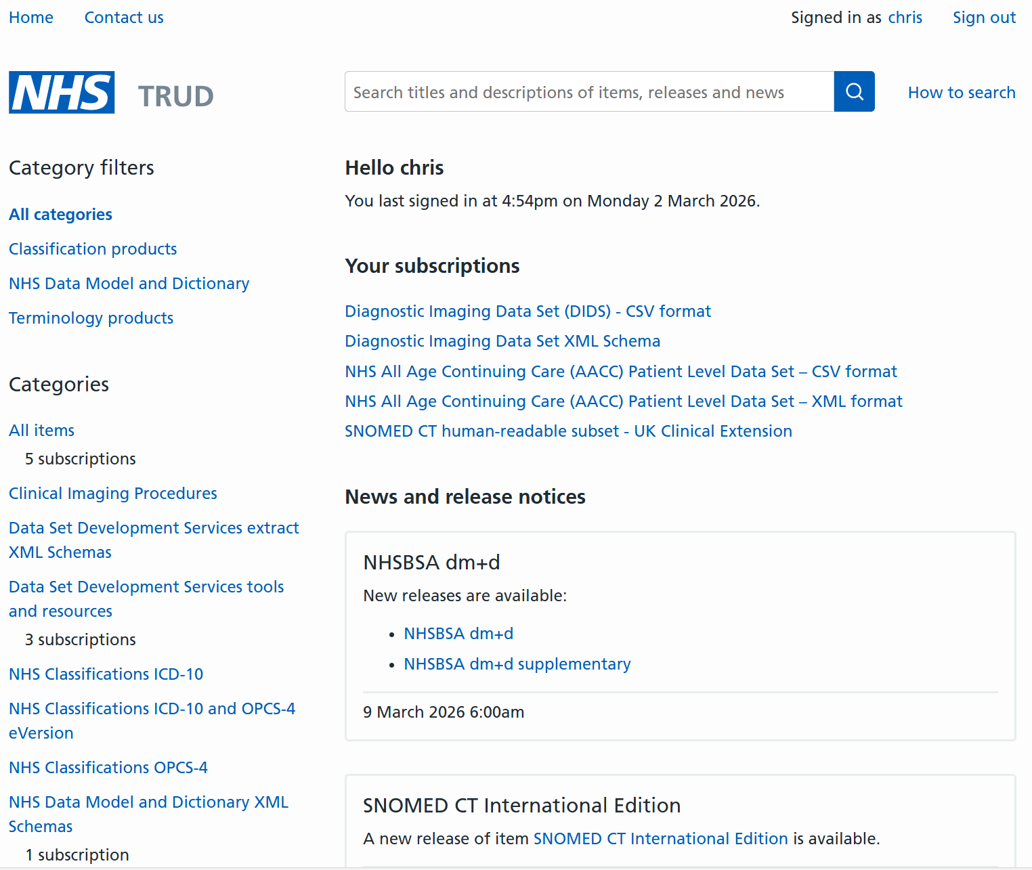
Feedback from the Questionnaire
TRUD Files
Notes:
Plain slide with subhead and bullets

Slide 9
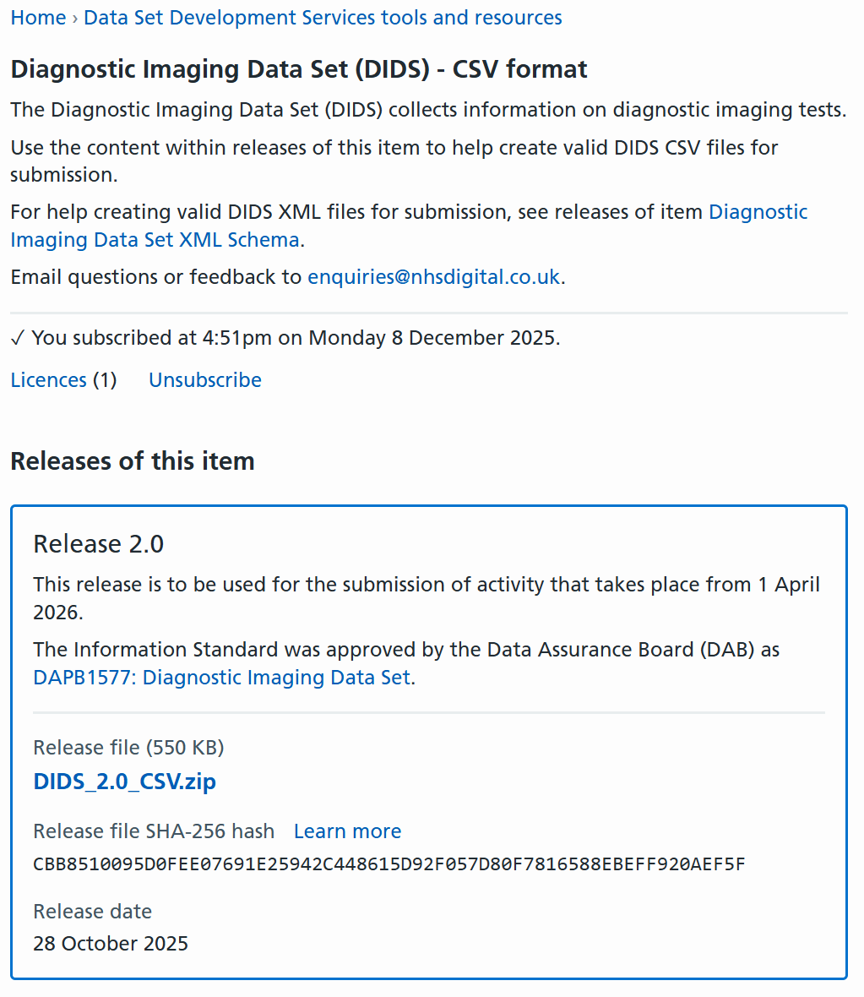
Feedback from the Questionnaire
TRUD Files
Notes:
Plain slide with subhead and bullets

Slide 10
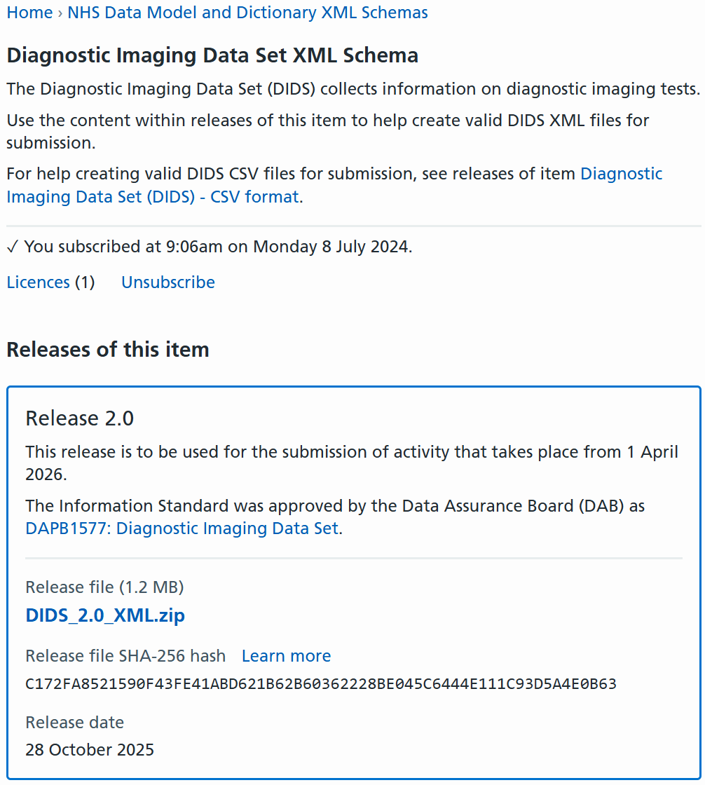
Feedback from the Questionnaire
TRUD Files
Notes:
Plain slide with subhead and bullets

Slide 11
Feedback from the Questionnaire
Timestamp formats – Technical Glossary tab of the TOS / ETOS
Timestamps are formatted as "max an25" in the Data Dictionary.
A Timestamp is represented with the components of date, time and either the number of hours offset (plus or minus) from Greenwich Mean Time, or the letter Z to signify that it is the same as Greenwich Mean Time.
For DIDS, offset time is restricted to:
+01:00
+00:00
-00:00
Examples of valid formats are:
2020-08-21T10:15:20+01:00 British Summer Time (GMT + 1 Hour)
2020-08-21T10:15:20+00:00 Greenwich Mean Time
2020-08-21T10:15:20-00:00 Greenwich Mean Time
2020-08-21T09:18:00Z Greenwich Mean Time.
Notes:
Plain slide with subhead and bullets

Slide 12
Feedback from the Questionnaire
Submission months – first three:
April 2026 activity
CODED PROCEDURE END TIMESTAMP
>=2026-04-01T00:00:00+01:00, and,
<=2026-04-30T23:59:59+01:00
May 2026 activity
CODED PROCEDURE END TIMESTAMP
>=2026-05-01T00:00:00+01:00, and,
<=2026-05-31T23:59:59+01:00
June 2026 activity
CODED PROCEDURE END TIMESTAMP
>=2026-06-01T00:00:00+01:00, and,
<=2026-06-30T23:59:59+01:00
Notes:
Plain slide with subhead and bullets

Slide 13
Feedback from the Questionnaire
Timestamp data items in early implementation period
Feedback has been received from the sector on the challenges of reporting the three new ‘timestamp’ data items as part of the implementation of DIDS v2.0.
These data items are the CODED PROCEDURE START TIMESTAMP, CODED PROCEDURE END TIMESTAMP and SERVICE REPORT ISSUE TIMESTAMP.
In response to the feedback, additional guidance is included on the expectations of data to be submitted in the initial implementation phase of DIDS v2.0.
The guidance aims to balance the move towards full conformance with the DIDS v2.0 Information Standard with provider implementation workload and timelines for technical changes, given the hard cut-over transition from DIDS v1.0 to DIDS v2.0.
Notes:
Plain slide with subhead and bullets

Slide 14
Feedback from the Questionnaire
For these timestamp data items, providers should therefore focus on the following in the early implementation period:
Ensuring that relevant imaging activity is not lost and is submitted in DIDS v2.0.
Submitting data in the correct format for these timestamp data items (i.e. is in the Diagnostic Imaging Data Set Release 2.0 XML Schema / CSV Format).
Where challenges are encountered with the accuracy of these data, providers should prioritise ensuring that the date that the activity takes place is accurate over the precise time of the activity.
Providers should work to submit the most accurate approximation of the time relevant for the data item wherever possible (where the exact time cannot be obtained).
As part of submitting data in the XML Schema or CSV Format the ‘time zone’ data needs to be submitted.
These arrangements are in place until the DIDS v2.0 full conformance date of 31 October 2026. Once the early submissions have been received then this guidance will be reviewed in light of the data quality of those submissions.
Notes:
Plain slide with subhead and bullets

Slide 15
Feedback from the Questionnaire
Local Codes and NICIP/SNOMED CT
DIDS v2.0 requires either a valid NICIP or SNOMED CT code to be submitted.
The interim ‘Local Codes Mapping’ Service which was included in DIDS v1.0 is being discontinued in DIDS v2.0 (following previous consultation).
Notes:
Plain slide with subhead and bullets

Slide 16
Feedback from the Questionnaire
NICIP / SNOMED Codes
DIDSREJ012 | Failed CODED PROCEDURE (NICIP) and CODED PROCEDURE (SNOMED CT) as both have valid values.
DIDSREJ013 | Failed CODED PROCEDURE (NICIP) and CODED PROCEDURE (SNOMED CT) as both are missing.
CODED PROCEDURE (SNOMED CT) | CODED PROCEDURE (NICIP) | Rules triggered
Valid Code | Missing
Valid Code | Invalid Code | DIDS00300302
Valid Code | Valid Code | DIDSREJ012
Invalid Code | Missing | DIDS00300402
Missing | Valid Code
Invalid Code | Valid Code | DIDS00300402
Invalid Code | Invalid Code | DIDS00300302, DIDS00300402
Missing | Invalid Code | DIDS00300302
Missing | Missing | DIDSREJ013
Notes:
Plain slide with subhead and bullets

Slide 17
Enhanced Technical Output Specification (ETOS)
Updated ETOS published 12/03/2026 (v2.0.15)
These are minor changes and follow user testing and feedback (Please see the Change Control tab, Excel row 247 / Change ID 141 onwards for more details).
  Some file rejections changed to warnings (potential reference data issues)
  2 Additional File-Level Rejections removed
  Missing CODED PROCEDURE END TIMESTAMP validation
  Error message text made clearer
We are not planning any further changes to the DIDS v2.0 ETOS, with exception of the NHS Data Model and Dictionary links planned to be updated for mid/late April.
In the event any further changes are required, we will notify users as quickly as possible.
At this time, please work to the published version: Diagnostic Imaging Data Set (DIDS) implementation tools and guidance - NHS England Digital:
Notes:
Plain slide with subhead and bullets

Slide 18
User Guidance
Updated DIDS v2.0 User Guidance published 17 March 2026 (following the version published in December 2025).
Diagnostic Imaging Data Set (DIDS) implementation tools and guidance - NHS England Digital
The updated guidance includes:
Additional guidance for the three ‘timestamp’ data items following feedback and queries received
More detail for the validation logic of NICIP and SNOMED CT codes
Additional examples defining activity in a reporting period (now showing April, May and June 2026)
Some minor updates in the table of data items
Submission file name considerations
Guidance is no longer ‘Draft’
Notes:
Plain slide with subhead and bullets

Slide 19
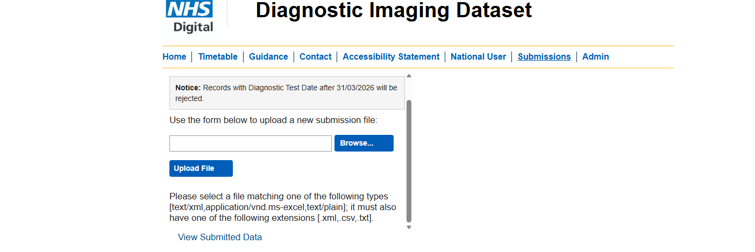
DIDS v1.0 Portal Message
‘Notice: Records with Diagnostic Test Date after 31/03/2026 will be rejected’
Message planned to be added to existing DIDS Portal by 31 March 2026:
Notes:
Plain slide with subhead and bullets

Slide 20
v2.0 File Name Considerations
File naming convention is not mandated in DIDS v2.0 and providers may use their local file naming conventions already in place (in conjunction with requirements of the landing platform such as no spaces).
Recommended that providers make file names meaningful to understand what data has been submitted and assist reviewing data quality feedback.
Recommended that providers consider including the following in the file name:
DIDS
ORGANISATION IDENTIFIER (CODE OF SUBMITTING ORGANISATION)
Year of the Reporting Month
Reporting Month
Version of the file submitted.
For example, a file name for the reporting month of April 2026 may be as below:
DIDS_ORGID_202604v1.xml
Notes:
Plain slide with subhead and bullets

Slide 21
Useful Addresses & Contacts
ISN Docs: DAPB1577: Diagnostic Imaging Data Set - NHS England Digital
Support and Guidance: Diagnostic Imaging Data Set (DIDS) implementation tools and guidance - NHS England Digital
TRUD: Home – NHS TRUD
Data Design Service: dataset.development@nhs.net
NDIT: england.nditprogramme@nhs.net
Data Liaison Service: england.dataliaison@nhs.net
UAT: england.ndsp-uat-support@nhs.net
Notes:
Plain slide with subhead and bullets

Slide 22
Recommended actions to take now (if not already)
Read the User Guidance published on the DIDS tools and guidance webpage: Diagnostic Imaging Data Set (DIDS) implementation tools and guidance - NHS England Digital
Download a copy of the DIDS v2.0 (Release 2.0) XML Schema / CSV Format from TRUD
Familiarise yourself with the Technical Output Specification (TOS) which contains the data items and their definitions for DIDS v2.0
Familiarise yourself with the updated Enhanced Technical Output Specification (ETOS) which contains validations NHS England will undertake when DIDS v2.0 data is received.
Care providers - ensure your IT system provider reviews the TOS, ETOS and User Guidance to understand scope and definition of each data item.
Provide any suggestions for data scenarios document.
Prepare for local data collection in DIDS v2.0 from 1 April 2026.

Slide 23
Getting started with the National Data Submission Portal
NHS England NDSP team
Notes:
Standard title slide

Slide 24
Agenda
Update on NDSP
Getting started – CIS2 accounts
Logging in and permissions
  How to log-in
  How to request permissions
How to submit data
Viewing previous submissions and validation feedback
Where to get help or find out more
Notes:
Plain slide with subhead and bullets

Slide 25

What is the National Data Submission Portal (NDSP)?
A single data submission portal that sits on the National Data Integration Tenant (NDIT) platform
Choice of submission routes
  File upload
  API
  Webform (not applicable for DIDS v2.0)
  FDP Local Tenant (not applicable for DIDS v2.0)
Consistent data validation
Collection management
Notes:
NDSP will sit on NDIT
A single data submission portal
Manage everything in one place
Ambition is to eventually consolidate 24+ legacy portals
Choice of submission routes to reduce burden
API, file transfer, file upload, webform and FDP local tenant flows
Consistent data validation
Data Validation Engine (DVE) using shared rules
Collection management
Management information, collection windows, permissions

Slide 26
NDSP Delivery Process
Design & Build
Testing
Live
September 2025 – February 2026
February – April 2026
April/ May 2026
Notes:
Plain slide with subhead and bullets

Slide 27
User Acceptance Testing (UAT) Version | Live Version
Guidance on NHS Futures | Updated guidance on NHS Futures
Migration of existing users + ability to request new users | Migration of existing users + ability to request new users
File upload submission (no real or personal identifiable data) | File upload submission (including test submission option)
Partial validations (excluding those that require Corporate Reference Data) | Full validation
Download all available validation feedback | Download all validation feedback
 | API submission (including test submission option)
Notes:
Plain slide with subhead and bullets

Slide 28
Accessing NDSP in the test period
You’re strongly encouraged to start trying out NDSP now, during the test period.
You have the opportunity now to make sure you:
Can log in
Have the correct permissions on your account
Know how to use the system
Are structuring your DIDS v2.0 data correctly
By getting everything set up now, you will reduce the likelihood of encountering delays or issues when DIDS v2.0 opens.
Notes:
It’s also helpful for us as you’ve helped us identify and fix a number of issues

Slide 29
Tips on putting together a test file
Please don’t submit any real patient data.
  You will need to use dummy NHS patient information.
  Dummy NHS numbers will need to pass the MOD 11 check to pass validation.
Your file doesn’t need to be long – you can test with just a few rows of dummy data.
To pass validation, you’ll need to use dates that align with the submission windows open within the portal.
  The submission windows in the test system align to the real DIDS v2.0 windows – so are in the future.
  Previously there was an issue where future data was being rejected, this has now been fixed.
Notes:
It’s also helpful for us as you’ve helped us identify and fix a number of issues

Slide 30
Share your feedback
Ongoing user research supports the design and development of NDIT and helps us ensure the platform is fit for your purposes.
Fill in our 3 question survey (it is very quick!) | https://feedback.digital.nhs.uk/jfe/form/SV_eS5m8DZXcFRcsR0
Volunteer for a short onboarding feedback interview. | Contact Sarah or Abhilaasha and we’ll send you more information about how to get involved in either of these activities (sarah.thew2@nhs.net or Abhilaasha.kaul@nhs.net )
Participate in a usability testing session

Slide 31
Getting started

Slide 32
Things you should do before you get started
These are the things that you should do before starting to use NDSP:
Find the link to NDSP (sent via email, and available on NHS Futures)
Ask for a CIS2 account (aka Profile) if you don’t have one

Slide 33

Setting up a CIS account if you don’t have one
NDSP uses CIS2 authentication.
Care Identity Service (CIS) is a service covering identity management and access management for services accessed by health and social care workers. CIS2 authentication is part of Care Identity Service (CIS).
To access services with CIS2, most users sign in using an NHS smartcard.
Smartcards are like chip and pin bank cards and are used in conjunction with a passcode via a smartcard reader.
However, CIS2 offers lots of other different two factor authentication methods.
To use them, you still need a CIS Account first.
Here a list of non-smartcard authenticators:
  Microsoft Authenticator
  NHS.net Connect (formerly NHSmail)
  Passkey
  iPad
  Windows Hello
  Security key, including YubiKey

Slide 34
Setting up a CIS account if you don’t have one
Follow these steps if you need a CIS account (aka CIS Profile).
Contact your Registration Authority: reach out to your Registration Authority (RA) or local CIS sponsor to discuss the registration process.
Submit your application: follow the application process provided by your Registration Authority and complete your identity verification.
Choose an Authenticator: select an authenticator method (smartcard, authenticator app, or security key) that suits your needs.
Each NHS smartcard/CIS Account typically have role-based access codes (RBAC) assigned. NDSP doesn’t need any code associated to your account.

Slide 35
How to find a Registration Authority
To find your Registration Authority you can:
Ask a colleague that has access to Care Identity Management
Contact your local IT helpdesk
Check if the primary care service provider contact details page contains the details you need
Contact iamplatforms@nhs.net
If your organisation doesn’t have a Registration Authority contact UAT our service desk: england.ndsp-uat-support@nhs.net

Slide 36
Problems with your existing CIS2 authenticator
If you have not used your CIS2 account for some time, you may not be able to access NDSP and may see an error message.
Your CIS2 account may be:
Inactive
Locked
What to do
Contact your local IT helpdesk or your Registration Authority (RA) to reactivate or unlock your account.

Slide 37
Logging in and permissions
Current DIDS user and new users

Slide 38
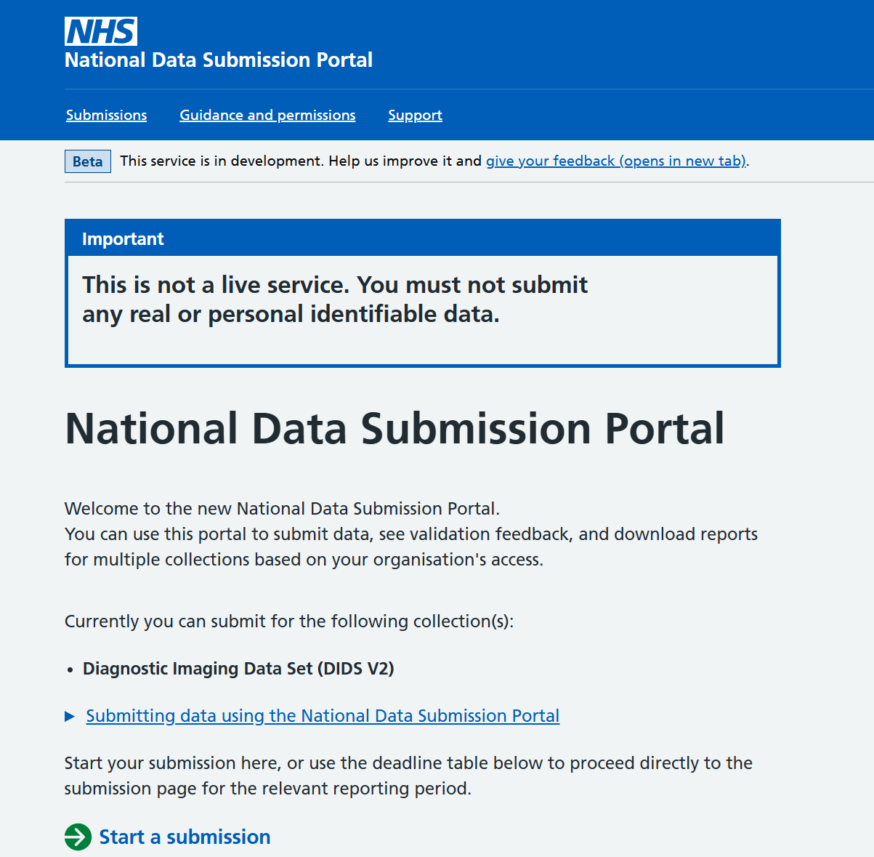
Existing DIDS users:
Check if your permissions have been migrated
If you are an existing user on DIDS legacy portal your permissions should be automatically migrated to NDSP.
After being logged into NDSP (UAT) using CIS2:
Check if your permissions have been migrated.
You should see the name of your collection on the NDSP home page.

Slide 39
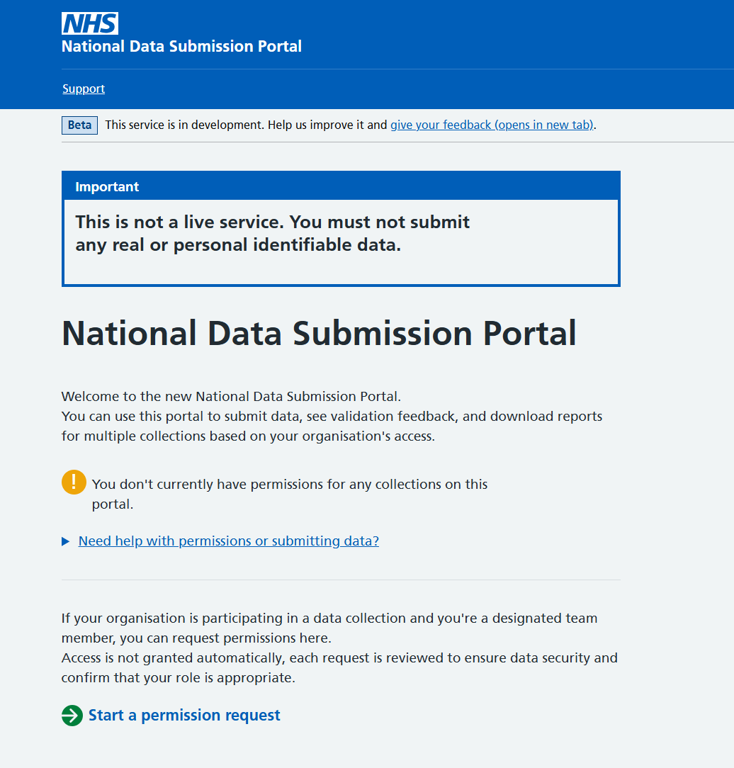
If your permissions have not been migrated or if you are a new submitter
If your permissions were not migrated, or you are a new user, you will not see your collection on the NDSP home page.
You will need to start a new permission request.

Slide 40









Permission request
NDSP uses a digital permission request process, replacing the DIDS Word (DUC) form used in legacy systems.
Legacy system
User filling in DUC form and send by email
IG Lead approve and send form by email
NHSE grant permissions
User login
NDSP
User login
User filling in NDSP online form
IG Lead approve by email
NHSE grant permissions

Slide 41
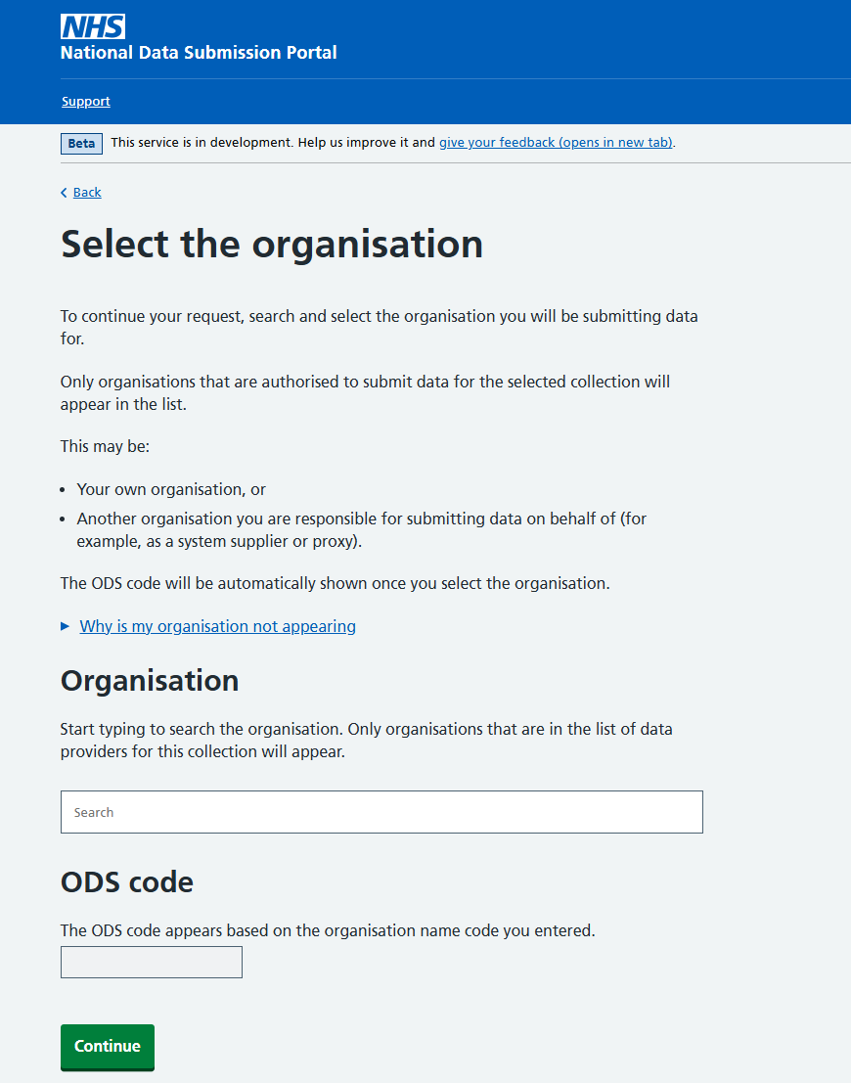
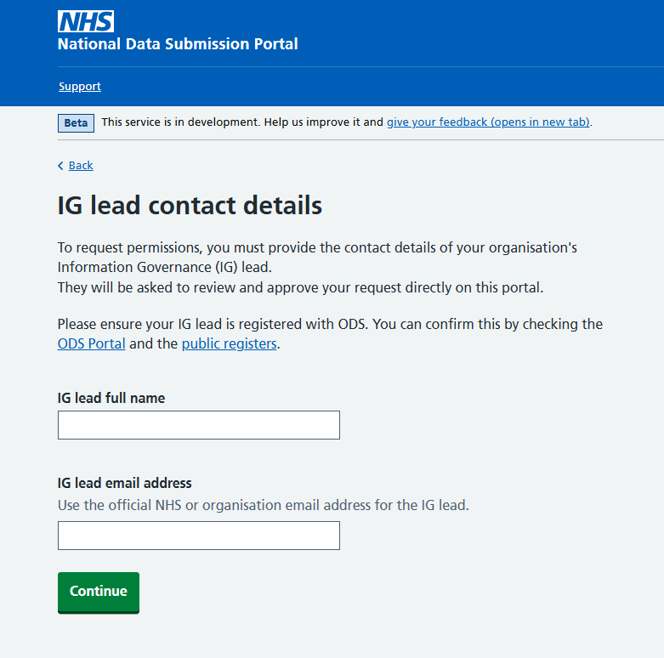
Permission request
You will be asked the same kind of information such as:
Organisation that you will be submit for
ODS code
IG lead contact

Slide 42



Permission model
If you submit for multiple organisations you have to ask permissions for each one.
Each permission on NDSP is associated with:
A data collection (e.g. DIDS v2.0)
An organisation
+
Permission
Data
Collection
Organisation
Notes:
You can get multiple permissions if you submit on behalf of multiple organisations – go to the “guidance and permissions” part of the portal and there are more details on the NHS Futures Guidance.

Slide 43
How to submit data
Via file upload

Slide 44
Before you submit a file..
You will need:
1. An active account, which has the permissions for your chosen organisation and collection.
2. An understanding of the file structure and file formats for your collection. Each collection shares its own specification and guidance.
3. A submission file prepared in line with the specification.

Slide 45
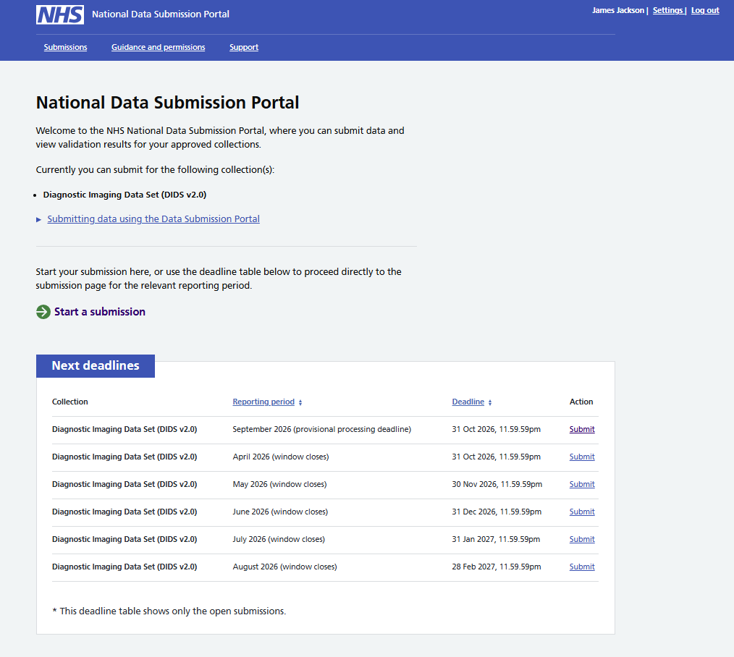
Starting a file submission
Before you can begin submitting data, you must log into the National Data Submission Portal. Once you are logged in, you will land on the home page, where you will see your available collection(s) listed.
You can start a submission by choosing ‘Submit’ next to a reporting period in the deadline table.

Slide 46
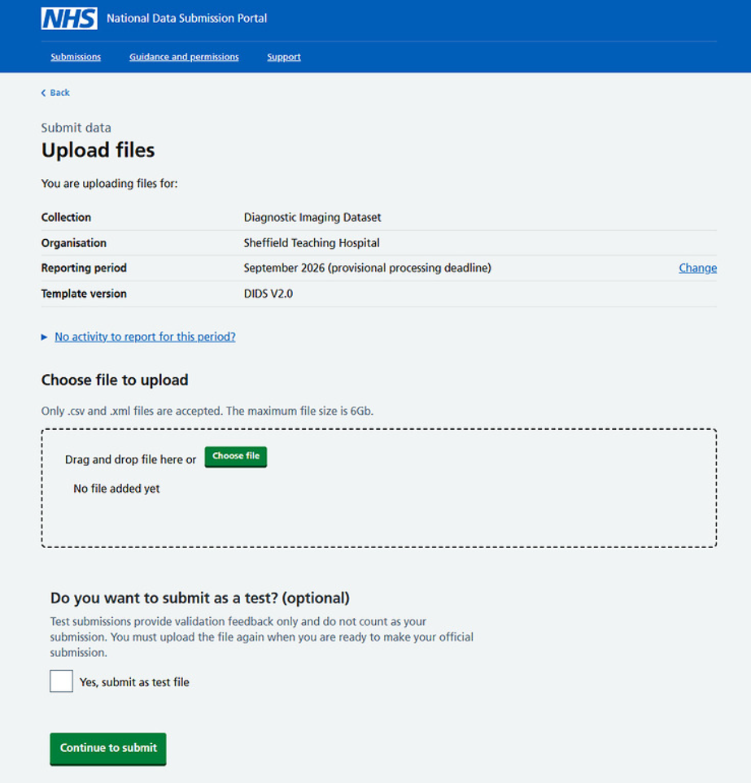
Choosing and uploading a file
The ‘Upload files’ page shows a summary of the collection and organisation you’re submitting for. You can check everything is correct before continuing.
You can then select the file (or multiple files depending on the collection) that you want to submit. You can either:
Drag the file from your computer and drop it into the upload box
Or
Click ‘Choose file’ then browse your folders and select the file you want to upload.
Only files in the correct format for the collection can be selected.

Slide 47
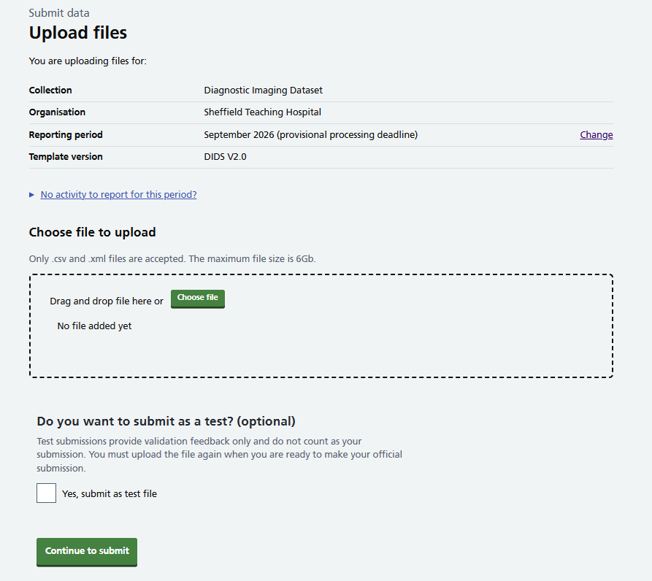
Test submissions
Test submissions allow you to:
Check that your file meets the technical and validation requirements
Receive full validation feedback
Correct issues before making a submission
When you submit a test file:
Your data is not processed or used by NHS England
No official submission is recorded for the reporting period
You can submit as many test files as you need while preparing your final dataset.
Use this option if you want to verify your data structure, run validation checks, or test new internal processes before sending a live file.
Note – if you run a test submission and decide that no changes are needed, you must still upload and submit the file again as a live submission. Test files are not processed or accepted as official data, so a live submission is required even if the test file passed validation without any issues.

Slide 48
Resubmission and the ‘last good file’ principle
Some collections, including DIDS 2.0 on NDSP work on a “last good file” principle:
You may submit a new file for the same reporting period at any time while the submission window is open.
NHS England will use the last successfully validated file as the official submission for that reporting period.
This means that if you choose to resubmit, the new file must include all required records for the reporting period, not just the changes.
Once your updated file passes validation, it becomes the official version held by NHS England.
If your organisation has already submitted data to NDSP for a reporting period, you can still submit another file to update or correct the data. When this happens, the portal will display a message informing you that your organisation already submitted for that period, but you can resubmit if you need to.

Slide 49
Viewing your submissions and validation reports

Slide 50
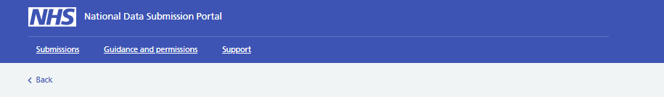
Viewing the status of your submissions
The submissions table gives you a summary of past submissions, and helps you navigate to details for each submission.
You can get to the submissions page from the top bar menu.

Slide 51
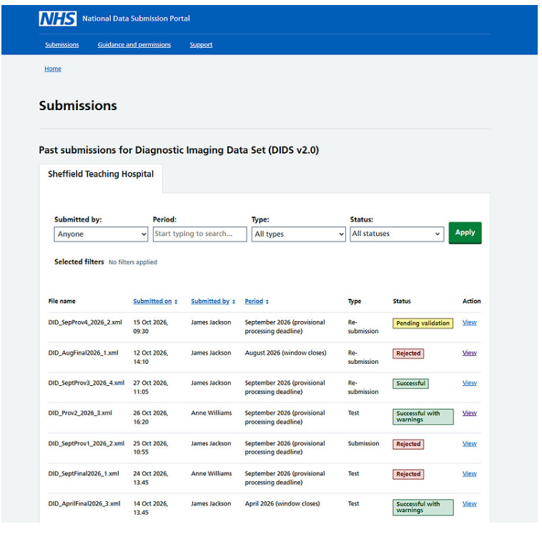
The submissions table
You can see a summary of all files submitted for a collection and the organisations you have permission to access.
From here you can see the status of each submission, who submitted it, and access validation feedback as it becomes available.
Submission statuses:
Pending validation – the file has been received and is waiting to be validated
Successful – the file passed validation with no errors or warnings
Successful with warnings – the file passed validation, but warnings were found
Rejected – the file failed validation and was not accepted
Statuses update automatically once validation is complete.

Slide 52
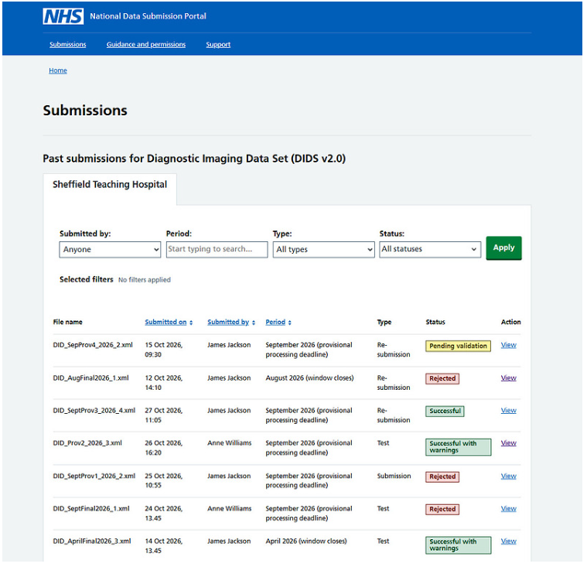
The validation process
Newly uploaded files will show as ‘Pending validation’’ whilst validation checks are run.
When the validation process is complete, the status of your file will automatically updated to the status that reflects the outcome of the validation. You will receive a notification to let you know that the validation results are ready.
You must refresh the page to see the updated status.
Clicking on the ‘view’ action for a particular table row will take you to the Submission Details and validation feedback page

Slide 53
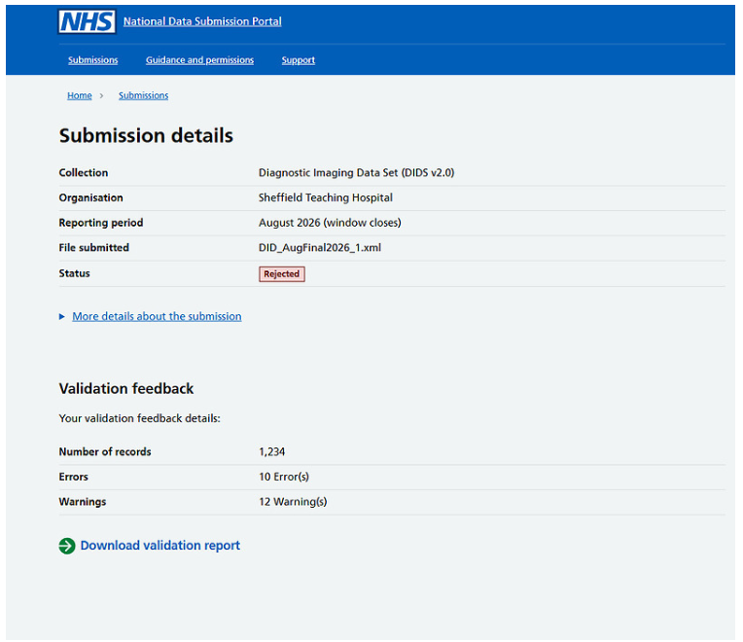
Submission details and viewing validation feedback
The Submission details page provides a view of a single data submission. It allows you to confirm what was submitted, check the current status, and review validation feedback once processing has completed.
The validation feedback section includes:
- Number of records processed
- Number of errors found during validation
- Number of warnings found during validation
Once the submission has been validated, you can select Download validation report to download the full validation report. This report provides detailed information about validation issues, including which records failed and why.

Slide 54
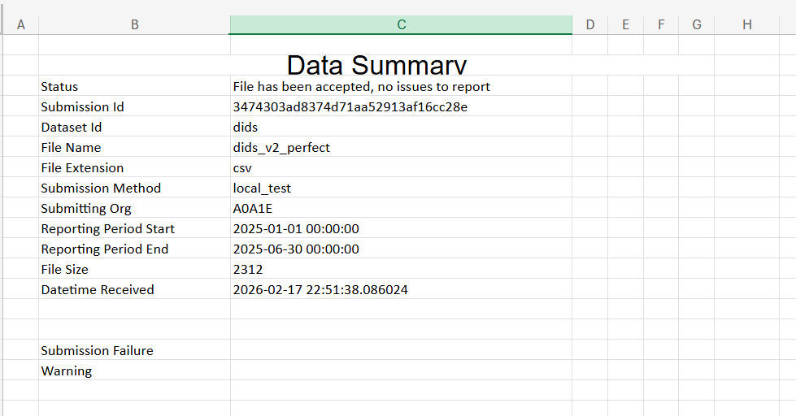
DIDS 2.0 Validation reports - tab 1
The report is an excel file with three tabs:
Summary tab (see right), gives you the file status, submission ID, file name and other descriptive data about the file and submission.

Slide 55
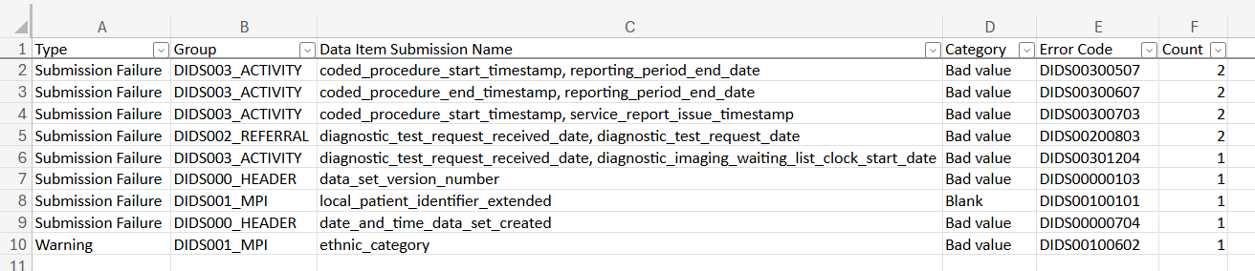
DIDS 2.0 Validation reports – tab 2
The error summary tab gives an overview of the types of any errors or warnings in your file, including counts of how often each error occurs.

Slide 56
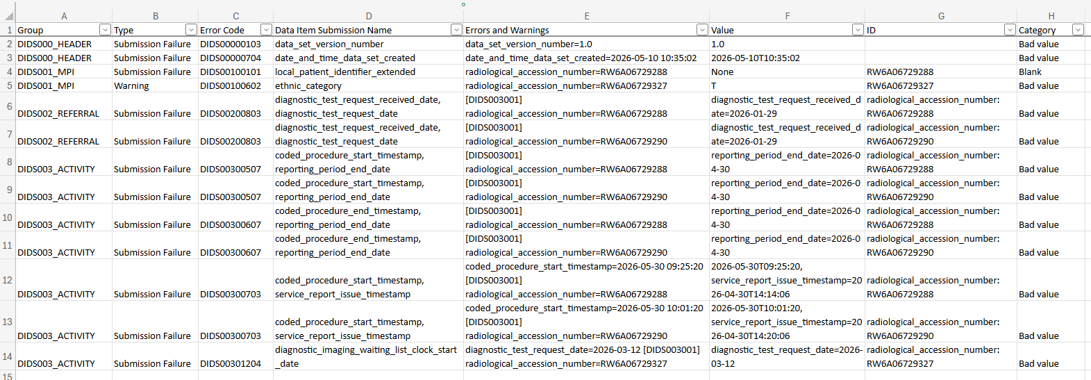
DIDS 2.0 Validation reports - tab 3
The error data tab gives you full details of each error and warning, including the error codes, nature of the issue and the accession number.

Slide 57
Where to go for more information on NDSP

Slide 58
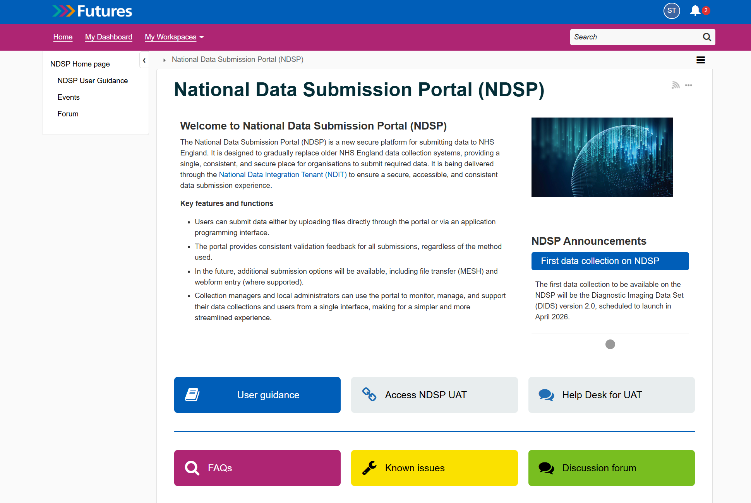
Further support
If you are having problems getting access or using the system you can:
1. Visit our NDSP support pages on NHS Futures
  Including FAQs & Known Issues
2. Email our support inbox for one-to-one support:
england.ndsp-uat-support@nhs.net
3. Come to one of our surgery sessions
Notes:
Plain slide with subhead and bullets

Slide 59
Q&A

Slide 60



Questions?
DIDS Webpage: Diagnostic Imaging Data Set (DIDS) - NHS England Digital
Get in touch: dataset.development@nhs.net
Notes:
Plain slide with subhead and bullets

Slide 61
End slide

