Slide 1
Diagnostic Imaging Data Set (DIDS) v2.0
Implementation Webinar 5
Date: 11/02/2026
Time: 10:00am – 11:30am
Presented by:
Chris Turner: Data Design Service & John Winter – Data Delivery Lead, NHSE
Notes:
Standard title slide

Slide 2
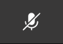
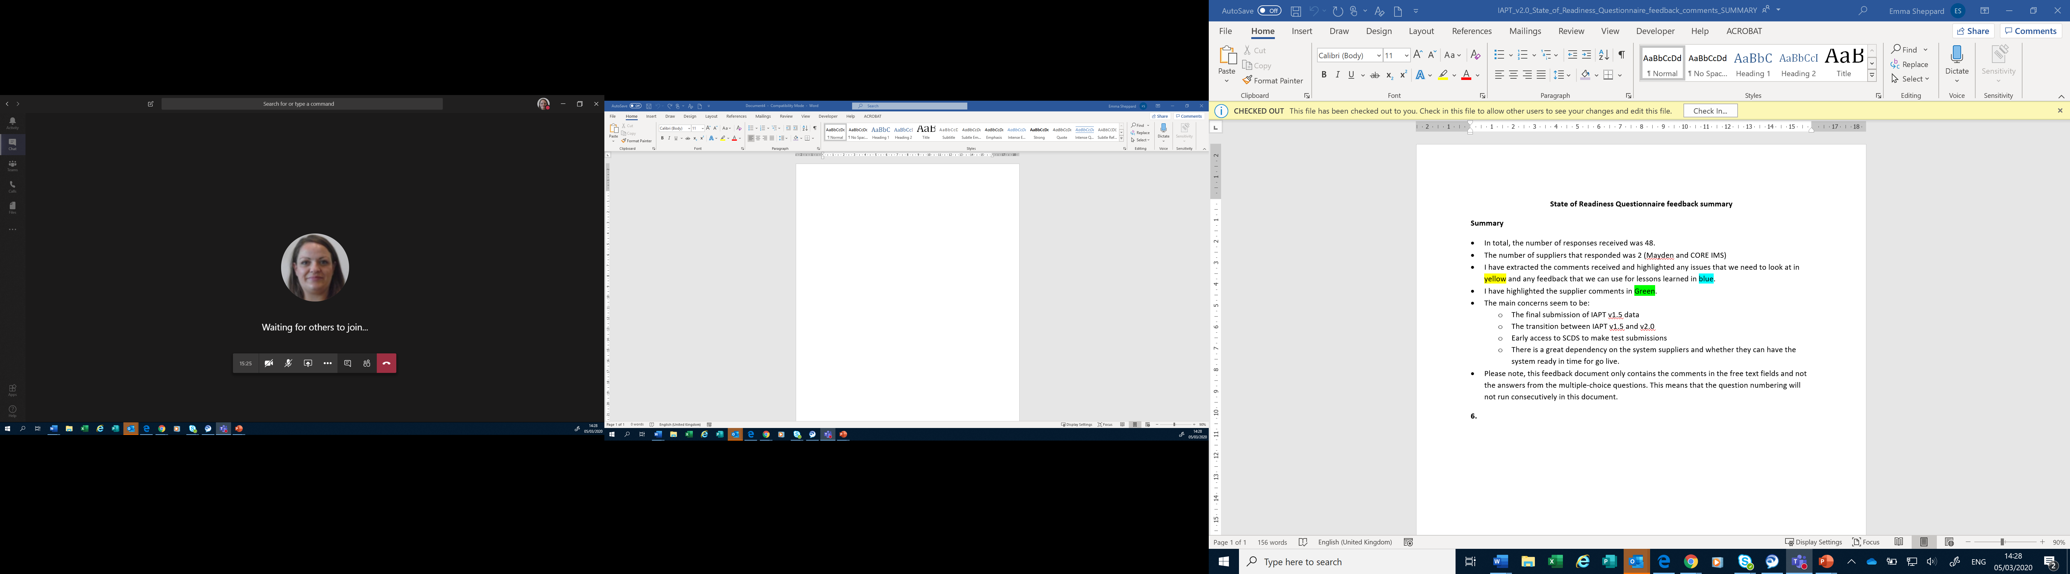
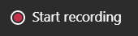
Housekeeping
Welcome and thank you for joining this webinar, the session will begin shortly.
Please note the following housekeeping points:
Please remain on mute throughout the webinar, unless indicated, to avoid disruption and noise interference for other attendees
If you wish to ask a question or raise a query during the webinar, you may do so via the meeting chat function, or by using the “raise your hand” function, all contributions are welcome!
To view the meeting chat, please select the ‘Show conversation’ icon in the Teams control task bar (pictured left)
If we are unable to answer your question due to time constraints, please forward it to dataset.development@nhs.net and we will pick it up via our mailbox
This webinar will be recorded and published. The recording will help us to update and publish the slide pack covering the questions and answers raised and allow people unable to make the webinar the chance to get involved.
Notes:
Plain slide with subhead and bullets

Slide 3

Webinars
This is the fifth in a series of planned webinars which is relevant to all providers, suppliers and services that are or may be in scope to submit the Diagnostic Imaging Data Set (DIDS).
The slides from the first 4 implementation webinars are available here: Diagnostic Imaging Data Set (DIDS) implementation tools and guidance - NHS England Digital
The target audience for this webinar is:
  All care providers / submitters
  IT system providers
  Other stakeholders with an interest in DIDS data
This webinar will include an update on the State of Readiness Questionnaire, frequently asked questions and an update on NDIT developments.
Future webinar planned for 18 March 2026 (10 a.m. to 11:30 a.m.)
Notes:
Plain slide with subhead and bullets

Slide 4
Technical Output Specification (TOS)
TOS new link: Diagnostic Imaging Data Set (DIDS) implementation tools and guidance - NHS England Digital – due to a minor update. The Additional File-Level Rejects tab has been removed (this tab remains in the ETOS).
This is a minor administrative update – there are no changes to data items or data item definitions in the TOS.
Notes:
Plain slide with subhead and bullets

Slide 5
Enhanced Technical Output Specification (ETOS)
Whilst we do not expect significant changes to the DIDS v2.0 ETOS, there is the potential that validations may change given that there are a number of new data items, user feedback on the new platform is ongoing and there is a testing period planned, ahead of go-live.
In the event any changes are required, we will notify users as quickly as possible.
At this time, please work to the current version:
Notes:
Plain slide with subhead and bullets

Slide 6
State of Readiness Questionnaire
DIDS v2.0 State of Readiness Questionnaire published 02 February 2026.
11 responses by 10 February; thank you to those of you who have completed it so far.
Please complete this by the deadline of 22 February 2026 if you have not already.
Responses allow NHS England to assess progress in conforming to the DIDS v2.0 changes, provide early assessment of expected data quality/coverage and allow opportunity for NHS England to consider additional support offerings.
A requirement in the DIDS v2.0 Information Standard Requirements Specification.
Notes:
Plain slide with subhead and bullets

Slide 7
State of Readiness Questionnaire
A word copy of the Questionnaire to support review across local teams can be requested via emailing dataset.development@nhs.net – please reference ‘DIDS v2.0’.
Questionnaire is to be completed and submitted via Citizen Space.
Please add relevant detail to responses – for example readiness challenges you are facing.
22 February deadline cannot be extended.
Notes:
Plain slide with subhead and bullets

Slide 8
Scope
In Scope
All imaging activity relating to people who receive NHS funded imaging services for the purpose of diagnosis, intervention and/or treatment are within scope of DIDS.
The scope of the data set requires record level data submission for all activity managed by radiology departments using Radiology Information Systems (RISs).
Submission of data may require pulling in information held in systems other than the RIS (e.g. EPRs) for imaging activity managed on the RIS.
Notes:
Plain slide with subhead and bullets

Slide 9
Scope
Out of Scope
The following areas are out of scope and should consequently not be included within DIDS:
Imaging activity not managed on the RIS (i.e. where managed in other local / provider systems that are separate to the RIS such as:
  Screening programmes such as breast screening
  Mobile cardiac ultrasound activity)
Imaging activity performed on the deceased, such as that carried out for postmortem purposes
Primary care dental x-rays
Notes:
Plain slide with subhead and bullets

Slide 10
XML Schema and CSV Format
DIDS v2.0 (Release 2.0) XML Schema and CSV Format are available on TRUD (Technology Reference Update Distribution).
Some users have already downloaded this though more users are still to do this.
Link to TRUD - https://isd.digital.nhs.uk/trud/users/guest/filters/0/home where you can find the template files, some notes / guidance and some example data.
Note: You may need to set up an account for TRUD (if not already) and subscribe to the DIDS Release 2.0 XML Schema and CSV Format releases.
We are aware there is a minor error in the sample data for one data item (diagnostic_imaging_waiting_list_clock_start_date) for the third record. The date should be 11/03/2026 rather than 12/03/2026.
Notes:
Plain slide with subhead and bullets

Slide 11
NHS Data Model and Dictionary publication date
NHS Data Model and Dictionary changes for DIDS v2.0 planned to go live in April 2026.
However, data item names and definitions are in the TOS and ETOS now (links will be updated subsequently where needed).
Further information on National code lists / information on coding is included in the NHS Data Model and Dictionary Change Request, ETOS and User Guidance.
Notes:
Plain slide with subhead and bullets

Slide 12
Top questions asked
Question: Where can I see the submission dates for DIDS v2.0?
Answer: The DIDS v2.0 timetable is published on the NHS England website. Information about when and how NHS England processes the data submitted is also included on here.
The first three months of activity for DIDS v2.0 are also shown below:
Activity month/reporting period | Submission window opens | Provisional processing deadline at 11.59.59 pm | Submission window closes at 11.59.59 pm
April 2026 | 1 May 2026 | 31 May 2026 | 31 October 2026
May 2026 | 1 June 2026 | 30 June 2026 | 30 November 2026
June 2026 | 1 July 2026 | 31 July 2026 | 31 December 2026
Notes:
Plain slide with subhead and bullets

Slide 13
Top questions asked
Question: Can I continue sending DIDS v1.0 data after 1 April 2026?
Answer: You need to submit DIDS v1.0 data after April 2026 but only for activity which takes place up to and including 31 March 2026. This activity is submitted in the existing DIDS Portal as per the existing DIDS v1.0 timetable.
All in scope activity which takes place from 1 April 2026 onwards must be submitted in DIDS v2.0 to NDIT. This is to be submitted as per the DIDS v2.0 timetable.
Notes:
Plain slide with subhead and bullets

Slide 14
Top questions asked
Question: Are the CODED PROCEDURE START TIMESTAMP and CODED PROCEDURE END TIMESTAMP data items mandatory?
Answer: Yes – the CODED PROCEDURE START TIMESTAMP and CODED PROCEDURE END TIMESTAMP data items are mandatory.
This follows DIAGNOSTIC TEST DATE being mandatory in DIDS v1.0. In the case of CODED PROCEDURE END TIMESTAMP then this defines the reporting month the activity flows in, so it is an essential data item.
If you have concerns about your readiness to flow these items in DIDS v2.0 or the accuracy with which you can do this, then in parallel with working on your implementation please complete the DIDS v2.0 State of Readiness Questionnaire with further details.
Notes:
Plain slide with subhead and bullets

Slide 15
Top questions asked
Question: Where can I find further detail of what is required for specific data items in DIDS v2.0?
Answer: The data items and their definitions to be submitted in DIDS v2.0 are defined in the TOS. The validations undertaken by NHS England when the data is submitted are in the ETOS.
The DIDS v2.0 User Guidance provides further details, including guidance for individual data items.
If there is guidance you cannot find, then please email dataset.development@nhs.net stating ‘DIDS v2.0’ and we can see how we can help.
Notes:
Plain slide with subhead and bullets

Slide 16
Top questions asked
Question: Where can I find further details of the new submission portal?
Answer: DIDS v2.0 will be collected on NDIT.
Guidance is planned to be available on NHS Futures when the UAT version is launched.
[An update on NDIT will be given shortly in this webinar].
Notes:
Plain slide with subhead and bullets

Slide 17
DIDS v2.0 Next Webinars
Please provide suggestions for content for the March DIDS v2.0 Implementation webinar – we had limited feedback for this webinar.
Please provide this by 28 February 2026 on what you would like covered via emailing dataset.development@nhs.net stating ‘DIDS v2.0’.

Slide 18
Recommended actions to take now
Read the User Guidance published on the DIDS tools and guidance webpage: Diagnostic Imaging Data Set (DIDS) implementation tools and guidance - NHS England Digital
Download a copy of the DIDS v2.0 (Release 2.0) XML Schema / CSV Format from TRUD
Familiarise yourself with the Technical Output Specification (TOS) which contains the new and amended data items for DIDS v2.0.
Care providers - ensure your IT system provider reviews the TOS and User Guidance to understand scope and definition of each data item.
Care providers and IT system providers - complete the State of Readiness Questionnaire if you haven’t already done so, by the deadline of 22 February 2026.
Provide suggestions for content for the March 2026 DIDS v2.0 implementation webinar by 28 February 2026.
Provide any suggestions for data scenarios document.

Slide 19
National Data Submission Portal (NDSP)
Robyn McNally, Simon Wyse & Sarah Thew
February 2026
Notes:
Standard title slide

Slide 20

What is the National Data Submission Portal (NDSP)?
A single data submission portal that sits on the National Data Integration Tenant (NDIT) platform
Choice of submission routes
  File upload
  API
  Webform (not applicable for DIDS v2.0)
  FDP Local Tenant (not applicable for DIDS v2.0)
Consistent data validation
Collection management
Notes:
A single data submission portal
Manage everything in one place
Ambition is to eventually consolidate 24+ legacy portals
Choice of submission routes to reduce burden
API, file transfer, file upload, webform and FDP local tenant flows
Consistent data validation
Data Validation Engine (DVE) using shared rules
Collection management
Management information, collection windows, permissions

Slide 21
NDSP Delivery Process
Design & Build
Testing
Live
September 2025 – February 2026
February – April 2026
April/ May 2026
Notes:
Plain slide with subhead and bullets

Slide 22
User Acceptance Testing (UAT) Version | Live Version
Guidance on NHS Futures | Updated guidance on NHS Futures
Migration of existing users + ability to request new users | Migration of existing users + ability to request new users
File upload submission (no real or personal identifiable data) | File upload submission (including test submission option)
Partial validations (excluding those that require Corporate Reference Data) | Full validation
Download all available validation feedback | Download all validation feedback
 | API submission (including test submission option)
Notes:
Plain slide with subhead and bullets

Slide 23
Authentication & Permissions

Slide 24
Access model
To make a submission on NDSP, you need both:
An account
One (or more) permission(s)
Each permission on NDSP is associated with:
A data collection (e.g. DIDS v2.0)
An organisation

Slide 25
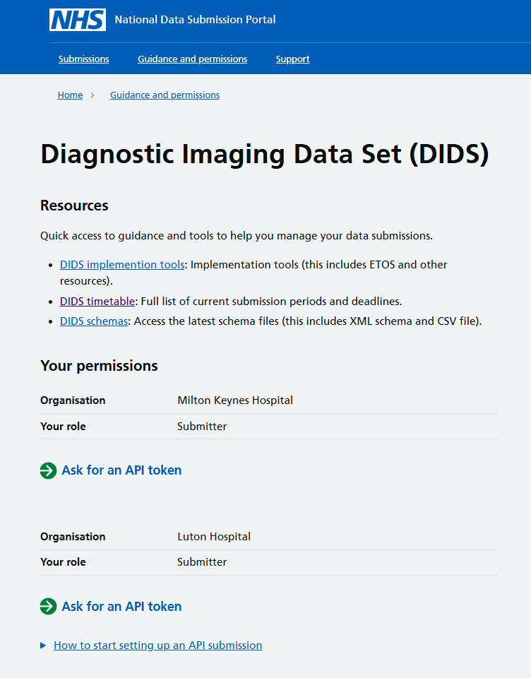
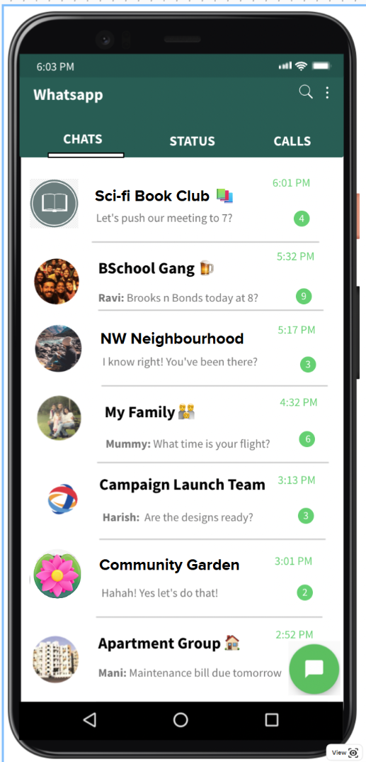
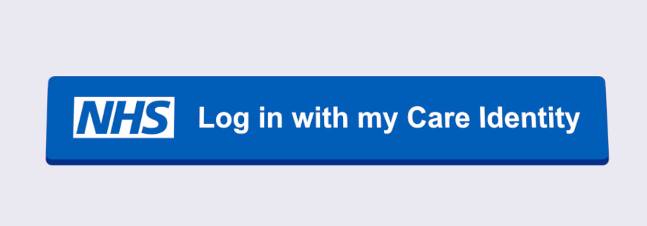

Access Model Comparison - WhatsApp
You create an account first
Then you can get access to the right group(s)

Slide 26
Authentication
All authentication will be using Care Identity Service (CIS) accounts.
CIS is an end-to-end service covering identity management, access management, smartcards and authenticators, authentication and authorisation for health and social care workers.
If you already have a CIS account, you will use this to sign in.
If you do not, your organisation’s Registration Authority can provide you with an account.
If you for any reason cannot create a CIS account with your Registration Authority, please contact us.
When you sign in, you will need to do two factor authentication.
  This can be done with or without a mobile phone using a CIS account – please discuss your options with your Registration Authority.
Notes:
Plain slide with subhead and bullets

Slide 27
Permission to submit
We will migrate the permissions of existing DIDS submitters to the new system.
However, if your current DIDS account and your CIS account are associated with different email addresses, we cannot guarantee your permissions will be migrated.
If you need a new permission to submit on behalf of an organisation, you must sign into NDSP using CIS and complete the “permission request” form.
The request will be emailed to - and need to be approved by - one of your organisation’s Information Governance Leads (Caldicott Guardian, SIRO or IAO), as named on the ODS Search and Export Portal.
Notes:
Plain slide with subhead and bullets

Slide 28
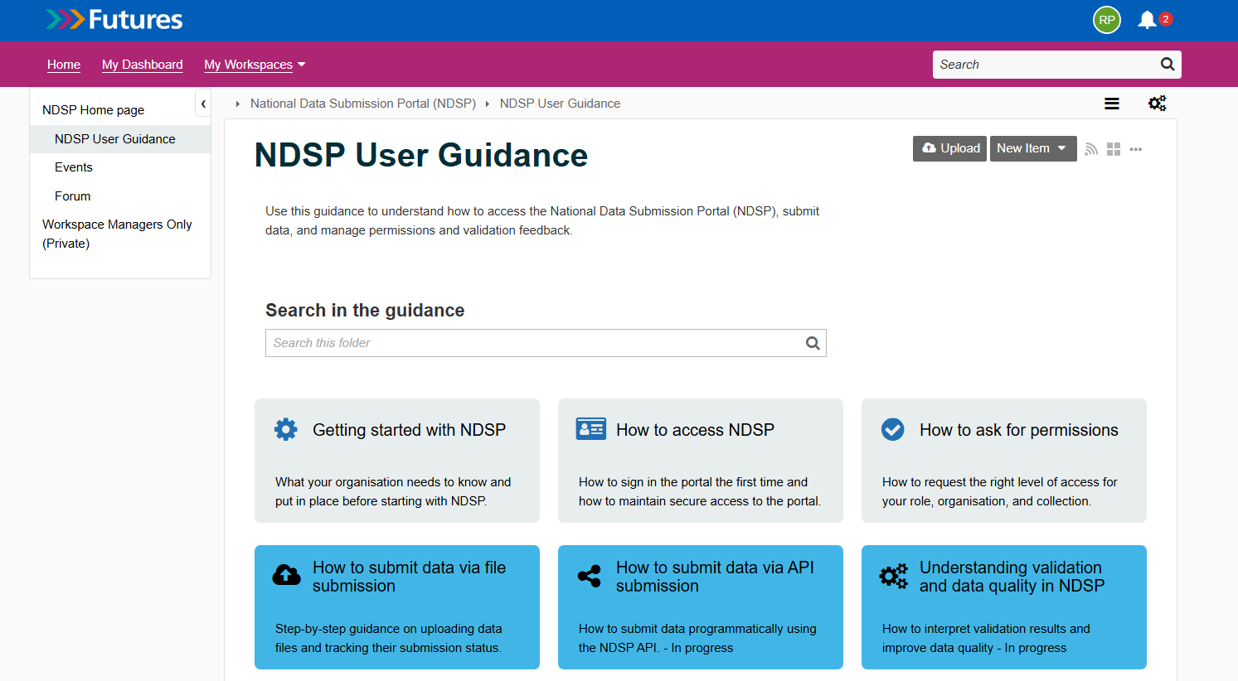
Guidance
Guidance will be available on NHS Futures when we launch the UAT version.
Notes:
Plain slide with subhead and bullets

Slide 29
NDSP demo

Slide 30
User research: help shape NDSP

Slide 31
You can shape the National Data Submission Platform
Ongoing user research supports the design and development of NDIT.
It is very important to have your involvement:
Understanding your needs and challenges
Testing and improving designs.
You have already helped us improve:
File submission
Access to error reports
Requesting access to collections
Notes:
Plain slide with subhead and bullets

Slide 32
How to get involved:
Attend our upcoming workshop to review error reporting file structure
UAT feedback and research interviews
Email Abhilaasha.Kaul2@nhs.net or look out for our invites in the DIDS user group.
Notes:
Plain slide with subhead and bullets

Slide 33
If you have any queries regarding NDIT, please contact:
england.nditprogramme@nhs.net

Slide 34



Questions?
DIDS Webpage: Diagnostic Imaging Data Set (DIDS) - NHS England Digital
Get in touch: dataset.development@nhs.net
Notes:
Plain slide with subhead and bullets

Slide 35
End slide

