Slide 1
Diagnostic Imaging Data Set (DIDS) v2.0
Implementation Webinar 4
Date: 21/01/2026
Time: 10:00am – 11:30am
Presented by:
Chris Turner: Data Design Service & John Winter – Data Delivery Lead, NHSE
Notes:
Standard title slide

Slide 2
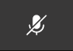
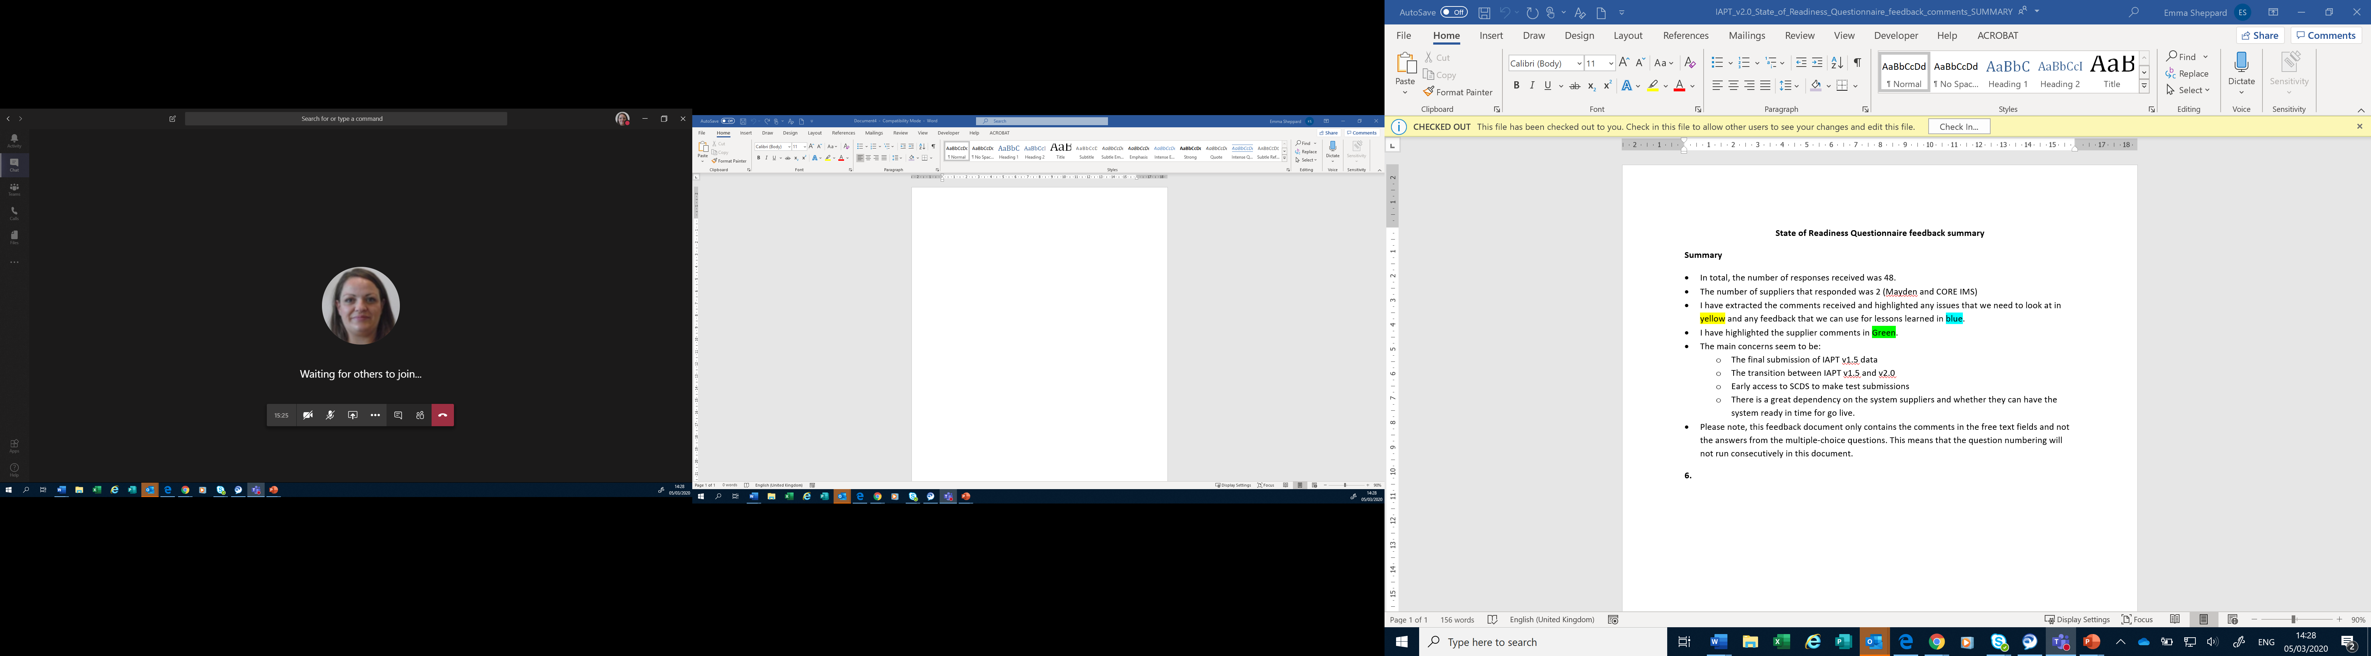
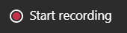
Housekeeping
Welcome and thank you for joining this webinar, the session will begin shortly.
Please note the following housekeeping points:
Please remain on mute throughout the webinar, unless indicated, to avoid disruption and noise interference for other attendees
If you wish to ask a question or raise a query during the webinar, you may do so via the meeting chat function, or by using the “raise your hand” function, all contributions are welcome!
To view the meeting chat, please select the ‘Show conversation’ icon in the Teams control task bar (pictured left)
If we are unable to answer your question due to time constraints, please forward it to dataset.development@nhs.net and we will pick it up via our mailbox
This webinar will be recorded and published. The recording will help us to update and publish the slide pack covering the questions and answers raised and allow people unable to make the webinar the chance to get involved.
Notes:
Plain slide with subhead and bullets

Slide 3

Webinars
This is the fourth in a series of planned webinars which is relevant to all providers, suppliers and services that are or may be in scope to submit the Diagnostic Imaging Data Set (DIDS).
The slides from the first 3 implementation webinars are available here: Diagnostic Imaging Data Set (DIDS) implementation tools and guidance - NHS England Digital
The target audience for this webinar is:
  All care providers / submitters
  IT system providers
  Other stakeholders with an interest in DIDS data
The focus of this webinar will be primarily a recap of elements covered from webinars 1, 2 & 3, an update on the DIDS v2.0 User Guidance, address some FAQs and an update on the latest NDIT developments.
Future webinars planned for 11 February and 18 March 2026 (both 10 a.m. to 11:30 a.m.)
Notes:
Plain slide with subhead and bullets

Slide 4
Key Points: Documentation Publication
DIDS v2.0 was published 23/10/2025
ISN: DAPB1577: Diagnostic Imaging Data Set - NHS England Digital
Implementation guidance (Amd 25/2025)
Change specification (Amd 25/2025)
Requirements specification (Amd 25/2025)
Technical output specification (Amd 25/2025)
Guidance / Support: Diagnostic Imaging Data Set (DIDS)
ETOS
DIDS v1.0 to v2.0 Mapping Guidance
DIDS v2.0 System Conformance Checklist
DIDS v2.0 Data Model
DIDS v2.0 User Guidance

Slide 5
Key Points: Documentation Publication
The supplementary guidance includes the Enhanced Technical Output Specification (ETOS) which includes data items collected, their definitions and the validations which will take place when DIDS v2.0 data is received by NHS England.
In addition to being in the TOS, all Data Group and Data Item definitions will be published in the NHS Data Model and Dictionary (planned for March 2026), with links to be added to the ETOS.

Slide 6
Key Points: Documentation Publication
DIDS v2.0 State of Readiness Questionnaire.
Planned to be published w/c 26 January and open for 3 weeks (via Citizen Space).
A requirement in the DIDS v2.0 Information Standard Requirements Specification.
Follows initial DLS engagement survey and 4 implementation webinars (including today).
A comms will be issued when the Questionnaire is live.
Please complete this by the deadline when published:
Responses allow NHS England to assess progress in conforming to the DIDS v2.0 changes, provide early assessment of expected data quality/coverage and allow opportunity for NHS England to consider additional support offerings.

Slide 7
Key Points: DIDS v2.0 - Data Model
‘Flat’ data model
4 Data Groups
DIDS Header
DIDS Master Patient Index
DIDS Referral
DIDS Activity
39 Data Items
Of which:
14 are Mandatory
23 are Required
2 are Pilot

Slide 8
Key Points: DIDS v2.0 - Mandatory Items
DATA SET VERSION NUMBER - (max n2.max n2)
ORGANISATION IDENTIFIER (CODE OF PROVIDER) - (min an3 max an6)
ORGANISATION IDENTIFIER (CODE OF SUBMITTING ORGANISATION) - (min an3 max an6)
PRIMARY DATA COLLECTION SYSTEM IN USE - (max an20)
REPORTING PERIOD START DATE - (an10 CCYY-MM-DD)
REPORTING PERIOD END DATE - (an10 CCYY-MM-DD)
DATE AND TIME DATA SET CREATED - (an19 YYYY-MM-DDTHH:MM:SS)

Slide 9
Key Points: DIDS v2.0 - Mandatory Items
LOCAL PATIENT IDENTIFIER (EXTENDED) - (max an20)
ORGANISATION IDENTIFIER (LOCAL PATIENT IDENTIFIER) - (min an3 max an5)
PATIENT SOURCE SETTING TYPE (DIAGNOSTIC IMAGING) - (an2)
RADIOLOGICAL ACCESSION NUMBER - (max an20)
ORGANISATION SITE IDENTIFIER (OF IMAGING) - (min an5 max an9)
CODED PROCEDURE START TIMESTAMP - (max an25)
CODED PROCEDURE END TIMESTAMP - (max an25)
CODED PROCEDURE (NICIP)
CODED PROCEDURE (SNOMED CT) [CODED PROCEDURE (NICIP) and CODED PROCEDURE (SNOMED CT) are not Mandatory but one, and only one of them, must be populated with a valid code]
See Implementation Webinar 2 for more details of the data set.

Slide 10
Key Points: DIDS v2.0 - Validations
All validations can be found in the DIDS v2.0 ETOS: Diagnostic Imaging Data Set (DIDS) implementation tools and guidance - NHS England Digital
7 File level validations – Additional File-Level Rejects tab
101 Data Item level validations – Blue group tabs or the Validations (Data Items) tab
108 Validations
99 Rejections
9 Warnings
(All Data Item Level validations)
(7) Additional File-Level Rejects tab
(92)
Data Item Level validations

Slide 11
Key Points: DIDS v2.0 - Validations
Whilst we do not expect significant changes to the DIDS v2.0 ETOS, there is the potential that validations may change given that there are a number of new data items, user feedback on the new platform is ongoing and there is a testing period planned, ahead of go-live.
In the event any changes are required, we will notify users as quickly as possible.

Slide 12
Key Points: DIDS v2.0 - Validations
All Data Item level validations generally fall into one of 5 categories
Blank
Format
Incorrect National Codes
Logical date order
Incorrect Codes at time of activity (CODED PROCEDURE END TIMESTAMP)
  Organisation Codes
  SNOMED Codes
  NICIP Codes
See Implementation Webinar 3 for more details of the validations and error messages.

Slide 13
Key Points: DIDS v2.0 - Submission Methods
There are two submission methods, with an API option also planned as an alternative:
  XML Schema (Extensible Markup Language)
  CSV File (Comma Separated Values)
The XML Schema contains the Header group information once per submission, whereas in the CSV File it must repeat, unchanged, in each row.
Link to TRUD - https://isd.digital.nhs.uk/trud/users/guest/filters/0/home where you can find the template files, some notes / guidance and some example data
Note: You may need to set up an account for TRUD (if not already) and subscribe to the DIDS v2.0 XML Schema and CSV Format releases.

Slide 14
Key Points: DIDS v2.0 - Submission Methods
There are sample files in the DIDS Release 2.0 XML Schema and CSV format to help understand what is required to be submitted.
See Implementation Webinar 3 for more details of the XML Schema and CSV format.

Slide 15
Key Points: DIDS v2.0 - Submission timetable
DIDS v2.0 Submission timetable information is on the DIDS website.
Data submissions are required every month starting from 1 May 2026, for submission of April 2026 data with a defined provisional and final submission model.
First 3 months shown of v2.0 activity below:
Activity month/reporting period | Submission window opens | Provisional processing deadline at 11.59.59 pm | Submission window closes at 11.59.59 pm
April 2026 | 1 May 2026 | 31 May 2026 | 31 October 2026
May 2026 | 1 June 2026 | 30 June 2026 | 30 November 2026
June 2026 | 1 July 2026 | 31 July 2026 | 31 December 2026

Slide 16
DIDS v2.0 User Guidance
Guidance has been published in draft at Diagnostic Imaging Data Set (DIDS) implementation tools and guidance - NHS England Digital
This is a mature draft which we believe will be useful guidance to providers, suppliers and other stakeholders.
We asked for feedback by 6 January 2026 on the draft. Only limited feedback has been received and we are working to finalise the document.
If you have any further feedback, please send this by 23 January 2026.

Slide 17
DIDS v2.0 Next Webinars
Please provide suggestions for content for February and March implementation webinars – we had limited feedback for this webinar.
Please provide this by 30 January 2026 on what you would like covered via emailing dataset.development@nhs.net stating DIDS v2.0.

Slide 18
Recommended actions to take now
Identify relevant stakeholders in your organisation and make them aware of the DIDS v2.0 requirements as per DAPB1577: Diagnostic Imaging Data Set - NHS England Digital.
Familiarise yourself with the Technical Output Specification (TOS) which contains the new and amended data items for DIDS v2.0.
If you are a care provider, use the DIDS Mapping Guidance from v1.0 to v2.0 to help understand how well your systems align to the data requirements.
If you are a care provider or IT system provider have a look at the validations in the Enhanced Technical Output Specification (ETOS).
IT system providers - review all related documents to fully understand the background, objectives and scope of the information standard.
Care providers - ensure your IT system provider reviews the TOS and User Guidance to understand scope and definition of each data item.
Look out for the State of Readiness Questionnaire and complete it by the deadline when published.
Provide suggestions for content for February and March 2026 implementation webinars by 30 January 2026.

Slide 19
National Data Submission Portal (NDSP)
Robyn McNally, Simon Wyse & Sarah Thew
January 2026
Notes:
Standard title slide

Slide 20
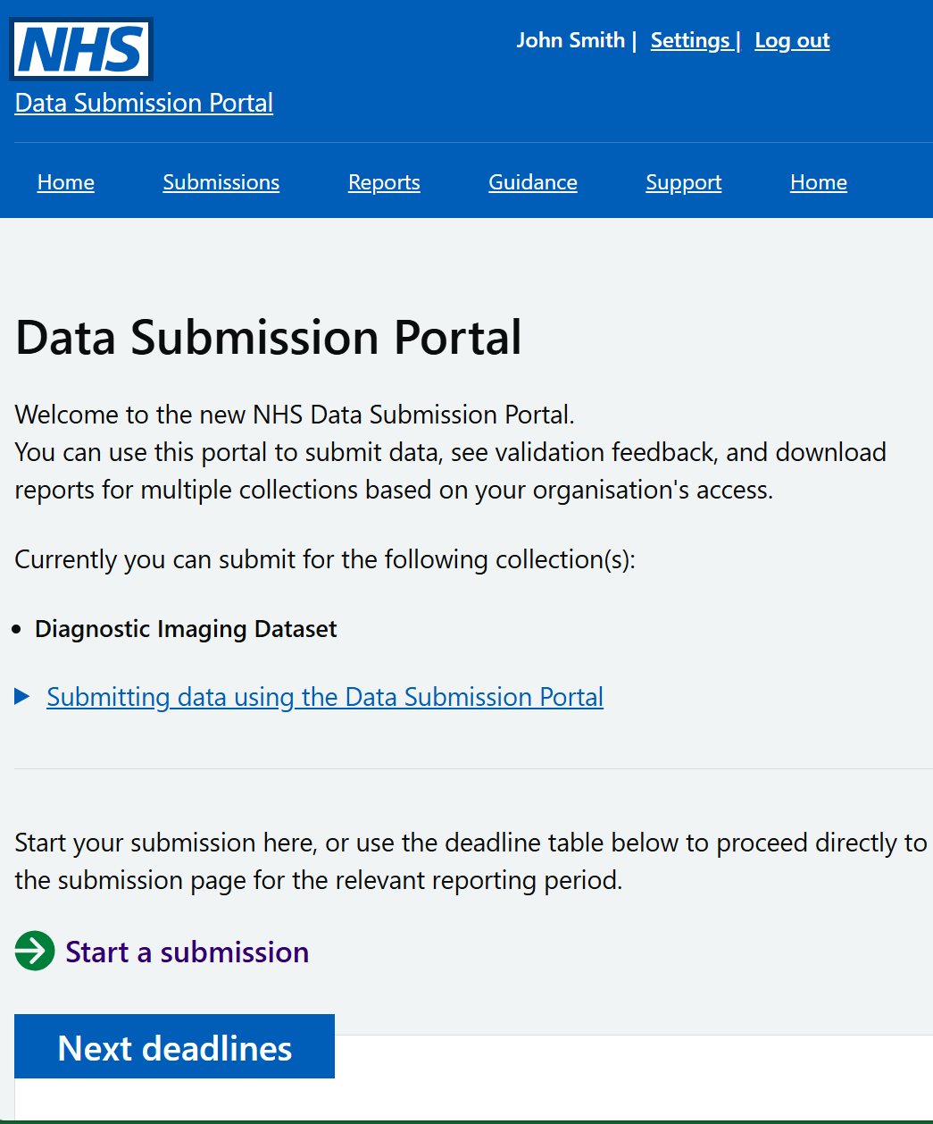
What is the National Data Submission Portal (NDSP)?
A single data submission portal that sits on the National Data Integration Tenant (NDIT) platform
Choice of submission routes
  File upload
  API
  Webform (not applicable for DIDS v2.0)
  FDP Local Tenant (not applicable for DIDS v2.0)
Consistent data validation
Collection management
Notes:
NDSP will sit on NDIT
A single data submission portal
Manage everything in one place
Ambition is to eventually consolidate 24+ legacy portals
Choice of submission routes to reduce burden
API, file transfer, file upload, webform and FDP local tenant flows
Consistent data validation
Data Validation Engine (DVE) using shared rules
Collection management
Management information, collection windows, permissions

Slide 21
NDSP Team Update
Build
Development
  Finalising authentication route
  Testing and bug fixes
  Preparation for User Acceptance Testing (UAT)
User research
  Requesting access to permissions
  Planning upcoming testing
UAT
Live
Notes:
Plain slide with subhead and bullets

Slide 22
User Acceptance Testing (UAT) Version | Live Version
Guidance on NHS Futures | Updated guidance on NHS Futures
Migration of existing users + ability to request new users | Migration of existing users + ability to request new users
File upload submission (no real or personal identifiable data) | File upload submission (including test submission option)
Partial validations (excluding those that require Corporate Reference Data) | Full validation
Download all available validation feedback | Download all validation feedback
 | API submission (including test submission option)
Notes:
Plain slide with subhead and bullets

Slide 23
Authentication
All authentication will be using the Care Identity Service (CIS).
CIS is an end-to-end service covering identity management, access management, smartcards and authenticators, authentication and authorisation for health and social care workers.
If you already have a CIS account, you will use this to sign in.
If you do not, your organisation’s Registration Authority can provide you with an account.
When you sign in, you will need to do two factor authentication.
  This can be done with or without a mobile phone using a CIS account – please discuss your options with your Registration Authority.
Notes:
Plain slide with subhead and bullets

Slide 24
Permission to submit
We will migrate the permissions of existing DIDS submitters to the new system.
However, if your current DIDS account and your CIS account are associated with different email addresses, we cannot guarantee your permissions will be migrated.
If you need a new permission to submit on behalf of an organisation, you must sign into NDSP using CIS and complete the “permission request” form.
The request will be emailed to - and need to be approved by - one of your organisation’s Information Governance Leads (Caldicott Guardian, SIRO or IAO), as named on the ODS Search and Export Portal.
Notes:
Plain slide with subhead and bullets

Slide 25
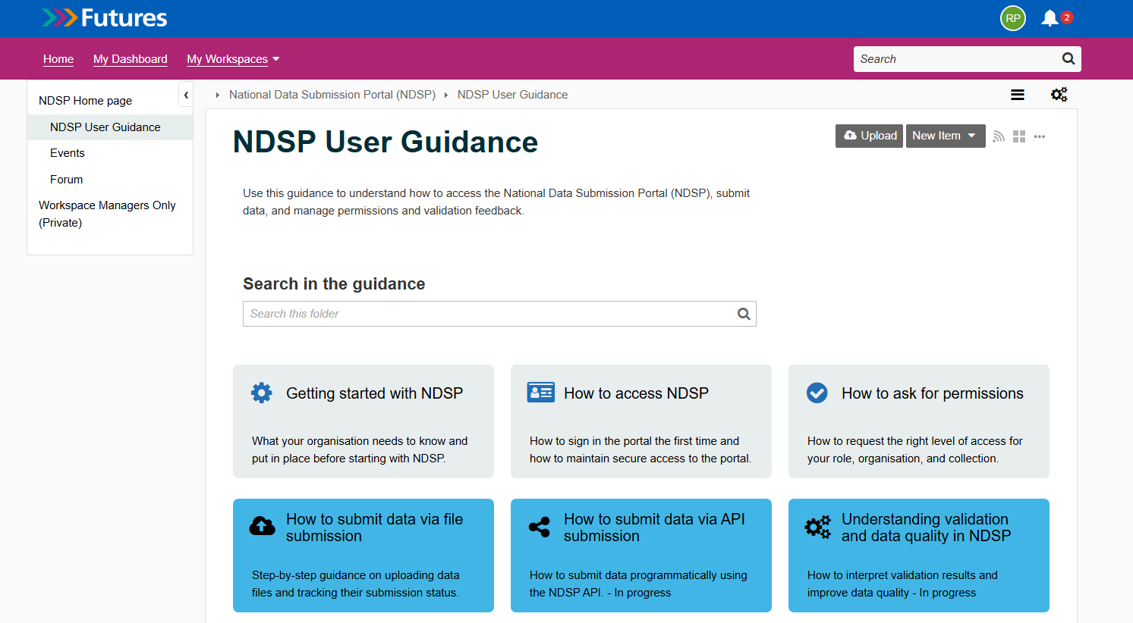
Guidance
Full guidance will be available on NHS Futures when we launch the UAT version.
Notes:
Plain slide with subhead and bullets

Slide 26
NDSP demo

Slide 27
User research: help shape NDSP

Slide 28
You can shape the National Data Submission Platform
Ongoing user research supports the design and development of NDIT.
It is very important to have your involvement:
Understanding your needs and challenges
Testing and improving designs.
You have already helped us improve:
File submission
Access to error reports
Requesting access to collections
Notes:
Plain slide with subhead and bullets

Slide 29
How to get involved:
Volunteer to help with content testing: contribute to a structured review the user guidance documents
Attend our upcoming workshop to review error reporting file structure
UAT feedback and research interviews
Email Abhilaasha.Kaul2@nhs.net or look out for our invites in the DIDS user group.
Notes:
Plain slide with subhead and bullets

Slide 30
If you have any queries regarding NDIT, please contact:
england.nditprogramme@nhs.net

Slide 31



Questions?
DIDS Webpage: Diagnostic Imaging Data Set (DIDS) - NHS England Digital
Get in touch: dataset.development@nhs.net
Notes:
Plain slide with subhead and bullets

Slide 32
End slide

