Slide 1
Diagnostic Imaging Data Set (DIDS) v2.0
Implementation Webinar 3
Date: 11/12/2025
Time: 10:00am – 11:30am
Presented by:
Chris Turner: Data Design Service & John Winter – Data Delivery Lead, NHSE
Notes:
Standard title slide

Slide 2
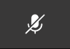
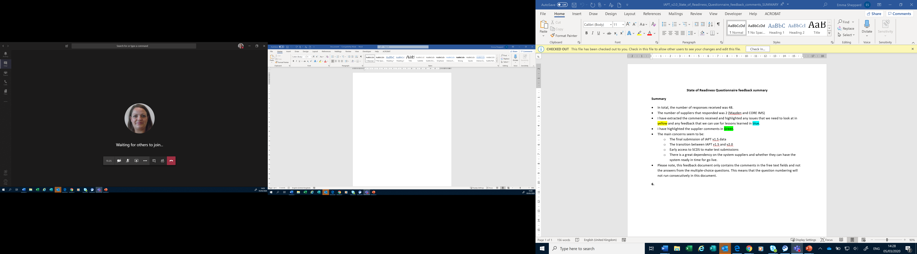
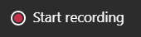
Housekeeping
Welcome and thank you for joining this webinar, the session will begin shortly.
Please note the following housekeeping points:
Please remain on mute throughout the webinar, unless indicated, to avoid disruption and noise interference for other attendees
If you wish to ask a question or raise a query during the webinar, you may do so via the meeting chat function, or by using the “raise your hand” function, all contributions are welcome!
To view the meeting chat, please select the ‘Show conversation’ icon in the Teams control task bar (pictured left)
If we are unable to answer your question due to time constraints, please forward it to dataset.development@nhs.net and we will pick it up via our mailbox
This webinar will be recorded and published. The recording will help us to update and publish the slide pack covering the questions and answers raised and allow people unable to make the webinar the chance to get involved.
Notes:
Plain slide with subhead and bullets

Slide 3

Webinars
This is the third in a series of planned webinars which is relevant to all providers, suppliers and services that are or may be in scope to submit the Diagnostic Imaging Data Set (DIDS).
The slides from the first 2 implementation webinars are available here: Diagnostic Imaging Data Set (DIDS) implementation tools and guidance - NHS England Digital
The target audience for this webinar is:
  All care providers / submitters
  IT system providers
  Other stakeholders with an interest in DIDS data
The focus of this webinar will be primarily to go through the Enhanced Technical Output Specification (ETOS) validations and details of the submission files to submit the data (XML Schema and CSV format).
Future webinar dates in 2026 will be announced by the end of January.
Notes:
Plain slide with subhead and bullets

Slide 4
ISN Publication
DIDS v2.0 was published 23/10/2025
Reminder of documentation:
ISN: DAPB1577: Diagnostic Imaging Data Set - NHS England Digital
Guidance / Support: Diagnostic Imaging Data Set (DIDS) - NHS England Digital
The Information Standard publication includes the Technical Output Specification (TOS) which defines the structure of the data set and data items to be collected.
The supplementary guidance includes the Enhanced Technical Output Specification (ETOS) which includes data items collected, their definitions and the validations which will take place when DIDS v2.0 data is received by NHS England.
In addition to being in the TOS, all Data Group and Data Item definitions will be published in the NHS Data Model and Dictionary (planned for March 2026), with links to be added to the ETOS.

Slide 5
DIDS v2.0 Validations
All validations can be found in the DIDS v2.0 ETOS: Diagnostic Imaging Data Set (DIDS) implementation tools and guidance - NHS England Digital
7 File level validations – Additional File-Level Rejects tab
101 Data Item level validations – Blue group tabs or the Validations (Data Items) tab
108 Validations
99 Rejections
9 Warnings
(All Data Item Level validations)
(7) Additional File-Level Rejects tab
(92)
Data Item Level validations

Slide 6
DIDS v2.0 Validations – File Level Rejections
Error Code | Validation Failure Message | Help Text
DIDSREJ001 | Submission file structure check. | The submission file must not be altered in ANY way that affects the transmission of data. All the fields listed must be present and the field types must be exactly as specified.
DIDSREJ007 | Failed data consistency NHS Number check in the MPI group: An NHS Number can only be allocated to one person, therefore if a duplicate NHS Number is submitted then all other data items in the MPI group must match. | Duplicate NHS numbers are accepted (when the same patient has had two or more pieces of activity in the same reporting period) but the other MPI data items submitted must match.
DIDSREJ008 | Failed data consistency Local Patient Identifier (Extended) check in the MPI group: A Local Patient Identifier (Extended) can only be allocated to one person, therefore if a duplicate Local Patient Identifier (Extended) is submitted then all other data items in the MPI group must match. | Duplicate Local Patient Identifiers (Extended) are accepted (when the same patient has had two or more pieces of activity in the same reporting period) but the other MPI data items submitted must match.
DIDSREJ009 | Failed duplicate Radiological Accession Number (RAN) check in the Activity group. A RAN is allocated to more than one piece of activity. | Duplicate Radiological Accession Numbers cannot be accepted.
DIDSREJ011 | Failed data consistency Header data items check in the Header group. In a CSV file submission each row from the Header group must match. | Differences in submitted Header groups data items in any row of a CSV file submission cannot be accepted.
DIDSREJ012 | Failed CODED PROCEDURE (NICIP) and CODED PROCEDURE (SNOMED CT) as both have valid values. | Both CODED PROCEDURE (NICIP) and CODED PROCEDURE (SNOMED CT) have a valid value, one and only one of these data items must have a valid value.
DIDSREJ013 | Failed CODED PROCEDURE (NICIP) and CODED PROCEDURE (SNOMED CT) as both are missing. | Neither CODED PROCEDURE (NICIP) or CODED PROCEDURE (SNOMED CT) have a valid value, one and only one of these data items must have a valid value.

Slide 7
DIDS v2.0 Validations - Data Item Level Validations
All Data Item level validations generally fall into one of 5 categories
Blank
Format
Incorrect National Codes
Logical date order
Incorrect Codes at time of activity (CODED PROCEDURE END TIMESTAMP)
  Organisation Codes
  SNOMED Codes
  NICIP Codes

Slide 8
DIDS v2.0 Validations - Blank
All Mandatory data items have a Blank validation to ensure there has been data submitted.
Example:
File Rejected - [DIDS001001] local_patient_identifier_extended is blank.
[DIDS001001] local_patient_identifier_extended=<local_patient_identifier_extended>
[DIDS003001] radiological_accession_number=<radiological_accession_number>
A unique error code will also be included in the report for reference.

Slide 9
DIDS v2.0 Validations - Format
All data items have a Format validation to ensure that any data submitted is in the format specified in the TOS.
Example:
File Rejected - [DIDS001001] local_patient_identifier_extended has an incorrect data format.
[DIDS001001] local_patient_identifier_extended=<local_patient_identifier_extended>
[DIDS003001] radiological_accession_number=<radiological_accession_number>
A unique error code will also be included in the report for reference.

Slide 10
DIDS v2.0 Validations - Date Order
All date data items have a Date validation to ensure that any dates submitted are in a logical order.
Example:
File Rejected - [DIDS002008] diagnostic_test_request_received_date is before [DIDS002006] diagnostic_test_request_date.
[DIDS002008] diagnostic_test_request_received_date=<diagnostic_test_request_received_date>
[DIDS002006] diagnostic_test_request_date=<diagnostic_test_request_date>
[DIDS003001] radiological_accession_number=<radiological_accession_number>
A unique error code will also be included in the report for reference.

Slide 11
DIDS v2.0 Validations - National Codes
All National Code List data items have a National Codes validation to ensure that the code submitted is valid against the list in the TOS / Data Dictionary.
Example:
Warning - [DIDS001004] nhs_number_status_indicator_code contains an invalid value.
[DIDS001004] nhs_number_status_indicator_code=<nhs_number_status_indicator_code>
[DIDS003001] radiological_accession_number=<radiological_accession_number>
A unique error code will also be included in the report for reference.

Slide 12
DIDS v2.0 Validations - Incorrect Codes at time of activity
All Organisation Code data items, as well as the SNOMED and NICIP code data items, have an Incorrect Code at time of activity validation to ensure they are valid against CODED PROCEDURE END TIMESTAMP.
Example:
File Rejected - [DIDS002004] organisation_identifier_referring_organisation is not a current (at time of activity) ODS Code (or a default value as defined in the NHS Data Model and Dictionary).
[DIDS002004] organisation_identifier_referring_organisation=<organisation_identifier_referring_organisation>
[DIDS003001] radiological_accession_number=<radiological_accession_number>
A unique error code will also be included in the report for reference.

Slide 13
DIDS v2.0 Validations
Whilst we do not expect significant changes to the DIDS v2.0 ETOS, there is the potential that validations may change given that there are a number of new data items, user feedback on the new platform is ongoing and there is a testing period planned, ahead of go-live.
In the event any changes are required, we will notify users as quickly as possible.

Slide 14
Submission Methods
There are two submission methods, with an API option also planned as an alternative:
  XML Schema (Extensible Markup Language)
  CSV File (Comma Separated Values)
The XML Schema contains the Header group information once per submission, whereas in the CSV File it must repeat, unchanged, in each row.
Link to TRUD - https://isd.digital.nhs.uk/trud/users/guest/filters/0/home where you can find the template files, some notes / guidance and some example data
Note: You may need to set up an account for TRUD (if not already) and subscribe to the DIDS v2.0 XML Schema and CSV Format releases.

Slide 15
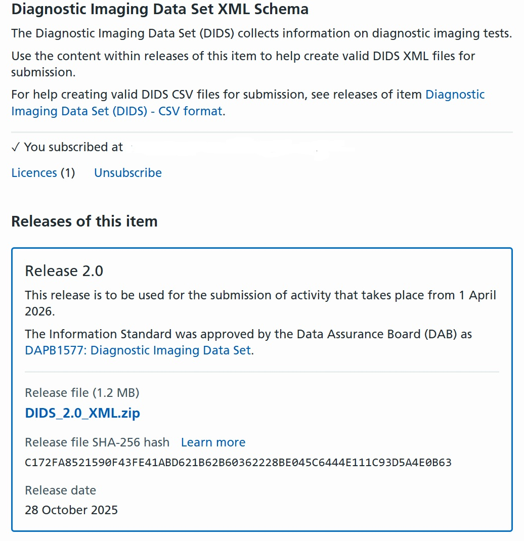
DIDS v2.0 XML Schema on TRUD

Slide 16
XML Schema
Example Header group data
<DIDS000_HEADER>
<data_set_version_number>2.0</data_set_version_number>
<organisation_identifier_code_of_provider>03XYZ</organisation_identifier_code_of_provider>
<organisation_identifier_code_of_submitting_organisation>03XYZ</organisation_identifier_code_of_submitting_organisation>
<primary_data_collection_system_in_use>My_DIDS_System</primary_data_collection_system_in_use>
<reporting_period_start_date>2026-04-01</reporting_period_start_date>
<reporting_period_end_date>2026-04-30</reporting_period_end_date>
<date_and_time_data_set_created>2026-05-10T10:35:02</date_and_time_data_set_created>
</DIDS000_HEADER>

Slide 17
XML Schema
Example MPI, Referral & Activity groups within a record:
<DIDS_v2_Record>
  <local_patient_identifier_extended>A1234567890123</local_patient_identifier_extended>
  <organisation_identifier_local_patient_identifier>03XYZ</organisation_identifier_local_patient_identifier>
  <nhs_number>1234567890</nhs_number>
  <nhs_number_status_indicator_code>01</nhs_number_status_indicator_code>
  <person_birth_date>1957-08-13</person_birth_date>
  <ethnic_category>Z</ethnic_category>
  <ethnic_category_2021/>
  <person_stated_gender_code>1</person_stated_gender_code>
  <postcode_of_usual_address>A99 9AA</postcode_of_usual_address>
  <general_medical_practice_patient_registration>02XYZ</general_medical_practice_patient_registration>
  <patient_source_setting_type_diagnostic_imaging>03</patient_source_setting_type_diagnostic_imaging>
  <referrer_code_diagnostic_imaging>C9999998</referrer_code_diagnostic_imaging>
  <treatment_function_code_referral_for_diagnostic_imaging>410</treatment_function_code_referral_for_diagnostic_imaging>
  <organisation_identifier_referring_organisation>03XYZ</organisation_identifier_referring_organisation>
  <service_request_priority_type>1</service_request_priority_type>
  <diagnostic_test_request_date>2026-01-28</diagnostic_test_request_date>
  <diagnostic_test_request_time>15:30:47</diagnostic_test_request_time>
  <diagnostic_test_request_received_date>2026-01-28</diagnostic_test_request_received_date>
  <diagnostic_test_request_received_time>15:30:54</diagnostic_test_request_received_time>
  <radiological_accession_number>RW6A06729288</radiological_accession_number>
  <organisation_site_identifier_of_imaging>03XYZ</organisation_site_identifier_of_imaging>
  <coded_procedure_nicip>XFOOL</coded_procedure_nicip>
  <coded_procedure_snomed_ct/>
  <coded_procedure_start_timestamp>2026-04-30T10:25:20+00:00</coded_procedure_start_timestamp>
  <coded_procedure_end_timestamp>2026-04-30T10:37:27+00:00</coded_procedure_end_timestamp>
  <service_report_issue_timestamp>2026-04-30T15:14:06+00:00</service_report_issue_timestamp>
  <diagnostic_imaging_cancer_indication_code/>
  <general_anaesthetic_administered_indicator>N</general_anaesthetic_administered_indicator>
  <referrer_radiology_procedure_evaluation_indicator>N</referrer_radiology_procedure_evaluation_indicator>
  <diagnostic_imaging_activity_category>02</diagnostic_imaging_activity_category>
  <diagnostic_imaging_waiting_list_clock_start_date/>
  <planned_diagnostic_due_date>2026-04-30</planned_diagnostic_due_date>
</DIDS_v2_Record>

Slide 18
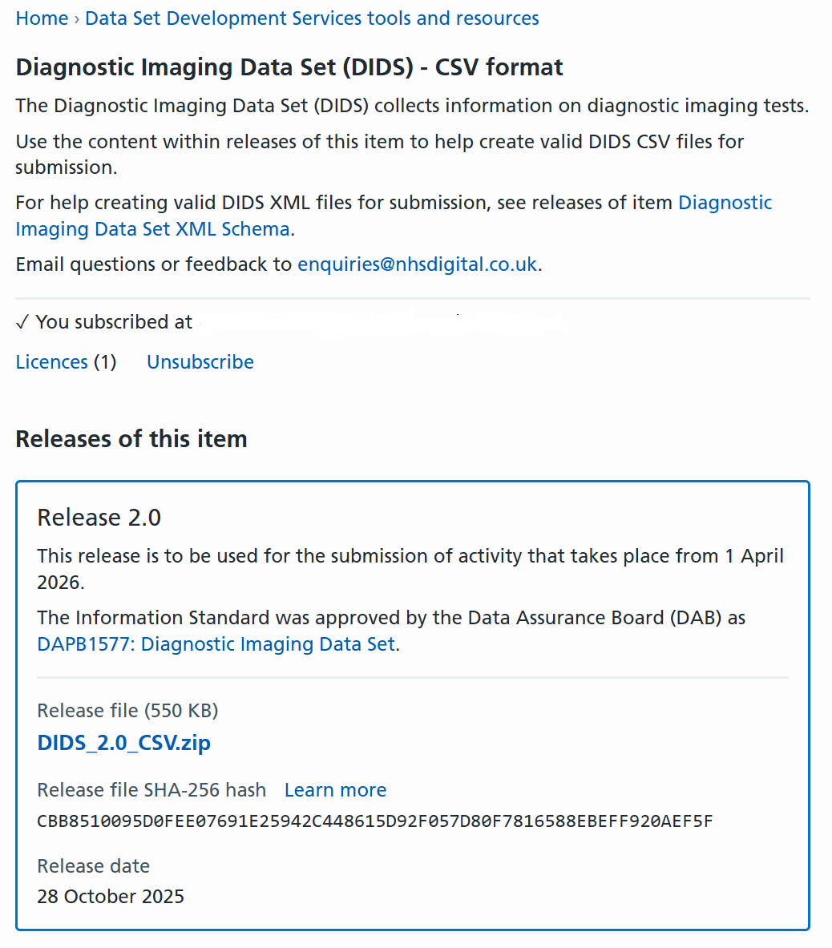
DIDS v2.0 CSV format on TRUD

Slide 19
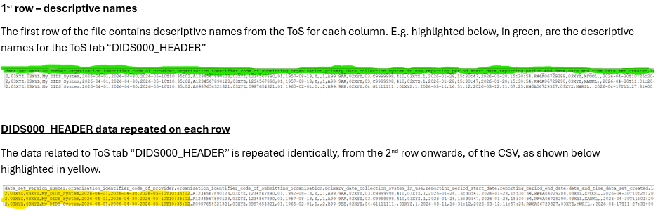
CSV File
CSV Notes

Slide 20
CSV File
Separator
“,” is used as the separator.
TOS Header (“tab” DIDS000_Header) data
To support submission processing the seven fields in the Technical Output Specification (TOS) “tab” DIDS000_Header are included as columns in each row of the submission CSV file. The values submitted in these columns will be identical for every row in the submission file.
Data Formats
The data must be in the correct format as detailed in the DIDS TOS. (NB no validation is possible in the CSV file, but validation will be undertaken by NHSE on submission).
CSV File
The following single template file (included in the zip file download) will require populating with data:
CSV_DIDS_v2.0.8
The CSV file contains data item names from TOS spreadsheet “tabs” DIDS000_Header, DIDS001_MPI, DIDS002_REFERRAL and DIDS003_ACTIVITY.
The first row of a submission must contain these data item names.

Slide 21
CSV File
Special Notes
For guidance, a CSV file containing sample data is included in the download pack.
Each field may or may not be enclosed in double quotes. i.e. ,Data, and ,“Data”, are both valid.
If a field contains no data, the separator/s for the field are still required. i.e. Data,,,Data,,Data,Data,,,,Data
If a patient has multiple scans for the same single referral, then values relating to DIDS000_Header, DIDS001_MPI and DIDS002_REFERRAL will be identical for every row recording the separate scans relating to DIDS003_ACTIVITY.
Providers should be aware that the following data items:
  NHS Number Status Indicator
  Patient Source Setting (Diagnostic Imaging)
  Diagnostic Imaging Cancer Indication Code
  Diagnostic Imaging Activity Category
All require a leading zero where a zero is specified within the National Codes in the TOS (for example need to be submitted as 01 and not just 1).
Care must be taken when opening a .csv file in Excel, as Excel will identify these as numbers and drop the leading zeros; therefore, you should reformat these columns as text before saving as .csv again.
Care must also be taken with date and time items in Excel to ensure that they are formatted as text and displayed correctly.

Slide 22
Submission timetable
DIDS v2.0 Submission timetable information is on the DIDS website.
Data submissions are required every month starting from 1 May 2026, for submission of April 2026 data with a defined provisional and final submission model.
First 3 months shown of v2.0 activity below:
Activity month/reporting period | Submission window opens | Provisional processing deadline at 11.59.59 pm | Submission window closes at 11.59.59 pm
April 2026 | 1 May 2026 | 31 May 2026 | 31 October 2026
May 2026 | 1 June 2026 | 30 June 2026 | 30 November 2026
June 2026 | 1 July 2026 | 31 July 2026 | 31 December 2026

Slide 23
Submission timetable
During the submission window, providers can make as many submissions as are needed.
Submissions ahead of the provisional processing deadline are strongly encouraged to enable timely data to be available for operational decision making and planning purposes.
No requirement for providers to do any further submissions after provisional processing if the quality of their existing submission is sufficient and no data has changed.
Any files submitted to and accepted by NDIT overwrite previously submitted files for DIDS v2.0 data.
Imperative that providers thoroughly check their data submission, as there are no opportunities to re-submit data for a time period once the submission window has closed.
NHS England will use the ‘last good file’ that passed validation, by either the provisional processing deadline or once the submission deadline window has closed, for national analysis and reporting.

Slide 24
Wider supplier and provider engagement
Update on wider engagement since last Webinar:
System supplier webinar held on 25/11/2025
Data Liaison Service have commenced engaging providers on their implementation/readiness

Slide 25
DIDS v2.0 User Guidance
Guidance has been published in draft at Diagnostic Imaging Data Set (DIDS) implementation tools and guidance - NHS England Digital
This is a mature draft which we believe will be useful guidance to providers, suppliers and other stakeholders.
Please review this and provide feedback:
Are any aspects unclear?
Is anything missing?
Are you concerned about the implementation of what is described?
Please provide feedback by 6 January 2026 to dataset.development@nhs.net
Aiming to publish a final version post feedback by 30 January 2026.

Slide 26
National Data Submission Portal (NDSP) &
National Data Integration Tenant (NDIT)
Robyn McNally & Sarah Thew
October 2025
Notes:
Standard title slide

Slide 27
The National Data Integration Tenant (NDIT) will be the secure national safe haven for data collection, processing and management for NHS England, including for the processing of identifiable data.

Slide 28
National Data Integration Tenant (NDIT)
NDIT forms a core part of the NHS England’s national data infrastructure, utilising Palantir Foundry technology and tooling.
NHS England remains the data controller or processor for all data within NDIT, following all legal and governance standards.
Over time, NDIT will replace other NHS England data collection, processing and management platforms and products, becoming the single ‘national safe haven for data’.
Notes:
Plain slide with subhead and bullets

Slide 29
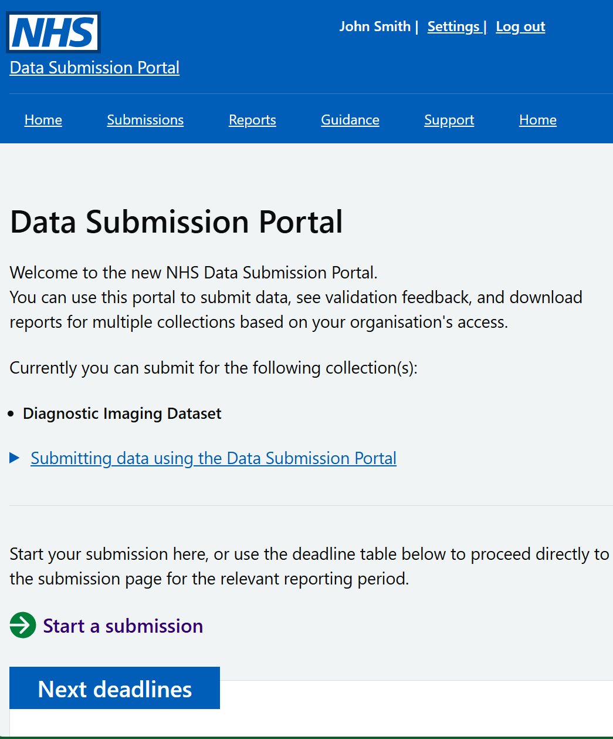
What will the National Data Submission Portal (NDSP) be?
A single data submission portal that sits on the NDIT platform
Choice of submission routes
  File upload
  API
  Webform (not applicable for DIDS v2.0)
  FDP Local Tenant (not applicable for DIDS v2.0)
Consistent data validation
Collection management
Notes:
NDSP will sit on NDIT
A single data submission portal
Manage everything in one place
Ambition is to eventually consolidate 24+ legacy portals
Choice of submission routes to reduce burden
API, file transfer, file upload, webform and FDP local tenant flows
Consistent data validation
Data Validation Engine (DVE) using shared rules
Collection management
Management information, collection windows, permissions

Slide 30
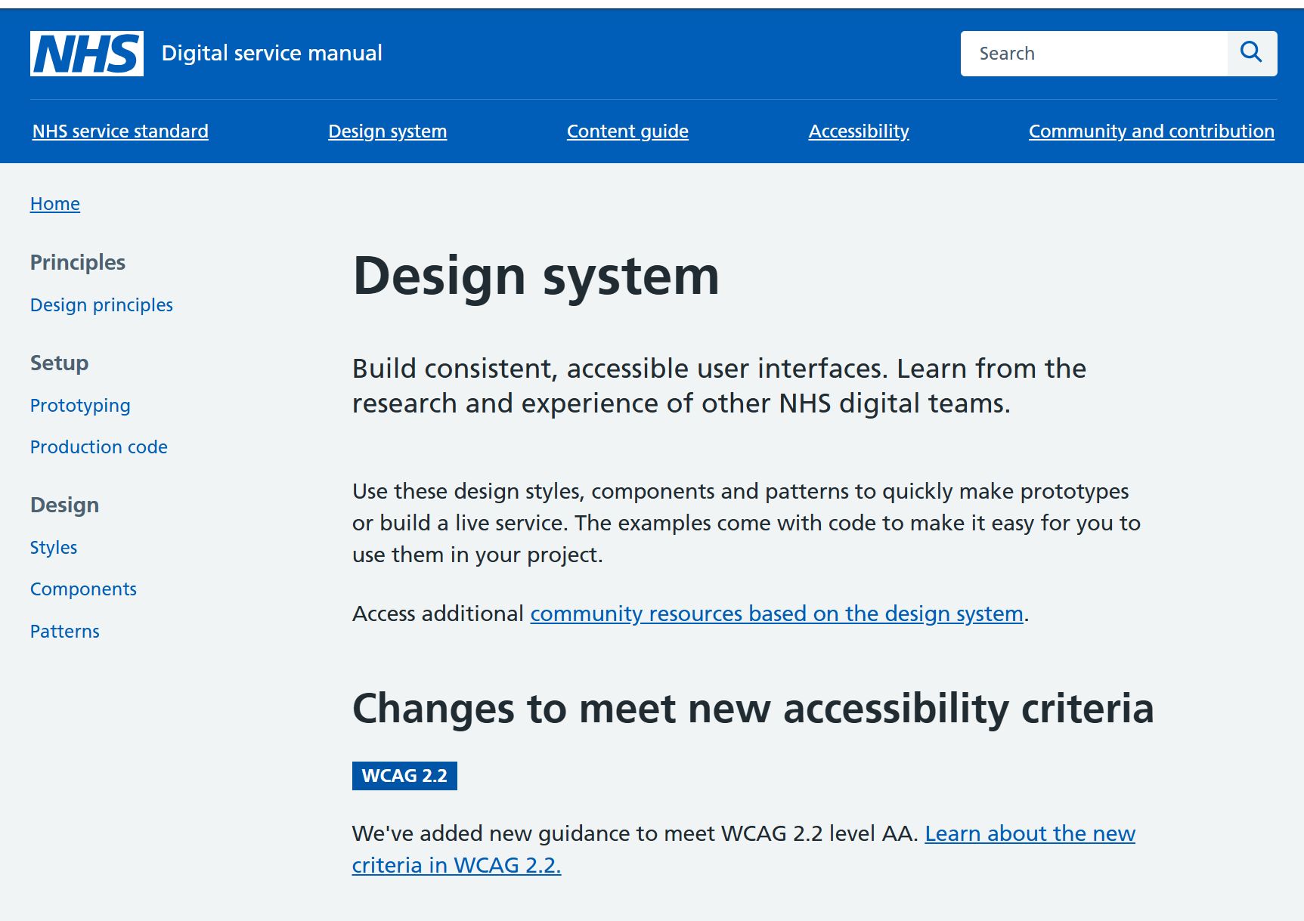
Principles
Accessible
Scalable
Secure
Reusable components
NHS Design System

Slide 31
NDSP for DIDS v2.0 Roadmap
Done | In progress | Next | Before go live
Submission portal File upload | Data validation engine Permissions management | Validation feedback API submission functionality Collection management functionality (for NHSE staff) | Iterations based on user testing Full guidance & training

Slide 32
NDSP demo

Slide 33
User research – call for participants

Slide 34
Help shape the NDIT platform
We have an ongoing user research programme supporting the design and development of NDIT.
It is very important to have your involvement in this work:
  Understanding your needs and challenges
  Testing and improving designs.
Some of you have already started to get involved – thank you!
If you’re interested in participating, look out for our email invitations, or please send me an email: Sarah.thew2@nhs.net
Notes:
Plain slide with subhead and bullets

Slide 35
Recommended actions to take now
Identify relevant stakeholders in your organisation and make them aware of the DIDS v2.0 requirements as per DAPB1577: Diagnostic Imaging Data Set - NHS England Digital.
Familiarise yourself with the Technical Output Specification (TOS) which contains the new and amended data items for DIDS v2.0.
If you are a care provider, use the DIDS Mapping Guidance from v1.0 to v2.0 to help understand how well your systems align to the data requirements.
If you are a care provider or IT system provider have a look at the validations in the Enhanced Technical Output Specification (ETOS).
Review the DIDS v2.0 User Guidance Diagnostic Imaging Data Set (DIDS) implementation tools and guidance - NHS England Digital and provide feedback by 6 January 2026.
IT system providers - review all related documents to fully understand the background, objectives and scope of the information standard.
Care providers - ensure your IT system provider reviews the TOS and User Guidance to understand scope and definition of each data item.
Care providers - reply to the DIDS v2.0 DLS Support email issued w/c 1 December by 19 December 2025.

Slide 36
Future Webinars
What has worked well in the webinars so far?
What could be better next time?
What topics would you like to be covered in future DIDS v2.0 webinars?
Please provide any feedback now or email this to the below referencing ‘DIDS v2.0’ by 6 January 2026:
dataset.development@nhs.net

Slide 37



Questions?
DIDS Webpage: Diagnostic Imaging Data Set (DIDS) - NHS England Digital
Get in touch: dataset.development@nhs.net
Notes:
Plain slide with subhead and bullets

Slide 38
End slide

