Slide 1
Diagnostic Imaging Data Set (DIDS) v2.0
Implementation Webinar 1
Date: 05/11/2025
Time: 10:00am – 11:00am
Presented by:
Chris Turner: Data Design Service, NHSE
Notes:
Standard title slide

Slide 2
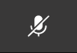
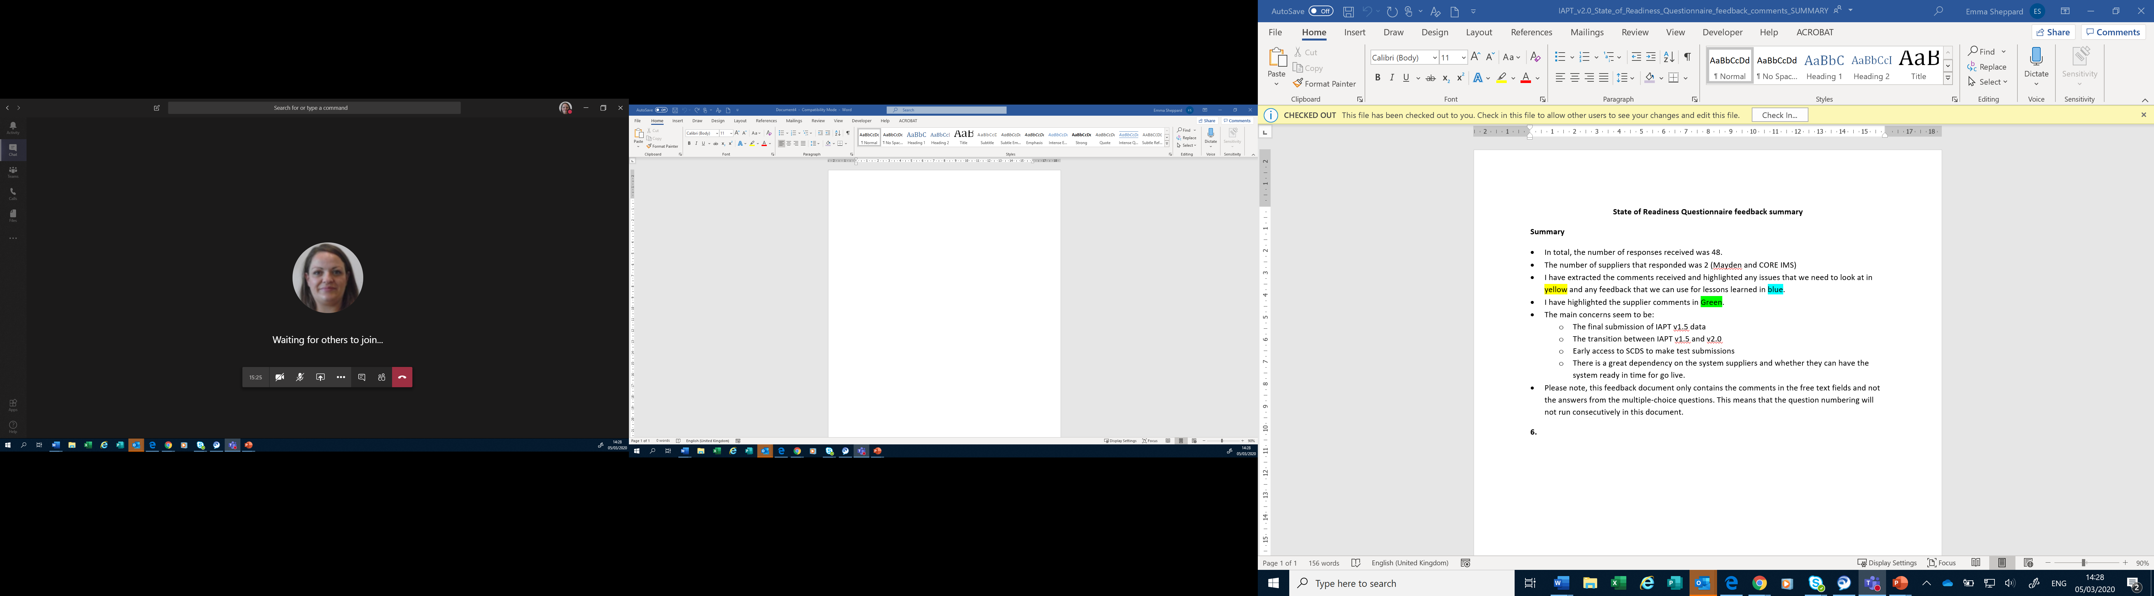
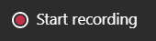
Housekeeping
Welcome and thank you for joining this webinar, the session will begin shortly.
Please note the following housekeeping points:
Please remain on mute throughout the webinar, unless indicated, to avoid disruption and noise interference for other attendees
If you wish to ask a question or raise a query during the webinar, you may do so via the meeting chat function, and there will time for questions at the end of the slides, all contributions are welcome!
To view the meeting chat, please select the ‘Show conversation’ icon in the Teams control task bar (pictured left)
If we are unable to answer your question due to time constraints, please forward it to dataset.development@nhs.net and we will pick it up via our mailbox
This webinar will be recorded and published. The recording will help us to update and publish the slide pack covering the questions and answers raised and allow people unable to make the webinar the chance to get involved.
Notes:
Plain slide with subhead and bullets

Slide 3

Webinars
This is the first in a series of planned webinars which is relevant to all providers, suppliers and services that are or may be in scope to submit the Diagnostic Imaging Data Set (DIDS).
The target audience for this webinar is:
  All care providers / submitters
  IT system providers
  Other stakeholders with an interest in DIDS data
The focus of this webinar will be primarily to discuss the launch of the Information Standard for DIDS v2.0 and what guidance and documentation is available.
Future webinar dates:
  18 November 2025 – 10:00am – 11:30am DIDS v2.0 Implementation Webinar 2 | NHS England Events
  11 December 2025 – 10:00am – 11:30am
Notes:
Plain slide with subhead and bullets

Slide 4
DIDS v2.0 – Development Overview
Overview (Planned Timelines)
Data Alliance Partnership Board (DAPB) process started in January 2024
We previously gave the view of activity potentially collected from 1 April 2025 and indicated that data would be submitted from 1 May 2025 (for v2.0)
Then DIDS v2.0 was moved to activity collected no earlier than June 2025, with data submitted no earlier than July 2025
DIDS v2.0 activity will now be collected from 1 April 2026, with data submitted from 1 May 2026.
Development Process
30 requirements logged
  NHSE
  Data Dictionary
  Care providers & IT providers
Requirements Elaboration - Complete:
Engagement with NHSE, NHS Data Model & Dictionary, Terminology teams and all stakeholders
Series of consultation ERGs and webinars
Online Public Consultation (w/ draft specification)
ISN Publication 23 October 2025

Slide 5
Changes to DIDS for v2.0
The high-level changes to DIDS v2.0 are on the following slides.
In the next webinar (18 November) we’ll go through the data groups and data items in more details.
DIDS v2.0 contains 39 data items split over 4 data groups.

Slide 6
Changes to DIDS for v2.0
Updated meta data relating to the submission file.
Improving the ability of the data set to capture detail about the referral for the patient, including the addition of:
  A new national code to capture where the source of the referral is from a Screening Programme.
  A new data item (TREATMENT FUNCTION CODE (REFERRAL FOR DIAGNOSTIC IMAGING)) to capture the Treatment Function Code of the referring service.
  A new data item (DIAGNOSTIC TEST REQUEST TIME) to capture the time the Diagnostic test request was made.
  A new data item (DIAGNOSTIC TEST REQUEST RECEIVED TIME) to capture the time the Diagnostic test request was received.

Slide 7
Changes to DIDS for v2.0
Improving the ability of the data set to capture detail about the imaging activity for the patient, including:
  Replacing the DIAGNOSTIC TEST DATE data item with two timestamp data items (CODED PROCEDURE START TIMESTAMP and CODED PROCEDURE END TIMESTAMP) to more accurately measure the time for image acquisition.
  A new data item (SERVICE REPORT ISSUE TIMESTAMP) to record more accurately the time the imaging report was available.
  A new data item (DIAGNOSTIC IMAGING CANCER INDICATION CODE) which indicates if the imaging showed a suspected or confirmed cancer and requires following up to better understand the stages of cancer or reoccurrence, demands in the system and delays in pathways.
  A new data item (GENERAL ANAESTHETIC ADMINISTERED INDICATOR) to identify patients that need a general anaesthetic in order to carry out the procedure.
  A new data item (REFERRER RADIOLOGY PROCEDURE EVALUATION INDICATOR) to improve accuracy of data regarding reporting turnaround times by identifying examination records which do not have a formal radiology report issued by the Radiology Department.
  A new data item (DIAGNOSTIC IMAGING ACTIVITY CATEGORY) to record the category of activity to understand if the activity relates to a diagnostic waiting list, is planned or unscheduled.
  A new data item (DIAGNOSTIC IMAGING WAITING LIST CLOCK START DATE) to record the date the waiting list started.
  A new data item (PLANNED DIAGNOSTIC DUE DATE) to record the date the planned activity was due.

Slide 8
Changes to DIDS for v2.0
Update out of date data items as highlighted by the NHS Data Model and Dictionary Service, to ensure alignment with other data sets and Data Dictionary editorial principles. These include renaming of data items, updates to descriptions and definitions, value lists and codes.
Transfer the submission mechanism from the current DIDS Portal to the National Data Integration Tenant (NDIT) (including subsequent processing).
Discontinue the interim “local codes mapping” service to enforce either a National Interim Clinical Imaging Procedure Codes (NICIP) or SNOMED CT code to be submitted.
Increase the timeliness of submissions and use of data by moving to a 3-month window to submit data with no exceptions (following the first 12 months of submissions which will have a 6-month window as standard, to support the sector in the implementation of the other changes).
Capturing all activity in DIDS v2.0 (rather than only the most complex where multiple activities take place as part of the same patient event).
Publication of a TOS (Technical Output Specification) and ETOS (Enhanced Technical Output Specification) documents in line with Data Design Service best practice.

Slide 9
Information Standard Publication
DIDS v2.0 was published 23/10/2025
DAPB1577: Diagnostic Imaging Data Set - NHS England Digital
At the above link you’ll find the:
  Technical Output Specification (TOS)
  Change Specification
  Requirements Specification
  Implementation Guidance

Slide 10
Further Documentation
New DIDS web pages introduced to support v2.0:
https://digital.nhs.uk/data-and-information/data-collections-and-data-sets/data-sets/diagnostic-imaging-dataset
At the above link you’ll find the below documents for DIDS v2.0:
  Enhanced Technical Output Specification (ETOS)
  Data Model
  Data Mapping Guidance v1.0 to v2.0
  System Conformance Checklist
  User Guidance including Data scenarios (to follow)

Slide 11
Further Documentation
TRUD:
Home – NHS TRUD
At the above link you’ll find the below documents for DIDS v2.0:
  XML Schema Diagnostic Imaging Data Set XML Schema – NHS TRUD
  CSV Format Diagnostic Imaging Data Set (DIDS) - CSV format – NHS TRUD
  Both XML and CSV packs include supporting information including some example data
You’ll need a TRUD account to access the above files, available from the Home link above.
We’ll go through the XML schema/CSV format in a future webinar.

Slide 12
Further Documentation
Data products:
Diagnostic Imaging Data Set (DIDS) data product - NHS England Digital
This page provides information on the DIDS data product, including:
  ATOS
  Published DIDS data
A Data Provision Notice (DPN) for DIDS v2.0 will be published in due course ahead of the collection commencing.

Slide 13
TOS v ETOS
The Technical Output Specification is part of the Information Standard and can only be changed via a corrigendum or a new Information Standard.
The Enhanced Technical Output Specification includes some extra information:
  Data Item validations
  NHS Data Dictionary links
This allows us to alter validations and links if needed without the need for an Information Standard uplift

Slide 14
Key Timelines
Webinars – Autumn 2025 to Spring 2026 (2025 dates confirmed in this webinar, 2026 dates will be confirmed by end of January 2026)
Readiness questionnaire – Planned for February 2026
Local collection of data - from 1 April 2026
National submission of data to NHSE - from 1 May 2026
Hard Cut Over by Activity date to v2.0
All activity up to and including 31/03/2026 must be submitted in DIDS v1.0
All activity from 01/04/2026 onwards must be sent in DIDS v2.0

Slide 15
DIDS v2.0 Activity Cut-Over Dates
DIDS v1.0 data in v1 schema
DIAGNOSTIC TEST DATE <=31/03/2026
DIDS legacy portal
Submitted as per DIDS v1.0 timetable information
DIDS v2.0 data in v2.0 schema
CODED PROCEDURE END TIMESTAMP >= 2026-04-01T00:00:00 +01:00
NDIT
(National Data Integration Tenant)
Submitted from
01/05/2026 onwards
Notes:
Please see DIDS v1.0 Timetable at NHS Digital Diagnostic Imaging Dataset - Timetable

Slide 16
Submission Documentation
Link to NDIT information
TRUD links for XML and CSV packs: v2.0 represents an opportunity to consider a change in submission format so think about which best suits you
Submission timetable, with submission windows for v2.0

Slide 17
Recommended actions to take now
Be aware of the location of the Information Standard documents for DIDS v2.0 and relevant supporting documents.
Familiarise yourself with these documents, including the TOS which contains the new and amended data items for DIDS v2.0.
Identify relevant stakeholders in your organisation and make them aware of the DIDS v2.0 requirements.
If you are a care provider or IT system provider have a look at the validations in the ETOS.
Look out for an invite for the next implementation webinar on 18 November where we will go through the data set in more detail.

Slide 18
National Data Submission Portal (NDSP) &
National Data Integration Tenant (NDIT)
Robyn McNally & Sarah Thew
October 2025
Notes:
Standard title slide

Slide 19
The National Data Integration Tenant (NDIT) will be the secure national safe haven for data collection, processing and management for NHS England, including for the processing of identifiable data.

Slide 20
National Data Integration Tenant (NDIT)
NDIT forms a core part of the NHS England’s national data infrastructure, utilising Palantir Foundry technology and tooling.
NHS England remains the data controller or processor for all data within NDIT, following all legal and governance standards.
Over time, NDIT will replace other NHS England data collection, processing and management platforms and products, becoming the single ‘national safe haven for data’.
Notes:
Plain slide with subhead and bullets

Slide 21

What will the National Data Submission Portal (NDSP) be?
A single data submission portal that sits on the NDIT platform
Choice of submission routes
  File upload
  API
  Webform (not applicable for DIDS v2.0)
  FDP Local Tenant (not applicable for DIDS v2.0)
Consistent data validation
Collection management
Notes:
NDSP will sit on NDIT
A single data submission portal
Manage everything in one place
Ambition is to eventually consolidate 24+ legacy portals
Choice of submission routes to reduce burden
API, file transfer, file upload, webform and FDP local tenant flows
Consistent data validation
Data Validation Engine (DVE) using shared rules
Collection management
Management information, collection windows, permissions

Slide 22
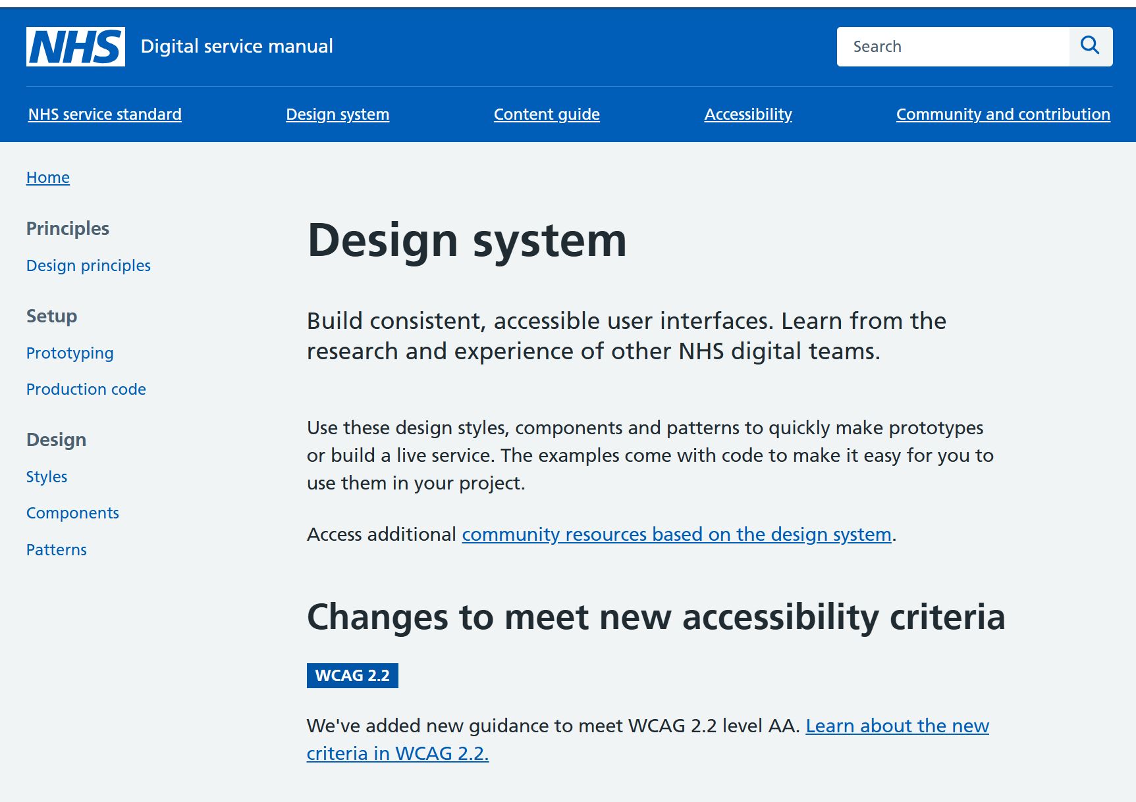
Principles
Accessible
Scalable
Secure
Reusable components
NHS Design System

Slide 23
NDSP for DIDS v2.0 Roadmap
Done | In progress | Next | Before go live
Submission portal File upload | Data validation engine Permissions management | Validation feedback API submission functionality Collection management functionality (for NHSE staff) | Iterations based on user testing Full guidance & training

Slide 24
NDSP demo

Slide 25
User research – call for participants

Slide 26
Help shape the NDIT platform
We have an ongoing user research programme supporting the design and development of NDIT.
It is very important to have your involvement in this work:
  Understanding your needs and challenges
  Testing and improving designs.
Some of you have already started to get involved – thank you!
If you’re interested in participating, look out for our email invitations, or please send me an email: Sarah.thew2@nhs.net
Notes:
Plain slide with subhead and bullets

Slide 27



Questions?
DIDS Webpage: Diagnostic Imaging Data Set (DIDS) - NHS England Digital
Get in touch: dataset.development@nhs.net
Notes:
Plain slide with subhead and bullets

Slide 28
End slide

