Slide 1



Welcome & House keeping
National Workforce Reporting Service (NWRS) Webinars 2025
Mute – Please ensure that you mute yourself on screen or on your own phone and that your webcam/camera is switched off. Please switch both on if speaking, though!
Questions – Please send your questions to the presenters via the CHAT box or raise your hand.
Slides, QAs, and link to previous webinar recording are available on our website:
NWRS website - Webinars

Slide 2


Aims of todays webinar
Agenda
 | Agenda item | Presenter | Time
1 | Welcome, Introductions & Housekeeping | Lindsey Johnson, Workforce, Training and Education Data & Analysis (NHSE) | 5 mins
2 | The importance of keeping NWRS up to date
3 | NWRS demonstration | Mohammad Moghees, Workforce, Training and Education Data & Analysis (NHSE) | 30 mins
4 | NWRS Data Quality & User Support | Lindsey Johnson, Workforce, Training and Education Data & Analysis (NHSE) | 10 mins
5 | NWRS Data Quality Dashboard | Achilles Sebukangaga, Workforce, Training and Education Data & Analysis (NHSE) | 15 mins
6 | Primary Care Publications | Sarah Brigg & Hattie Taylor, Workforce, Training and Education Data & Analysis (NHSE) | 15 mins
7 | Final comments and close | Lindsey Johnson, Workforce, Training and Education Data & Analysis (NHSE) | 5 mins

Slide 3
The importance of keeping NWRS up to date
Understanding staff capacity in General Practices (GP) and Primary Care Networks (PCN) is more important than ever:
It is the only national collection of the workforce in GPs and PCNs at individual staff level and provides a clearer picture about the local, regional and national primary care workforce
Provision of workforce data is a contractual requirement for practices and PCNs as it is crucial for understanding changing capacity across the primary care workforce
The information you provide is used to monitor government targets, develop policy and inform workforce planning
The detail contained in the data is used at both national and local level for workforce planning purposes
The data helps shape how investment, training and resource is directed across the primary care workforce
Therefore, it is critical that the information you submit to NHS England through the NWRS about your staff is accurate and complete and kept current to reflect any staffing changes; the redesigned NWRS system simple, straight forward and easy to use. NWRS is a “live” collection so providers can log in at any time to review and update their information.

Slide 4
NWRS demonstration

Slide 5
Key Points
New User Request / Changes in Users Permissions / Mergers / Closures / Name Changes / General Questions and Support etc
  Contact email ssd.nationalservicedesk@nhs.net (please quote “NWRS” in the subject line)
NWRS is a monthly collection so login at least once a month to update and review your workforce data -
Check the NWRS DQ Dashboard for confirmation of your Last Login and which fields are yet to complete
  (https://digital.nhs.uk/data-and-information/areas-of-interest/workforce/national-workforce-reporting-service-nwrs#nwrs-dashboard)
Only records which have the status "Submitted" will be extracted, not “In progress”
Check the monthly NWRS extraction reminder letter for changes and updates.
All staff undertaking funded PCN roles (regardless of how many practices they work across) should be recorded against the PCN. This includes the Clinical Director and any staff funded through the Additional Roles Reimbursement Scheme (ARRS)

Slide 6
Useful Links
Contact Email - ssd.nationalservicedesk@nhs.net
SDCS Collection Page - https://datacollection.sdcs.digital.nhs.uk/
NWRS DQ Dashboard - https://digital.nhs.uk/data-and-information/areas-of-interest/workforce/national-workforce-reporting-service-nwrs#nwrs-dashboard
NWRS Support Page - https://digital.nhs.uk/data-and-information/areas-of-interest/workforce/national-workforce-reporting-service-nwrs/support
NWRS How to Videos - https://digital.nhs.uk/data-and-information/areas-of-interest/workforce/national-workforce-reporting-service-nwrs/support#how-to-videos
NWRS Guidance and Support - https://digital.nhs.uk/data-and-information/areas-of-interest/workforce/national-workforce-reporting-service-nwrs/guidance
NWRS How we use your data - https://digital.nhs.uk/data-and-information/areas-of-interest/workforce/national-workforce-reporting-service-nwrs/how-we-use-the-workforce-data-you-provide
ODS (Searching Organisation Code) - https://odsportal.digital.nhs.uk/Organisation/Search
GP Publication - https://digital.nhs.uk/data-and-information/publications/statistical/general-and-personal-medical-services
PCN Publication - https://digital.nhs.uk/data-and-information/publications/statistical/primary-care-network-workforce
Primary Care Workforce Quarterly Update Publication - https://digital.nhs.uk/data-and-information/publications/statistical/primary-care-workforce-quarterly-update

Slide 7
Data Quality

Slide 8
Data quality- key points
High numbers of “in progress” records
Records should be completed unless you are provisionally entering details for a member of staff who has not started yet. Ensure all records are marked as “submitted” rather than “in progress”, otherwise we won’t receive complete information in the data extract used for publication of staff numbers. You can check these either in your staff table or on the data quality dashboard. Go into "in progress" records and click through to the end of the form (filling out any missing details) and click “submit”. If you exit the form before the last page, they remain “in progress” and this often happens if people edit records.
Missing staff records
All staff in roles for which funding is received should be recorded in NWRS, as well as staff paid by the organisation. This includes ARRS staff at PCNs (which now include GPs). These need to be added to NWRS if not already recorded.
Many GP practices do not currently have nurses recorded; we've been working with data providers to investigate and get this information completed.
Missing data
Particularly for GPs, quite a few records still have blank name values or “Doctor 1”, “Doctor 2”, etc. There is an automatic lookup on the system for GMC number and name, so please check your records and add these details.
Notes:
There are a number of data quality issues we see and are asked about, which cause staff numbers to not reflect the true numbers working at primary care providers. Please make sure you check for these issues. We recommend using the Data Quality Dashboard as the first port of call, which will be covered in the next segment of this presentation.

Slide 9
Data quality- key points
“Ghost” records
High numbers of duplicate records in the system from old organisation changes during the creation of PCNs, whereby staff records remain in the GP practice module as well as the PCNs they now work for.
  GP practices who have staff records for those working for/paid via the PCN should mark these staff as leavers by going into the contract section of that record, and responding "No" to the "Do they still work here?" question. Some follow up questions on destination on leaving will appear, which need to be completed to indicate that the person now works for the PCN.
Other requirements/recommendations
You must inform us as soon as you/a member of staff no longer works at your organisation (preferably in advance) so we can revoke NWRS access.
Also please inform us if your organisation is closing/merging; we do not receive this information automatically so your records (and access) will remain with the old organisation until we are asked to update this.
Log onto NWRS at least once per month to check records – this is monitored and reflected in our user statistics on the NWRS dashboard.
Each organisation should have a minimum of two NWRS users (more is fine!) to cover planned and unplanned absence, and to ensure Comms are received.

Slide 10
NWRS User Support
The webpage has a news section which includes a list of system updates issued. There is also an extraction timetable, GDPR information and a section on how data are used.
We maintain a comprehensive guidance page. This contains sections on accessing the system, general guidance, information on reporting responsibilities, viewing data, using the DQ dashboard, providing staff information, job role specific queries, staff leavers, transfers and record removal, organisation changes and a list of roles in NWRS/specification. The content can be navigated online or can be downloaded as a .pdf.
We also provide:
  ‘How-to’ in system demos are hosted on the support page linked from the main NWRS page
  Quarterly webinars for data providers, where we demo the system and dashboard, and offer opportunity to raise questions.
  We offer 1-1 data provider video support calls to address detailed queries including data quality issue resolution using screen share – contact ssd.nationalservicedesk@nhs.net with "NWRS support call" in the subject line.
  Dedicated support service for NWRS queries (ssd.nationalservicedesk@nhs.net)
We issue monthly extraction reminders ("Comms") to data providers, which include important updates and any changes to the system (roles, functionality, guidance, etc.).

Slide 11
Data Quality Dashboard demonstration

Slide 12
DQ dashboard - summary
The NWRS dashboard has been designed to support improvements to the quality and completeness of workforce information collected from GP practices and primary care networks using the National Workforce Reporting Service (NWRS). The dashboard also enables stakeholders to monitor progress at a local and regional level.
The dashboard is updated weekly on our website together with .csv dashboard files at GP and PCN level.

Slide 13
Publications

Slide 14
General Practice Workforce
https://digital.nhs.uk/data-and-information/publications/statistical/general-and-personal-medical-services
First release - 30 September 2015
Second - 31 March 2016
Quarterly from 30 September 2016
Monthly from 30 June 2021

Slide 15
Excel Bulletin Tables
England-level figures, September 2015 onwards:
FTE and headcount by gender and job role
FTE and headcount by age band and staff group
FTE work commitment (FTE bandings) by staff group
GP headcount by country of qualification
Counts by staff group per 100,000 registered patients
Regional figures - current month
Regional (ICB and Sub-ICB) FTE and headcount by job role
Regional headcount by ethnicity and staff group
Annex A
England-level data quality – submission and estimation rates, September 2015 onwards
Annex B
Total ad-hoc locum FTE and headcount, December 2017 onwards
Headcount of ad-hoc locums in other roles within general practice, December 2017 onwards
Annex C
Regional FTE and headcount ad-hoc locum figures December 2017 onwards

Slide 16
CSVs
Individual-level CSV
A row for each role held by a staff member working in general practice
Can be used to calculate headcount and FTE for all job roles
All geographical levels down to Sub-ICB Location level
Comes with step-by-step guidance on how to pivot the data
Practice-level CSVs
Aggregated FTE and headcounts for each job role for each practice providing data
High-level long / thin file recently introduced
Gender and age band breakdowns included in long-standing detailed file
Do not include fully-estimated records or staff whose practice is unknown

Slide 17
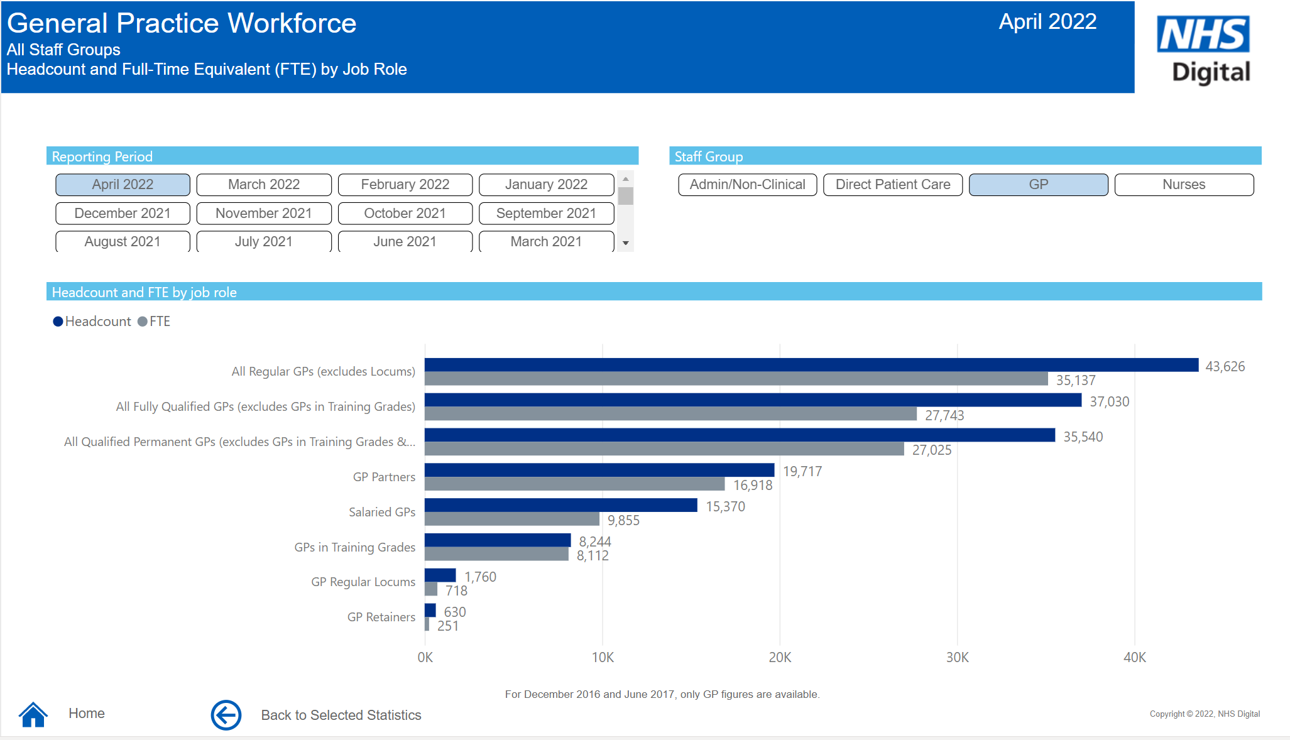
Interactive tool
September 2015 to present, high-level figures presented in variety of visualisations
Interactive charts displaying different characteristics of staff
ICB and practice-level information presented
Access the dashboard here

Slide 18
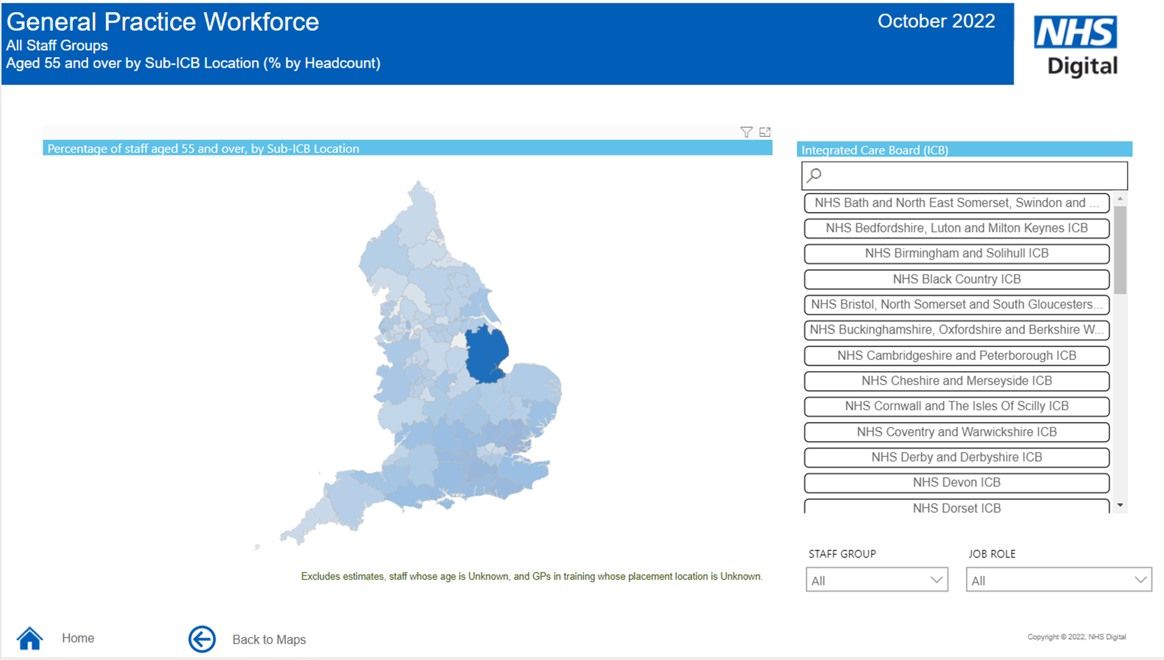

Slide 19
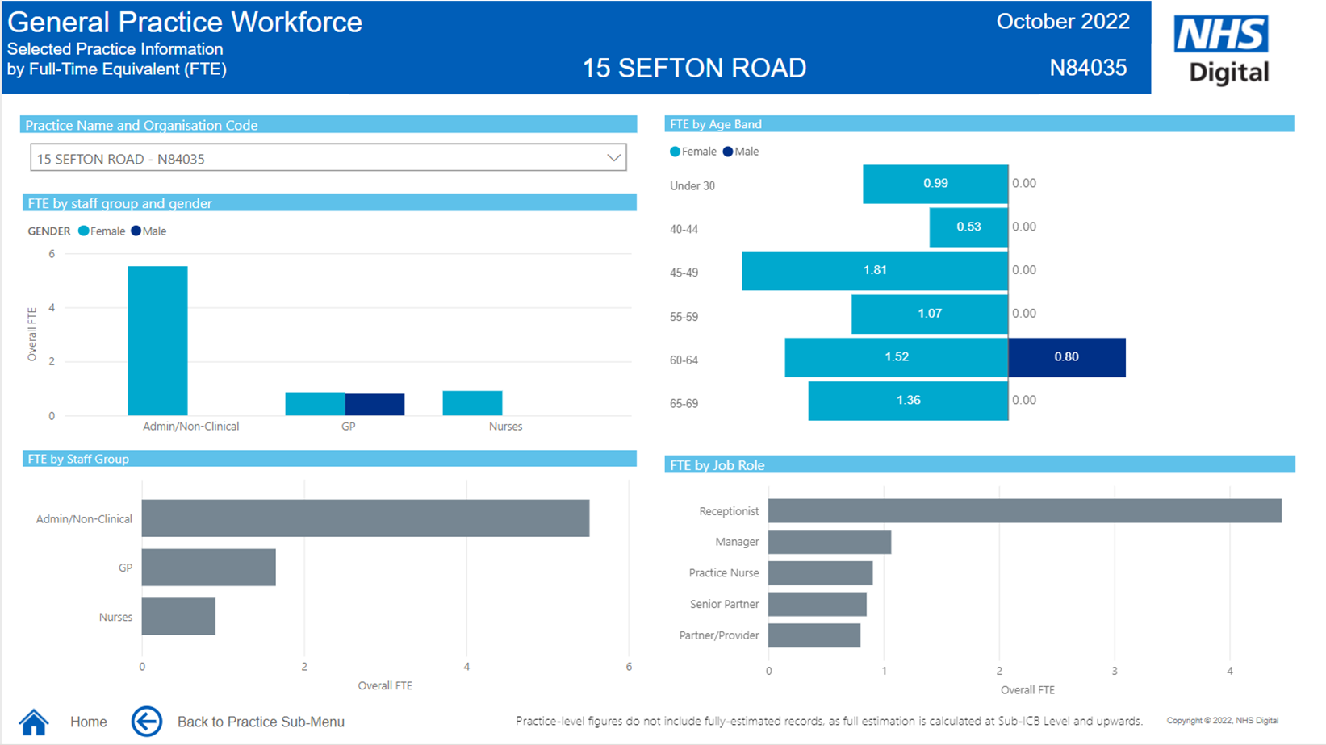

Slide 20
Quarterly and biannual outputs
Every quarter, for March, June, September and December data:
GP joiners and leavers: annual counts of joiners to and leavers from the Qualified Permanent GP workforce (excluding GPs in training and locums) – FTE and headcount
GP joiners and leavers: annual counts of joiners to and leavers from the Qualified GP workforce (excluding GPs in training) – FTE and headcount
GP joiners and leavers at region and ICB level – 4 CSV files, introduced from 31 December 2022 publication
Tracking GPs into and out of partner and salaried roles – headcounts by previous and next role presented in Excel tables, introduced from 31 December 2022 publication
Ethnicity by job role tables, to be introduced from 31 March 2023 publication
Every six months, for March and September data, regional tables presenting:
FTE work commitment (FTE bandings) by staff group
FTE by staff group per 100,000 registered patients and patient counts by age bands
Interactive pre-set pivoted tables for the current reporting period and guidance in how to use the files

Slide 21
Supplementary analysis
Tracking GPs in training into fully-qualified general practice roles (TIS to NWRS)
Breakdowns by gender and country of qualification also provided
Available at https://digital.nhs.uk/supplementary-information/2024/tracking-gps-in-training-into-fully-qualified-general-practice-roles---september-2024

Slide 22
Primary Care Network Workforce
https://digital.nhs.uk/data-and-information/publications/statistical/primary-care-network-workforce
Quarterly publications from March 2020 to December 2022
Monthly from January 2023

Slide 23
Monthly files
Excel bulletin tables
FTE and headcount by gender and job role
FTE and headcount by age band and staff group
Contracted services FTE by job role
Regional (down to Sub-ICB) FTE and headcount by job role
Individual-level CSV
A row for each role held by a staff member working in PCNs
Can be used to calculate headcount and FTE for all job roles
All geographical levels down to PCN level
Comes with step-by-step guidance on how to pivot the data

Slide 24
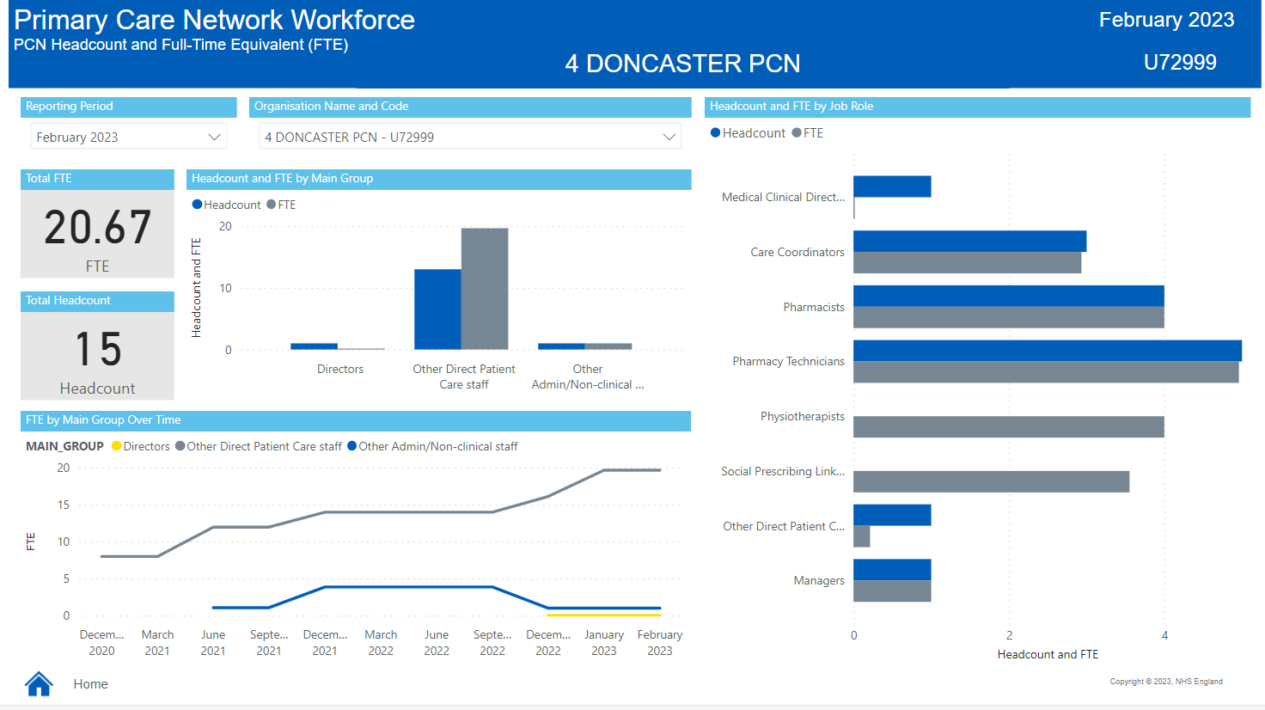
Interactive dashboard

Slide 25
Primary Care Workforce, Quarterly Update
https://digital.nhs.uk/data-and-information/publications/statistical/primary-care-workforce-quarterly-update
Launched in May 2022
Combines the FTE from the General Practice Workforce and PCN Workforce
Presents statistics relating to March, June, September and December each year
Also includes 'collated FTE figure'

Slide 26
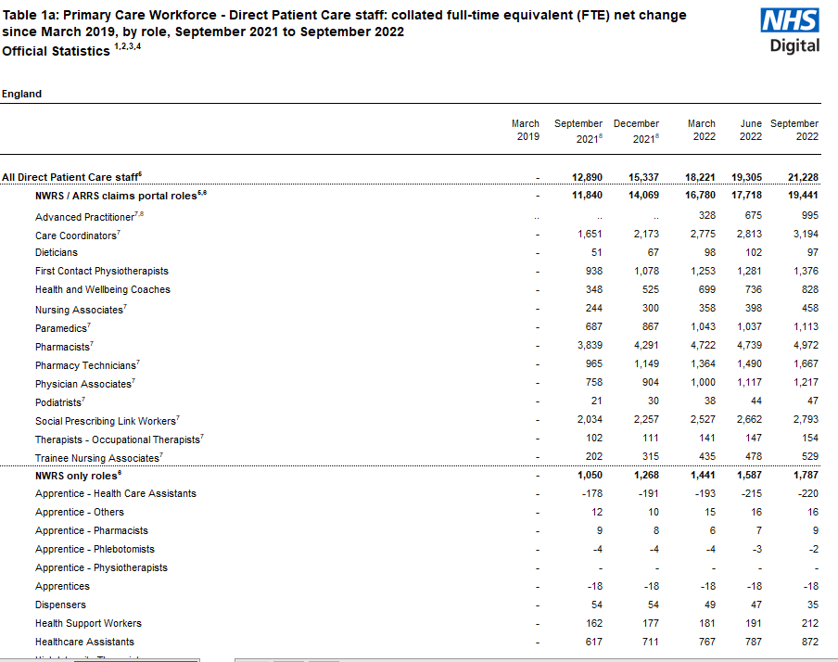
Primary Care Workforce, Quarterly Update – 'collated' FTE
Created because of low NWRS completion rates by PCNs
Uses ARRS claims data to supplement NWRS to give a fuller picture of Direct Patient Care staff in post and progress towards 26k
Primarily presents net change in FTE since March 2019, because ARRS claims can only be made for additional staff recruited since then and monitoring tends to consider changes net of that baseline
Contact us at: england.primarycareworkforce1@nhs.net

Slide 27
Primary Care Workforce recruited through the Additional Roles Reimbursement Scheme (ARRS)
https://digital.nhs.uk/data-and-information/publications/statistical/mi-primary-care-workforce-recruited-through-the-additional-roles-reimbursement-scheme-arrs
First publication May 2025
Initial focus on GPs recruited through the scheme
May be expanded to cover other staff groups in the future

Slide 28
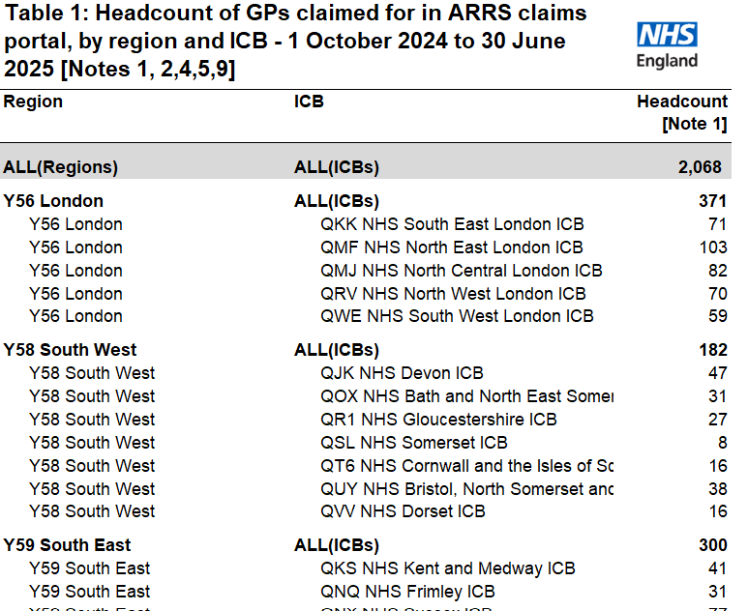
GPs recruited through the Additional Roles Reimbursement Scheme (ARRS)
Figures are based on claims that have been submitted and approved
Claims data from October 2024 up to the portal extraction date
Data available at Region, ICB and PCN level for HC and FTE
Contact us at: england.primarycareworkforce1@nhs.net

Slide 29
End slide

