Slide 1
PLACE
Webinar 2026
Notes:
Standard title slide

Slide 2
Patient Led Assessment of the Care Environment (PLACE)
Webinar 2026
Notes:
Standard title slide

Slide 3
Agenda
10.15 to 10.20am – overview and updates (Hayley Morris)
10.20 to 10.30am – Detailed updates (Max Kindred)
10.30 to 10.40 – What is PLACE (Hayley Morris)
10.40 to 10.50 – Training and Guidance (Hayley Morris)
10.50 to 10.55 – Trust best practice (Reza Miah)
10.55 to 11.00 – Patient assessor experience (Carol Bassi)
11.00 – 11.15am – Questions and close out (All)

Slide 4
Welcome to today’s PLACE webinar
Joining me are, Michael Bellas, Robert Grogan and Julie Windsor
Please post your questions in the chat box, we will be on hand to manage these, put them on the screen and ask the panel once the presentations have finished.
At the end, please ask any further questions by raising your hand in Teams. We will answer as many of these as time permits. If you do not have a chance to ask your questions, please add them to the chat.
There will be an FAQ document produced following today’s event, this will include all questions that come in whether we answer them or not during the session.
The slides and recording from today will be made available alongside the FAQs. You will also have the NHS England email addresses for any follow up questions

Slide 5

Overview
Good environments matter
Good environments don’t just happen
People will use what they can see and judge, to make assumptions about what they cannot see, and cannot judge
A dirty, badly-maintained hospital, with poor food, might make patients think the nurses are uncaring and the doctors unsafe

Slide 6
Updates this year
Changes
Changes have been made this year based on feedback from users, feedback from experts and also inline with legislation and guidance.
One of the main changes is that it is more user friendly to the sectors – such as Mental Health providers, where N/A has been added to areas where appropriate.
We have had detailed engagement sessions to agree the updates.
A burden assessment has not been completed this year and although the majority of feedback from the User Group was that the collection does not take longer, we did receive feedback from one Trust advising that it did take them longer to complete so please bear this in mind.

Slide 7
Further detail on updates from Max Kindred
Organisational questions
Almost every question now refers to the site, rather than the organisation
Significant question review
Many questions that are assessable by patients have move to be patient-assessed, e.g. travel provision, wifi and social spaces
Questions removed that overlap with PAM and ERIC
Simplification of meal timings and options and snacking requirements, aim for flexible and adaptable meal times that meet the needs of patients

Slide 8
Further detail on updates from Max Kindred
Internal ward area
No major changes
Cleanliness and Condition/Appearance for all ward items
Simplification of dementia clock requirement
Additional social space questions

Slide 9
Further detail on updates from Max Kindred
External areas and food assessment
Significant question review
External areas – parking questions now patient-assessed and new public transport questions
Food assessment – assessment of menu options and availability offered to patients,
Addition of an excellent taste score – no expectation of 100% achievement. Sites achieving 100% will be audited

Slide 10
What does PLACE do?
PLACE provides motivation for improvement by NHS organisations providing a clear message, directly from patients, about how the environment or services might be enhanced.
The assessments involve local people (known as patient assessors) going into hospitals as part of teams to assess how the environment supports the provision of clinical care, assessing such things as privacy and dignity, food, cleanliness and general building maintenance and, more recently, the extent to which the environment is able to support the care of those with dementia or with a disability.
The assessments take place every year, and results are published to help drive improvements in the care environment. The results show how hospitals are performing both nationally and in relation to other hospitals providing similar services.
Notes:
Plain slide with subhead and bullets

Slide 11
What does PLACE look at?
PLACE assesses several non-clinical aspects of the healthcare premises identified as important by patients and the public, known as domains:
Cleanliness
Food and hydration
Privacy, dignity and wellbeing
Condition, appearance and maintenance
Dementia: how well the needs of patients with dementia are met
Disability: how well the needs of patients with a disability are met
PLACE is voluntary but has a high utilisation rate, including non-NHS providers e.g. BUPA.
https://digital.nhs.uk/data-and-information/areas-of-interest/estates-and-facilities/patient-led-assessments-of-the-care-environment-place
Notes:
Plain slide with subhead and bullets

Slide 12
History of PLACE
2000
Patient Environment Action Teams (PEAT) inspections introduced
2013
2018-19
Relaunch of collection after COVID-19, although some trusts were unable to take part or complete returns.
2020-21
2022
Full national review of PLACE collection to ensure the collection remained relevant and delivered its aims, resulting in a significant revision of the question set and guidance for the 2019 programme
The national PLACE assessment programme was paused due to the COVID-19 Pandemic.
New PLACE Collection Announced: Stronger Patient Voice; Public Identifies Priorities; and Focus on Improvement: Hospitals must report publicly and outline improvement plans.
Notes:
Plain slide with subhead and bullets

Slide 13
PLACE timeline 2025
Preparation
Collection
Analysis
Official launch
September 2026
Closes
November 2026
Publication
February 2027 TBC
Guidance updated
Queries answered
Late submitters chased
Power BI updated
User survey

Slide 14
Following the assessment
The information from the assessment will be sent for analysis and publication
Each hospital will have a separate score for each domain
The results will be published nationally, including a Power-BI analysis:
Patient-Led Assessments of the Care Environment (PLACE) - NHS England Digital
Organisations will be required to publish a response about how they intend to use the findings

Slide 15
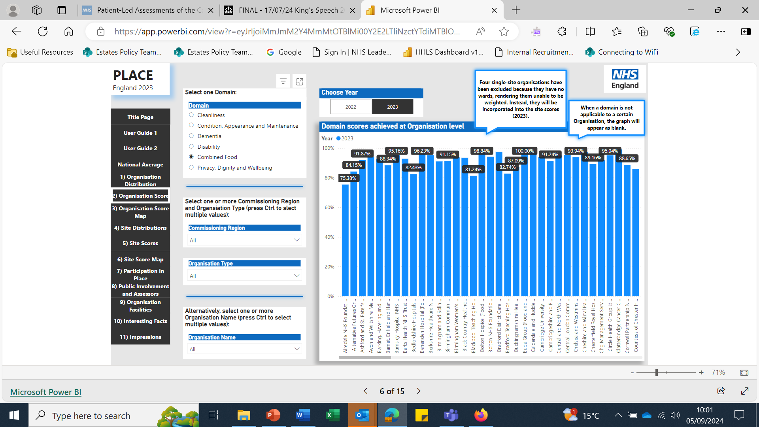
Dashboard example

Slide 16
Usage
Beyond local usage by NHS Trust Boards, the data is used:
PLACE is included within the triangulation work along with PAM and PLACE
The Soft FM team use the data to provide a national overview of the relevant areas and as part of the packs they use for their visits to individual trusts. It has helped shaped the national food standards, national cleaning standards and [currently in development] the national portering standards;
The PLACE data is provided to the Care Quality Commission to use in their intelligent monitoring system;
Specific briefings, including those for Ministers, to support Policy development. It provided them with metrics to show the impact of their Policies effectiveness
Notes:
Plain slide with subhead and bullets

Slide 17
Overview of PLACE
Annual voluntary collection introduced April 2013
Covers NHS trusts, voluntary, independent and private healthcare providers
Completed by teams of staff and patient assessors (minimum of 50%)
Covers selection of wards and departments, communal and external areas
Questions score towards one or more non-clinical domains: Cleanliness; Food/Hydration; Privacy, Dignity and Wellbeing; Condition, Appearance and Maintenance; Dementia; and Disability.
NHS Digital manage data collection, validation and publication
Achieves a high response rate – typically 97% - 99%
It is for organisations to discuss their results locally and take any necessary improvement action

Slide 18
Way forward:
2024/2025 Review: Annual updates to PLACE questions were not completed for 2024 or 2025, due to resource and contractual issues.
Need for 2026 Review: We have completed and finalised the review, gathering feedback and working with specialists in each area to ensure the collection is in line with guidance and legislation.
Improving Data Utilisation: While PLACE data is effectively used by the NHS and NHSE, its integration with other datasets like ERIC and NHS PAM can be significantly improved. This “triangulation” work has begun but requires substantial effort to complete.
Notes:
Plain slide with subhead and bullets

Slide 19
PLACE Lite
PLACE Lite has been used for a number of years, replacing the full programme from 2020
Standard practice in some organisations, complements annual collection
Organisations determine frequency and are free to choose the categories and areas covered
Often used to monitor progress of action plans generated from the annual results
Many organisations run PLACE Lite with support from patient assessors, but this is not a requirement

Slide 20
PLACE – patient assessors
Recognise some organisations struggle with recruiting patient assessors
Guidance offers suggestions and will provide templates to write out and advertisements to encourage take up
NHS England looking at the training material for patient assessors
Consider linking with neighbouring trusts to arrange staff members to act as patient assessors if necessary.
Assessors were invited from across NHSE to participate and In 2025, this was extended to DHSC as well, this will be replicated for 2026.

Slide 21
Further Information
If you have any further queries please contact NHS England or NHS Digital using the following:
NHS England: For matters related to the questions and guidance.
  england.place@nhs.net
NHS Digital: For matters related to software and access.
  placenotifications@nhs.net

Slide 22
Patient-Led Assessment of the Care Environment
(PLACE)
Patient assessor training slides
August 2026
Notes:
Standard title slide

Slide 23
Contents
PLACE overview
Patient assessors
Completing the PLACE assessment
What are you looking at?
PLACE: to note
Following the PLACE assessment
PLACE

Slide 24
PLACE overview
Good environments matter.
Good environments don’t just happen.
People will use what they can see and judge, to make assumptions about what they cannot see, and cannot judge.
A dirty, badly-maintained hospital, with poor food, might make patients think the nurses are uncaring and the doctors unsafe.

Slide 25
Patient assessors
Patient assessors are:
independent of the hospital being assessed
able to communicate clearly with people
objective when assessing and gathering evidence
able to present a point of view clearly and reasonably
team workers who are open to the views of others
healthy and not suffering from any infections such as colds or flu.

Slide 26
Patient assessors
Patient assessors are not:
connected to the hospital as a current or former employee (have not been connected within the previous two years) (note: trust non-executive governors are not classed as employees)
narrow or closed minded
obstinate or stubborn
unwilling to be part of a team.
You have the right to an opinion; you do not have the right to be right.

Slide 27
Patient assessors
Before the assessment patients assessors should:
  read and understand the assessment forms
  read the published guidance
  clarify any points with the team leader.

Slide 28
Patient assessors
Patient and staff assessors should work as a team to reach an agreed view.
Each person has their own perspective – and all are welcome.
Questions are designed to be objective, so there should rarely be major disagreements.
One person in each team fills in the form on behalf of all.

Slide 29
Patient assessors
You are there to offer your own view, it’s ok to use your experiences.
But try to also think beyond your own situation.
Do not focus on single issues – even if they are very dear to your heart.
Do not add questions or criteria that are not there.

Slide 30
Completing the PLACE assessment
There are rules about what should be assessed:
  for 1-10 wards assess them all
  thereafter 10 or 25% - whichever is greater (in practice only the very biggest will have more than 10)
  any emergency department or minor injuries unit
  the external areas
  at least 25% of everything else – non-wards areas such as outpatient departments, communal areas – precisely where to go should be agreed by the team.

Slide 31
Completing the PLACE assessment
If you are not assessing all wards, the team should agree those which are to be assessed.
Hospitals are asked to rotate wards that are assessed so that over a period of time they are all seen. The team leader should be able to advise which were assessed last time (if not all).
When you arrive you should have some input into where you go.
Some areas, e.g. non-patient areas, theatres, hospital kitchens, etc, are excluded.

Slide 32
Completing the PLACE assessment
In bigger hospitals you are likely to split into smaller teams – perhaps several. That’s fine but there should always be
  at least 50% patient assessors
  no fewer than two patient assessors per team.
Assessments may also happen over more than one day, with different patient assessors.

Slide 33
Completing the PLACE assessment
Sampling is ok – you don’t have to see every single item to make a judgement.
Judge the things you can see based on what you can see.
  ‘Have I seen enough, to be sure it’s clean enough?’

Slide 34
What are you looking at….?
PLACE assesses a number of non-clinical aspects of the healthcare premises identified as important by patients and the public, known as domains:
Cleanliness
Food and hydration
Privacy, dignity and wellbeing
Condition, appearance and maintenance
Dementia: how well the needs of patients with dementia are met
Disability: how well the needs of patients with a disability are met

Slide 35
What are you looking at….?
There are a variety of forms but only those that apply need to be completed.
PLACE considers several different areas:
communal areas (reception, corridors, etc) – this can be ignored in very small units where there are no such areas
external areas – the hospital grounds and gardens – again can be ignored if there are none
emergency department/minor injuries units – if there is one
outpatient departments - if there are any
wards in acute or community hospitals, or treatment centres or hospices
wards in mental health or learning disabilities hospitals or units.
There are also two factual questionnaires the hospital completes on the facilities (e.g. car parking) and catering service.

Slide 36
What are you looking at….?
Cleanliness
  This is a visual test or, where something is out of sight but in reach, a touch (e.g. finger) test.
  If you can’t see it, but can reach it you will need to touch, e.g. dust on high surfaces.
  If you can’t see it, and can’t reach it, leave it alone. Never stand on anything to reach an area you cannot reach/see from the floor.

Slide 37
What are you looking at….?
Cleanliness (2)
Please do not use anything, e.g. wet wipes, to try to reveal dirt that is not visible.
Where there is just one of something (a floor) you need to say whether it is all clean (pass), mostly clean (qualified pass) or not clean enough (fail). This has to be a team decision using judgement and common sense.

Slide 38
What are you looking at….?
Cleanliness (3)
Where there are many of the same thing (e.g. over-bed tables), look at as many as you need to reach a decision. If they are all clean then pass. If 80% (8/10) or more are clean then qualified pass. If less than 80% (7/10) then fail.
If you see any bodily substance or bodily fluid (blood, faeces, etc) then it is an immediate fail for those items (i.e. blood on a curtain means fail for curtains, not for the floor).
Don’t confuse cleanliness with condition – something can be clean but in a poor state of repair.

Slide 39
What are you looking at….?
Condition, appearance and maintenance
This looks at the state of repair or fixtures and fittings; the condition of decoration and floor coverings; tidiness, waste management, etc.
The scoring and scoring criteria are the same as for cleanliness.
Do not confuse condition with cleanliness – something can be in good condition but dirty/stained (a stain is not dirt if it cannot be removed other than through specialist cleaning).

Slide 40
What are you looking at….?
Privacy, dignity and wellbeing
  This looks at the extent to which the environment supports the provision of care with regard to privacy, dignity and wellbeing. It is not an assessment of staff practice.
  Most questions require yes/no responses.

Slide 41
What are you looking at….?
Dementia
  This section looks at the extent to which environments support the care of people with dementia.
  The assessments should be undertaken in all hospitals unless such patients are never admitted, and in all communal areas, emergency departments and outpatient departments/wards unless such patients will not be present (e.g. paediatric/maternity wards or ante/post natal clinics).

Slide 42
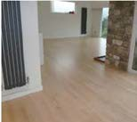

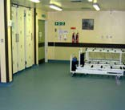


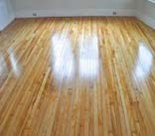
What are you looking at….?
Dementia (2)
All questions require yes or no answers and should be clear and unambiguous.
There is no scope for re-interpretation. If the question asks is the floor un-patterned, then it must be un-patterned. But try not to confuse a pattern with tonal aspects; for example, some non-slip floors in shower areas may have a ‘sparkle’ effect – this is part of the non-slip quality and not a pattern.
Examples of good flooring choices
Examples of poor flooring choices

Slide 43
What are you looking at….?
Food
There are two components to the food assessment – the service and food tasting:
  Set of questions about the service: you will need to spend a little time watching what happens on the ward to be able to answer all of these. If you don’t see something happen, assume it doesn’t. Don’t accept statements about what normally happens – there can be a mile of difference between policy and practice.

Slide 44
What are you looking at….?
Food (2)
Food tasting:
  Food is sampled on the ward(s) at end of service – so you can check the temperature, i.e. not in a separate room with food specifically provided for the assessment team, unless there is no other option.
  Every dish must be tasted - not by everyone, but by at least two people.
  If you don’t like or eat a particular food, it’s ok not to taste that – you won’t be objective.
  Try not to let personal preference get in the way – even if a dish is not a favourite, you can still say whether it is cooked well/looks nice.

Slide 45
What are you looking at….?
Food (3)
Food tasting continued
There are three components to the tasting section:
  taste: scored on a 5-point scale of excellent to very poor
  texture and appearance: what does the food look like, how is it to eat other than in terms of taste? – scored on a 3-point scale of good/acceptable/poor
  is the temperature appropriate to the food, i.e. hot food hot, cold food, e.g. ice cream, cold? – yes or no.

Slide 46
What are you looking at….?
Disability
  This assesses the needs of those with disabilities and how well hospital environments meet them. This is mostly addressed through existing questions rather than specific ones – the only specific ones are those relating to audiovisual appointment alert systems, hearing loops, braille lift buttons and lift floor announcements.

Slide 47
What are you looking at….?
Scoring
  PLACE was designed to be a score-as-you-go assessment. By the time you leave a ward or outpatient department etc, the assessment form should be completed.
  The only time this may not happen is in communal areas where you may need to look at a few different places before agreeing a score. In this case you will need to take a note of anything you wish to take into account.

Slide 48
PLACE: to note
PLACE has very clear boundaries – it does not include clinical care or staff attitude and behaviour.
But – if you see something beyond PLACE that you are concerned with, you should report it:
  to the staff on the ward/department
  to the lead assessor
  in the notes section of the assessment form;
  to the Care Quality Commission (if you have very serious concerns).

Slide 49
PLACE: to note
Respect patients’ privacy – don’t ask about their condition or treatment.
Be alert to signs that a patient wants to talk to you (or doesn’t!).
Not all rooms will be able to be assessed – e.g. if a patient is sleeping, or has an infection.
Take care not to interfere with the work of the hospital – especially at mealtimes.
Know what to do in an emergency (e.g. fire or cardiac arrest).

Slide 50
PLACE: to note
Feel free to ask patients for their views on any of the PLACE topics, but remember:
  This is not a patient survey - we are interested in your views.

Slide 51
Following the PLACE assessment
At the end of the survey you will be asked to:
Complete an overall summary to describe your general impressions. You can complete this as a team of patient assessors or as individuals.
Provide advice on what you would like to see changed for next year that is:
  reasonable, specific and achievable
  not too detailed, not too broad;
Confirm to the team that you are happy with the process.

Slide 52
Following the PLACE assessment
The information from the assessment will be sent to
NHS Digital for analysis and publication.
Each hospital will have a separate score for each domain.
The results will be published nationally.
Organisations will be required to publish a response about how they intend to use the findings.

Slide 53
PLACE
Patient assessors are fundamental to the success of PLACE.
We cannot over-emphasise the importance of your view, so remember:
  be objective
  be reasonable
  be open-minded
  be honest.

Slide 54
Patient Led Assessment of Care Webinar June 2026 – Trust & Patient Rep Experience
Barts Health NHS Trust
Presenter: Reza Miah - PLACE Manager, Soft FM, Estates & Facilities
Supported By: Carol Bassi (Barts Health NHS Trust Patient Rep Champion)

Slide 55
Barts Health NHS - Trust Vision & Values vs PLACE
Below outlines how Barts Health NHS Trust meet the Trust Values, when we undertake and oversee PLACE process on behalf of the organisation.
Our Commitment to Patients – Through PLACE assessments and engagement, we prove that we ‘value patient voices’. When undertaking assessments, we do speak to able patients on the wards and users to make them aware of PLACE and also collate feedbacks. By involving patient reps (users from the community), we also give them the voice and opportunity to contribute and help us improve our patient environment, where appropriate.
Welcoming – Part of PLACE process, we ‘Introduce ourself by saying “Hello, my name is …“ to the staff and patients at all times. We always ‘Smile’ and ‘acknowledge’ the other person(s) presence during our assessments. We ‘Treat’ others as you would wish others to treat us. We also ‘Ensure’ the environment is safe and pleasant for our patients, our colleagues and our visitors when we undertake our assessments.
Engaging - Part of PLACE process, we ‘Get involved in making improvements’ and bring others with us including staff, patient reps and independent assessors. We always ‘Encourage feedback from patients and colleagues and respond to it’ by creating site-based action plans. We ‘Use feedback to make improvements and empower colleagues to do this without needing to seek permission’, via our site action plans. We always ‘Appreciate that this may be a new experience for patients and colleagues; help them to become comfortable’ by providing regular training and buddy them up with experienced assessors. We always ‘Acknowledge efforts and successes; by saying thank you’ on assessment days and at the planned Appreciation event, by giving out certificates and holding a one-of-a-kind event in the NHS.
Collaborative – We ‘Give time and energy to developing relationships within and outside own team’ by getting all involved. Through our initiate work we do at Soft FM, we ‘Demonstrate pride in Team Barts Health’. We have and always will ‘Respect and utilise the expertise of colleagues. Finally, we appreciate and accept ‘Know your own and others' part in the plan’.
Accountable – ‘Always strive for the highest possible standard’, as Soft FM. We ‘Fulfil all commitments made to colleagues, supervisors, patients via PLACE process. ‘Admit mistakes, misjudgements, or errors; immediately inform others when unable to meet a commitment; don't be afraid to speak up to do the right thing’. We ‘Do not pretend to have all the answers; actively seek out those who can help’. I as the PLACE lead ‘Take personal responsibility for tough decisions and see efforts through to completion’.
Respectful – From behalf of Soft FM, we always aim to ‘Be helpful, courteous and patient’. ‘Remain calm, measured and balanced in challenging situations. ‘Show sensitivity to others' needs and be aware of your own impact’ Also ‘Encourage others to talk openly and share their concerns’.
Equitable – Soft FM always ‘Value the perspectives and contributions of all and that all backgrounds are respected’. ‘Recognise that individuals may have different strengths and needs, and that different cultures may impact how people think and behave. Be curious to find out’. ‘Work to enact policies, procedures and processes fairly’. We recognise to ‘Be open to change and encourage open, honest conversation that helps foster an inclusive work and learning environment’. Finally, we will always ‘Remember that we all have conscious and unconscious bias; get to know what yours are, and work to mitigate them’.

Slide 56
Barts Health NHS Trust
Whether you’re looking to gain experience in a large, fast-paced hospital or get out into the community, we have a range of opportunities that allows you to build your entire career in one trust. For us, every day is different. We provide care to a diverse population of 2.5 million across east London – that’s 6,000 people every day, speaking over 60 different languages. Our patients are at the heart of everything we do, and we are committed to ensuring that people living in east London live healthy lives.
We serve one of the most diverse populations in the country... and we're committed to eliminating discrimination, valuing diversity and promoting equality of opportunity to build and sustain an inclusive environment to deliver and receive safe and compassionate care. Our WeBelong inclusion strategy is all about embedding inclusion into everything we do, fuelled by the energy and enthusiasm of our staff networks – enabling people to share their lived experiences and be heard.
We are with you for every moment of your healthcare journey. From diagnosis to recovery, we will provide seamless, innovative, and equitable hospital care for all our patients - as we build a healthier future for generations to come across east London and beyond. Our vision is to be a high-performing group of NHS hospitals known for leading innovation, reducing inequalities, and transforming lives by championing excellence and providing outstanding healthcare. We're moving towards a future that focuses on combining specialties and clinical expertise, prevents ill health, embraces digital innovation, and expands our care closer to home. Aligned with national NHS goals, this transformation puts patients first and is shaped by the experiences, insights and voices of the people we treat.
The services we offer are driven by the unique needs of our people in one of the most diverse and fast-growing populations with some of the most deprived and under-privileged communities in the country. Every day, we provide a mix of specialist and routine care for over 7,000 people across five hospitals. Working as a group of hospitals enables us to combine our strengths, share expertise, and deliver consistent, high-quality care for more than 2.5 million people. Each hospital has a unique mix of specialist skills and cares for their local communities:
The Royal London Hospital is one of the biggest hospitals in London, combining specialist centres of excellence with routine care for people in Tower Hamlets. It is home to a major trauma centre, hyper-acute stroke services, and the London Air Ambulance. It also provides cutting-edge complex surgery, critical care, renal services and dentistry as well as having one of the UK’s largest children's hospitals.
St Bartholomew's Hospital in the City, the oldest hospital in the country, is now a world-class centre for cardiac and cancer care, the largest heart hospital in the UK and one of London’s top cancer centres, serving patients from beyond the capital.
Whipps Cross Hospital is a busy local hospital serving Waltham Forest and Redbridge while developing specialist expertise in frailty and care for older people to meet local needs and become a group centre of excellence.
Newham Hospital is a busy local hospital and a centre of excellence for planned orthopaedic surgery, as well as having a busy emergency department and a large maternity unit.

Slide 57
Barts Health NHS Trust - Overview of How We Approach
Background
We have almost over 250 plus patient reps contacts in our books. Some have been taking part prior to PLACE during PEAT, and many have been recruited by word of mouth and reaching out to external organisations and panels, each year. We provide face to face and online training for existing and newcomers each year. We always ensure newcomers are buddying up with existing and experienced patient reps to gain support throughout the assessment. Patient reps comes from many background and from various of groups. This includes Trust Volunteers, Patient Panels, Patient Voice, WTG, Healthwatch, Age UK, Older Peoples Reference Groups, Faith groups, independent assessors and anyone who may raised concerns, we invite them to take part. Ust recently we invited ICB staff as well as Project Search interns to take part. We have had Youth members and University students taking part too. Some of our experienced patient reps attend with me (as an independent assessor) to assess other external NHS hospitals and Private healthcare like BUPA 9upon invitation). This helps to understand and learn more from these visits outside of our environment.
We undertake PLACE assessments across four of our hospitals out of the five hospitals, which are Royal London Hospital, St Bartholomew's Hospital, Newham Hospital and Whipps Cross Hospital. We undertake two days of assessments for each of our hospitals within the timeframe provided by NHSE. Within the assessments, it will include unannounced assessment of minimum 10 wards, 5 extra wards for food assessment, OPD areas, A&E/Minor Injuries, External and Internal areas. Areas are chosen on the day at the beginning. We have 4 teams per day, that can have almost 10 to 15 assessors per team including staff and Patient reps. Each morning, we have site-based Executive members attending for introduction and to listen to feedbacks at the end of each day.
Process
In each team, we can have up to 10 to 15 each day. We create a schedule that ensures balance and covers all areas to be visited. The organisation is aware of the dates, but none of the areas are aware if the teams will visit them, and if we do, they are not aware of when. We complete our assessments on tablets, completed by nominated Trust staff, but teams are led by patient reps. We ensure and provide brief training and advice each morning, such as what to assess and approximately how long to spend on each area(s), as the last thing we want is to distract the ward staff and our patients. We also advise to our assessors to hand out certificates to staff and areas that they believe have done really well. This helps to motivate the staff and wards. It also encourages others to step up too, where improvements are required.
Part of the teams will include staff and patient reps on a 50% ratio. The teams will also include independent assessors, as well as representatives from Trust suppliers and PFI partners too. If the numbers are more from Trust side, we ensure any extras become observers and cannot take part in scoring, but able to contribute. Upon completion of the day’s assessment, we allow each team and each members to share their feedback, regardless of positive or negative. We generate all feedbacks and use the exception report to create site-based action plan and ensure our site-based Head of Facilities to take clead on all action and update all patient reps at the following PLACE. Additionally, we also undertake Quarterly PLACE Lite and invite limited patient reps for each hospitals and also internal PLACE Lite takes place each month too, led by Soft FM. Finally, as a ‘Thank You’ gesture, we organise annual ‘PLACE Appreciate Event, and hand out internal certificates to all participants and invite Trust services and Trust Partners to showcase their services too. This helps to recruit newcomers too.

Slide 58
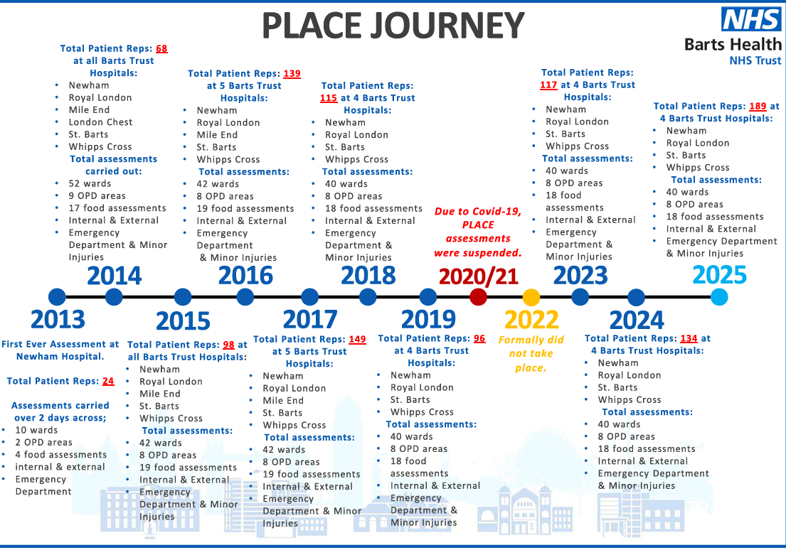
Barts Health NHS Trust - PLACE Journey

Slide 59
Barts Health NHS Trust - Key Impact
189
Patient Reps joined (Over 2 days period) our assessments across NUH, RLH, SBH & WXH
Over 100
Staff assessors and observers joined (over 2 days period) to support the assessments
40
Ward assessments undertaken across all BH hospitals
18
Food assessments undertaken
8
Outpatient areas (OPD) assessments undertaken
All
Internal (Public areas) assessments visited and assessed
All
Site External (Hospital areas only) assessed
Emergency Department (Including Minor Injuries) assessed across the hospitals

Slide 60
Barts Health NHS Trust - PLACE 2025 Results
Barts Health NHS Sites | Cleanliness | Food | Organisation Food | Ward Food | Privacy, Dignity & Wellbeing | Condition, Appearance & Maintenance | Dementia | Disability | General Site Average
 | 2025
Newham University Hospital | 99.48% | 96.98% | 99.48% | 96.44% | 83.02% | 98.82% | 80.19% | 82.24% | 92.08%
Royal London Hospital | 98.33% | 93.86% | 98.96% | 92.83% | 86.45% | 98.80% | 83.33% | 79.09% | 91.46%
St Bartholomews Hospital | 99.60% | 94.96% | 96.88% | 94.44% | 85.50% | 98.39% | 76.96% | 76.38% | 90.39%
Whipps Cross University Hospital | 98.29% | 94.18% | 99.48% | 93.13% | 77.33% | 99.40% | 74.66% | 78.52% | 89.37%
Barts Health NHS Trust (Organisational Average) 2025 | 98.70% | 94.90% | 98.92% | 94.11% | 82.79% | 98.94% | 79.08% | 79.08% | 90.82%
2025 National Average % | 98.55% | 92.13% | 92.79% | 92.30% | 89.37% | 97.00% | 85.68% | 87.12% | 91.87%

Slide 61
Site Actions – Newham Hospital
Date - Newham Hospital assessment undertaken on 17th & 18th September 2025, over two consecutive days.
Attendance - 39 patient reps and 34 staff reps attended over the course of two days.
Assessment – 10 x wards, 2 x OPD areas, ED, Internal & external and 4 x food assessments undertaken over two consecutive days.
Compliance – NUH achieved an overall PLACE score of 92.08%, exceeding both the Barts Health organisational average (90.83%) and the national average (91.87%). Performance was above the national benchmark in five of the eight assessed domains. The strongest variance was observed in Organisation Food, which exceeded the national average by 6.69%, alongside Food (+4.85%) and Ward Food (+4.14%). Scores were below the national average in Privacy, Dignity & Wellbeing (-6.35%), Dementia (-5.49%), and Disability (-4.88%). Overall, the results indicate strong performance across environmental and catering domains, with the site performing above both Trust and national benchmarks overall.
Top 3 Areas of Concern are – Collated from site-based exception report, available upon request but shared with the site.
  Privacy, Dignity and Well-Being – such as to review of disability provisions within the environments
  Cleanliness & Conditions – review of communal areas and wards.
  Dementia Friedly Environment – lack of required provisions for patient with dementia or users attending with dementia.
Update on Site Action Plan – Following review of the date from the Exception report, it has been included as part of the site-based Action plan, including all other feedbacks from the observation, led by our Soft FM Head of Facilities to work alongside the site key stakeholders to review and action accordingly. Action plan is available upon request from site-based Head of Facilities. In Addition, proposal made to undertake internal site PLACE Lite (once a month) and also Quarterly PLACE Lite’ led by PLACE Manager, involving the local site Soft FM team, IPC and couple of external patient reps. The next PLACE Lite is scheduled in July.
Risks – Clinical/medical patient data on view, leading to non-compliance of patient confidentiality across the areas identified within the Exception report.
Escalation – Lack of day rooms, social/communal areas or playroom on the wards, as identified within the Exception report.

Slide 62
Site Actions – Whipps Cross Hospital
Date – Whipps Cross Hospital assessment undertaken on 30th September & 1st October 2025, over two consecutive days.
Attendance - 51 patient reps and 34 staff reps attended over the course of two days.
Assessment – 10 x wards, 42 x OPD areas, ED, Internal & external and 5 x food assessments undertaken over two consecutive days.
Compliance – WXH achieved an overall PLACE score of 89.37%, below both the Barts Health organisational average (90.83%) and the national average (91.87%). Performance was above the national benchmark in four of the eight assessed domains. The strongest variance was observed in Organisation Food, which exceeded the national average by 6.69%, alongside Food (+2.05%), Ward Food (+0.83%), and Condition, Appearance & Maintenance (+2.40%). Scores were below the national average in Cleanliness (-0.26%), Privacy, Dignity & Wellbeing (-12.04%), Dementia (-11.02%), and Disability (-8.60%). Overall, the results indicate strong performance in catering and estate-related domains, with lower scores observed in patient experience and accessibility-related domains.
Top 3 Areas of Concern are – Collated from site-based exception report, available upon request but shared with the site.
  Cleanliness & Conditions – review of areas as identified in the Exception report.
  Dementia Friedly Environment – lack of required provisions for patient with dementia or users attending with dementia.
  General food assessment, service and presentation – within the wards such as packaged foods not opened and placed on a plate for patients identified with having difficulty opening packages.
Update on Site Action Plan – Following review of the date from the Exception report, it has been included as part of the site-based Action plan, including all other feedbacks from the observation, led by our Soft FM Head of Facilities to work alongside the site key stakeholders to review and action accordingly. Action plan is available upon request from site-based Head of Facilities. In Addition, proposal made to undertake internal site PLACE Lite (once a month) and also Quarterly PLACE Lite’ led by PLACE Manager, involving the local site Soft FM team, IPC and couple of external patient reps. The next PLACE Lite is scheduled in July.
Risks – By discussing with staff mealtimes are not protected, as identified within the Exception report.
Escalation – Clinical/medical patient data on view, leading to non-compliance of patient confidentiality across the areas identified within the Exception report.

Slide 63
Site Actions – Royal London Hospital
Date – Royal London Hospital assessment undertaken on 21st & 22nd October 2025, over two consecutive days.
Attendance - 63 patient reps and 33 staff reps attended over the course of two days.
Assessment – 10 x wards, 4 x OPD areas, ED, Internal & external and 5 x food assessments undertaken over two consecutive days.
Compliance – RLH achieved an overall PLACE score of 91.46%, exceeding the Barts Health organisational average (90.83%) but remaining below the national average (91.87%). Performance was above the national benchmark in four of the eight assessed domains. The strongest variance was observed in Organisation Food, which exceeded the national average by 6.17%, alongside Food (+1.73%), Ward Food (+0.53%), and Condition, Appearance & Maintenance (+1.80%). Scores were below the national average in Cleanliness (-0.22%), Privacy, Dignity & Wellbeing (-2.92%), Dementia (-2.35%), and Disability (-8.03%). Overall, the results indicate strong performance in catering-related domains, with several environmental domains performing close to national benchmarks.
Top 3 Areas of Concern are – Collated from site-based exception report, available upon request but shared with the site.
  Privacy, Dignity and Well-Being – such as access and provisions within the patient environments including lack of access to patient entertainment
  Dementia Friedly Environment – lack of required provisions for patient with dementia or users attending with dementia.
  General food assessment, service and presentation – within the wards.
Update on Site Action Plan – Following review of the date from the Exception report, it has been included as part of the site-based Action plan, including all other feedbacks from the observation, led by our Soft FM Head of Facilities to work alongside the site key stakeholders to review and action accordingly. Action plan is available upon request from site-based Head of Facilities. In Addition, proposal made to undertake internal site PLACE Lite (once a month) and also Quarterly PLACE Lite’ led by PLACE Manager, involving the local site Soft FM team, IPC and couple of external patient reps. The next PLACE Lite is scheduled in July.
Risks – General cleanliness issues highlighted in OPD areas as identified within the Exception report.
Escalation – Not an urgent escalation but the site required to review dementia provisions as identified within the Exception report.

Slide 64
Site Actions – St Bartholomew’s Hospital
Date – St Bartholomews Hospital assessment undertaken on 5th November 2025.
Attendance - 35 patient reps and 25 staff reps attended.
Assessment – 10 x wards, 4 x OPD areas, ED, Internal & external and 5 x food assessments undertaken over two consecutive days.
Compliance – SBH achieved an overall PLACE score of 90.39%, below both the Barts Health organisational average (90.83%) and the national average (91.87%). Performance was above the national benchmark in five of the eight assessed domains. The strongest variance was observed in Organisation Food, which exceeded the national average by 4.09%, alongside Food (+2.83%), Ward Food (+2.14%), Cleanliness (+1.05%), and Condition, Appearance & Maintenance (+1.39%). Scores were below the national average in Privacy, Dignity & Wellbeing (-3.87%), Dementia (-8.72%), and Disability (-10.74%). Overall, the results indicate strong performance in catering and environmental domains, with several domains performing above national benchmarks.
Top 3 Areas of Concern are – Collated from site-based exception report, available upon request but shared with the site.
  Cleanliness & Conditions – review of areas as identified in the Exception report.
  Dementia Friedly Environment – lack of required provisions for patient with dementia or users attending with dementia.
  General food assessment, service and presentation – within the wards such as separate area, away from the bed-side, where patients can take their meals if they choose to do so.
Update on Site Action Plan – Following review of the date from the Exception report, it has been included as part of the site-based Action plan, including all other feedbacks from the observation, led by our Soft FM Head of Facilities to work alongside the site key stakeholders to review and action accordingly. Action plan is available upon request from site-based Head of Facilities. In Addition, proposal made to undertake internal site PLACE Lite (once a month) and also Quarterly PLACE Lite’ led by PLACE Manager, involving the local site Soft FM team, IPC and couple of external patient reps. The next PLACE Lite is scheduled in July.
Risks – No system in place in the reception area to support patients with hearing / visual impairment, as identified within the Exception report.
Escalation – The organisation have areas or outlets with a 3 star or less rating from the Food Standards Agency, as identified within the Exception report.

Slide 65
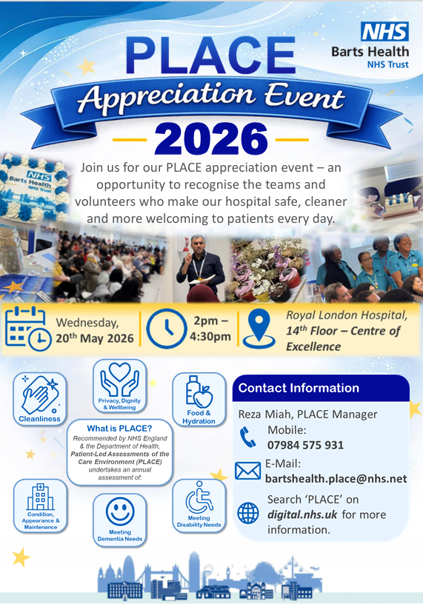
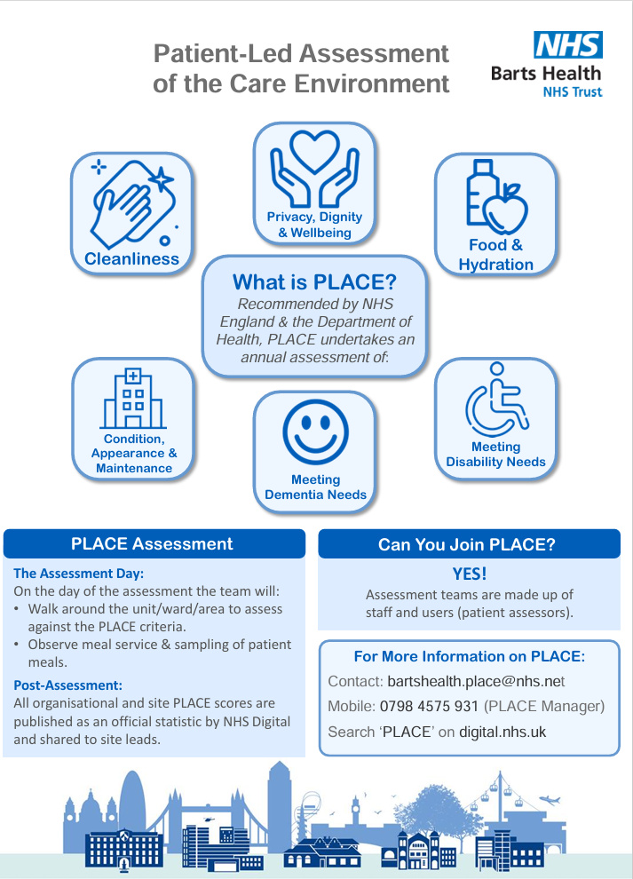

Slide 66
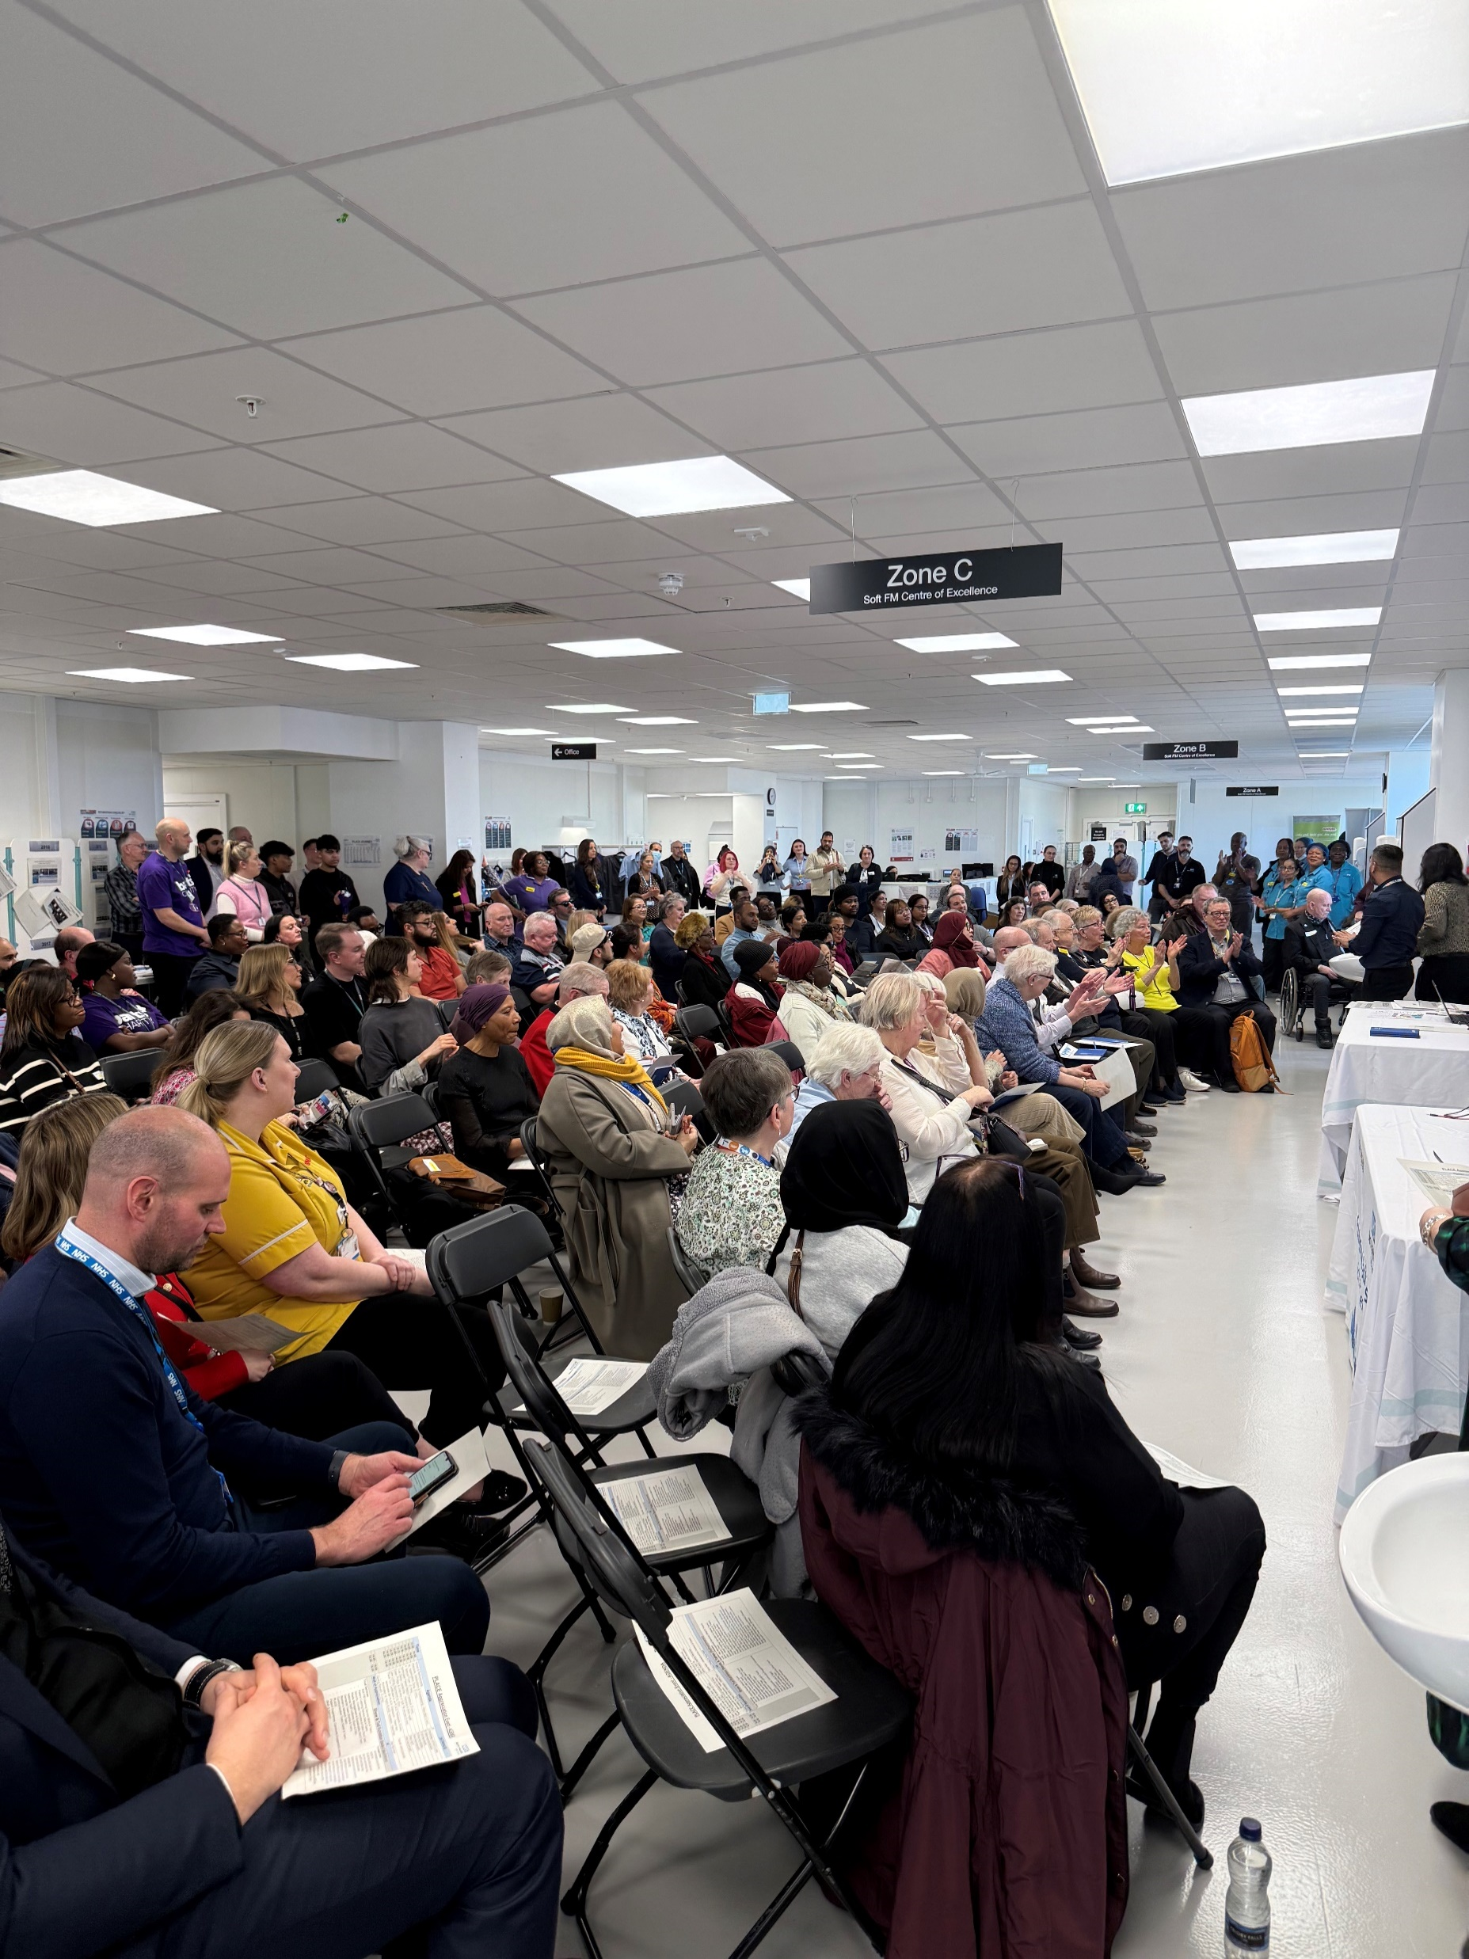
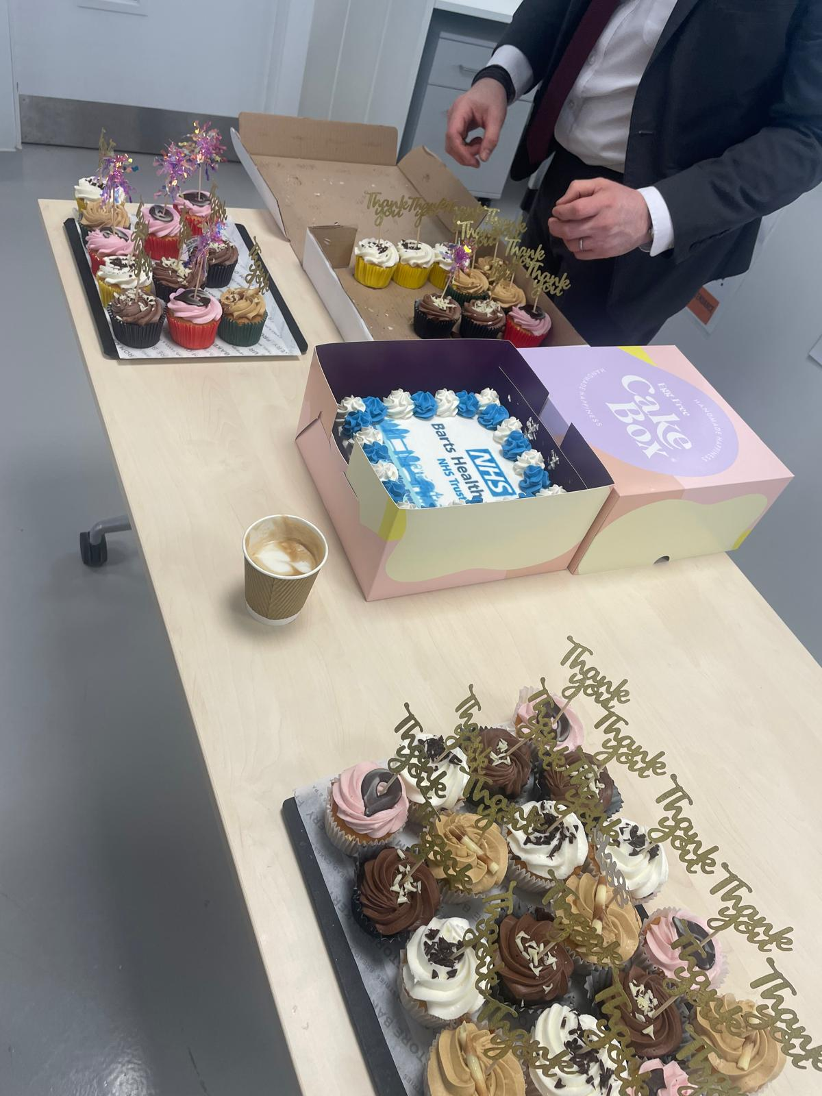
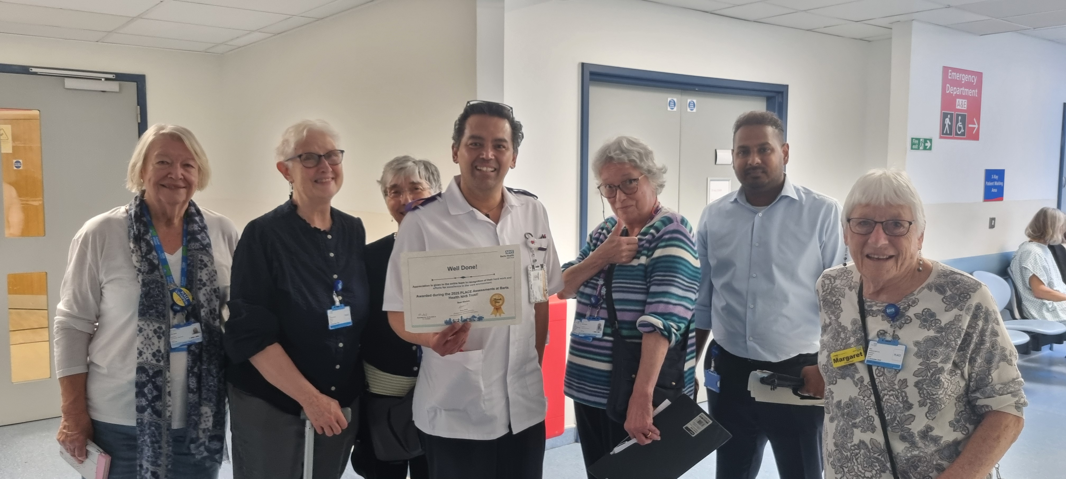
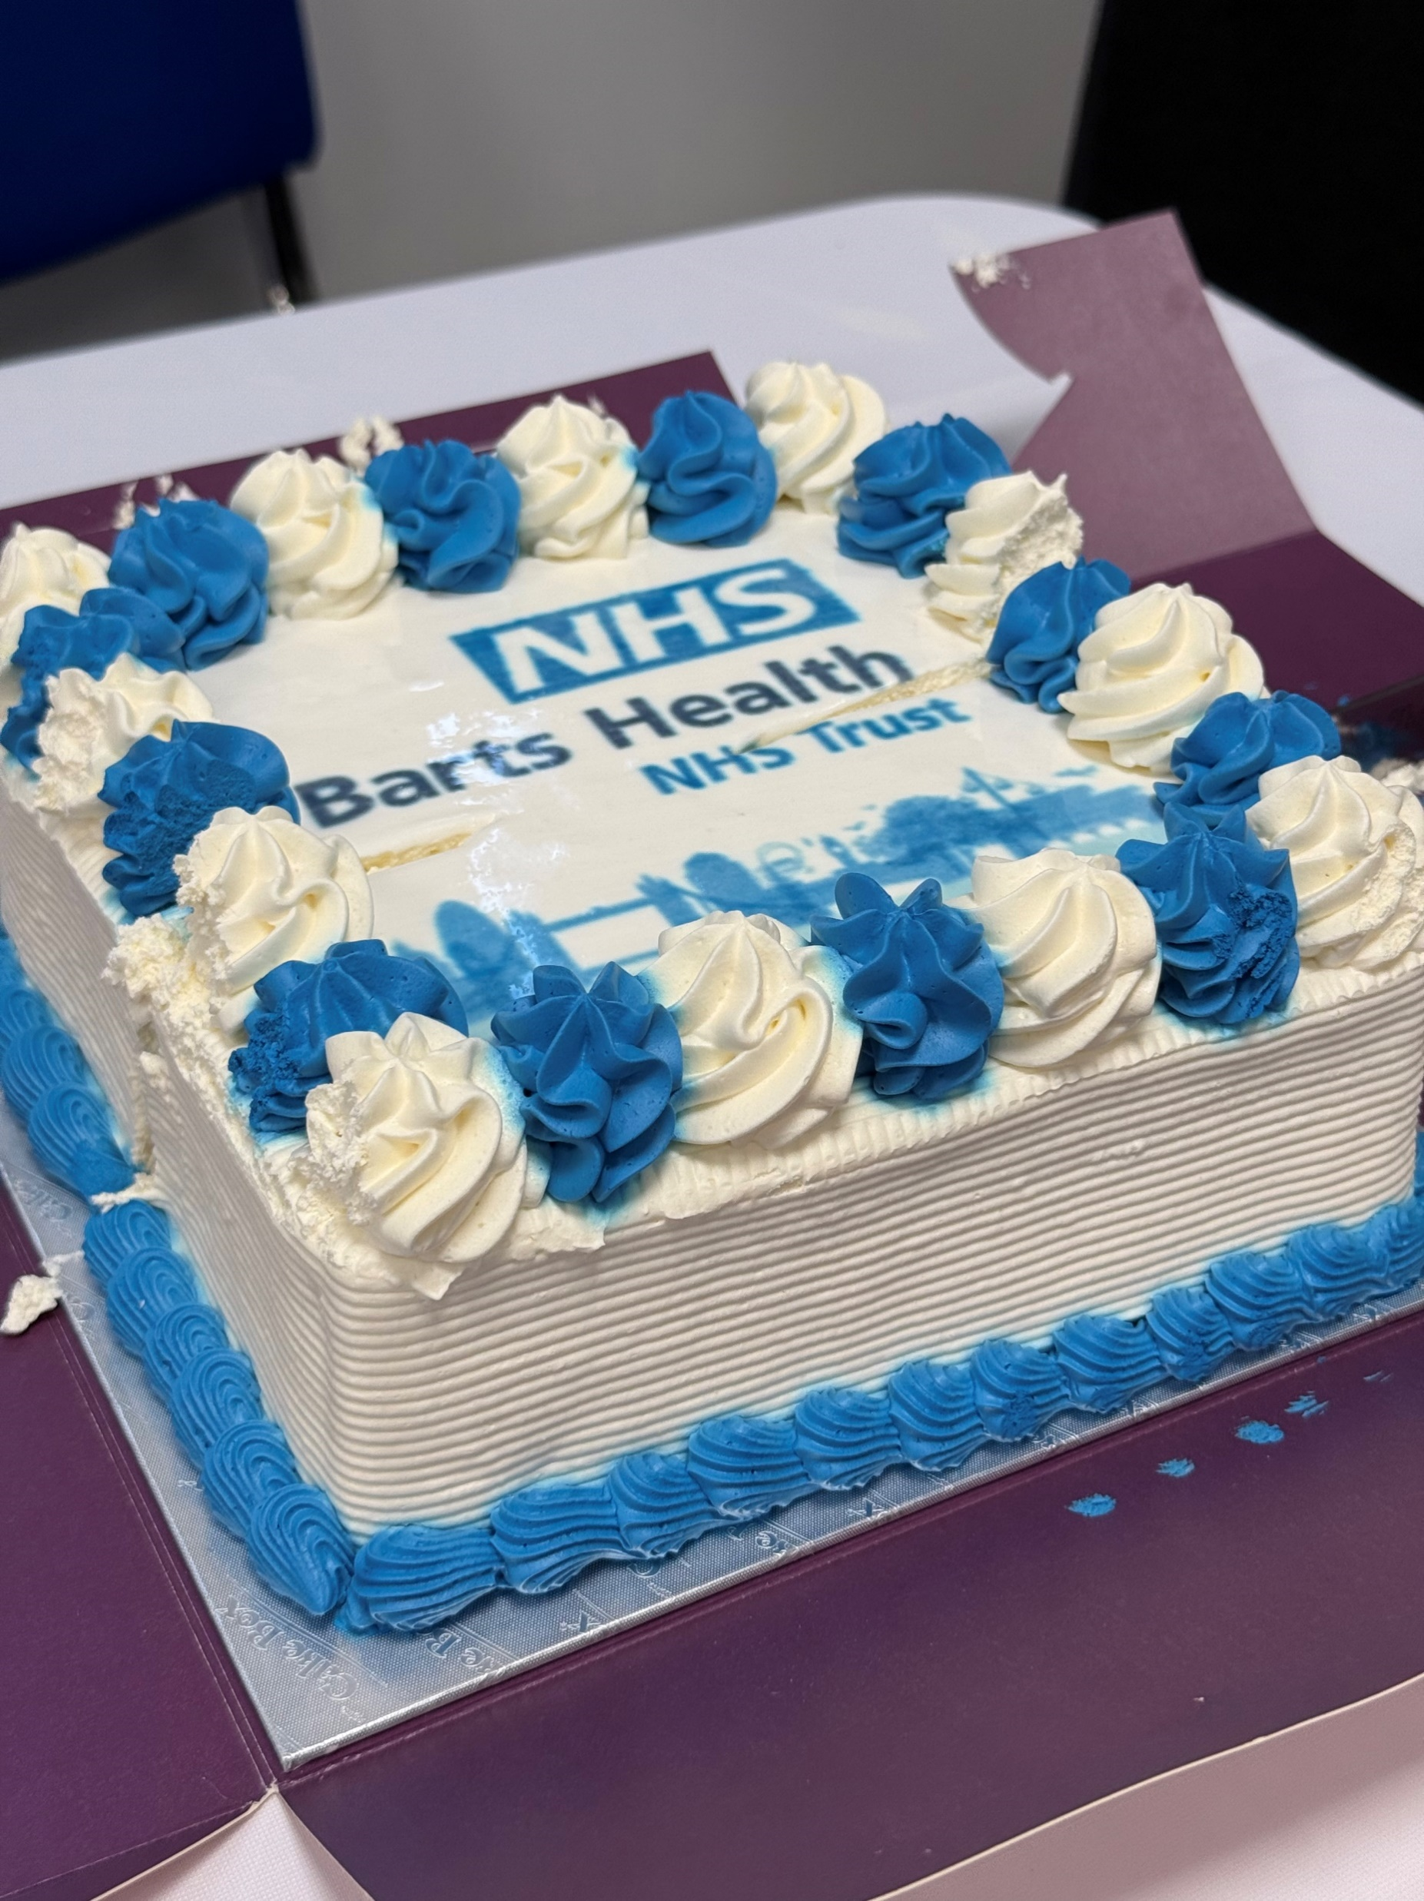
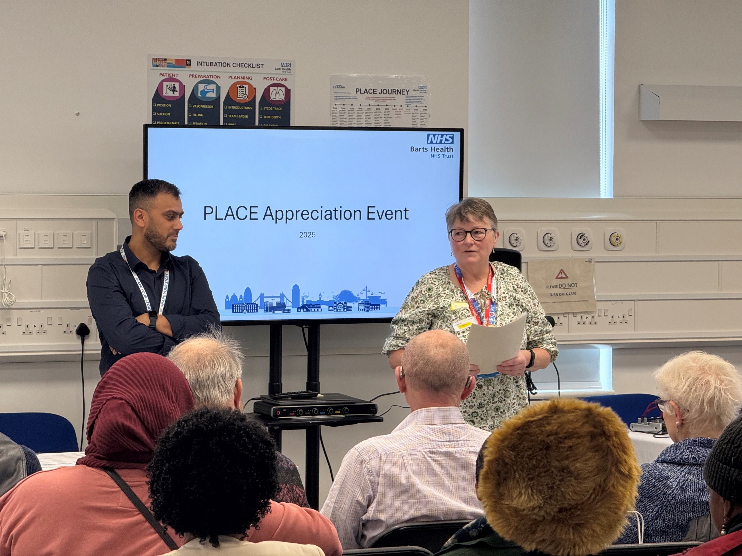
Barts Health NHS Trust - PLACE Appreciation 2026 Event
Date – Wednesday 20th May 2026 at Soft FM Centre of Excellence, Royal London Hospital
Attendance – Over 200 plus in attendance with the inclusion of Trust colleagues, Patient reps, Independent assessors, NHSE and Trust Suppliers. Another 100 plus were unable to join.
Summary – We believe that we lead the way in NHS and Healthcare Organisations, by holding this unique event to ‘Thank’ all the patient reps and volunteers who took part in 2025’s assessments across all our hospitals. Bart’s Health NHS Trust has the highest number of patient reps involved in the PLACE process each year than any other organisations. Each year, we attract more and more volunteers through word of mouth and by also approaching local councils and their organisations.
History - Some of the key number of patient reps have been supporting the Trust since PLACE was first introduced from 2013, previously they were also involved in PEAT (patient Environment Action Team) inspections. Over the years, sadly we lost a lot of volunteers and staff too, who gave so much to make PLACE a success at Barts Health. Some of the volunteers have been Council members, ex NHS staff, CEOs, Private healthcare and Entrepreneurs. Some volunteers even became council for their local wards and just recently, one of our Newham Council member has now become the Mayor of Newham. The Trust is continuing to recruit every year including young adults and also continuing to touch base with the local Health Watch, AGE UK, Older People’s Reference Groups, RNIB, local patient Panels and Forums. Project Search interns even joined us at the assessments last year for the very time and also joined us at the event to celebrate too. A unique collaboration working by Soft FM.
Recognition – During the event, we hand out certificates to patient reps and independent assessors who helps us to undertake our assessments. We also recognise and hand our certificates to those patient reps who have been involved with our assessments 10 years and beyond too. We also hand out certificates, as a token of appreciation to our Trust Services, Suppliers and External organisations, who attend to showcase their services too. This is a vital learning opportunity as well as a sign of collaboration working. It is our duty to educate and share our expertise to our users of the hospital, on what great work we do for our patients. Finally, as a special award, each year, the PLACE Manager recognises individual(s) who have gone out of their way to support the PLACE at Barts Health by letting cut a cake, as an appreciation.
As each year the number of attendance is growing, we are looking at a larger venue to host this unique and the most anticipated event, held by Soft FM.

Slide 67
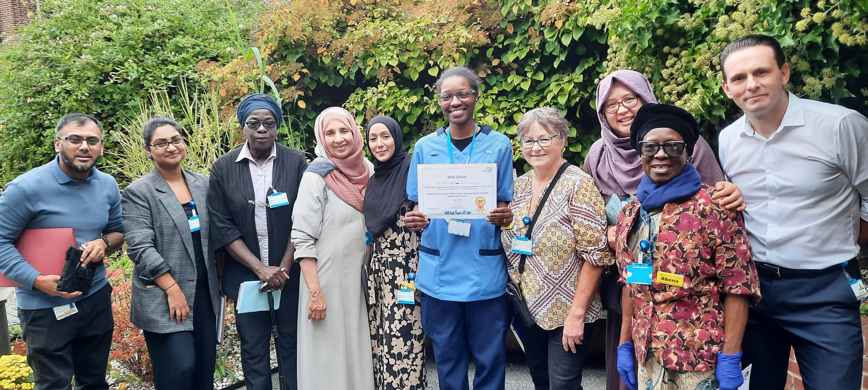
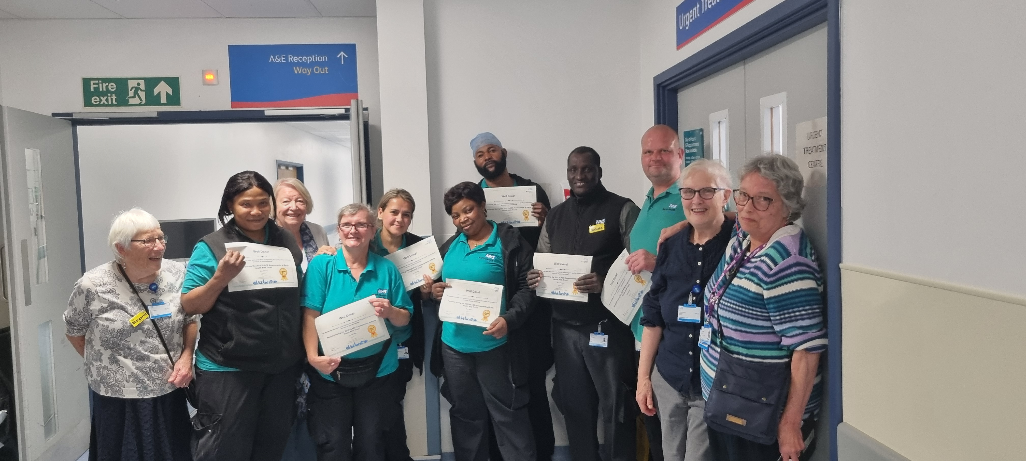
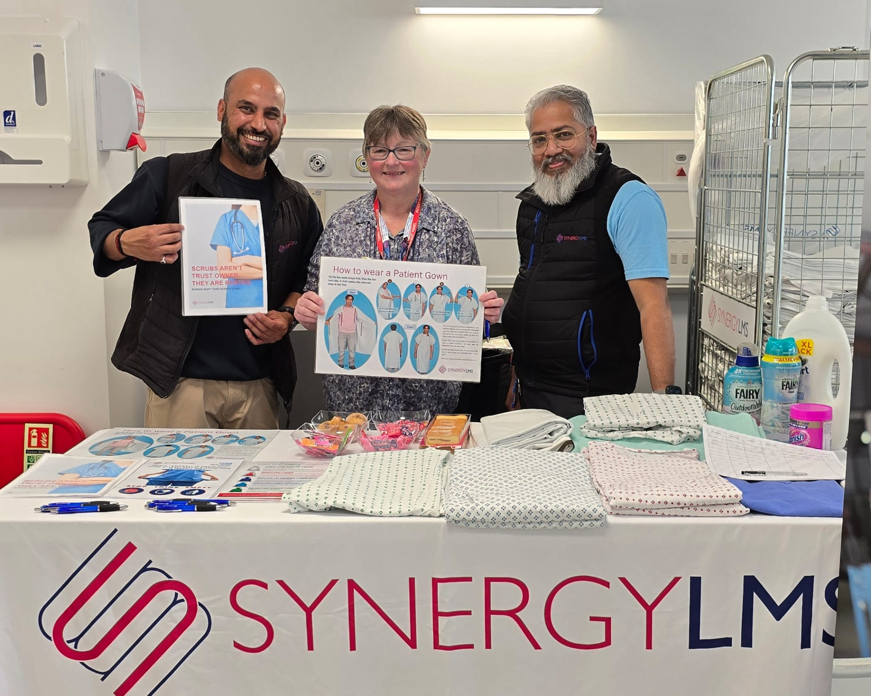
Patient Assessor Point of View – Carol Bassi (3 mins)
Top Tips for being a patient assessor:
Know your role and boundaries as a patient assessor
Work well as part of a team
Have good observation skills
Be confident to ask questions and communicate with respect
Give valuable feedback that is fair, balanced and objective
Recognise good practice
Top Tips which result in Positive Outcomes and the impact they have on the hospital:
More responsive services
Safer environments
Better patient experience
Improved accessibility
Higher standard of maintenance
Recognition of Good Practice

Slide 68
Q & As
If you have any further queries, please contact NHS England or NHS Digital using the following:
NHS England:
  england.place@nhs.net
NHS Digital:
  placenotifications@nhs.net

